Slide 1
Comparative Analysis of Fault Tolerance in Elixir and Other Distributed and Concurrent Programming Languages
Dissertation Preparation
Nuno Ribeiro 1230201

Slide 2
Context and Problem
Rapidly evolving landscape of software development makes fault tolerance and resilience to become a critical attributes for building robust and scalable systems.
Elixir stands as an important language in building fault-tolerant software, and it is a popular and reference language on building this type of systems due to the inheritance capabilities of Erlang and the BEAM.
Lack of comprehensive, up-to-date research that directly compares the fault tolerance and resilience aspects of Elixir with other programming languages motivate this dissertation.
2

Slide 3
Objectives
01
03
05
Comprehensively analyze the fault-tolerant mechanisms in Elixir.
Compare Elixir’s fault-tolerant capabilities with those languages about strengths, weaknesses, and trade-offs.
Extract best practices and propose potential improvements in fault-tolerant system design.
02
04
Identify the most popular and relevant distributed and concurrent languages and their fault-tolerant mechanisms.
Conduct benchmarking experiments to empirically evaluate and compare the fault tolerance and resilience of Elixir and other languages.
3

Slide 4
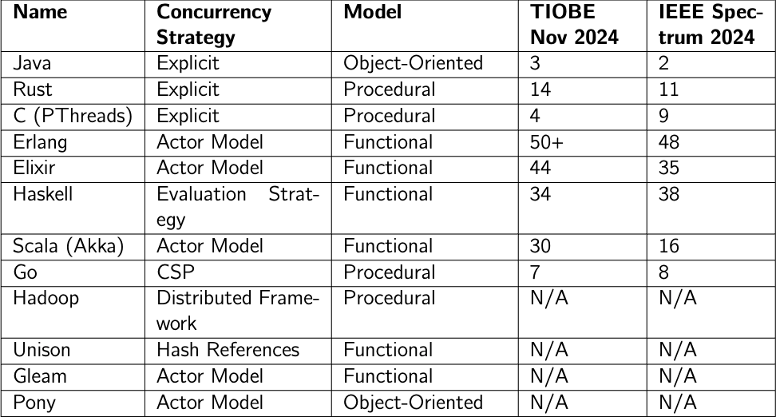
Distributed and Concurrency Programming Languages
4

Slide 5
Research Questions
01
02
Research Question 1
How do the programming languages Elixir, Scala with Akka, and Go implement fault tolerance mechanisms in distributed systems, and what are the comparative strengths, weaknesses, and trade-offs of each approach?
Research Question 2
What are the most effective benchmarking strategies for distributed environments focusing on fault tolerance aspects?
5

Slide 6
Elixir, Scala with Akka and Go
Elixir
Built for fault tolerance and concurrency.
“Let it crash” philosophy with process supervision.
Mature resources (OTP) for fault recovery.
Lightweight processes with preemptive scheduling.
Hot-code swapping for live updates.
Scala with Akka
Extends JVM with actor-based concurrency.
Tools: Clustering, Persistence, Circuit Breakers.
Requires configuration, runs atop JVM.
Mutable constructs introduce risks.
Presumably, higher overhead than BEAM on some cases.
6

Slide 7
Elixir, Scala with Akka and Go
Go
Explicit error handling over “let it crash” philosophy.
Concurrency via goroutines and channels.
Libraries (Proto-Actor) merge CSP with actors.
Cooperative scheduler that could lead to a CPU monopolization.
Lacks native fault tolerance and distribution integration but it has mature libraries.
Comparison Points
Preemptive Schedule vs Cooperative Schedule.
How each languages handles distribution.
Tools and support.
Garbage collector strategies.
Error handling philosophy.
7

Slide 8
Literature Review of Benchmarking Strategies
Benchmarking fault tolerance in distributed environments is challenging.
No formal standard exists for benchmarking fault tolerance, complicating comparisons.
Most benchmarks evaluate both fault tolerance and performance metrics simultaneously.
Chaos engineering tries to mimic randomness real-world faults, while deterministic error injection offers greater reproducibility.
A hybrid approach combining generic application simulations with deterministic error injection offers a balanced perspective.
Effective strategies should integrate performance monitoring, resilience assessment, and static code analysis for a holistic approach to fault tolerance.
8

Slide 9
Future Work
Purpose
Development of a chat application to evaluate fault tolerance and resilience in distributed systems.
Exploration of how Elixir, Scala with Akka, and Go handle faults.
Simulate distributed communication within a fixed setup using inter-VM communication.
Two implementations for Go: Proto-Actor library and a native model using goroutines and gRPC.
System Elements
Clients: Send/receive messages, manage connections, simulate failures.
Discovery: Registry for client locations.
Chats: Manage group conversations.
External Injector: Orchestrate faults and activities.
External Logger: Log events and metrics for analysis.
9

Slide 10
Future Work
Configurations
Adjustable message characteristics (size, type, algorithm).
Simulate failures (crashes, cascading failures).
Control client behavior (activity frequency, activity action).
Test supervision strategies and connectivity parameters.
Test Scenarios
Client Crash Recovery: Measure recovery time and system state consistency.
Chat Crash Recovery: Evaluate replication and leader election (Raft).
Message Delivery Durability: Test message flow consistency under stress.
Network Test: Simulate network partitions and latency spikes.
10

Slide 11
Comparative Analysis of Fault Tolerance in Elixir and Other Distributed and Concurrent Programming Languages
Dissertation Preparation
Nuno Ribeiro 1230201

