Slide 1











Supervised Machine Learning: Regression and Classification
WEEK 1
Prepared by: Intern Nouamat Jawhar
Submitted to: CEO.Natasha Alkhatib, DR.Rami khoder

Slide 2

Learning Goals
After a week:
Define machine learning
Define supervised learning
Define unsupervised learning
Implement and visualize a cost function
Implement gradient descent
Optimize a regression model using gradient descent
Write and run Python code in Jupyter Notebooks
Define a regression model

Slide 3
What is machine learning?
is the science of getting computers to learn without being explicitly programmed.
2 Main types of ML Algorithms:
-Supervised Learning (Regression , Classification)
-Unsupervised Learning (Clustering , Anomaly Detection, ,Dimensionality Reduction)

Slide 4

SUPERVISED LEARNING
Learns from being given right answers.
Regression
Classification
Predict a number.
Infinite possible outputs.
Application:
Spam filtering, Speech recognition.
Predict categories.
Small Nb of possible outputs.
Application:
Breast Cancer detection.

Slide 5
unSUPERVISED LEARNING
Takes data without labels and tries to automatically group them into clusters.
Clustering
EXAMPLE: In Google News, The head news of the articles below this are other related articles , so finding the articles that mention similar words & grouping them into clusters.
The algorithm has to figure out on his own without supervision, what are the clusters of news articles today.

Slide 6
unsupervised learning
Clustering
Dimensionality reduction
Anomaly detection
Group similar data points together.
Find unusual data points.
Compress data using fewer numbers.

Slide 7

Linear Regression Model
is one example of regression model & particular type of supervised learning.
So first train your model to learn from the training set to predict
example the client house price by the model
Training Set
Learning Algorithm
Data used to train the model is called “Training Set”
Some functions
x(feature)
f(hypothesis)
y hat(prediction of y)

Slide 8
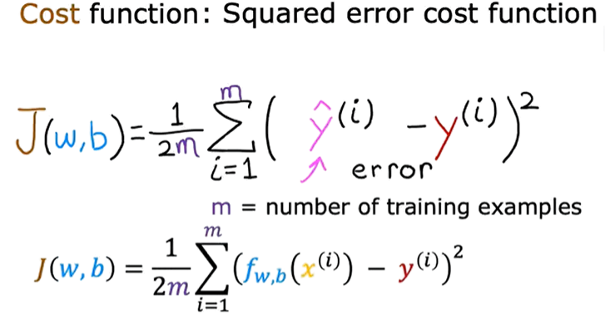
Cost Function
In order to implement linear regression the first key step is first to define something called cost function
to see how the cost function can be used is to find the best parameters for your model also we want to fit a straight line to the training data.
The squared error :

Slide 9
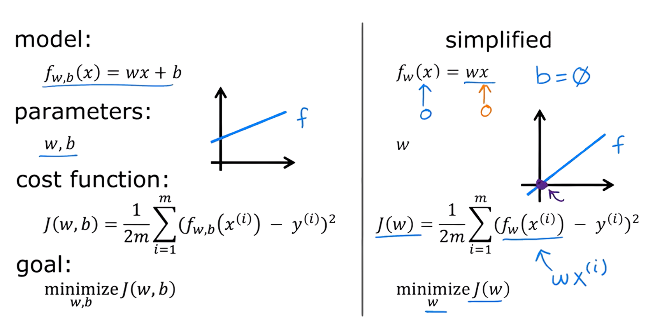
cost function
RECAP you want to fit a straight line to the training data

Slide 10
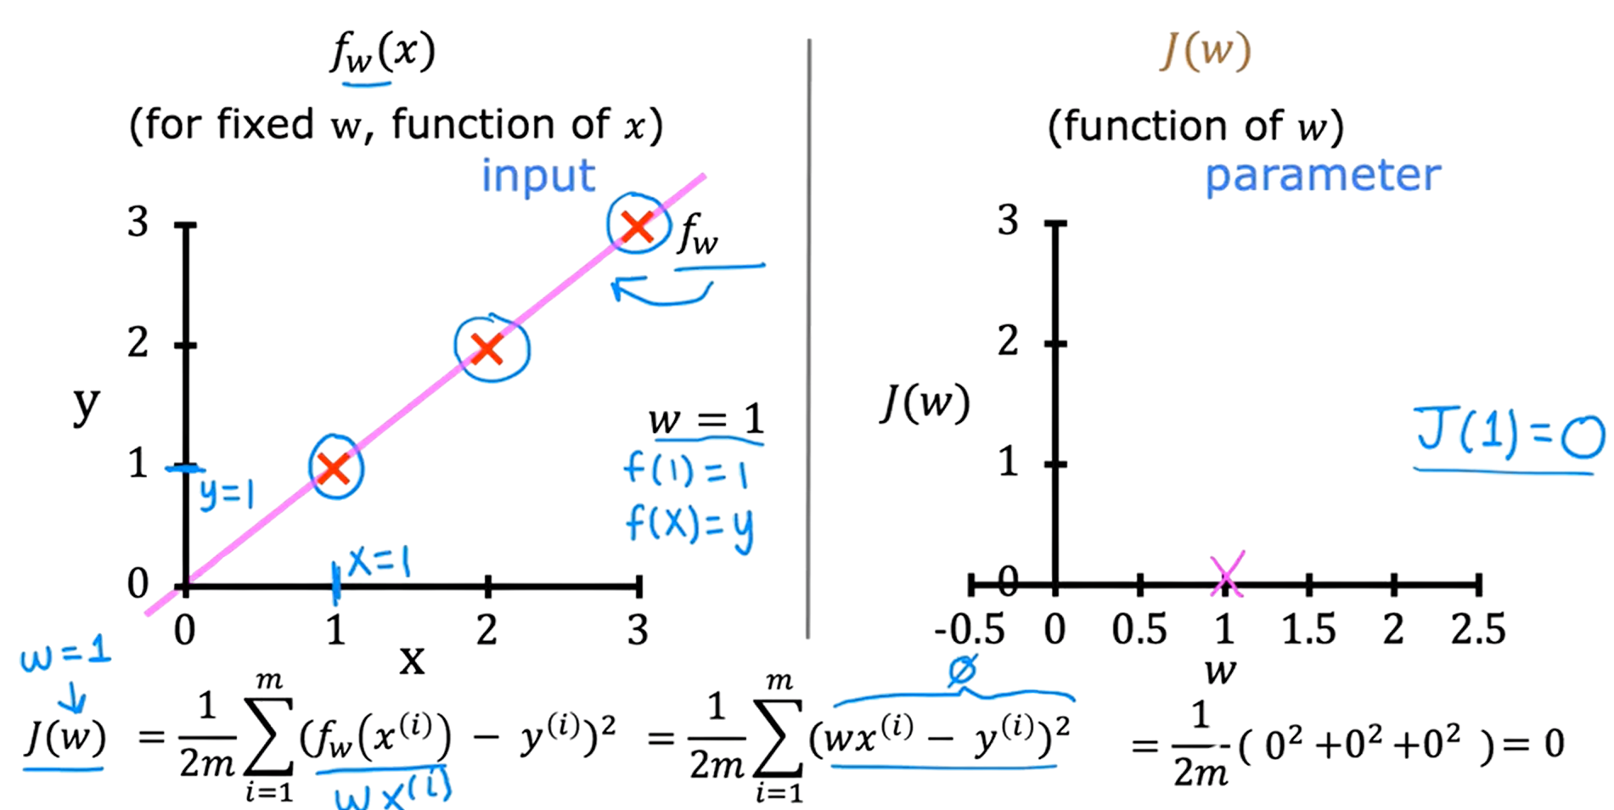

SIMPLIFIED VERSION OF LINEAR REGRESSION

Slide 11
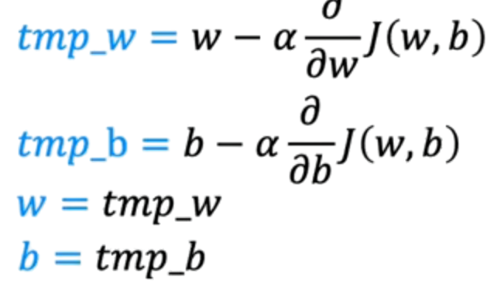

Gradient Descent
used for training the most advanced neural network models also called deep learning models.
Correct simultaneous update:
Start with some w,b.
Keep changing w,b to reduce J(w,b).
Until we settle at or near a minimum
You can choose the starting values for the parameters w & b
Here J(w,b) : -not squared error cost
-not linear regression
And you will always end up with bow shape

Slide 12
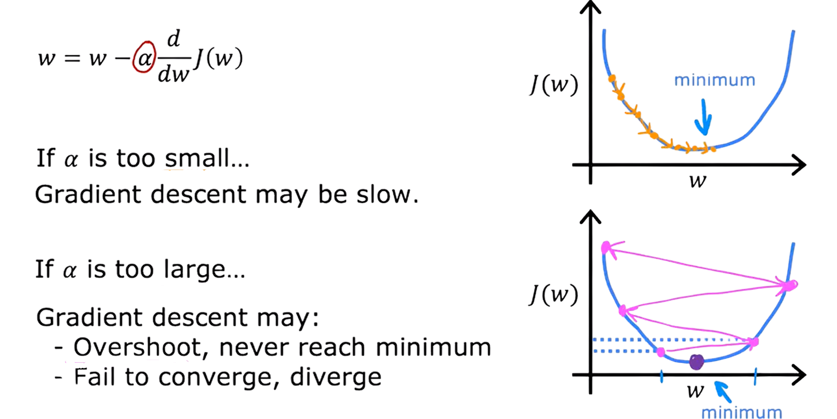
learning rate
Have huge impact on the efficiency of your implementation of gradient descent
Can reach local minimum with fixed learning rate.
Near a local minimum:
-Derivative becomes smaller.
-Updates steps become smaller.

Slide 13
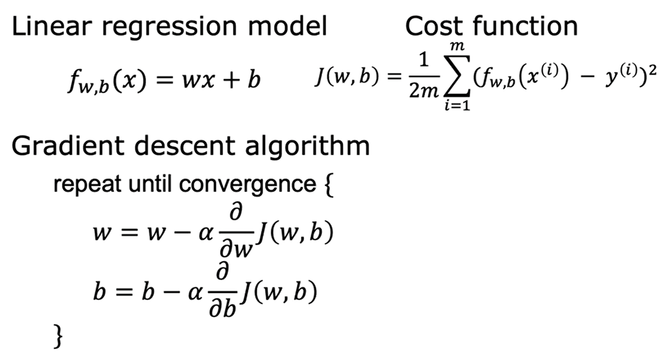
gRADIENT DESCENT FOR LINEAR REGRESSION

Slide 14

Running Gradient descent
The batch was also named for this concept in machine learning.
And then it turns out that there are other versions of gradient descent that do not
look at the entire training set, but
instead looks at smaller subsets of the training data at each update step.
But we'll use batch gradient descent for linear regression.

Slide 15
The End!
Thanks for listening!

