Slide 1
Restaurant Revenue Prediction using Machine Learning Algorithms
Rajani Suryavanshi
Toshit Patil
Gaurav Wani
Under the guidance of: -
Prof. Meiliu Lu

Slide 2
Problem Statement
New restaurant sites take large investments of time and capital to get up and running. When the wrong location for a restaurant brand is chosen, the site closes within 18 months and operating losses are incurred.
TFI had organized a competition on Kaggle for prediction of restaurant’s revenue. There are 100,000 regional locations for which revenue needs to be predicted depending upon various data fields mentioned in database.
The main purpose of this project is to predict revenue of the restaurants in the given test dataset from the already established restaurant data by using Machine Learning Algorithms.

Slide 3
Literature Review
Read discussion forums which described the problem statement more in detail.
Found out multiple approaches that could be used to solve this challenge.
Helped us realize in advance that our dataset needs a lot of pre-processing.
Discovered the over-fitting solution submitted with 0 RMSE value.

Slide 4
Dataset
Dataset consists of following fields: -
Id : Restaurant id.
Open Date : opening date for a restaurant
City : City that the restaurant is in.
City Group: Type of the city. Big cities, or Other.
Type: Type of the restaurant.
FC: Food Court
IL: Inline
DT: Drive Thru
MB: Mobile
P1 - P37: These are the p-variables and are a measure of the following:-
Demographic data: Population, age, gender distribution, development scale
Real Estate Data: M2 of the location, front façade, car parking etc.
Commercial data: schools, banks etc.
REVENUE: The revenue column indicates a (transformed) revenue of the restaurant in a given year and is the target of predictive analysis.

Slide 5
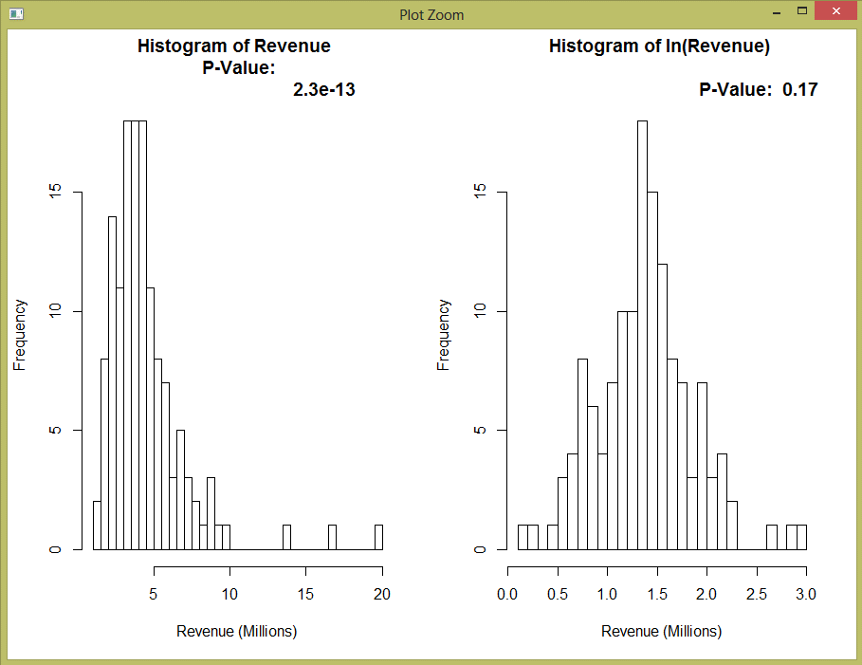
Insights of the Training Data
There are 137 rows and 43 features in training data.
Training data shows variation in revenue depending upon City, Open Date and Type.
There are 38 unique cities and uni-codes are mentioned in the city names.
Revenue column is left skewed and it’s representation after taking logarithm is shown below :-

Slide 6
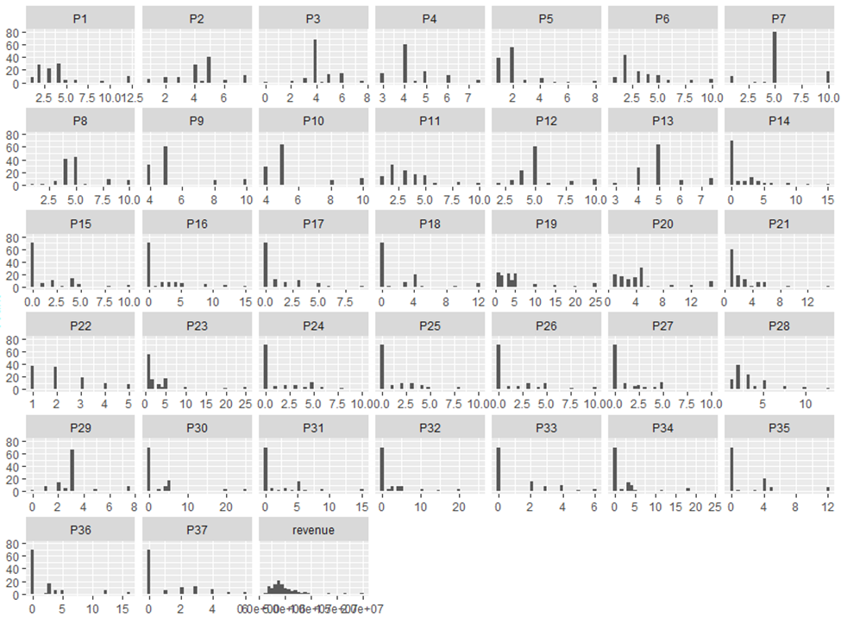
Variation in P-Values
P-values are indicating Real estate data, Commercial data and population related information. Following is chart showing obfuscated values of P-variables.

Slide 7
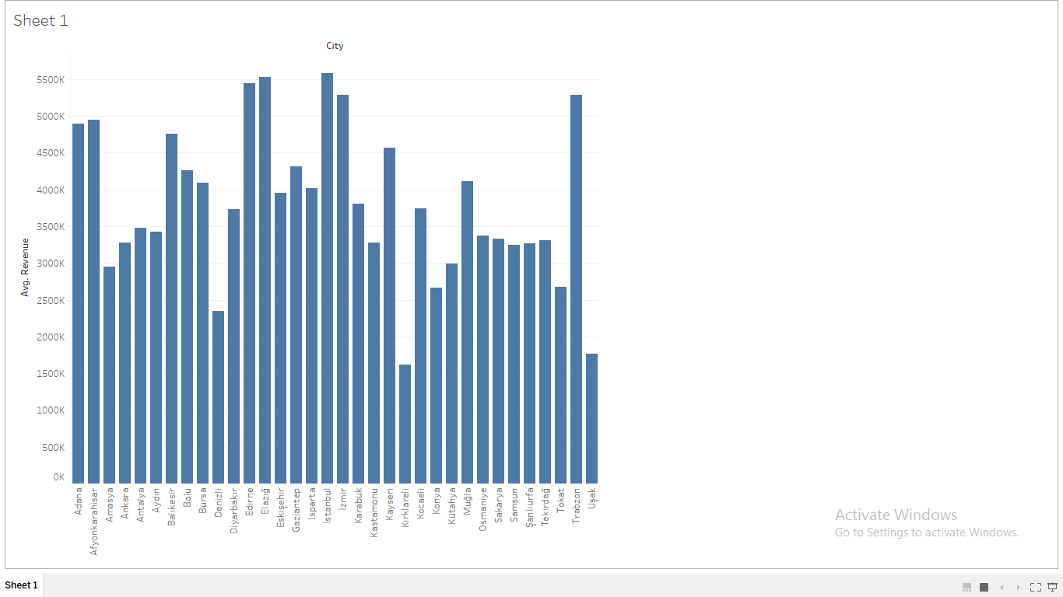
Representation of City Vs Revenue
http://athena.ecs.csus.edu/~patiltr/geomap.html

Slide 8
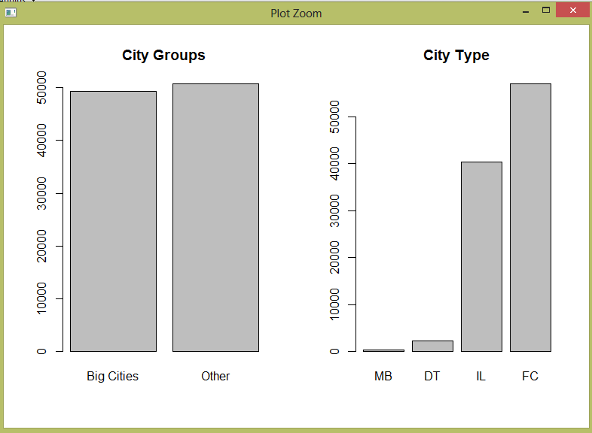
Insights of Testing Data
There are 100,000 rows and 42 features in test data.
There are 54 unique cities and uni-codes are mentioned in the city names.
There are more than 20 additional cities in test data and one additional type Restaurant Type – MB(Mobile).

Slide 9
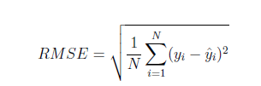
Score Measure: RMSE
The score measure presented in the competition is the root mean squared error of the test set revenue.
Where y_{i} is the predicted revenue of the i^{th} restaurant and y is the actual revenue of the i^{th} restaurant.

Slide 10

PRE-PROCESSING
Since the training dataset is very small and we have to make the best out of what is available, we required a lot data preprocessing.
This was the most difficult step of our Project.

Slide 11
Formatted Open-Date into three columns date, month and year. Using Boruta package, we found that year plays crucial role in predicting the revenue.
Open Date (mm/dd/yyyy)
07/17/1999
03/09/2013
Month | Day | Year
07 | 17 | 1999
03 | 09 | 2013

Slide 12
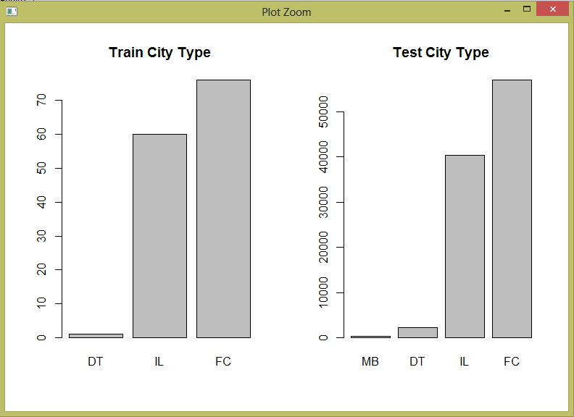
To over-ride issue with an additional type in test data, we have replaced MB with FC and DT with IL.

Slide 13
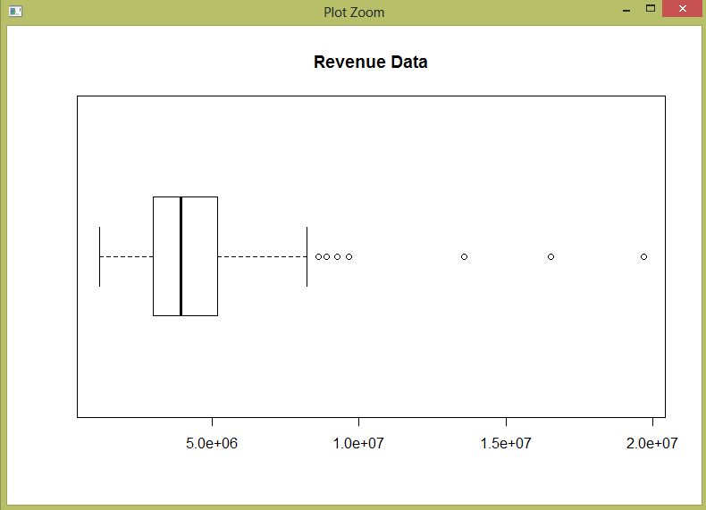
Removed outliers in revenue column.

Slide 14
Converting all the selected train and test data into numeric.
Converted categorical data into numeric.
The predictor’s input must be numeric, hence converted all the selected data columns into numeric.
Boruta package for feature selection
Other Pre-Processing Approaches tried and in-efficient.
Mice Imputation for removing Zeroes
Reducing values of Obfuscated P-variables
Principal Component Analysis of P-variables

Slide 15
SVM Regression
Support Vector Machine can be applied not only to classification problems but also to the case of regression.
Model in R using SVM:
fit<- svm(x=as.matrix(train_cols),y=labels,cost=10,scale=TRUE,type="eps-regression")
predict_svm<-as.data.frame(predict(fit,newdata=testdata))
RMSE Value: -
Public Score : 1947658.58962
Private Score: 2259411.40638

Slide 16
Random Forest Algorithm
Random Forest is one of the best useful technique used for multiple decision tree generation.
Since our dataset contains lots of attributes to consider for the prediction, we built the model with it.
Model in R using Random Forest:
rf = cforest(train$revenue ~., data = train_cols, controls=cforest_unbiased(ntree=1000))
Prediction = predict(rf, testdata, OOB=TRUE, type = "response")
RMSE Value :-
Public Score : 1847620.47650
Private Score: 2159509.40783

Slide 17
Gradient Boosting Machine
One of the most efficient algorithm.
Gradient boosting = Gradient descent + Boosting
This is much similar to that of Ada-Boosting technique, that we introduce more of weak learner to compensate shortcomings of existing weak learner
Gradient boosting was introduced to handle a variety of loss function
Basically, consecutive trees are introduced to solve net loss of prior trees
Result of new trees are partially applied the entire solution
RMSE Value: -
Public Score : 1735157.84896
Private Score: 1809970.61757

Slide 18
Conclusion
Random Forest works the best on our preprocessed data.
Gradient Boosting Machine is working much better than SVM.
Preprocessing of data is very important. It improved our RMSE scores drastically.
Algorithm | Public Score | Private Score
GBM | 1892936.84870 | 1866654.72370
Random Forest | 1765716.60593 | 1812835.346
SVM | 1801175.32591 | 2104348.55376

Slide 19
References
“Dataset: Restaurant Revenue Prediction”, https://www.kaggle.com/c/restaurant-revenue-prediction
Blog: http://rohanrao91.blogspot.com/2015/05/tfi-restaurant-revenue-prediction.html
Bikash Agrawal ,” Kaggle Walkthrough: Restaurant Sales Prediction”, Boost AI, University of Stavanger.
Nataasha Raul, et al. “Restaurant Revenue Prediction using Machine Learning”, International Journal of Engineering Science, Vol.6, Issue 4
SauptikDhar, Vladimir Cherkassky, “Visualization and interpretation of SVM Classifiers”, Wiley interdisciplinary Reviews
V2 Maestros, “Applied Datascience with R”, [Lecture Notes]

