Slide 1

Benefits of using Julia for scientific applications

Slide 2
What is Julia?
It is a dynamic, easy to use, just-in-time compiled language.
It is intentionally developed for solving the problem of the two languages, providing ease and expressiveness of high-level languages (such as R, MATLAB or Python) and offering performances that approaches that of statically-compiled languages like C or Fortran.
It is easy to develop parallel working codes, due to its simple language syntax. Passing from CPU to GPU(s) is also a simple process, and a single code can run in both CPUs and GPUs, making Julia very flexible.
Complete documentation here: https://docs.julialang.org/en/v1/

Slide 3
What makes Julia, Julia?
Just-in-time compilation: it allows mix the benefits from low- and high-level languages;
A rich language of types for constructing and describing objects;
Multiple dispatch: the possibility to define different function behaviors across the combination of the argument types;
Automatic generation of efficient and specialized code for different argument types;
The REPL mode, that introduce a lot of interactive features;
Good performance, approaching that of statically-compiled languages like C.
Complete documentation here: https://docs.julialang.org/en/v1/

Slide 4
Advantages of Julia
Free and open source;
User-defined types are as fast and compact as built-ins;
No need of vectorization;
No need of third part visualization software;
Designed for parallelism and distributed computation;
Efficient support for Unicode, including but not limited to UTF-8;
Powerful shell-like capabilities for managing other processes;
Lisp-like macros and other metaprogramming facilities.
Complete documentation here: https://docs.julialang.org/en/v1/

Slide 5
The case study
The Julia capabilities are tested via the implementation of the Dumbser-Osher-Toro (DOT) method to the 2D SWE (fixed bed, no friction), the test case is a circular dam-break in the centre of the domain, the initial velocity is zero and the initial step is 1.5 meters.
We have 4 codes, the first running in MATLAB, the second one running in series on CPU, and two version of the same code running on the NVIDIA GeForce RTX 2080 Ti GPU. The difference between the two makes one much faster than the other.

Slide 6
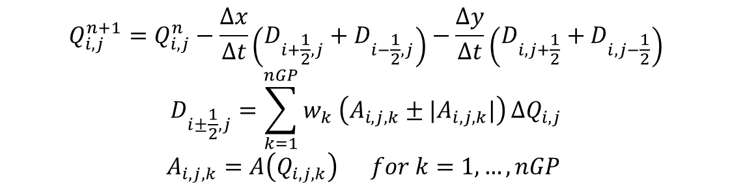
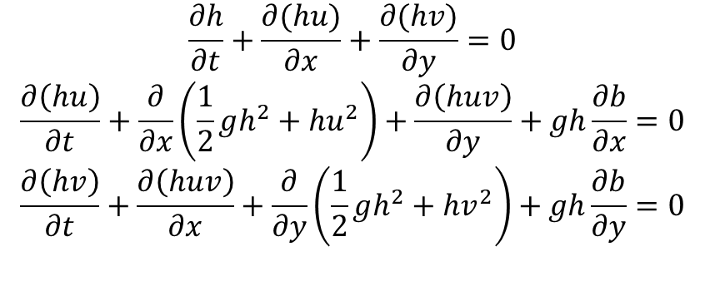
Equations and numerical scheme
$$\frac{∂h}{∂t}+\frac{∂(hu)}{∂x}+\frac{∂(hv)}{∂y}=0$$
$$\frac{∂\left(hu\right)}{∂t}+\frac{∂}{∂x}\left(\frac{1}{2}gh^{2}+hu^{2}\right)+\frac{∂\left(huv\right)}{∂y}+gh\frac{∂b}{∂x}=0$$
$$\frac{∂\left(hv\right)}{∂t}+\frac{∂\left(huv\right)}{∂x}+\frac{∂}{∂y}\left(\frac{1}{2}gh^{2}+hv^{2}\right)+gh\frac{∂b}{∂y}=0$$
$$Q_{i,j}^{n+1}=Q_{i,j}^{n}−\frac{Δx}{Δt}\left(D_{i+\frac{1}{2},j}+D_{i−\frac{1}{2},j}\right)−\frac{Δy}{Δt}\left(D_{i,j+\frac{1}{2}}+D_{i,j−\frac{1}{2}}\right)$$
$$D_{i±\frac{1}{2},j}=\sum_{k=1}^{nGP}{w_{k} \left(A_{i,j,k}±|A_{i,j,k}|\right)}{ΔQ}_{i,j}$$
$$A_{i,j,k}=A\left(Q_{i,j,k}\right) for k=1, …, nGP$$

Slide 7
Motivation about the scheme
Characteristics of the scheme:
Explicit
High-order not oscillatory scheme
It requires the knowledge of the eigenstructure of the equations
Flexible for each hyperbolic system (from a coding viewpoint)
Reliable, especially for shock waves and sharp solutions
The core of the code can be very nice optimized and used for any hyperbolic system of PDE!

Slide 8
Performance evaluation
We can immediately compare the time for solving the same problem for the four codes:
(nx = ny = 256, lx = ly = 40 m, final time = 2 s, CFL = 0.49, nGP = 3)
TIMES (s) | MATLAB | JULIA CPU | JULIA GPU | JULIA GPU OPT
1 | 177.67 | 16.94 | 1.24 | 0.64
2 | 178.87 | 16.80 | 1.25 | 0.63
3 | 181.41 | 16.85 | 1.24 | 0.63
4 | 177.99 | 16.87 | 1.23 | 0.63
5 | 177.22 | 16.88 | 1.25 | 0.63
Average | 178.63 | 16.87 | 1.24 | 0.63

Slide 9
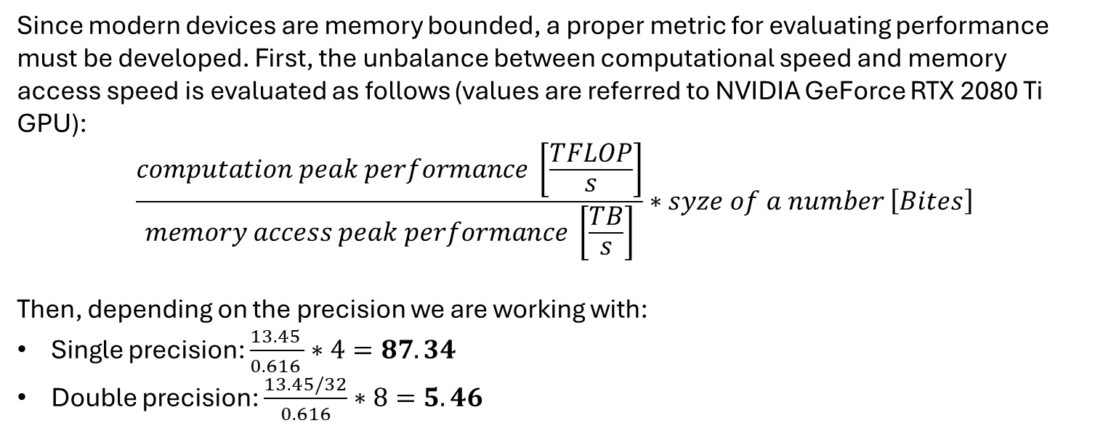
GPU Performance evaluation
Since modern devices are memory bounded, a proper metric for evaluating performance must be developed. First, the unbalance between computational speed and memory access speed is evaluated as follows (values are referred to NVIDIA GeForce RTX 2080 Ti GPU):
$$\frac{computation peak performance \left[\frac{TFLOP}{s}\right]}{memory access peak performance \left[\frac{TB}{s}\right]}∗syze of a number \left[Bites\right]$$
Then, depending on the precision we are working with:
Single precision: $\frac{13.45 }{0.616 }∗4=87.34$
Double precision: $\frac{13.45/32}{0.616}∗8=5.46$

Slide 10
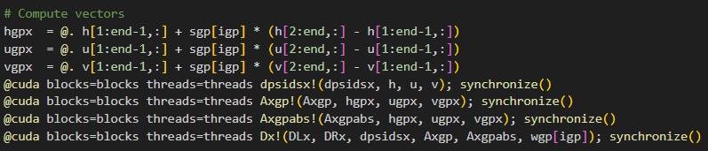
Core of the codes
The difference in the two implementation is the number of array used for the solution!
Only the D arrays are necessary, they are needed for the update formula; all the others are temporary array that only increases the number of memory access.

Slide 11
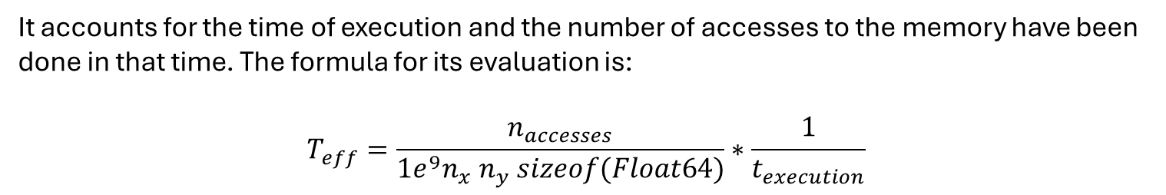
Effective memory throughput
It accounts for the time of execution and the number of accesses to the memory have been done in that time. The formula for its evaluation is:
$$T_{eff}=\frac{n_{accesses}}{1e^{9}n_{x} n_{y} sizeof(Float64)}∗\frac{1}{t_{execution}}$$
Considering only the x direction (y is the same), the two codes performs the following memory accesses (reads or writes) at any iteration:
GPU: 99
GPU_opt: 48
Leading to the following (maximum) effective throughput memory access:
GPU: 429.43 GB/s (69.6%) Threads = (8, 2) nx = ny = 1024
GPU_opt: 508.27 GB/s (82.5%) Threads = (8, 16) nx = ny = 1024
The Peak memory access is 616 GB/s.

Slide 12
Regarding my thesis
Main objective: Investigating how to get a model that converges fast to the steady state of a 2D morphodynamical problem. We are interested in the long-term situation of a water body.
1D case: the steady solution (for the water depth) is given by the solution of a simple ODE, so, making use of the hypothesis:
Water adapts instantaneously to bed changes
we can decouple the problem in two:
Morphological part: using the Godunov method (or any other) we get the evolution in time of the bed (small eigenvalue, large dt);
Hydrological part: adapting the water layer to the new bed conformation we complete a very fast code.

Slide 13
1D case
The 1D case does not require any new development, but it is easier to work with; Thus, we have a 1D DOT scheme as reference, and an idea that I am testing:
Pseudo-transient solution
The idea is based on the method explained in Räss et al. 2022 (GMD - Assessing the robustness and scalability of the accelerated pseudo-transient method).
Keeping the previous hypothesis, we are trying to get the steady state integrating in the so-called pseudo-time, that should allow to accelerate the process since we are not interested in what happened while iterating but just in the final configuration.

