Slide 1

Benefits of using Julia for scientific applications

Slide 2
What is Julia?
It is a dynamic, easy to use, just-in-time compiled language.
It is intentionally developed for solving the problem of the two languages, providing ease and expressiveness of high-level languages (such as R, MATLAB or Python) and offering performances that approaches that of statically-compiled languages like C or Fortran.
It is easy to develop parallel working codes, due to its simple language syntax. Passing from CPU to GPU(s) is also a simple process, and a single code can run in both CPUs and GPUs, making Julia very flexible.
Complete documentation here: https://docs.julialang.org/en/v1/

Slide 3
What makes Julia, Julia?
Just-in-time compilation: it allows mix the benefits from low- and high-level languages;
Optional typing: specification is not mandatory;
A rich language of types for constructing and describing objects;
Multiple dispatch: the possibility to define different function behaviors across the combination of the argument types;
Automatic generation of efficient, specialized code for different argument types;
Good performance, approaching that of statically-compiled languages like C.
Complete documentation here: https://docs.julialang.org/en/v1/

Slide 4
Advantages of Julia
Free and open source;
User-defined types are as fast and compact as built-ins;
No need of vectorization;
No need of third part visualization software;
Designed for parallelism and distributed computation;
Powerful debugging tools (no code slowing down) together with the interactive REPL mode;
Efficient support for Unicode, including but not limited to UTF-8;
Powerful shell-like capabilities for managing other processes;
Lisp-like macros and other metaprogramming facilities.
Complete documentation here: https://docs.julialang.org/en/v1/

Slide 5
The case study
The Julia capabilities are tested via the implementation of the Dumbser-Osher-Toro (DOT) method to the 2D SWE (fixed bed, no friction), the test case is circular dam-break in the middle of the domain, the initial velocity is zero and the initial step is 1.5 meters.
We have 4 codes, the first running in MATLAB, the second one running in series on CPU, and we developed two version of the same running on the NVIDIA GeForce RTX 2080 Ti GPU. The difference between the two makes one much faster than the other.

Slide 6
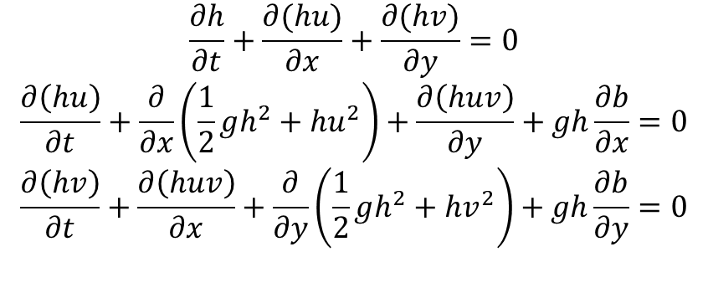
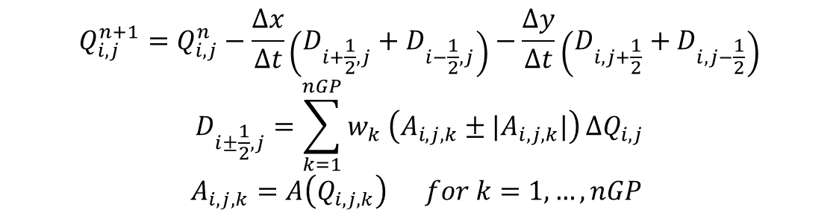
Equations and numerical scheme
$$\frac{∂h}{∂t}+\frac{∂(hu)}{∂x}+\frac{∂(hv)}{∂y}=0$$
$$\frac{∂\left(hu\right)}{∂t}+\frac{∂}{∂x}\left(\frac{1}{2}gh^{2}+hu^{2}\right)+\frac{∂\left(huv\right)}{∂y}+gh\frac{∂b}{∂x}=0$$
$$\frac{∂\left(hv\right)}{∂t}+\frac{∂\left(huv\right)}{∂x}+\frac{∂}{∂y}\left(\frac{1}{2}gh^{2}+hv^{2}\right)+gh\frac{∂b}{∂y}=0$$
$$Q_{i,j}^{n+1}=Q_{i,j}^{n}−\frac{Δx}{Δt}\left(D_{i+\frac{1}{2},j}+D_{i−\frac{1}{2},j}\right)−\frac{Δy}{Δt}\left(D_{i,j+\frac{1}{2}}+D_{i,j−\frac{1}{2}}\right)$$
$$D_{i±\frac{1}{2},j}=\sum_{k=1}^{nGP}{w_{k} \left(A_{i,j,k}±|A_{i,j,k}|\right)}{ΔQ}_{i,j}$$
$$A_{i,j,k}=A\left(Q_{i,j,k}\right) for k=1, …, nGP$$

Slide 7
Motivation about the scheme
Characteristics of the scheme:
Explicit
High-order not oscillatory scheme
It requires the knowledge of the eigenstructure of the equations
Flexible for each hyperbolic system (from a coding viewpoint)
Reliable, especially for shock waves and sharp solutions
The core of the code can be very nice optimized and used for any hyperbolic system of PDE!

Slide 8
Performance evaluation
First we can compare the time for solving the same problem for the Three codes:
TIMES (s) | MATLAB | JULIA CPU | JULIA GPU | JULIA GPU OPT
1 | 177.67 | 16.94 | 1.24 | 0.64
2 | 178.87 | 16.80 | 1.25 | 0.63
3 | 181.41 | 16.85 | 1.24 | 0.63
4 | 177.99 | 16.87 | 1.23 | 0.63
5 | 177.22 | 16.88 | 1.25 | 0.63
Average | 178.63 | 16.87 | 1.24 | 0.63

Slide 9
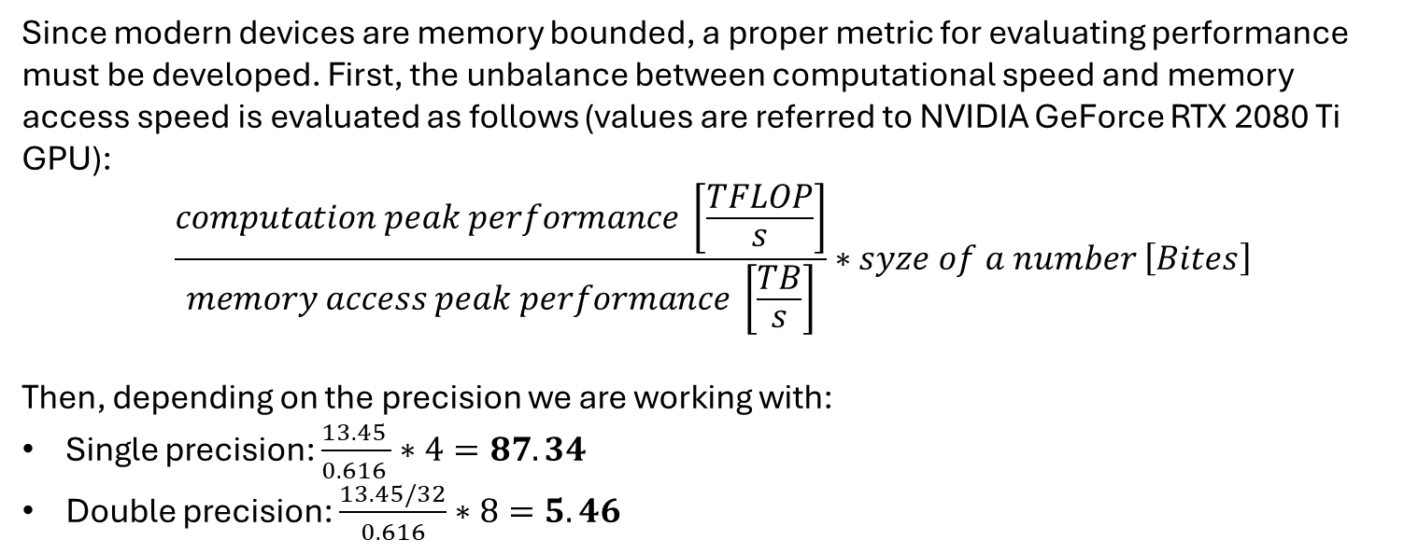
GPU Performance evaluation
Since modern devices are memory bounded, a proper metric for evaluating performance must be developed. First, the unbalance between computational speed and memory access speed is evaluated as follows (values are referred to NVIDIA GeForce RTX 2080 Ti GPU):
$$\frac{computation peak performance \left[\frac{TFLOP}{s}\right]}{memory access peak performance \left[\frac{TB}{s}\right]}∗syze of a number \left[Bites\right]$$
Then, depending on the precision we are working with:
Single precision: $\frac{13.45 }{0.616 }∗4=87.34$
Double precision: $\frac{13.45/32}{0.616}∗8=5.46$

Slide 10
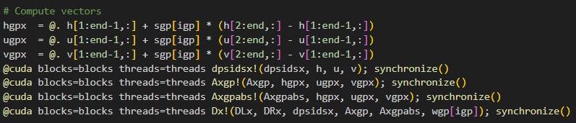
Core of the codes
The difference in the two implementation is the number of array used for the solution!
Only the D arrays are necessary, they are needed for the update formula; all the others are temporary array that only increases the number of memory access.

Slide 11

Effective memory throughput
It accounts for the time of execution and the number of accesses to the memory have been done in that time. The formula for its evaluation is:
$$T_{eff}=\frac{n_{accesses}}{1e^{9}n_{x} n_{y} sizeof(Float64)}∗\frac{1}{t_{execution}}$$
Considering only the x direction (y is the same), the two codes performs the following memory accesses (reads or writes) at any iteration:
GPU: 99
GPU_opt: 48
Leading to the following (maximum) effective throughput memory access:
GPU: 429.43 GB/s (69.6%) Threads = (8, 2) nx = ny = 1024
GPU_opt: 508.27 GB/s (82.5%) Threads = (8, 16) nx = ny = 1024
The Peak memory access is 616 GB/s.

