Slide 1
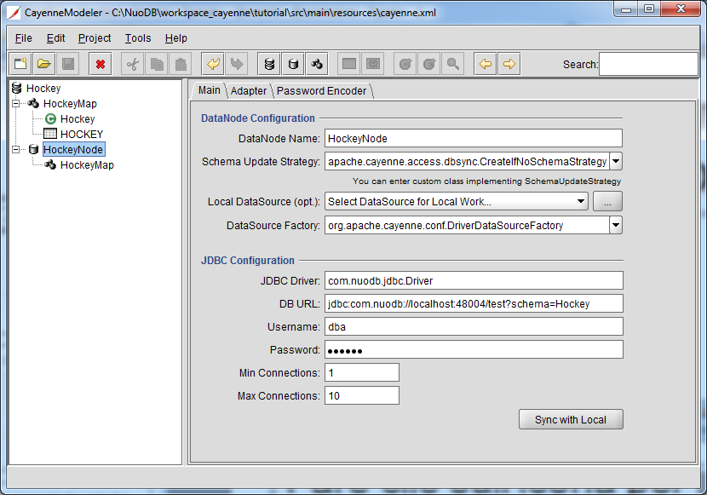
1. Use the Cayenne modeler to bind to the NuoDB database

Slide 2
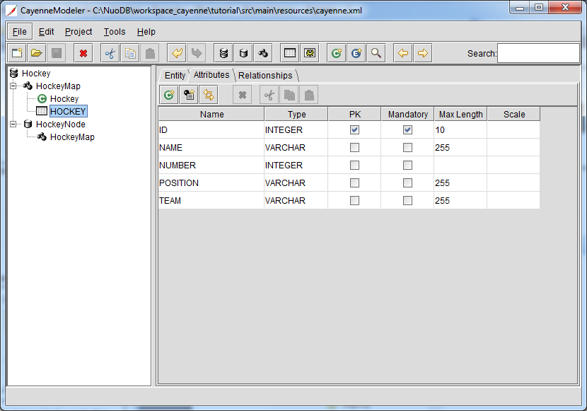
2. Declare the columns of the table

Slide 3
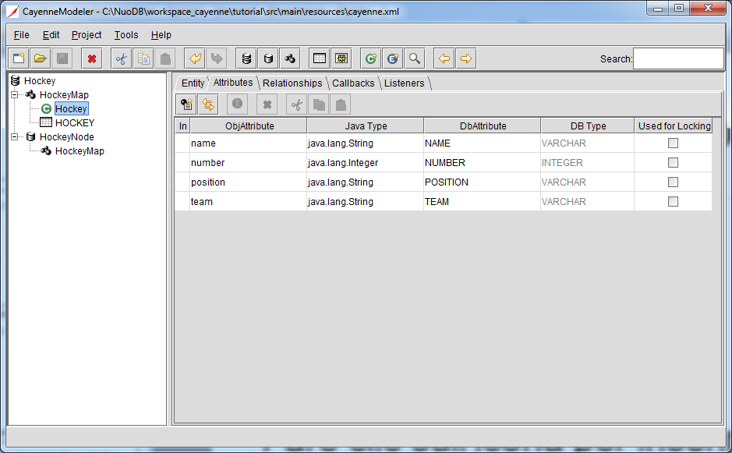
3. Create the corresponding object

Slide 4
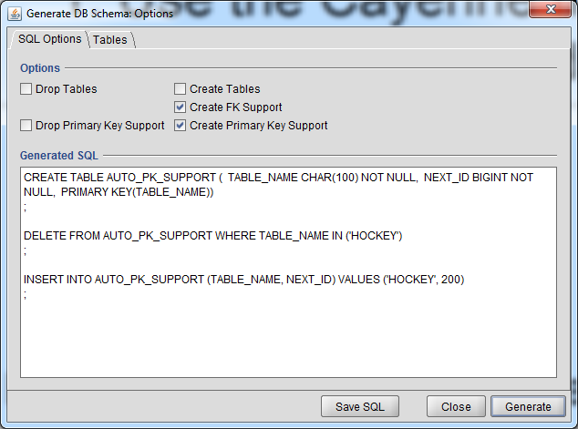
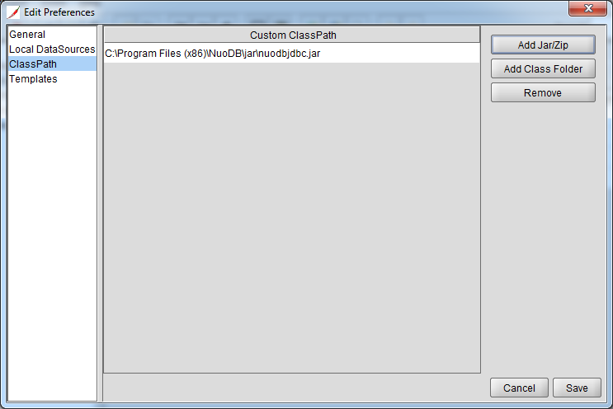
4. Add the nuodbjdbc.jar to the classpath, then generate the AUTO_PK_SUPPORT helper table

Slide 5
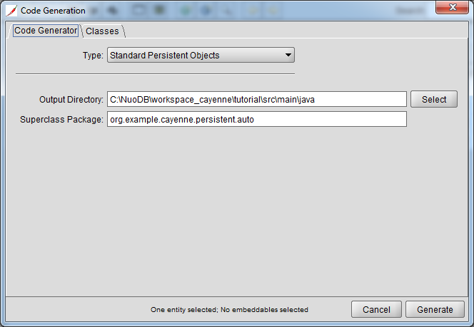
5. Generate the Java classes

Slide 6
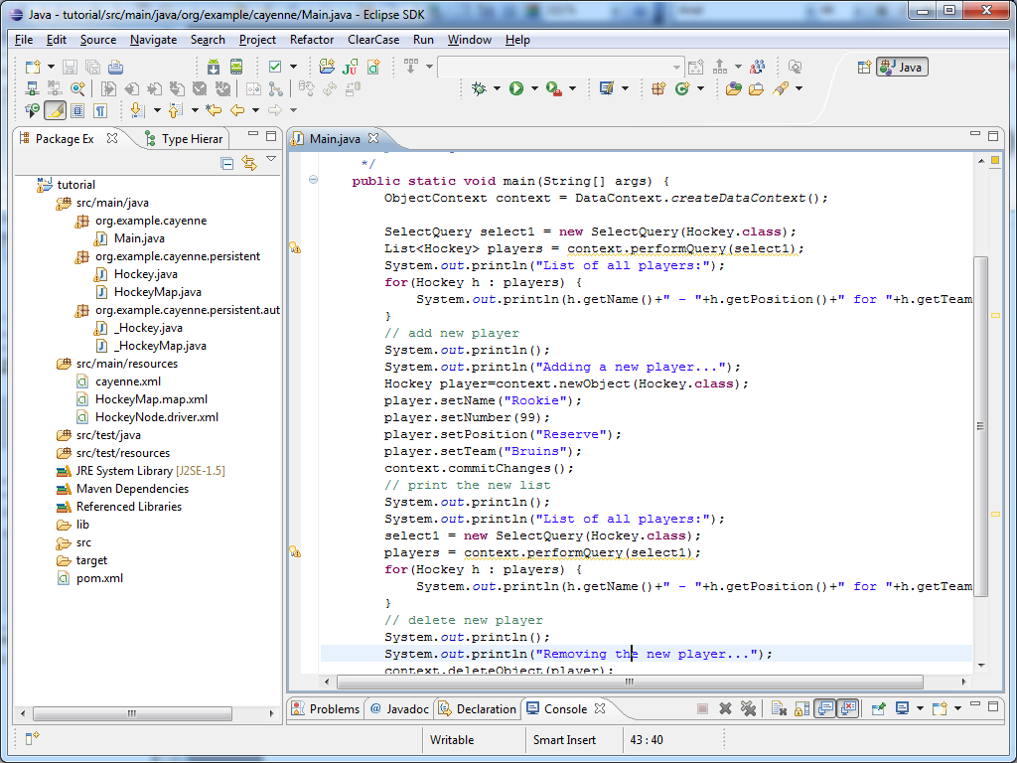
6. Build the Eclipse project

Slide 7
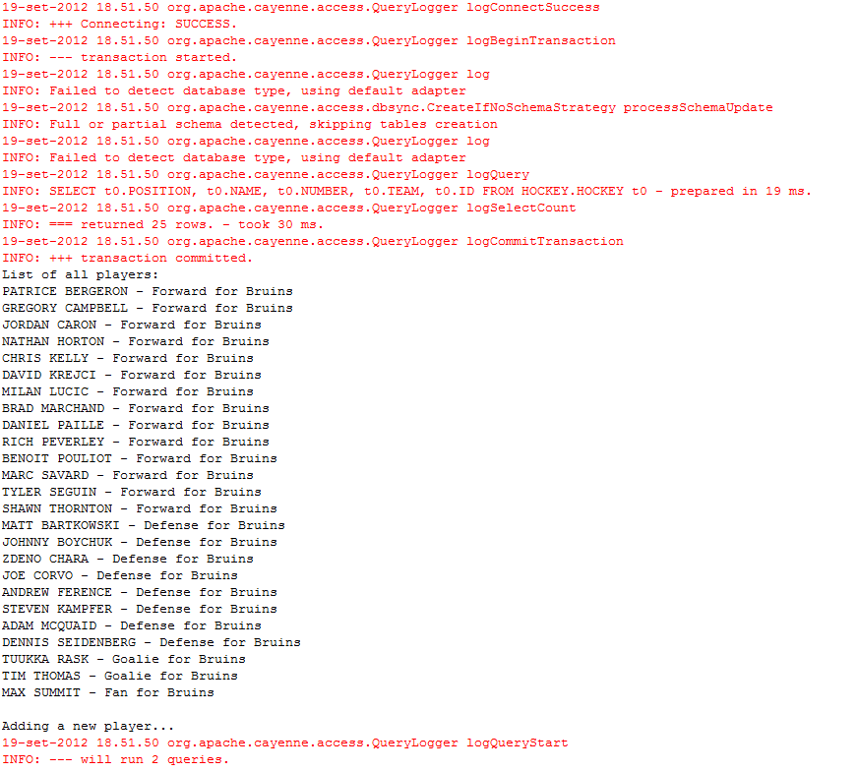
7. Add the nuodbjdbc.jar to the classpath, and run it

