Slide 1
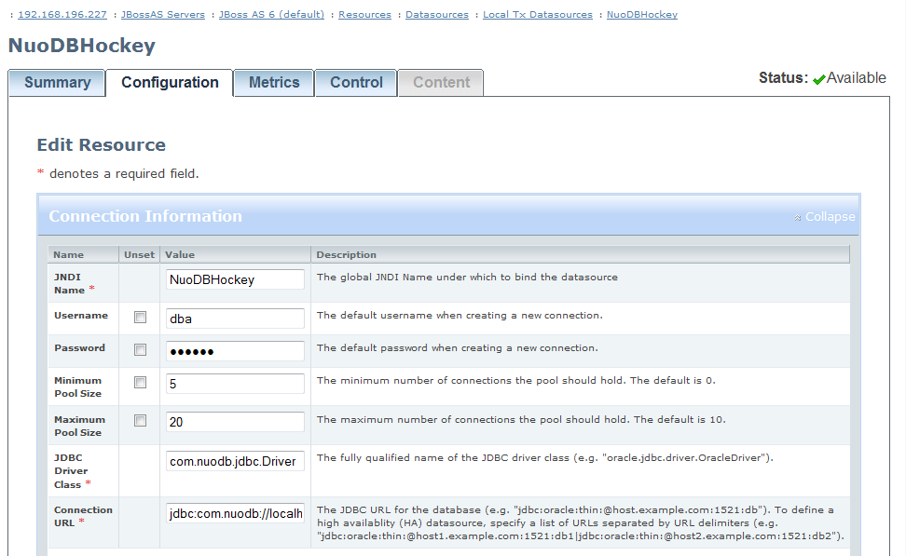
1. Set up a JNDI datasource
Add a nuodb-ds.xml file to the <jboss>\server\default\deploy folder

Slide 2
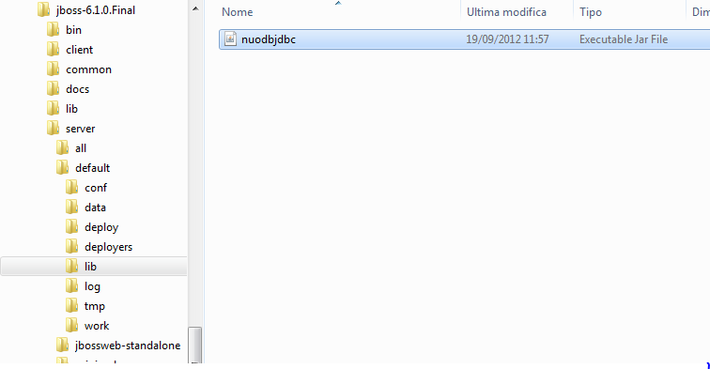
2. Drop the nuodbjdbc.jar JDBC driver in <jboss>\server\default\lib

Slide 3
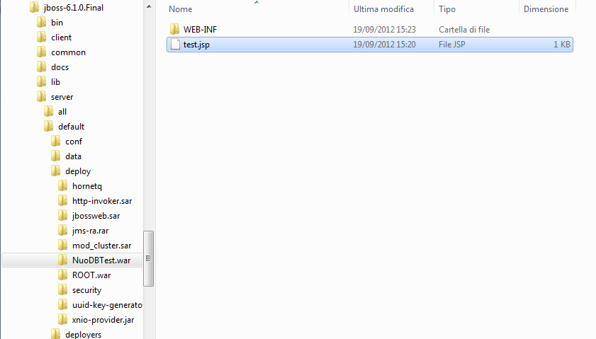
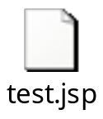
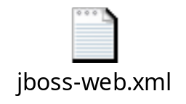
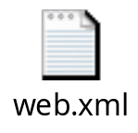
3. Create the JSP application

Slide 4
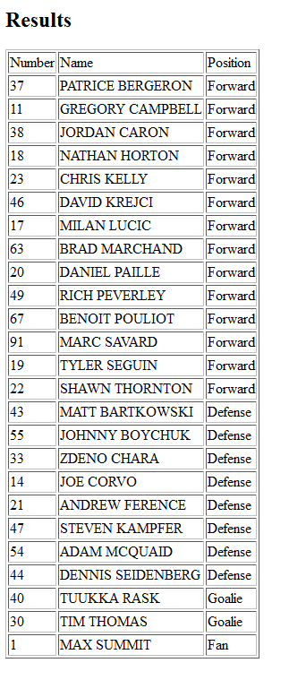
4. Connect to the application

