Slide 1
1. Set up a JNDI datasource
Modify the <tomcat>\conf\context.xml to include
<Context>
…
<Resource name="jdbc/NuoDBHockey" auth="Container" type="javax.sql.DataSource"
maxActive="100" maxIdle="30" maxWait="10000"
username="dba" password="goalie" driverClassName="com.nuodb.jdbc.Driver"
url="jdbc:com.nuodb://localhost:48004/test?schema=Hockey"/>
</Context>

Slide 2
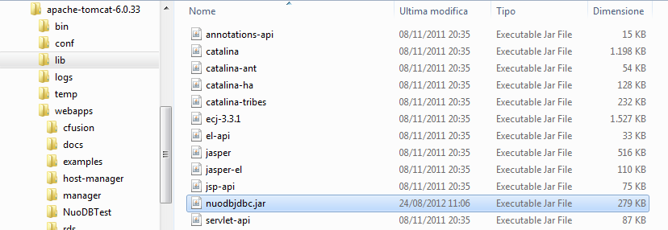
2. Drop the nuodbjdbc.jar JDBC driver in <tomcat>\lib

Slide 3
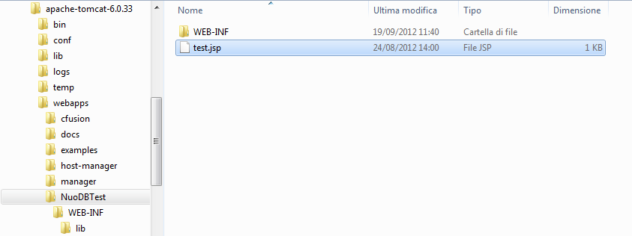


3. Create the JSP application

Slide 4
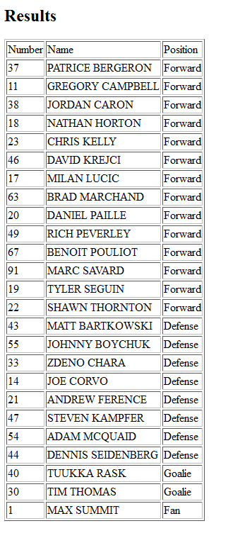
4. Connect to the application

