Slide 1
1. Install Node.js dependencies
> npm install generic-pool
> npm install db-nuodb

Slide 2
2. Start the sample
> node index.js

Slide 3
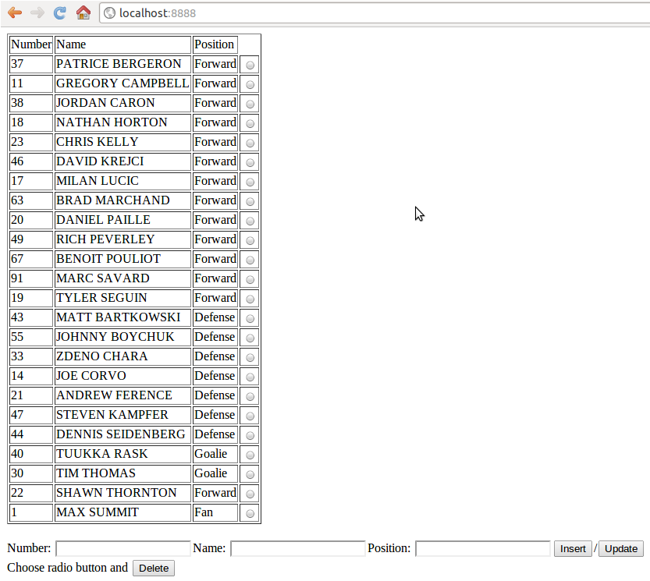
3. Connect to the application

