Slide 1

Storefront Demo
Developer Setup Guide
How to configure and run the Storefront Demo via the Eclipse IDE
Version 1 – May 5, 2013

Slide 2

Configure Environment
Install all of the following:
JDK 1.6+
Apache Maven 3.0+
Apache Tomcat 6.0+ (or other web app server)
Eclipse
Eclipse m2e plugin (Maven Integration for Eclipse)
Eclipse IDE for Java Developers (includes Git support)
Eclipse Java Web Developer Tools
Eclipse Web Developer Tools

Slide 3
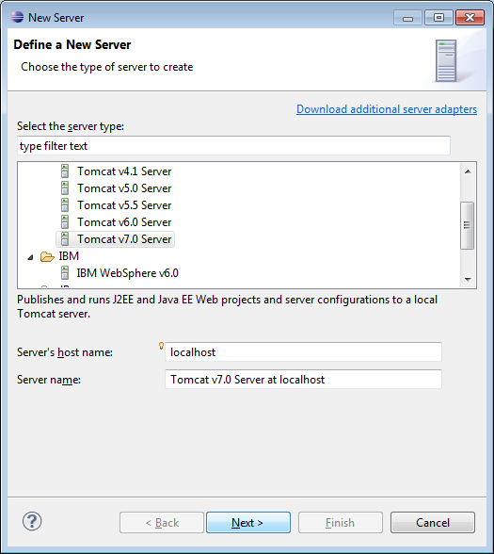
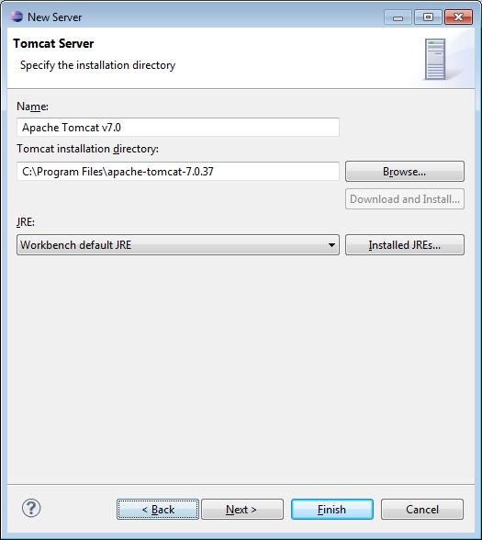
Configure Web Server
Window > Show View > Other > Server > Servers
Right click in view: New > Server
Use wizard to configure Tomcat Server (or compatible)
Right click on server in Servers view > Open
Change ports so they do not conflict with NuoDB and others (e.g. change 8080 to something else, like 9080)

Slide 4
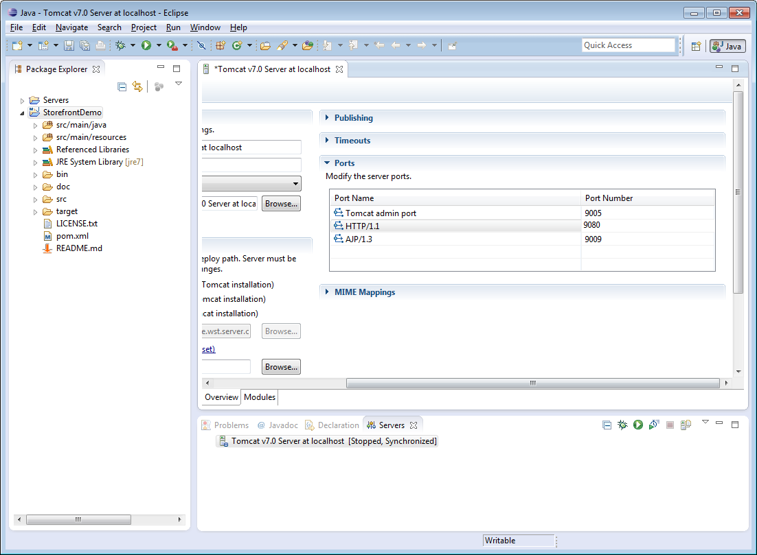

Slide 5
Import Storefront from Git
File > Import
Git >Projects from Git
Follow wizard with https://github.com/nuodb/nuodb-samples.git location URI

Slide 6
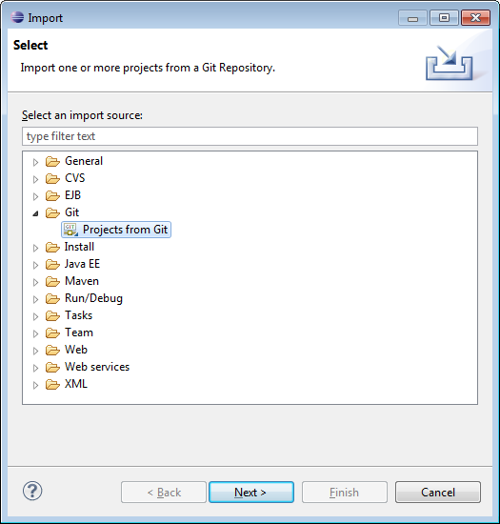
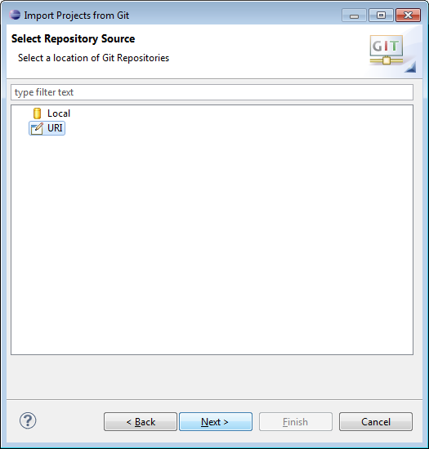
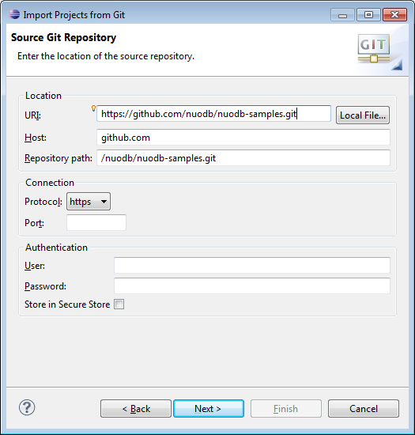
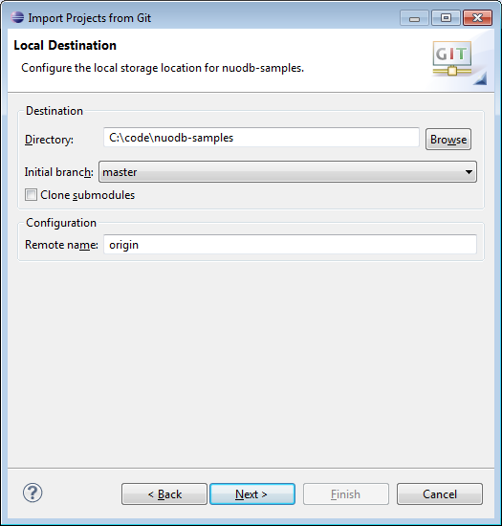
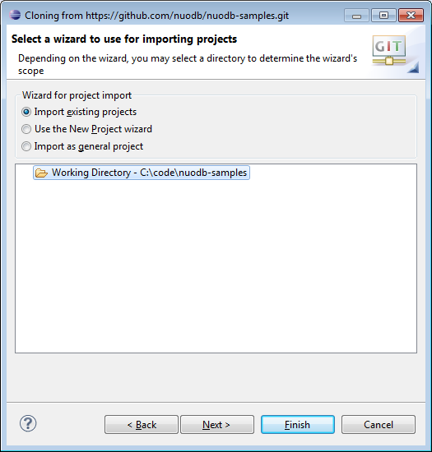
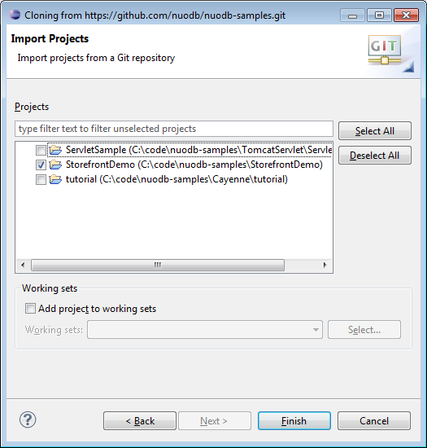

Slide 7
Rebuild Storefront Project
Go to root directory of project using a command prmpt
Run command “mvn eclipse:clean”
Refresh project
Configure > Convert to Maven Project
Project > Build project (if not configured to build automatically)
You may see some JavaScript “errors” in the Problems view: these can be safely ignored

Slide 8
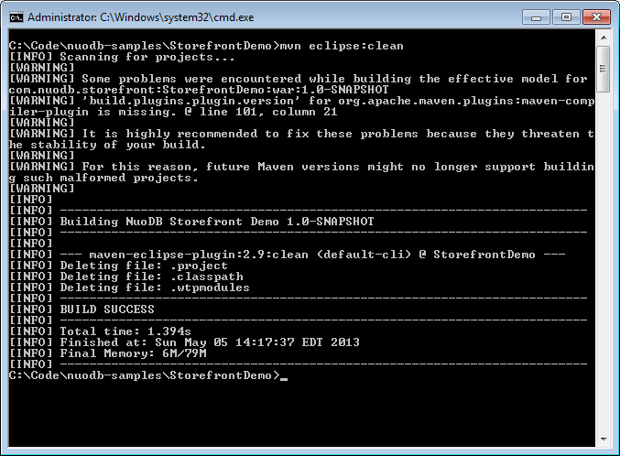
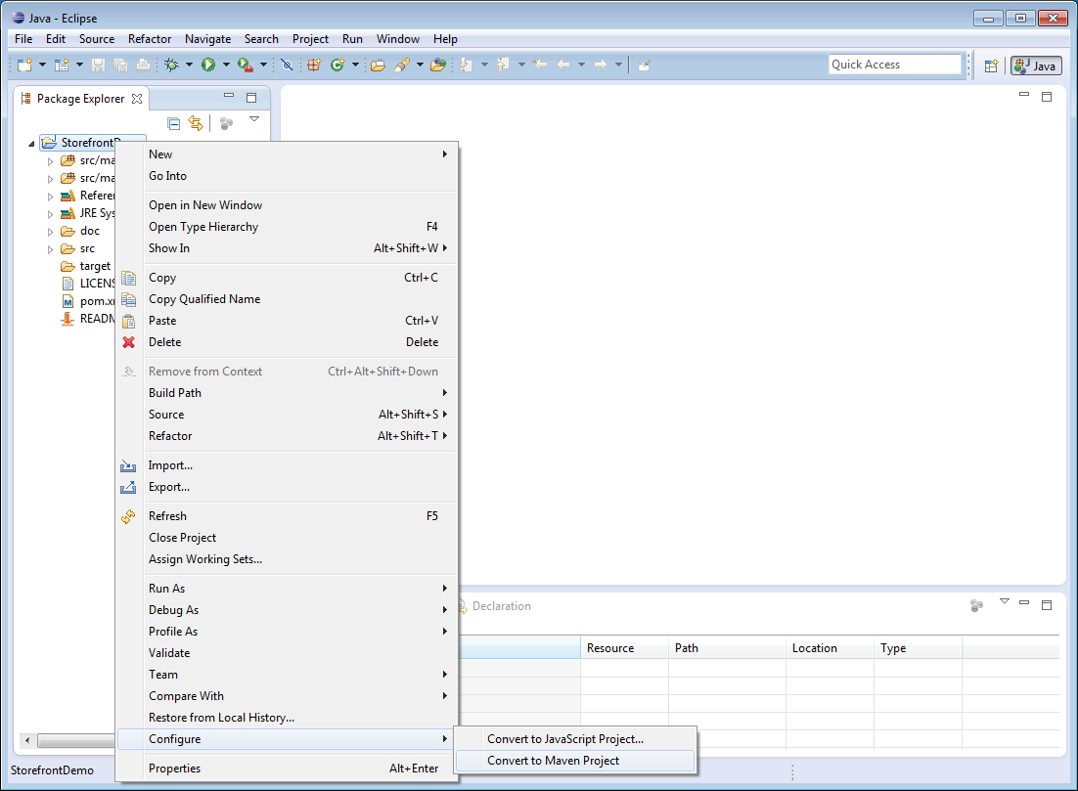

Slide 9
Create Storefront Database
Open NuoDB Console
Start Database
Walk through wizard
Storefront is pre-configured with these connection settings:
  Database name: Storefront
  Username: StorefrontUser
  Password: StorefrontUser
If you change these defaults while using the wizard, edit connection.url setting in src/main/resources/hibernate.cfg.xml to match

Slide 10
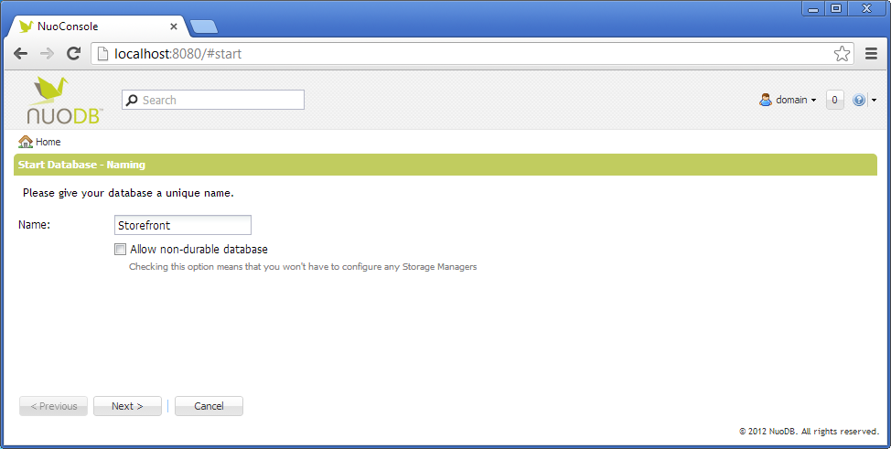
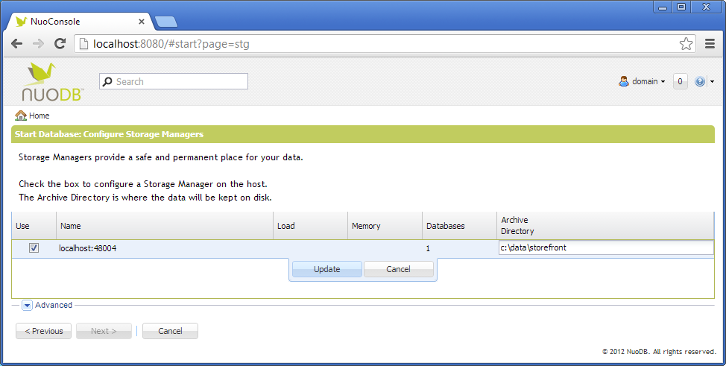
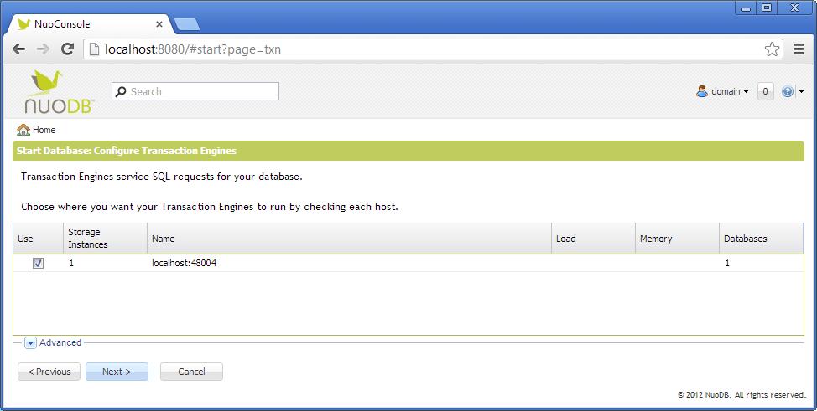
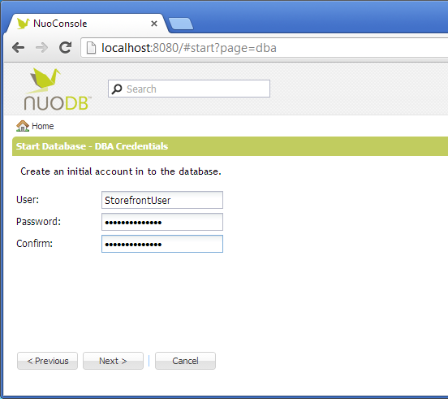

Slide 11
Run Storefront
Project context menu: Debug As > Debug on Server
Choose Tomcat (or compatible)
Click Finish
Storefront will load in the built-in browser
Choose one of the product load options that appears (this will only appear if the database is empty)
For simulation and monitoring tools, click the “Admin” link
For best results, view the app in a standalone web browser like Chrome (not the browser integrated into Eclipse)

Slide 12
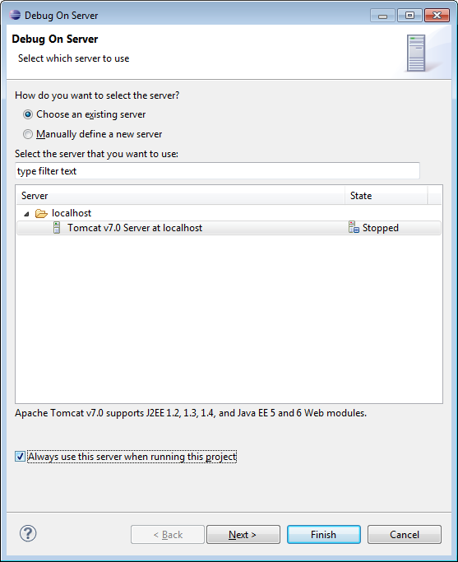
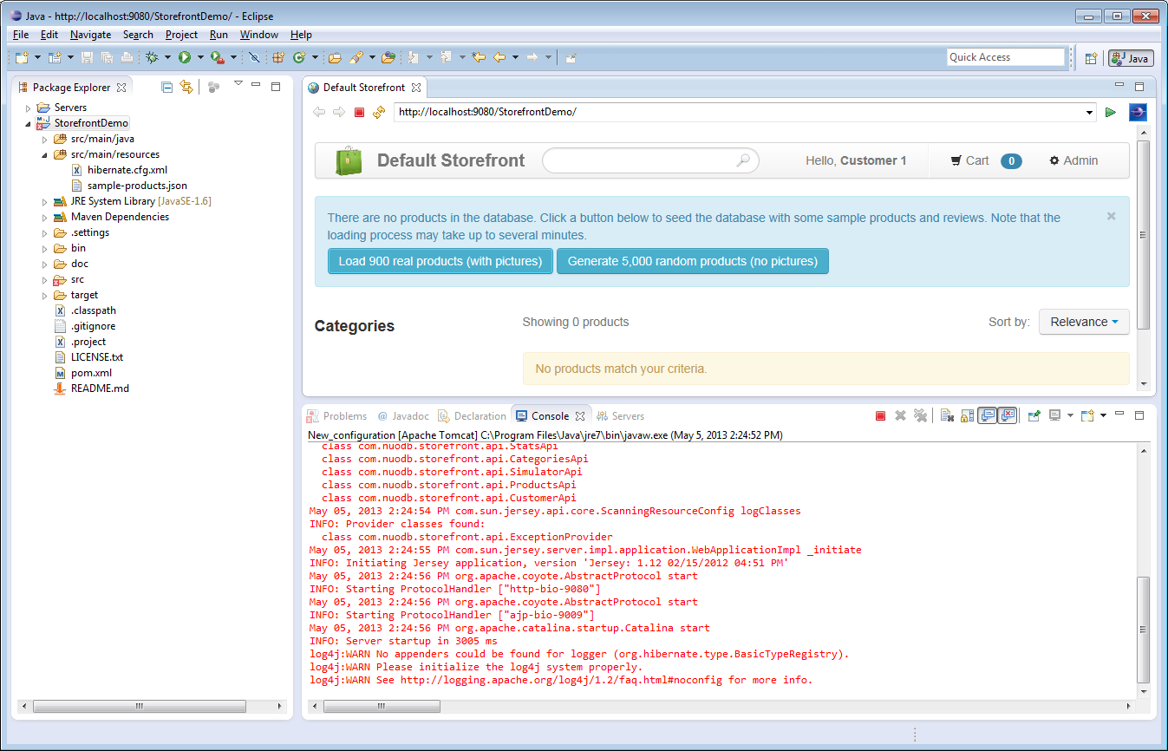
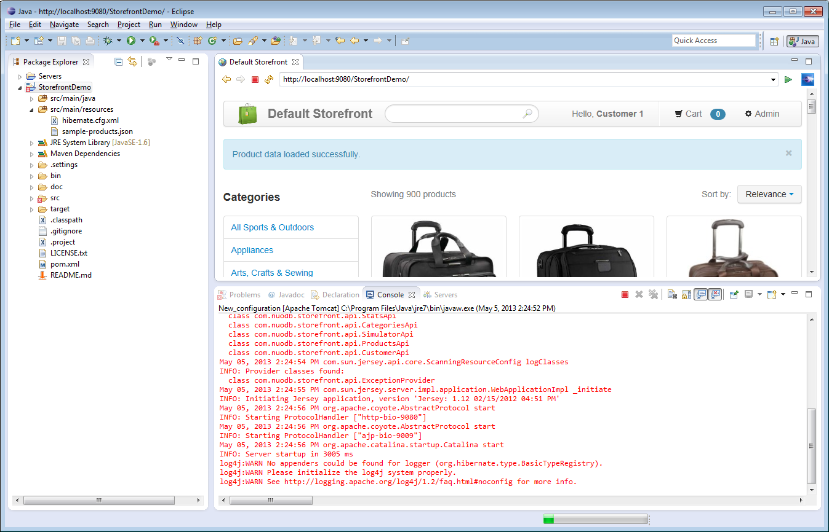

Slide 13
