Slide 1
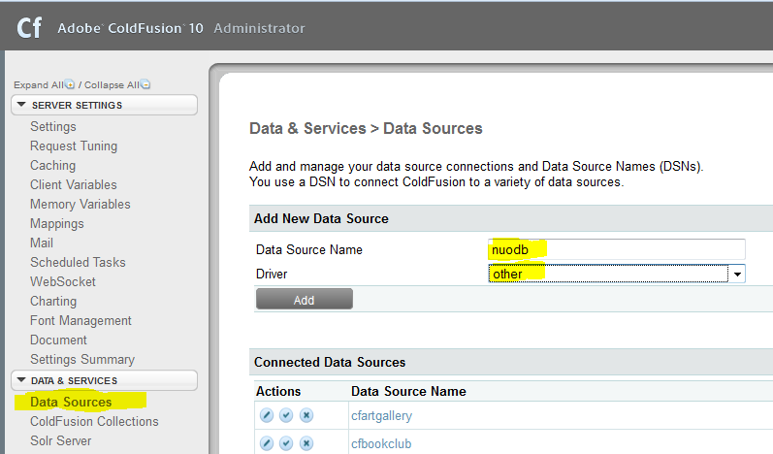
1. Set up a NuoDB datasource (1/2)

Slide 2
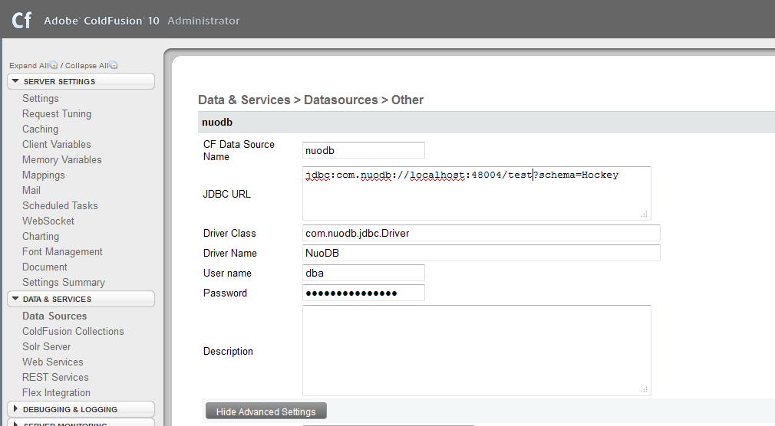
2. Set up a NuoDB datasource (2/2)

Slide 3
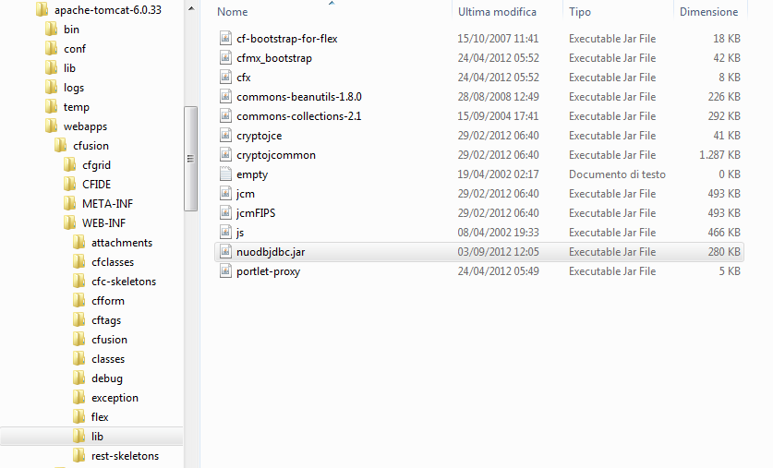
3. Drop the nuodbjdbc.jar JDBC driver in ColdFusion

Slide 4
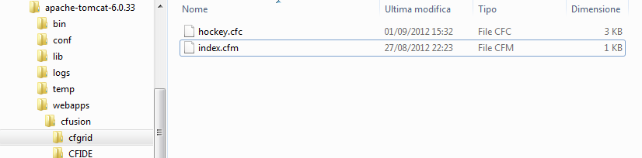

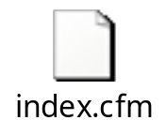
4. Create the cfgrid application

Slide 5
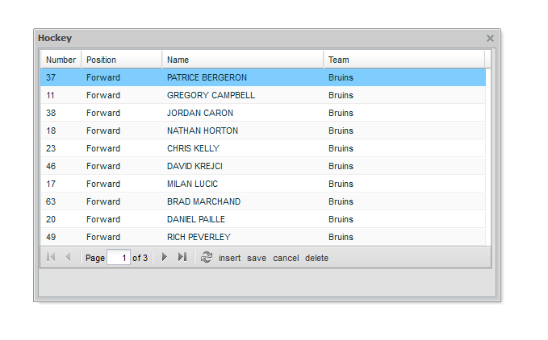
5. Connect to the application

