Slide 1
Tutorial 2: Abaqus with Analysis Input File

Slide 2
Abaqus Basics
Preprocessing
Abaqus/CAE
Interactive Mode
Input file (text):
Job.inp
Analysis Input file
Simulation
Abaqus/Standard
FEM Solver
Output file:
Job.odb, job.dat
Postprocessing
Abaqus/CAE

Slide 3
Why do I go with input files?
Analysis with input files
ABAQUS solver reads the analysis input file
Advantage:
User can change model directly without GUI
FASTER than analysis using GUI
Useful for minor modification (GUI automatically create an input file)
Disadvantage:
No visual information (should use GUI to check model layout)
User has to discretize model

Slide 4
Input File: frame.inp
*HEADING
Two-dimensional overhead hoist frame
SI units (kg, m, s, N)
1-axis horizontal, 2-axis vertical
*PREPRINT, ECHO=YES, MODEL=YES, HISTORY=YES
**
** Model definition
**
*NODE, NSET=NALL
101, 0., 0., 0.
102, 1., 0., 0.
103, 2., 0., 0.
104, 0.5, 0.866, 0.
105, 1.5, 0.866, 0.
*ELEMENT, TYPE=T2D2, ELSET=FRAME
11, 101, 102
12, 102, 103
13, 101, 104
14, 102, 104
15, 102, 105
16, 103, 105
17, 104, 105
*SOLID SECTION, ELSET=FRAME, MATERIAL=STEEL
** diameter = 5mm --> area = 1.963E-5 m^2
1.963E-5,
*MATERIAL, NAME=STEEL
*ELASTIC
200.E9, 0.3
Truss element
Solid section
Elastic material

Slide 5
Input File: frame.inp
**
** History data
**
*STEP, PERTURBATION
10kN central load
*STATIC
*BOUNDARY
101, ENCASTRE
103, 2
*CLOAD
102, 2, -10.E3
*NODE PRINT
U,
RF,
*EL PRINT
S,
**********************************
** OUTPUT FOR ABAQUS QA PURPOSES
**********************************
*EL FILE
S,
*NODE FILE
U, RF
*END STEP
CLOAD
PERTURBATION STATIC
Truss element
Solid section
Elastic material

Slide 6
Input File: frame.inp
*HEADING
Two-dimensional overhead hoist frame
SI units (kg, m, s, N)
1-axis horizontal, 2-axis vertical
*PREPRINT, ECHO=YES, MODEL=YES, HISTORY=YES
**
** Model definition
**
*NODE, NSET=NALL
101, 0., 0., 0.
102, 1., 0., 0.
103, 2., 0., 0.
104, 0.5, 0.866, 0.
105, 1.5, 0.866, 0.
*ELEMENT, TYPE=T2D2, ELSET=FRAME
11, 101, 102
12, 102, 103
13, 101, 104
14, 102, 104
15, 102, 105
16, 103, 105
17, 104, 105
*SOLID SECTION, ELSET=FRAME, MATERIAL=STEEL
** diameter = 5mm --> area = 1.963E-5 m^2
1.963E-5,
*MATERIAL, NAME=STEEL
*ELASTIC
200.E9, 0.3
**
** History data
**
*STEP, PERTURBATION
10kN central load
*STATIC
*BOUNDARY
101, ENCASTRE
103, 2
*CLOAD
102, 2, -10.E3
*NODE PRINT
U,
RF,
*EL PRINT
S,
**********************************
** OUTPUT FOR ABAQUS QA PURPOSES
**********************************
*EL FILE
S,
*NODE FILE
U, RF
*END STEP

Slide 7
Format of Input File
Model data section
Information required to define the structure being analyzed
History data section
Type of simulation (static, dynamics, etc)
The sequence of loading or events for which the response of the structure is required
Divided into a sequence of steps
Output request
Input file
Composed of a number of option blocks (describing a part of the model)
Each option block begins with a keyword line (starting with *), which is usually followed by one or more data lines.
Description for the data lines (starting with **)

Slide 8
Format of Input File cont.
Keyword line
*ELEMENT, TYPE = T2D2, ELSET = FRAME
Element set FRAME is 2-dimensional truss element
*NODE, NSET=PART1
All nodes below belong to a set PART1
*ELEMENT, TYPE = T2D2,
ELSET = FRAME
Maximum 256 characters per line

Slide 9
Format of Input File cont.
Data line - Keyword line usually followed by data lines
*NODE
101, 0., 0., 0.
102, 1., 0., 0.
103, 2., 0., 0.
104, 0.5, 0.866, 0.
105, 1.5, 0.866, 0.
104
105
101
102
103

Slide 10
Format of Input File cont.
*ELEMENT
11, 101, 102
12, 102, 103
13, 101, 104
14, 102, 104
15, 102, 105
16, 103, 105
17, 104, 105
104
17
105
13
14
15
16
101
11
102
12
103

Slide 11
Format of Input File cont.
Model data
Heading
The first option in any Abaqus input file must be *HEADING
Description of the problem
*HEADING
Two-dimensional overhead hoist frame
SI units (kg, m, s, N)
1-axis horizontal, 2-axis vertical
Data file printing options
Input file echo
*PREPRINT, ECHO=YES, MODEL=YES, HISTORY=YES
Comments
**
** Model definition
**

Slide 12
Format of Input File cont.
Element connectivity
Keyword *ELEMENT specifies element type, element set
*ELEMENT, TYPE=T2D2, ELSET=FRAME
11, 101, 102
12, 102, 103
13, 101, 104
14, 102, 104
15, 102, 105
16, 103, 105
17, 104, 105
Section properties
Keyword *SOLID SECTION specifies area, I, etc
*SOLID SECTION, ELSET=FRAME, MATERIAL=STEEL
** diameter = 5mm --> area = 1.963E-5 m^2
1.963E-5,

Slide 13
Format of Input File cont.
Material properties
Keyword *MATERIAL followed by various suboptions
*MATERIAL, NAME=STEEL
*ELASTIC
200.E9, 0.3
History data
Starts with keyword *STEP, followed by the title of the step
*STEP, PERTURBATION
10kN central load
Analysis procedure
Use *STATIC immediately after *STEP
Boundary conditions
Keyword *BOUNDARY
(UX, UY, UZ, UR1, UR2, URS) = (1, 2, 3, 4, 5, 6)

Slide 14
Format of Input File cont.
Boundary conditions cont.
Format: Node number, first dof, last dof, displ value
103, 2,2, 0.0
103, 2,2
103, 2
101, 1
101, 2
Built in constraints
ENCASTRE: Constraint on all displacements and rotations at a node
PINNED: Constraint on all translational degrees of freedom
XSYMM: Symmetry constraint about a plane of constant
YSYMM: Symmetry constraint about a plane of constant
ZSYMM: Symmetry constraint about a plane of constant
XASYMM: Antisymmetry constraint about a plane of constant
YASYMM: Antisymmetry constraint about a plane of constant
ZASYMM: Antisymmetry constraint about a plane of constant

Slide 15
Format of Input File cont.
Applied loads
concentrated loads, pressure loads, distributed traction loads, distributed edge loads and moment on shells, nonzero boundary conditions, body loads, and temperature
*CLOAD
102, 2, -10.E3
Output request
neutral binary file (.odb), printed text file (.dat), restart file (.res), binary result file (.fil)
*EL PRINT
S, E
*NODE PRINT
U,
RF,
End of step
*END STEP

Slide 16
Modifying Input File
Multiple Sections (FRAME1 and FRAME2)
Assign new section to element 6
*ELEMENT, TYPE=T2D2, ELSET=FRAME1
11, 101, 102
12, 102, 103
13, 101, 104
14, 102, 104
15, 102, 105
16, 103, 105
*ELEMENT, TYPE=T2D2, ELSET=FRAME2
17, 104, 105
*SOLID SECTION, ELSET=FRAME1, MATERIAL=STEEL
** diameter = 5mm --> area = 1.963E-5 m^2
1.963E-5,
*SOLID SECTION, ELSET=FRAME2, MATERIAL=STEEL
2.0E-5,

Slide 17
Modifying Input File (Made by ABAQUS)
Input files made by GUI
Find the files in the work directory (to check where the directory is: Files > Set Work Directory)
Automatically made by GUI when users submit a model (ex: [Jobname].inp)
Edit the existing input file

Slide 18
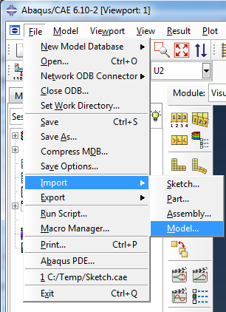
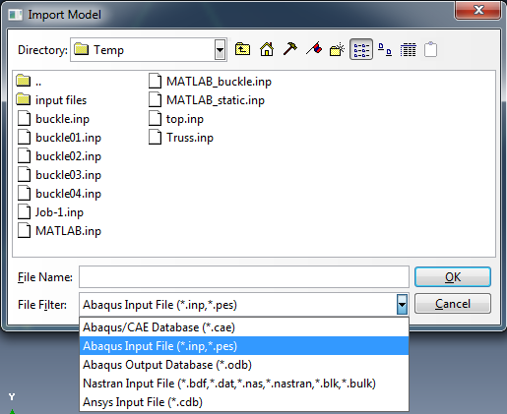
Run ABAQUS
Using Abaqus/CAE
Import the input model
Advantage: visually check FEM model
Disadvantage: A couple of commands do not work (ex: text out request commands)

Slide 19
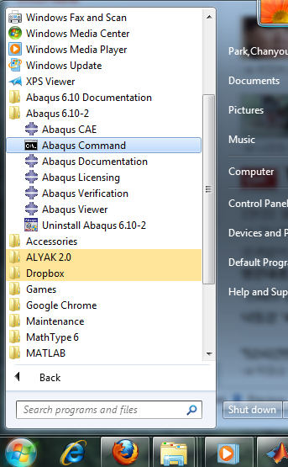
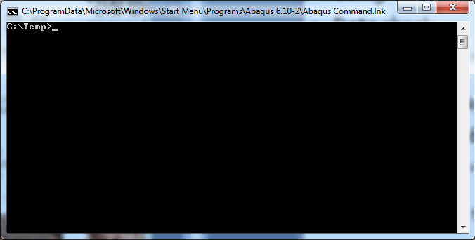
Run ABAQUS
Using Command Prompt
Data check
abaqus job=frame datacheck interactive
Check for **ERROR or **WARNING
Solving the problem
abaqus job=frame continue interactive
Show frame.dat file

Slide 20
Run ABAQUS
Basic commands in command prompt
cd [directory name] : change directory to new directory
(ex: cd test)
cd / : change directory to root at once
dir : see available files in current directory

Slide 21
Batch Test
Running many jobs
Useful to run many jobs at the same time
Create a batch file (ex: multirun.bat)
Making a batch file
Make an empty text file and write a list of files
Change the file name and extension (ex: newname.txt -> multirun.bat)
(
abaqus job=frame-1 interactive
abaqus job=frame-2 interactive
abaqus job=frame-3 interactive
abaqus job=frame-4 interactive )

