Slide 1

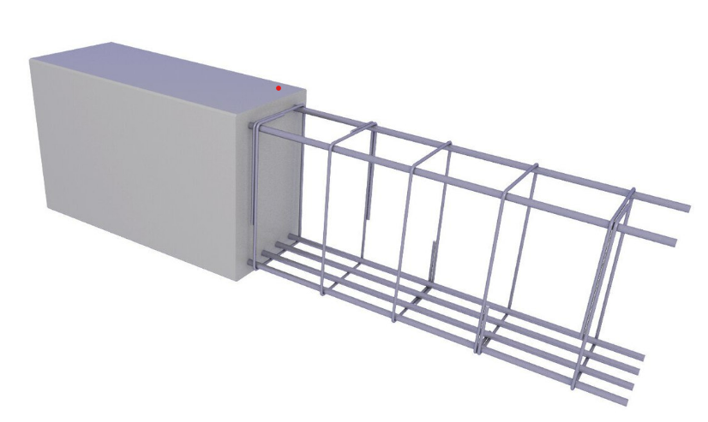
Concrete Compressive Strength Analysis using Machine Learning Models
Instructor: Dr. LU Gao
Prepared BY: NUPOOR KUMBHAR (UH ID – 2351355)

Slide 2
ABSTRACT
Research efforts have demonstrated that the concrete compressive strength not only depends on cement water ratio but is also influenced by other ingredients and factors.
Modeling the behavior of concrete strength is a complex model due to the involvement of many factors and the advancement of technology has made it possible to evaluate via multiple predictive models.
Multiple machine learning models were developed on the dataset to identify the best features and their impact on the concrete compressive strength.
Additionally Deep Learning model implementation was integrated to perform deep analysis study on the behavior of the data set and its impact on all the features.

Slide 3
INTRODUCTION
Importance of Concrete Compressive Strength: It is imperative for high-performance concrete used in advanced construction and structural engineering. Compressive strength provides better resistance in different environmental conditions.
The factors that have been considered to affect the compressive strength include ingredient composition and curing process, among others. Correct modeling and prediction are very important for optimization purposes in material design to achieve safety and cost efficiency in construction projects.
Machine Learning in Predictive Modeling: Traditional methods are usually cumbersome and resource-intensive. Machine learning opens up a whole new, radically better way of examining complicated nonlinear relationships among variables to improve the accuracy of prediction and insight into sensitivities.
Project Details and Results: A regression model has been implemented using the dataset from UCI Machine Learning Repository in which regression and deep learning models are applied for compressive strength predictions. The results indicate higher accuracy in prediction and shed light on useful insights related to the relationship of variables with compressive strength.

Slide 4
DATA OVERVIEW
Source: This dataset originates from the UC Irvine Machine Learning Repository, a well-known repository of high-quality datasets that have been used in empirical machine learning research.
Composition: The dataset comprises 1,030 entries described by 8 features-cement, blast furnace slag, fly ash, water, superplasticizer, coarse aggregate, fine aggregate, and age of concrete-these feature variables are highly relevant to the prediction of concrete compressive strength.
Variable Types: The dataset involves continuous and integer variables; as a result, there are 8 quantitative input variables and 1 quantitative output variable, concrete compressive strength.
Data Quality: There are no missing values in this dataset; therefore, it is accurate, reliable, robust, and dependable for predictive modeling analysis.

Slide 5
DATA PRE-PROCESSING
Data Preprocessing Steps: The three major steps are the removal of missing values, normalization using the Min-Max Scaler, and division of data into training and testing.
Tools and Process: The dataset was imported into Python, and preprocessing was done using the sklearn library. The dataset was checked for missing values; there were none, hence it can be said that it's reliable and accurate.
Data Quality: The data was dependable and accurate; no missing values were detected in the preliminary check.
Normalizing and Splitting of Data: Data has been divided into training and testing for model performance assessment. Normalization of features is performed using Min-Max Scaler, which rescales values within the range of [0,1] to be more accurate for the model.

Slide 6
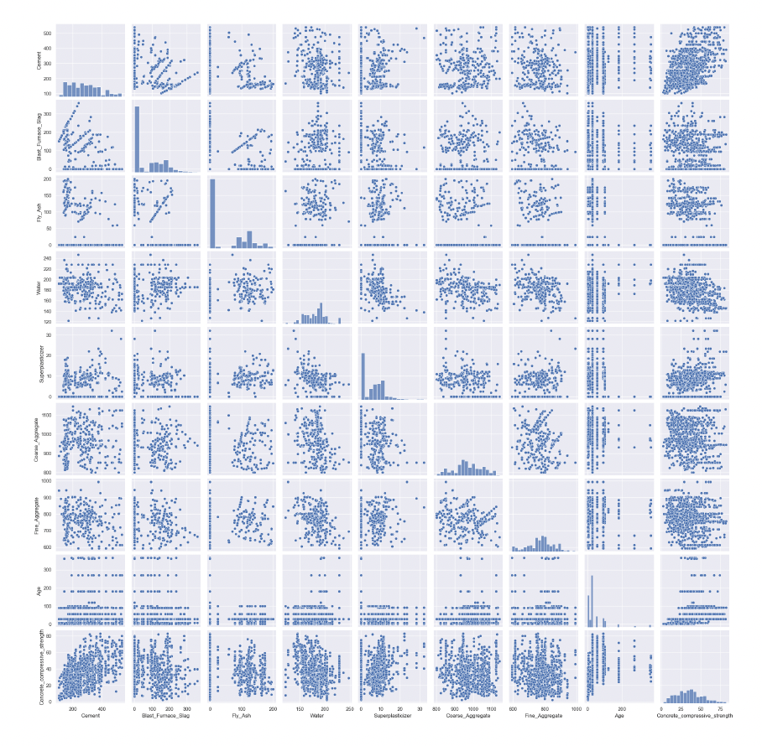
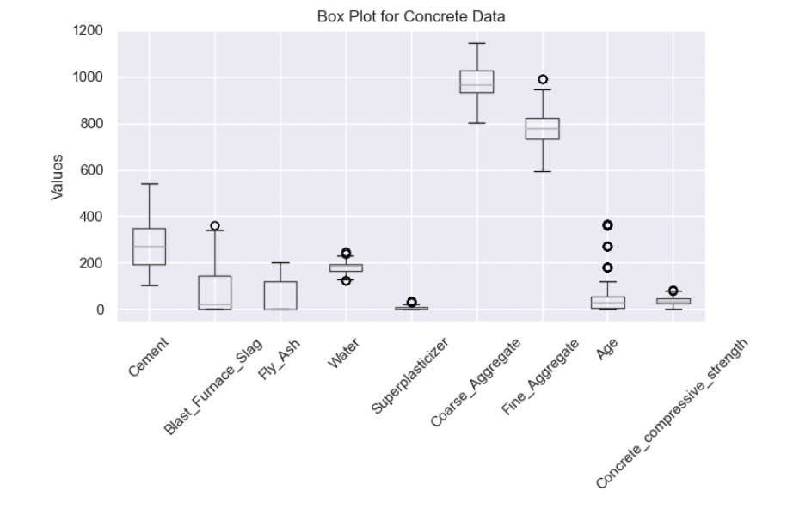
EXPLORATORY DATA ANALYSIS (EDA)
Data Analysis):
Purpose: Understands data structure and quality, identifies key variables, and establishes relationships among features and concrete compressive strength.
Benefits: Detects missing values, outliers, and multicollinearity issues, guiding preprocessing steps and optimizing data for accurate predictions.
Visualization Techniques
Pair Plots: Show relationships and interactions between features, identify trends, outliers, and correlations, and guide feature selection.
Box Plots: Visualize distribution and spread of key variables, detect outliers, and summarize statistical measures like median and quartiles.

Slide 7
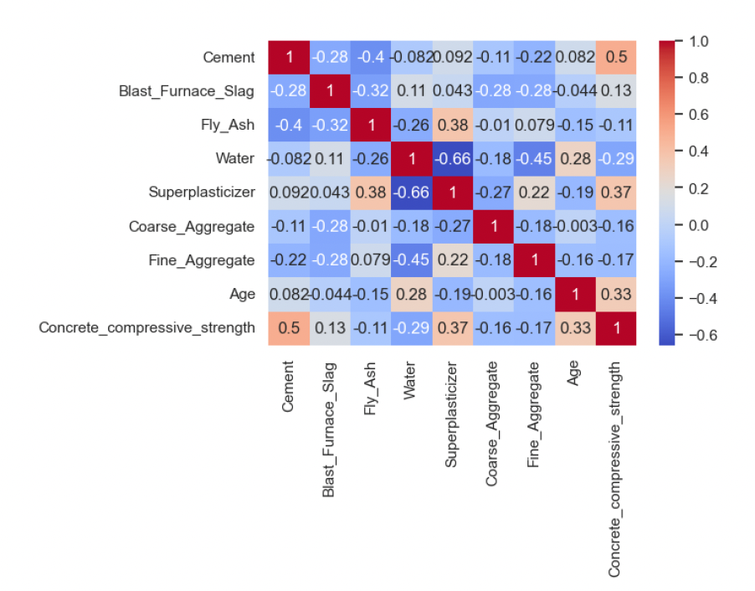
EXPLORATORY DATA ANALYSIS (EDA)
Correlation Heatmap ):
Purpose: Highlights relationships among features and the target variable (compressive strength), identifies key influencers, and addresses multicollinearity.
Benefits: Simplifies model development by focusing on impactful features, reducing redundancies, and improving predictive accuracy and efficiency.

Slide 8
MODEL TRAINING AND EVALUATION
The Decision Tree, Random Forest, Gradient Boosting, Support Vector Machine, K-Nearest Neighbors, and Artificial Neural Network models were trained and compared for the task of prediction of concrete compressive strength.
MAE, RMSE, and R² Score are used for the evaluation of this model. Lower MAE and RMSE values indicate better performance, while a higher R² score shows better performance.
Random Forest and Gradient Boosting had very low MAE and RMSE values while their R² scores were very high. The Random Forest had the lowest MAE-3.71, lowest RMSE-5.44, and highest R²-0.89.
KNN and SVR did very poorly; high MAE and RMSE values with low R² scores. Moderate performances from ANN and Decision Tree but were outdone by Random Forest and Gradient Boosting.
Models evaluated
Performance metrics
Top Performers
Model Comparison

Slide 9
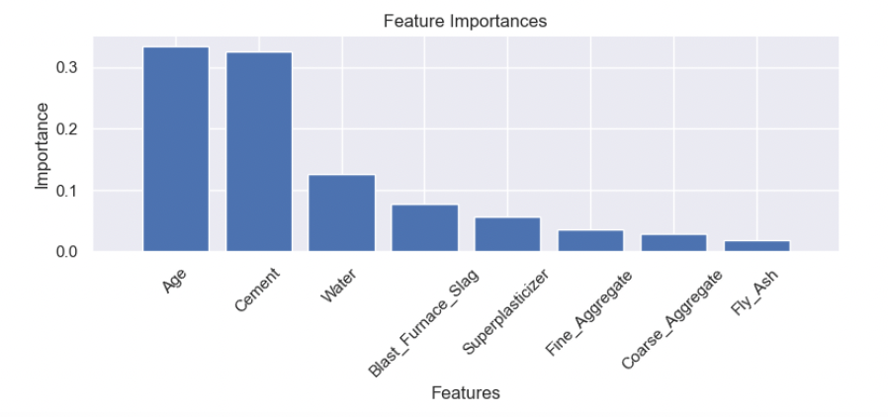
FEATURE IMPORTANCE
Purpose of Feature Importance:
Improves model accuracy by reducing noise and avoiding overfitting.
Enhances interpretability and optimizes resource utilization.
Supports data-driven decisions.
Application in Concrete Compressive Strength:
Uses Random Forest model for tuning key ingredients.
Key Findings:
Top Features: Age and Cement (~0.35 each).
Moderate Importance: Water (~0.15).
Minimal Contribution: Fly Ash, Coarse Aggregate, Fine Aggregate.

Slide 10

HYPERPARAMETER TUNING
Gradient Boosting vs. Random Forest: Gradient Boosting performs closely to Random Forest. Hyperparameter tuning using RandomizedSearchCV improved its performance metrics.
Performance Metrics: After tuning, Gradient Boosting achieved an RMSE of 4.44 and an R² of 0.92, compared to Random Forest's RMSE of 5.44 and R² of 0.89.
Conclusion: Gradient Boosting shows better overall performance with lower RMSE and higher R², making it a strong alternative, especially when fine-tuning and flexibility in learning rates are prioritized.

Slide 11
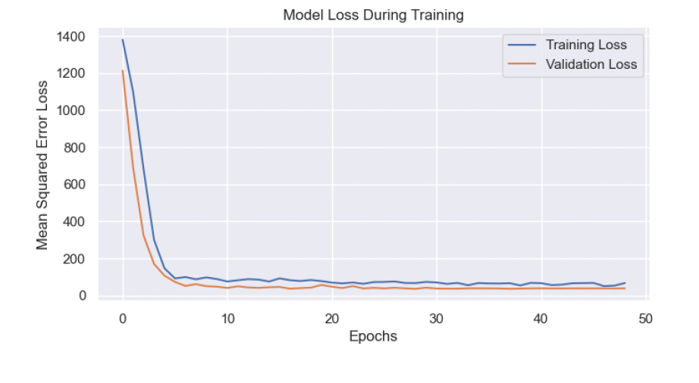
DEEP LEARNING MODELING
Deep Learning Model Implementation: Keras via TensorFlow was used to extract relevant features from the data and find the nuanced pattern in it. Performance Metrics: MAE for this deep learning model is 4.64, RMSE is 6.03, and R² is 0.86, which is competitive compared to other models such as Random Forest and Gradient Boosting. Conclusion: This model is an average performer, however, it could give better results with more features and hyperparameter tuning.

Slide 12
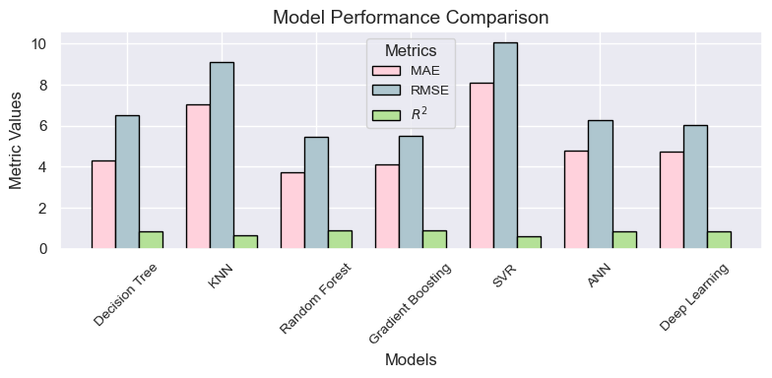
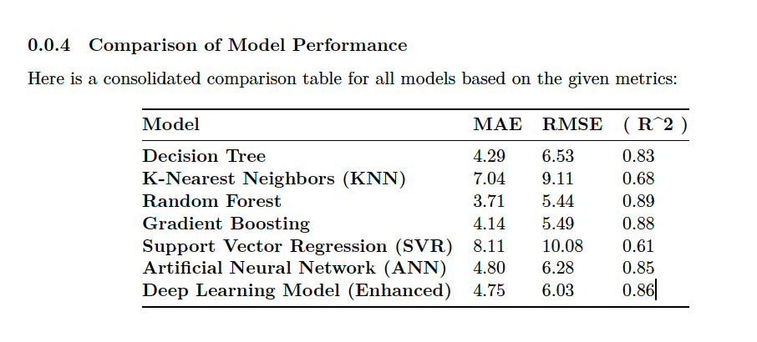
CONCLUSION
Best Model: Random Forest had the best prediction results for concrete compressive strength, balancing bias and variance, and is less prone to overfitting.
Strong Competitor: Gradient Boosting is also strong, with potential for further improvement through hyperparameter tuning.
Deep Learning Models: Promising but require larger datasets and more tuning to realize their full potential.
Poor Performers: SVR and KNN performed poorly and are not recommended without substantial tuning.
Feature Importance: Age and Cement were the most significant predictors (~0.35 each), followed by Water (~0.15). Other features like Fly Ash, Coarse Aggregate, and Fine Aggregate had minimal impact. This supports the choice of Random Forest as the best model.

Slide 13
FUTURE SCOPE
This project demonstrates the potential of using Artificial Neural Networks (ANN) and ensemble methods for predicting concrete compressive strength with high accuracy.
Enhancing Model Performance:
Future work includes hyperparameter tuning to further optimize Random Forest's performance.
Exploring hybrid approaches, combining Random Forest with advanced techniques like neural networks, can achieve even greater accuracy.
Expanding the Dataset:
Incorporating diverse concrete compositions and environmental factors, such as curing time, temperature, and humidity, can significantly enhance the model's generalization ability.
Practical Applications:
Integrating predictive models into real-world construction workflows can revolutionize material design, making it more efficient and cost-effective.
These models can also enable automated quality control and predictive maintenance, supporting sustainability in the construction industry.
Long-term Vision:
This work contributes to smarter and more sustainable construction processes, reducing waste and improving overall project outcomes.

Slide 14
REFERENCES
[1] Yeh, I. (1998). Modeling of strength of high-performance concrete using artificial neural networks. Cement and Concrete Research, 28, 1797-1808.
[2] Popovics, S. (1990). ANALYSIS OF THE CONCRETE STRENGTH VERSUS WATER CEMENT RATIO RELATIONSHIP. Aci Materials Journal, 87, 517-529.
[3] Al Yamani, W.H., Ghunimat, D.M., & Bisharah, M.M. (2023). Modeling and predicting the sensitivity of high-performance concrete compressive strength using machine learning methods. Asian Journal of Civil Engineering, 24, 1943-1955.
[4] Yeh, I. (1998). Concrete Compressive Strength [Dataset]. UCI Machine Learning Repository. https://doi.org/10.24432/C5PK67.
[5] Torre, A., García, F., Moromi, I., Espinoza, P., & Acuña, L. (2015). Prediction of compression strength of high performance concrete using artificial neural networks. Journal of Physics: Conference Series, 582.
[6] Yeh, I. (2007). Modeling slump flow of concrete using second-order regressions and artificial neural networks. Cement & Concrete Composites, 29, 474-480.
[7] Hameed, M.M., & Alomar, M.K. (2019). Prediction of Compressive Strength of High-Performance Concrete: Hybrid Artificial Intelligence Technique. International Conference on Applied Computing to Support Industry: Innovation and Technology.
[8] Islam, N., Kashem, A., Das, P., Ali, M.N., & Paul, S. (2023). Prediction of high-performance concrete compressive strength using deep learning techniques. Asian Journal of Civil Engineering, 1-15.
[9] Zhang, P., Zhang, D., Zhao, X., Zhao, X., Iqbal, M., Tuerxunmaimaiti, Y., & Zhao, Q. (2024). Natural language processing‐based deep transfer learning model across diverse tabular datasets for bond strength prediction of composite bars in concrete. Computer-Aided Civil and Infrastructure Engineering.
[10] Xie, C., Wang, J., Wu, Z., Nie, S., Hu, Y., & Huang, S. (2023). Application of deep learning in civil engineering: boosting algorithms for predicting strength of concrete. J. Intell. Fuzzy Syst., 45, 9109-9122.

Slide 15

THANK YOU

