Slide 1

ALCOHOL DETECTION AND
VEHICLE LOCKING SYSTEM
N U Praneeth Reddy – 21BAI1500

Slide 2

INTRODUCTION
The threat of drunk driving is one of the main causes of traffic accidents in the modern world. Drunk drivers frequently find themselves in compromised conditions when operating a car, which leads to unsafe driving practices on roads.
Imagine a world in which every car on the road is outfitted with life-saving, intelligent technology that is intended to stop accidents caused by intoxicated drivers. The ground-breaking Arduino-based alcohol detection engine lock is designed to detect and prevent a vehicle from operating when the driver's blood alcohol content is higher than the permitted limit. This clever gadget ensures road safety for drivers and other commuters by fusing the power of Arduino microcontrollers with state-of-the-art alcohol sensing technology.
The developed system serves as a crucial component of an automobile ignition locking mechanism, effectively preventing the car from starting when the driver is intoxicated. Through the adoption of this advanced alcohol detection system, the primary goal is to significantly diminish the occurrence of alcohol-related accidents and advocate for safer driving practices.

Slide 3

METHODOLOGY
The Alcohol Detection with Engine Locking system is designed to reduce accidents caused by drunk driving.
It utilizes an MQ-3 sensor to detect alcohol in the environment, with its output signal based on alcohol concentration. When the concentration surpasses a threshold, the Arduino microcontroller is activated.
The microcontroller then stops the vehicle's DC motor, preventing movement, and activates a blinking red LED as a drunk driving alert. Additionally, the system creates a client and utilizes Twilio's API to send an SMS to a pre-set emergency contact number, including the vehicle's location information.
This integrated system aims to provide a comprehensive solution by combining the alcohol sensing capability of the MQ-3 sensor, decision-making of the Arduino microcontroller, LED alert system, and SMS notifications.

Slide 4

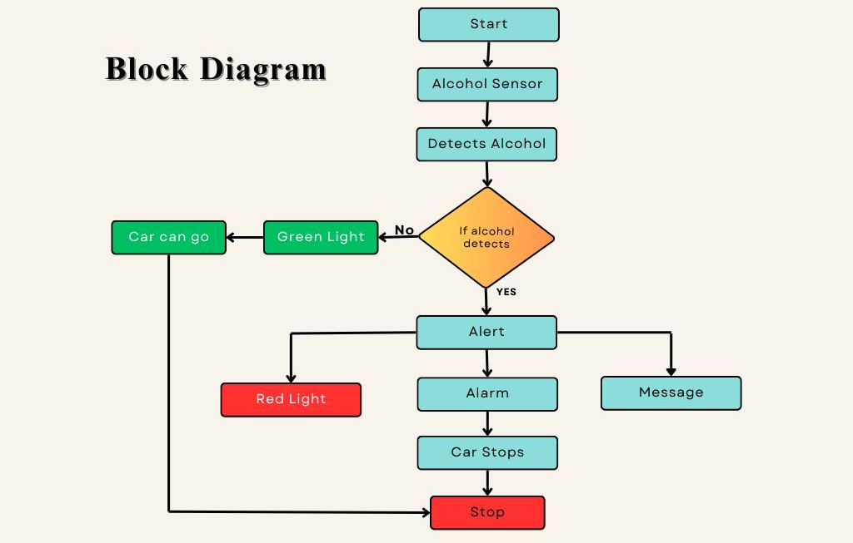

Slide 5
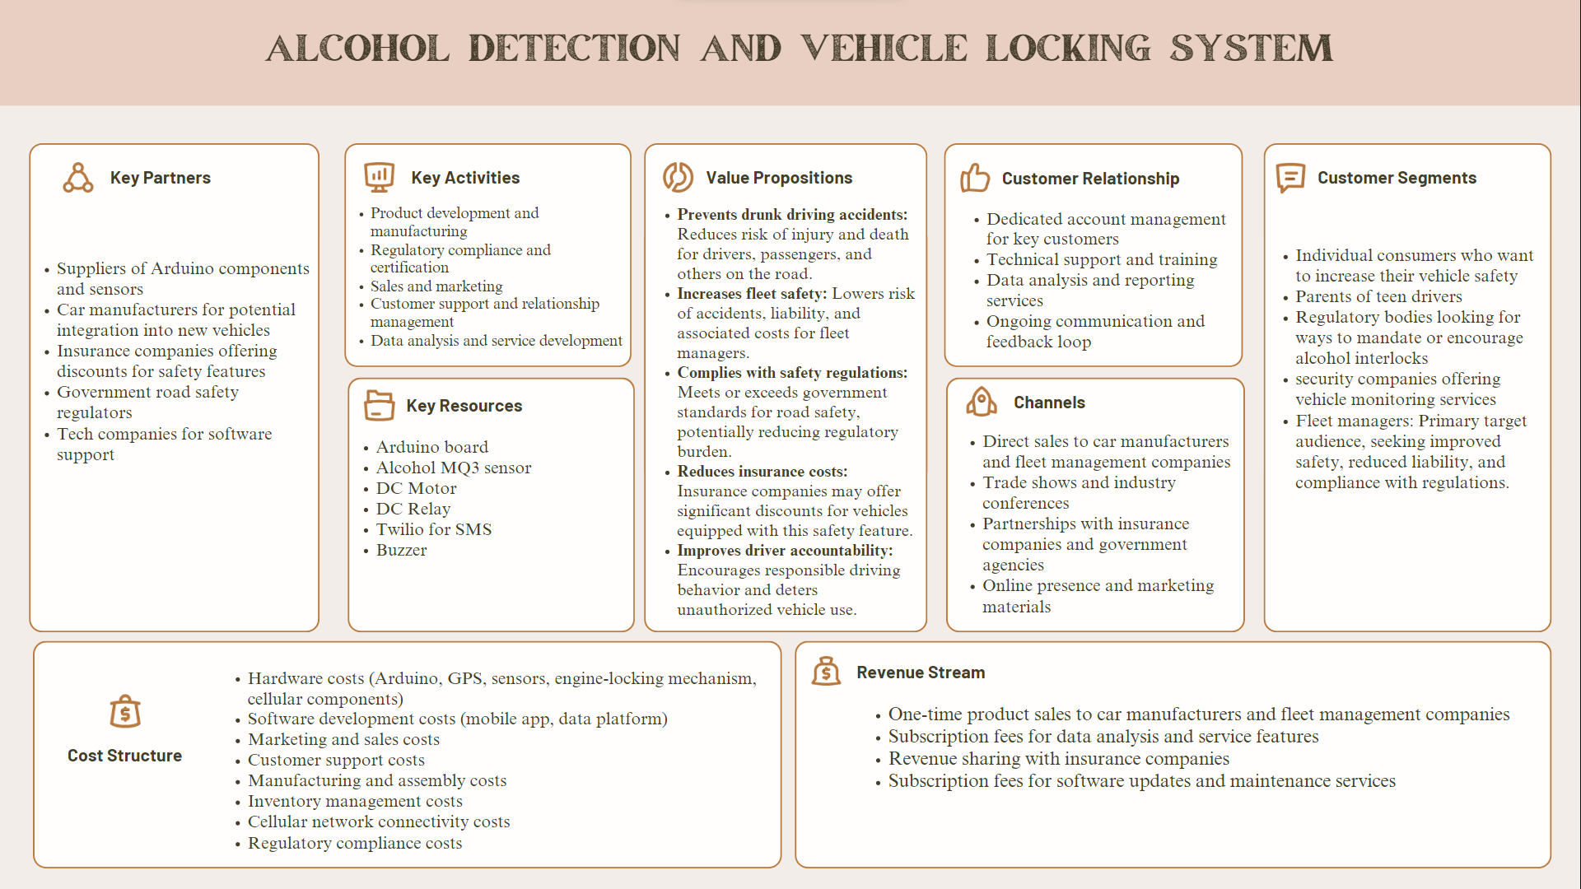
Business Model

Slide 6
Market Opportunity
The Arduino-based alcohol sensing engine lock, has a significant market opportunity in the automotive and transportation sectors. The system detects alcohol levels in the driver's breath and stops the engine or sends and SMS to the authorized mobile number if excessive alcohol is detected.
Global Market Size: The global market for automotive safety systems is projected to reach $14.3 billion by 2025, growing at a CAGR of 10.5% from 2020 to 2025.
Indian Market Size: In India, the automotive safety market size is expected to reach Rs 27,000 crore by 2025, growing at a CAGR of 16% from 2020 to 2025.
customer rank​ | Customer Segment ​
1​ | Commercial fleet operators seeking to ensure road safety for their fleet.​
2​ | Regulatory bodies looking for ways to mandate or encourage alcohol interlocks.​
3​ | Individual consumers who want to increase their vehicle safety.​
Marketing Strategy
To reach your target customers, you can use the following marketing strategies:
Online advertising: Utilize online platforms such as Google Ads, Facebook Ads, and Instagram Ads to target parents of teen drivers, commercial fleet operators, and regulatory bodies.
Influencer marketing: Partner with influencers in the automotive and safety industries to promote your product and reach a wider audience.
Content marketing: Create informative content (blog posts, videos, infographics) on the importance of alcohol sensing engine locks and how they can improve road safety. Share this content on your website and social media channels.
Trade shows and events: Attend trade shows and events related to the automotive and safety industries to showcase your product and generate leads.
Referral program: Implement a referral program to encourage satisfied customers to refer their friends and family to purchase your product.

Slide 7
Conclusion
The proposed alcohol detection system with its various components presents a comprehensive solution to address the critical issue of drunk driving and enhance road safety. By utilizing the MQ-3 alcohol sensor, Arduino Uno microcontroller, DC motor, relay, LED, and buzzer, the system effectively detects alcohol levels, simulates engine locking, and provides visual and audible warnings.
The integration of an emergency SMS notification feature adds an extra layer of safety. In the event that the alcohol concentration surpasses the threshold, the system generates an SMS using the Twilio API. This SMS is sent to a pre-selected emergency contact, providing vital information about the vehicle's location. This feature ensures prompt intervention and assistance in case of emergencies, enhancing overall public safety.
The implementation of this system has the potential to make a significant impact by actively detecting and preventing drunk driving instances. Through continuous monitoring, engine locking, visual and audible warnings, and emergency SMS notifications, the proposed alcohol detection system provides a comprehensive solution to mitigate the risks associated with alcohol-impaired driving.

