Slide 1
Vision Beyond the Haze: Innovations in Cataract Detection and Diagnosis
Presented by
N U Praneeth Reddy(21BAI1500)

Slide 2
Project Scope
Eye diseases are a significant health concern globally, with cataracts being one of the most common problems, particularly affecting aging populations.
Detecting cataracts in their early stages is crucial to prevent vision loss and blindness, highlighting the importance of accurate diagnosis and timely interventions.
This paper explores the use of deep learning techniques, specifically Convolutional Neural Networks (CNNs), to classify glaucoma using publicly available fundus images.
Three CNN meta-architectures, namely Resnet50, Resnet101, and VGG19, are employed to diagnose glaucoma, achieving high accuracy and reliability in predicting the disease.

Slide 3
Introduction
Cataract is a leading cause of blindness worldwide, responsible for an estimated 51% of blindness cases globally.
Early detection of cataracts is crucial for effective management and prevention of vision loss.
Traditional methods of cataract diagnosis rely heavily on clinical examination and subjective evaluation by ophthalmologists.
Automated and computer-aided diagnosis systems offer the potential to improve accuracy, efficiency, and accessibility of cataract diagnosis.

Slide 4
Related Works
Numerous studies have investigated the application of machine learning and deep learning techniques for automated cataract diagnosis.
Early approaches focused on handcrafted feature extraction and traditional machine learning classifiers, such as Support Vector Machines (SVMs) and Random Forests.
More recent research has shifted towards deep learning-based methods, leveraging convolutional neural networks (CNNs) for feature learning and classification.
Notable studies have demonstrated the feasibility and effectiveness of CNNs in accurately detecting and classifying cataracts from fundus images.
However, challenges remain, including limited annotated datasets, class imbalance, and variations in image quality and patient demographics.
Despite these challenges, deep learning-based approaches show promising potential for enhancing the efficiency and accuracy of cataract diagnosis.

Slide 5
Dataset
Dataset Size: 6716 fundus images
Extracted Cataract Images: 1088 fundus images
Source: Medical centers across China, by Shanggong Medical Technology Co., Ltd.
Database: Ophthalmology Intelligent Recognition (ODIR) database
Patient Data: Includes data on 5000 patients
Information Provided: Color fundus images of both right and left eyes, along with diagnostic keywords
Utilized Subset: Only normal fundus images of cranial nerves extracted for study

Slide 6
Data Preprocessing
Resizing: Resizing the fundus images to a standard size of 224x224 pixels using OpenCV ensures consistency in input dimensions, which is crucial for neural network architectures that expect uniform input sizes.
Grouping: Dividing the images into appropriate glaucoma and fundus groups based on key diagnosis helps in creating distinct datasets for training and evaluation, which is fundamental for supervised learning tasks like classification.
Data Balancing: Randomly selecting identical samples from both groups ensures balanced datasets. This prevents the model from being biased towards the majority class (e.g., fundus images) and improves its ability to accurately classify both classes.
Data Augmentation: Applying techniques such as rotation, shift, shear, zoom, and flip increases the diversity of the training dataset. This augmentation helps the model generalize better by exposing it to variations commonly encountered in real-world data.
Purpose: The overarching goal of these preprocessing steps is to standardize input, balance the dataset, and enhance model robustness. Standardization ensures uniform dimensions, dataset balancing reduces bias during training, and data augmentation increases the diversity of training samples, thereby improving model generalization.
Improving Model Performance: By enhancing the training dataset and standardizing input, the preprocessing pipeline contributes to the effectiveness and reliability of deep learning models in clinical applications, particularly in glaucoma detection. These steps collectively aim to improve the performance of the model by providing it with a more representative and varied dataset for learning.

Slide 7
VGG19 Model
Introduction to VGG-19:
VGG-19, or Visual Geometry Group 19, is a deep convolutional neural network architecture introduced in 2014.
It comprises 19 layers, featuring a series of convolutional layers followed by max-pooling layers.
Key Features:
Deep but uniform architecture with 3x3 convolutional filters and 2x2 max-pooling windows.
Known for its simplicity and effectiveness in image classification tasks.
Achieves high accuracy due to its ability to capture intricate features from images.
Pre-training on ImageNet:
Typically initialized with pre-trained weights on the ImageNet dataset, a large-scale image database.
Pre-training allows the network to learn generic features from diverse images before fine-tuning for specific tasks.
Fine-tuning for Specific Tasks:
After pre-training, VGG-19 can be fine-tuned for specific tasks such as binary classification.
Fully connected layers at the end of the network are adapted to the target task, while retaining generic features learned from ImageNet.
Training Process:
Trained using the ADAM optimizer, a popular choice for training deep neural networks.
Augmented data, obtained by applying transformations to original images, is used to increase dataset diversity and improve model robustness.
Training involves multiple epochs, with performance evaluated on separate test data to monitor generalization ability.

Slide 8
ResNet101 Model
Introduction:
ResNet101, an extension of the ResNet (Residual Network) framework, is a deep convolutional neural network renowned for its depth and exceptional performance in image classification tasks.
Key Innovation:
Introduces residual connections to address vanishing gradient problem in deep networks.
Learns residual mappings, facilitating efficient training of very deep networks with hundreds of layers.
Training Approach:
Pre-trained on ImageNet, leveraging learned features.
Custom models built by adding layers onto pre-trained base.
Includes batch normalization, skip connections, and final sigmoid layer for binary classification.
Application in Glaucoma Diagnosis:
Captures high complexity and adapts to gradient issues.
Valuable tool for analyzing retinal images and aiding in glaucoma diagnosis.

Slide 9
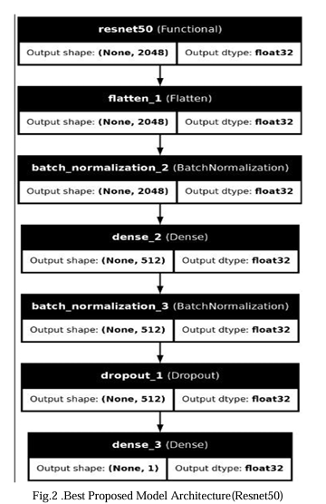
ResNet50 Model (Best Model)
ResNet50: Initially developed for image recognition tasks, ResNet50 is chosen due to its ability to handle deep networks effectively, thanks to residual learning. Residual connections allow gradients to flow more efficiently during training, mitigating the vanishing gradient problem and enabling training of very deep networks.
Pre-trained Model: The implementation uses a pre-trained ResNet50 model that comes with weights learned from the ImageNet dataset. By leveraging pre-trained weights, the model starts with some level of knowledge about general image features, which can be fine-tuned for the specific task of glaucoma detection.
Model Configuration:
include_top=False: This setting excludes the classification layers at the top of the ResNet50 model. Instead, additional layers specific to glaucoma detection are added later.
input_shape=(224,224,3): The input shape is defined as (224,224,3), which corresponds to the typical size and channels of input images.

Slide 10
ResNet50 Model (Best Model)
Model Extension:
Flatten Layer: Converts the output of the ResNet50 base model into a one-dimensional vector, preparing it for further processing.
Batch Normalization Layers: Normalize activations from the previous layers, which helps stabilize and accelerate model convergence.
Dense Layer: Introduces a fully connected layer with 512 hidden units and ReLU activation function. ReLU is chosen for its effectiveness in accelerating convergence.
Dropout Layer: Helps prevent overfitting by randomly dropping 50% of input units during training. This regularization technique increases the model's generalizability.
Output Layer: Consists of a combination of root and sigmoid functions, facilitating binary classification (presumably distinguishing between glaucoma-positive and glaucoma-negative cases).
Benefits:
Glaucoma Detection: The resulting model is tailored for binary classification tasks specific to glaucoma detection.
Regularization: Techniques like Dropout are employed to prevent overfitting, enhancing the model's robustness and improving accuracy on unseen data.

Slide 11
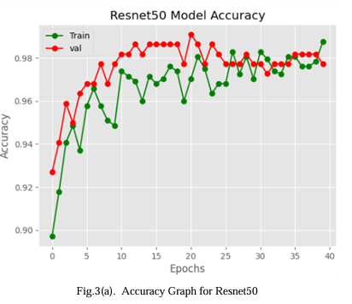
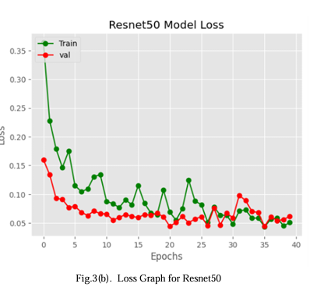
Result Analysis
The Figures below 3(a) and 3(b) represent the accuracy and loss graph of the Resnet50 model, respectively. When the Resnet50 model has been fitted to the dataset, at the first epoch, the training accuracy is 87.19% and the loss is 40.21%. But the validation accuracy high compared to the training accuracy (92.69%) and the loss is also low (16.01%), which indicates that the model initially learns Good. As the number of epochs increases, training and validation accuracy both increases, and the loss function also starts to decrease. At epoch 21, the Resnet50 model found its highest validation accuracy, which is 99.09%. At that time, validation loss was 4%, training accuracy was 96.66%, and training loss was 6.87 %. The model’s validation accuracy is always slightly greater than the training accuracy which shows that the model generalizes better with the data.

Slide 12
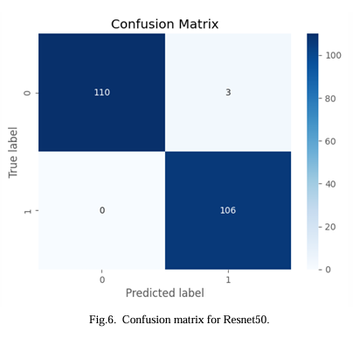
Analysis of the Best Model
In recognizing normal and cataract photos, Figure 6 displays True Positive, True Negative, False Positive, and False Negative cases. According to the results, the Resnet50 model predicts normal images 97% accurately as “normal,” while incorrectly predicting 3% of normal images as “cataract.” The figure also shows that the model predicts 100 % of cataract photos that are truly “cataract,” while 0% of photos are wrongly predicted as “normal.”

Slide 13
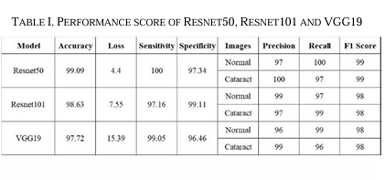
Our work is compared with all the previous research work mentioned in Related Work. In that case, by using EfficientNet they got an accuracy of 94.88% to date. The InceptionResnetV2 got an overall accuracy of 98.17%. The MobileNet V3got96.62% accuracy after being trained using more than 2500 images. The use of MobileNet-V2 model for feature extraction and a random forest classifier got an accuracy of 90.68% in the grading severity of cataract. On the other hand, our proposed best trained Resnet50 model achieved the training accuracy of 96.66 % and validation or testing accuracy of 99.09 % by using only 594 Cataract images and 500 normal images which reached the new state-of-the-art. Hence, this research work is novel.

Slide 14
Conclusion
The combination of previously trained algorithms such as ResNet50, ResNet101, and VGG19 represents a leap forward in glaucoma diagnostics. Notably, the ResNet50 model achieved an impressive testing accuracy of 97.58% and certification accuracy of 99.09%, setting unprecedented standards in the field This development heralds a turning point in healthcare, especially to help underserved communities with limited optical skills.
Looking ahead, our focus shifts to improving the accuracy of these models with wider data sets and new visualization techniques. By acknowledging complexity, we seek to deepen our understanding of the complex imaging system model, thereby increasing the accuracy and efficiency of analysis. Additionally, creating a user-friendly website would provide universal access, enabling individuals from all walks of life to take control of their eye health with ease.
Essentially, our vision extends beyond mere innovation; It includes the goals of equity, empowerment and excellence in health care. With every walk, we are paving the way for a future where technology will overcome barriers, enrich lives and transform the global health landscape.

Slide 15


