Slide 1


Rockbuster Stealth LLC
Nupur Parikh

Slide 2
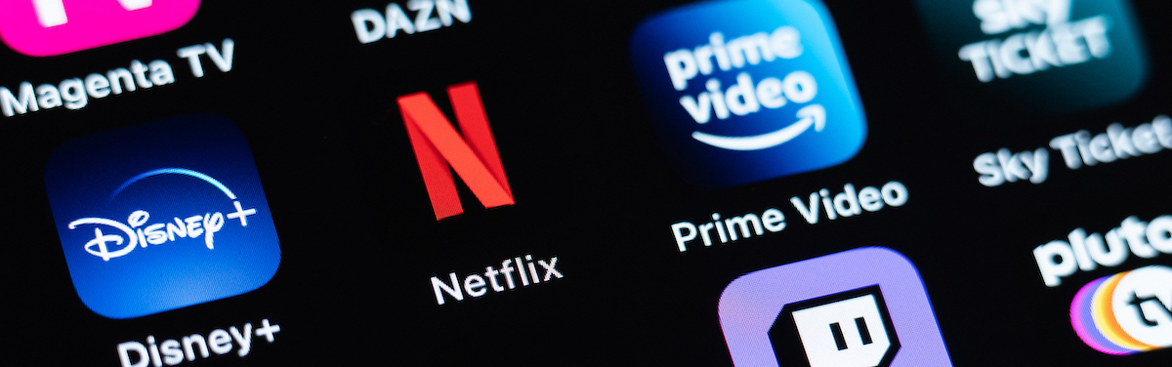
Introduction
Rockbuster Stealth LLC is a movie rental company that used to have stores around the world.
Currently, Rockbuster is facing stiff competition because of new streaming services, such as Netflix and Amazon Prime
Rockbuster is analyzing the market to launch an online movie rental service.

Slide 3
Objectives
Which movies contributed the most/least to revenue gain?
What was the average rental duration for all videos?
Which countries are Rockbuster customers based in?
Where are customers with a high lifetime value based?
Do sales figures vary between geographic regions?

Slide 4
Overview
There are 2 stores in total worldwide
There are 599 customers based in 109 countries
The total number of rentals is 16,044
There are 1000 films in 1 language

Slide 5

Which movies contributed the most/least to revenue gain?

Slide 6
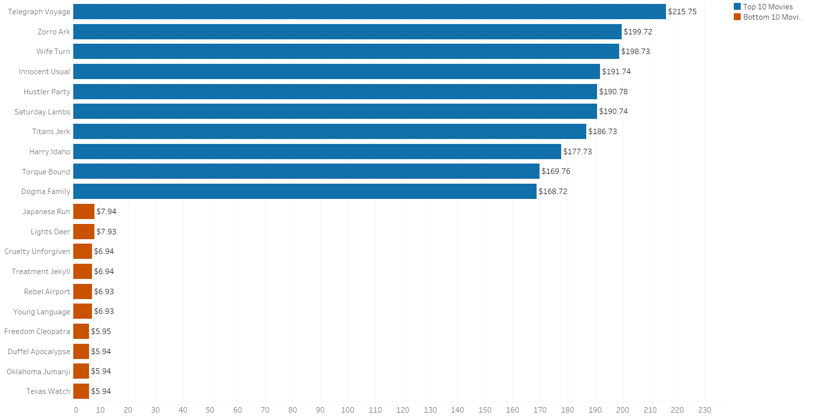
Top 10 & Bottom 10 Movies
The most popular movie is Telegraph Voyage, with a top revenue total of $215.85. This movie is rated PG.
The least popular movies are Texas Watch, Oklahoma Jumanji, and Duffel Apocalypse. They are all tied with a low revenue total of $5.94. They are rated NC-17, PG, and G, respectively.

Slide 7
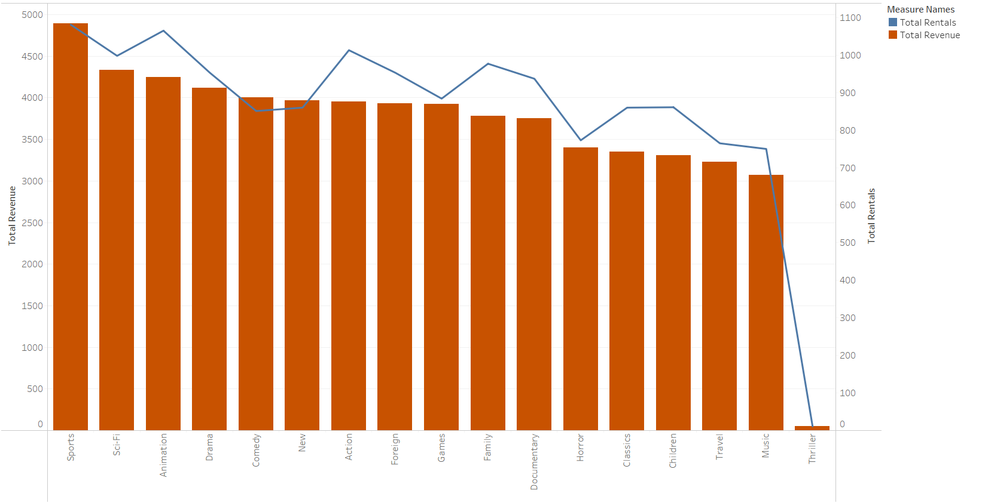
Movie Genres
The top performing genre is Sports, with the highest revenue and the highest number of rentals.
The lowest is Thriller with revenue and rentals because there is only 1 Thriller title.
Some movies genres have higher rentals but lower revenue stream (e.g., Animation and Action)

Slide 8
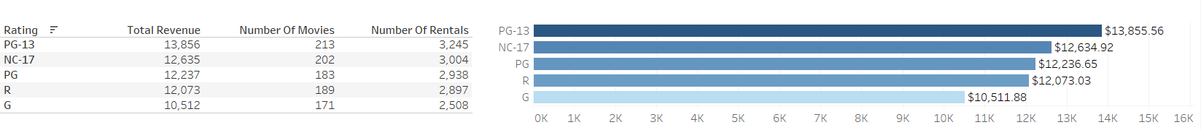
Movie Ratings
The most popular genre is PG-13, despite the most popular movie falling under the PG category.
The middle three genres are close in terms of revenue, despite having some of the least popular movies (Texas Watch and Oklahoma Jumanji).
G falls far behind as the least popular genre.

Slide 9

What was the average rental duration for all videos?

Slide 10
Rental Duration and Rental Rates
 | MIN | MAX | AVG | COUNT
Rental Duration | 3 | 7 | 4.99 | 1000
Rental Rate | 0.99 | 4.99 | 2.98 | 1000
Length | 46 | 185 | 115.27 | 1000
Replacement Cost | 9.99 | 29.99 | 19.98 | 1000
The average rental duration is 4.99 days, with a minimum of 3 days and a maximum of 7 days.
The average rental rate is $2.98, with a minimum of $0.99 and a maximum of $4.99.

Slide 11

Which countries are Rockbuster customers based in?

Slide 12
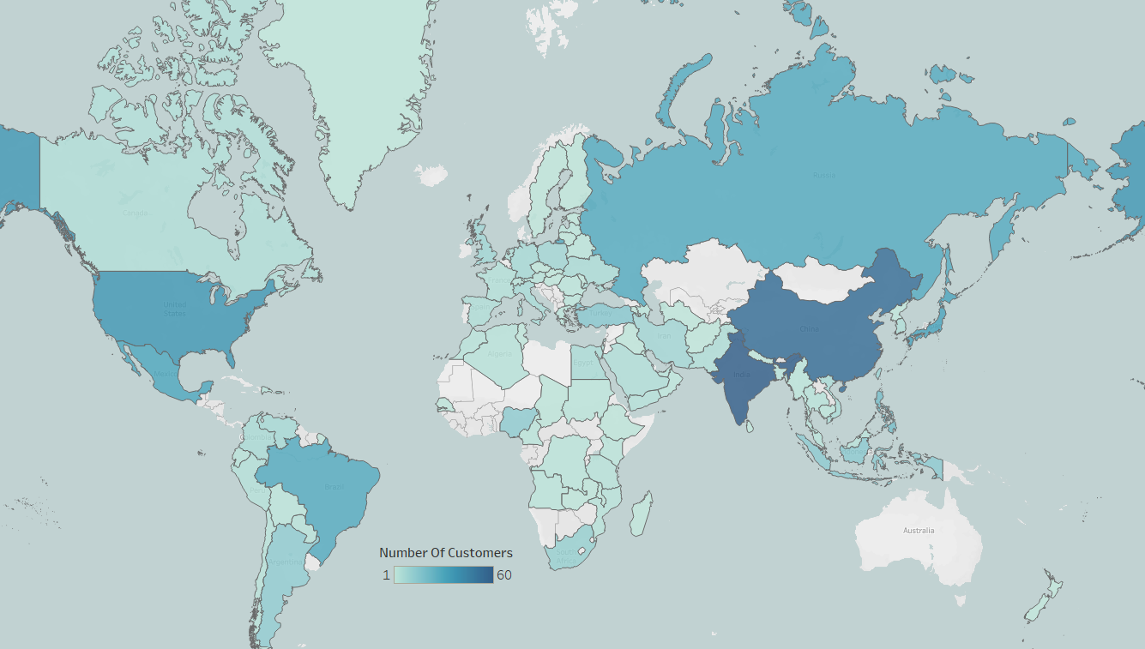
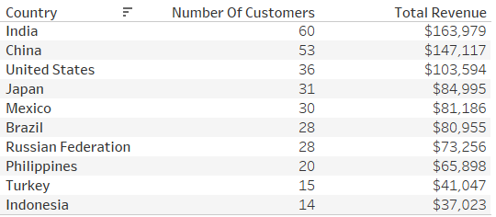
Top Countries
There are 599 customers based in 109 countries.
India consists of the most customers, China following close behind.
India, China, and United States generate the most income.
There are 41 countries with only 1 customer.

Slide 13
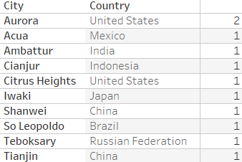
Top Cities
The top cities in the top countries.
The city with the most customers is Aurora in United States.
All other cities have only one customer.

Slide 14

Where are customers with a high lifetime value based?

Slide 15
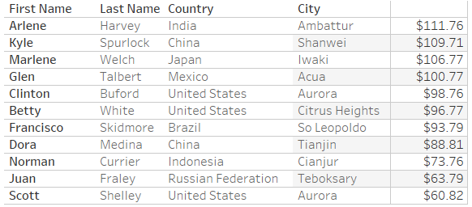
Top 10 Customers in Top Countries

Slide 16
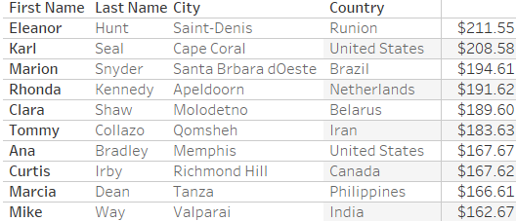
Top 10 Customers Globally
Not all top 10 customers globally are from top countries!
The top 10 global customers paid more than customers from top 10 countries

Slide 17

Do sales figures vary between geographic regions?

Slide 18
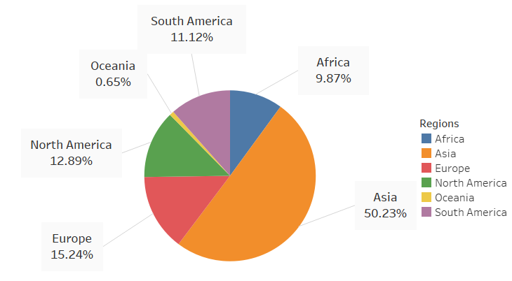
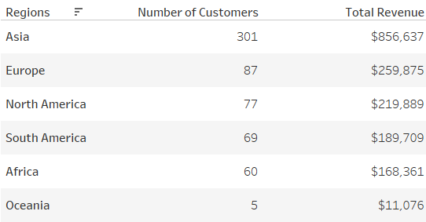
Global Revenue
Asia accounts for half of the global sales.
Asia also accounts for 50% of the overall customers.

Slide 19
Conclusions
Sports is the most popular genre and Thriller is the least popular, because there is only one.
G movies are the least popular with PG-13 as the most popular.
There are a few loyal customers.
Asia is where most of the revenue comes from.
The average rental rate is 4.99 days and average rental duration is $2.98.

Slide 20
Recommendations
Acquire more titles under the Sports, Sci-Fi, and Animation genres, as they generate the most revenue and rentals.
1
Promote Sports, Sci-Fi, and Animation movies.
2
Invest in movies in different languages to attract customers that do not speak English.
3
Promote and acquire movies in the PG-13 movies, as they tend to have the most rentals and garner the most revenue.
4
Focus marketing efforts in Asian and African countries as they have the most customers.
5
Open a rewards program for loyal customers.
6

Slide 21

Thank you! Questions?
Link for Tableau Public:
Rockbuster Visualizations Storyboard

