Slide 1
Successfully Moving a Design Environment to the Cloud
Nupur Bhonge
Applications Engineer

Slide 2





About us
Pioneer & market leader in SoC design & IP management solutions for the semiconductor industry
300+ customers
Founded in 1997
Headquartered in Fremont, CA
Worldwide offices
USA, Europe, Japan, Korea, China, Taiwan, Israel & India
24x7 worldwide support
2

Slide 3
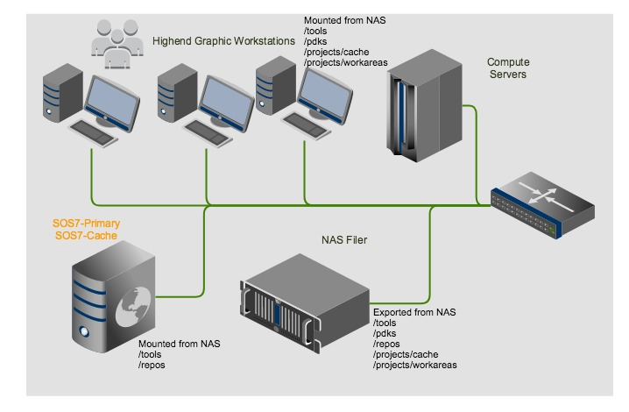
Classical EDA design environment
High-performance NAS file server exports volumes using NFS protocol
Each machine (servers and workstations) mounts the NAS-exported NFS volumes
Workstations render high-end graphics and the server accesses large data stored on the NFS volumes for typical activities
A typical setup requirement for a startup or small deployment
Notes:
Startups and small deployment
Key characteristics -
Scarce compute resources which multitask
Design engineers also work part time CAD and IT roles
Challenges –
EDA tool performance affects user experience
Shared NAS/NFS drives – bottleneck
Talking points –
- Cache server
- Distributed repositories
> EDA workloads comprise of workflows and supporting set of software tools for design, verification, validation and data management
> Industry is rethinking of compute infrastructure currently in the form of in house, owned and maintained datacenters
> The challenge is how to set up or migrate such a complex design environment in the cloud, while matching the requirements of startups and enterprise deployments.
> Deploying a ClioSoft SOS7 design management environment is a simple and straightforward process.
After your initial environment is setup, you can access existing design data and collaborate with other design teams, vendor organizations, and quickly enable global access controls.
a cohesive environment that allows geographically and functionally diverse teams to focus on design implementation
SOS7 is specifically designed to address the needs of hardware flows

Slide 4
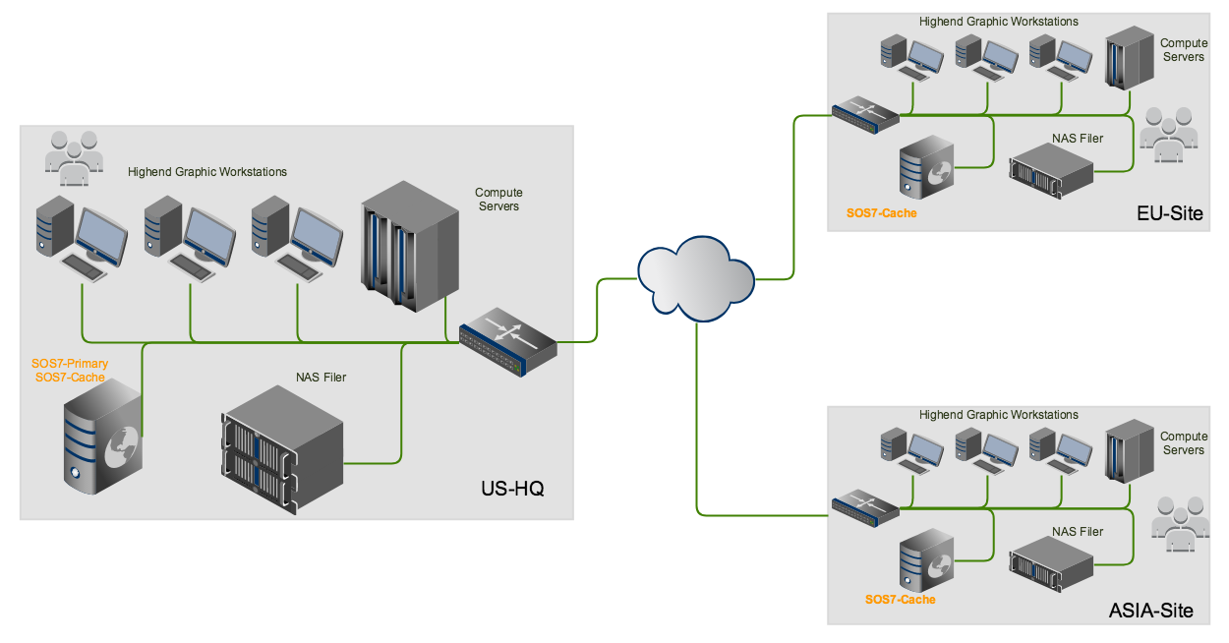
Classical EDA design environment
Enterprise deployments replicate design environments at multiple sites.
Notes:
Startups and small deployment
Key characteristics -
Scarce compute resources which multitask
Design engineers also work part time CAD and IT roles
Challenges –
EDA tool performance affects user experience
Shared NAS/NFS drives – bottleneck
Talking points –
- Cache server
- Distributed repositories
> EDA workloads comprise of workflows and supporting set of software tools for design, verification, validation and data management
> Industry is rethinking of compute infrastructure currently in the form of in house, owned and maintained datacenters
> The challenge is how to set up or migrate such a complex design environment in the cloud, while matching the requirements of startups and enterprise deployments.
> Deploying a ClioSoft SOS7 design management environment is a simple and straightforward process.
After your initial environment is setup, you can access existing design data and collaborate with other design teams, vendor organizations, and quickly enable global access controls.
a cohesive environment that allows geographically and functionally diverse teams to focus on design implementation
SOS7 is specifically designed to address the needs of hardware flows

Slide 5
On-Premise Challenges & Potential Solutions
Challenges
Addressing peak capacity usage
Need to upgrade continuously
Maintaining Reliability and uptime
Disaster recovery
Capital Expense
Solutions
On-demand resources
Access to the latest & greatest resources
Resources managed by a specialized third party vendor
Durable storage options against site-level failures
Operational Expense
Notes:
Peak-capacity planning – On-premises environment setup requires an upfront capital
investment. Your IT teams must plan for the compute and storage resources for all
phases of the project. Depending on the nature of the project, this is not a trivial task.
Your project team’s demand might exceed the planned capacity or leave hardware
resources unused. Both cases could impact your project schedule and costs.
Continuous upgrades – As your project progresses, the simulation and verification
tasks become more complex and consume more resources. The CAD and IT teams
must constantly upgrade the infrastructure to handle the workload. Planning these
upgrades is more difficult if multiple teams share the infrastructure and have competing
deadlines. Typically, even well-planned hardware upgrades are time consuming and
cause disruptions to design teams.
Reliability and uptime – Reliability is a major concern with an on-premises CAD
infrastructure system. One of the biggest concerns for any data center is server uptime.
If the CAD system goes down, the loss of productivity could significantly increase
engineering costs.
High-availability & disaster recovery – Server farms, which were previously
maintained at each design center, are often consolidated into a limited number of data
centers. For example, if your company has 20 design centers across America and
Europe, you might consolidate all their servers into four data centers, geographically
distributed across the two continents. Maintaining the high-availability of data centers is
challenging and often depends on the reliability of external factors. In addition, IT teams
need a well-curated plan for disaster recovery for server farms.

Slide 6

Solution is cloud!

Slide 7
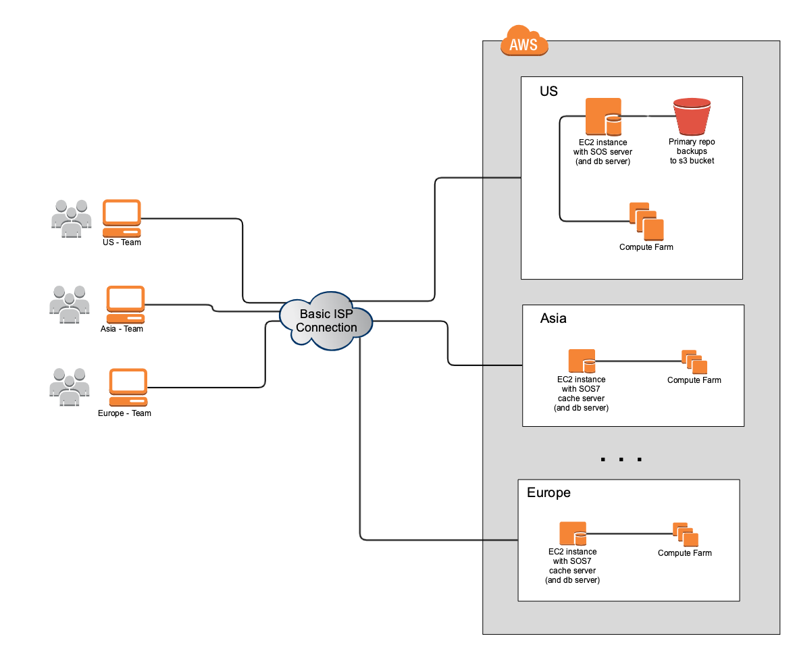
All-in cloud model
Minimal hardware investment
On-demand “pay-per-use” instances for simulations and verifications
Resources managed by cloud vendor like AWS
High Availability and uptime
High durability storage options
Monitoring tools
Controllable OpEx!
Notes:
Complete cloud solutions have all benefits of hybrid model with no hardware investment – no longer dependant on on-premise data centers
Only access to remote desktop client to access the cloud, typically VNC connections
Faster POC
(8 9s)

Slide 8
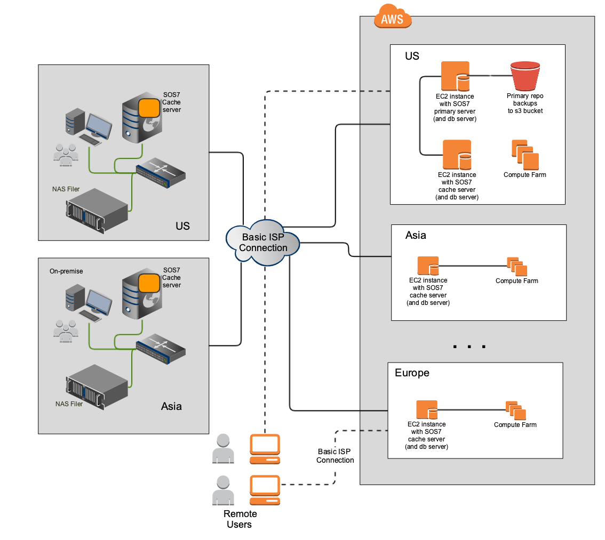
Hybrid Model
On premise environment cannot be replaced easily
Example: Emulation setups
Current infrastructure investment
Data privacy compliance
Notes:
Best use case for a hybrid mode - Maximize the performance of DM server while maximizing the returns from the on-premise investment
During POC phase, it is possible to determine network, storage, and compute performance parameters, before release to production
In this hybrid environment, cloud can host the primary SOS7 servers and the repositories, with the SOS Cache hosted in the on-premises data centers.
The distributed architecture support of SOS7 servers enables you to host SOS7 repositories in multiple geographical locations

Slide 9
Considering going to the cloud yet?
Choose compute infrastructure wisely
Compute instances
Storage options
Connectivity to the cloud from all design sites
High bandwidth & low latency
Security and access control
Cloud compatibility of software
Licensing model
Performance scaling
Data privacy and retention compliance
Example: ITAR standards
Geography based IP & PDK usage agreements
Notes:
managing and accessing licenses is largely unchanged
Either hybrid model for licensing OR on cloud
On cloud reduces network latency and improve reliability
Remote desktops –
open-source solutions such as VNC
commercial solutions such as AWS WorkSpaces.
Performance scaling – horizontal/vertical

Slide 10
Where do I start ?
Data management solution is a good place to start!
Supports the design data all through the lifecycle of the project.
Affects every part of the design data: analog, digital, rf, pcb, etc.

Slide 11
Is your Data Management platform Cloud Ready?
Tight integration with design tools for a better user experience.
Non-intrusive fit into design flows
Optimizing storage
Avoid disk space explosion
Connecting teams
Not just remote design teams but also partner organizations.
Support for composite objects not just files!
Manage logical and atomic design objects
Notes:
managing and accessing licenses is largely unchanged
Either hybrid model for licensing OR on cloud
On cloud reduces network latency and improve reliability
Remote desktops –
open-source solutions such as VNC
commercial solutions such as AWS WorkSpaces.
Performance scaling – horizontal/vertical

Slide 12
Details: SOS7 - All in cloud model with AWS
SOS7 tool cohesively supporting all major EDA vendor tools and flows
Optimized data storage management with Caching enabled.
Estimated 90% disk space saving
Additional SSL security for communication
Patented UDMA technology

Slide 13
Details: SOS7 - Hybrid model with AWS
All the benefits of the all-in-cloud model
Cache minimizes the effect of latency
Prefetch design objects that you need at the site
No change required to existing IT infrastructure

Slide 14
SOS7 on AWS cloud
SOS7 has been on the cloud for 5+ years!
Several customers using hybrid or all in cloud deployment
Resources -
AWS:
Best Practices for Deploying ClioSoft SOS7 on AWS - Whitepaper https://d1.awsstatic.com/whitepapers/best-practices-cliosoft-sos7-aws.pdf
ClioSoft AMI available on AWS Marketplace - https://aws.amazon.com/marketplace/pp/B07SBJZD6N?qid=1565215694785&sr=0-1&ref_=srh_res_product_title

