Slide 2
A Next-Generation, Cloud-based EDA Environment, Built Easily in the AWS Cloud
Jessica Tandel Amit Varde Nupur Bhonge
Dnyanesh Digraskar

Slide 3
Why Cloud for EDA?
Cloud Promise: Elasticity and Scale
On-demand resources especially for EDA datasets and simulations
Access to the latest & greatest resources
Resources managed by a specialized third party vendor
Durable storage options against site-level failures
Operational Expense in the cloud vs Capital expense on premise

Slide 4
EDA Workloads in the cloud
All-in-the-cloud Design Environment
Startups and small/medium companies
Convert CAPEX to OPEX
Hybrid Design Environment
Leverage existing on-premise resources
Satisfy the “need for scale” with cloud

Slide 5
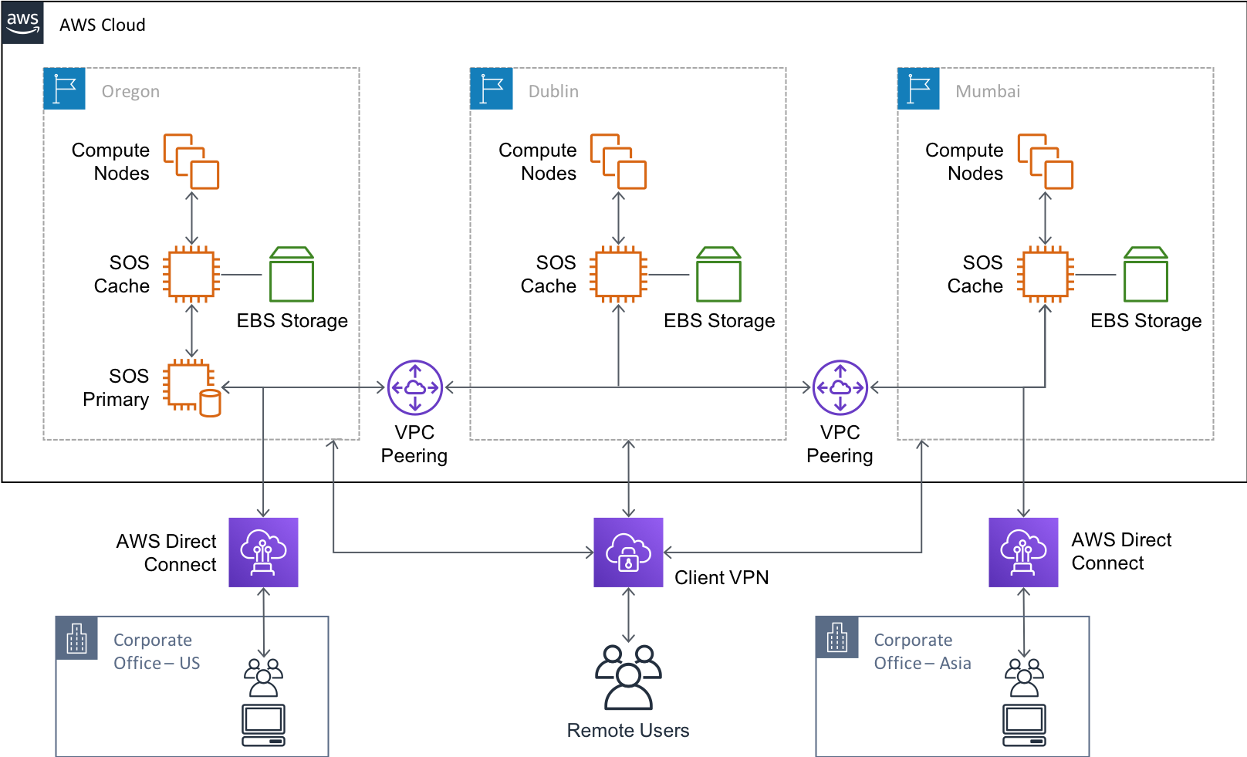
All-in-cloud Model
Source: Best Practices for Deploying ClioSoft SOS on AWS

Slide 6
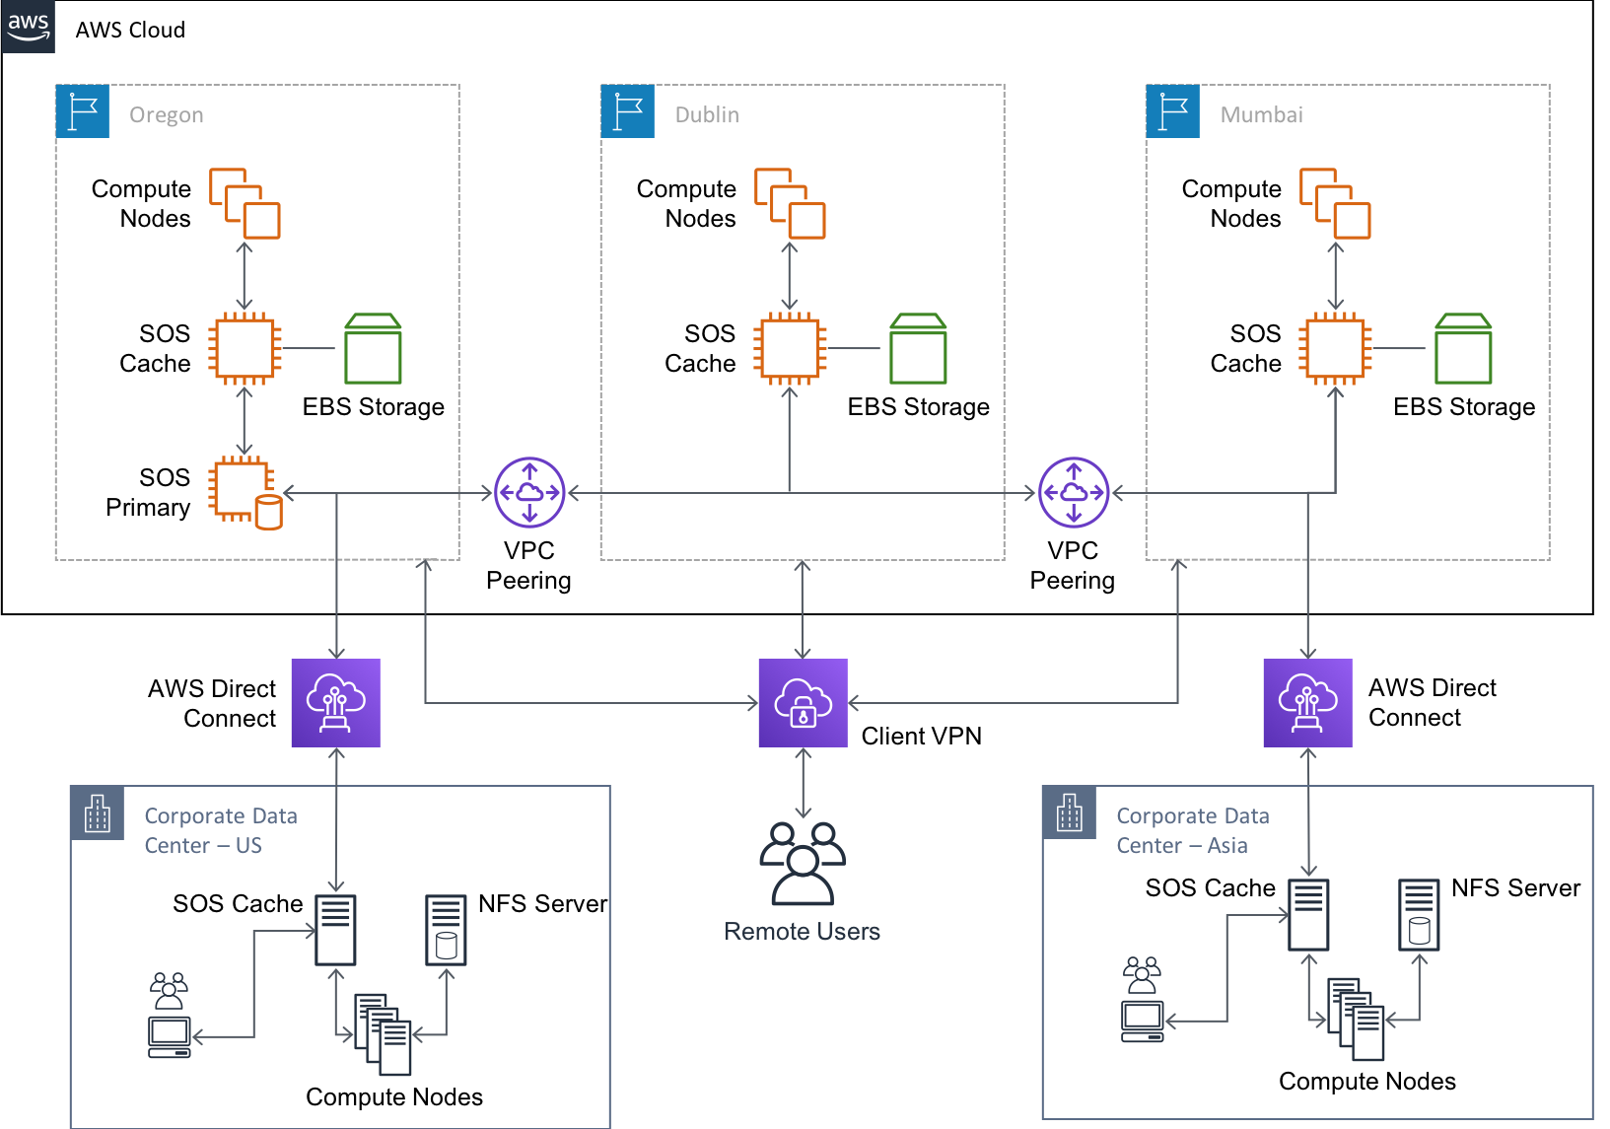
Hybrid Cloud Model
Source: Best Practices for Deploying ClioSoft SOS on AWS

Slide 7
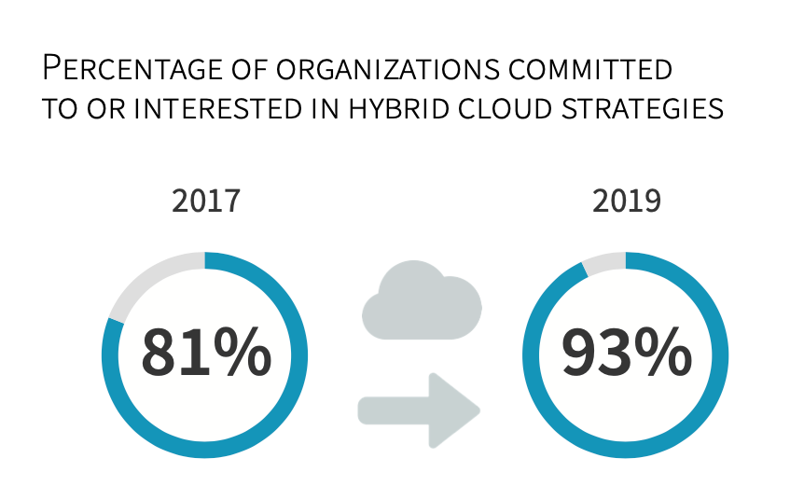
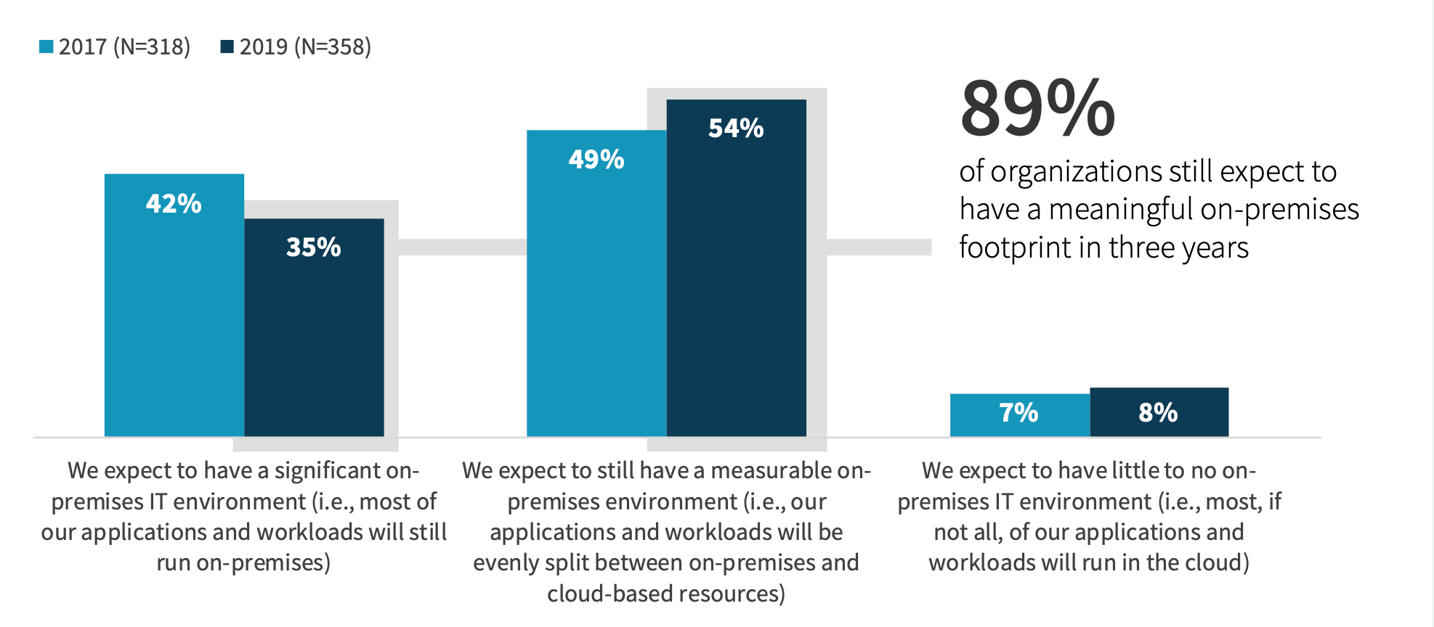
Customers like hybrid Cloud
Source:ESG – Hybrid Cloud Trends and Strategies E-Book

Slide 8



Hybrid Cloud: Concerns across the teams
IT
> To Provision resources and Operating costs
CAD > EDA tools and automation on the cloud
Design > Access to design data & results on the cloud
RESOURCE AVAILABILITY AND STORAGE CONCERNS

Slide 9

IT team
Knows:
How to deploy cloud resources?
How to maintain cloud resources?
Networking aspects
Doesn’t know:
All the data needed in the cloud?
When is it need it by?
How frequently does it change?
What is the data retention policy?

Slide 10
CAD team
Knows:
How to setup and maintain EDA tools?
How to automate flows?
Design data storage needs
Doesn’t know:
Deploying and maintaining cloud resources
WHAT data is required for simulation and WHEN should it run?

Slide 11
Design Engineering team
Knows:
WHAT data is required for simulation?
WHEN to do they need the data to run the simulation?
HOW long do they need to run the simulation?
Doesn’t know:
EDA Tools setup and automation
Deploying and maintaining cloud resources

Slide 12
Hybrid EDA Cloud is team-effort
IT
Provisions Network and Compute Resources
CAD Automates workflows with scripts and hooks
Design Engineer
Define when and what data to use for workload
Successful Hybrid Cloud Solution

Slide 13
Use Case: Analog & Mixed Signal SoC
Hierarchical SOC is complex
Analog, Digital, Memory, and RF subcomponents
Simulation & Verification of Design
Needs Scale and Elasticity of cloud
Needs automation to reduce errors & increase efficiency

Slide 14
Use Case: TOOLS
AWS Cloud Tools
AWS SOCA
AWS ParallelCluster
Cliosoft
SOS: Design Management Tools
VDD: Visual Design Diff
EDA Simulator from any vendor
Depends on the simulation/verification needed

Slide 15
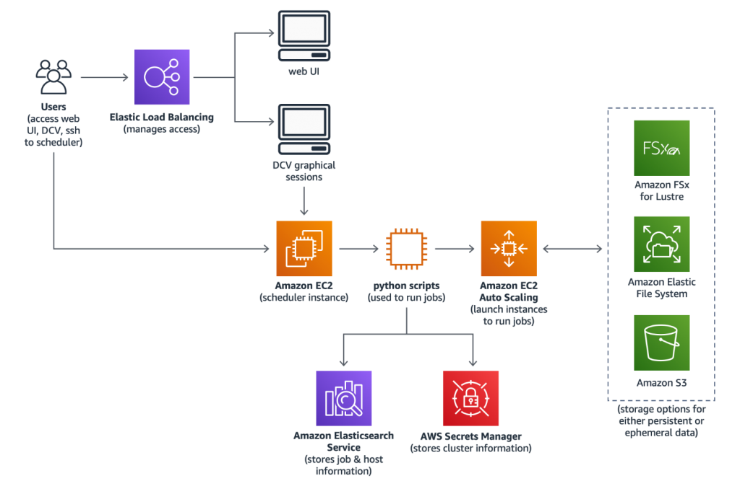
AWS: Scaling EDA Workloads
SOCA: (Scale-Out Computing) on AWS solution helps customers deploy and operate a multiuser environment for computationally intensive workflows, such as computer-aided engineering (CAE).
Source:Scaling EDA Workloads using Scale-Out Computing on AWS

Slide 16

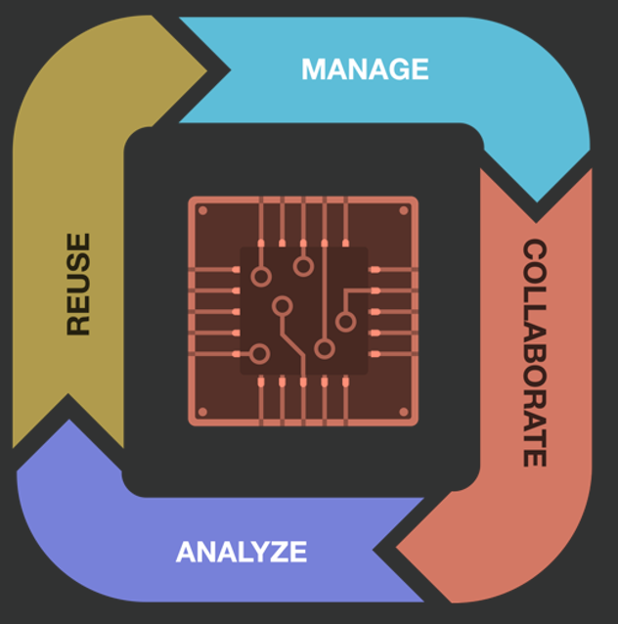



Cliosoft SOS
Design management for analog, mixed-signal, digital and RF designs
SOS - Cache: Data Sync & Scrubs unwanted data
Workarea Triggers: Simulate ONLY data is available
Project Views: Sync Labeled data to the cloud
Design Tagging: Tags files based on design Hierarchy
Notes:
Compare two versions of schematics or layouts
Hierarchical comparison supported
Differences highlighted graphically in editor
Property changes are also flagged
Option to ignore cosmetic changes
Accompanying text listing
Step through changes
Useful to:
Review changes before checkin
Layout engineer to identify schematic ECOs
Design change reviews

Slide 17


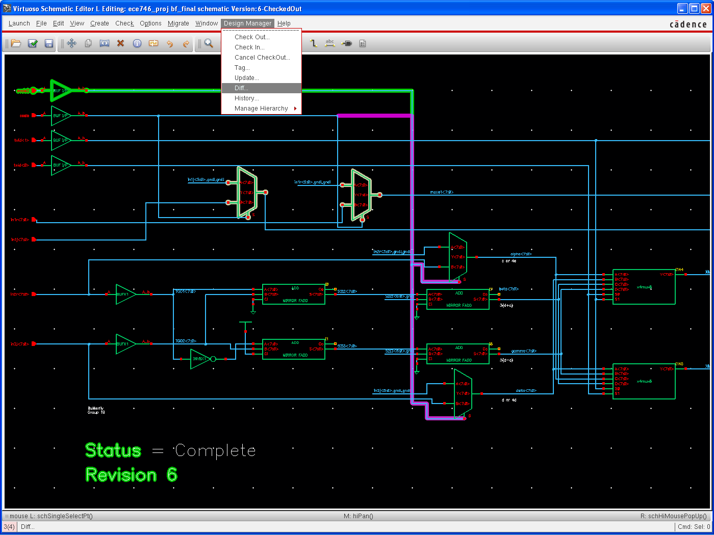

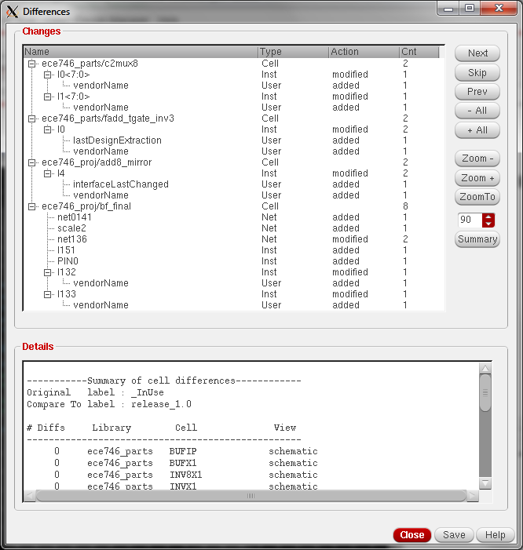


VISUAL DESIGN DIFF
Compare Two Versions of Schematics or Layouts
Review design changes before checkin
Identify schematic ECOs easily for layout engineer
Simplify design change reviews
Hierarchical diff
Notes:
Compare two versions of schematics or layouts
Hierarchical comparison supported
Differences highlighted graphically in editor
Property changes are also flagged
Option to ignore cosmetic changes
Accompanying text listing
Step through changes
Useful to:
Review changes before checkin
Layout engineer to identify schematic ECOs
Design change reviews

Slide 18
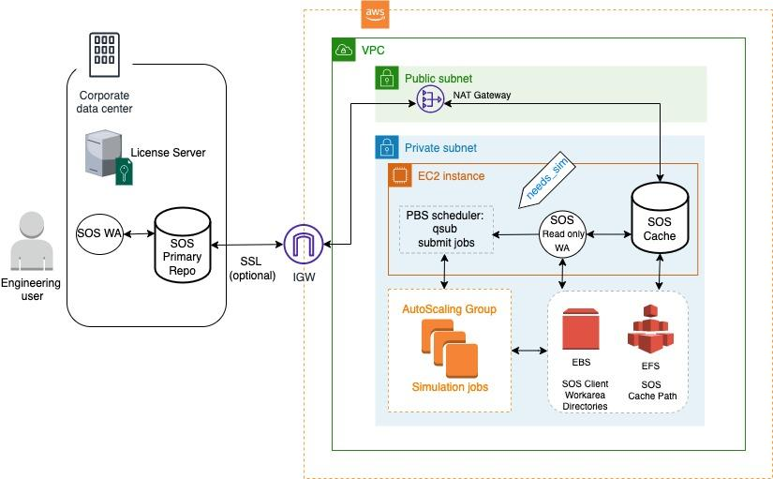
Successful Hybrid EDA Architecture

Slide 19
IT Setup : SOCA
Source:Scaling EDA Workloads using Scale-Out Computing on AWS

Slide 20
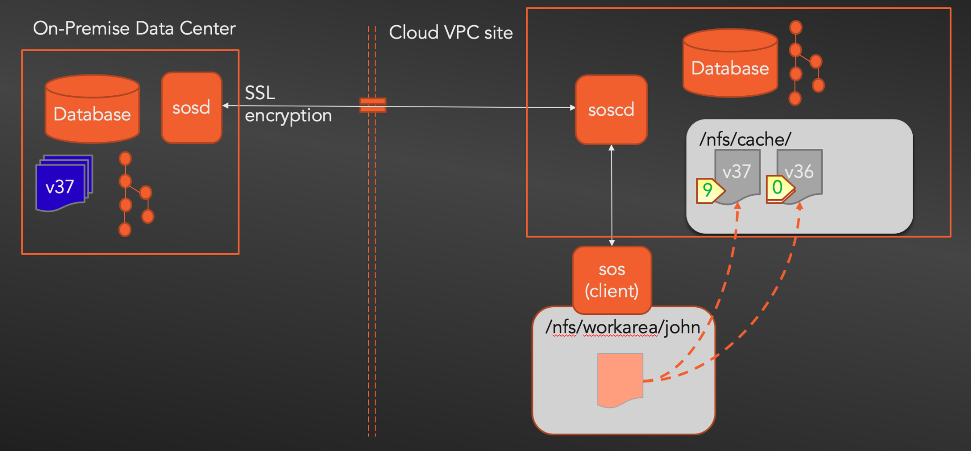

CAD Setup : SOS Cache & Triggers
SOS Cache Server on AWS instance
Trigger to apply Tag

Slide 21
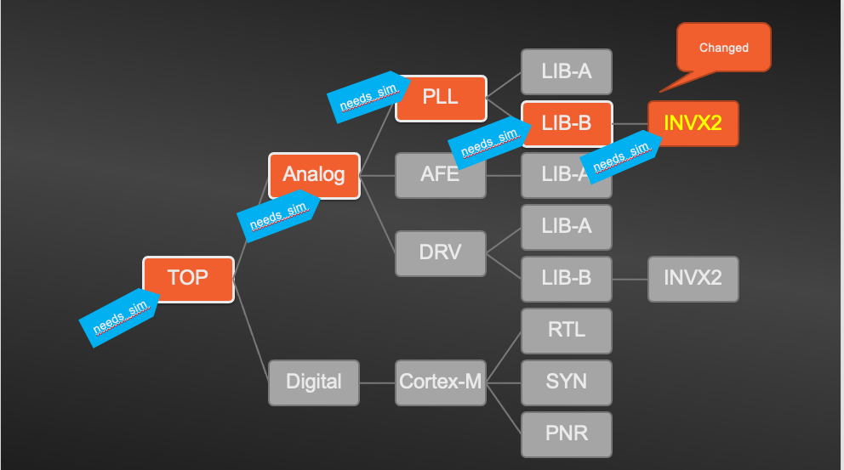
Hierarchical Tag based on VDD results

Slide 22
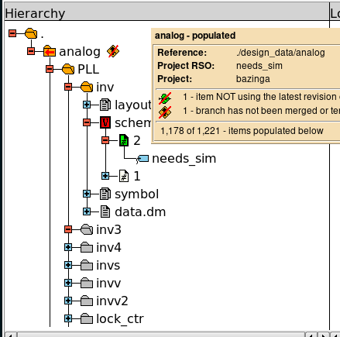
Design Team Setup: Project Workarea
Workarea:
Revisions Search Order (RSO): needs_sim[tag]
Auto-updated
Object Required for Simulation
Objects NOT required for simulation

Slide 23

Complete WorkFlow Summary
No
Run Local Simulation for sanity checks
Engineer make a change to Hierarchy
Are changes significant?
needs_sim
Tag design hierarchy automatically
Run VDD to Evaluate the changes
Example:
Need to run full-chip simulation when:
Any Electrical Changes to schematic
More than 10% of cells changed
New objects added in the hierarchy
Yes
Update Cloud Workarea with objects that “need_sim” only
needs_sim
Trigger Simulation from Cloud Workarea
Sim pass or fail?
Fail
Run Simulation on AWS
Pass

Slide 24


Summary
Successful Hybrid EDA Cloud Solution
Innovate faster with scalability brought by AWS
Enable experimentation with computational elasticity
Reduce human interaction & error using automation with Design Aware workloads
Optimize cost of experimentation in the cloud with data management

Slide 25
THANK YOU!

