Slide 1


COVID-19 data analytics
Team Members: Anuya labdi
Akshay raut
Nupur agrawal
GUIDED BY : PRAKASH GORE
AKIB SHAIKH

Slide 2
COVID-19 data analytics and reporting with Azure DataFactory and Azure SQL
The global COVID-19 pandemic arrived in Europe with its first confirmed case in Bordeaux, France, on 24 January 2020, and subsequently spread widely across the continent. By 17 March 2020, every country in Europe had confirmed a case and all have reported at least one death, with the exception of Vatican City.

Slide 3





TECHNOLOGIES
Azure Data Factory
Azure Data Lake Gen2
-Blob Storage
SQL Server
SQL Database
Power BI

Slide 4
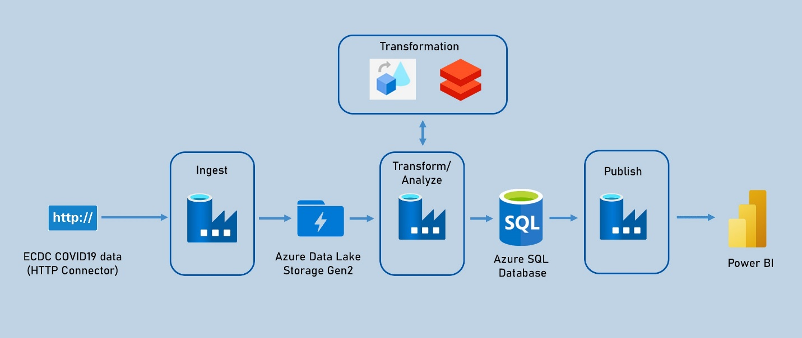

architecture

Slide 5
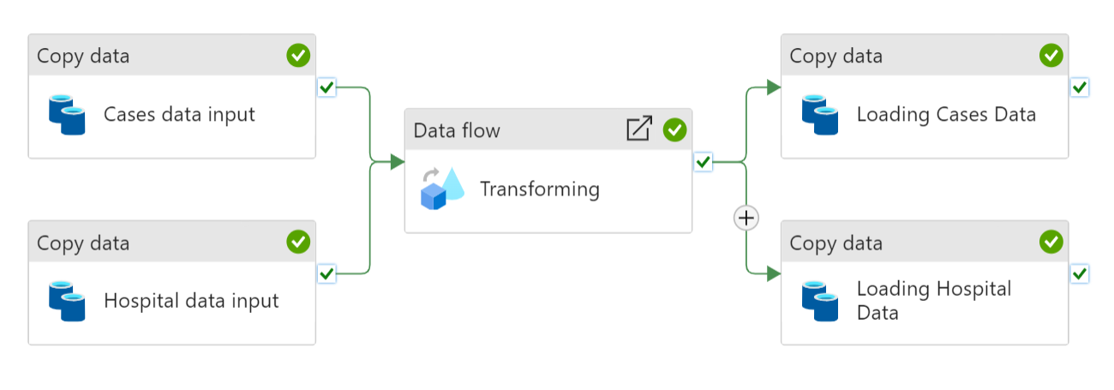
Azure Data Factory Pipeline

Slide 6
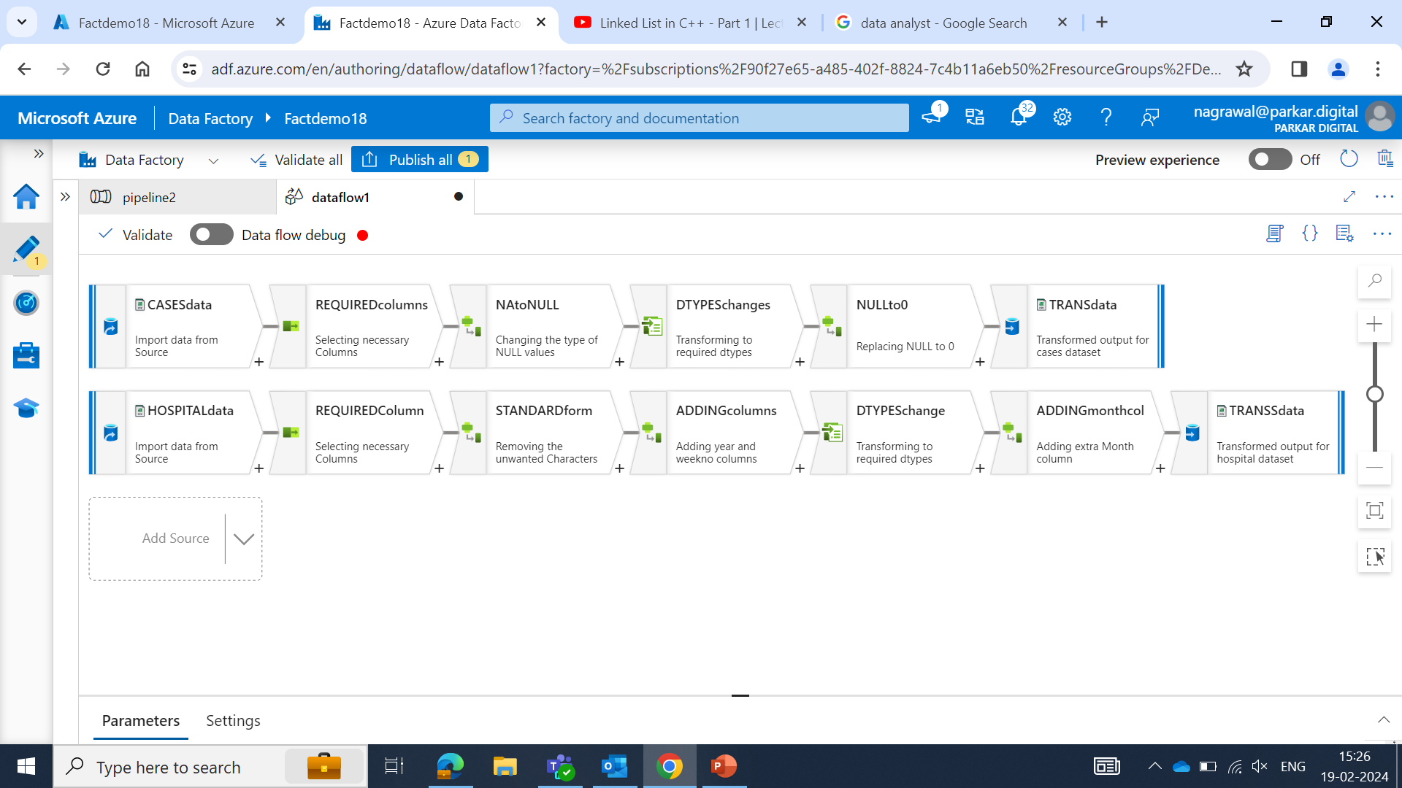
Transformation using DATA flows

Slide 7
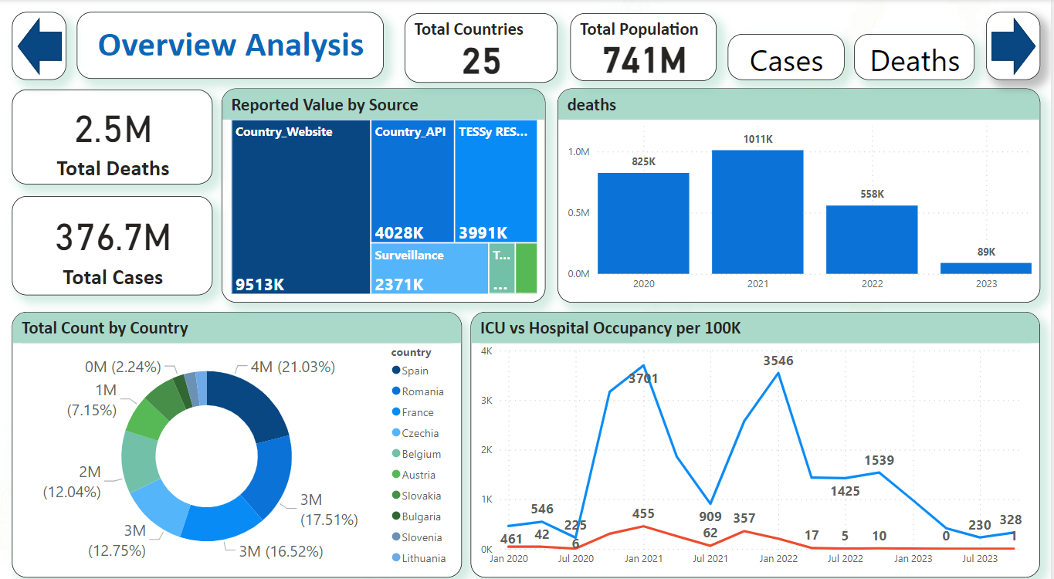
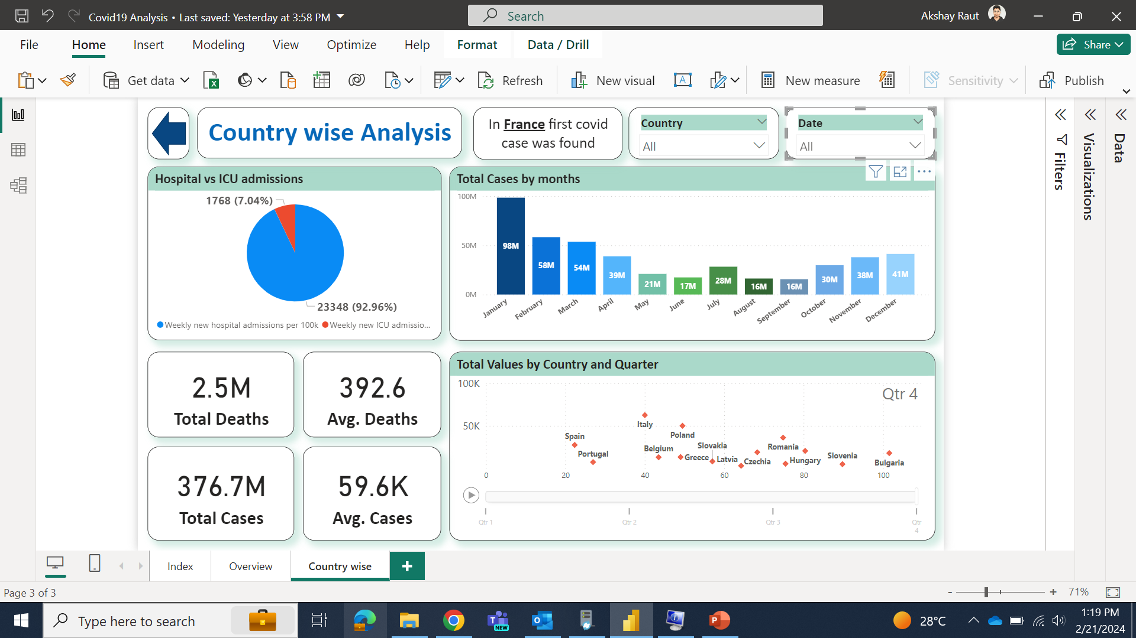
DASHBOARDS

Slide 8

THANK YOU

