Slide 1
CampusKart (OLX for IIT Ropar) DEP.X5
Antara Agarwal - 2019CSB1076
Krithika Goyal - 2019CSB1094
Nupur Rathi - 2019CSB1104

Slide 2
Problem Statement
There is no specific platform for exchanging products in IIT Ropar for the IIT Ropar community. Most exchanges for items like lab coats and cycles are done via shared google sheets or broadcasted emails.
We created CampusKart, an application that allows students, faculty, and support staff to simply offer their products for sale to individuals who are interested in purchasing them.

Slide 3
Tech Stack Used
Flutter for Frontend
Django for Backend
PostgreSQL for database
Firebase for User Authentication and Notifications

Slide 4
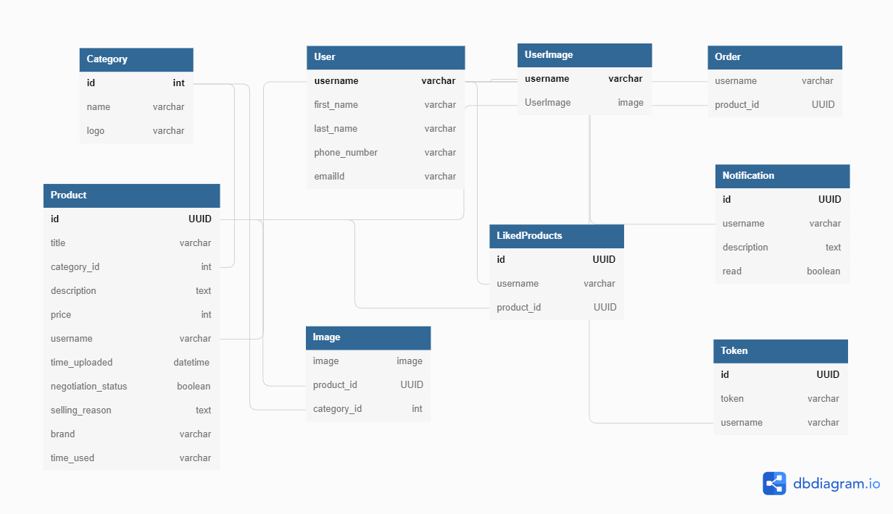
Database Schema

Slide 5
Salient Features
Registration with email verification using IIT Ropar email IDs.
Login using IIT Ropar email id and password.
Forgot password option available to change users account password.
Users can upload a product they want to sell along with multiple images.
The description given can be formatted in any way the user seems suitable.
Notification to all the registered users when a new product is uploaded.
Products will be live for one month.
Notification to the user 5 days before their product is to be deleted, and after product deletion.
Users can view, delete and edit their uploaded products.
Users can browse through the multiple products uploaded by others.​
Users can browse the products by category and search them by title or username.
Filter and Sort options are available.
Wishlist option to add products to wishlist.
Whatsapp, email, call or sms the seller to negotiate/ talk with them.
Users can edit their profile to update their name, phone number, and profile picture.
Recent products are shown in the carousel on the homepage.

Slide 6
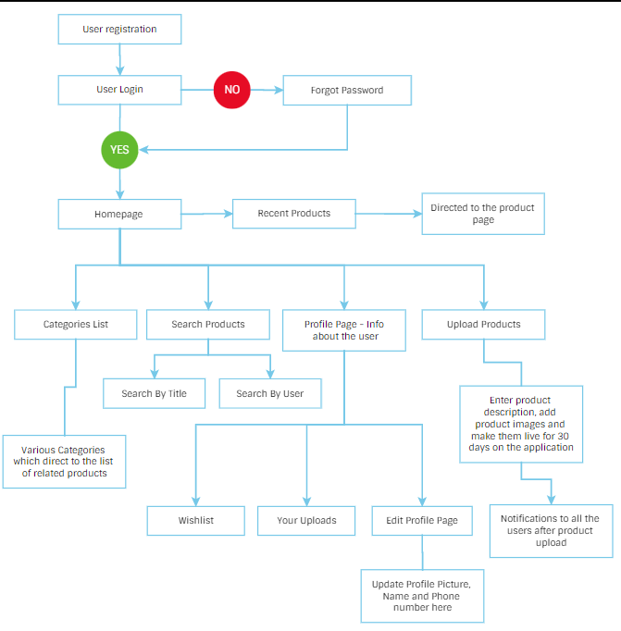
Flowchart
Workflow of our app
Sign out

Slide 7
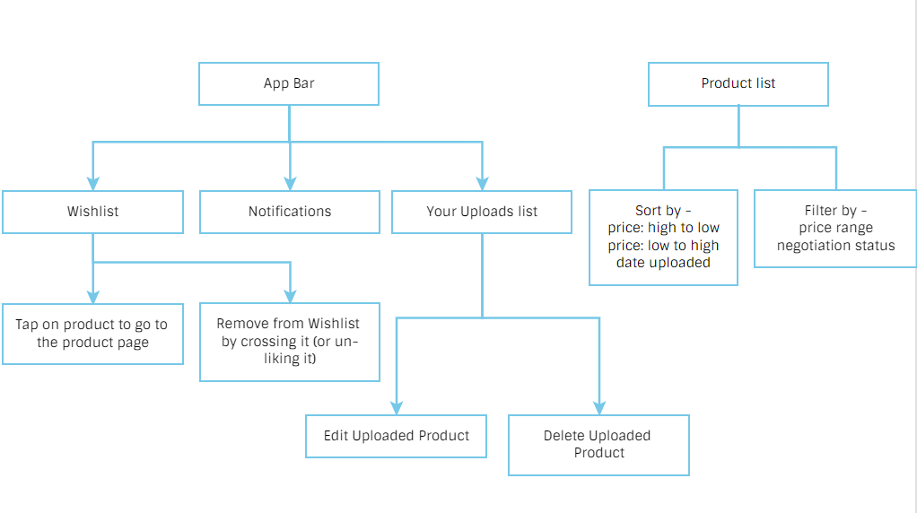

Slide 8
Screenshots
Images of our application with their description

Slide 9
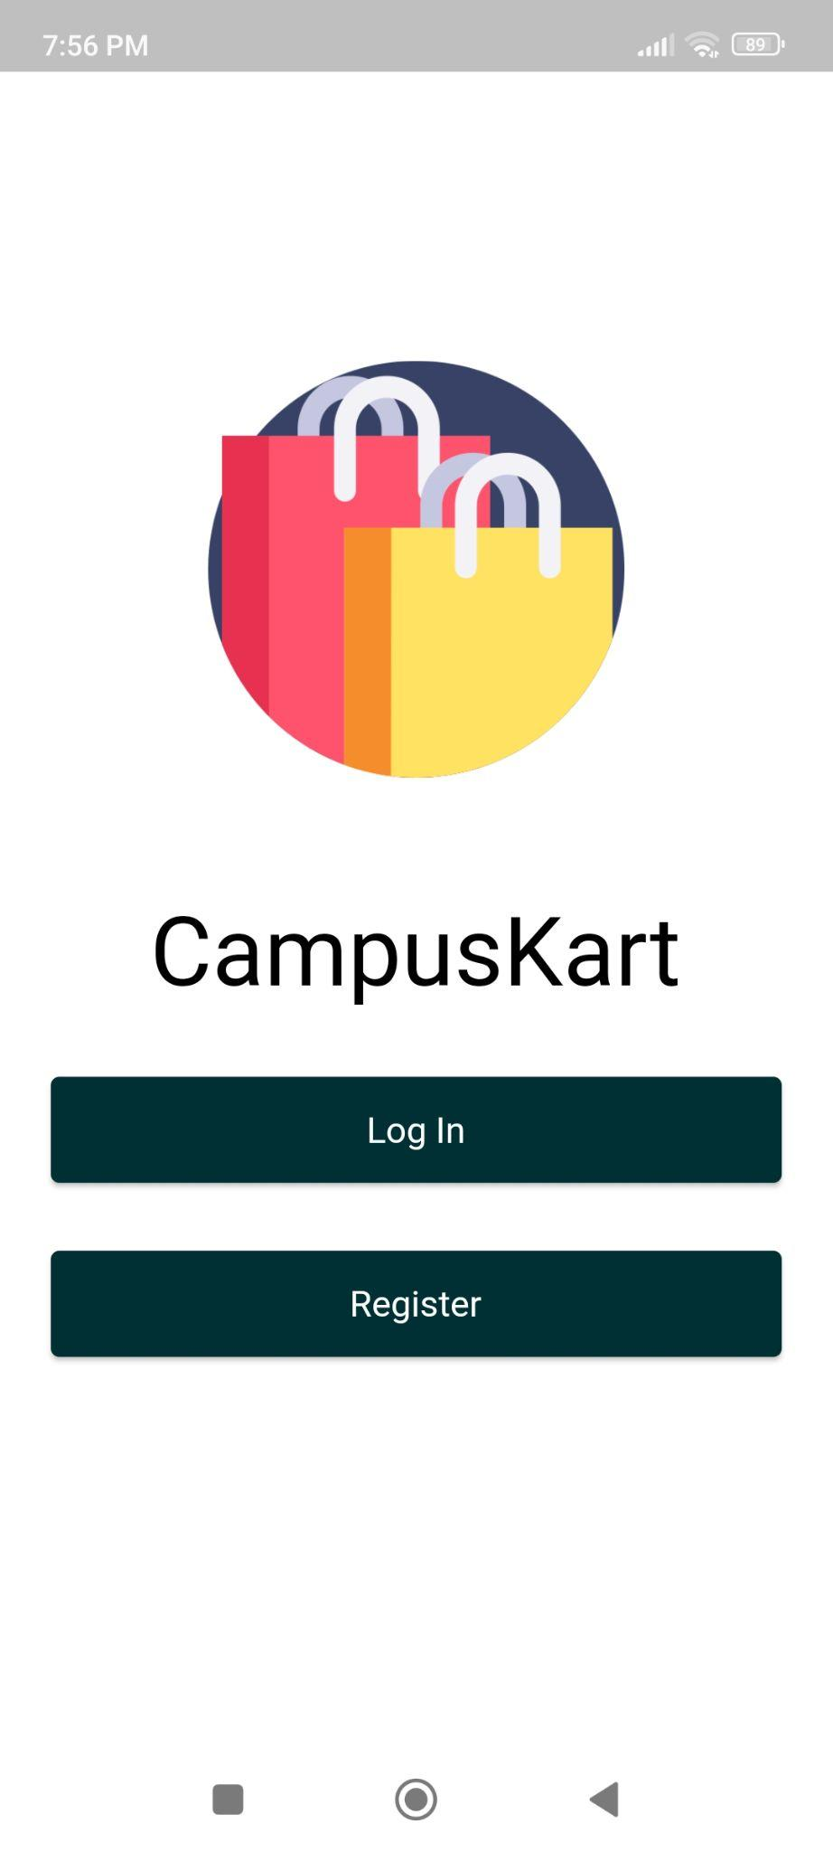
Welcome Screen
Log in button - user can log in to his/her account from here.
Register button - user can register from here.

Slide 10
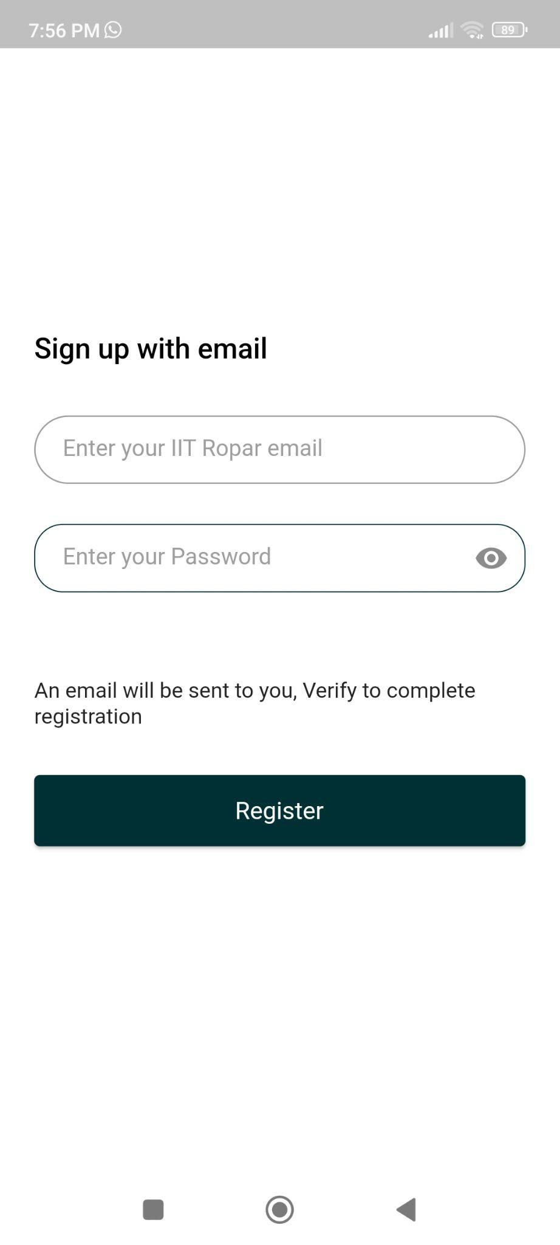
Registration Screen with email verification
Email must be from IIT Ropar Domain
Show Password Button
Password must be at least 6 characters long

Slide 11
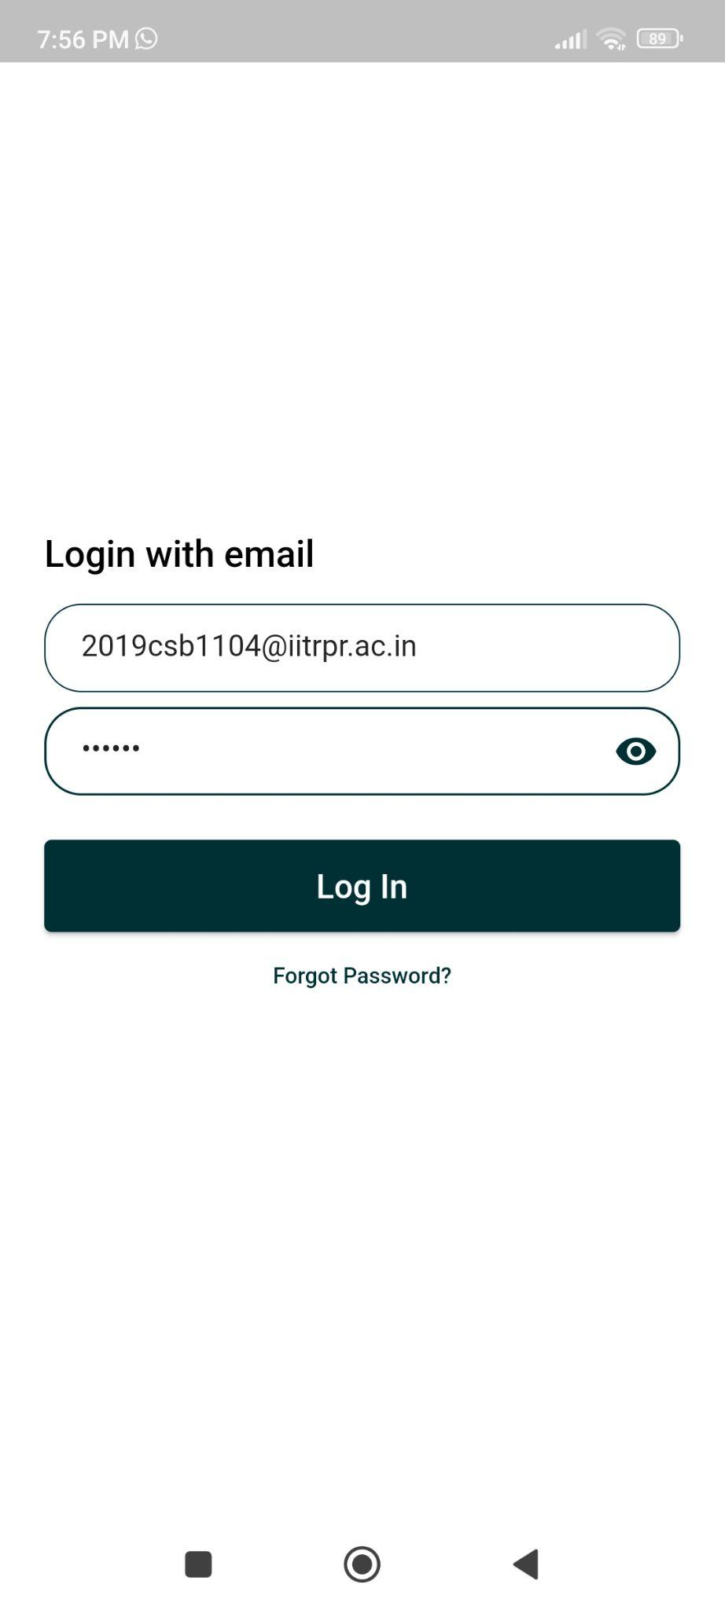
Login Screen
Email must be from IIT Ropar Domain
Show Password Button
Forgot Password

Slide 12
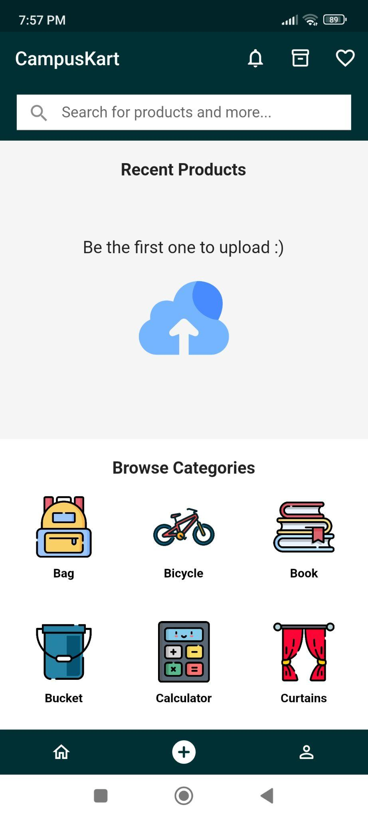
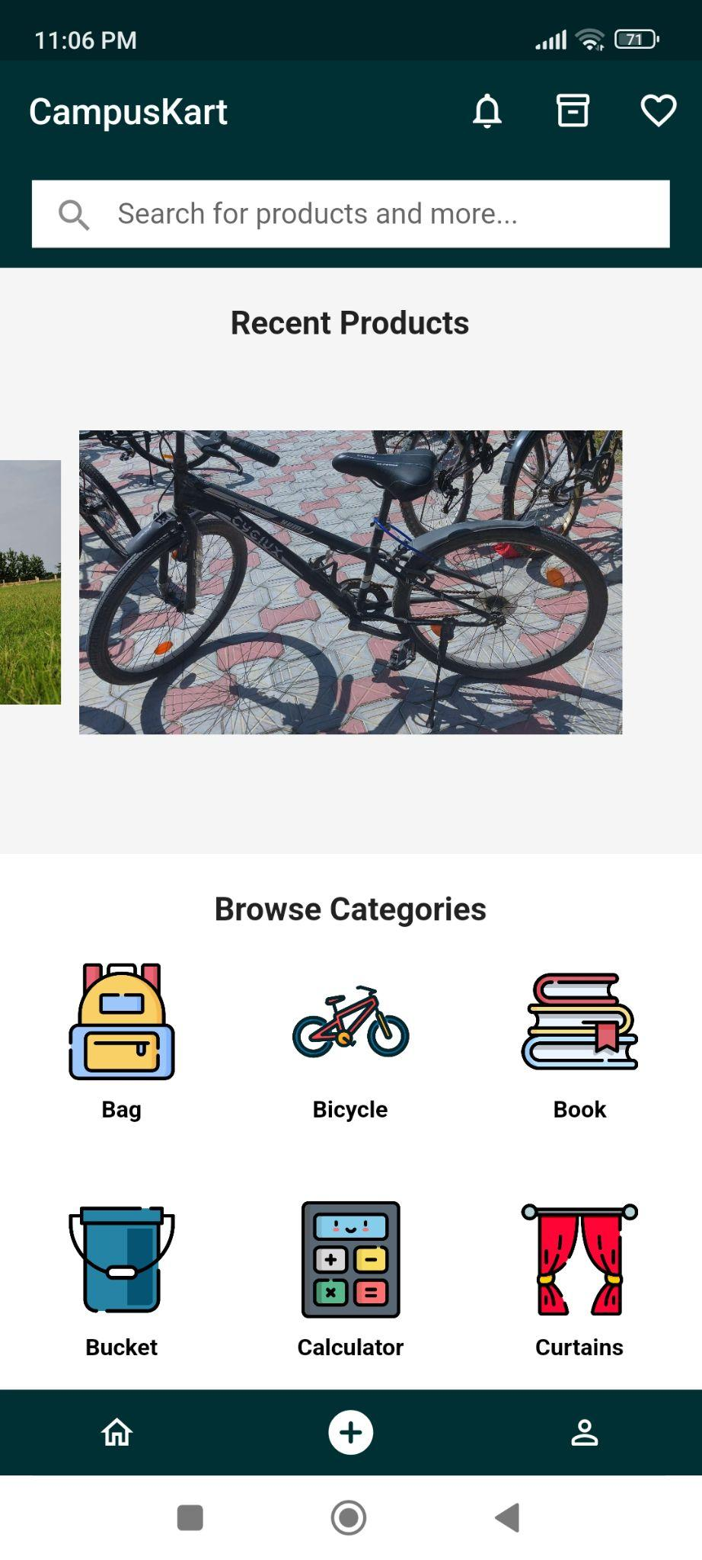
Homepage
Recent Products are displayed here. User can tap on the carousel image to navigate to product page.
When no products are present, the user is prompted to upload a product
Various Categories are present, clicking on the categories leads us to the list of all the products in that category.

Slide 13
App Bar and
Bottom Bar
Wishlist
Profile Page
Your Uploaded Products
Upload Product
Notifications
Homepage
Bottom Bar
App bar
Search Bar

Slide 14
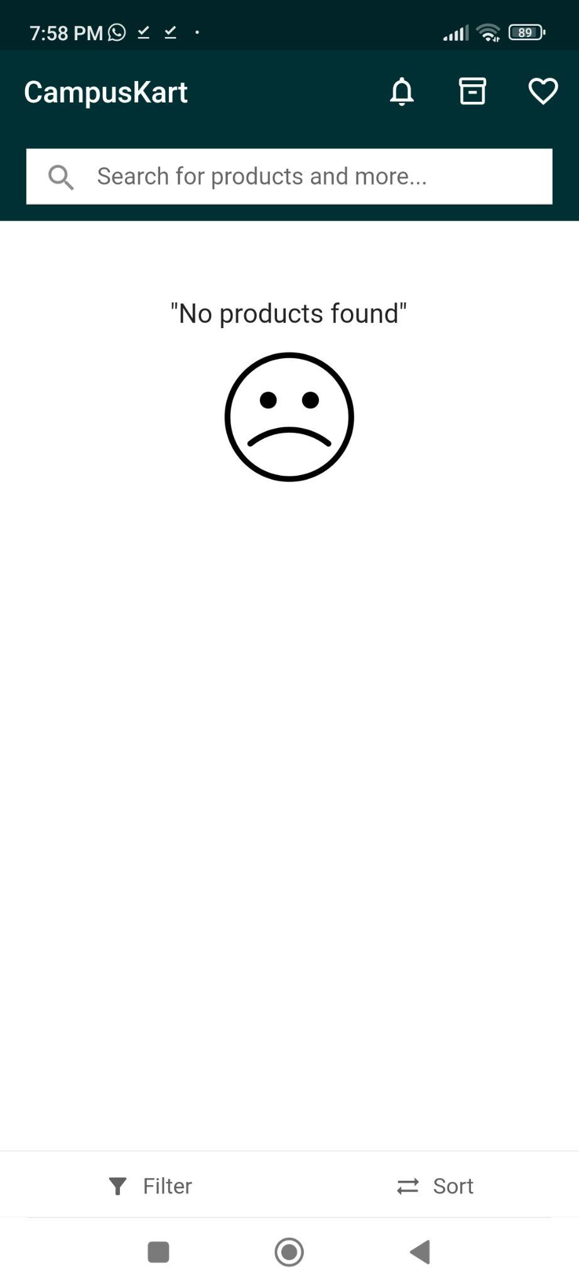
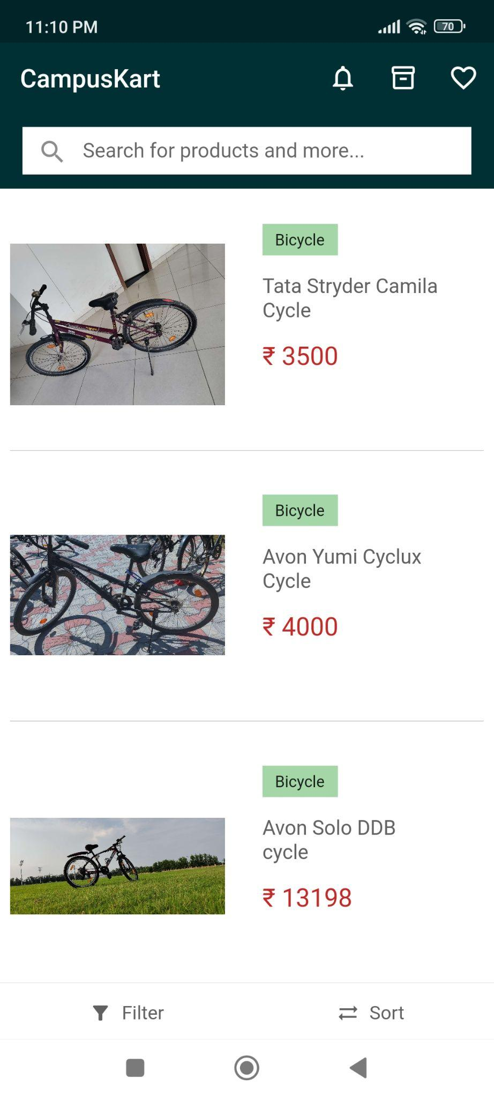
Category List
Products in the ‘Bicycles’ Category
When no products are present in the category list, this is shown.

Slide 15
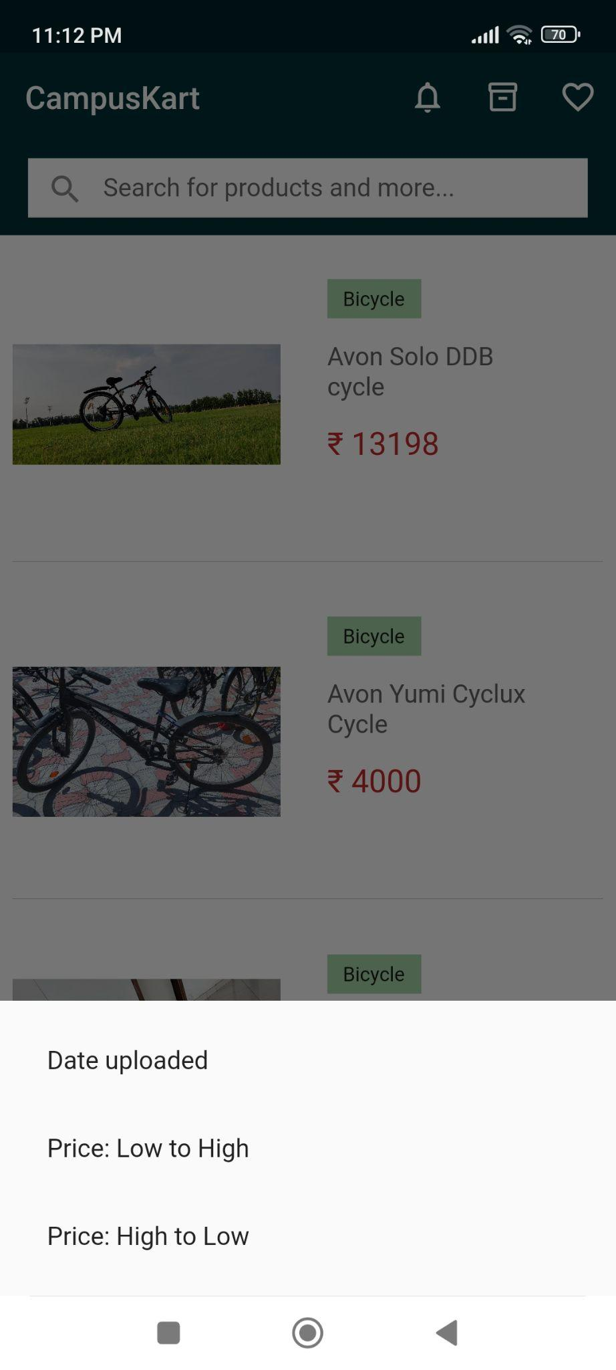
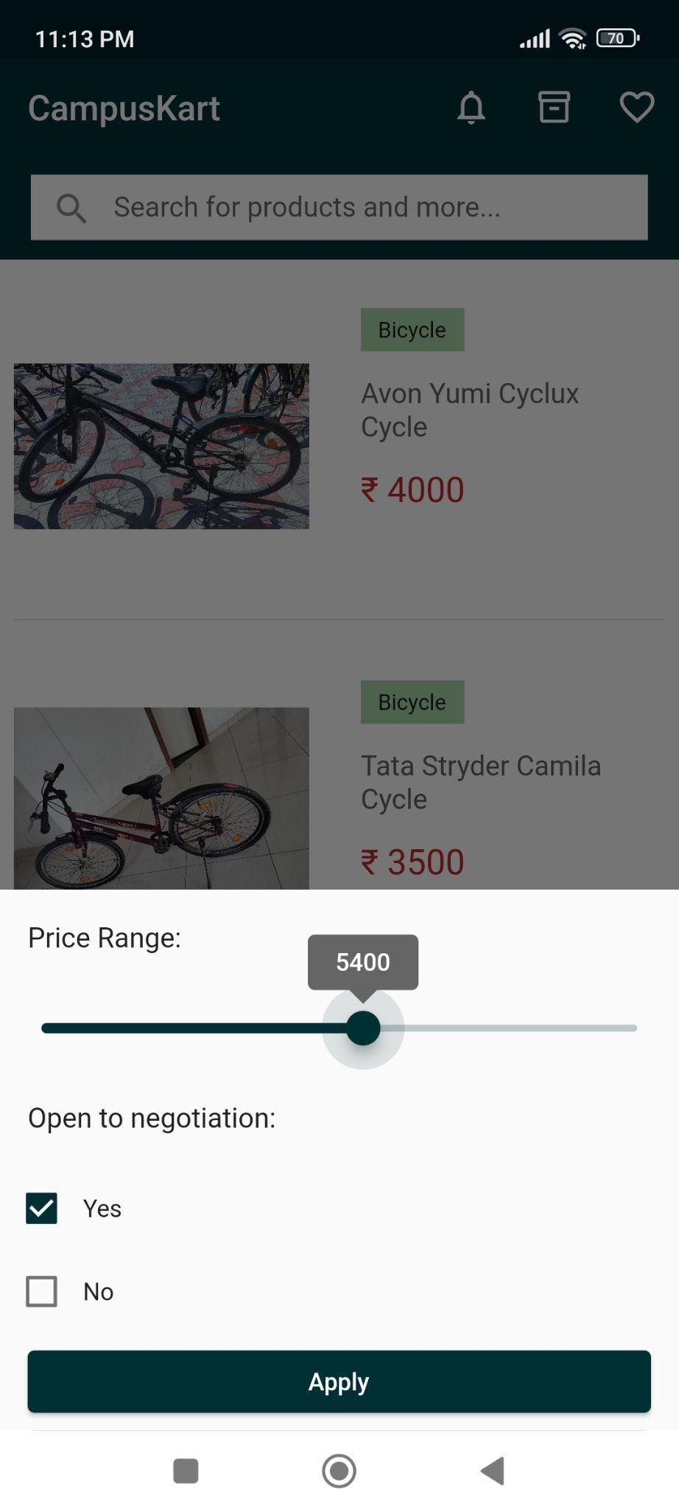
Sorting and Filtering
Filtering by price range and if the user is open to negotiation
Various Sort options present for the products list

Slide 16
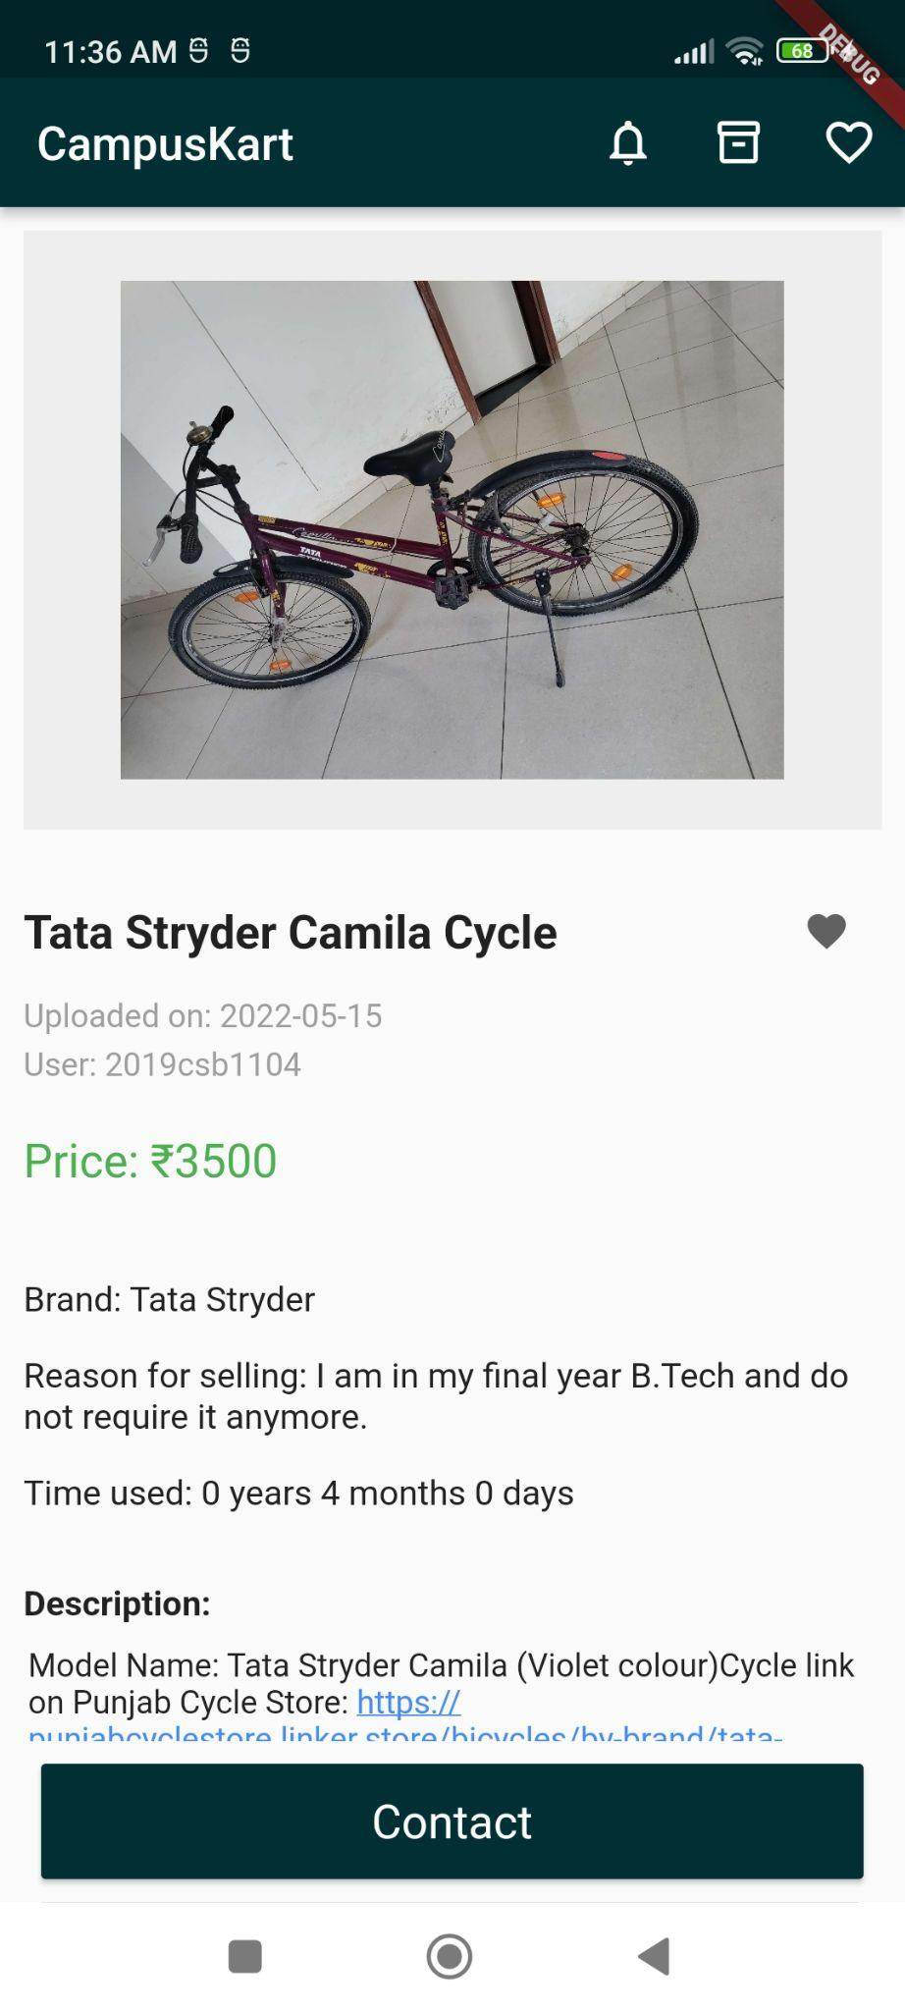
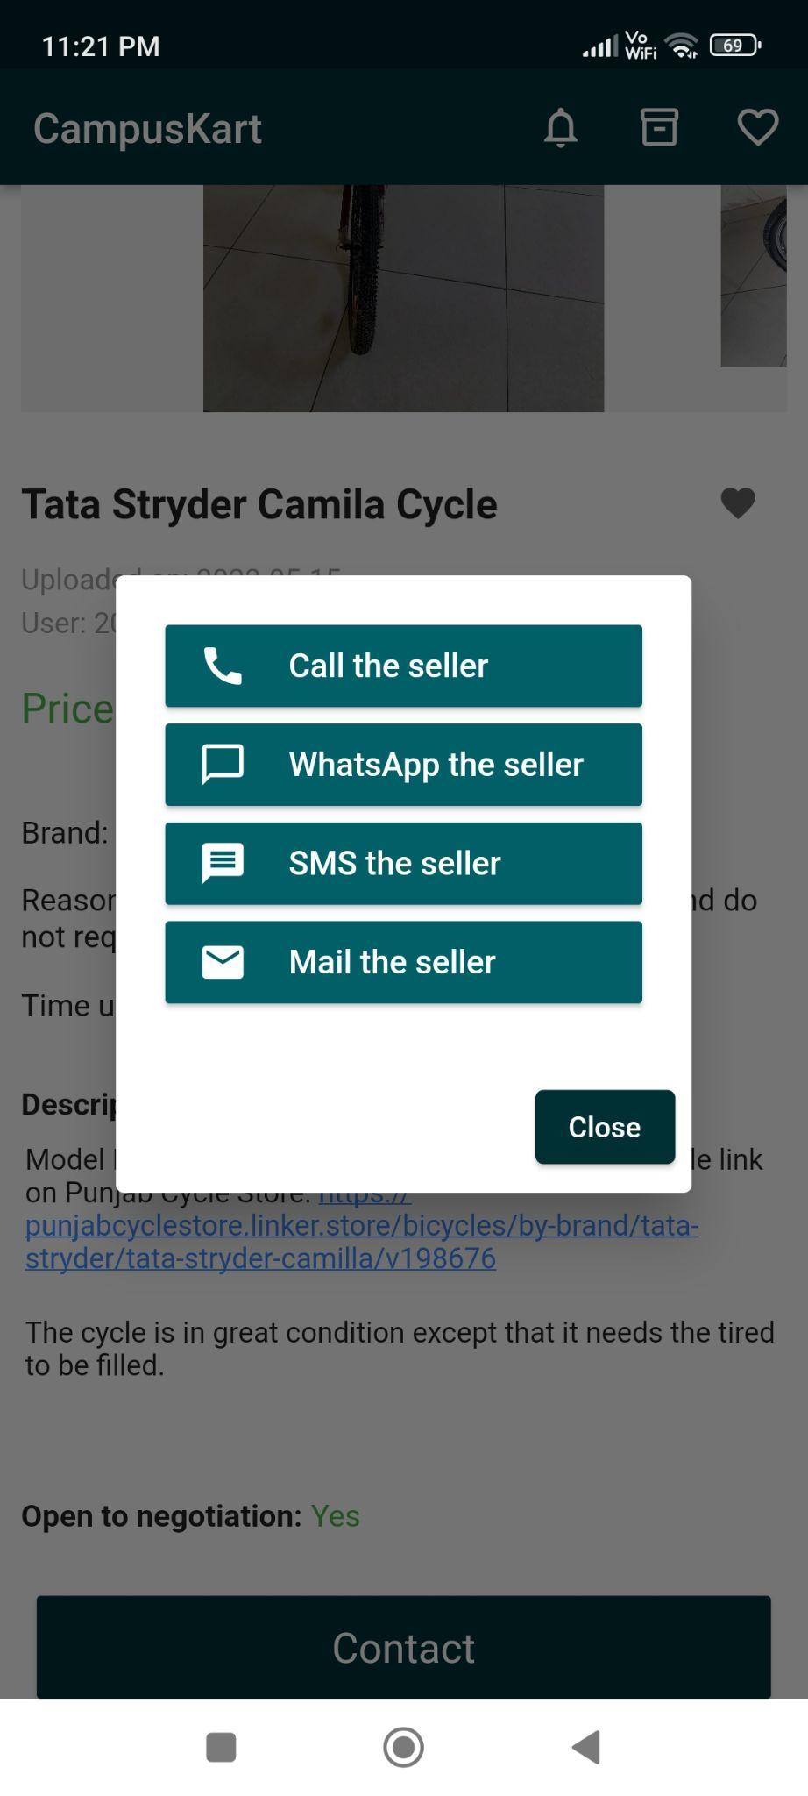
Product Page
Product pictures
(shown in a carousel)
Wishlist (like) button
Description and Price
Contact the seller

Slide 17
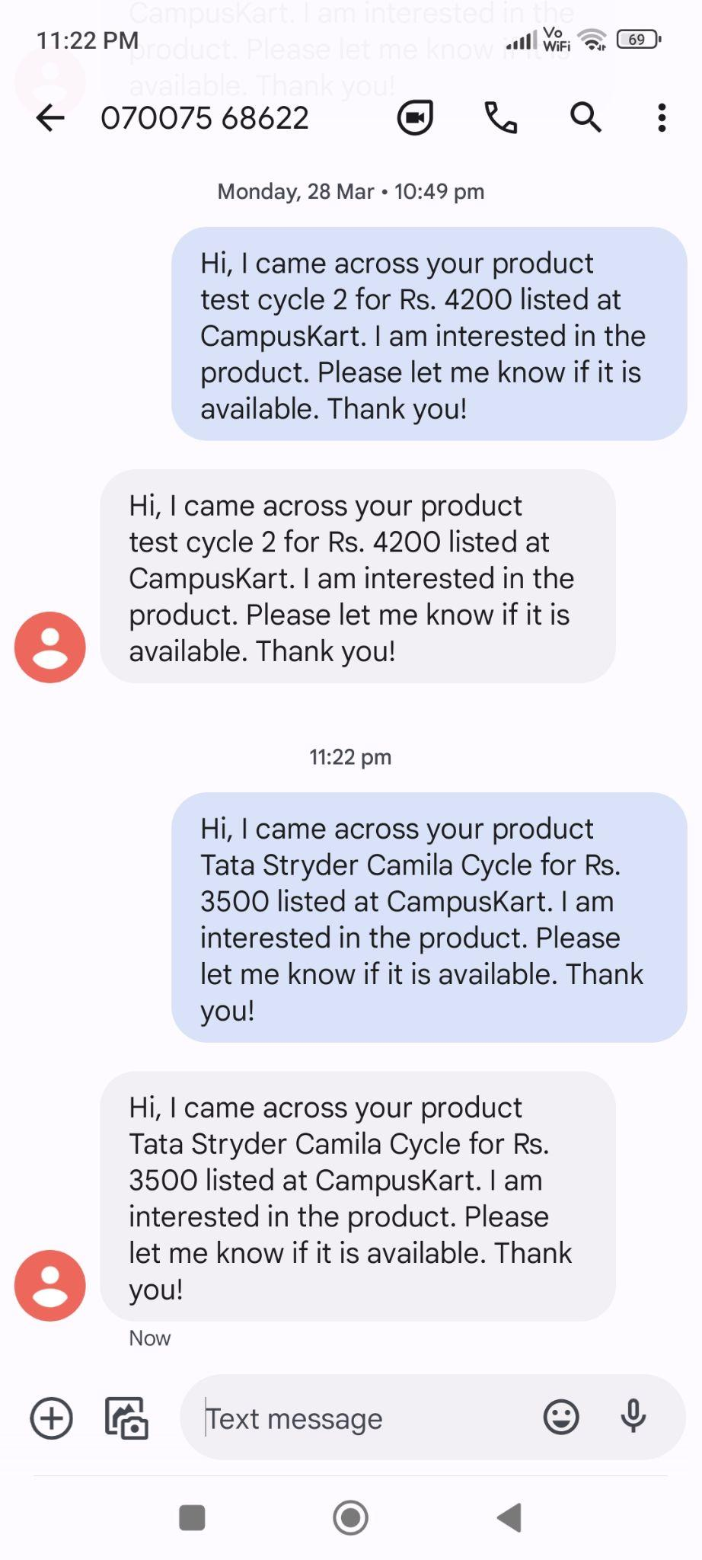
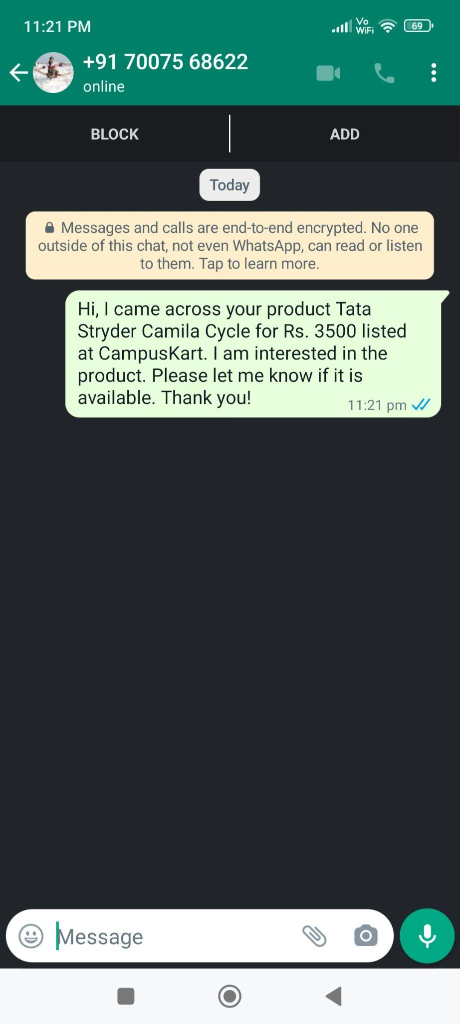
Contact the Seller (1)
Contact the seller via Whatsapp - predefined message is suggested to user
Contact the seller via SMS - predefined message is suggested to user

Slide 18
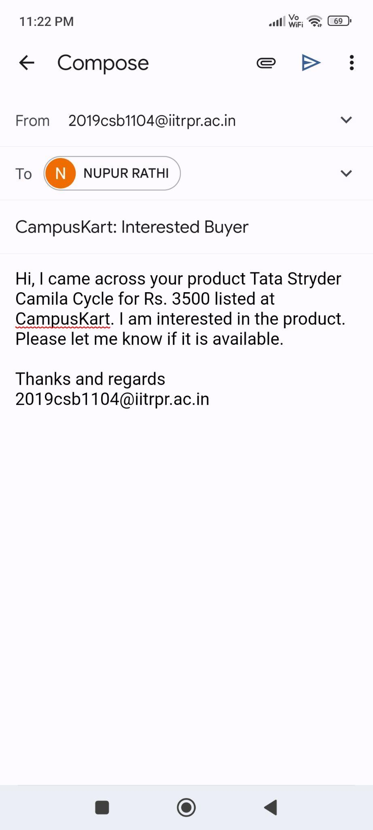
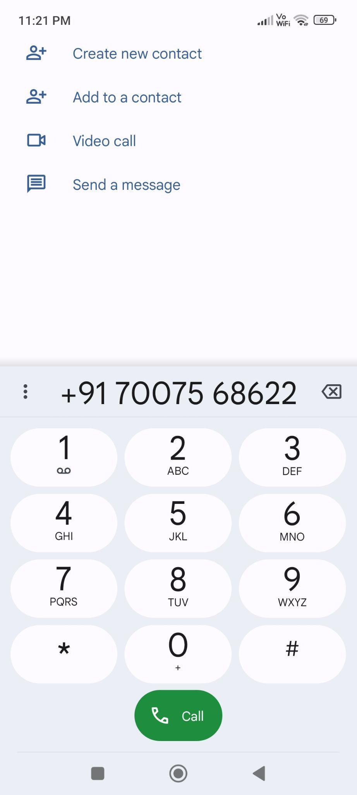
Contact the Seller (2)
Contact the Seller
via Email - predefined email is suggested to user
Call the seller

Slide 19
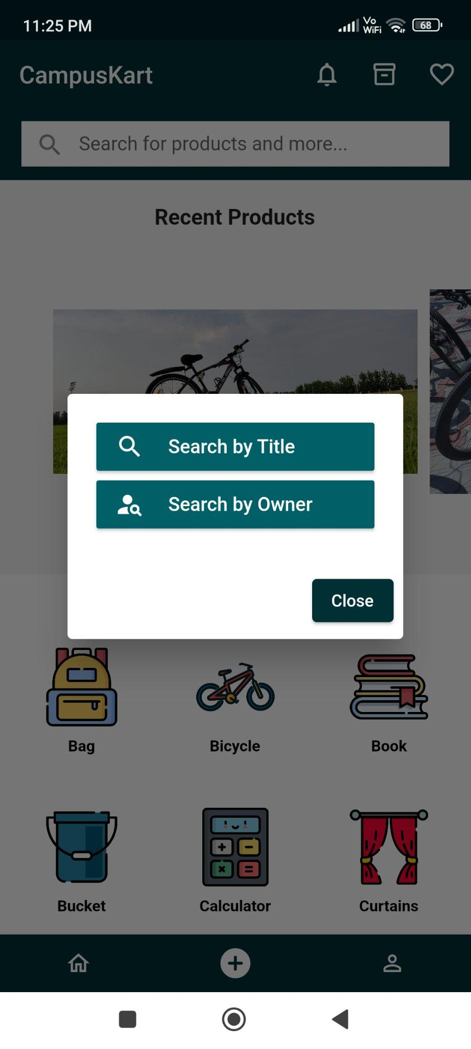
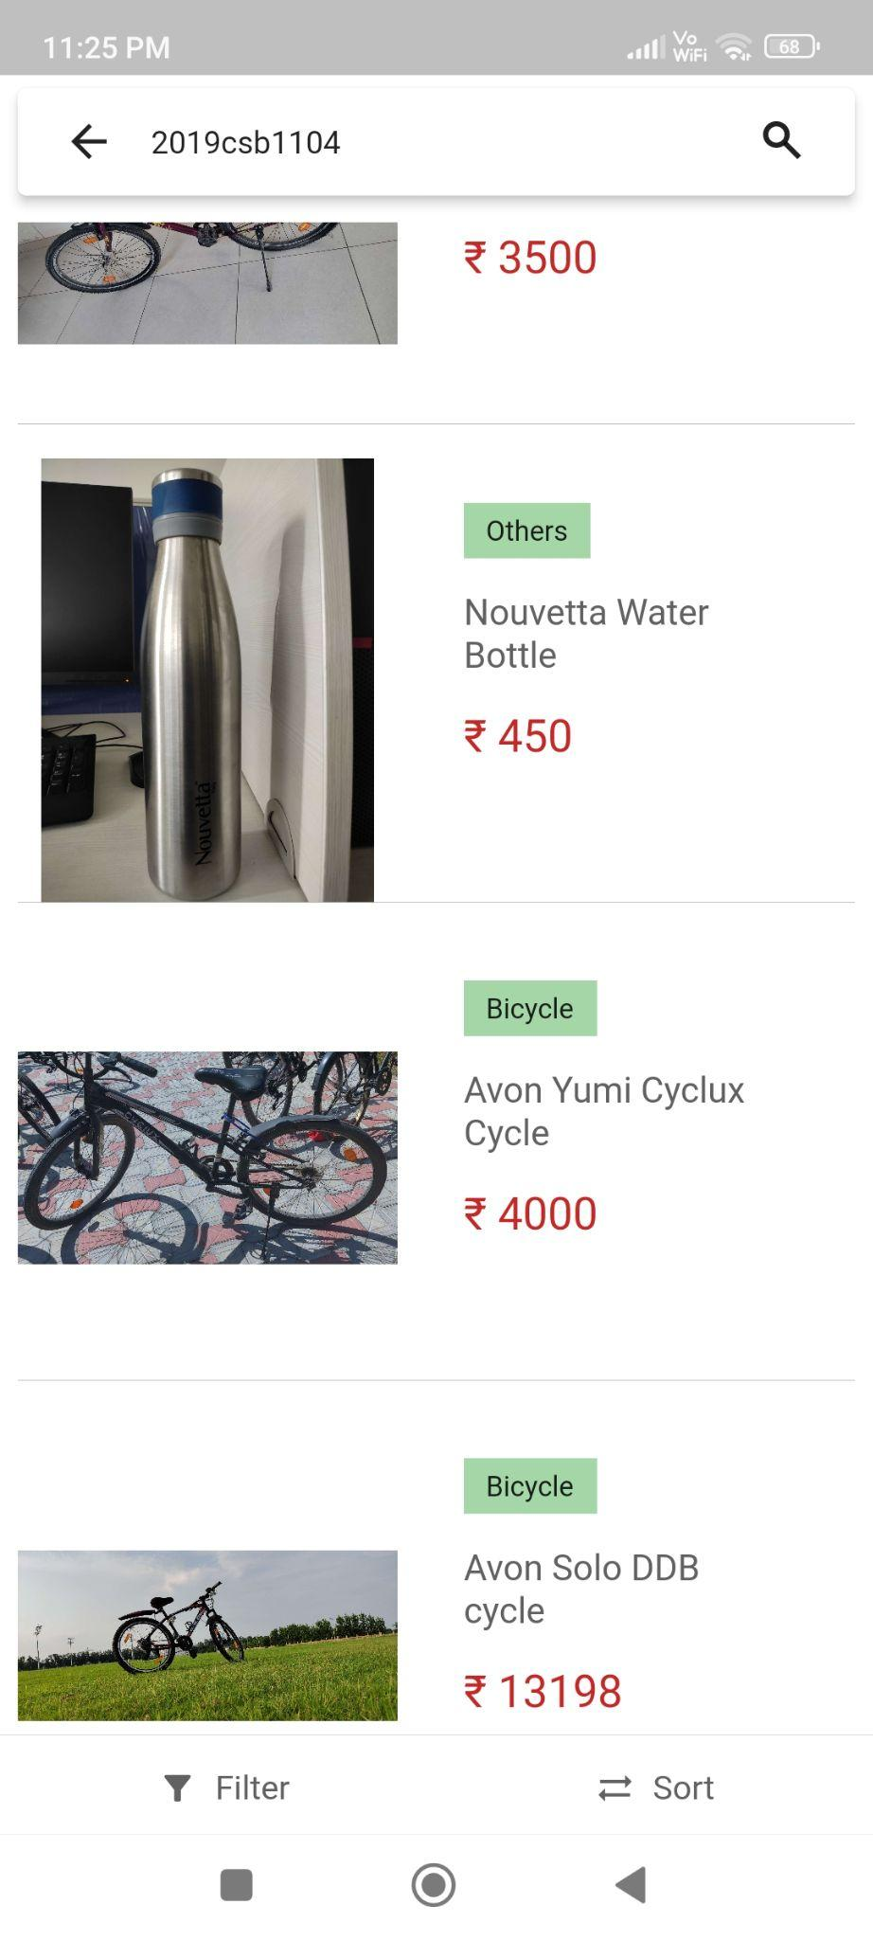
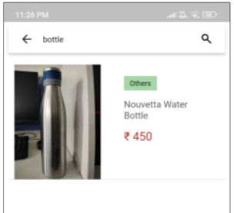
Searching Feature
Search by user
Searching
Search by title

Slide 20
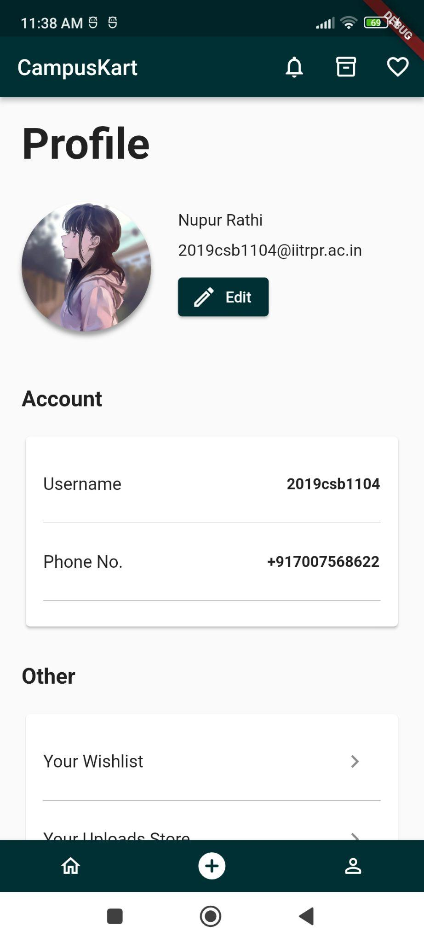
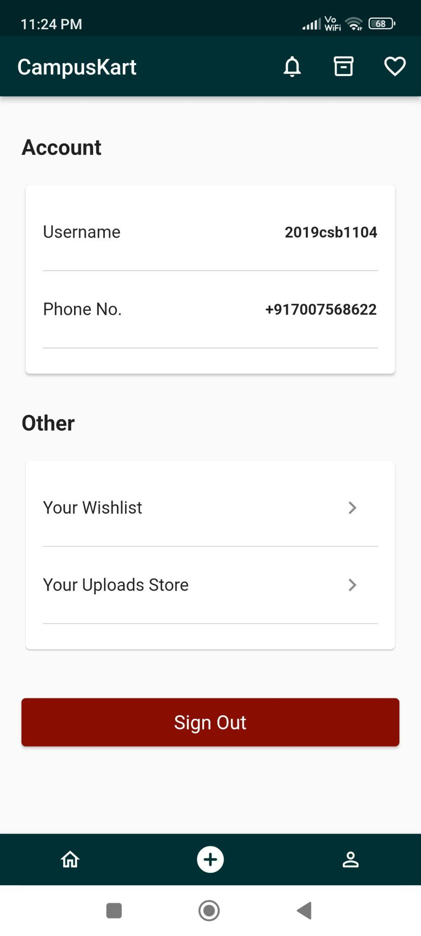
Profile Page
User name, email address
and profile picture
User can navigate to edit profile page
Wishlist
User Phone number
Uploaded products
Sign Out Button

Slide 21
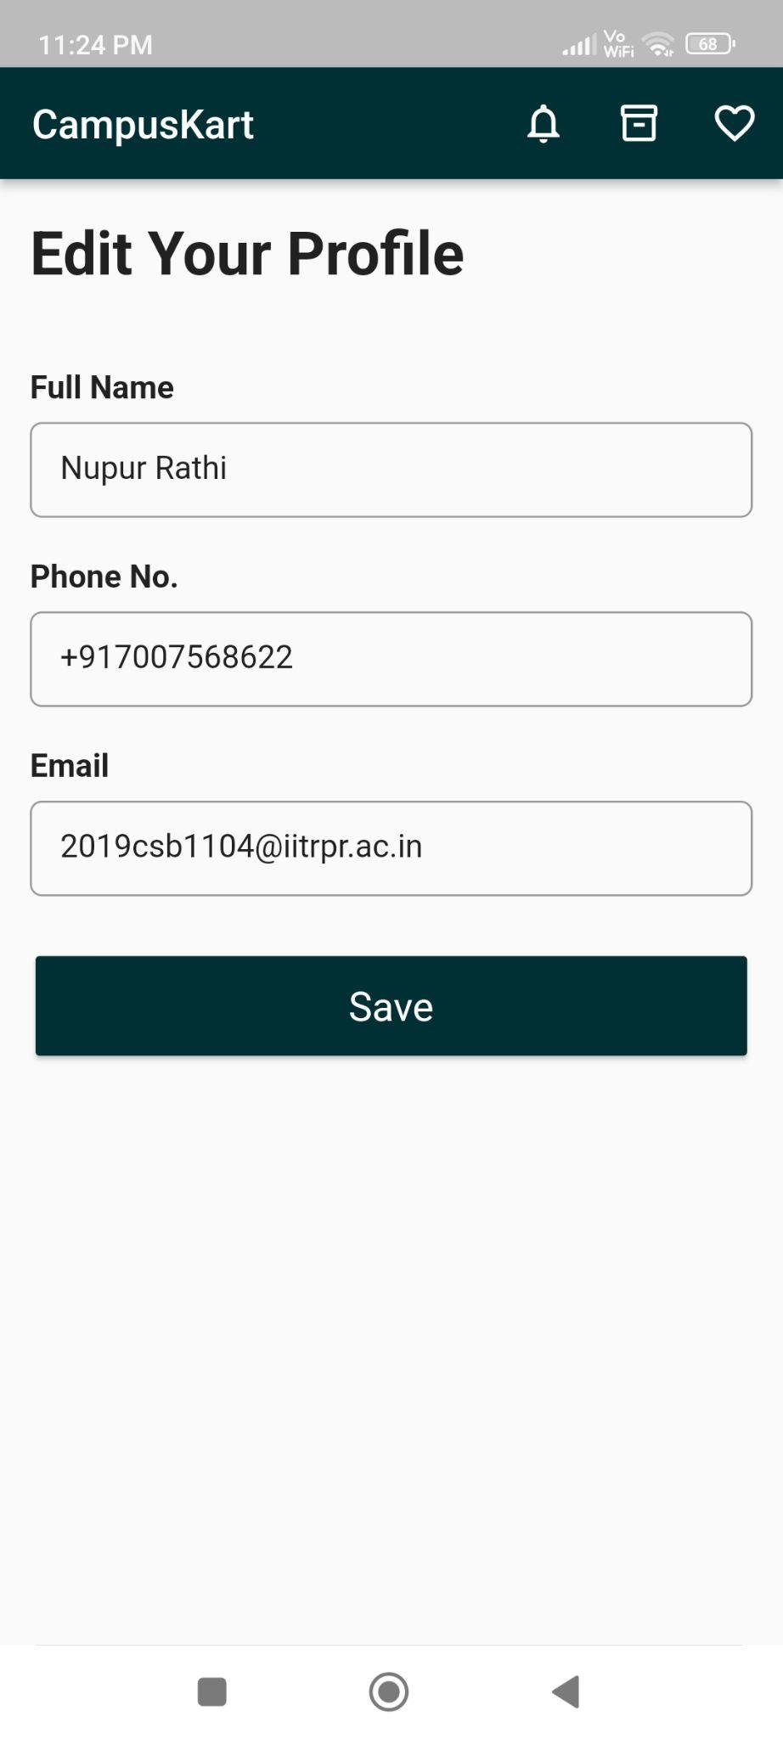
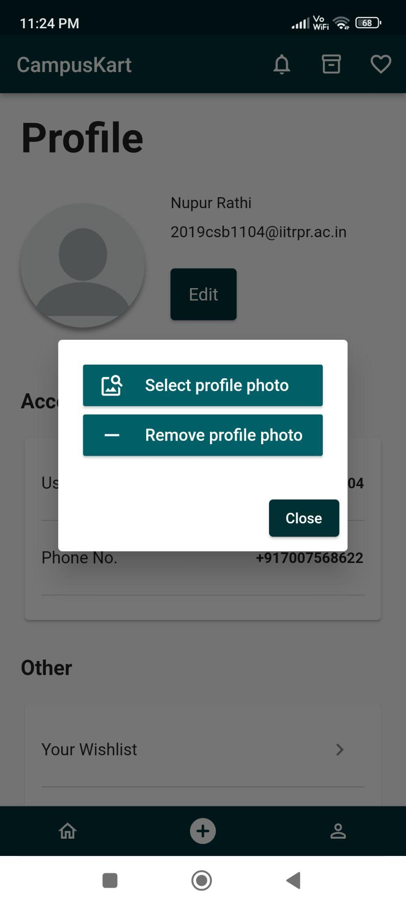
Edit Profile Page
User can edit their name, phone number and profile picture

Slide 22
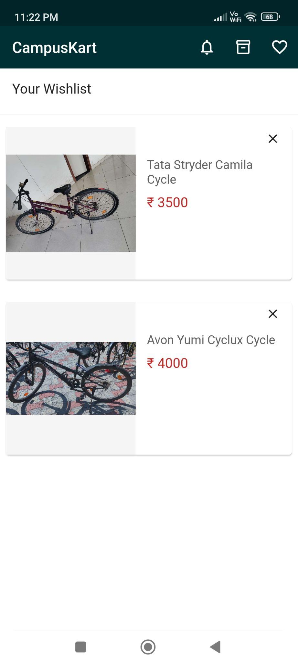
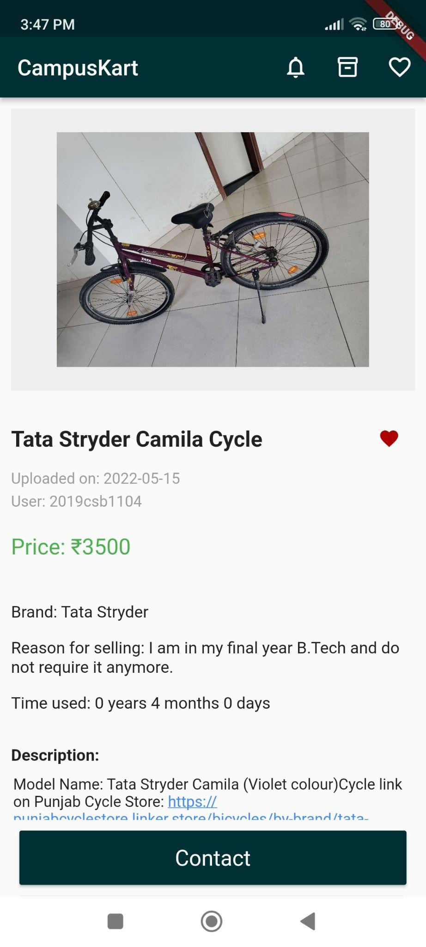
Wishlist
Wishlist Products - user can tap on the product card to move to its product page
User can remove the product from his wishlist

Slide 23
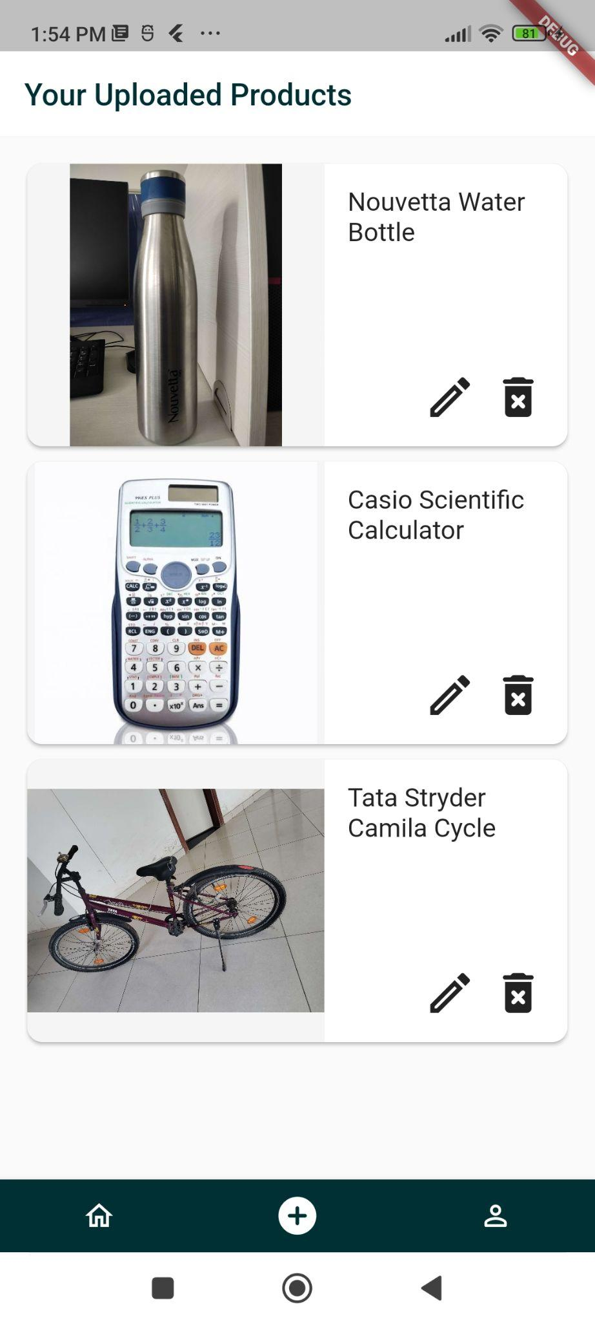
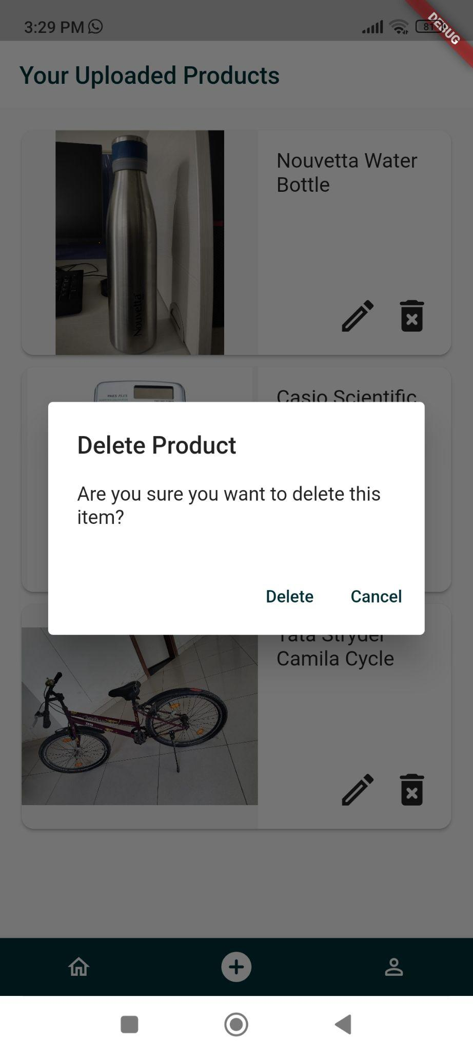
Your Uploaded Products
Your Uploaded Products list
User can delete his uploaded products (like after he has sold it to someone)
User can edit his uploaded products.

Slide 24
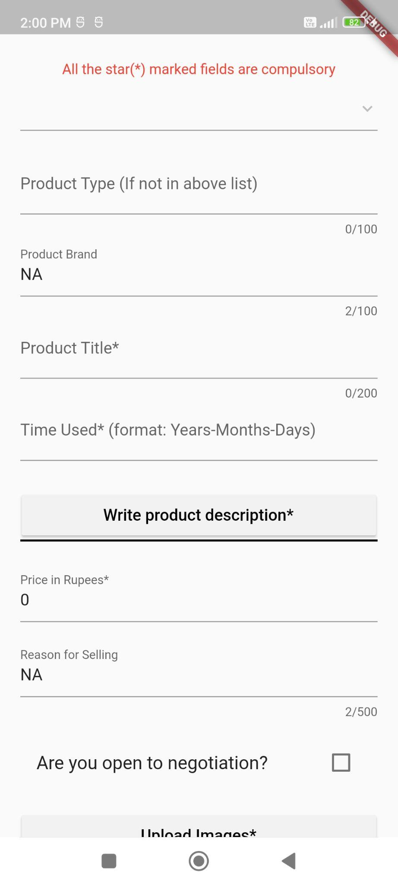
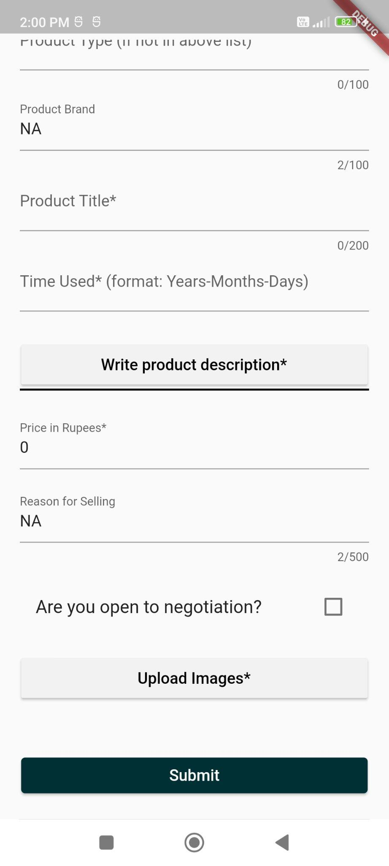
Upload Product
Star marked fields are compulsory
Upto 3 images can be
uploaded of a single
product

Slide 25
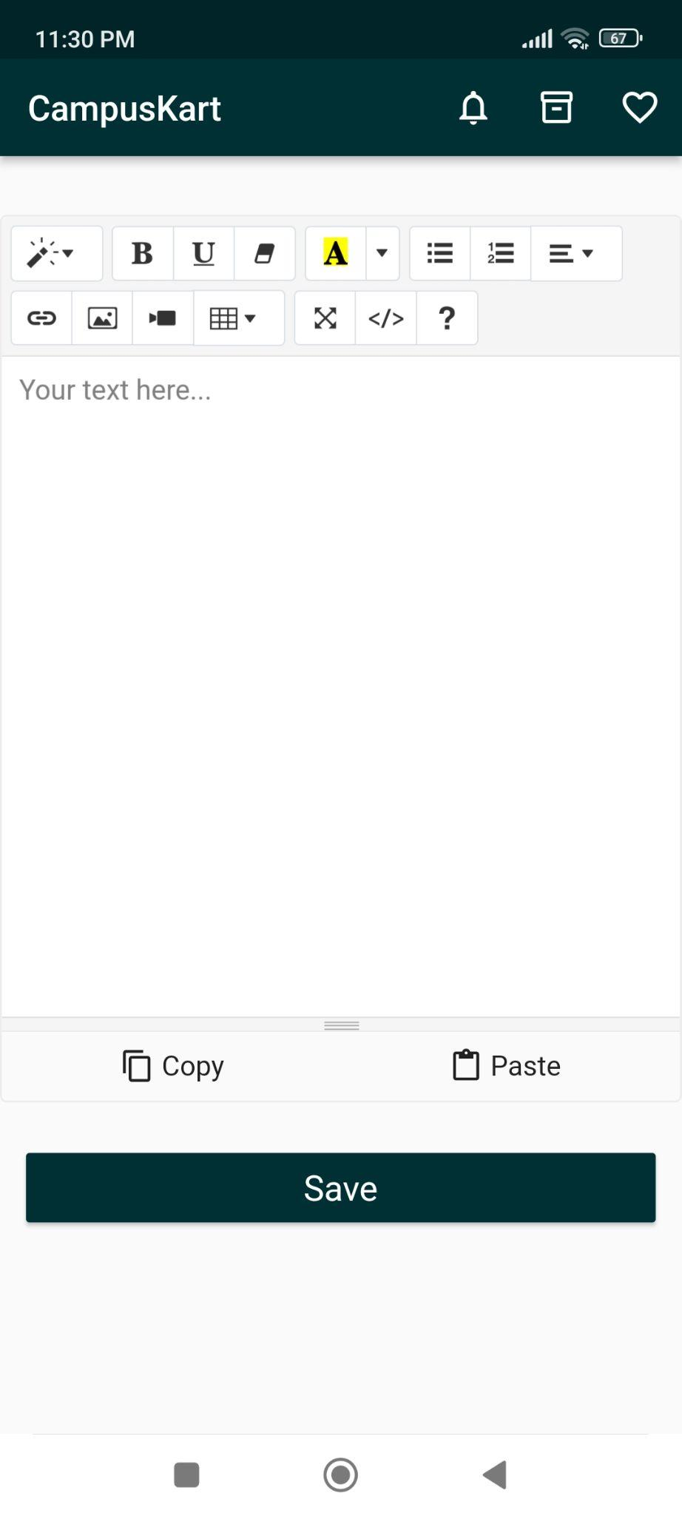
Description Page
User can use any of these tools available to format the description of the product
Save the description

Slide 26
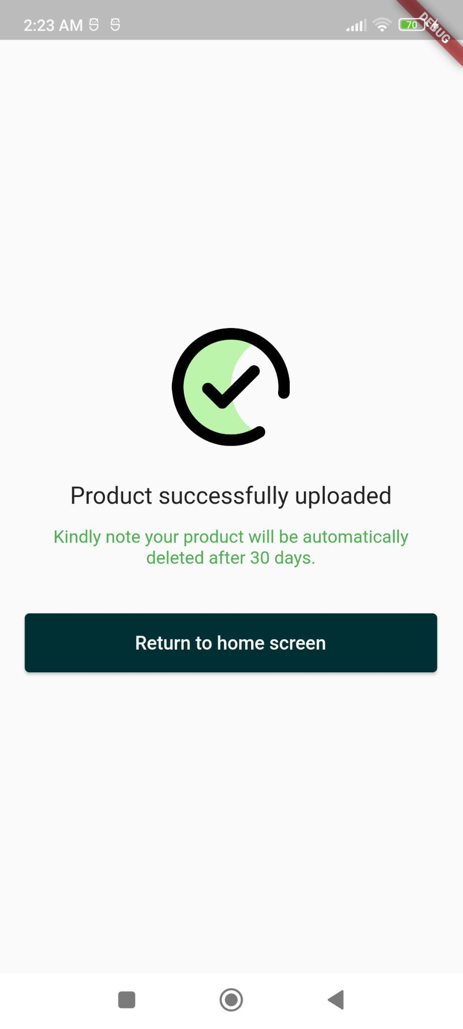
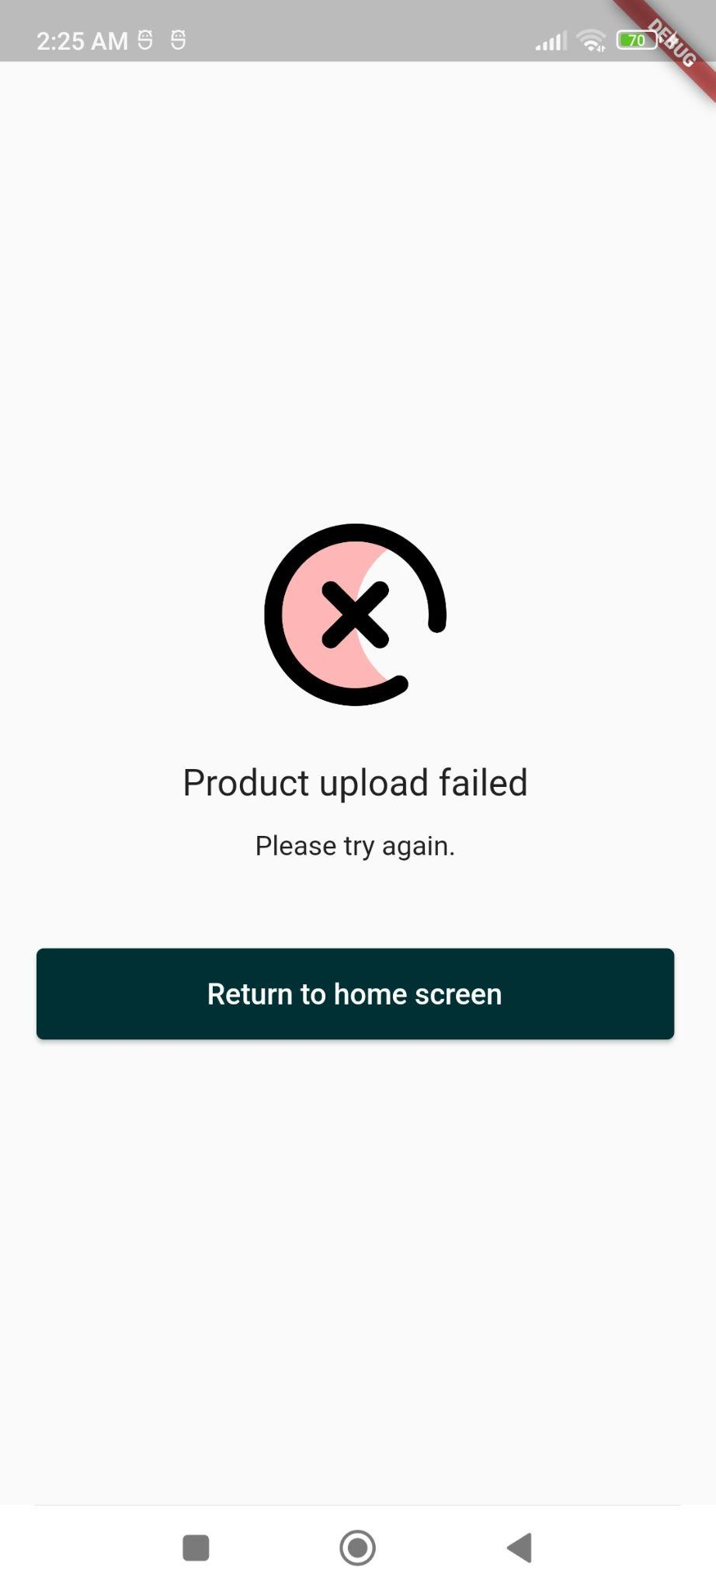
Product upload successful/
unsuccessful
Product upload
failed
Product upload
Successful. Products are live for 30 days

Slide 27
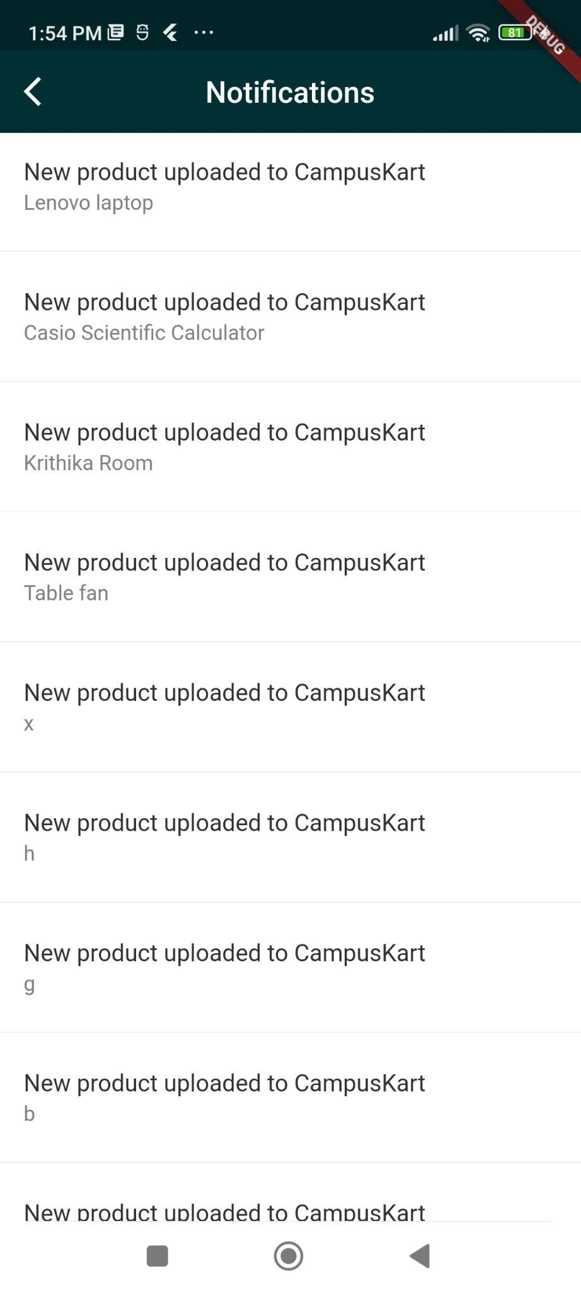
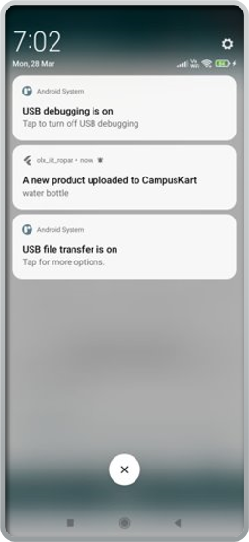
Notifications
Push Notifications shown on screen
Notifications of all the products uploaded

Slide 28
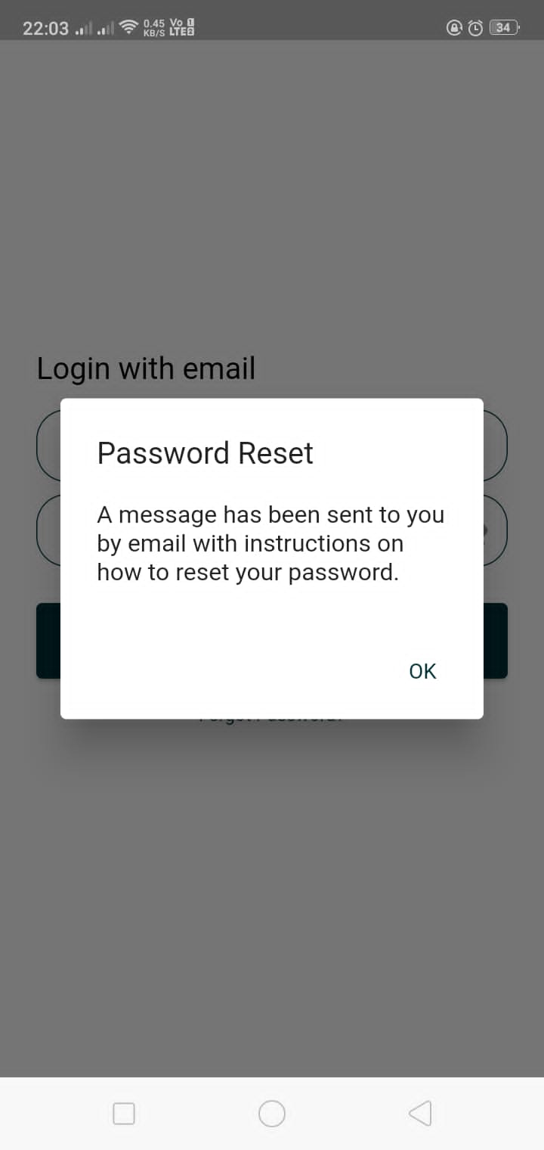
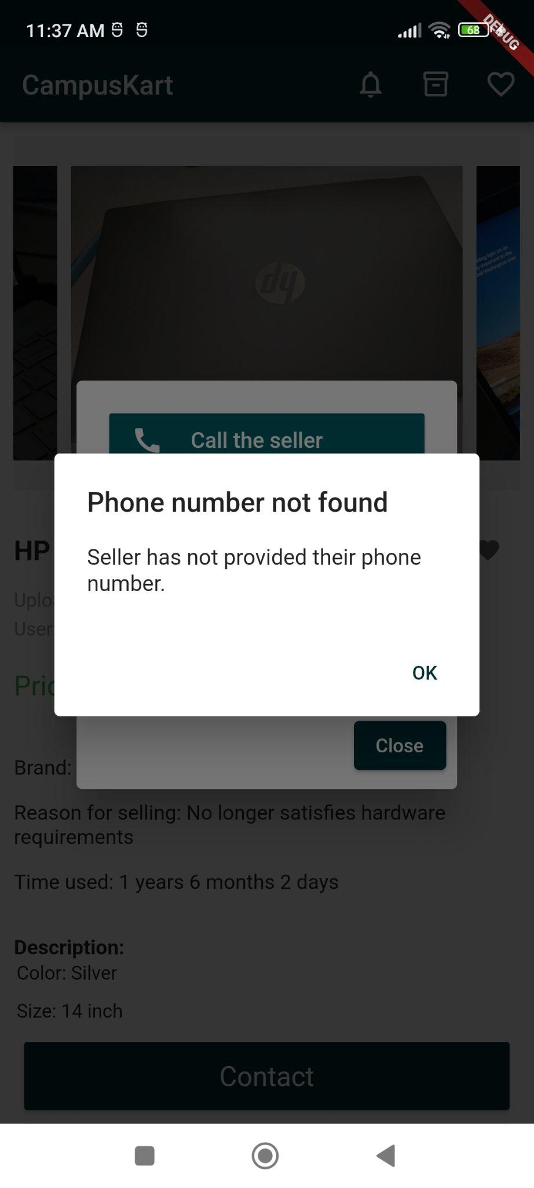
Pop Ups
Pop up shown on forgot password .
Pop up shown when the seller has not provided their phone number and a buyer tries to contact them by calling, whatsapp or SMS.

Slide 29
Team Members and Individual Contributions
Antara Agarwal
Edit profile - User can edit their phone number and name
User authentication (Register, Login, forgot password, email verification)
Wishlist
Profile page - (display user details, sign-out)
Krithika Goyal
Search by title
Search by user
Product upload with images (also html editor for product description)
Edit your uploaded products
Select profile picture
Notifications
Nupur Rathi
Fetch and Display products list and individual products
Recent products
Browse categories
Sort and Filter products
Contact the seller - whatsapp, SMS, call, email
Your Uploaded products - display and delete
We developed many small features like navigation stack push and pop, UI designing etc. and fixed many bugs together.

Slide 30
Credits
Special thanks to our mentor Dr. Puneet Goyal who guided us throughout our project.
Also thanks to all our team members who worked hard and made this application possible.
THANKS

