Slide 1

Modeling Depression
Daniel, Ashwin, Nupur, Jose, Sep

Slide 2
Model Selection
Logistic Regression
Support Vector Machines
Random Forrest
Decision Tree
Neural Network
Why these?
Problem type
Regression vs Classification
Probability vs Binary Category

Slide 3
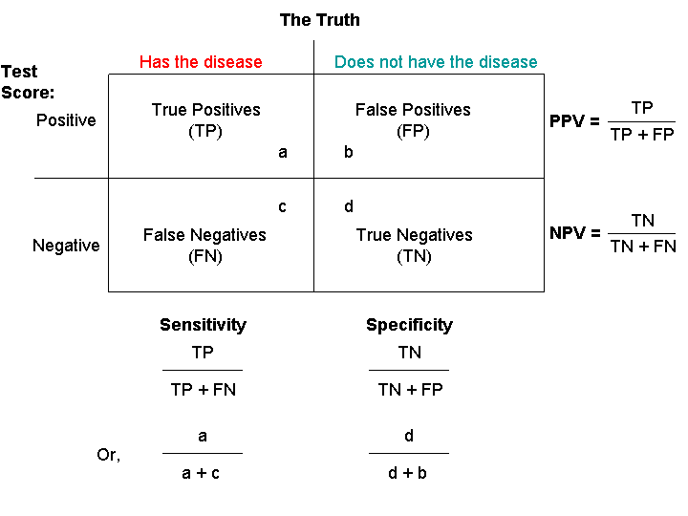
Statistical Measures
Confusion Matrix
Sensitivity
Specificity

Slide 4
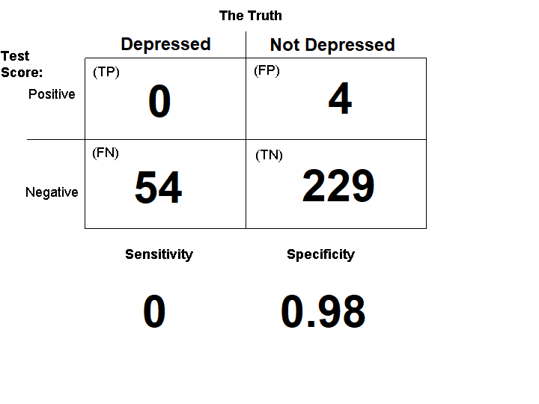
Logistic Regression
Simple
Coefficients
Odds Ratio
Many Features are a challenge

Slide 5
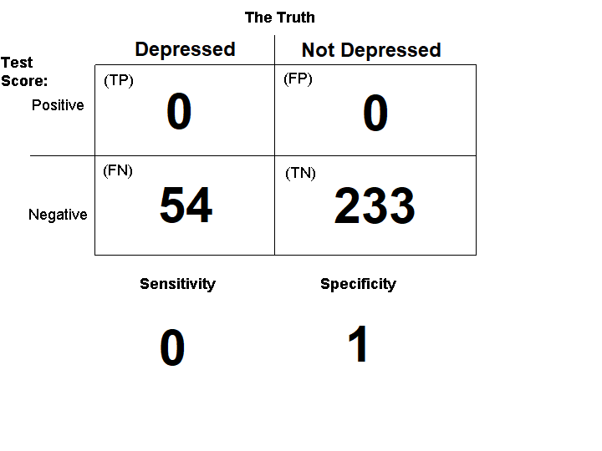
Support Vector Machine
Relatively Simple
Linear vs Nonlinear(polynomial kernel)
Largest hyperplane
Struggles with larger datasets

Slide 6
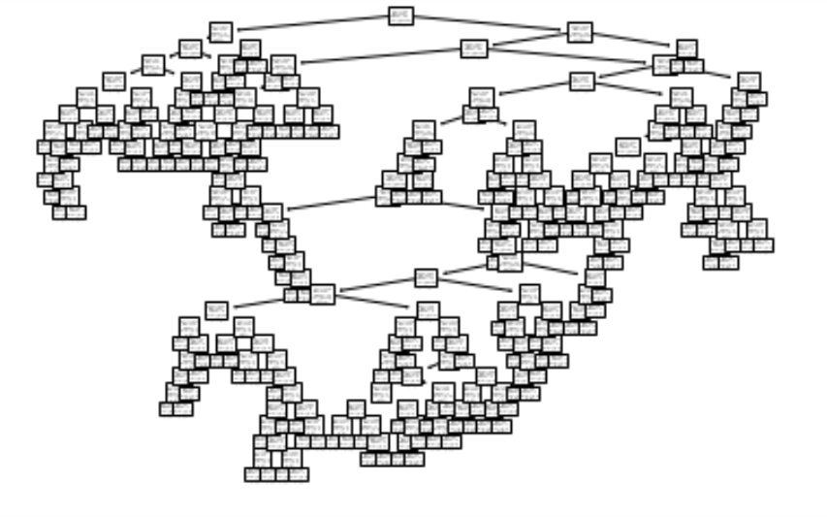
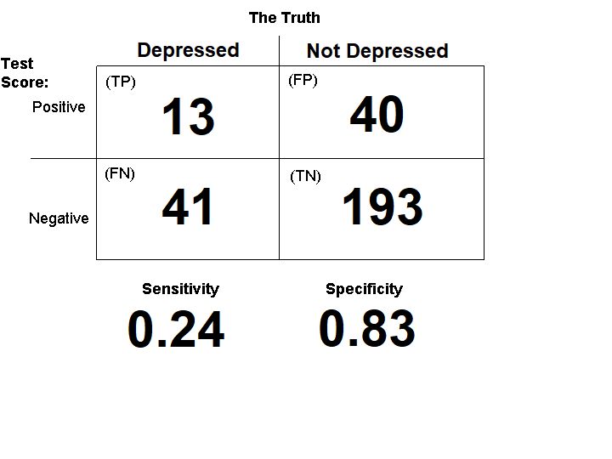
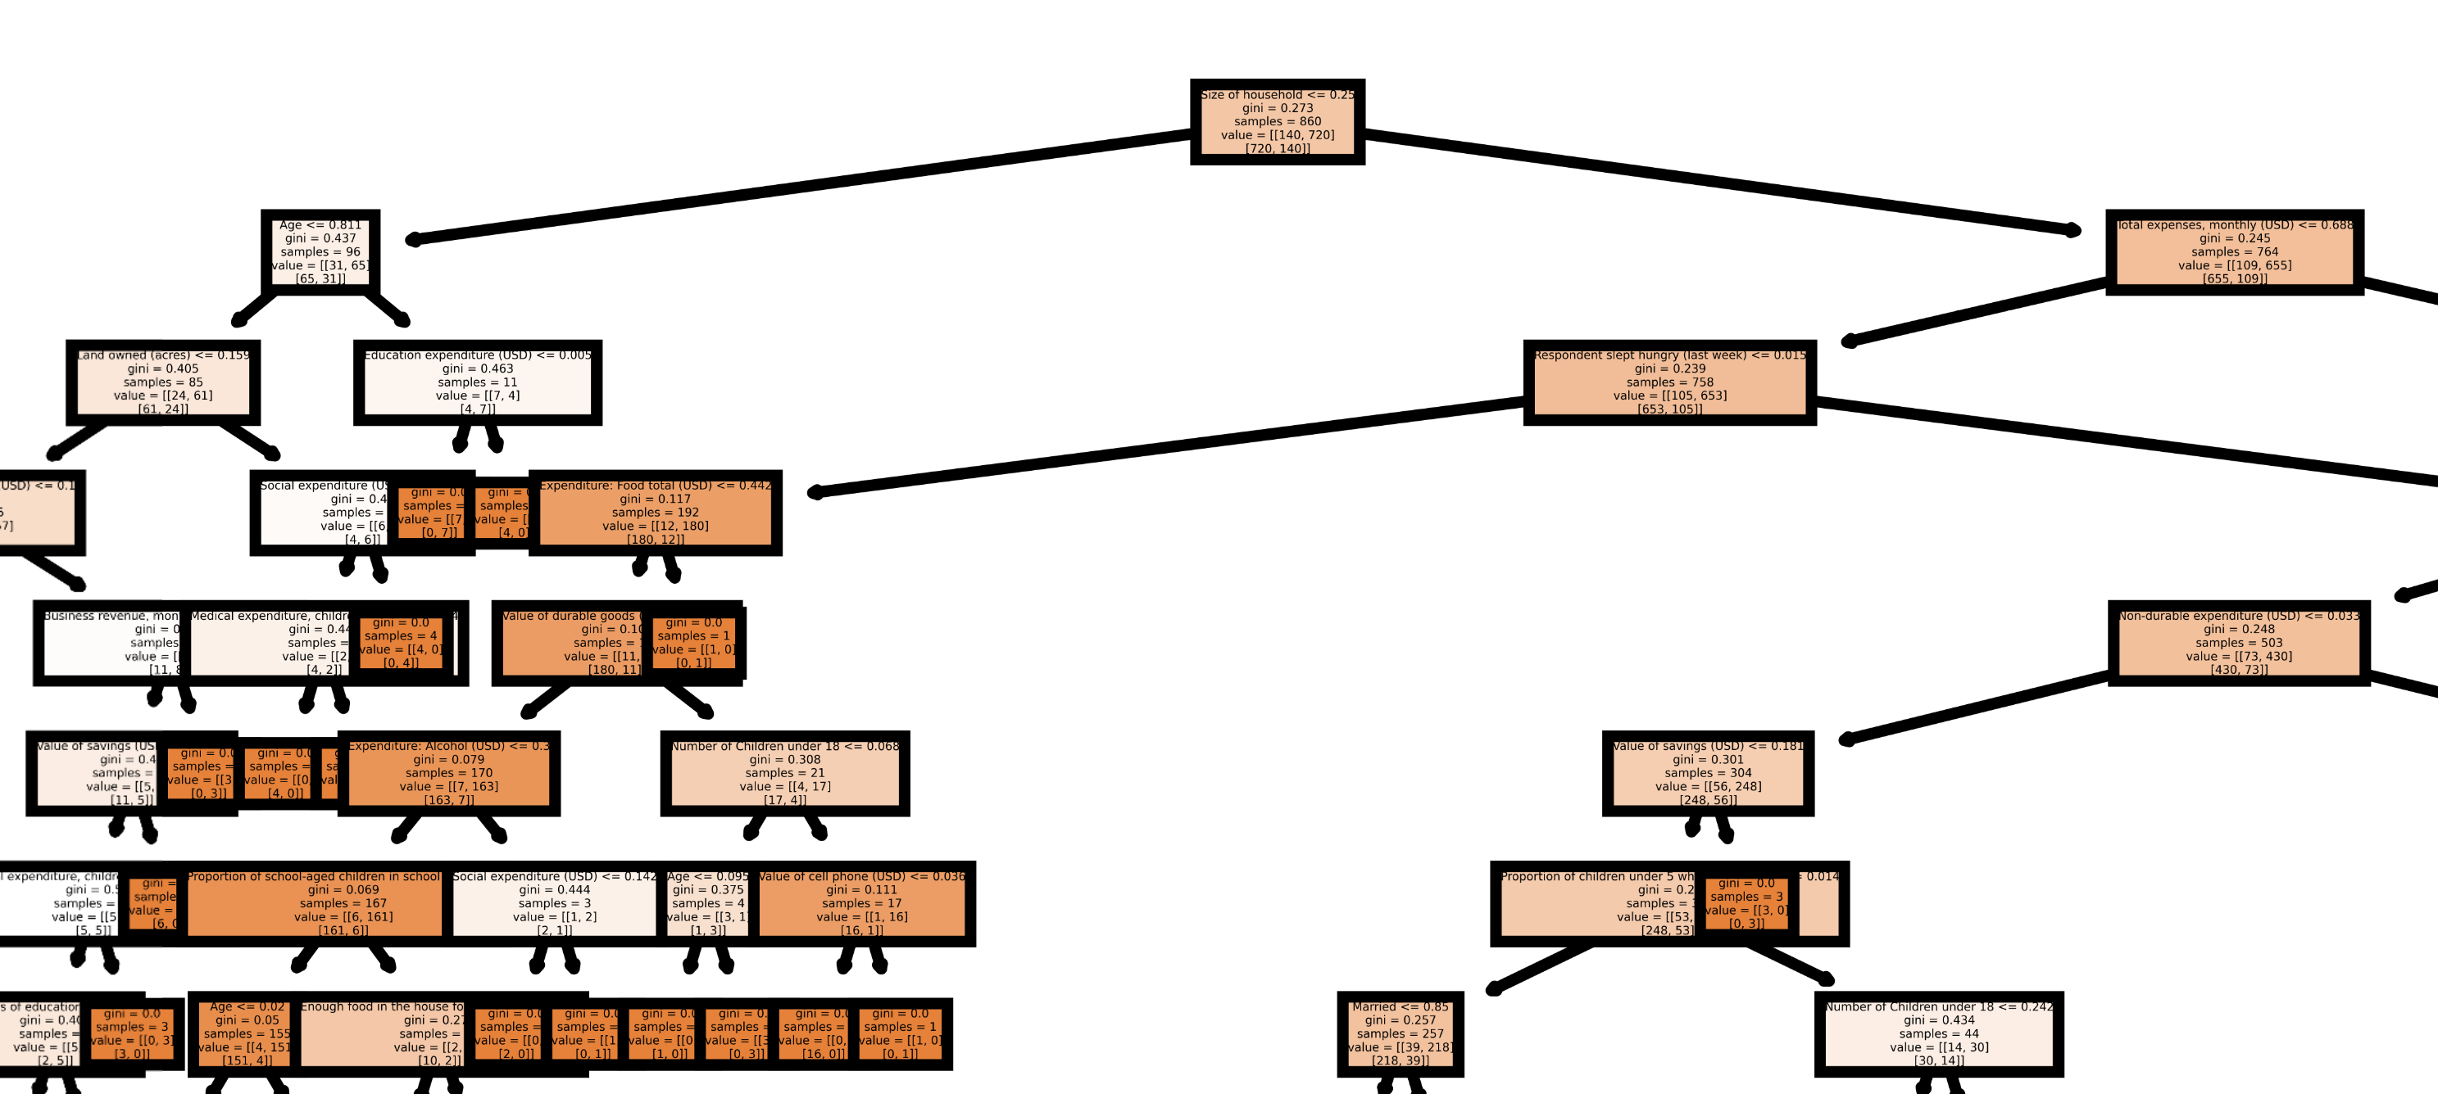
Decision Tree
Intuitive
Can handle many features

Slide 7
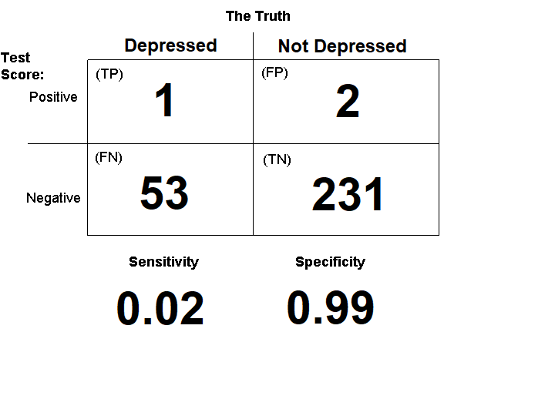
Random Forrest
Less likely to become overfit to data
Still intuitive

Slide 8
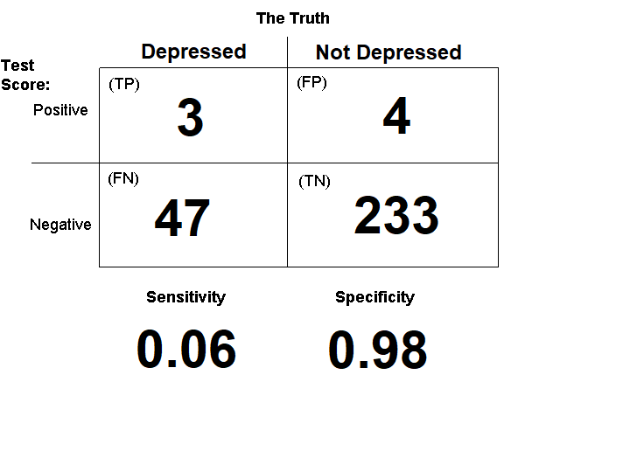
Neural Network
Can handle large datasets with multiple varriables
Deep
Two hidden layers

