Slide 1
Progress Indicator for Windows AND MAC !
First / Title Slide
Demo: This slide is Skipped
1s
This presentation contains useful hints on how to use the Progress Indicator (PI)! Read it!
PI was originally developed by Edgar Loper, modified by Adam Wilson but heavily extended and made working at all on MS-Office 2016 (2010 + 2013, 32bit and 64bit, MAC and Windows) by Olaf Nöhring.
Please drop me a line if you find this tool useful. You find my contact information on my website:
http://url.olaf-noehring.de/progressindicator

Slide 2

Demo: This slide is Skipped
2s
Please scroll through all slides to make yourself familiar with the Progress Indicator
Want to know what version you are using? Check out the HELP of the ribbon.

Slide 3
Want to play first?
Play
Explaination
one
last
final
You can start playing with the Progress Indicator right now (but I suggest reading this presentation first ... or at least afterwards)
Change to the Progress Indicator tab in the ribbon
Make changes
See the indicator and sections update immediately.
Hint: This is a demo presentation for development and testing purposes. For this reason we have tried to cover every possible angle here. (Use the checkboxes in the Ignore fiels as well.)

Slide 4
About this Presentation
Play
Explaination
one
last
final
In general you should know:
This presentation itself is a
  demo for the Progress Indicator
  documentation for the Progress Indicator
The different colors on the pages have some meaning:
  White: page is a very simple, regular page
  Orange: page has a skip comment
  Yellow: page is hidden from display in PowerPoint
  Greenish: The page is in a specially named section „PISectionnameHidden“

Slide 5

Indicator: Create Remove and Update
Play
Explaination
one
last
final
Create creates the indicator
Create also updates the indicator.
Usually every time you change something on the ribbon the indicators will be updated!
You can prevent from auto updating by Unchecking the Auto-Update. As Auto-Update redraws all indicators after every change you make, this might slow down your workflow – especially when working with large presentations.
Remove does that: It removes the indicators, but the settings will stay in your presentation. You can use the Create button later to apply the last settings and redraw the indicators.
Help opens a help window with some hints and tricks – and a link to my website ☺
Don‘t forget: If you change your presentation, add/delete/reorder slides/sections you probably want to update (press Create) the progress indicator!

Slide 6
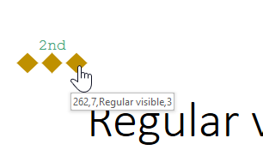
Understanding Hyperlinks
Play
Explaination
one
last
final
Each indicator is a link to that slide, so is the section title. Links work only when you start your presentation, but not in design view!
Clicking on the indicator will take you to the specific page
Clicking on the section title will take you to the first page of that section.
Windows version only (sorry Mac users): When you hover (mouse over) the indicator/section title you will see something like this:
262 is the ppt internal presentation unique ID which never changes (and is needed for the link to work)
7 is the slide number in your presentation "development" window
Regular visible is the slide title (is one exists, otherwise "-" will be shown)
3 is the slide with the third indicator

Slide 7

Shape Settings
Play
Explaination
one
last
final
Type of the indicator (196 predefined shapes to choose from, some common on top of the list)
Size of the indicator
Color for the indicator when a slide was already seen (Seen), is currently shown (Active) and not yet seen (Unseen)

Slide 8
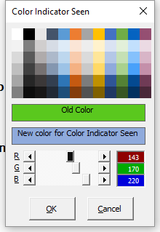
Color Chooser
Play
Explaination
one
last
final
When you click on a Choose Color button (indicator color, section title font color, section background; each seen/active/unseen) a color chooser will open.
The title of the window will let you know what color you are working on.
The color chooser allows to change the colors by
  choose from a set of colors. These colors are calculated each time from the current theme colors. This means, after changing your theme you can easily adjust the indicator colors to match!
  entering RGB values (0-255)
  change sliders for RGB

Slide 9
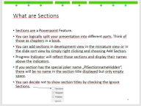

What are Sections
Play
Explaination
one
last
final
Sections are a Powerpoint Feature.
You can logically split your presentation into different parts. Think of those as chapters in a book.
You can add sections in development view in the miniature view or in the slide sort view by simply right clicking and choosing Add Section.
Progress Indicator will reflect those sections and display their names above the indicators.
If you section has the special joker name “PISectionnameHidden“, there will be no name in the section title displayed but only empty space.
You can decide not to show section titles by checking the Ignore Sections.
Sections without a slide will never be shown.
Starting in version 1.827 you can also have a section with the special name “PISectionHidden”. None of the pages in this section will get an indicator and/or section title. This makes it easily possible to have some backup slides which nobody notices but which are available in case you want to show them. Probably you want to place a section with this name at the end of your presentation. You can have more than one section with this name.

Slide 10
What are Sections
Play
Explaination
one
last
final
Sections are a Powerpoint Feature.
You can logically split your presentation into different parts. Think of those as chapters in a book.
You can add sections in development view in the miniature view or in the slide sort view by simply right clicking and choosing Add Section.
Progress Indicator will reflect those sections and display their names above the indicators.
If you section has the special joker name “PISectionnameHidden“, there will be no name in the section title displayed but only empty space.
You can decide not to show section titles by checking the Ignore Sections.
Sections without a slide will never be shown.
Starting in version 1.827 you can also have a section with the special name “PISectionHidden”. None of the pages in this section will get an indicator and/or section title. This makes it easily possible to have some backup slides which nobody notices but which are available in case you want to show them. Probably you want to place a section with this name at the end of your presentation. You can have more than one section with this name.

Slide 11

Section Settings
Play
Explaination
one
last
final
Font (Arial, Calibri…)
Fontsize
Color for the Title when a slide was already seen (Seen) , currently shown (Active) and not yet seen (Unseen)
Color for the background of the titles when a slide was already seen (Seen), currently shown (Active) and not yet seen (Unseen)
The option to use the background color or not (which would show the background color of your slide)
Checking „Below“ will place the sectiontitles below the indicator shapes.

Slide 12
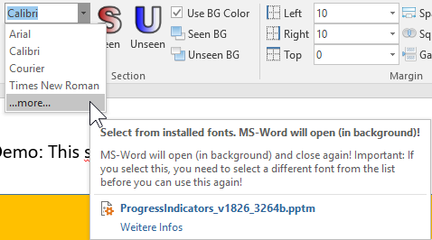
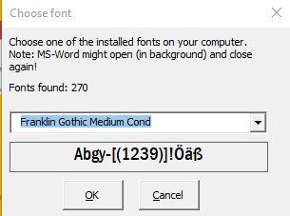
Section Settings – Font-Chooser
Play
Explaination
one
last
final
You can choose from all installed fonts!
Press the „…more…“ and the font-chooser will open.
Hint: MS Word might open in the background (and close again)
Please note: If you choose "...more..." and want to choose another font from the list afterwards again, you need to choose one of the other fonts in the list first.

Slide 13

Margin, Space, Squeeze and Gap
Play
Explaination
one
last
final
Left and right margins for the indicators / sections
  if 0 the section titles will start on the left and end on the right side
  Negativ values are possible!
Top defines space to the top of the page.
  A very large value will place the indicators / sections on the bottom of your presentation
  Negativ values are possible!
Space defines space between different section (titles)
Squeeze (also Spread) influences the space between the indicators in each section.
  Large negative values result in funny effects (try once!)#
Gap is the vertical space between the section titles and the indicators
Please note: You can enter values by hand. We noticed, that on MAC the values you enter will be used, but not displayed in the ribbon correctly (MAC only displays values that are present in the dropdown list).

Slide 14

What are Skipped-Slides
Play
Explaination
one
last
final
You can use the ribbon (area Slide) to Skip (and Unskip) a page.
By clicking the Skip button the slide will get a specific comment.
The tool evaluated if a comment like this is present, if so Skipped slides will usually not get an indicator (but are displayed when you start your presentation).
You can remove the comment either by using the Unskip button or by simply removing the comment by hand.
You can choose to ignore the Skiped comments.
Checking Ignore Skipped will place indicators on your Skipped paged as well.

Slide 15
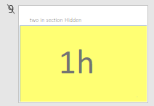

What are Hidden Slides
Play
Explaination
one
last
final
It‘s a basic PowerPoint feature, that you can hide slides from being seen when you start your presentation.
Hidden slides are represented in development view with their number striketrough like this:
Hidden slides do not get progress indicators by default.
If you want to put progress indicators also on hidden slides, you need to UNcheck Ignore Hidden

Slide 16
Demo: Slide is Hidden
h

Slide 17
Demo: This slide is Skipped
s

Slide 18
Demo: Skipped Slide in section: PISectionnameHidden
This slide is in a section with the name „PISectionnameHidden“. The sectionname will be displayed empty!
Sectionnames can be used more than once!
1st secH
skipped

Slide 19
Demo: Two in sect. Hidden (#1)
1h

Slide 20
Demo: Two in sect. Hidden (#2)
2h

Slide 21
Demo: Two in section Skipped (#1)
1s

Slide 22
Demo: Two in section Skipped (#2)
2s

Slide 23
Demo: Two in sect. Hidden AND Skipped (#1)
H+S

Slide 24
Demo: Two in sect. Hidden AND Skipped (#2)
H+S

Slide 25
I am so lonely
Play
Explaination
one
last
final
For demonstration this is a regular slide, but the only one in the section.

Slide 26
Special section names: PISectionnameHidden
Play
Explaination
one
last
final
This slide is in a section with the name „PISectionnameHidden“.
„PISectionnameHidden“ is a joker which will make the sectionname be displayed empty!
Sectionnames can be used more than once!
Maybe we (deveoplers) decide to change „PISectionnameHidden“ to something else: Just look in the HELP of the ribbon where the actual name is always displayed.
2nd secH

Slide 27
Play
Explaination
one
last
final
For demonstration purposes this slide does not have a title

Slide 28
Demo: 3 slides in section x-HI-x Hidden AND Skipped
H+S

Slide 29
PISectionHidden inner 1
Some backup slide in the middle of your presentation.
None of the slides in the section with the name „PISectionHidden“ will get an indicator and / or section titles!

Slide 30
PISectionHidden inner 2

Slide 31
Regular visible, last slide
Play
Explaination
one
last
final
This slide has a regular comment which is independent from the skip-comment
Have you droped me a line yet? You find my contact information on my website:
http://url.olaf-noehring.de/progressindicator

Slide 32
This slide will be ignored because of the Section Title „ PISectionHidden“
Some backup slides at the end of your presentation

Slide 33
This slide will be ignored because of the Section Title „ PISectionHidden“

Slide 34
This slide will be ignored because of the Section Title „ PISectionHidden“
Some backup slides at the end of your presentation

Slide 35
This slide will be ignored because of the Section Title „ PISectionHidden“

Slide 36
This slide will be ignored because of the Section Title „ PISectionHidden“
Some backup slides at the end of your presentation

Slide 37
This slide will be ignored because of the Section Title „ PISectionHidden“

Slide 38
This slide will be ignored because of the Section Title „ PISectionHidden“
Some backup slides at the end of your presentation

Slide 39
This slide will be ignored because of the Section Title „ PISectionHidden“

