Slide 1

ME-366: Electro-Mechanical System Design
Project Update
Week – 05
Group – A7

Slide 2
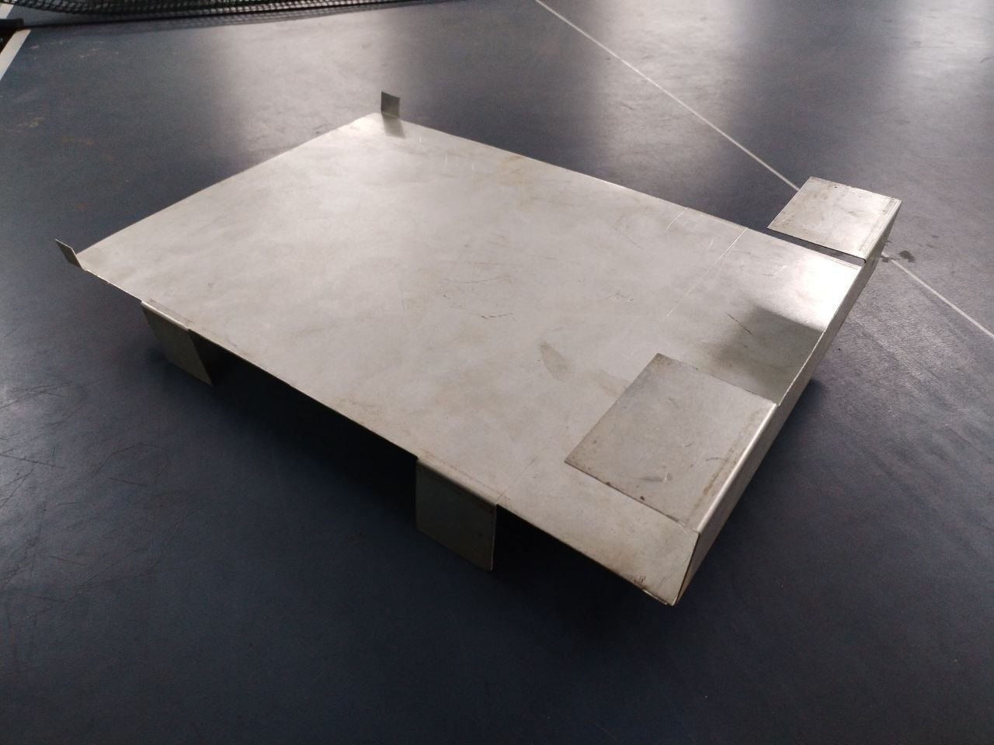
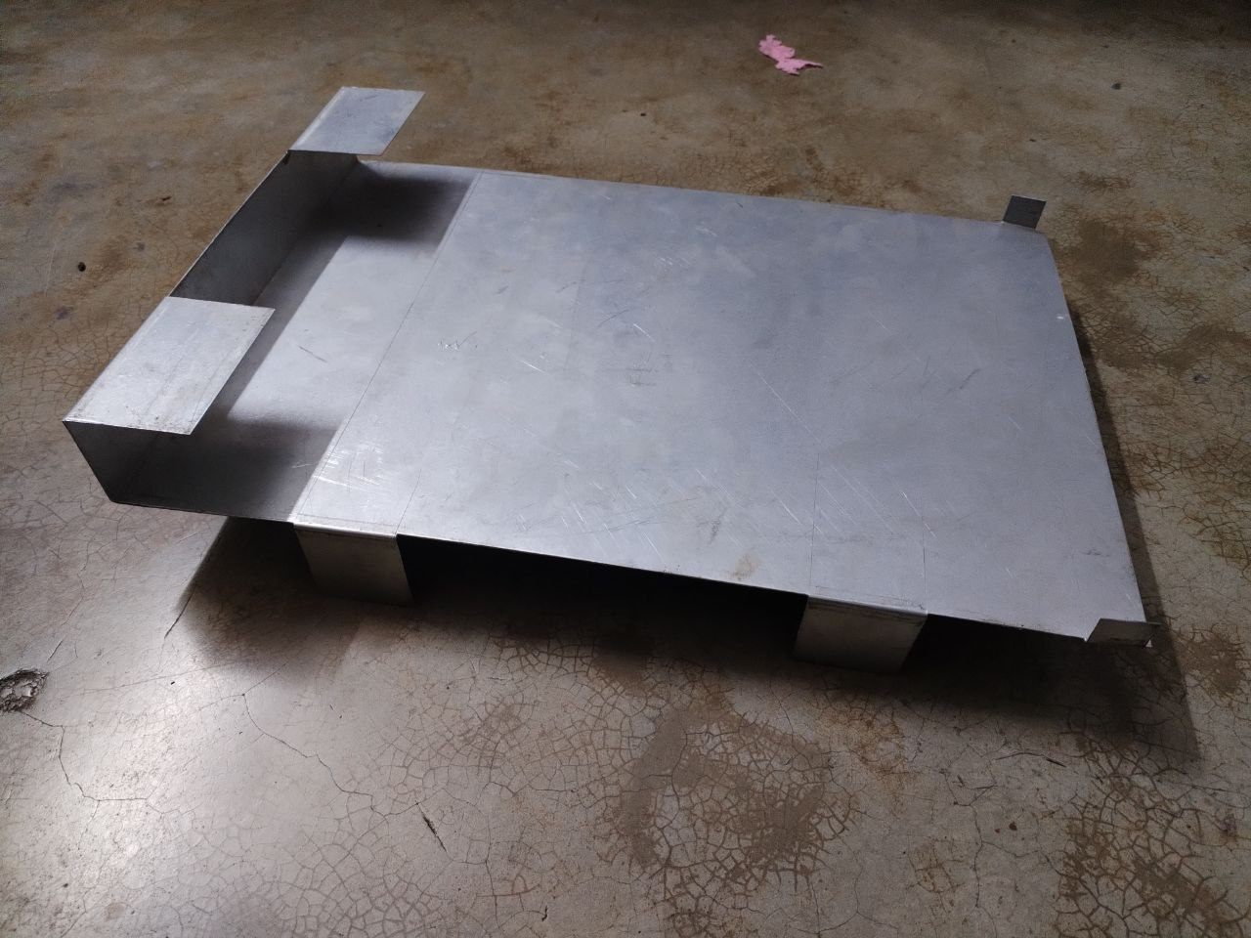
Making the Chassis by Sheet Metal
Dimensions
length = 435 mm
Width= 300 mm
PART 01
Chassis
Sheet Metal thickness = 0.75mm

Slide 3
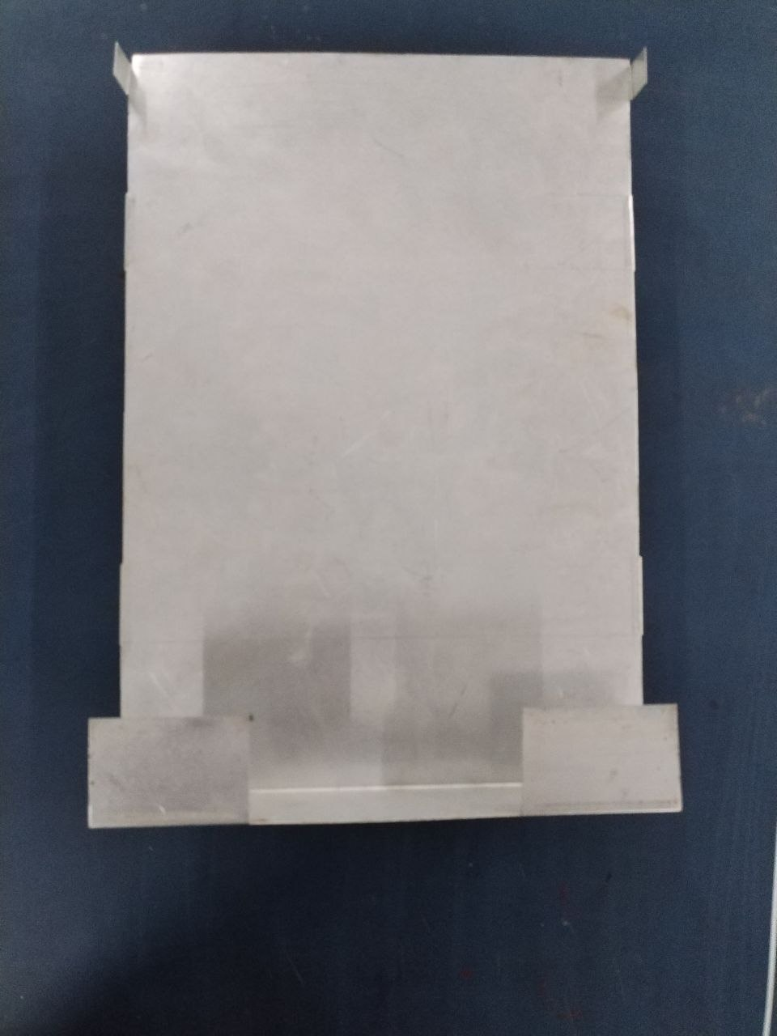
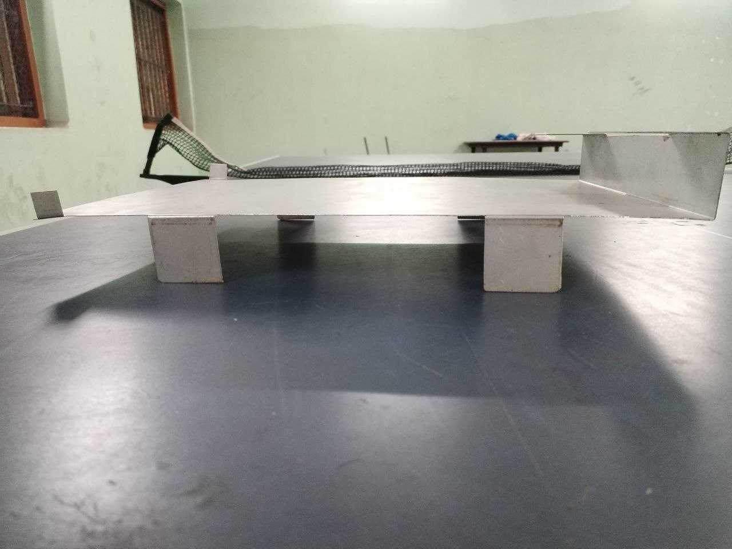
Making the Chassis by Sheet Metal
TOP VIEW
Motor and wheel
PART 02
Chassis
Arm mount will fit here
SIDE VIEW

Slide 4
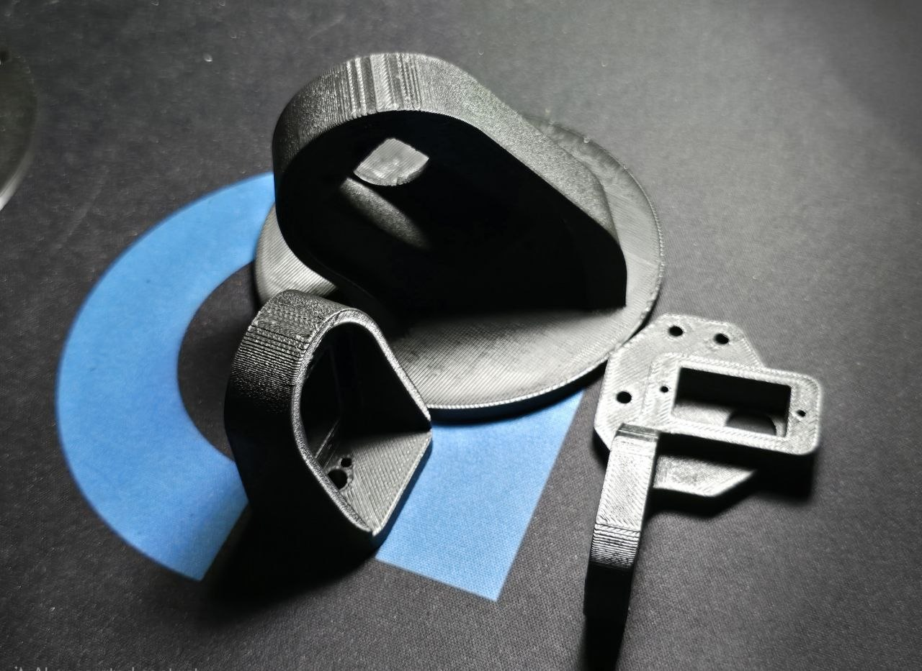
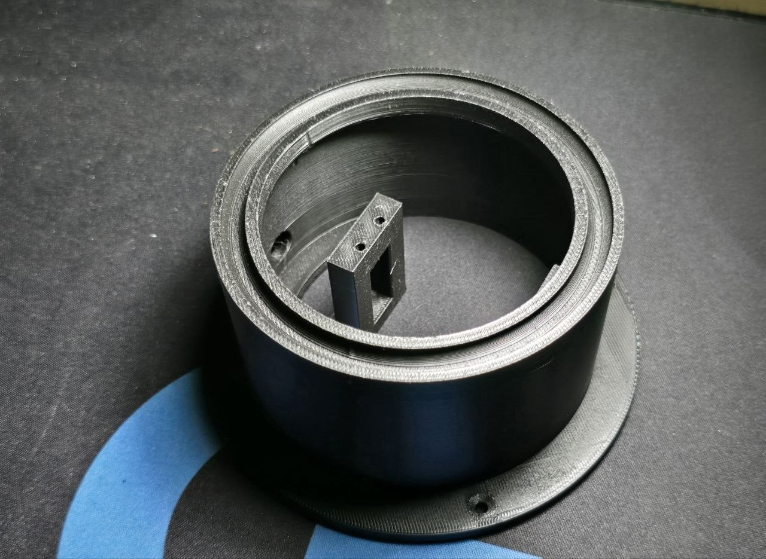
Making the Arm by 3D printing
Advantages of 3D Printing the Arm :
Lightweight — plastic is far lighter than metal, reducing the load the motors/servos have to carry and lowering overall system weight.
Design flexibility — complex shapes, curves, and internal features
.
PART 03
ARM
Adjustable strength-to-weight ratio — infill density can be to balance strength and weight exactly where needed
Easy and fast to fabricate — no cutting, welding, or specialized tooling needed; just print, remove supports, and it's ready.

Slide 5
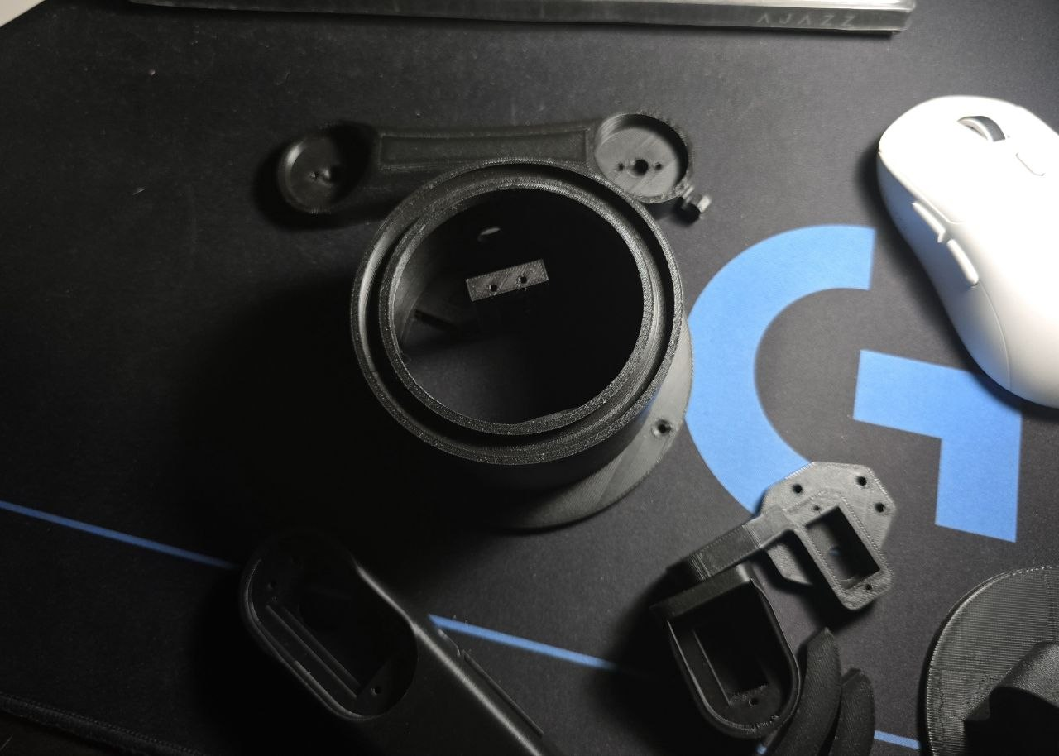
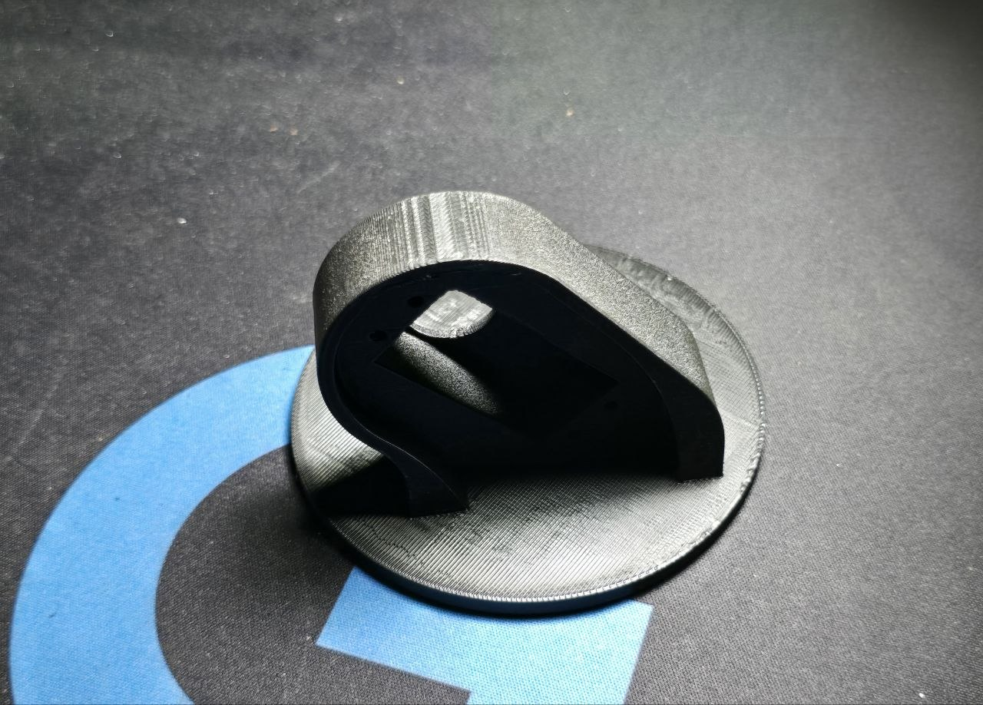
Making the Arm by 3D printing
Total mass of the arm is about 218 gm
PART 04
ARM

Slide 6
Motor details
MG995 Servo Motor
Specification | Value
Type | Analog RC servo, metal gear
Operating voltage | 4.8 V – 7.2 V
Stall torque | 9.4 kg·cm @ 4.8 V, 11 kg·cm @ 6 V
Operating speed | 0.20 s/60° @ 4.8 V, 0.16 s/60° @ 6 V
Rotation angle | ~180° (some variants 360°)
No-load current | 170 mA
Stall current | ~1.2 A
Weight | 55 g
Dimensions | 40.7 × 19.7 × 42.9 mm
Control signal | PWM, 50 Hz, 600–2400 µs pulse
PART 05
Motor

Slide 7
Motor details
TD-8120MG Servo Motor
Specification | Value
Type | Digital RC servo, metal gear
Operating voltage | 4.8 V – 7.2 V
Stall torque | 20.5 kg·cm @ 4.8 V, 22.8 kg·cm @ 7.2 V
No-load speed | 0.18 s/60° @ 4.8 V, 0.14 s/60° @ 7.2 V
Rotation angle | 180° / 270° / 360° (variant-dependent)
Stall current | 2.1 A @ 4.8 V, 2.7 A @ 7.2 V
Weight | 56 g
Dimensions | 40.0 × 20.5 × 40.5 mm
Control signal | PWM, 500–2500 µs, 1500 µs neutral
PART 06
Motor

Slide 8
Motor details
JGB37-550 DC Gear Motor
Specification | Value
Type | Brushed DC motor + metal spur gearbox
Operating voltage | 6 V – 12 V (rated 12 V)
No-load speed | ≈282–300 RPM @ 12 V (nearest catalog step)
Gear ratio | ≈1:20 (interpolated for this speed step)
Rated torque | ≈5–6 kg·cm @ 12 V (interpolated — confirm with your supplier's datasheet)
No-load current | 1.1 A @ 12 V
Stall current | ~20 A @ 12 V
Shaft diameter | 6 mm, D-shaped
Weight | ~300 g
PART 07
Motor

Slide 9
Problems we faced:-
1.Difficulty in selecting the appropriate sheet metal thickness.
2.Maintaining dimensional accuracy during fabrication.
3.Ensuring proper alignment of chassis components.
4.Communication and coordination issues with the fabrication engineers at Patuatuli.
5.Delays due to heavy traffic while traveling to and from the workshop.
6.Multiple design modifications during the fabrication process.
7.Time constraints caused by repeated adjustments and rework.
8.Limited availability of suitable materials and fabrication resources.
PART 08
Difficulties

Slide 10

THANK YOU
This is all Project Update
For Week – 05

