Slide 1
Predicting Yellow and Red Cards in Football
Nur Amira Johari | BPSN2 | 22130975

Slide 2
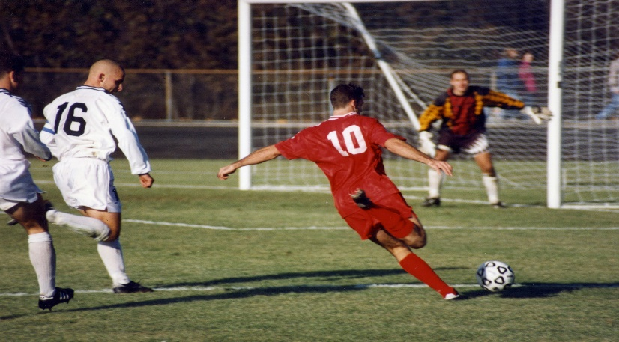
Background of Study
Football, or soccer, is a highly popular global sport with significant revenue and millions of fans.
Player behavior and relationships in football go beyond physical abilities.
The issuance of yellow and red cards by match officials is a crucial aspect of the game.
Predicting when and why disciplinary sanctions are applied is essential for teams, players, and fans.
This research focuses on football analytics and predictive modeling to forecast card issuance.

Slide 3
Significance and Research Objectives
This research contributes to the field of sports analytics and data-driven decision-making.
Acknowledges the impact of COVID-19 on football dynamics, which affected match suspensions and attendance.
Main goal: Construct robust predictive models for yellow and red card issuance during football matches.
Utilizes Poisson regression and negative binomial regression for analysis.
Key dataset features include country, competition level, kick-off time, referee details, bookmaker odds, attendance, and referee experience.
Aims to identify factors influencing card issuance and enhance understanding of refereeing decisions in football.

Slide 4
Literature Review
Related Studies on Football Data
Related Studies on Modelling Football Data
Divos (2020): Applied financial mathematics and machine learning to model in-play football betting.
Decroos et al. (2019): Emphasized player actions beyond goals to predict match outcomes.
Peña et al. (2012): Investigated factors influencing yellow and red card issuance and potential biases in referee decisions.
Kovalchik et al. (2016): Explored factors associated with yellow card accumulation using machine learning.
Clarke & Norman (2019): Explored the integration of data science in football analytics.
Borland & MacDonald (2020): Examined the impact of COVID-19 on football dynamics, especially fan absence.
Fernandez-Corugedo & McMahon (2021): Studied the economic implications of COVID-19 on the football player market.
Karlis & Ntzoufras (2003): Introduced bivariate Poisson models to analyze joint goal distributions in football matches.
Dixon & Coles (1997): Modeled association football scores using Poisson regression to identify market inefficiencies.
Mohan & Samuelsen (2017): Utilized negative binomial regression to model goals scored by a single team, addressing overdispersion.
Islam et al. (2020): Applied negative binomial regression to study factors influencing antenatal care visits in healthcare.
Baio & Blangiardo (2010): Developed a Bayesian hierarchical model for probabilistic football match outcome predictions, considering team-specific attributes and temporal effects.

Slide 5
Methodology
Data
The dataset used, obtained from Smartodds, comprising football matches from various European leagues across seasons, countries, and competition levels.
Key variables in the dataset:
country: Designates match location.
competition_level: Classifies matches by competition level.
kick_off_datetime: Provides precise match time.
referee: Records the referee's name.
sup_implied, tg_implied: Implied odds for match outcomes and total goals based on Asian handicap.
team1_yc, team2_yc, team1_rc, team2_rc: Count of yellow and red cards for each team.
attendance_value: Quantifies match attendance.

Slide 6





Poisson Regression
Negative Binomial Regression
Probability mass function:
Probability mass function:
General equation:
General equation:

Slide 7




Akaike Information Criterion (AIC)
Root Mean Squared Error
(RMSE)
Bayesian Information Criterion (BIC)
Mean Absolute Error (MAE)

Slide 8
Data Exploration
Data Quality Assessment
Duplicate Data Detection
Missing Data Analysis
Unique Values of Categorical Variables
Data Transformation and Imputation
Missing Data Imputation
Data Transformation

Slide 9
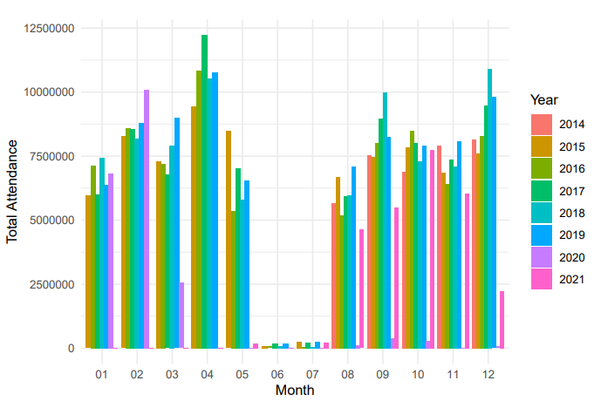
Results and Discussion
Dataset analysis revealed a significant drop in attendance due to COVID-19 in April 2020.
Dataset divided into pre-COVID (20879 observations) and COVID era (6376 observations).
Pre-COVID dataset split: 70% training, 30% validation for predictive models.

Slide 10

Modeling Yellow Cards
Poisson Regression
Negative Binomial Regression
Initial predictors: country, competition level, implied support, implied target goals, attendance, kick-off time, matches, referee group.
AIC-based model: More predictors selected.
BIC-based model: Simpler model with fewer predictors.
Both models showed similar predictive accuracy
Same predictors as Poisson models.
AIC-based model retained all predictors.
BIC-based model was more parsimonious, excluding competition level.
Both models demonstrated nearly identical predictive performance.

Slide 11

Modeling Red Cards
Poisson Regression
Negative Binomial Regression
Initial predictors: country, competition level, implied target goals, kick-off time.
AIC-based model included all predictors.
BIC-based model excluded competition level.
Both models demonstrated nearly identical predictive accuracy.
Same predictors as Poisson models.
AIC-based model retained all predictors.
BIC-based model was more parsimonious, excluding competition level.
Both models showed consistent predictive performance.

Slide 12

Testing Models on Yellow and Red Cards During COVID-19
Used previously trained Poisson and negative binomial regression models.
Surprisingly, RMSE and MAE metrics were consistent with pre-COVID models.
Suggests factors like country, implied target goals, and kick-off time had similar impacts during the pandemic.
AIC and BIC-based models produced nearly identical results, indicating model robustness.
Similar to yellow cards, red card prediction models showed consistent performance during the COVID-19 period.
RMSE and MAE metrics remained stable, emphasizing the significance of core predictors.
Both AIC and BIC-based models delivered similar accuracy, showcasing their adaptability.

Slide 13
Conclusion

Slide 14
Limitation and Suggestion
Future research areas:
Inclusion of player-specific data.
Exploration of referee-specific data.
Adoption of advanced machine learning techniques.
Real-time data integration.
Consideration of contextual factors.
Analysis of the impact of external events.
Validation across different football leagues and competitions.

Slide 15

Thank you!

