Slide 1
Employee Attrition
By:
Nuranisda Triawati

Slide 2
OUTLINE
1
Data Background
Machine Learning Model
2
3
Data Preprocessing and Analysis
Conclusion and Recommendation
4

Slide 3
01
Data Background

Slide 4
Business Understanding
Problem Statement
A large company named XYZ, employs, at any given point of time, around 4000 employees. However, every year, around 15% of its employees leave the company and need to be replaced with the talent pool available in the job market. The management believes that this level of attrition (employees leaving, either on their own or because they got fired) is bad for the company, because of the following reasons:
The former employees’ projects get delayed, which makes it difficult to meet timelines, resulting in a reputation loss among consumers and partners
A sizeable department has to be maintained, for the purposes of recruiting new talent
More often than not, the new employees have to be trained for the job and/or given time to acclimatise themselves to the company

Slide 5
Business Understanding
Goal of the case study
Develop a machine learning model to predict employee attrition
Find out the important feature
Giving recommendation to prevent employee attrition

Slide 6
Dataset
There are 5 Dataset for this project:
General Data -> This Dataset contains employee general work related details
Manager Survey Data -> This Dataset contains the details of survey given by the manager of every employee
Employee Survey Data -> (It contains the details of survey given by employee
In time -> This dataset contains the office entry time for the year 2015
Out time -> This dataset contains the office exit time for the year 2015

Slide 7
Data Preprocessing
and Analysis
02

Slide 8
Data Preprocessing
Dataset | Feature | Rows
General Data | 24 | 4410
Manager Survey Data | 3
Employee Survey Data | 4
In Time | 262
Out Time | 262
Dataset | Feature | Rows
General Data | 24 | 4410
Manager Survey Data | 3
Employee Survey Data | 4
Mean Time | 2
Processing the in_time and out_time datasets to get the average working hours
Dataset
In Time
Dataset
Out Time
Mean time
Dataset | Feature | Rows
Mean Time | 2 | 4410

Slide 9



4410 rows
Merge all dataset
30 features
1 target

Slide 10
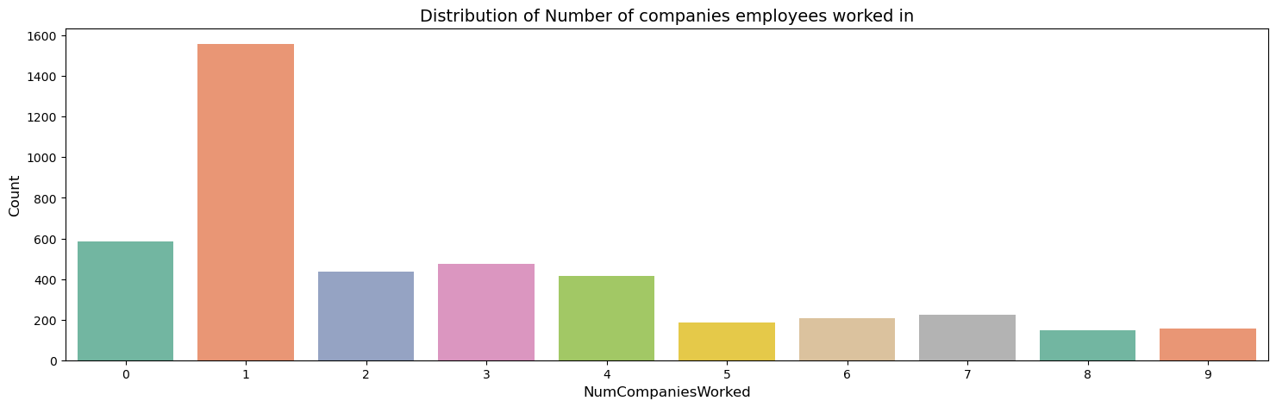
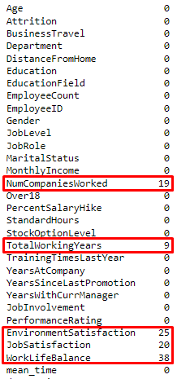
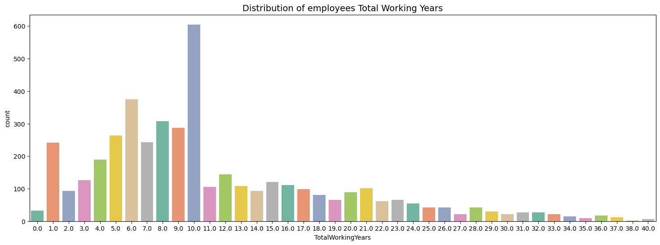
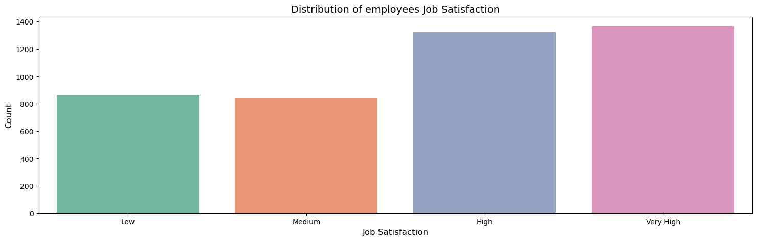
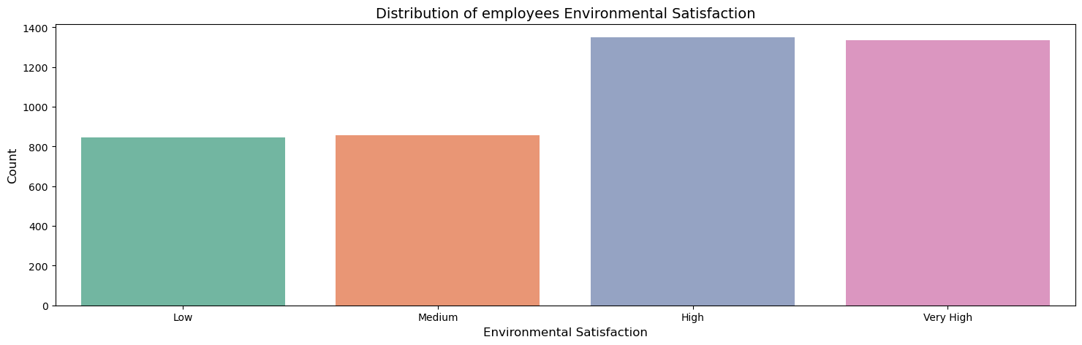
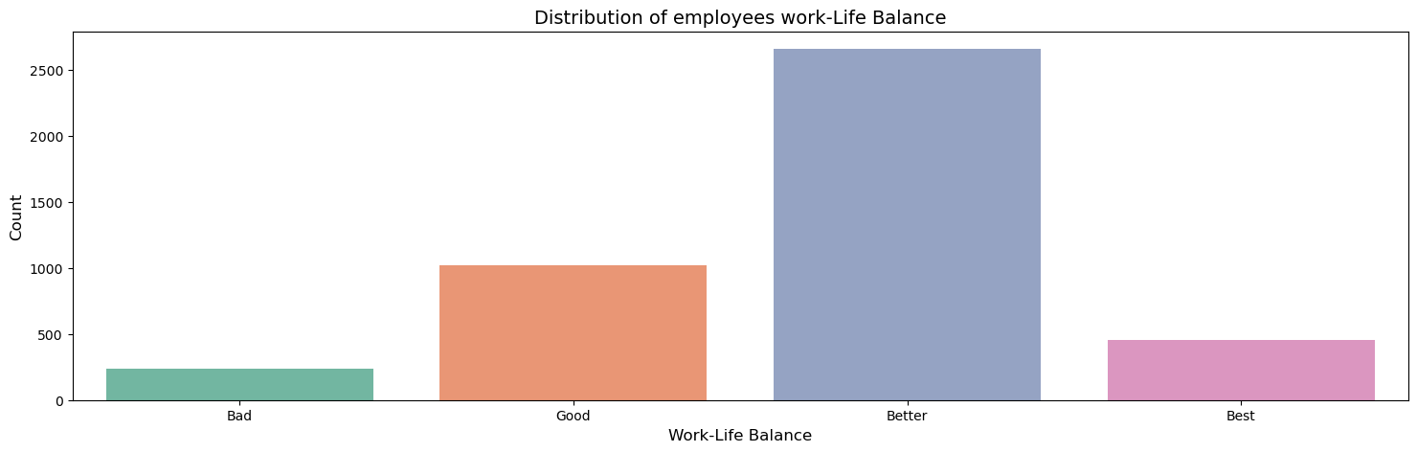
Handling Missing Value and Duplicated Data
Data handling: fill the ordinal data’s missing value with mode
Missing Value
There are no duplicate data in this dataset

Slide 11
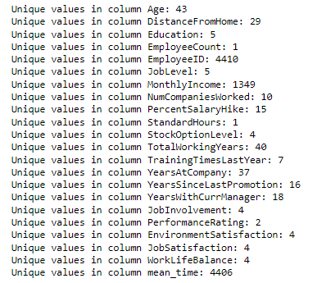
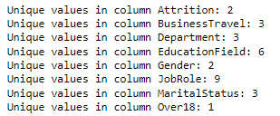
Drop un-used data columns
Drop: EmployeeID
Drop: EmployeeCount, StandardHours, anf Over18 columns (because only have 1 unique value)
4410 rows
26 features
1 target

Slide 12
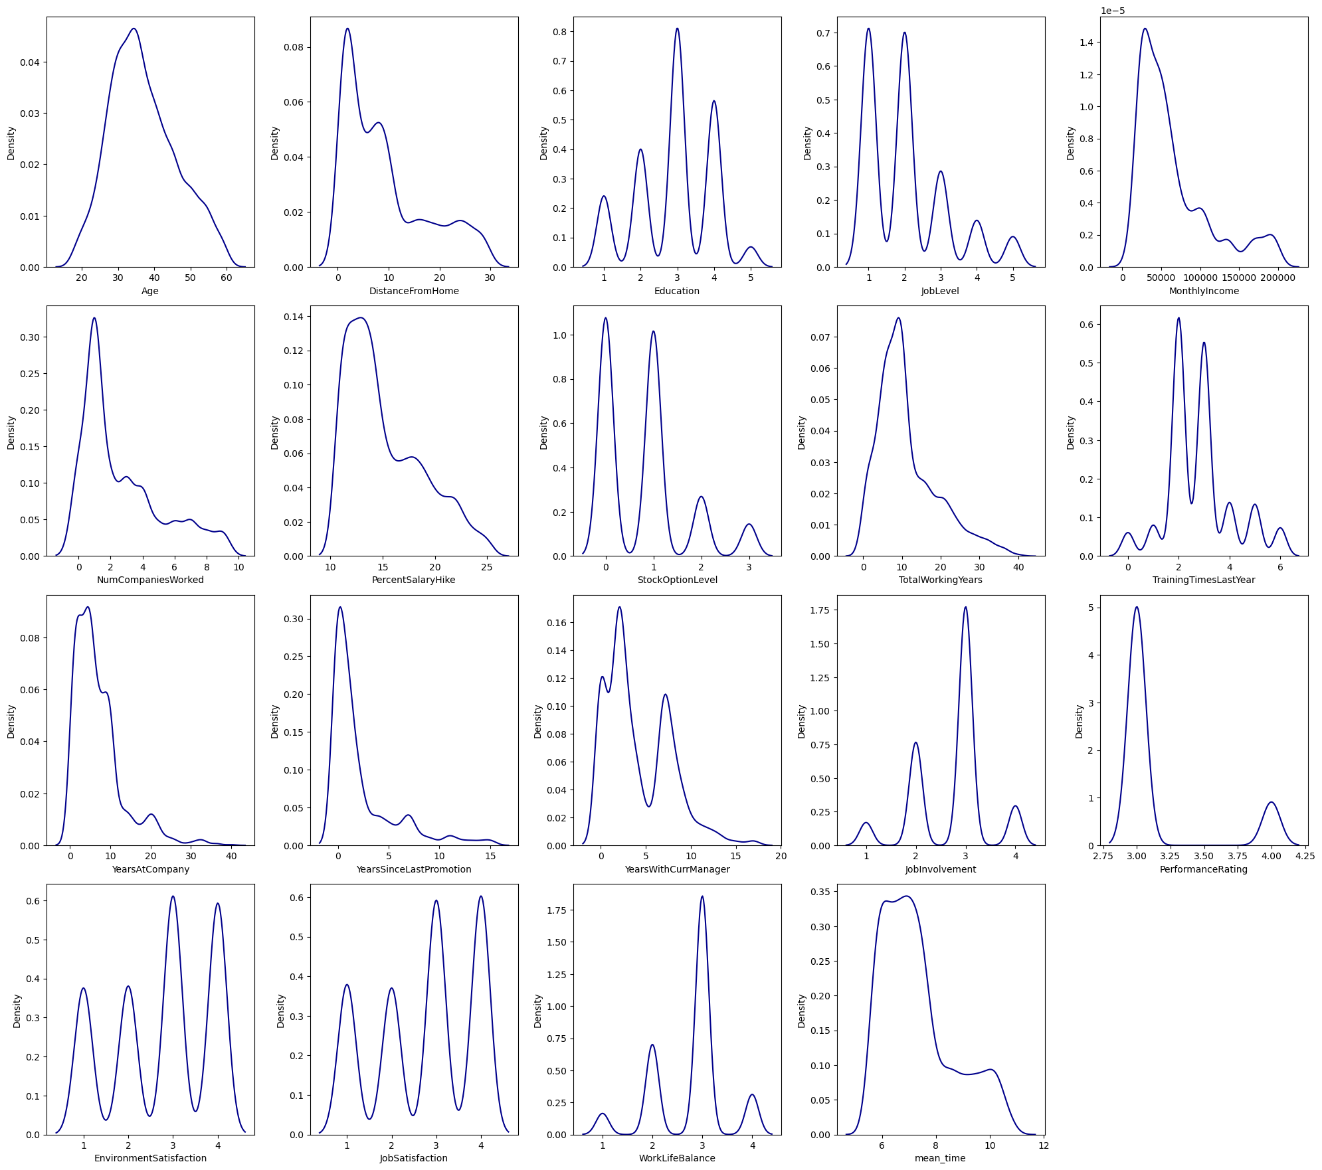
Data Analysis
Observation:
- We can ignore interpreting feature columns with limited discrete values such as Education, JobLevel, NumCompaniesWorked, StockOptionLevel, TrainingTimesLastYear,JobInvolvement, YearsSinceLastPromotion, YearsWithCurrManager, PerformanceRating, EnvironmentSatisfaction, JobSatisfaction, and WorkLifeBalance.
- Except age, most of the Columns are in Skew Distribistion form

Slide 13
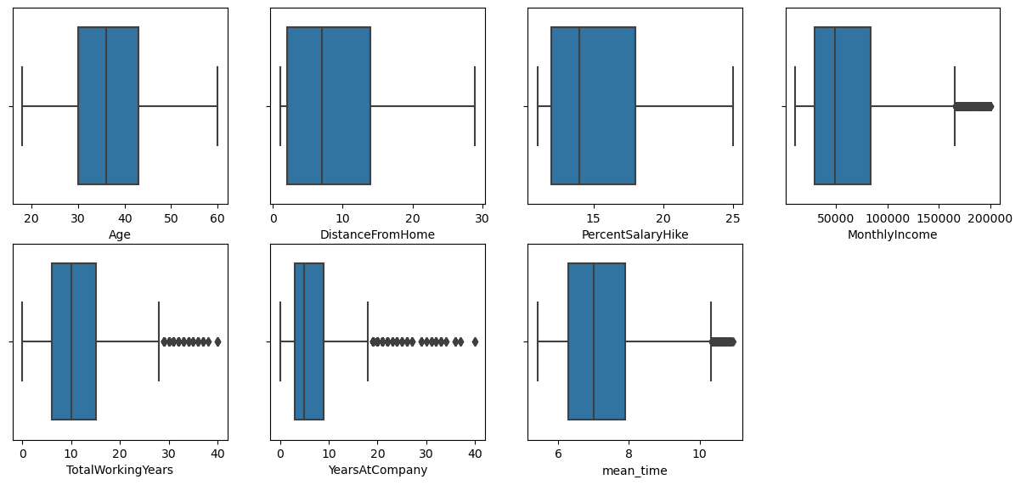
Data Analysis
Observation:
from BoxPlot ,Trying to find is there any outliers in Numerical columns:
can Observe outliers on MonthlyIncome , TotalWorkingYears, YearsAtCompany, and mean_time Columns
from observing on that columns can say those columns some of values not outliers. Because there is highly possibilites on occuring those numerical values on those features or columns

Slide 14
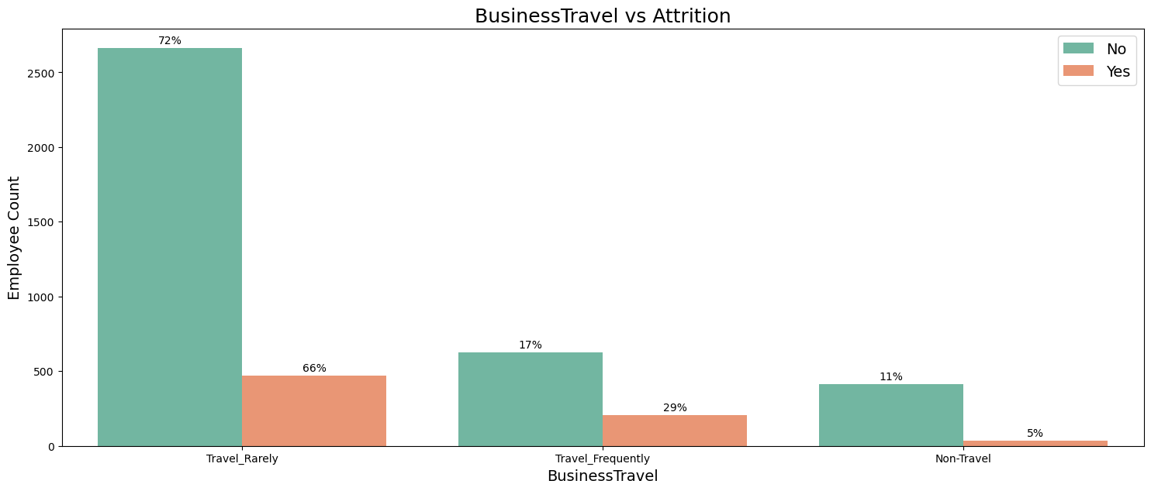
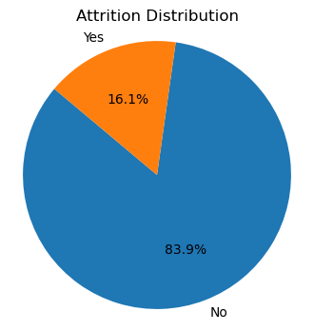
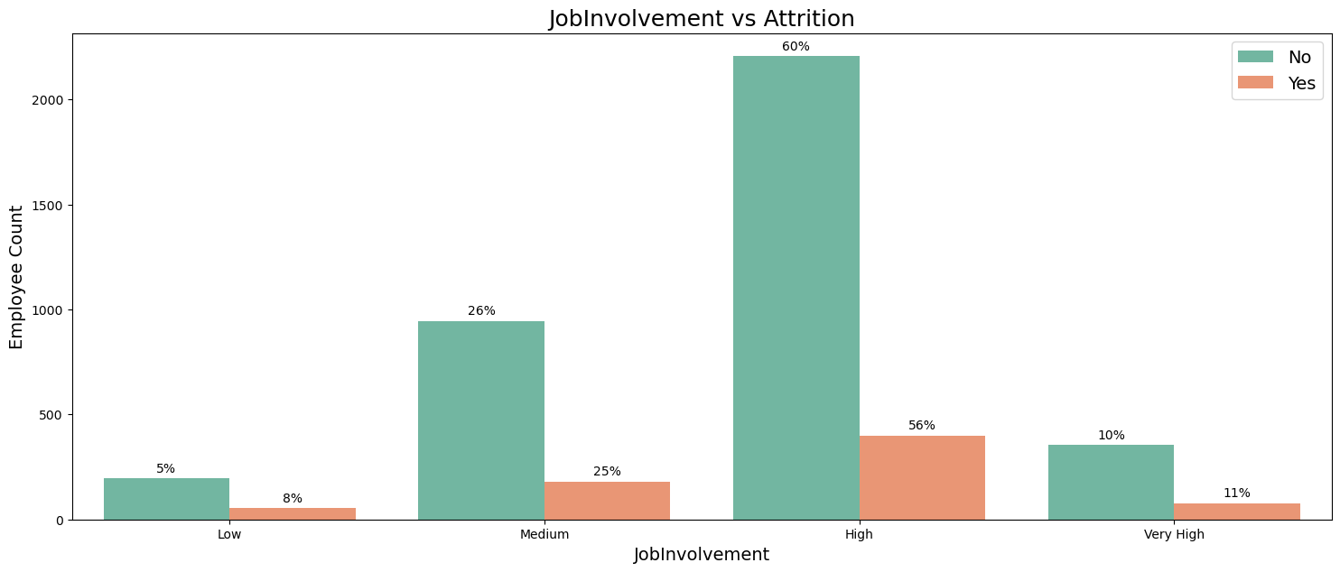
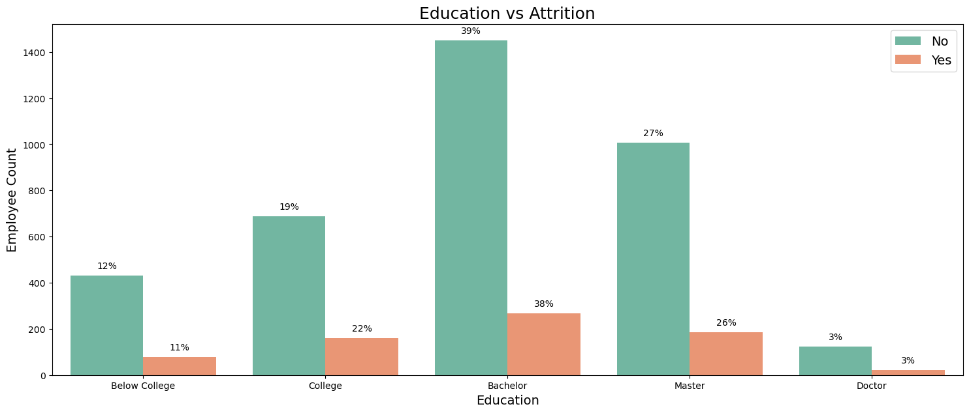
Data Analysis
Employees who travel rarely has maximum Attrition rate
Employees with high job involvement is have the tendency to attrition
The class ‘Attrition’ distribution is imbalance
Employees with Bachelor Education has maximum Attrition rate

Slide 15
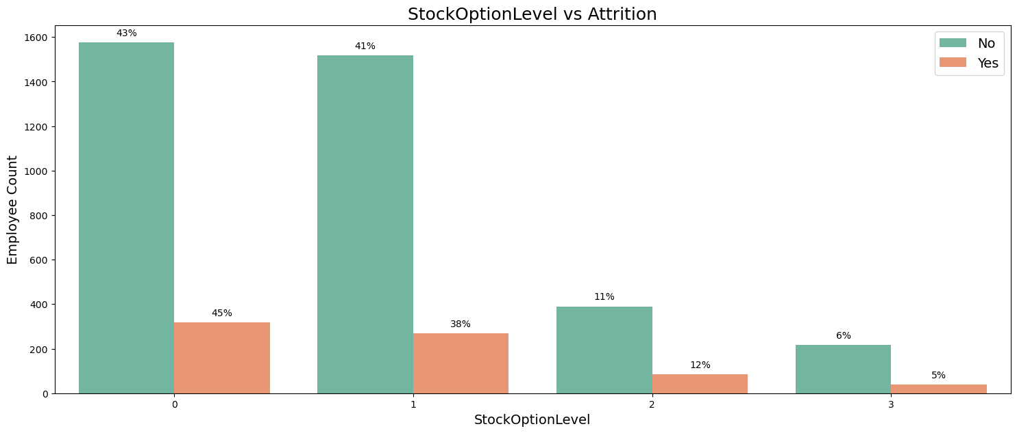
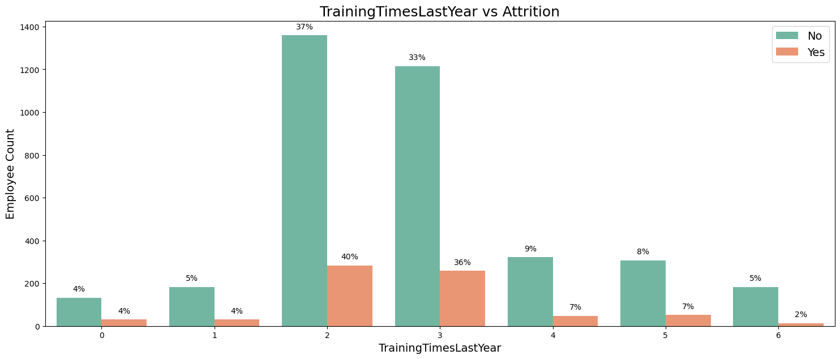
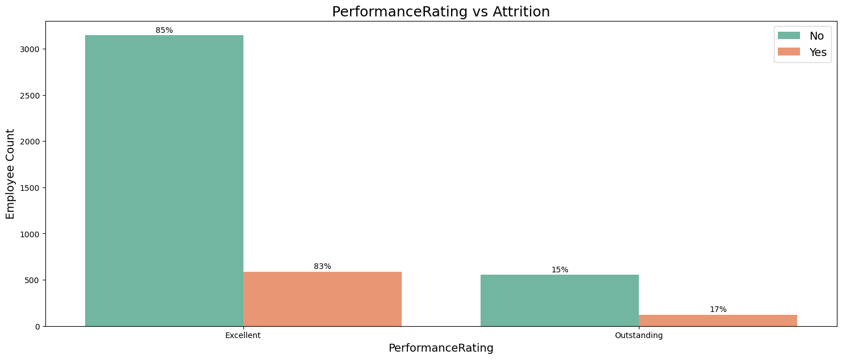
Data Analysis
Employees with lower stock option level has maximum Attrition rate
Low amount of training time in one year will give a tendency for someone to leave his job
Performance rating is not the main factor for someone to leave the company

Slide 16
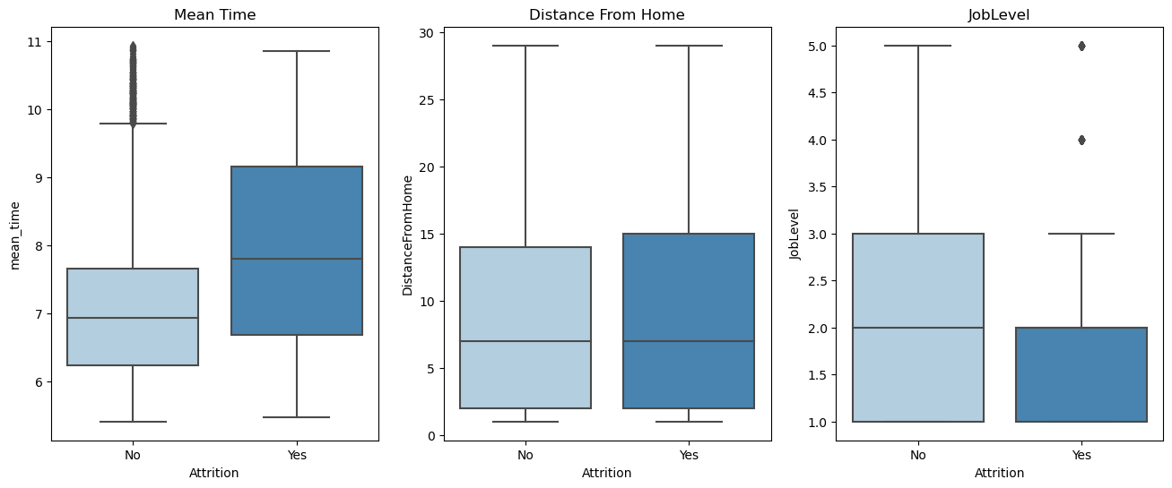
Data Analysis
Employees with high average working hours and greater distance from home have a tendency to experience attrition. And people with lower job levels are more likely to leave their jobs.

Slide 17
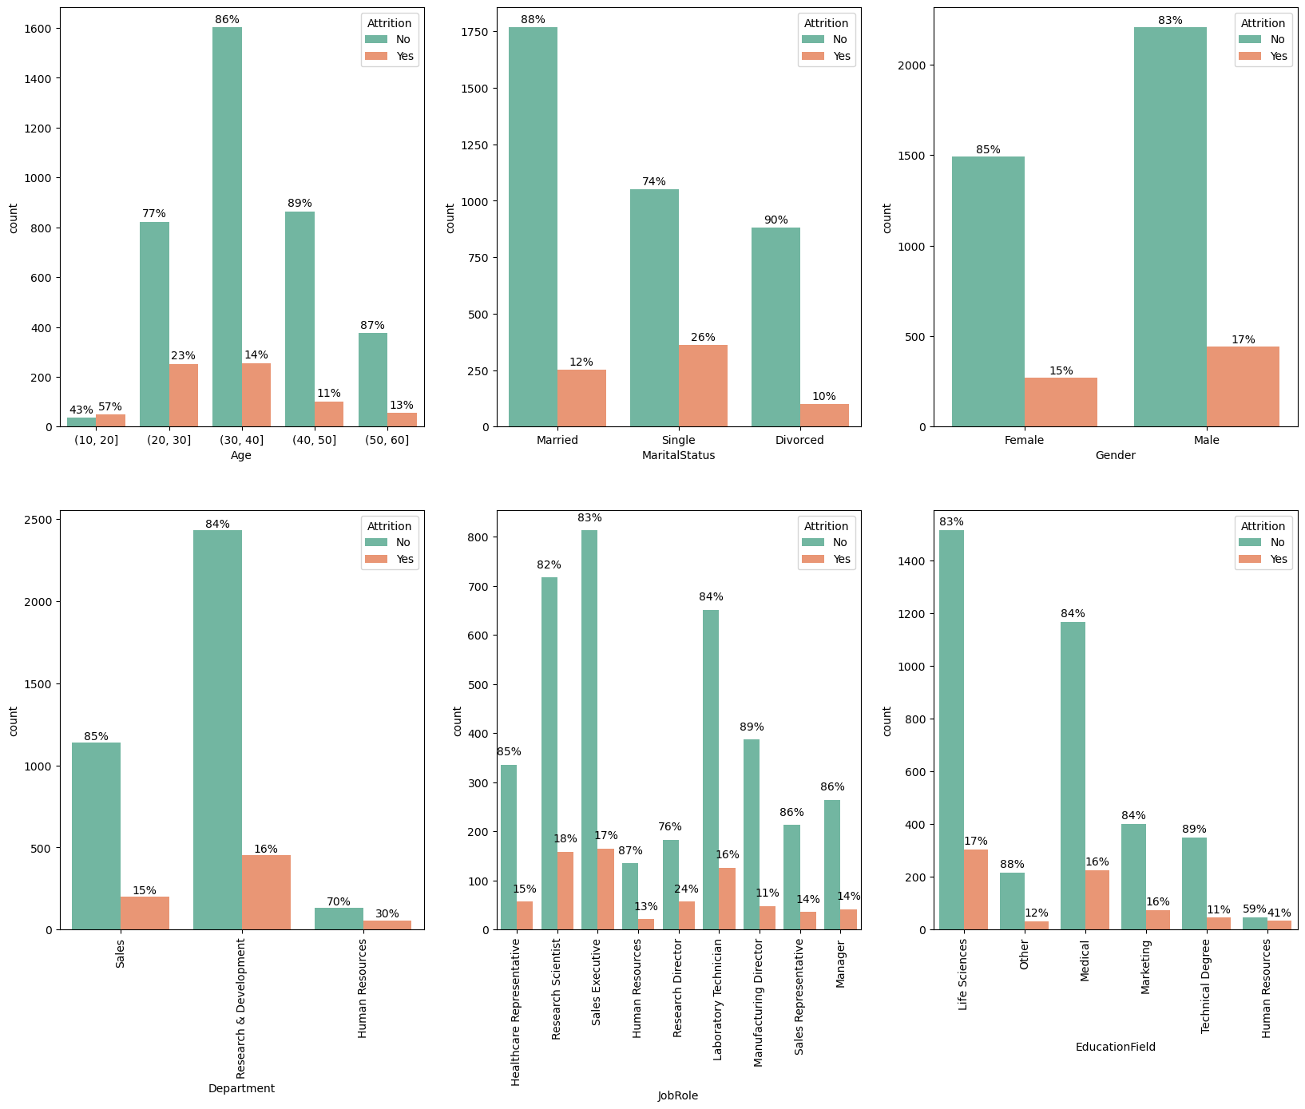
Data Analysis
Age : 23% of 20-30 age group wants to leave the company.
Marital Status : 26% of single people wants to leave the company.
Gender : 17% of male employes wants to leave the company.
Department : 16% of Research & Development department wants to leave the company.
Job Role: Job roles of employee having maximum attrition is Sales Executive, Laboratory Technician, and Research Scientist.
Education Field : Employees with education field Life Science and Medical has tendency to attrition.

Slide 18
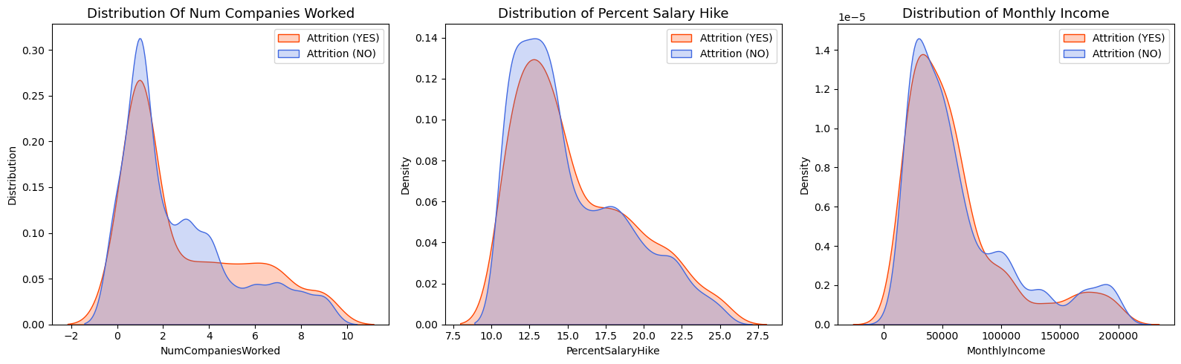
Data Analysis
Employees who have a small number of workplaces, have a low salary increase percentage and monthly income will have a higher tendency to experience attrition.

Slide 19
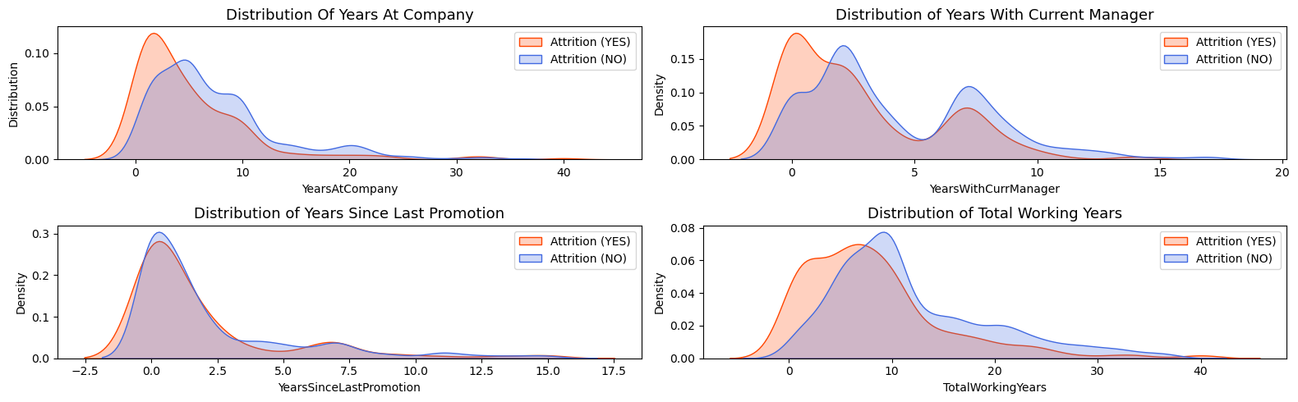
Data Analysis
With increase in the years since the last promotion and have spent a long time at the company, Attrition rate decreases

Slide 20
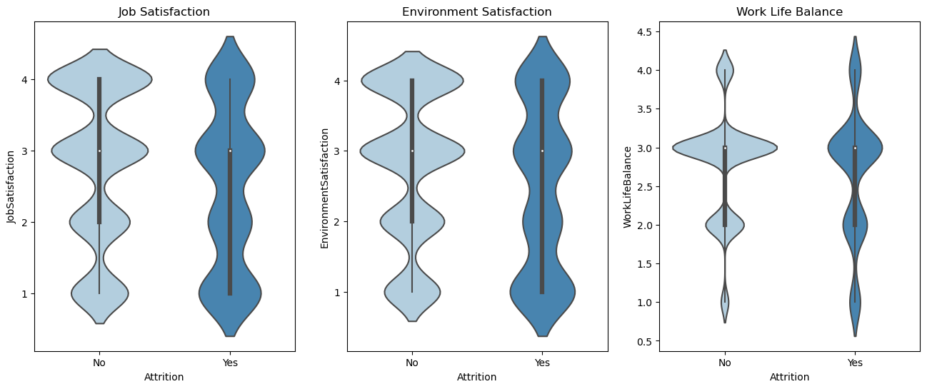
Data Analysis
Employees who want to quit their jobs are not quite satisfied with their jobs. Work life balance is lower.

Slide 21
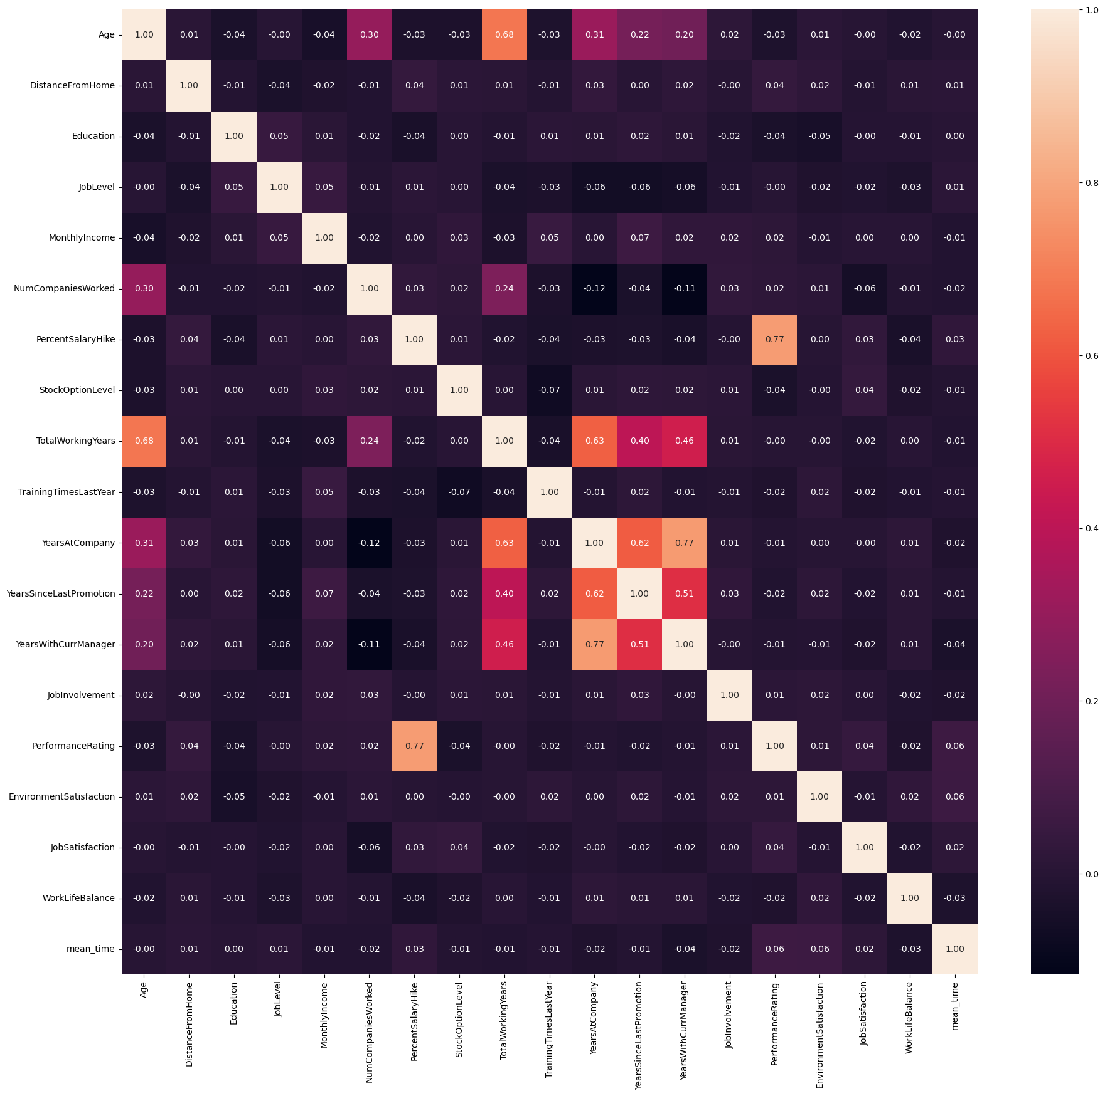
Data Analysis
Observation:
There is no higher dependency between numeric column from the heatMap Plot

Slide 22
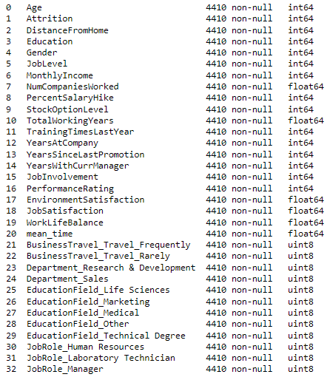
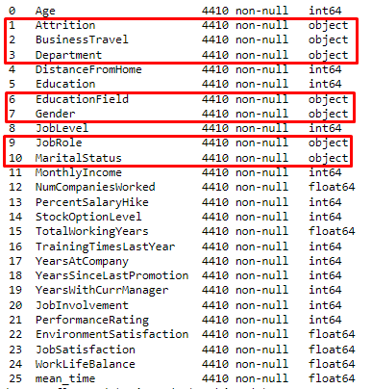
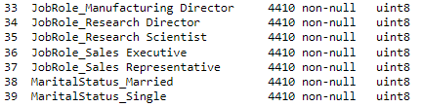
Encoding data categorical
One Hot Encoding: BusinessTravel, Departemen, EducationField, JobRole, MaritalStatus
Binary Encoding: Attrition, Gender
4410 rows
40 features
1 target

Slide 23
Feature Selection using BorutaShap
13 attributes confirmed important | YearsSinceLastPromotion, YearsAtCompany, JobSatisfaction, MonthlyIncome, EnvironmentSatisfaction, TotalWorkingYears, BusinessTravel_Travel_Frequently, WorkLifeBalance, YearsWithCurrManager, mean_time, Age, NumCompaniesWorked, MaritalStatus_Single
25 attributes confirmed unimportant | Education, MaritalStatus_Married, BusinessTravel_Travel_Rarely, JobRole_Human Resources, EducationField_Marketing, Department_Sales, PercentSalaryHike, JobRole_Research Scientist, JobRole_Sales Executive, EducationField_Technical Degree, Department_Research & Development, DistanceFromHome, EducationField_Medical, JobRole_Sales Representative, PerformanceRating, TrainingTimesLastYear, EducationField_Life Sciences, EducationField_Other, JobRole_Manufacturing Director, JobRole_Laboratory Technician, JobRole_Research Director, Gender, JobRole_Manager, StockOptionLevel, JobLevel
1 tentative attributes remains | JobInvolvement
I decided to use 13 attributes confirmed important and 1 tentative attributes
4410 rows
14 features
1 target

Slide 24
03
Modelling

Slide 25
LIST OF MODEL
Classifier |  | precision | recall | F1-score
Logistic Regression | 0 | 0.87 | 0.98 | 0.92
 | 1 | 0.70 | 0.23 | 0.34
 | Accuracy |  |  | 0.86
 | Macro avg | 0.78 | 0.60 | 0.63
 | Weighted avg | 0.84 | 0.86 | 0.83
Random Forest | 0 | 0.98 | 1.00 | 0.99
 | 1 | 0.98 | 0.89 | 0.93
 | Accuracy |  |  | 0.98
 | Macro avg | 0.98 | 0.94 | 0.96
 | Weighted avg | 0.98 | 0.98 | 0.98
Because the class ‘Attrition’ distribution is IMBALANCE, so need NOT to use accuracy. Use recall (sensitivity) instead. It is more important to capture as many employees at risk of attrition as possible (minimize false negatives), so recall may be more relevant.

Slide 26
LIST OF MODEL
Classifier |  | precision | recall | F1-score
KNN | 0 | 0.89 | 0.95 | 0.92
 | 1 | 0.58 | 0.37 | 0.45
 | Accuracy |  |  | 0.86
 | Macro avg | 0.74 | 0.66 | 0.69
 | Weighted avg | 0.84 | 0.86 | 0.84
Decision Tree | 0 | 0.98 | 0.97 | 0.98
 | 1 | 0.86 | 0.92 | 0.89
 | Accuracy |  |  | 0.96
 | Macro avg | 0.92 | 0.95 | 0.93
 | Weighted avg | 0.96 | 0.96 | 0.96
The model that has the highest recall value is the Decision Tree model (0.92).
I will try to use hyperparameter tuning for the Decision Tree model.

Slide 27
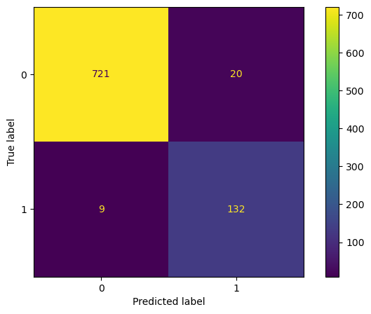
Decision Tree using HP Tuning
Classifier |  | precision | recall | F1-score
Decision Tree (HP Tuning) | 0 | 0.99 | 0.97 | 0.98
 | 1 | 0.87 | 0.94 | 0.90
 | Accuracy |  |  | 0.97
 | Macro avg | 0.93 | 0.95 | 0.94
 | Weighted avg | 0.97 | 0.97 | 0.97
The Decision Tree model using hyperparameter tuning gets an increase in the recall value to 0.94.

Slide 28
Conclusion
The employee attrition dataset is consist of 4410 rows and 40 columns (after merging all dataset and processing the in_time & out_time dataset). The dataset is slightly imbalanced and has outliers in some features. To transform the non-numerical columns into numerical, I did one-hot encoding for the features and binary encoding for the target variable. After encoding process and selecting the important feature using BorutaShap, the dataset has 14 features. I scale the data using standar scaler and split the dataset into 80% training data and 20% test data. I choose Logistic Regression, KNN, Random Forest, and Decision Tree as the model to predict the employee attrition and the target variable is binary (1: Yes, 0: No).
The 13 attributes confirmed important: YearsSinceLastPromotion, YearsAtCompany, JobSatisfaction, MonthlyIncome, EnvironmentSatisfaction, TotalWorkingYears, BusinessTravel_Travel_Frequently, WorkLifeBalance, YearsWithCurrManager, mean_time, Age, NumCompaniesWorked, MaritalStatus_Single. And 1 tentative attributes remains: JobInvolvement.
The evaluation is using Recall metric. Prediction results using Decision Tree have the best performance, having a recall evaluation metric value of 0.92. Then I tried using Hyperparameter tuning for Decision Tree, and the resulting recall evaluation metric value increased to 0.94.

Slide 29





Business Recommendation
Offer flexible work such as telecommuting, remote work options, flextime (which requires employees to work a standard number of hours, but can choose the time). This can help ease the burden on employees who have constant business trips, and employees who have homes far from the office.
Set clear expectations for new employees regarding their job duties, performance standards, and career growth opportunities. Providing a roadmap for success can help motivate employees and increase their likelihood of staying with the company beyond the first year.
Conduct regular salary reviews to ensure that employee compensation remains competitive within the industry and region. Consider adjusting salaries based on market trends and individual performance. Creating good work environment to increase job satisfaction index.
Provide additional compensation to employees for their overtime hours. Ensure that compensation complies with statutory regulations and takes into account industry and company financial standards.
Reducing young employee attrition requires a combination of understanding their motivations, providing growth opportunities, fostering a positive work environment, and offering competitive compensation and benefits. Consider implementing mentorship programs, offering career development opportunities, conducting stay interviews to understand their concerns, and promoting work-life balance initiatives. Regularly solicit feedback and take action on areas for improvement to demonstrate that their voices are valued.

Slide 30
Thankyou
My github:
https://github.com/nuranisda
My linkedin:
www.linkedin.com/in/nuranisdatriawati

