Slide 1
EECS 233: Final Project
By Fiona Liu and Varun Garg

Slide 2
Summary
Created implementations of ordered integer lists of:
IntLinkedBag
IntArrayBag
Used the implementations of the two classes from homework 3.
Analyzed the run times of the following methods:
add()
remove()
addAll()

Slide 3
Implementation: add(int element)
Same implementation for both data structures
Traverses through the bag of integers until it find a value in the bag greater than the element. Then places the element before that value.
IntArrayBag.add(int element): O(N) as first the method find where to put the element, and then it pushes all the other elements to the next position.
IntLinkedBag.add(int element): O(N) as the method has to find the value in the bag that is greater than the element, which could be all the elements in the bag.

Slide 4
Experimental Run Time: add(int element)

Slide 5
Implementation: remove(int target)
Kept the same implementation in both classes from homework 3.
The method traverses the bag till it finds the target element to remove.
IntArryBag.remove(): O(N) as target element is first found, then removed, then the elements in front of the target element are moved back one place in the int array.
IntLinkedBag.remove(): O(N) as target element is first found and then removed. If the element is towards the end of the list, then this could take about N computations.

Slide 6
Experimental Run Time: remove(int target)

Slide 7
Implementation: addAll(bag)
Multiple elements were added to the end or start of the data structures, and then a mergesort algorithm was called to sort them in ascending order.
IntArrayBag.mergeSort(): O[(N₁+N₂)log(N₁+N₂)] as N₁ elements are added to the end of the bag first, and N₂ are the elements already in the bag. Then mergesort is called to sort the final array with N₂ elements.
IntLinkedBag.mergeSort(): O[(N₁+N₂)log(N₁+N₂)] as the linked list elements (N₁) are added to the start of the array. Then mergesort is called.

Slide 8
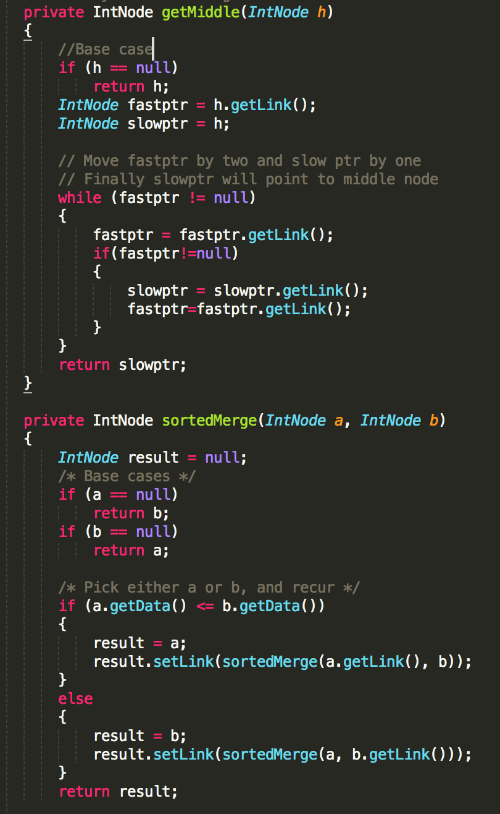
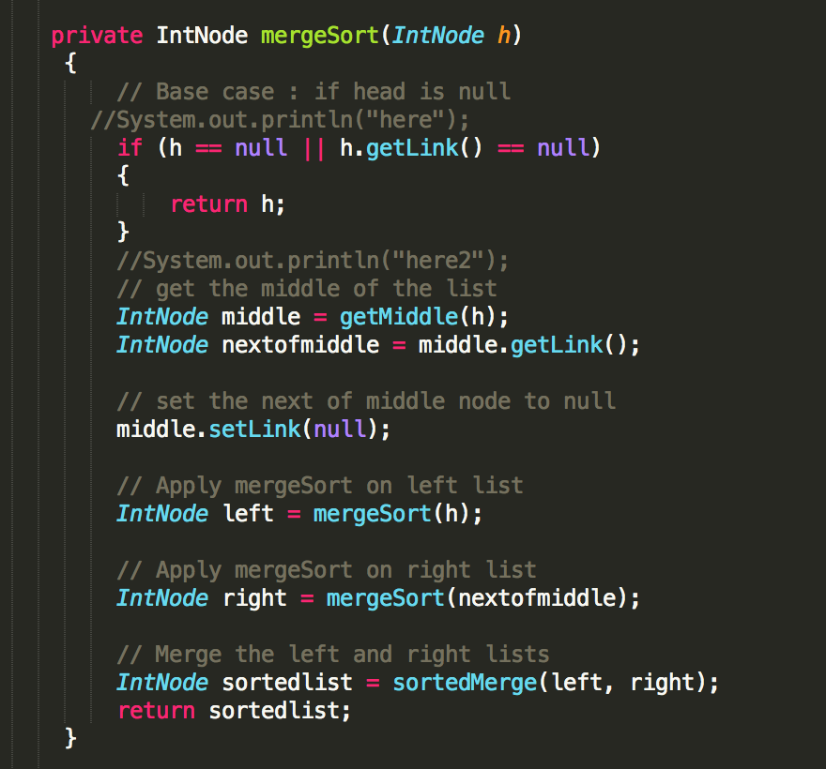

Slide 9
Experimental Run Time: addAll()
Notes:
We could not get data for N > 3000 for addAll() in IntLinkedBag because of stack overflow execption

Slide 10
Experimentation Code

Slide 11
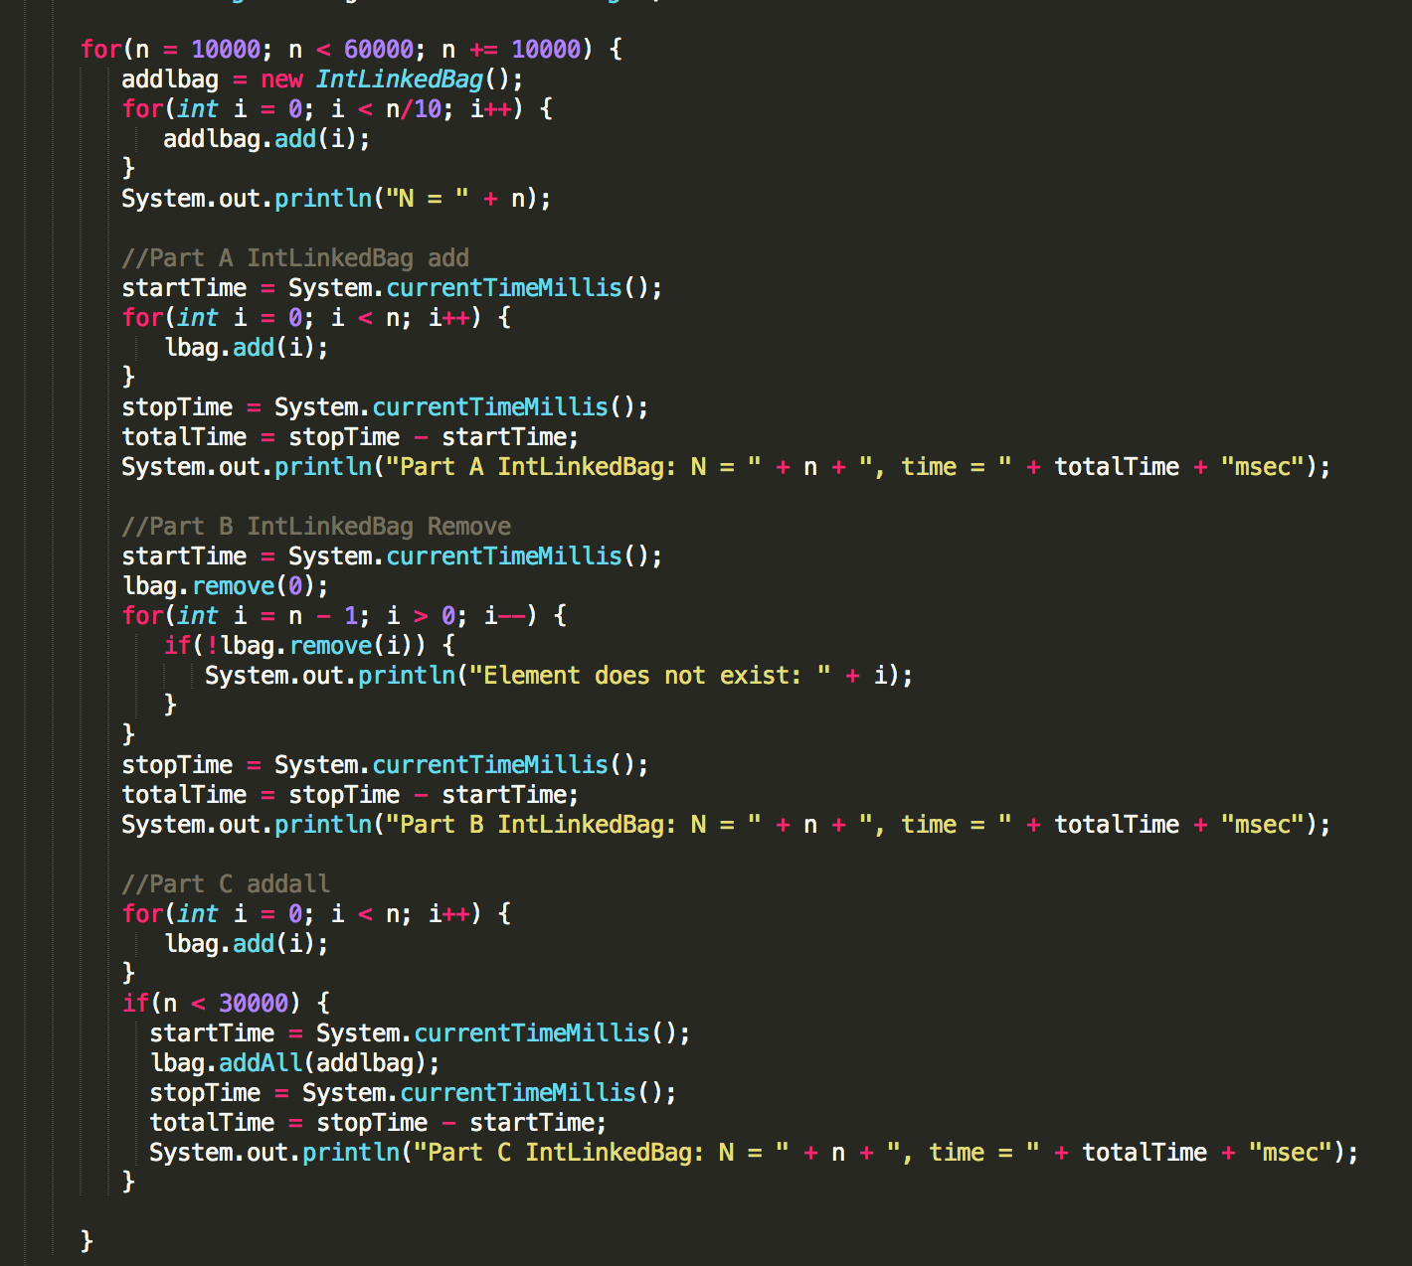

Slide 12
IntLinkedBag.addAll(bag) problem!
Cannot use mergsort because of stack overflow excpetion for N > 3000.
Different implementation required, like add each element from the new bag using the the add() method.

