Slide 1
INTELLIGENT CIRCUIT SKETCH RECOGNITION EE421 TERM PROJECT Asst. Prof. Dr. HAKAN TORA
NURAY GÜL M. CAN ALPTEKİN
130505009 120505006

Slide 2
Problem:
We usally draw our circuit degins on papers.
But paper is not a useful media for storing information.
Also we want to change some components or try different functions on our circuit designs. And this is difficult to do on paper.
To solve these problems, we try to recognize circuit components on hand-written circuits by using image processing methods and neural network.

Slide 3
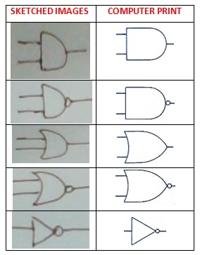
SKETCHED AND COMPUTER PRINT

Slide 4
METHODS:
IMAGE PROCESSING PART:
Image acquisition ( For all circuit components) (By sketching and capturing them)
Load Images and Preprocessing
Preprocessing(Image binarization,segmentation,etc)
Build image databases for training and testing after image processing(Feature Extraction)
NEURAL NETWORK PART:
Training the network for all components
Testing on a sketched circuit
Results (Recognition Performance)

Slide 5
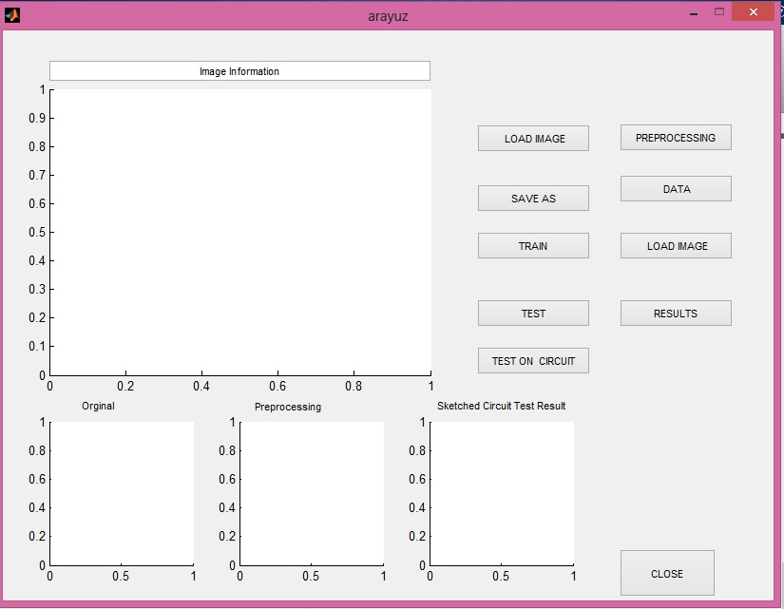
METHODS:

Slide 6
THANKS FOR YOUR ATTENTION!

