Slide 1
ATILIM UNIVERSITY
EE421 TERM PROJECT
ASST. PROF. DR. HAKAN TORA
INTELLIGENT CIRCUIT SKETCH RECOGNITION
NURAY GÜL M. CAN ALPTEKİN
130505009 120505006

Slide 2
CONTENT:
What is the Circuit Sketch Recognition?
Methods for Shape Analysis
Steps of Circuit Sketch Recognition
1) Image Acquisition
2) Preprocessing
3)Feature Extraction
4) Classification
a)Neural Network (NPRTOOL)
Results and Discussion

Slide 3
WHAT IS THE CIRCUIT SKETCH RECOGNITION?
Circuit sketch recognition can be defined as handwriting recognition
Handwriting recognition is the ability of a computer to receive and interpret intelligible handwritten input from sources such as paper documents, photographs, touch-screens and other devices.
But also we can define it as shape analysis or shape recognition by using image processing applications.

Slide 4
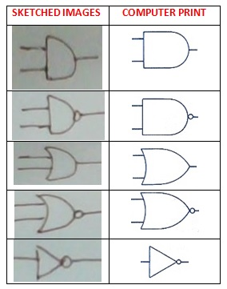
SKETCHED AND COMPUTER PRINT

Slide 5
METHODS FOR SHAPE ANALYSIS:
Shape Analysis : Step that consists on identifying an object using only its shape
Shape analysis procedures are based on the use of shape descriptors
There exists several shape descriptors:
*Including boxes
*Moment descriptors
*Guzman polygons
*Freeman chain coding
*Fourier descriptors

Slide 6
METHODS FOR SHAPE ANALYSIS:
A good shape descriptor should have the following properties:
good fidelity to the initial shape
good discrimination between different shapes
good behavior with shape recognition operations :
- invariance with translation
- invariance with rotation
- invariance with scaling

Slide 7
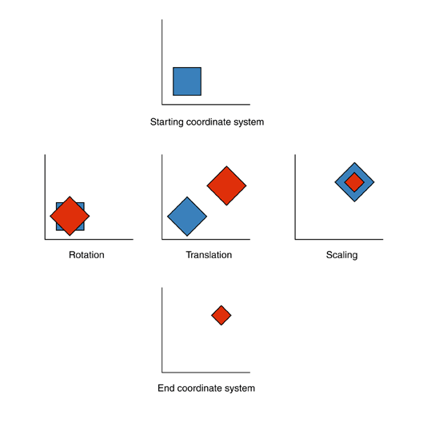
METHODS FOR SHAPE ANALYSIS:
ROTATION,TRANSLATION & SCALING

Slide 8
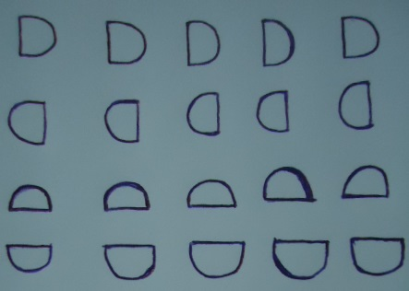
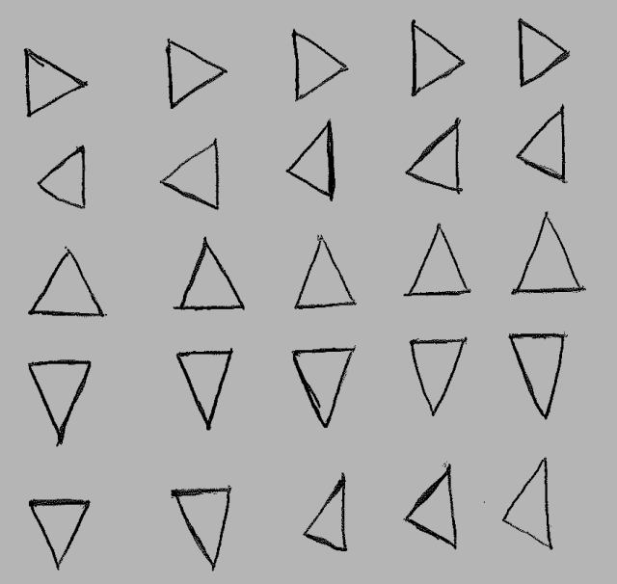
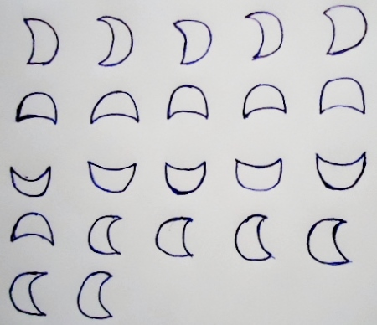
STEPS OF CİRCUİT SKETCH RECOGNİTİON
1) IMAGE ACQUİSİTİON
We can take the photo or scan it.
Captured Images Scanned Image

Slide 9
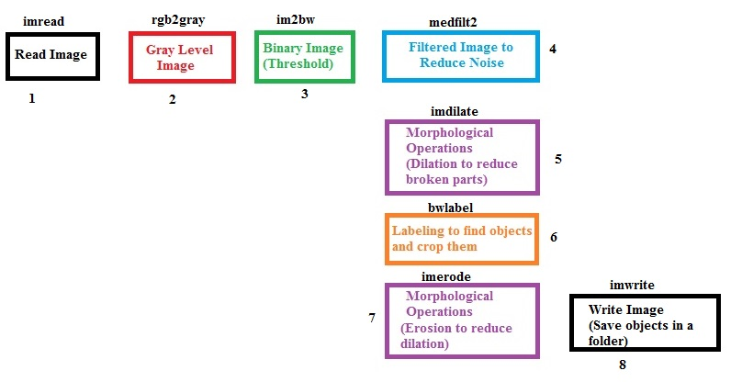
STEPS OF CİRCUİT SKETCH RECOGNİTİON
2) PREPROCESSING

Slide 10




STEPS OF CİRCUİT SKETCH RECOGNİTİON
1) PREPROCESSING
Before Preprocessing
Result of Preprocessing

Slide 11
3)FEATURE EXTRACTİON:
FOURIER DESCRIPTORS
Tool which allows to describe the external shape of an object, that is to its contour
Fourier Descriptors are boundary (edge) based descriptors
These descriptors represent the shape in frequency domain.
Low frequency components contain information about the general features of the shape, and the higher frequency components contain finer details of the shape.
Though different people may have different drawing habits, the subset of the low frequency coefficient tend to be similar for the same electronic component.
So although the number of coefficients generated from the Fourier transform is usually large, the dimensions of the Fourier descriptors used for shape recognition can be greatly reduced.

Slide 12
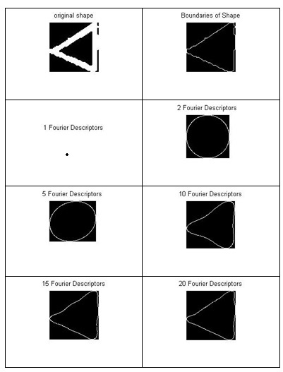

Slide 13
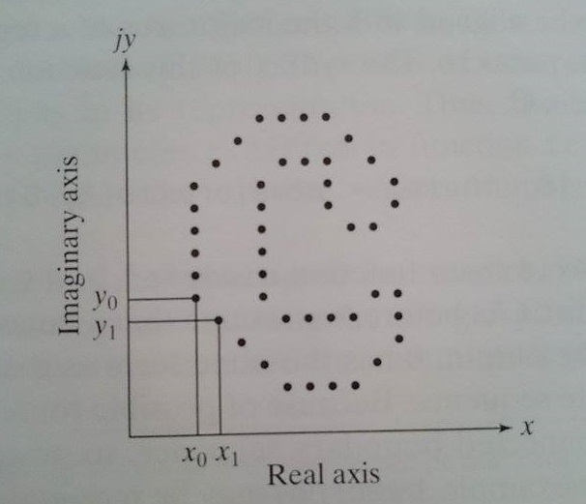
FOURIER DESCRIPTORS
Step1: Extract the Boundary
K – point digital boundary in the xy plane:
Starting at an arbitrary point : (x0,y0) and centroid is: (xc,yc)
Coordinate pairs: (x0,y0),(x1,y1),(x2,y2),…,(xK-1,yK-1)
x(k)=xk and y(k)=yk
Create an s sequence: S(k)=[x(k),y(k)]

Slide 14
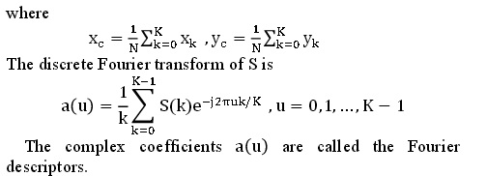
FOURIER DESCRIPTORS
Step 2: Creating Complex Numbers and FFT
Each coordinate pair can be treated as a complex number:

Slide 15
FOURIER DESCRIPTORS
Step 3: Normalization and Magnitude
For u = 0, a(u) represents the position of the center of gravity of the shape. This term is not interesting for the shape description. Without this term, the description won't be affected by a translation of the shape.
The first frequency component, a(u) for u = 1, describes the size of the shape. If all the other components are set to zero, the shape becomes a circle (in fact, a N-sided polygon). One can use this component to normalize the set of Fourier descriptors.
So, by dividing the Fourier descriptors with the magnitude of the 1st Fourier descriptor, we achieve scale invariance, by only considering the magnitude of the Fourier descriptors, we achieve rotation invariance

Slide 16
FOURIER DESCRIPTORS
Step 4: Getting Significative Fourier Descriptors
By applying normalization, the 0th and 1st Fourier descriptors do not provide any information. Hence these are eliminated.
Experimentally we choose number of coefficients of Fourier descriptor to be 20 and use 2nd–21th Fourier descriptor as the feature vector
Now, we have 20 values to use as features in classification part.

Slide 17
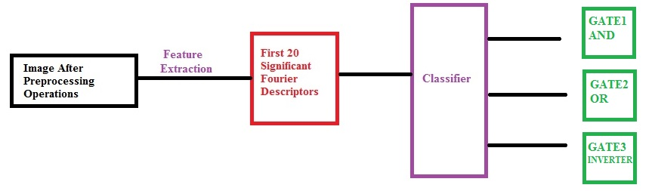





3)CLASSIFICATION:
NEURAL NETWORK : NPRTOOL

Slide 18
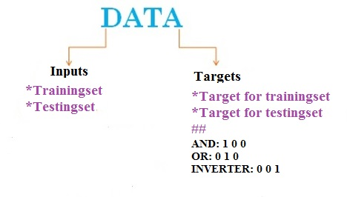
NEURAL NETWORK : NPRTOOL
MATLAB neural network is a powerful tool for pattern recognition and classification.

Slide 19
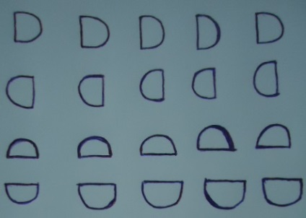
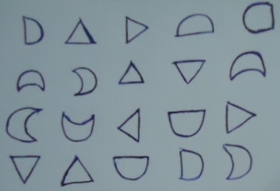


INPUTS:
Training images Testing Image:
20 AND
20 OR
*6 AND
*6 OR
*8 INVERTER
20 INVERTER

Slide 20
INPUTS:
20 images are used for each gates in training set. So total image number is 60. trainingset.mat is 20x60
20 images of mixed gates are used in testing set. So testset.mat is 20x20
Target for training set is 3x60
Target for testing set is 1x20

Slide 21
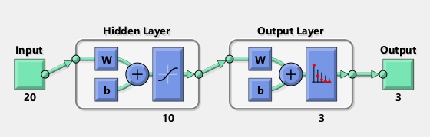
CRATE NETWORK:
We get this network when we use nprtool. We have 20 inputs(FDs) and 3 outputs (Gates) (100 ->AND, 010 -> OR, 001->INVERTER)
We train the network by using our datasets for training and test it by using our datasets for testing

Slide 22
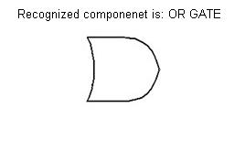
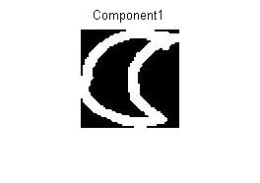
TEST THE NETWORK:
a=test(:,1);
b=net(a)
gate(b)
x=imread('F:\ee421proje\test\Component1.jpg');
imshow(x)

Slide 23
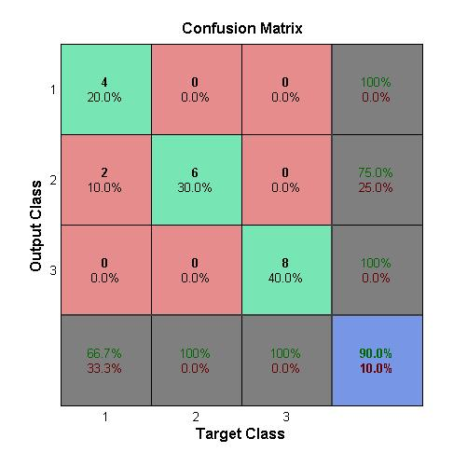
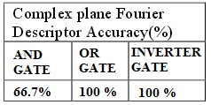
RESULTS & DISCUSSION:

Slide 24
RESULTS & DISCUSSION:
According to confusion matrix we get 90 % accuracy rate. This is meaning that our network finds 90 percent of the objects truly and 10 percent of them are known as another component.
In our testing image we had 6 AND gate, 6 OR gate, and 8 inverter.
Our network just confused 2 of the AND gates to the OR gates. And it knows all other components truly.

Slide 25
REFERENCES:
http://ganymed.imib.rwth-aachen.de/deserno/ps-pdf/vorlesungen/Master-BE-2010-04-Texture-Shape.pdf
http://www.creatis.insa-lyon.fr/~bernard/files/courses/DIP-5_EN_ImageAnalysis_part3.pdf
http://www.math.uci.edu/icamp/summer/research_11/bhonsle/Fourier_descriptor.pdf
https://homepages.cae.wisc.edu/~ece533/project/f06/karrels_ppt.pdf
http://en.wikipedia.org/wiki/Handwriting_recognition
https://stacks.stanford.edu/file/druid:bf950qp8995/Liu_Xiao.pdf
Digital Image Processing using MATLAB R.C. Gonzalez,R.E. Woods, S.L. Eddins
http://www.tsi.telecom-paristech.fr/pages/enseignement/ressources/beti/descript_fourier/Part1.html

Slide 26
THANKS FOR YOUR ATTENTION! ☺

