Slide 1
-Selenium Headless Testing -Log4j logging
By Nurbek

Slide 2
What Is Headless Browser?
A headless browser is a web-browser without a graphical user interface. This program will behave just like a browser but will not show any GUI.
Some of the examples of Headless Drivers include
HtmlUnit
PhantomJS
ZombieJS
Watir-webdriver
Today we will focus on HtmlUnit and PhatomJS
Also, in Jenkins, tests run in headless mode.

Slide 3
HTMLUnitDriver
HTML UnitDriver is the most light weight and fastest implementation headless browser for of WebDriver. It is based on HtmlUnit. It is known as Headless Browser Driver. It is same as Chrome, IE, or FireFox driver, but it does not have GUI so one cannot see the test execution on screen.
Implementation:
WebDriver driver = new HtmlUnitDriver();
No need to set the driverpath
By default, JavaScript is disabled. To enable JavaScript, a small change is needed:
WebDriver driver = new HtmlUnitDriver(true); - not recommend it as it’s quite buggy
Notes:
import java.util.concurrent.TimeUnit;
import org.openqa.selenium.By;
import org.openqa.selenium.WebDriver;
import org.openqa.selenium.WebElement;
import org.openqa.selenium.htmlunit.HtmlUnitDriver;
public class HtmlUnitTest {
public static void main(String[] args) {
// Creating a new instance of the HTML unit driver
WebDriver driver = new HtmlUnitDriver();
driver.manage().timeouts().implicitlyWait(5, TimeUnit.SECONDS);
// Navigate to Google
driver.get("http://www.google.com");
// Locate the searchbox using its name
WebElement element = driver.findElement(By.name("q"));
// Enter a search query
element.sendKeys(“Selenium Tutorials");
// Submit the query. Webdriver searches for the form using the text
// input element automatically
// No need to locate/find the submit button
element.submit();
// This code will print the page title
System.out.println("Page title is: " + driver.getTitle());
driver.quit();
}
}

Slide 4
Pros and Cons of Html Unit Driver:
Pros:
Since it is not using any GUI to test, your tests will run in background without any visual interruption
It is platform independent and easier to run several tests concurrently. Ideal for Load Testing.
Fastest implementation of WebDriver
Supports JavaScript
Cons
Emulates other browsers’ JavaScript behaviour
Can’t see what’s going on with

Slide 5
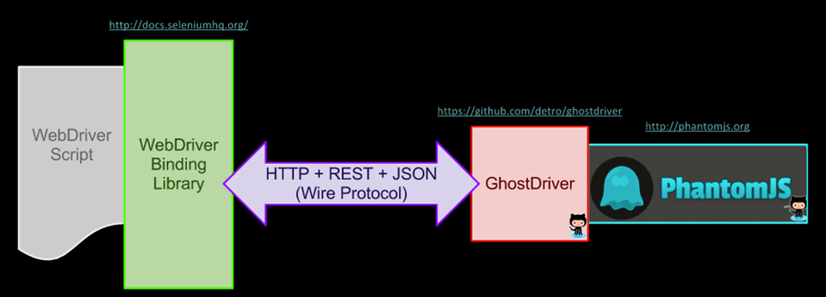
PhantomJS
PhantomJS is a headless browser with JavaScript API. It is an optimal solution for Headless Website Testing, access and manipulate webpages & comes with the standard DOM API.

Slide 6
Implementation for PhantomJs
Download phantomjs zip from http://phantomjs.org/download.html that’s compatible with your OS
Notes:
package htmldriver;
import java.io.IOException;
import org.openqa.selenium.WebDriver;
import org.openqa.selenium.phantomjs.PhantomJSDriver;
public class HeadlessBrowserTestPhantomJS {
public static void main(String[] args) throws InterruptedException, IOException {
System.setProperty("phantomjs.binary.path", "/Users/nismailov/Documents/Libraries/drivers/phantomjs.exe");
WebDriver driver = new PhantomJSDriver();
driver.get("https://google.com/");
System.out.println("TITLE OF THE PAGE IS: \n" + driver.getTitle());
driver.quit();
}
}

Slide 7
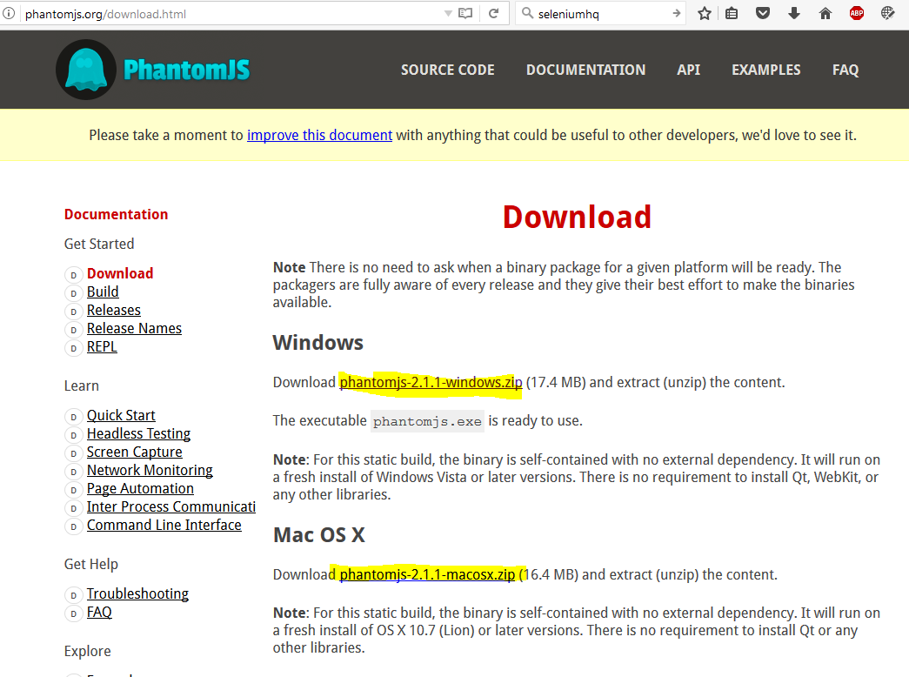

Slide 8
Implementation for PhantomJs Continued
Unzip and drop the phantomjs.exe to the desired location (such as libraries/drivers) etc
Make sure Selenium is in your project libraries (either using buildPath or Maven dependencies)
Add this to your java code:
System.setProperty("phantomjs.binary.path", "/Users/SuperUser/Documents/Libraries/drivers/phantomjs.exe");
//(Change the path to the appropriate location on your machine. Mac users- don’t need “.exe” at the end)
WebDriver driver = new PhantomJSDriver();
Notes:
<dependency>
<groupId>org.seleniumhq.selenium</groupId>
<artifactId>selenium-java</artifactId>
<version>3.4.0</version>
</dependency>

Slide 9
Log4j with Selenium
Agenda:
Into to Log4j
Why use it
How to implement and add it to the project

Slide 10
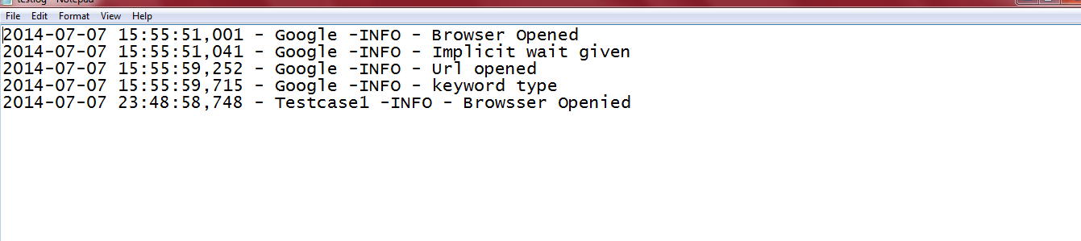
What is logging?
The log file is a just simple file, which keeps track of the record or event or info when any event happens or any software run. This whole process is known as logging. We can create a log file as simple log file as well as HTML format.

Slide 11
Introduction Log4j
Log4j is a fast, flexible and reliable logging framework (APIS) written in Java developed in early 1996. It is distributed under the Apache Software License.. It is a tool used for small to large scale Selenium Automation projects.

Slide 12
Why use it?
Open Source
Logging vs Sysout is what separates experienced automation engineers from newbies
In Log4j, we use log statements rather than println statements in the code to know the status of a project while it is executing
With Log4j, it is possible to store the flow details of our Selenium Automation in a file or databases
Helps us to keep a history of the test runs as the console output in Eclipse IDE gets renewed every time

Slide 13
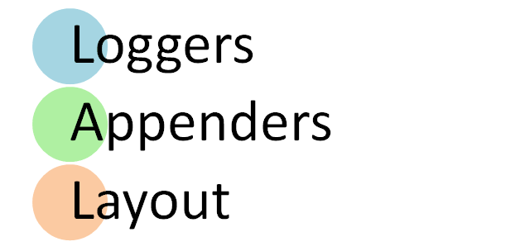
Log4j

Slide 14
Loggers: It is responsible for logging information. To implement loggers into a project following steps need to be performed -
Create an instance for logger class: Logger class is a Java-based utility that has got all the generic methods already implemented to use log4j
Define the Log4j level: Primarily there are five kinds of log levels
All - This level of logging will log everything ( it turns all the logs on )
DEBUG – print the debugging information and is helpful in development stage
INFO – print informational message that highlights the progress of the application
WARN – print information regarding faulty and unexpected system behavior.
ERROR – print error message that might allow system to continue
FATAL – print system critical information which are causing the application to crash
OFF – No logging

Slide 15
Appenders: It is used to deliver LogEvents to their destination. It decides what will happen with log information. In simple words, it is used to write the logs in file.
Following are few types of Appenders
ConsoleAppender logs to standard output
File appender prints logs to some file
Rolling file appender to a file with maximum size
Layouts: It is responsible for formatting logging information in different styles.

Slide 16
// Here we have defined root logger
log4j.rootLogger=INFO,CONSOLE,R,HTML,TTCC
// Here we define the appender
log4j.appender.CONSOLE=org.apache.log4j.ConsoleAppender
log4j.appender.R=org.apache.log4j.RollingFileAppender
log4j.appender.TTCC=org.apache.log4j.RollingFileAppender
log4j.appender.HTML=org.apache.log4j.FileAppender
// Here we define log file location
log4j.appender.R.File=./log/testlog.log
log4j.appender.TTCC.File=./log/testlog1.log
log4j.appender.HTML.File=./log/application.html
// Here we define the layout and pattern
log4j.appender.CONSOLE.layout=org.apache.log4j.PatternLayout
log4j.appender.CONSOLE.layout.ConversionPattern= %5p [%t] (%F:%L)- %m%n
log4j.appender.R.layout=org.apache.log4j.PatternLayout
log4j.appender.R.layout.ConversionPattern=%d - %c -%p - %m%n
log4j.appender.TTCC.layout=org.apache.log4j.TTCCLayout
log4j.appender.TTCC.layout.DateFormat=ISO8601
log4j.appender.HTML.layout=org.apache.log4j.HTMLLayout
log4j.appender.HTML.layout.Title=Application log
log4j.appender.HTML.layout.LocationInfo=true

Slide 17
Implementation:
Download the jar file: or use maven dependency
https://mvnrepository.com/artifact/log4j/log4j/1.2.17
<dependency>
<groupId>log4j</groupId>
<artifactId>log4j</artifactId>
<version>1.2.17</version>
</dependency>

Slide 18
Create a log4j.properties file in the project’s main directory
Add the sample code
Write a test case
Create a logger instance:
Logger logger=Logger.getLogger(“[ClassName]”);
configure log4j properties file
PropertyConfigurator.configure("Log4j.properties");
Add logger messages:
logger.info("Url opened");
Notes:
// Here we have defined root logger
log4j.rootLogger=INFO,CONSOLE,R,HTML,TTCC
// Here we define the appender
log4j.appender.CONSOLE=org.apache.log4j.ConsoleAppender
log4j.appender.R=org.apache.log4j.RollingFileAppender
log4j.appender.TTCC=org.apache.log4j.RollingFileAppender
log4j.appender.HTML=org.apache.log4j.FileAppender
// Here we define log file location
log4j.appender.R.File=./log/testlog.log
log4j.appender.TTCC.File=./log/testlog1.log
log4j.appender.HTML.File=./log/application.html
// Here we define the layout and pattern
log4j.appender.CONSOLE.layout=org.apache.log4j.PatternLayout
log4j.appender.CONSOLE.layout.ConversionPattern= %5p [%t] (%F:%L)- %m%n
log4j.appender.R.layout=org.apache.log4j.PatternLayout
log4j.appender.R.layout.ConversionPattern=%d - %c -%p - %m%n
log4j.appender.TTCC.layout=org.apache.log4j.TTCCLayout
log4j.appender.TTCC.layout.DateFormat=ISO8601
log4j.appender.HTML.layout=org.apache.log4j.HTMLLayout
log4j.appender.HTML.layout.Title=Application log
log4j.appender.HTML.layout.LocationInfo=true

Slide 19
References
http://learn-automation.com/headless-browser-testing-using-selenium-htmlunitdriver/
http://learn-automation.com/how-to-create-log-files-in-selenium/
https://www.guru99.com/tutorial-on-log4j-and-logexpert-with-selenium.html
https://www.guru99.com/selenium-with-htmlunit-driver-phantomjs.html

