Slide 1


HAZELCAST
Nurdan Kaya
29.07.2021

Slide 2

Content
Hazelcast statistics
What is Hazelcast?
In Memory Data Grid (IMDG)
Hazelcast features
Key components of Hazelcast
Caching with Hazelcast
Distributed data structures
Data partitioning
Data pipelines – Hazelcast Jet

Slide 3






Hazelcast was founded by Enes Akar, Fuad Malikov and Talip Öztürk.
The companies choose Hazelcast
Notes:
Hazelcast türkiye ve dünya çapında birçok şirket tarafından tercih ediliyor

Slide 4
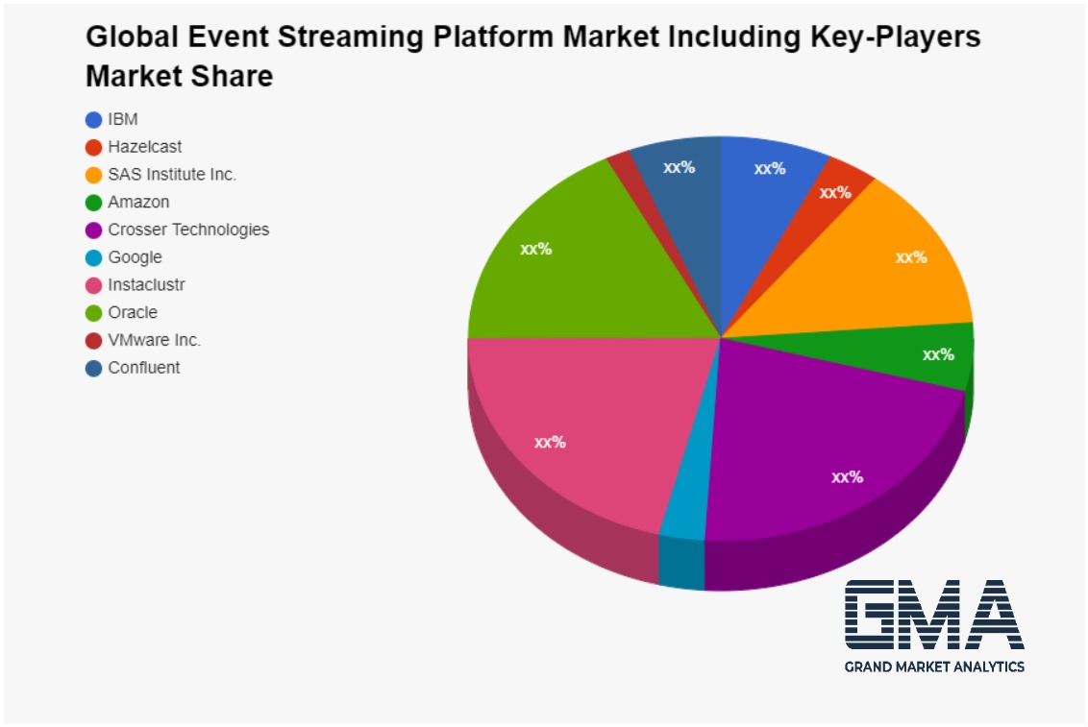
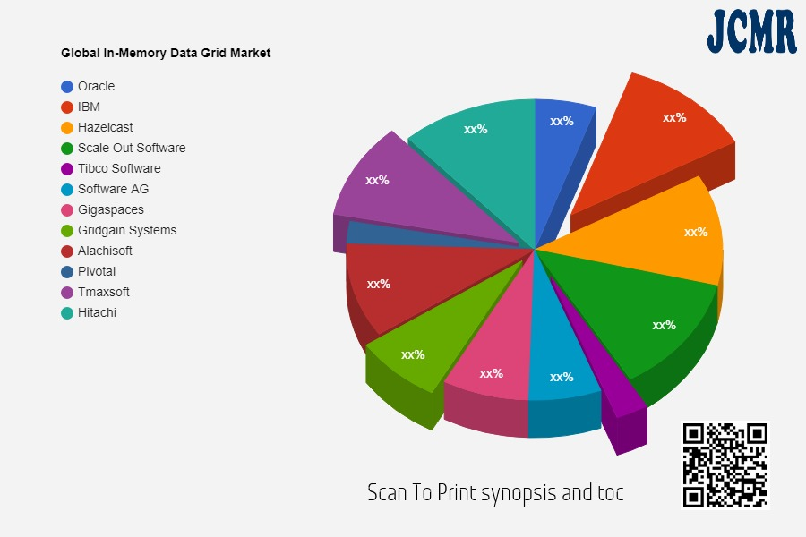
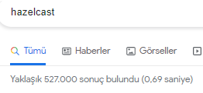
In-Memory Data Grid Market by Key Players Gridgain Systems Alachisoft Oracle IBM Software AG Gigaspaces Pivotal Scale Out Software Tibco Software Hazelcast Hitachi Tmaxsoft
Notes:
Hazelcast IMDG pazarında oracle ıbm gibi büyük şirketlerle birlikte önemli bir yere sahip

Slide 5
What is HAZELCAST?
Distributed IN MEMORY DATA GRID(IMDG) platform
Hazelcast is a distributed computation and storage platform
Distributed implementation of java.util.(Queue, Set, List, Map)
Notes:
Farklı tanımlarını koydum
Distributed data structure for java

Slide 6

Notes:
Büyük bir iş var ve artık bilgisayarın kapasitesi yetmiyor
Bilgisayarı güçlendir
Bir task ı daha küçük task lara bölerek farklı bilgisyarlara paylaştır ->hazelcast

Slide 7
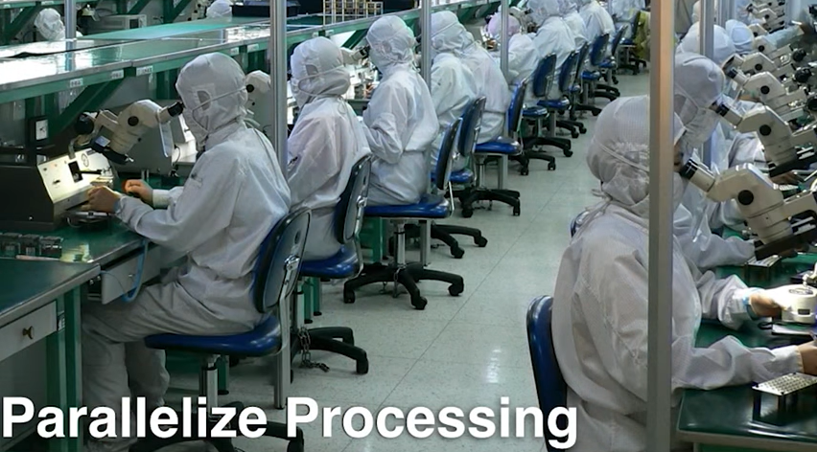
Notes:
VERİ RAM DE TUTULUR HER ZAMAN DISKE GITMEZ

Slide 8
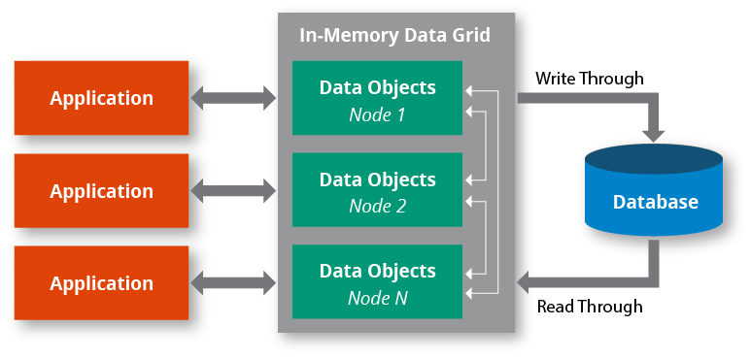
IN MEMORY DATA GRID(IMDG)
IMDG is a set of networked/clustered computers that pool together their random access memory (RAM) to let applications share data with other applications running in the cluster.
Shortly , IMDG is a distributed in-memory data store
(but, not just for storage …)
Notes:
Birkaç bilgisayar bir araya gelerek(cluster) RAM de tutulan ortak veri havuzundaki verileri diğer app lerle paylaşması

Slide 9
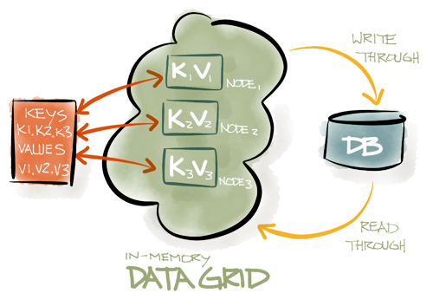
IN MEMORY DATA GRID(IMDG)
IMDGs are built for data processing at extremely high speeds.
They are designed for building and running large-scale applications that need more RAM than is typically available in a single computer server
This enables the highest application performance by using RAM along with the processing power of multiple computers that run tasks in parallel.
IMDG is valuable for extensive parallel processing on large data sets.
Notes:
Imdg verileri yüksek hızda işler
Large-scale, fazla RAM ihtiyacı olan uygulamalar için tasarlanmış
Büyük veri setlerinde yapılan parallel processing de kullanışlı

Slide 10
HAZELCAST FEATURES
Open source
Java based, simple
The data is always stored in-memory (RAM) of the servers.
Distributed computation, data structures, and events
Streaming data processing
Connectors to read from/write to systems like Apache Kafka, JMS, JDBC and HDMS
Replication of web sessions (filter, Tomcat, Jetty based)
…
For more : Enterprise edition

Slide 11


HAZELCAST
Hazelcast is a data platform that integrates with your existing infrastructure to make your applications run faster.
Current Application Performance
Application Performance with Hazelcast
Notes:
Hazelcast bizim altyapımızla entegre olarak uygulamayı hızlandırır

Slide 12
KEY COMPONENTS
Member
Cluster
Partitions
Streaming engine
Storage engine
Sources
Sinks
Connectors

Slide 13
KEY COMPONENTS
Member
computational and data storage unit
(typically JVM)
Cluster
set of members communicating with each other
(Members which run Hazelcast automatically discover one another and form a cluster at runtime)

Slide 14
KEY COMPONENTS
Partitions
memory segments that store portions of data
They can contain hundreds or thousands of data entries each, depending on the memory capacity of your system.
Hazelcast automatically creates backups of these partitions which are also distributed in the cluster.

Slide 15
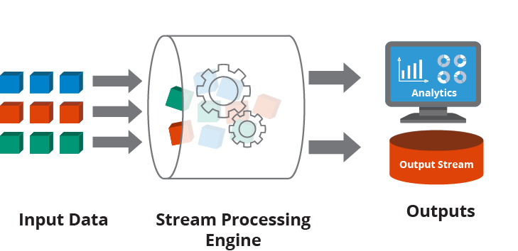
KEY COMPONENTS
Streaming engine
It focuses on data transformation while it does all the heavy lifting of getting the data flowing and computation running across a cluster of members.
It supports working with both bounded (batch) and unbounded (streaming) data.

Slide 16
KEY COMPONENTS
Sources
Sources are where Hazelcast pulls the data
Storage engine
It is distributed, fast, and operational data store dealing with persistence of data.
Connectors
Sinks
Sinks are where it outputs the processed data result

Slide 17
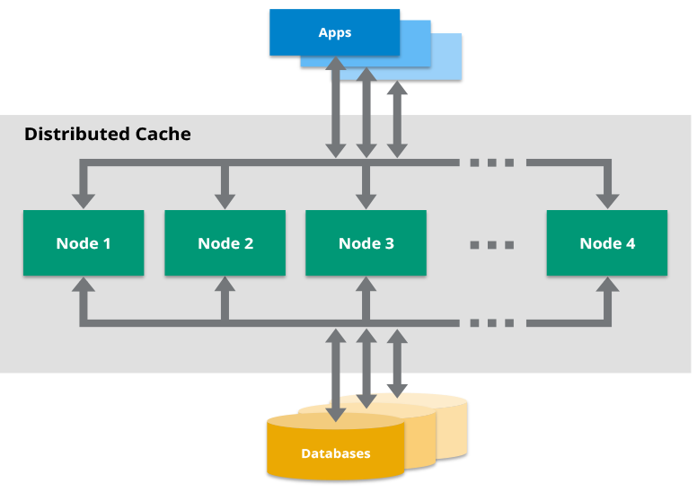
CACHING WITH HAZELCAST

Slide 18
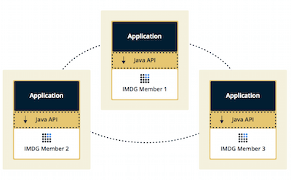
Caching Topologies – EMBEDDED MODE
Application and the cached data are stored on the same device.
When a new entry is written to the cache, Hazelcast takes care of distributing it to the other members.
+ Data access is faster because applications don’t need to send a request to the cache cluster over the network.
.
- It can be embedded only in Java apps. To use this mode, you must write application with Java.

Slide 19
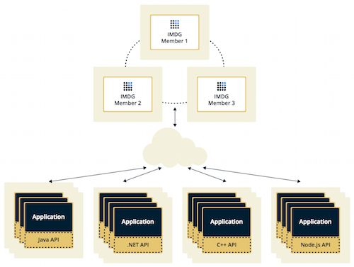
Caching Topologies – CLIENT/SERVER MODE
Cached data is separated from the application.
(Hazelcast cluster is independant of your application, which means that they can be independently created and scaled.)
Hazelcast members run on dedicated servers and applications connect to them through clients.
+ Supports independent scaling.
- To read from a cache or write to it, clients need to make network requests, which leads to higher latency than embedded mode.

Slide 20
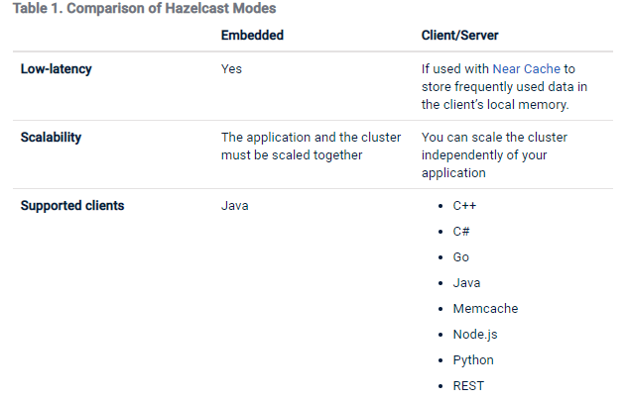
EMBEDDED VS CLIENT/SERVER

Slide 21
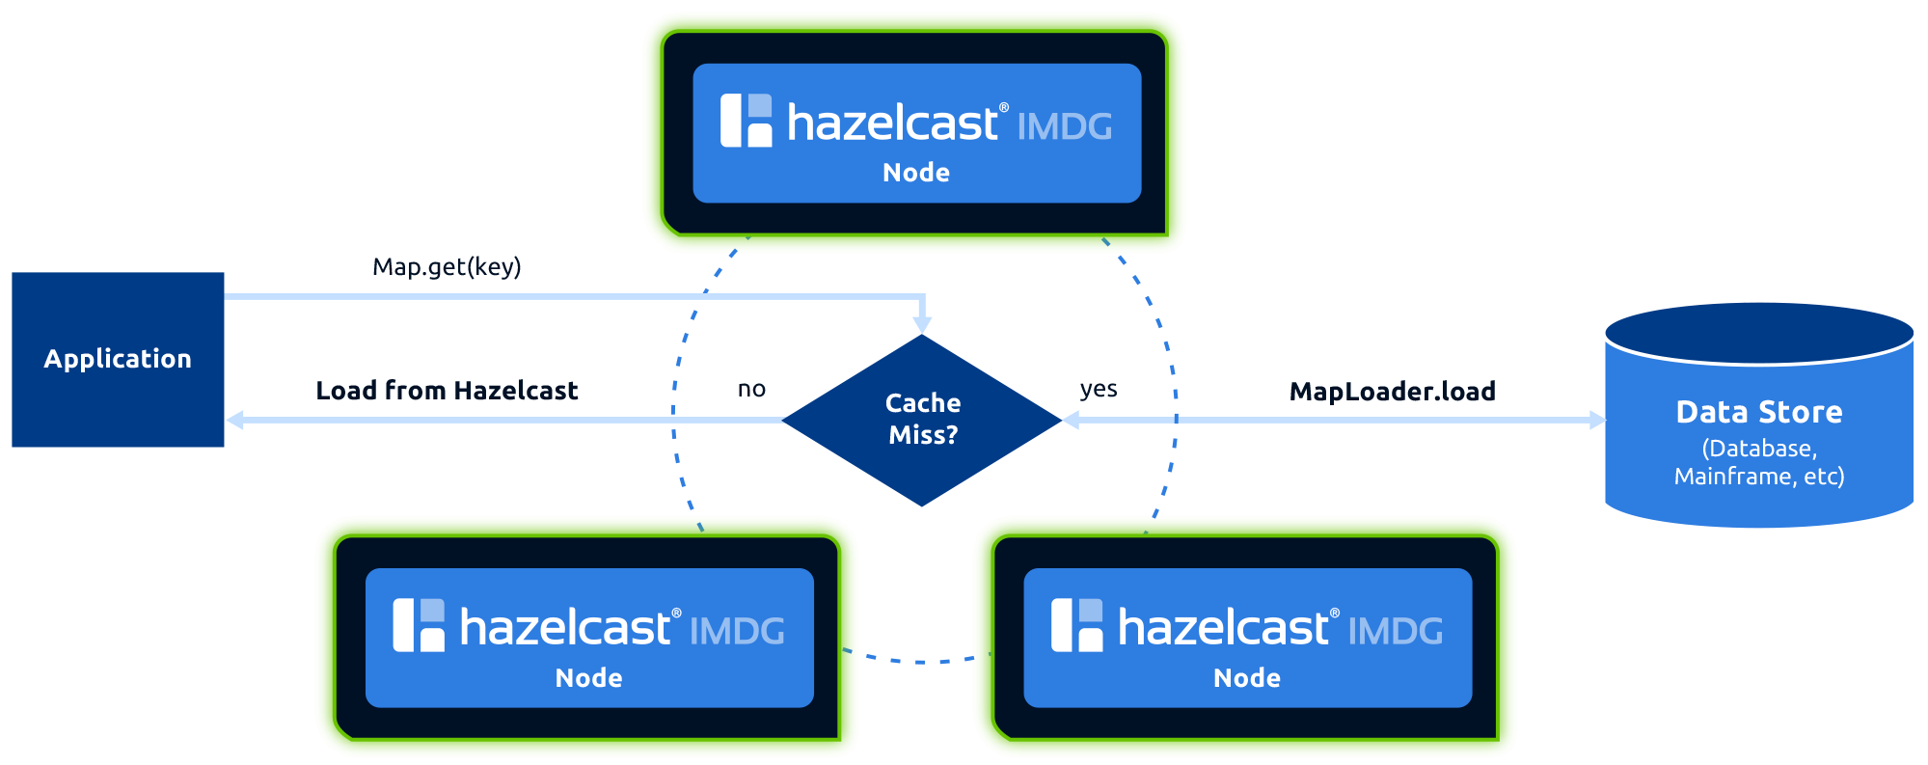
Cache Access Patterns
read-through-cache

Slide 22
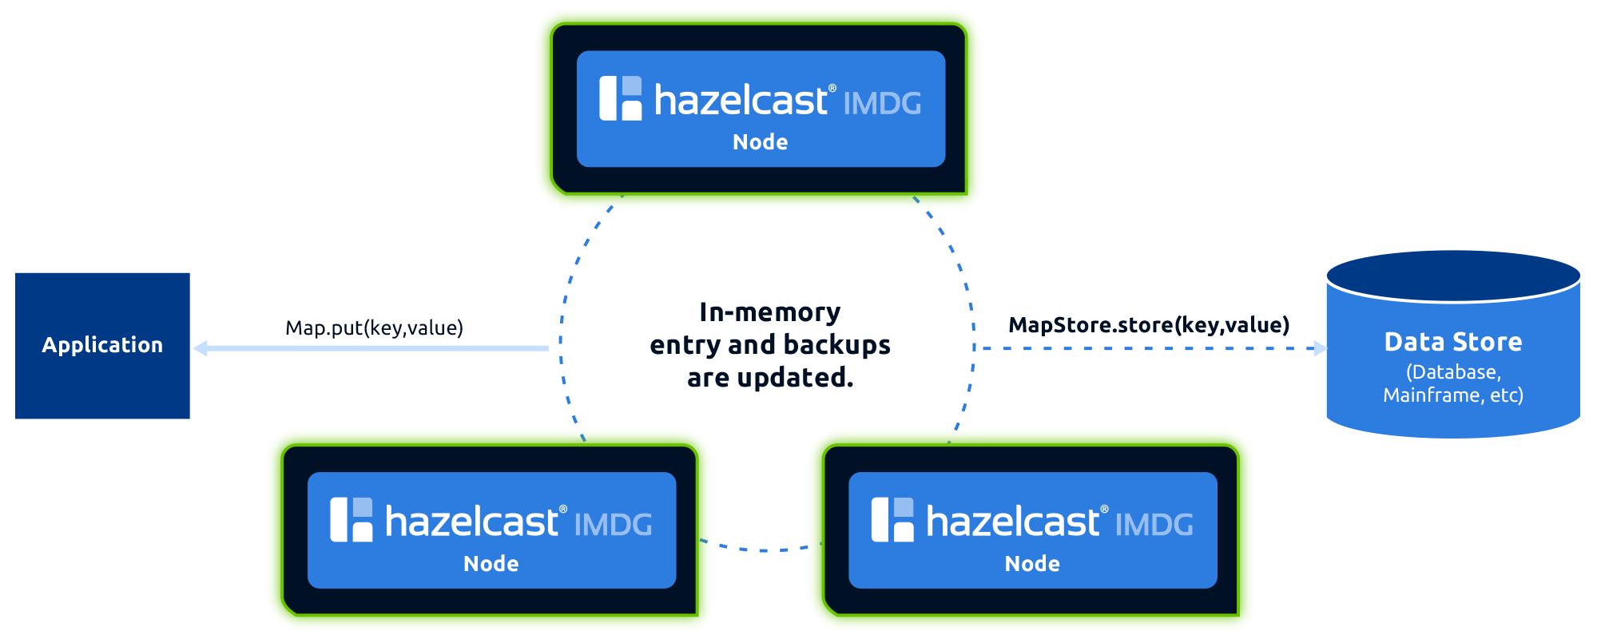
Cache Access Patterns
write-through-cache

Slide 23
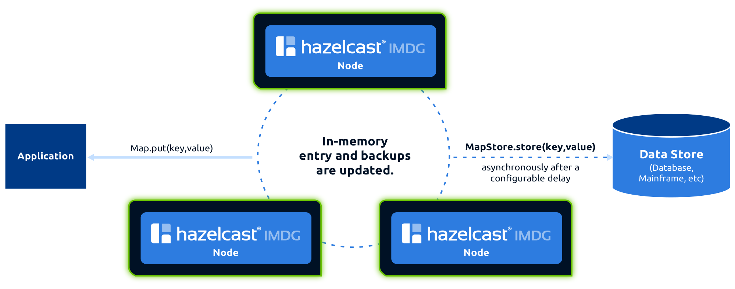
Cache Access Patterns
Write-Behind Cache

Slide 24
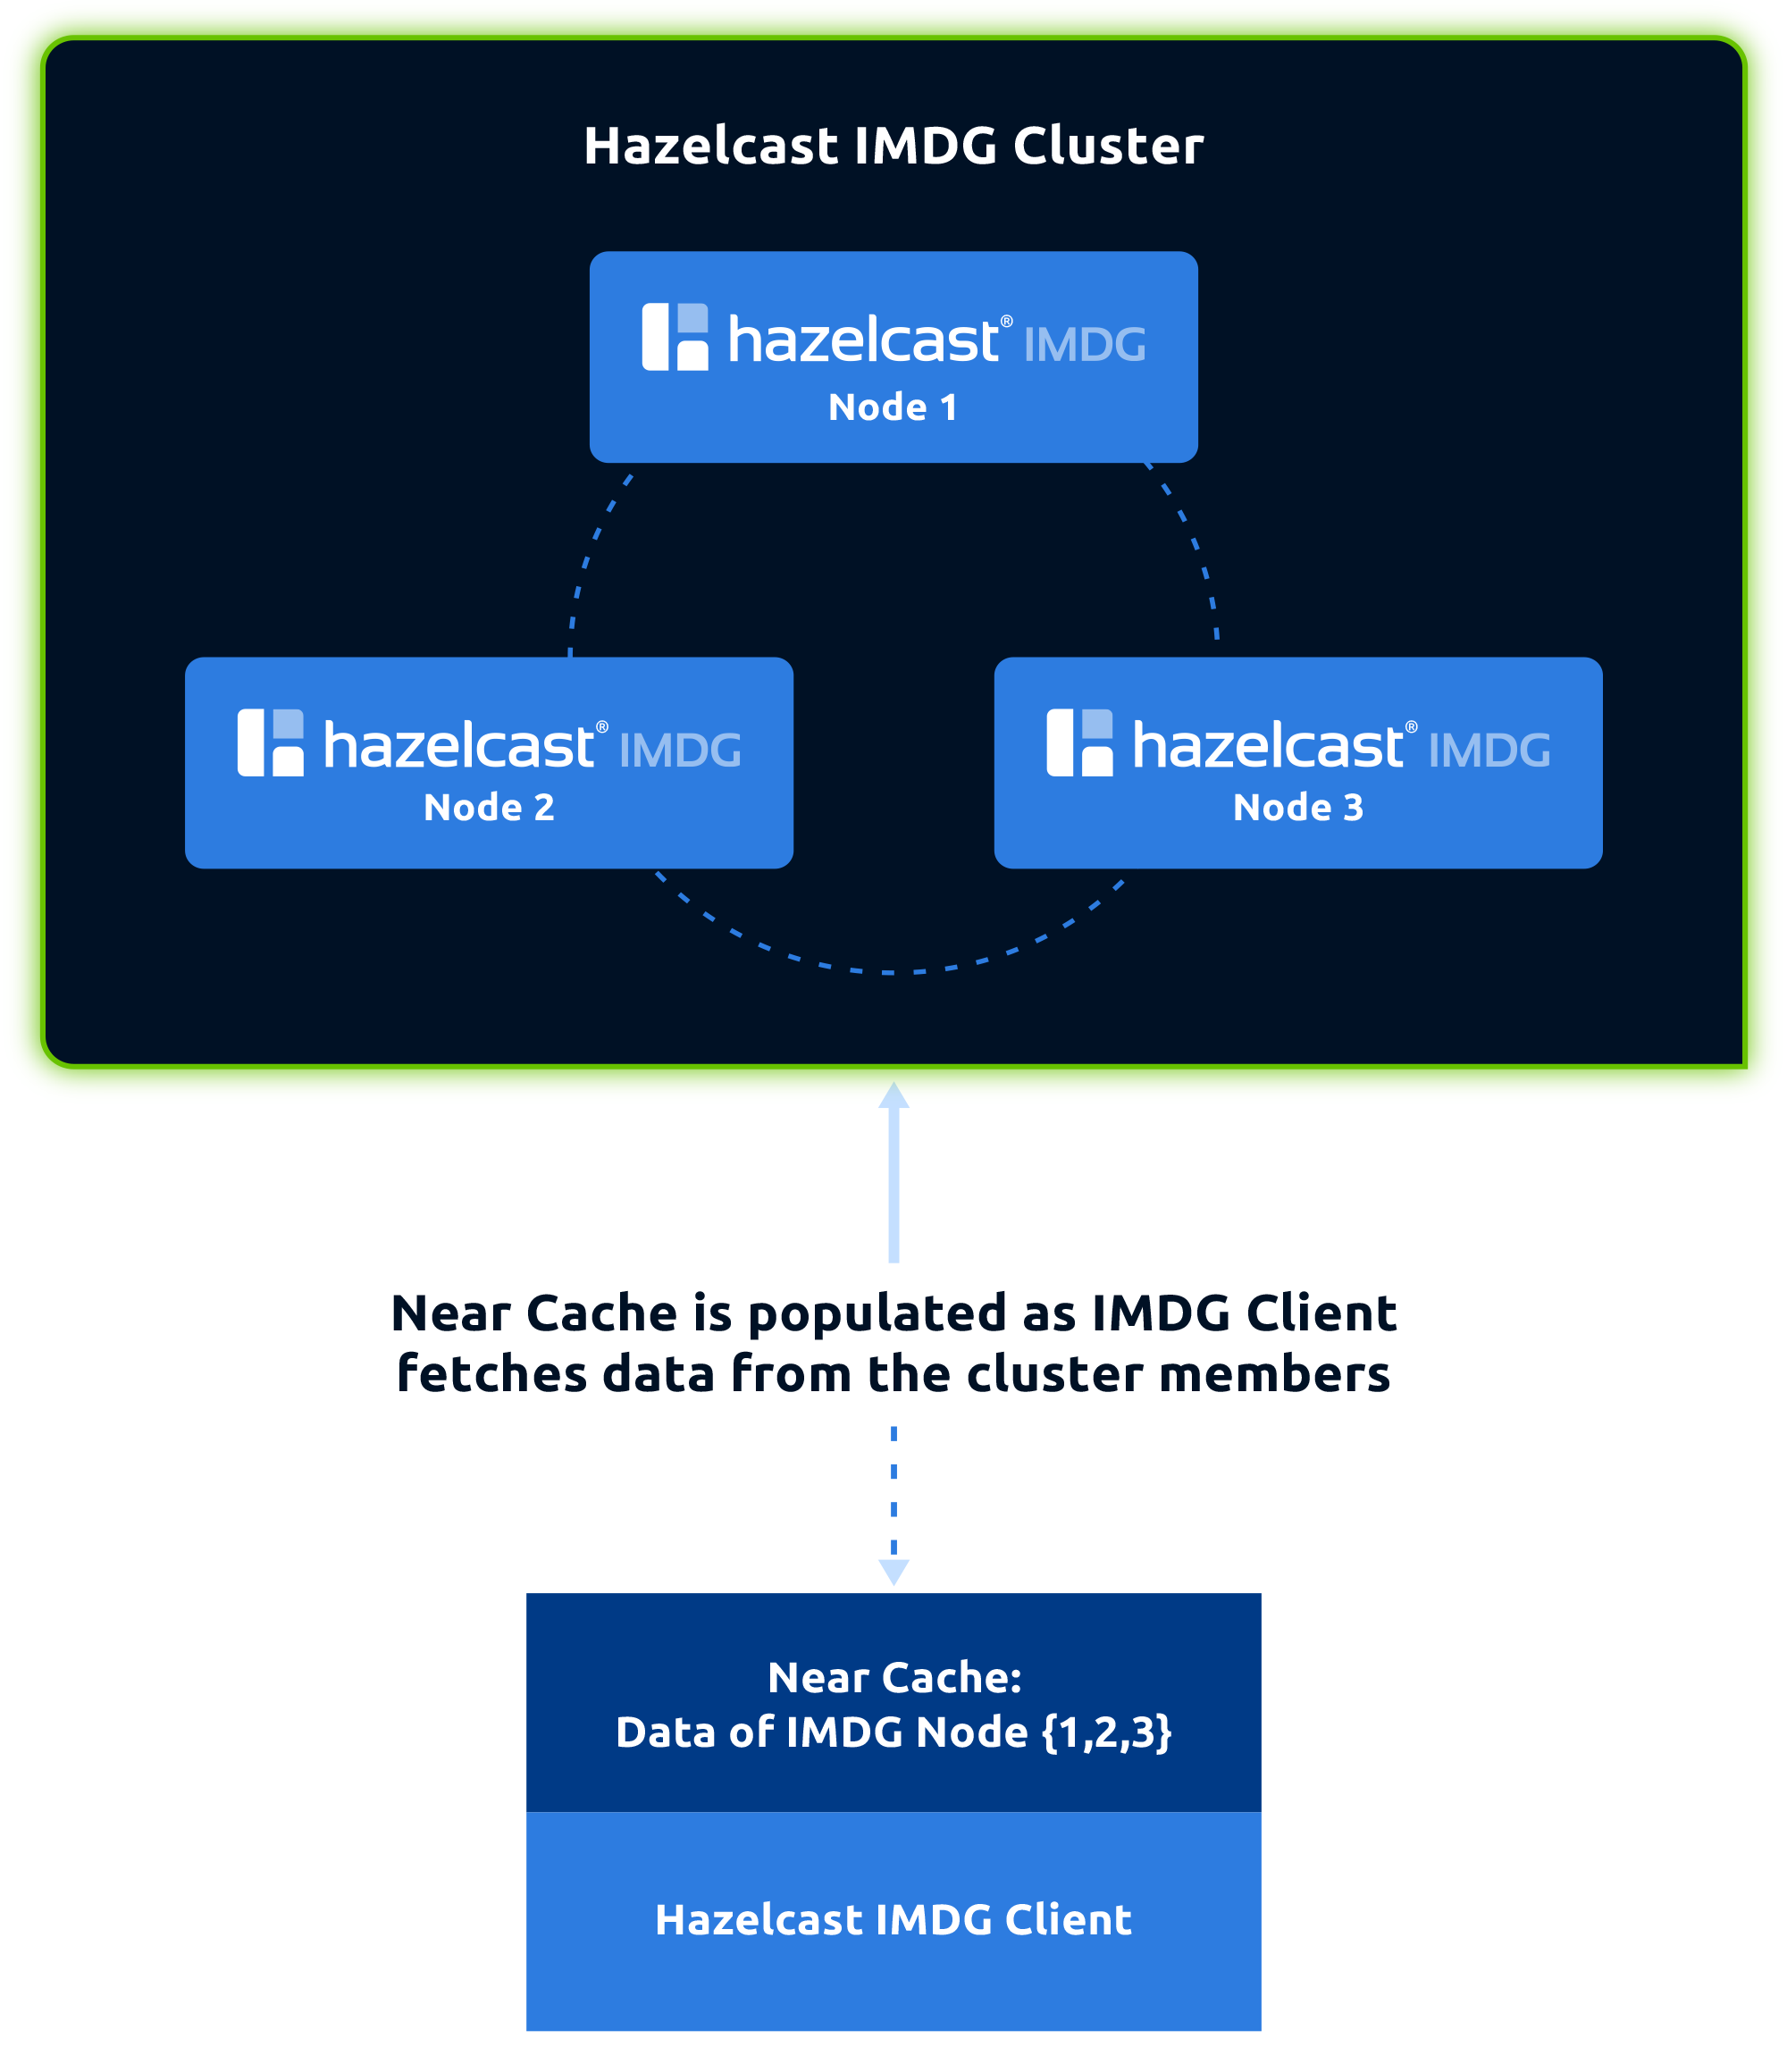
Cache Access Patterns
Near Cache

Slide 25
Distributed Data Structures
Hazelcast has two types of distributed objects in terms of their partitioning strategies:
Data structures where each partition stores a part of the instance, namely partitioned data structures.
2.Data structures where a single partition stores the whole instance, namely non-partitioned data structures.
Notes:
Hazelcast Partition stratejilerine göre iki tip distributed object tipine sahip.

Slide 26
non-partitioned Hazelcast
data structures:
Queue
Set
List
Ringbuffer
FencedLock
ISemaphore
IAtomicLong
IAtomicReference
FlakeIdGenerator
ICountdownLatch
Cardinality Estimator
PN Counter
partitioned Hazelcast data structures:
Map
MultiMap
Cache (Hazelcast JCache implementation)
Event Journal

Slide 27

DATA PARTITIONING
The memory segments in Hazelcast IMDG = partitions
Size of the partitions, i.e., amount of data entries they can store, is limited by the physical capacity of your system.
The partitions are distributed equally among the members of the cluster.
By default, Hazelcast creates a single copy/replica of each partition.
One of these replicas --> PRIMARY
Others --> BACKUPS
The cluster member which owns the "primary" replica of a partition is called the --> "partition owner"

Slide 28
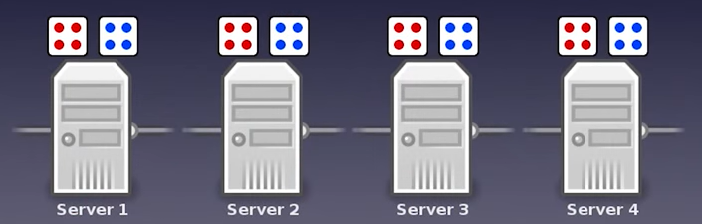
DATA PARTITIONING
With 4 cluster nodes every server holds ¼ real data and ¼ backups
Notes:
(hazelcast offers 271 partition)
2 node var 130 131,
1 node daha gelirse 90 90 91
Yeni node geldikçe partitionlar migrate ediyo

Slide 29
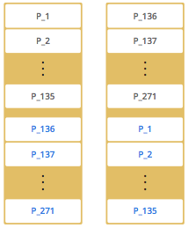
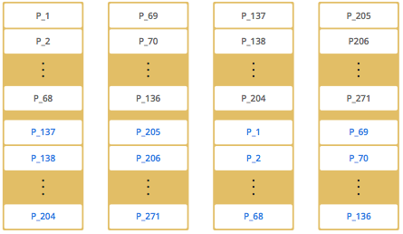

Slide 30
DEMO

Slide 31
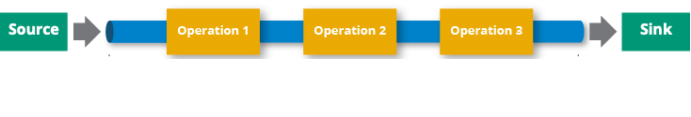
DATA PIPELINES
Pipeline is a series of steps for processing data
Pipeline consists of three elements:
One or more sources: Where you take your data from.
Processing stages: What you do to your data.
At least one sink: Where you send the results of the last processing stage.

Slide 32
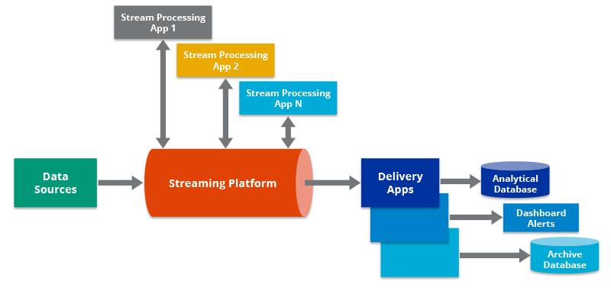
DATA PIPELINES
Pipelines allow you to process data that’s stored in one location and send the result to another such as from a data lake to an analytics database, or into a payment processing system.
Depending on the data source, pipelines can be used for the following use cases:
Stream processing: Processes an endless stream of data such as events to deliver results as the data is generated.
Batch processing: Processes a finite amount of static data for repetitive tasks such as daily reports.
Notes:
Pipeline veriyi işleyerek bir uygulamadan diğerine gönderebilir
Veri kaynağına göre pipeline stream or batch processing de kullanılabilir

Slide 33

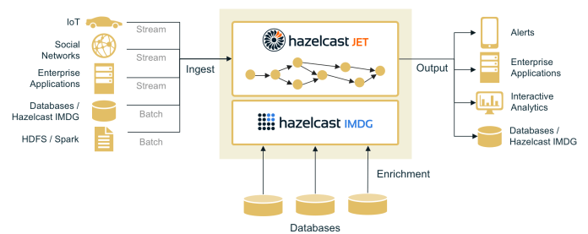
Jet Engine
The Jet engine is a batch and stream processing system that allows Hazelcast members to do both stateless and stateful computations over large amounts of data with consistent low latency.
Jet integrates out of the box with many popular data storage systems such as Apache Kafka, Hadoop, relational databases, message queues and many more.
Jet also comes with a fully-featured, in-memory key-value store. Use it to cache results, store reference data or as a data source itself.
Notes:
Stream processing engine
Stream ve batch processlerini düşük gecikmeyle işler
Apache kafka hadoop gibi data storage systemslerle entegre olabilir

Slide 34
HAZELCAST USE CASES
Increasing the transactions per second and system uptime in payment processing
Authorizing and authenticating the credit cards using multiple algorithms within milliseconds for fraud detection
Decreasing order processing times with low latencies in e-commerce
Being a real-time streamer to detect application performance
Clustering highly changing data with event notifications, e.g., user based events, and queueing and distributing background tasks
Being a distributed topic (publish/subscribe server) to build scalable chat servers for smartphones
Increasing the transactions per second and system uptime in payment processing
Notes:
Kredi kartlarına fraud detection yaparak yetkilendirmeyi milisaniyeler içinde yapabiliriz
E ticaret sitesinde siparişleri düşük gecikmeyle işleyebiliriz
Real time da uygulama performanısını ölçen streamer da kullanılır
Backgroud taskları kuruğa alabilir ve distribute edebiliriz
Kısa bir örnekle açıklayalım.X ve Y isimli iki farklı uygulamamız olduğunu düşünelim.X uygulaması içerisinde uygulamanın bulunduğu sunucunun ram, cpu kullanımı gibi bilgilerin var olduğunu düşünelim.Bu bilgiler 3 saniyede bir Y uygulamamıza göndererek Y uygulaması içerisinde bu değerleri ekrana bastığımız dashboard ekranı olduğunu düşünelim.3 saniyede basılan bu verileri database kullanarak bir tabloyu doldurabiliriz.Fakat bu yöntem bize veritabanında select, insert gibi komutları 3 saniyede bir çalıştırmamız gerektiği anlamına geliyor.Bu bize performans açısından büyük bir problem oluşturacaktır.

Slide 35
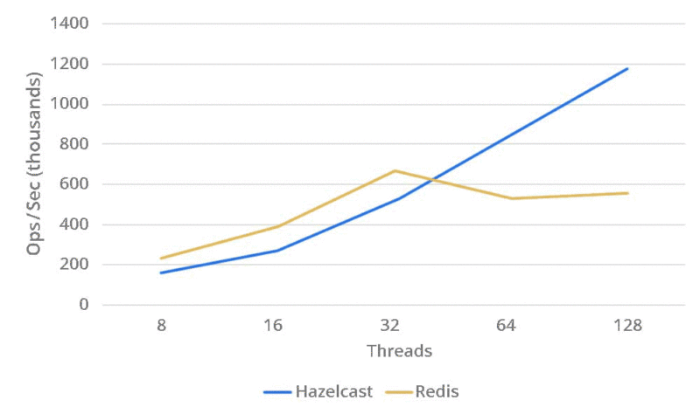
Hazelcast vs Redis

Slide 36
References
https://hazelcast.com/
https://www.youtube.com/watch?v=66Mb72btt2E
https://www.youtube.com/watch?v=DL405QMJ8M8&ab_channel=IstanbulCoders
https://www.javainuse.com/hazelcast

Slide 37
Thank you :)
ANY QUESTİONS?
Thank you ! (:

