Slide 1

AIRLINE PASSENGER SATISFACTION

Slide 2
CONTENT
PROBLEM
MOTIVATION
INTRODUCTION
METHOD
RESULTS
CONCLUSION
REFERENCES

Slide 3
PROBLEM
Customer competition is increasing between sectors day by day.
The development of technology and the consequent expansion of the services offered are among the factors affecting this.
The establishment of new companies is increasing competition. Each company has goals such as gaining new customers, customer satisfaction, customer loyalty.

Slide 4
MOTIVATION
Competition is increasing day by day in the airline sector, which is the fastest and most comfortable transportation of our time. Because in a short time, intercity and intercountry travel have become an indispensable element.
On the other hand, ensuring satisfaction and adding new customers play a key role in increasing earnings.

Slide 5
INTRODUCTION
Customer satisfaction can be defined [11] as an overall customer attitude towards a service provider, or an emotional reaction to the difference between what customers anticipate and what they receive regarding the fulfillment of some needs, goals, or desires.
It is necessary to determine how positive or negative the services provided are received by the customer.
Some services are compulsory for customer’s comfort and reliability. On the other hand, some services are arbitrary for customer’s entertainment and luxurious services.
Services are offered to ease the journey before, during and after the flight.
In terms of some features, not every customer may be offered the same service and quality (business, eco class).

Slide 6
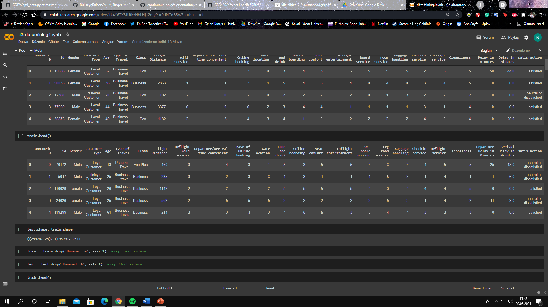
METHOD
In this study, to ensure the satisfaction of airline customers, customer satisfaction is estimated according to the features given by using “Airline Customer Satisfaction” data from Kaggle[3].
Data has 129,880 records and 25 attributes.

Slide 7
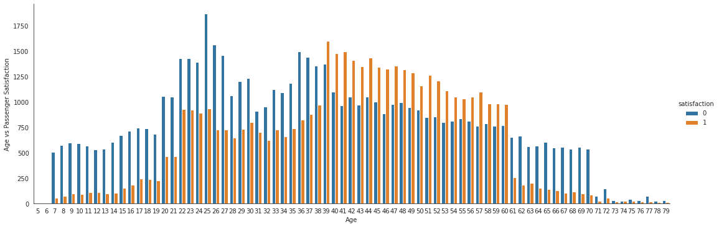
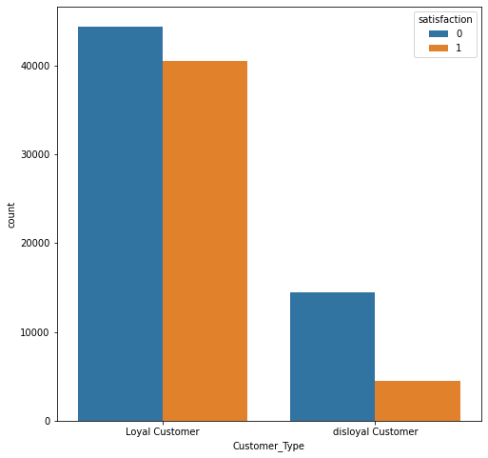
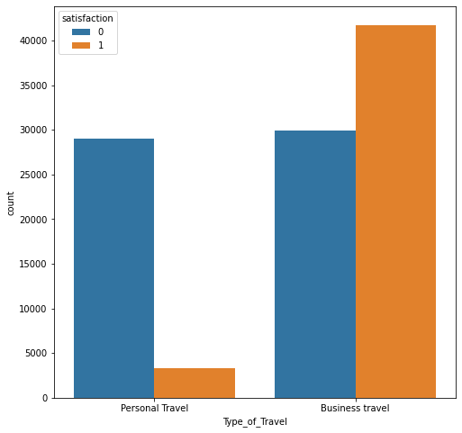

Slide 8
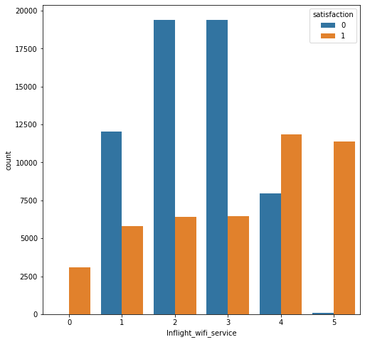
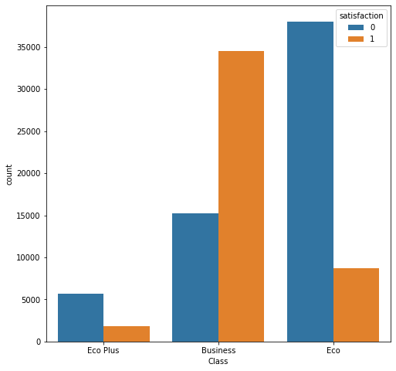

Slide 9
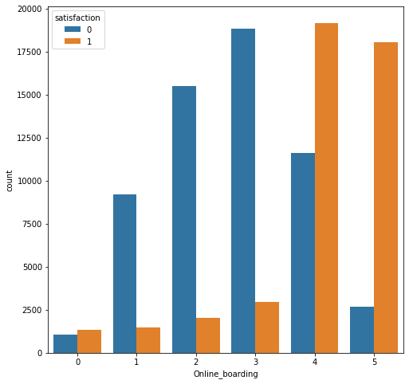
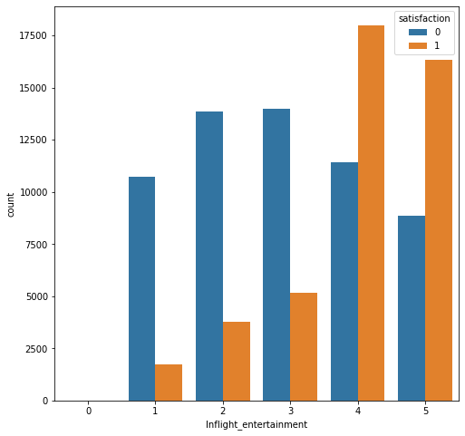

Slide 10
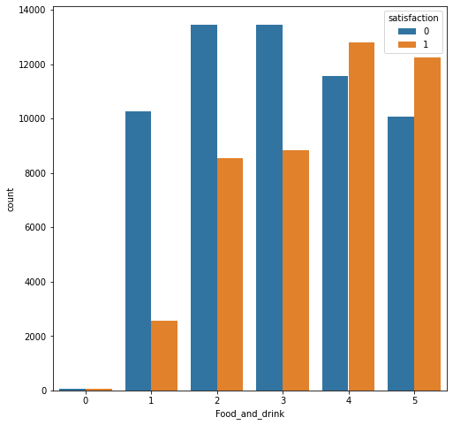
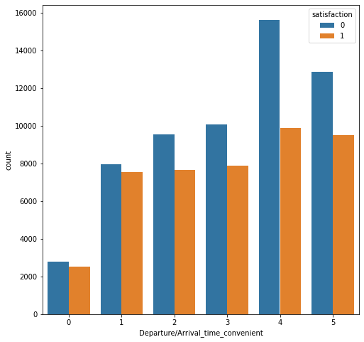

Slide 11
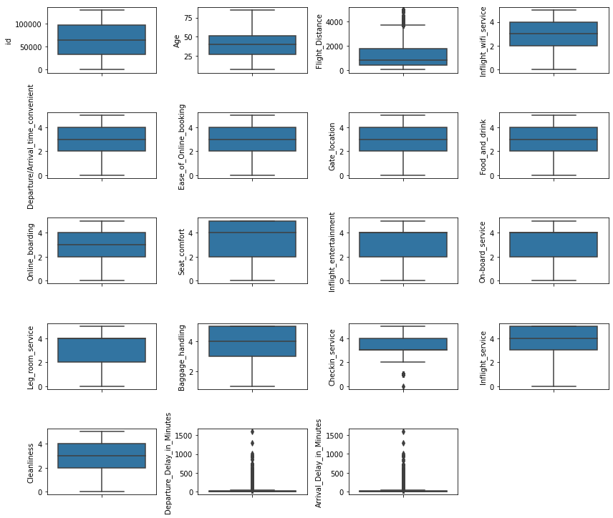
OUTLIER DETECTION
After the visualization outlier graph, 40 values were detected.
Outlier values were dropped from the data.

Slide 12
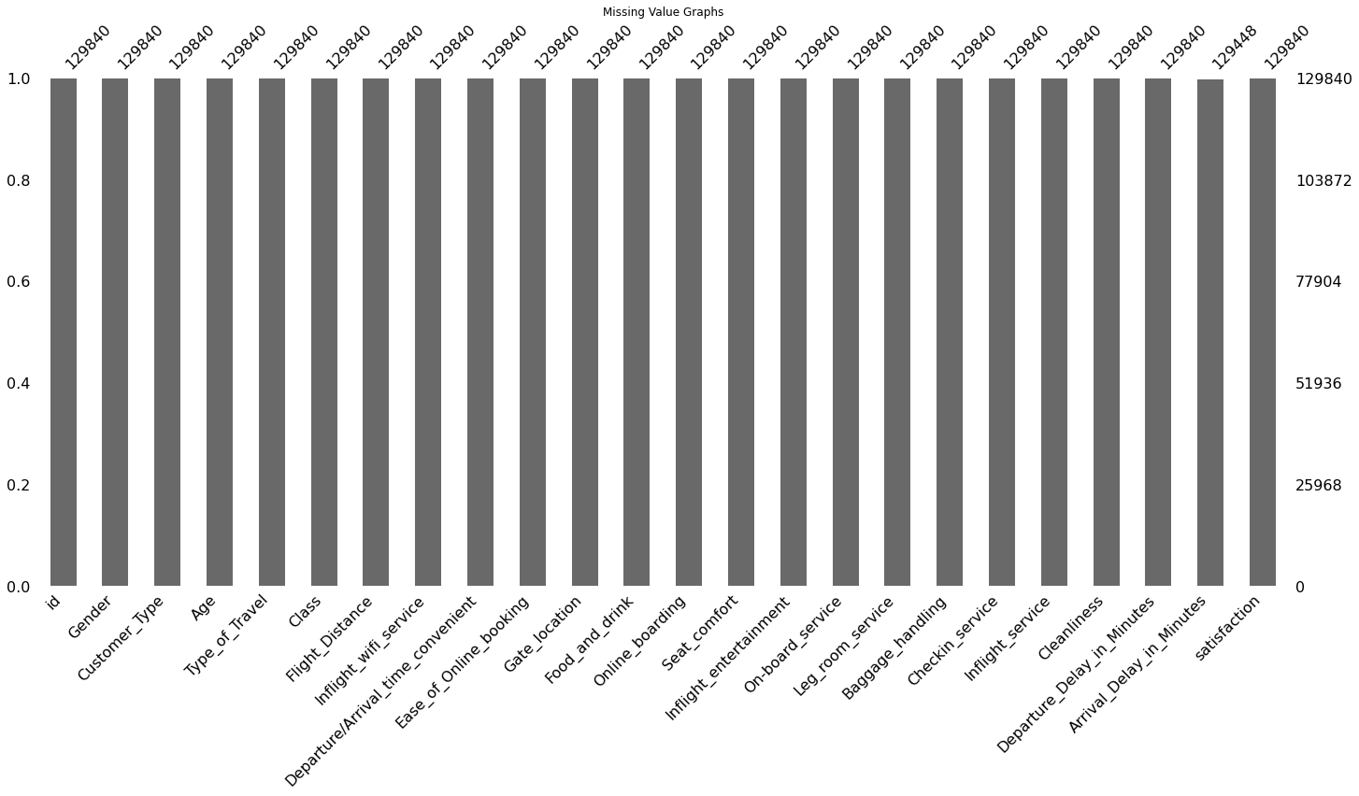
MISSING VALUES
Data has not almost missing values.
Just Arrival Delay in Minutes attribute has 392 missing values.
This column is numeric so, were filled mean values 15. Thus, data is not affected by missing values.

Slide 13
FEATURE SELECTION
Wrapper Method
It [12] work by evaluating a subset of features using a machine learning algorithm that employs a search strategy to look through the space of possible feature subsets, evaluating each subset based on the quality of the performance of a given algorithm. It detects the interaction between variables and finds the optimal feature subset for the desired machine learning algorithm.
Parameter;
n_estimators=100
random_state=0
Type of travel,
Class,
Inflight wifi service,
Online boarding,
Seat comfort,
Inflight entertainment

Slide 14
Chi-Square Method
It [13] is to be used when the feature is categorical, the target variable is any way can be thought of as categorical. It measures the degree of association between two categorical variables. We calculate Chi-square between each feature and the target and select the desired number of features with the best Chi-square scores. It determines if the association between two categorical variables of the sample would reflect their real association in the population.
Parameters:
k=10
Type of travel, Class,
Inflight wifi service,
Online boarding,
Seat comfort,
Inflight entertainment,
Customer Type, Flight distance,
On-board service, Leg room service

Slide 15
DECISION TREE
After data preprocessing data 129,880 and 24 attribute.
Data was split 80:20, train shape is 103864 and 23 attributes. Test data 25976 data and 1 attribute.
Parameter: max_depth = 10, gini index (accuracy: %92)
max_depth = 3, gini index (accuracy: %84)
max_depth = 5, gini index (accuracy: % 88)
Model’s input;
Customer Type,Type of Travel
Class, Flight distance
Inflight wifi service, Online boarding
Seat comfort, Inflight entertainment
On-board service, Leg room service.

Slide 16
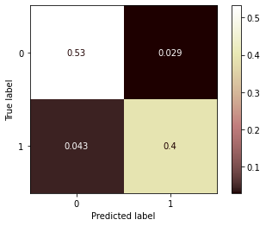
RESULTS
Model results according to the selected features;
Parameter: max_depth = 10, gini index
Accuracy : % 92.84
Time Taken : 0.11017
 | Precision | Recall | F1-score | Support
0 | 0.92539 | 0.94902 | 0.93706 | 14573
1 | 0.93264 | 0.90222 | 0.91718 | 11403
Accuracy |  |  | 0.92847 | 25976
Macro avg | 0.92902 | 0.92562 | 0.92712 | 25976
Weighted avg | 0.92858 | 0.92847 | 0.92833 | 25976

Slide 17
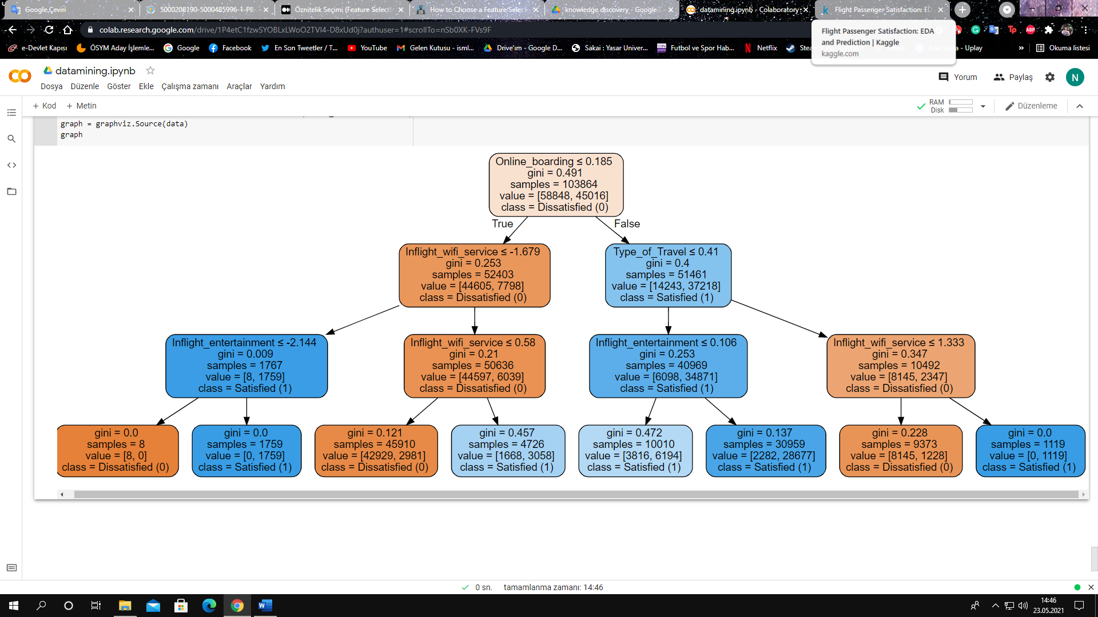

Slide 18
CONCLUSION
Customer satisfaction is of particular importance in each sector. This is the case in the aviation industry. The services that companies offer to ensure the satisfaction of their customers and make them loyal customers are also important. Preprocessing stages and visualizations were performed in the data set used. Wrapper and Chi Square methods were used in the feature selection. The results were tested in the Decision Tree algorithm with Python on Colab environment and the highest accuracy rate was determined at 92%.
With decision tree results, different classification methods can be retested. In this way, the accuracy rate can be increased. Otherwise, change can be examined by adding more features in addition to the study. The data set collected for future studies can be expanded. Weather information can be assessed in the fear or anxiety of passengers. The cost may have been overlooked when focusing on customer satisfaction. Ticket prices can be added to the data set. Most studies in the literature have been found to be text mining-based research. A text attribute can be added to the data set. In this way, studies can be more successful with a diversified data set.

Slide 19
REFERENCES
[1] QIN, Zhicheng. The Factors Influencing Low-cost Airline Passenger Satisfaction and Loyalty in Bangkok, Thailand. 2012. Ph.D. Thesis. University of the Thai Chamber of Commerce.
[2] BASWARDONO, W., et al. Comparative analysis of decision tree algorithms: Random forest and C4. 5 for airlines customer satisfaction classification. In: Journal of Physics: Conference Series. IOP Publishing, 2019. p. 066055
[3] https://www.kaggle.com/teejmahal20/airline-passenger-satisfaction
[4] BATTAL, Sema, et al. at compete A Survey on e-complaints: The case of Turkish Airlines. Journal of Tourism Leisure and Hospitality, 2019, 1.1: 15-21.
[6] BOGICEVIC, Vanja, et al. Visual data mining: analysis of airline service quality attributes. Journal of Quality Assurance in Hospitality & Tourism, 2017, 18.4: 509-530.
[7] OKUMUS, Fevzi, et al. Airport service quality drivers of passenger satisfaction. Tourism Review, 2013.
[8] SEZGEN, Eren; MASON, Keith J.; MAYER, Robert. Voice of airline passenger: A text mining approach to understand customer satisfaction. Journal of Air Transport Management, 2019, 77: 65-74.
[9] RAHIM, A. Ganiyu. Perceived service quality and customer loyalty: The mediating effect of passenger satisfaction in the Nigerian Airline Industry. 2016.
[10] NAMUKASA, Juliet. The influence of airline service quality on passenger satisfaction and loyalty: The case of Uganda airline industry. The TQM Journal, 2013.
[11] HANSEMARK, Ove C.; ALBINSSON, Marie. Customer satisfaction and retention: the experiences of individual employees. Managing Service Quality: An International Journal, 2004.
[12] Younes Charfaoui, Hands-on with Feature Selection Techniques: Wrapper Methods, 2020.
[13] Dr. Saptarsi Goswami, Using the Chi-Squared test for feature selection with implementation, 2020

