Slide 1
READINGLAB · SESSION 0
Least Squares Foundations
Session 0 · what the ridge paper assumes you already know
Nurdaulet Akhanov
Friday, 4 September 2026 · 6 pm · Lecture Hall 1

Slide 2
WHY A SESSION 0
Fourteen pages that take five things for granted
Hoerl & Kennard (1970) never explain these. Today we build them from one table of cars:
• the linear model written as Y = Xβ + ε
• correlation between predictors as an angle
• the eigenvalues of XᵀX, and why a small one is bad news
• least squares: unbiased, with covariance σ²(XᵀX)⁻¹
• error = variance + bias², so unbiased is not the same as accurate
Session 1 uses all five to break least squares, then to fix it.
2

Slide 3
PART I · THE MODEL
Five cars, three numbers each
Car | Weight (t) | Horsepower | Fuel (L/100 km)
1 | 1.2 | 95 | 6.4
2 | 1.4 | 100 | 7.1
3 | 1.0 | 90 | 5.8
4 | 1.8 | 150 | 9.6
5 | 1.6 | 115 | 8.2
We want to predict fuel from the other two columns.
Fuel is the response. Weight and horsepower are the predictors.
3

Slide 4
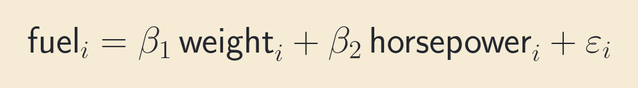
PART I · THE MODEL
From the table to an equation
• β₁ and β₂ belong to the relationship, not to any single car. They are what we want.
• εᵢ is everything the two measurements miss: driver, tyres, weather, the scale.
• No amount of staring at the table reveals β. We will have to estimate it.
4

Slide 5
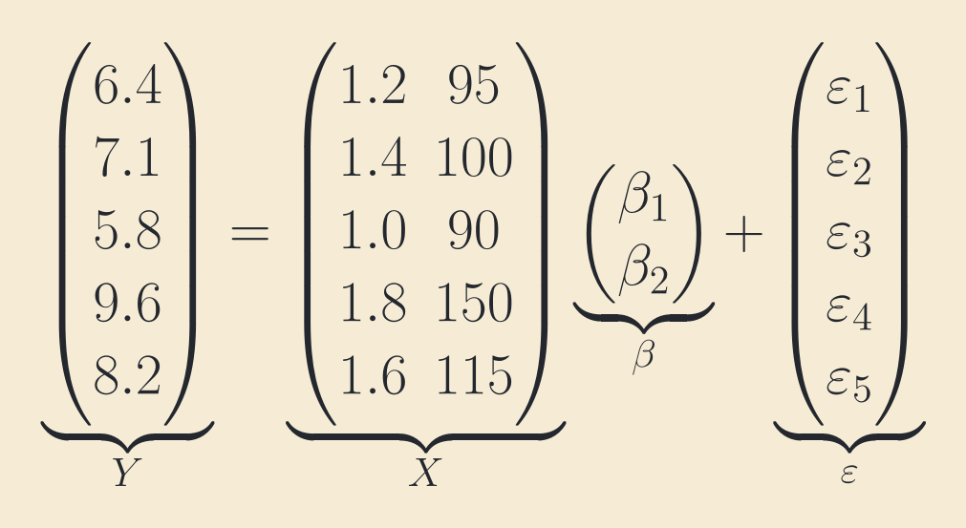
PART I · THE MODEL
Five equations become one
• Y = Xβ + ε. X has n = 5 rows, one per car, and p = 2 columns, one per predictor.
• Every paper on the reading list starts from this line.
5

Slide 6
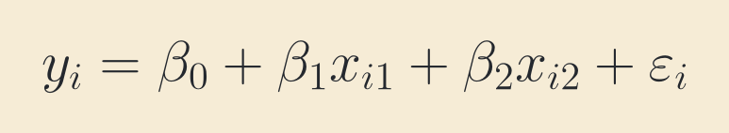
PART I · THE MODEL
The intercept is a question about the origin
• A real model has an intercept β₀; it lets the fitted plane sit above or below zero.
• Without β₀ the fit must pass through the origin: a car with zero weight and zero horsepower.
• Carrying β₀ through every formula is a nuisance. The cleaner move is to relocate the origin.
6

Slide 7
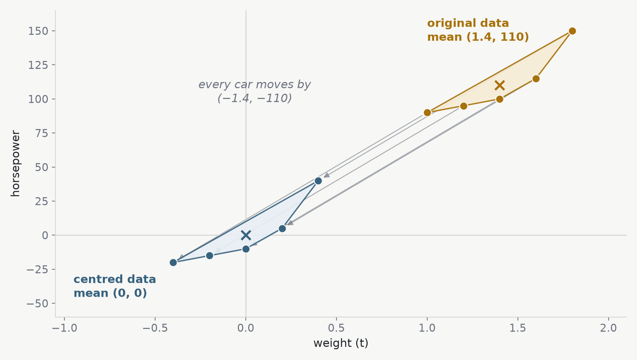
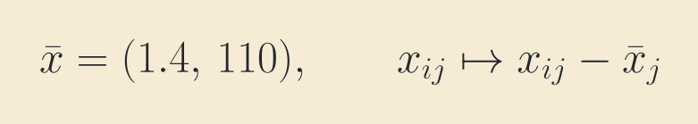
PART I · THE MODEL
Centring moves the origin to the average car
• Subtract each column's mean from every entry, and do the same to y.
• Every car moves by the same vector, so the cloud slides as one rigid piece.
• Distances, angles, and the shape are untouched. Only the mean has moved, to (0, 0).
7

Slide 8
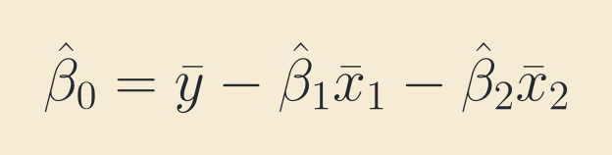
PART I · THE MODEL
What centring buys us
• The average car is now the origin, and its predicted fuel is the average fuel: the intercept is exactly zero.
• So we fit only the slopes, on centred data, from Y = Xβ + ε with no β₀ in sight.
• The intercept comes back for free afterwards. For the cars: β̂₁ = 2.83, β̂₂ = 0.027, β̂₀ = 0.52.
• Ridge regression shrinks slopes, never the intercept. Centring is what keeps the two apart.
8

Slide 9
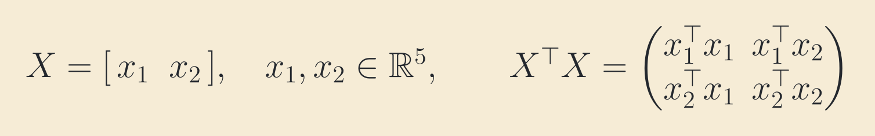
PART II · THE GEOMETRY OF CORRELATION
Predictors are vectors
• Read X by columns: weight is one vector in ℝ⁵, horsepower is another.
• XᵀX collects their dot products. It is p × p, so rows and columns now index predictors, not cars.
• The whole story of this session and the next lives inside that small matrix.
9

Slide 10
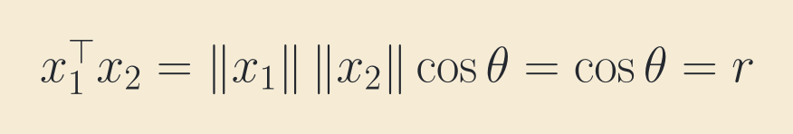
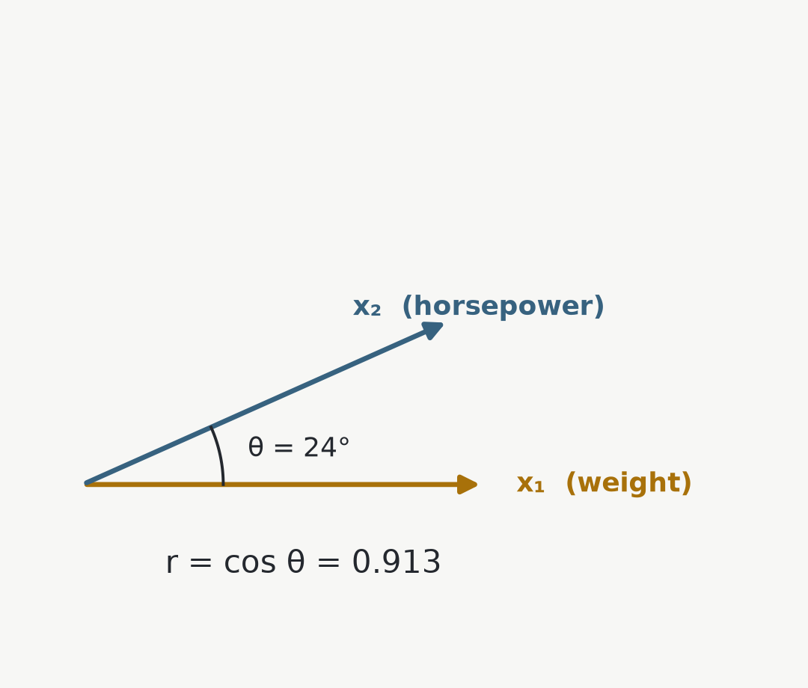
PART II · THE GEOMETRY OF CORRELATION
Correlation is an angle
• Centre both columns and scale each to unit length.
• Their dot product is the cosine of the angle between them, and that is the sample correlation. For the cars, r = 0.913.
• |r| ≤ 1 is Cauchy–Schwarz, nothing more.
• Nearly parallel columns mean nearly redundant predictors.
10

Slide 11
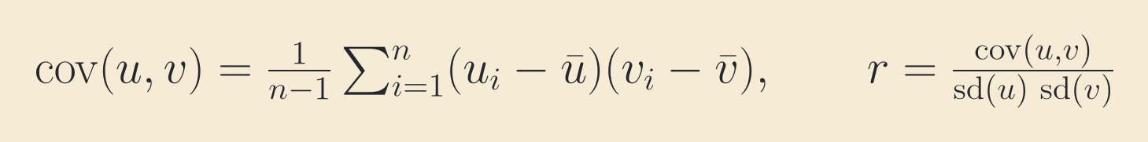
PART II · THE GEOMETRY OF CORRELATION
Why standardize? A detour through covariance
• Covariance is the crude measure of co-movement: centre, multiply entry by entry, average. For the cars, cov(weight, hp) = 7.0.
• But 7.0 of what? Tonne-horsepower. Measure weight in grams and the same five cars give 7 000 000. The number carries the ruler.
• The standard deviation is the typical distance from the mean, in the variable's own units: sd(u) = √cov(u, u). Here sd(weight) = 0.3162 t and sd(hp) = 24.238.
• Divide by the standard deviations and the ruler cancels: 7.0 / (0.3162 × 24.238) = 0.913, in tonnes or in grams alike.
• Standardizing does that division once, on the data itself. Afterwards a plain dot product already is the correlation, and the ridge paper assumes exactly that.
11

Slide 12
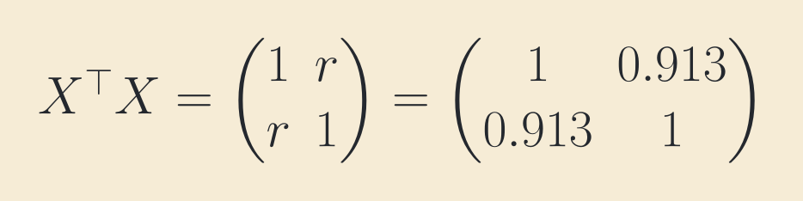
PART II · THE GEOMETRY OF CORRELATION
XᵀX is the correlation matrix
• On the diagonal: squared column lengths, all equal to 1.
• Off the diagonal: the pairwise correlations.
• The trace is p, so the eigenvalues always add up to p. They share a fixed budget.
12

Slide 13
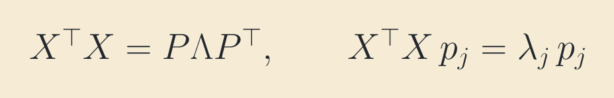
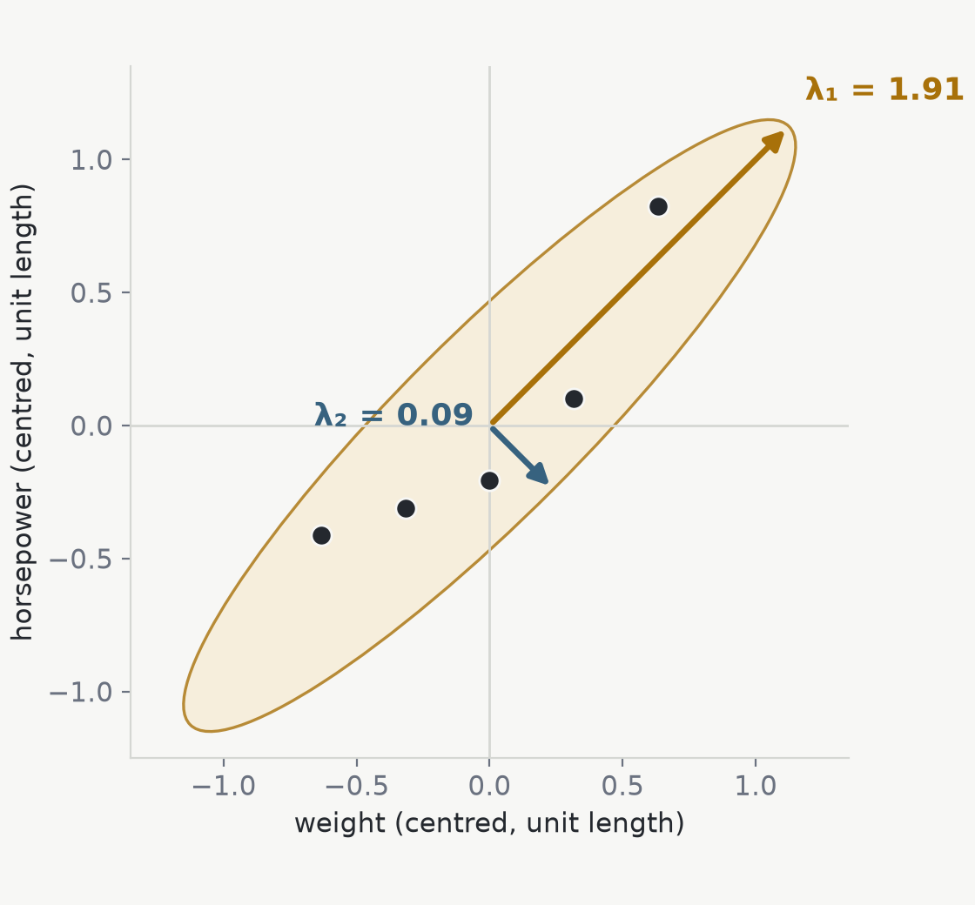
PART II · THE GEOMETRY OF CORRELATION
Eigenvalues: where the information is
• Each eigenvalue is the spread of the data cloud along its eigenvector.
• For the cars: λ₁ = 1.91 along the diagonal, λ₂ = 0.09 across it. They sum to 2.
• Along the short axis the data barely varies. Whatever the coefficients do in that direction, the data cannot tell.
• Remember the small one. Everything in Session 1 is about 1/λ₂.
13

Slide 14
PART II · THE GEOMETRY OF CORRELATION
What we assume about the noise
E[ε | X] = 0 Cov(ε | X) = σ²Iₙ
COV MEANS COVARIANCE MATRIX
Cov(Z | X) = E[(Z − E[Z | X])(Z − E[Z | X])ᵀ | X]
DIAGONAL ENTRIES
OFF-DIAGONAL ENTRIES
Var(εᵢ | X) = σ²
Cov(εᵢ, εⱼ | X) = 0, i ≠ j
Every observation has the same error variance.
Errors from distinct observations are uncorrelated.
Normality is not assumed.
14
Notes:
Cov means covariance matrix. For a random vector, the diagonal contains variances and the off-diagonal entries contain pairwise covariances. Apply the definition to the error vector. Under zero conditional mean, Cov(epsilon given X) equals E of epsilon epsilon transpose given X. The spherical-error assumption sets every diagonal entry to sigma squared and every off-diagonal entry to zero.

Slide 15
PART III · WHAT MAKES AN ESTIMATE GOOD
Least squares: make the leftovers small
NOTATION
β = true coefficients
B ∈ ℝᵖ = candidate
β stays fixed. B is the vector varied during minimization.
φ(B) = ‖Y − XB‖²
gradient with respect to B: −2XᵀY + 2XᵀXB
at B = β̂: XᵀXβ̂ = XᵀY
The minimizing candidate receives the name β̂.
15
Notes:
Use beta only for the true unknown coefficient vector. Use capital B for a candidate value in the optimization. Differentiate phi of B, then call the minimizing candidate beta hat. This notation matches Section 8 of the tutorial.

Slide 16
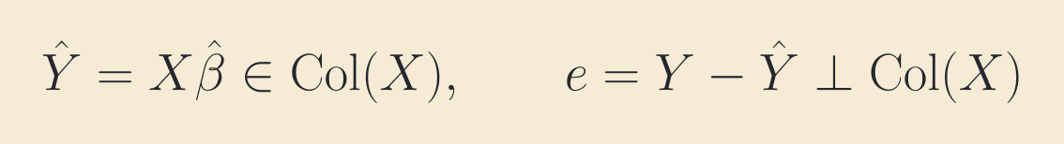
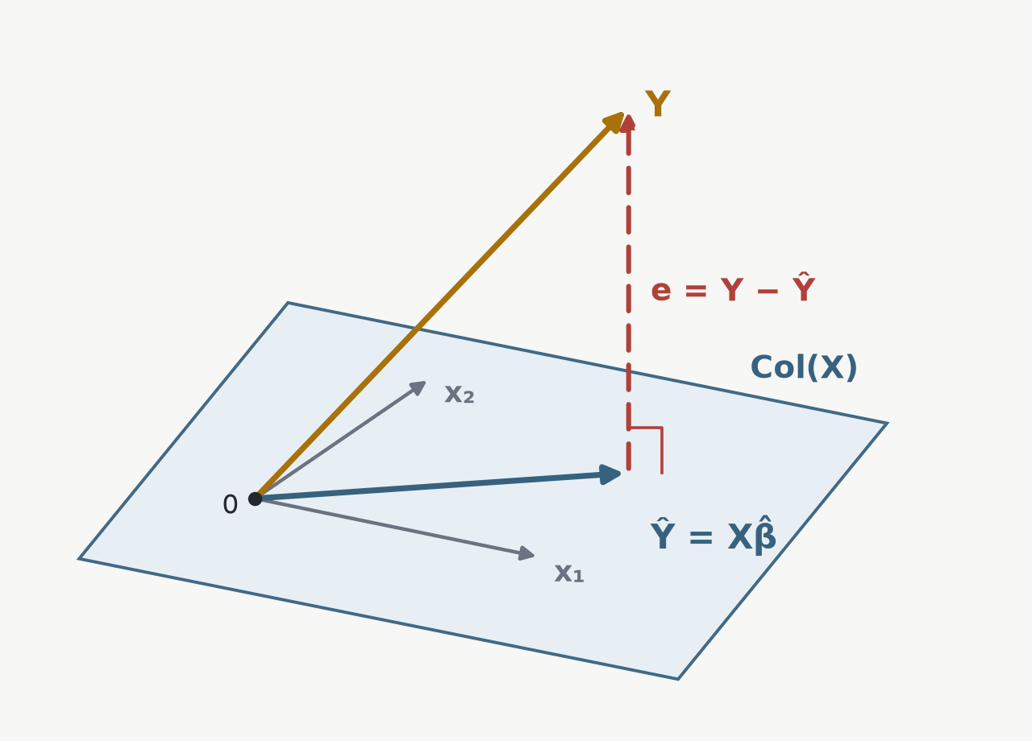
PART III · WHAT MAKES AN ESTIMATE GOOD
Least squares as orthogonal projection
• Every fitted vector has the form XB, so it lies in the column space of X.
• Least squares selects Ŷ = Xβ̂, the point in Col(X) nearest to Y.
• At the nearest point, the residual e = Y − Ŷ is perpendicular to every column of X. Thus Xᵀe = 0, which gives the normal equations.
• Ŷ lives in ℝⁿ. β̂ lives in ℝᵖ and gives the coordinates of Ŷ in the columns of X.
16

Slide 17
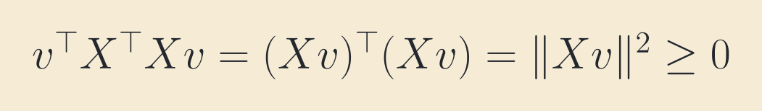
PART III · WHAT MAKES AN ESTIMATE GOOD
When can XᵀX be inverted?
• So XᵀX is positive semidefinite for any X.
• If the columns are linearly independent, Xv ≠ 0 whenever v ≠ 0, the quadratic form is strictly positive, and the inverse exists.
• Nearly dependent columns keep the inverse but make it enormous. That is the ridge paper's whole subject.
17

Slide 18
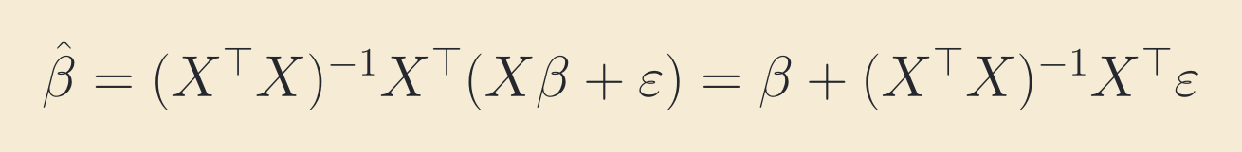
PART III · WHAT MAKES AN ESTIMATE GOOD
The estimate is a random variable
• β and X are fixed. Redraw the noise, and the estimate moves.
• An estimator therefore has a distribution, and we can ask two questions of it:
• where is its centre, and how wide is its spread?
18

Slide 19
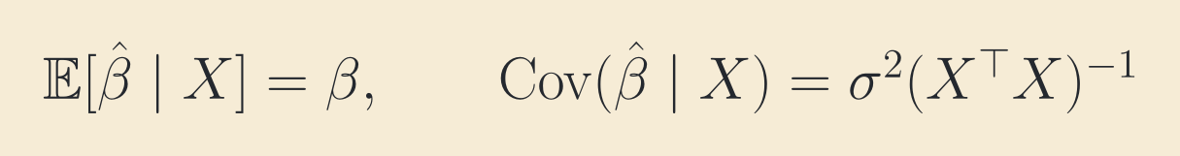
PART III · WHAT MAKES AN ESTIMATE GOOD
Unbiased, with covariance σ²(XᵀX)⁻¹
• The centre is exactly right: least squares is unbiased.
• The spread is the inverse of the correlation matrix. Along eigenvector pⱼ the variance is σ²/λⱼ.
• For the cars: σ²/λ₁ = 0.52 σ² but σ²/λ₂ = 11.5 σ².
• One direction of the estimate is 22 times noisier than the other, and the data caused it.
19

Slide 20
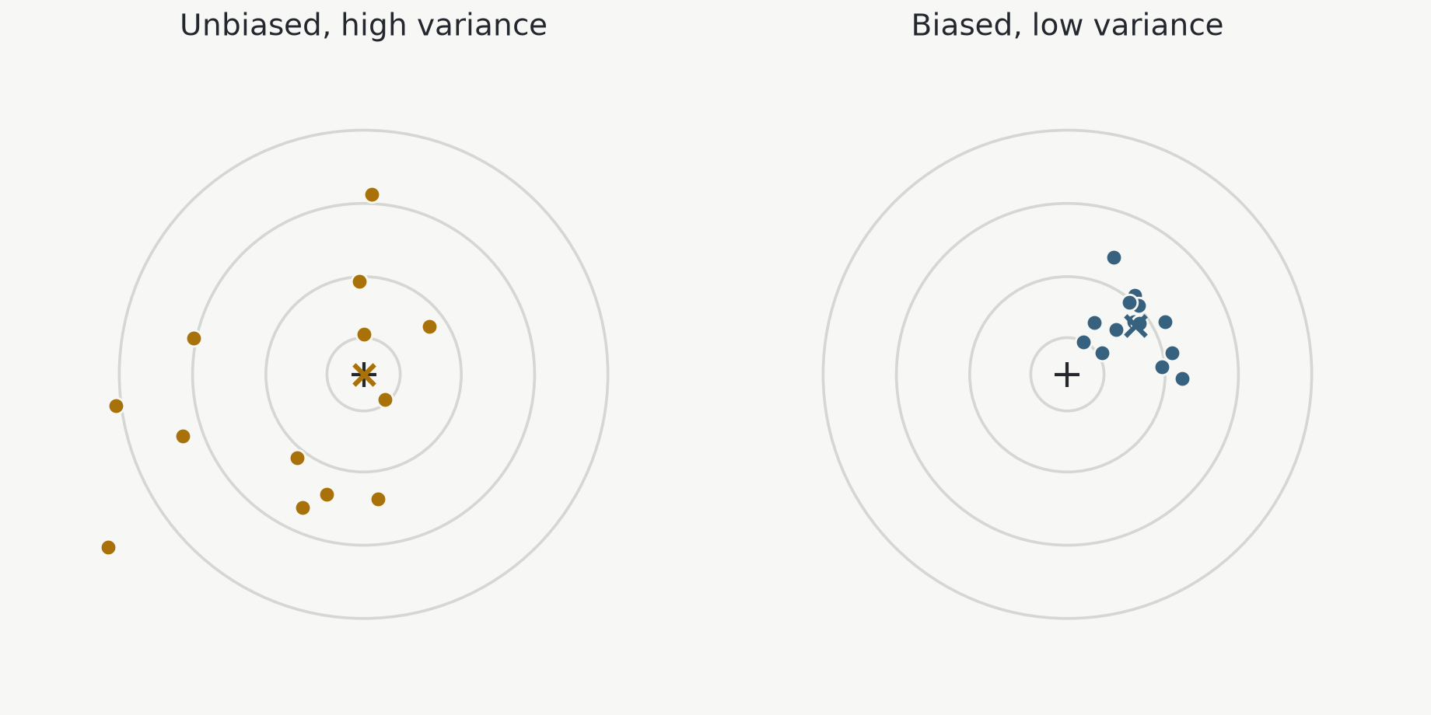
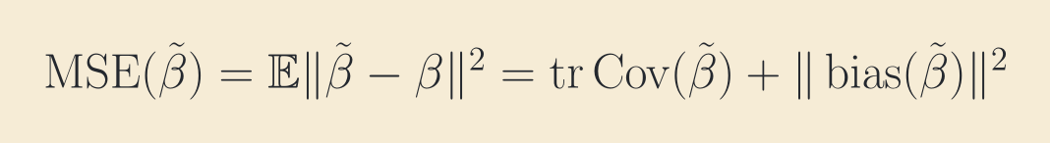
PART III · WHAT MAKES AN ESTIMATE GOOD
Unbiased is not the same as accurate
• Player A is centred on the bullseye but scatters widely. Player B aims a little off and clusters tightly.
• Every single dart of B lands closer. Mean squared error scores both players on the same scale.
20

Slide 21
PART III · WHAT MAKES AN ESTIMATE GOOD
The Gauss–Markov theorem
COMPARISON CLASS
β̃ = CY
CX = I
Linear in Y
Unbiased for every β
Var(aᵀβ̂ | X) ≤ Var(aᵀβ̃ | X) for every a ∈ ℝᵖ
The vector a selects a direction: Var(aᵀβ̂ | X) = aᵀ Cov(β̂ | X)a. Setting a = eⱼ compares coefficient j.
C = (XᵀX)⁻¹Xᵀ + D, DX = 0
Var(aᵀβ̃ | X) − Var(aᵀβ̂ | X) = σ²‖Dᵀa‖² ≥ 0
Ridge is biased, so Gauss–Markov does not compare ridge with least squares.
21
Notes:
Begin with the comparison class. Any competitor has the form beta tilde equals C Y. Unbiasedness for every beta requires C X equals I. The theorem says that ordinary least squares has no larger variance in any direction a. Choosing a standard basis vector compares one coefficient. For the proof, write C as the least squares matrix plus D. The condition D X equals zero removes the cross terms, leaving sigma squared times the squared length of D transpose a. This quantity cannot be negative. Ridge falls outside the theorem because ridge is biased.

Slide 22
PART III · WHAT MAKES AN ESTIMATE GOOD
Where this leaves us
• In the eigenvector basis, every 1/λⱼ becomes 1/(λⱼ + k). The small eigenvalue can no longer explode.
• The price is bias. Session 1 proves that for some k > 0 the trade lowers the mean squared error, always.
• Bring the centred model, the eigenvalues, and the bias–variance split. The paper assumes all three.
22

Slide 23
CLOSING
Exercises I — the matrix XᵀX
1. Prove that XᵀX is symmetric, whatever the shape of X. That is what licenses XᵀX = PΛPᵀ.
2. Prove that vᵀXᵀXv ≥ 0 for every v, so XᵀX is positive semidefinite and its eigenvalues are ≥ 0.
3. Prove that a symmetric M with vᵀMv > 0 for every v ≠ 0 is invertible. When does XᵀX qualify?
4. Prove that unit-length u, v have |uᵀv| ≤ 1, with equality only when parallel. Deduce r = cos θ ∈ [−1, 1].
5. Prove that the eigenvalues of a symmetric matrix sum to its trace. Deduce Σλⱼ = p for standardized columns.
6. Prove that A⁻¹ keeps the eigenvectors and reciprocates the eigenvalues. Deduce the variance σ²/λⱼ along pⱼ.
Work in pairs. Every one of these six is used somewhere in the ridge paper.
23

Slide 24
CLOSING
Exercises II — the model
7. Prove that E[εᵢ] = 0, E[εᵢ²] = σ² and E[εᵢεⱼ] = 0 for i ≠ j are exactly Cov(ε) = σ²I. Which assumption is the diagonal, which the off-diagonal?
8. Derive the normal equations twice: by orthogonal projection, and by differentiating ‖Y − XB‖².
9. Prove that least squares is unbiased and that Cov(β̂ | X) = σ²(XᵀX)⁻¹.
10. Prove E‖β̃ − β‖² = tr Cov(β̃) + ‖bias‖², and show that the cross-term vanishes.
11. For β̃ = cβ̂ with 0 ≤ c ≤ 1, prove the best c is B/(B + V). Is it ever 1?
Mark the line where each assumption about ε enters.
24

Slide 25
CLOSING
Before Session 1 you should be able to prove
1. XᵀX is symmetric and positive semidefinite; positive definite under full column rank.
2. A symmetric matrix with vᵀMv > 0 for every v ≠ 0 is invertible.
3. Unit-length vectors have |uᵀv| ≤ 1, so a dot product of standardized columns is a correlation.
4. The eigenvalues of a symmetric matrix sum to its trace, hence to p under this scaling.
5. A⁻¹ keeps the eigenvectors and reciprocates the eigenvalues, so the variance along pⱼ is σ²/λⱼ.
6. E[εᵢεⱼ] = 0 for i ≠ j and E[εᵢ²] = σ² are exactly Cov(ε) = σ²I.
7. Orthogonal projection gives the normal equations. Full column rank makes the least squares coefficients unique.
8. Least squares is unbiased with covariance σ²(XᵀX)⁻¹.
9. Vector MSE = total variance + squared bias.
10. Gauss–Markov compares only linear unbiased estimators.
11. A biased estimator can have a lower MSE.
Next: Hoerl & Kennard (1970), “Ridge Regression: Biased Estimation for Nonorthogonal Problems”.
25

