Slide 1
CNVC User Manual
Project Name |  | CNVC
System - Features
Methodology | Stage
 | Step
Document Number
Win In | PL | QA | PM | Customer

Slide 2
Revision History
Version | Revision Date | Amendments |  |  | Author | Approver
 |  | Part | Page | Type: Explanation (Before->After)
1.0 | 2023.09.08 |  |  | Revision | Lee Seung-wook
 | 24/3/27 |  |  | Add "Control Belt Move Permit" parameter | Lee Seung-wook
 | 24/7/3 |  |  | Add instructions for setting and applying parameters | Park Si-hyung
 | 24/7/30 |  |  | Adding Parameter Settings and Modifying Modeling Methods | Park Si-hyung
 | 24/9/13 |  |  | Add Parameter Settings | Jeong Min-seok

Slide 3
List
1. How to Install the CNVC Essential Program ........................................................... 4
2. How to Run the CNVC Program and Apply Patches ......................................................... 6
3. Description of CNVC Features and Units ............................................................... 12
4. Troubleshooting Procedures .................................................................... 34
5. Special Scenarios, Parameter Settings, and Application Methods .............................................. 53
6. RemoteView (Remote Access) Settings and Description...................................................................... 94
7. LGCNS.ezControl.Modeler Modeling Method ......................................................... 96
8. How to Use the UI Modeler................................................................... 101

Slide 4
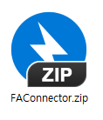
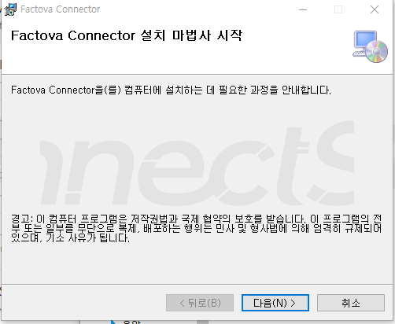
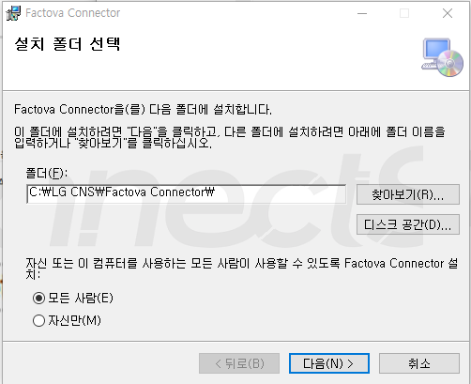
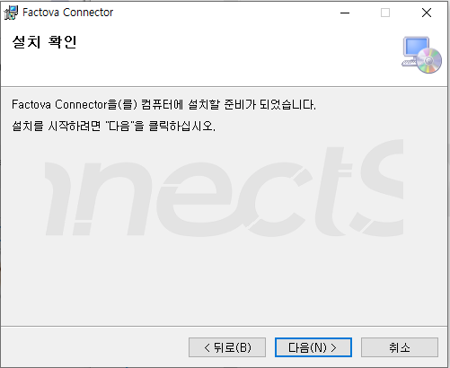
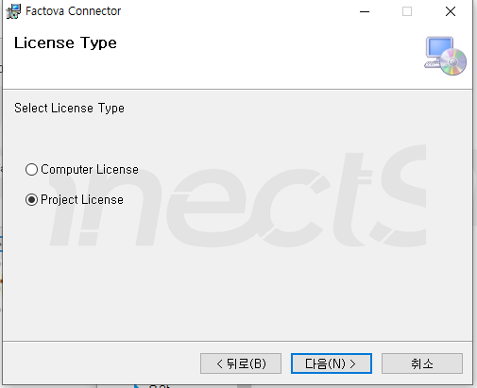
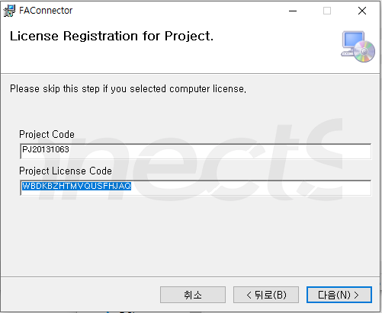
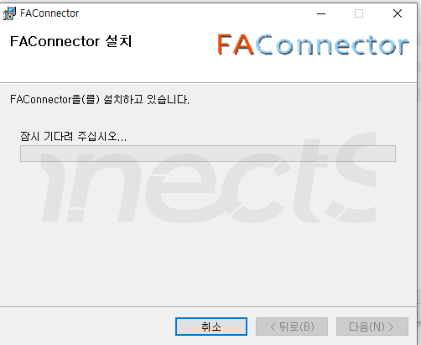
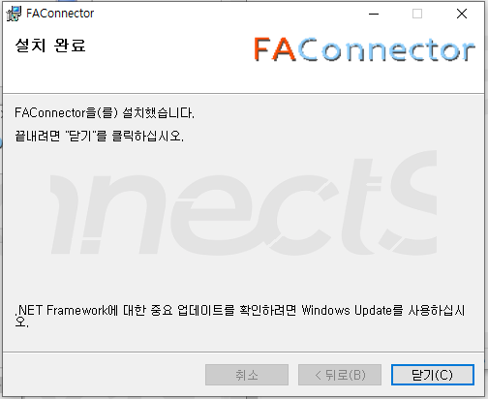
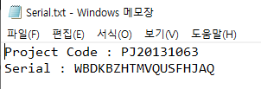
2. CNVC CIM Setup
1. Installing the CNVC CIM Software
Extract the CNV CIM archive from the deployment file
2. Installing the Factova Connector
Unzip the FAConnector.zip file from the distribution package -> Run the FAConnectorSetup.msi file -> Follow the steps shown in the figure below (※Serial number required!!)

