Slide 1
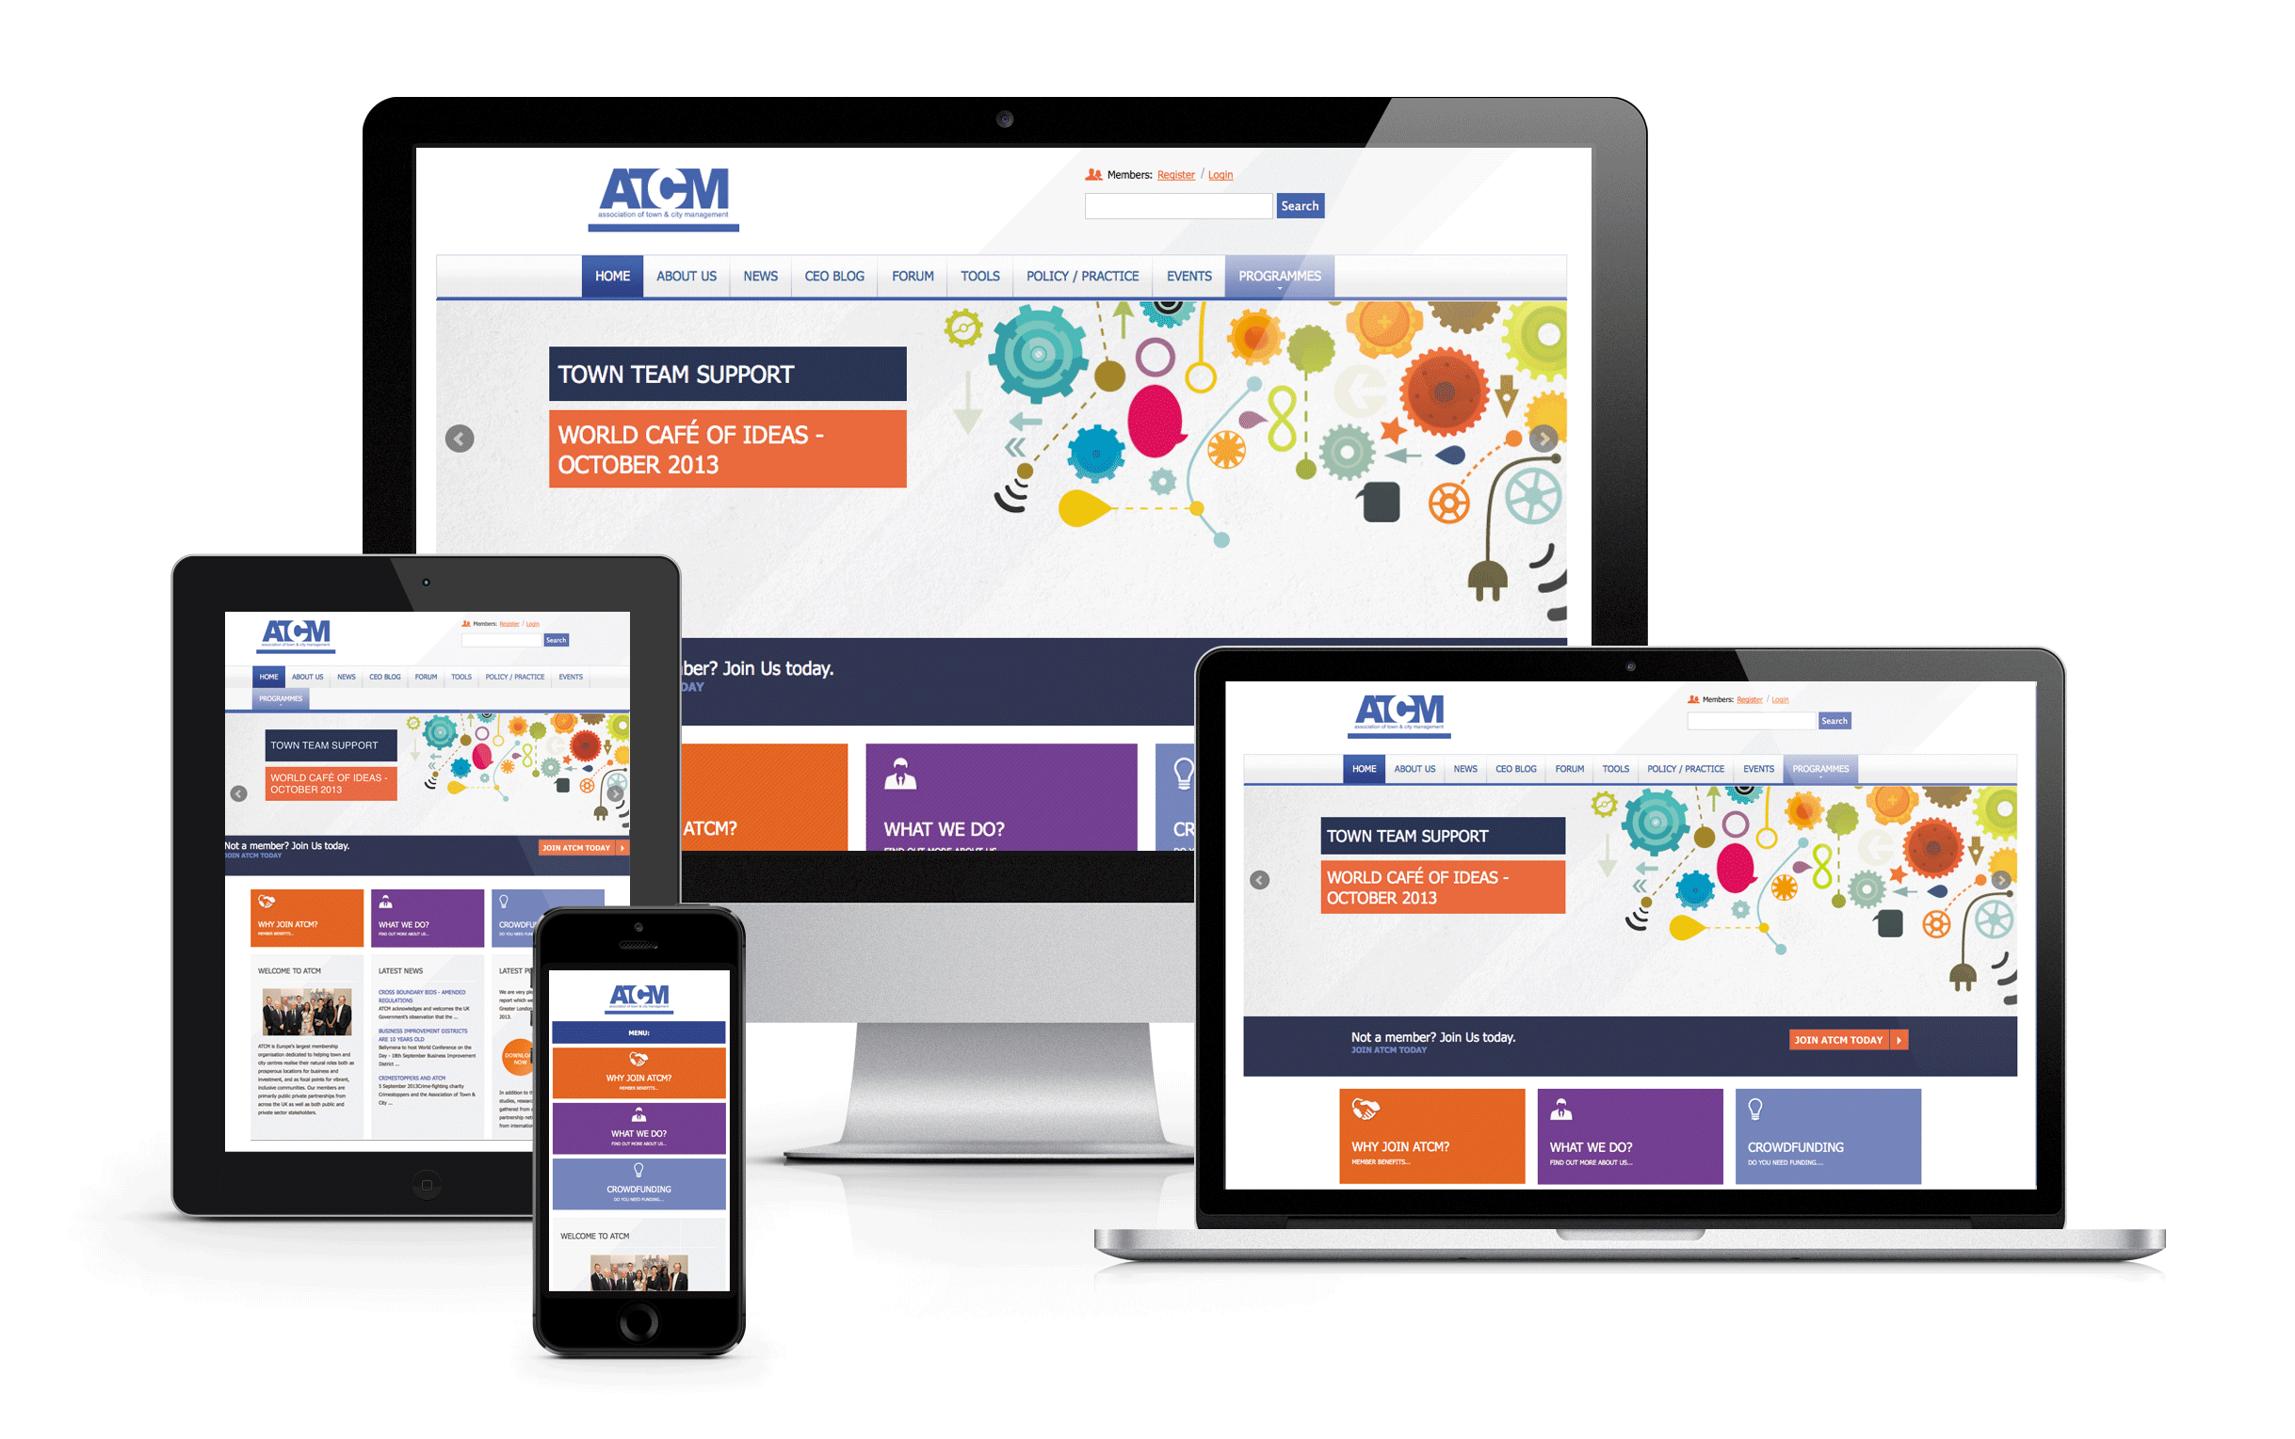
Responsive Web Design
Notes:
NOTE:
To change the image on this slide, select the picture and delete it. Then click the Pictures icon in the placeholder to insert your own image.

Slide 2
What is Responsive Web Design?
Responsive web design makes your web page look good on all devices.
Responsive web design uses only HTML and CSS.
Responsive web design is not a program or a JavaScript

Slide 3
What is The Viewport?
The viewport is the user's visible area of a web page.
The viewport varies with the device, and will be smaller on a mobile phone than on a computer screen.
Before tablets and mobile phones, web pages were designed only for computer screens, and it was common for web pages to have a static design and a fixed size.
Then, when we started surfing the internet using tablets and mobile phones, fixed size web pages were too large to fit the viewport. To fix this, browsers on those devices scaled down the entire web page to fit the screen.
This was not perfect!! But a quick fix.

Slide 4
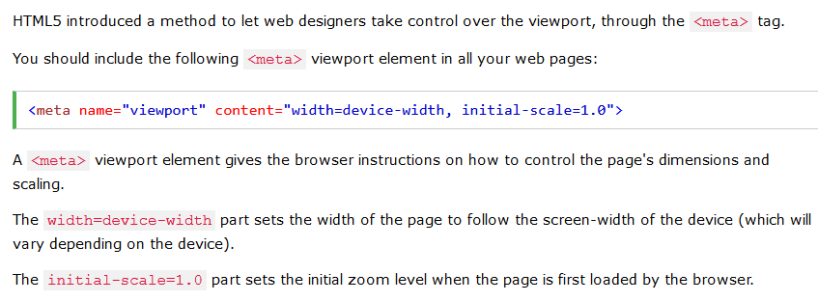
Setting The Viewport

Slide 5
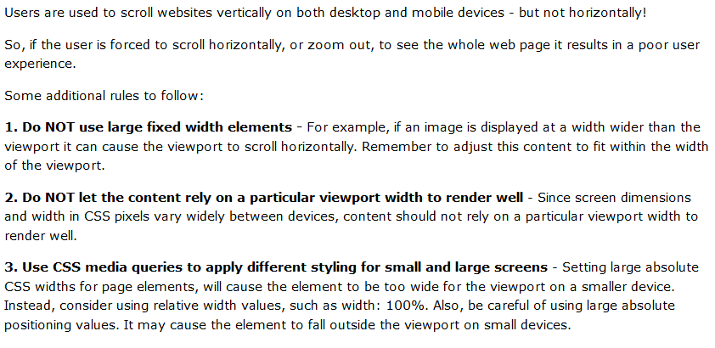
Size Content to The Viewport

Slide 6
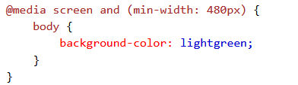
CSS 3 Media Queries
Using media queries are a popular technique for delivering a tailored style sheet to tablets, iPhone, and Androids
Media queries can be used to check many things, such as:
width and height of the viewport
width and height of the device
orientation (is the tablet/phone in landscape or portrait mode?)
resolution

Slide 7
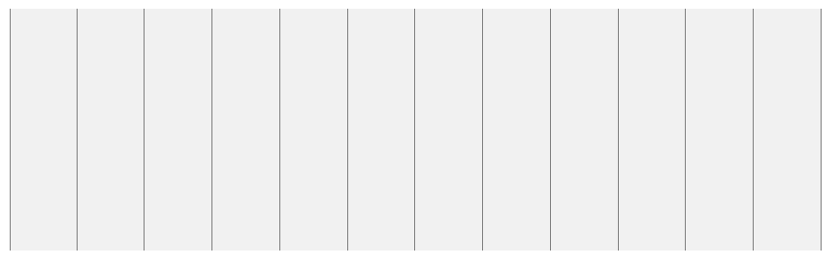
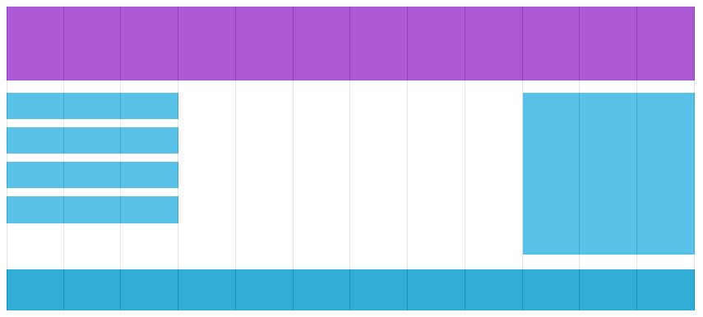
1.What is a Grid-View?
Many web pages are based on a grid-view, which means that the page is divided into columns.
Using a grid-view is very helpful when designing web pages. It makes it easier to place elements on the page.

Slide 8
Steps to Build a Responsive Grid-View
1.Set the view port inside the meta tag
2. First ensure that all HTML elements have the box-sizing property
3.Calculate the column width:-
First we must calculate the percentage for one column: 100% / 12 columns = 8.33%
So each column will have 8.33%,now we can create a class for all 12 columns
.col-1 {width: 8.33%;} .col-2 {width: 16.66%;} .col-3 {width: 25%;} .col-4 {width: 33.33%;} .col-5 {width: 41.66%;} .col-6 {width: 50%;} .col-7 {width: 58.33%;} .col-8 {width: 66.66%;} .col-9 {width: 75%;} .col-10 {width: 83.33%;} .col-11 {width: 91.66%;} .col-12 {width: 100%;}

Slide 9
Steps to Build a Responsive Grid-View
All these columns should be floating to the left, and have a padding of 15px:
[class*="col-"] { float: left; padding: 15px; border: 1px solid red; }
Each row should be wrapped in a <div> The number of columns inside a row should always add up to 12:
we will add a style that clears the flow:-
.row:after { content: ""; clear: both; display: block; }

Slide 10
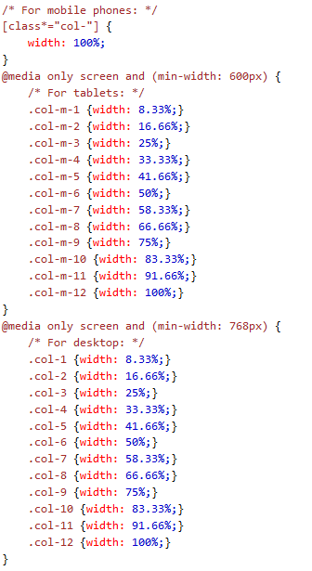
Always Design for Mobile First Media Queries

Slide 11
2.Using Css Grid
CSS Grid Layout (aka "Grid"), is a two-dimensional grid-based layout system that aims to do nothing less than completely change the way we design grid-based user interfaces.
CSS has always been used to lay out our web pages, but it's never done a very good job of it. First, we used tables, then floats, positioning and inline-block, but all of these methods were essentially hacks and left out a lot of important functionality (vertical centering, for instance).
Flexbox helped out, but it's intended for simpler one-dimensional layouts, not complex two-dimensional ones (Flexbox and Grid actually work very well together).
Grid is the very first CSS module created specifically to solve the layout problems we've all been hacking our way around for as long as we've been making websites.

Slide 12
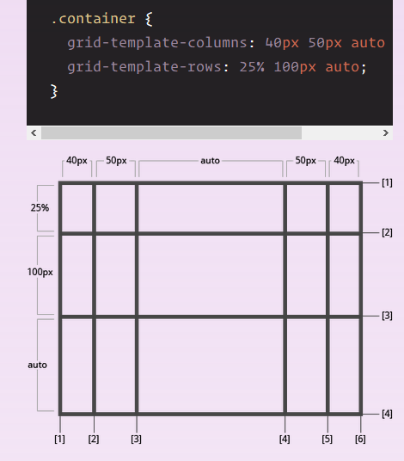
2.Css Grid
Read More
https://css-tricks.com/snippets/css/complete-guide-grid/

Slide 13
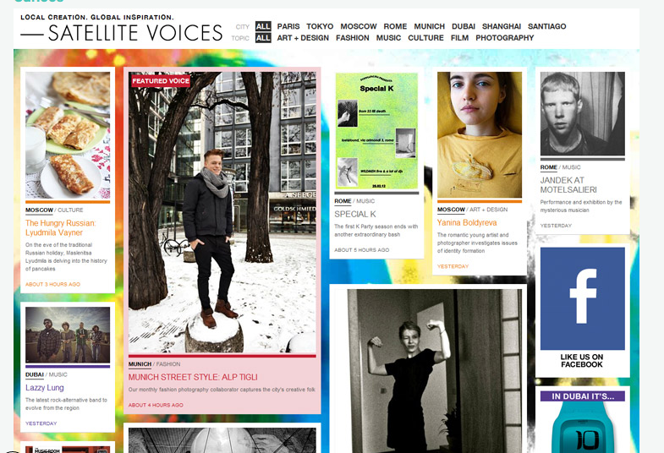
3.Web Pages Created By Css Grid
SEE More Examples
https://www.awwwards.com/30-grid-based-websites.html

Slide 14
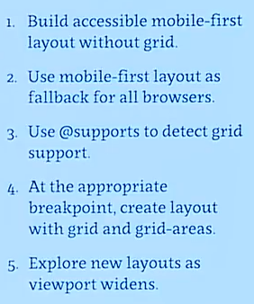
3.Grid Tips

Slide 15
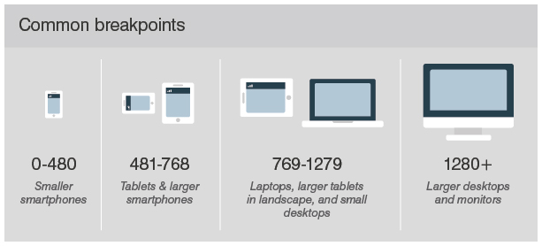
Common Break Points

