Slide 1
The Box Model
Margin
Padding
Border
Content
Notes:
NOTE:
To change the image on this slide, select the picture and delete it. Then click the Pictures icon in the placeholder to insert your own image.

Slide 2
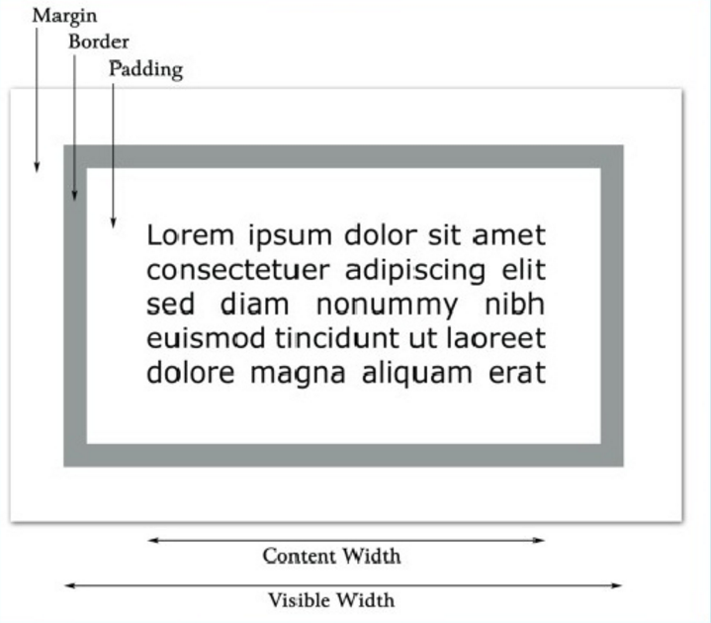
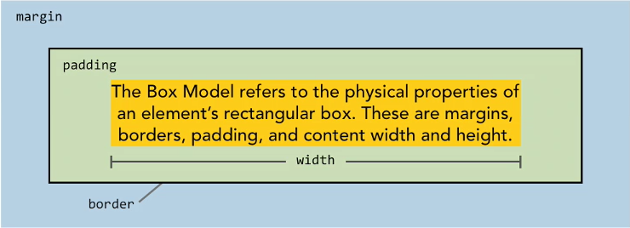
The Box Model > Styling Container Elements
The box model is a term used to describe the rules and properties surrounding the physical properties of all HTML elements on the page.
All elements on your webpage are considered to be a rectangular box. The properties of this box, its width, height, padding and margin define not only the size of the element but how it relates to the elements around it. Without these properties we wouldn’t be able to control layout at all.
Notes:
Margins calculate, but they will be sacrificed.
If large width, overflow happens. (show it)
overflow: hidden/scroll/auto

Slide 3
The Box-Model > Border
Three different ways you can apply borders in terms of syntax.
Border Syntax:
/* Verbose */ 12 times
border-top-width: width;
border-top-color: color;
border-top-style: style;
/* Directional Shorthand Notation */ 4 times
border-top: width style color;
/* Uniform Shorthand Notation */ 1 time
border: width style color;

Slide 4
The Box-Model > Border
Example:
border-top-width: 1px;
border-top-color: #000;
border-top-style: solid;
border-top: 1px solid #000;
border: 1px solid #000;

Slide 5
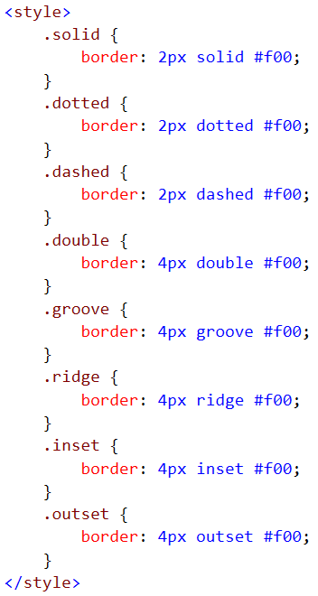
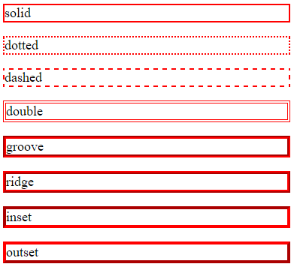
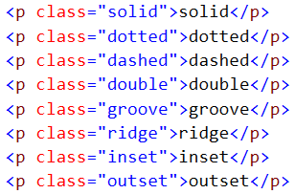
The Box-Model > Border
Different border styles example
Use a higher value (>= 3px) for double, groove, ridge, inset, outset

Slide 6
The Box-Model > rounded-corners
You can create rounded corners by using the border-radius property.
border-radius Syntax
border-radius: allsides;
border-radius:50px:
border-radius: topleftandbottomright bottomleftandtopright;
border-radius: 15px 50px
border-radius: topleft bottomleftandtopright bottomright;
border-radius: 15px 50px 30px:
border-radius: topleft topright bottomright bottomleft;
border-radius: 15px 50px 30px 5px
border-top-left-radius: value;
border-radius: horizontalradius/verticalradius;

Slide 7
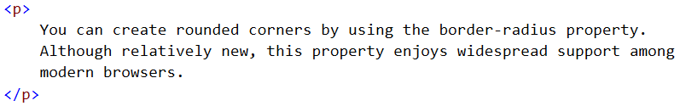
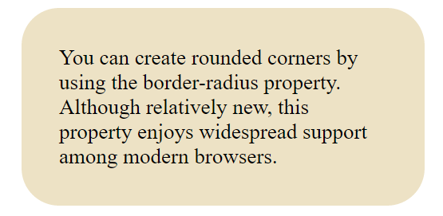
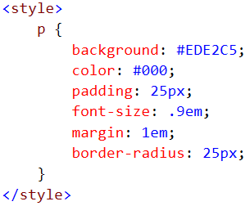
The Box-Model > rounded-corners

Slide 8
The Box Model > margin (element-spacing)
Margins help us control the spacing between elements and can be specified individually for the top, right, bottom and left sides of an element.
Syntax:
margin-top: value;
Auto margins example:
.four p { width: 80%; margin-right: auto; margin-left: auto; }
Centers the paragraph horizontally
Auto: it takes whatever is left over from the width of an element and go ahead and apply the margin to that.

Slide 9
The Box-Model > Padding
The space inside an element is controlled through three properties.
Width
Height
Padding
Padding is the space between an element content and the inside edge of its border.
Primarily used to keep content away from its edge.
Example:
padding-left: 50px;
Padding has a cumulative effect on the total height and width of an element.

Slide 10
The Box-Model > Short Hand (Margins and Padding)
Short Hand Syntax: (works for both margin or padding)
margin: top right bottom left;
padding: top leftandright bottom;
margin: topbottom leftright;
padding: allsides;
Example:
margin: 10px 15px 20px 30px;
padding: 10px 20px 15px;
margin: 10px 30px;
padding: 30px;

Slide 11
The Box-Model > Element Sizing
Width of an element is the summation (cumulative) of the width, padding and margin values.
The width property is a content width.
If no height is defined, the height of the elements will be calculated based on borders, padding, and content. Margins are used in calculating overall width and height, but are not actually considered part of the container width and height and are the first to be sacrificed if the element's width and height no longer fits within the parent.
Account all properties when designing a box to fit.

Slide 12
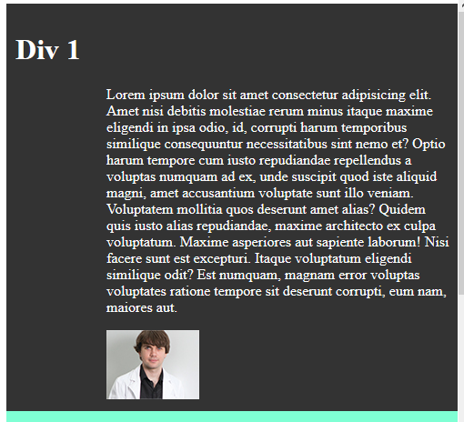
Use Padding to position Div content

Slide 13
What's the full width and height of the ff Div
Div
{
Width:100px;
Height:200px;
Padding:10px;
Margin:10px;
Border:10px solid red;
}

Slide 14
Images, Lists, Tables & Forms
Notes:
NOTE:
To change the image on this slide, select the picture and delete it. Then click the Pictures icon in the placeholder to insert your own image.

Slide 15
Images
CSS plays a good role to control image display. You can set the following image properties using CSS. The border property is used to set the width of an image border. The height property is used to set the height of an image. The width property is used to set the width of an image.
img { max-width: 100%; height: auto; }
Note:-You can create a responsive image by using max-width property

Slide 16

Images(Rounded Images)
Use the Border-radius property to create rounded images.
img {
border-radius: 50%;
}

Slide 17
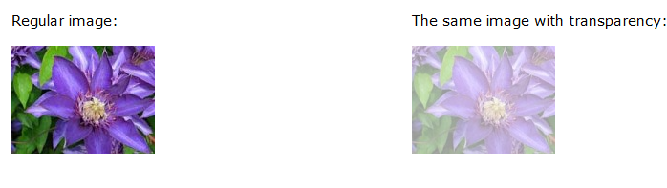
Image Opacity / Transparency
Creating transparent images with CSS is easy.
The CSS Opacity property is a part of the CSS3 recommendation.
img { opacity: 0.4; filter: alpha(opacity=40); /* For IE8 and earlier */ }
img { -webkit-filter: grayscale(100%); /* Chrome, Safari, Opera */ filter: grayscale(100%); }
You can use the filter property to create a black and white image.

Slide 18
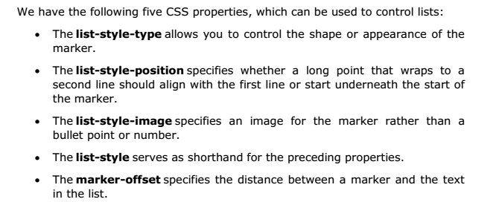
LISTS

Slide 19
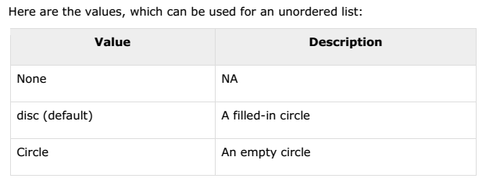
The list-style-type Property

Slide 20
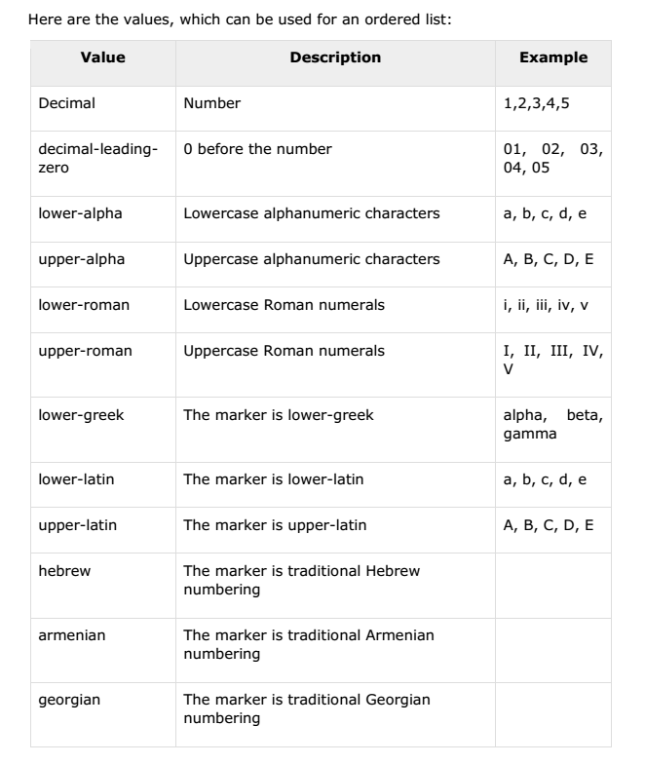
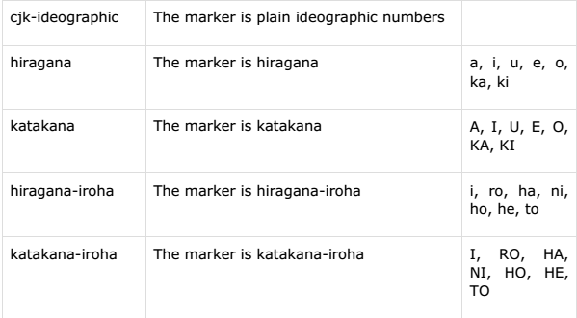

The list-style-type Property
list-style-type: katakana;

Slide 21
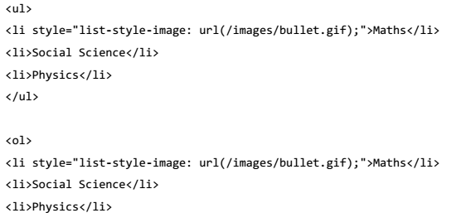

The list-style-image Property
The list-style-image allows you to specify an image so that you can use your own bullet style. The syntax is similar to the background-image property with the letters url starting the value of the property followed by the URL in brackets. If it does not find the given image then default bullets are used.
list-style-image:url("assets/apple.png");

Slide 22
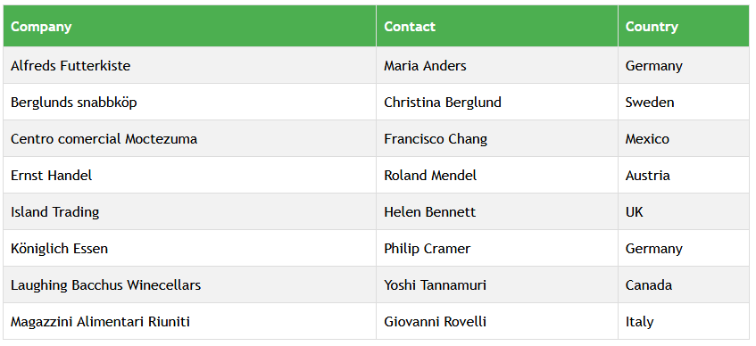
CSS Tables

Slide 23
Table Borders
To specify table borders in CSS, use the border property.
The example below specifies a black border for table, th, and td elements:
table, th, td { border: 1px solid black; }

Slide 24
Table Width and Height
Width and height of a table is defined by the width and height properties.
The example below sets the width of the table to 100%, and the height of the th elements to 50px:
table { width:100%; } th { height:50px; }

Slide 25
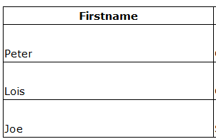
Table Text Alignment
The text in a table is aligned with the text-align and vertical-align properties.
The text-align property sets the horizontal alignment, like left, right, or center:
td { text-align:right; }
td { height:50px; vertical-align:bottom; }

Slide 26
Table Padding
To control the space between the border and content in a table, use the padding property on td and th elements:
td { padding:15px; }

Slide 27
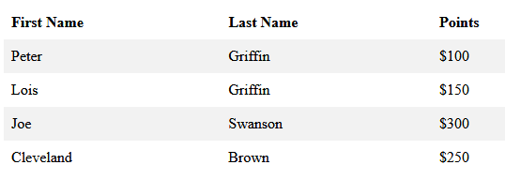
Table Color
The example below specifies the color of the borders, and the text and background color of th elements:
table, td, th { border:1px solid green; } th { background-color:green; color:white; } tr:nth-child(even){background-color: #f2f2f2}

Slide 28
Table Collapse
The border-collapse property sets whether the table borders should be collapsed into a single border:
table { border-collapse: collapse; } }

Slide 29
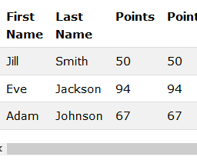
Responsive Table
Add a container element (like <div>) with overflow-x:auto around the <table> element to make it responsive:
<div style="overflow-x:auto;">

Slide 30

Forms
Styling Input Fields
input { width: 100%; }
If you only want to style a specific input type, you can use attribute selectors:-
input[type=text] { width: 100%; padding: 12px 20px; margin: 8px 0; box-sizing: border-box; border: 2px solid red; border-radius: 4px; background-color: #3CBC8D; }

Slide 31
CSS Layout
Display
Width max-width
Position
Overflow
Float and clear
Inline-block
Horizontal and vertical align
Notes:
NOTE:
To change the image on this slide, select the picture and delete it. Then click the Pictures icon in the placeholder to insert your own image.

Slide 32
Display
A block-level element always starts on a new line and takes up the full width available (stretches out to the left and right as far as it can). <div> <h1> - <h6> <p> <form><header> <footer> <section>
An inline element does not start on a new line and only takes up as much width as necessary. <span><a><img>

Slide 33
CSS Display and Visibility
HIDING AN ELEMENT
DISPLAY:NONE OR VISIBILITY:HIDDEN
Changing How an Element is Displayed
h1.hidden { visibility: hidden; } | h1.hidden { display: none; }
li { display: inline; } | span { display: block; }
Notes:
A block-level element always starts on a new line and takes up the full width available (stretches out to the left and right as far as it can). <div> <h1> - <h6> <p> <form><header> <footer> <section>
An inline element does not start on a new line and only takes up as much width as necessary. <span><a><img>

Slide 34
Position
The position property specifies the type of positioning method used for an element (static, absolute, relative or fixed)
Static is the default value.
IE7 and IE8 support the fixed value only if a !DOCTYPE is specified.
Syntax
position: static|absolute|fixed|relative|initial|inherit;
static The default position in the page flow
relative Relative to its normal position in the flow
absolute Relative to its containing block (the first ancestor that is not static)
fixed Relative to the browser windows (regardless of scrolling)

Slide 35
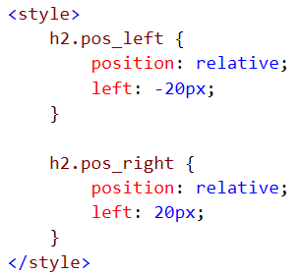
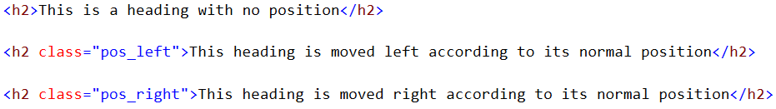
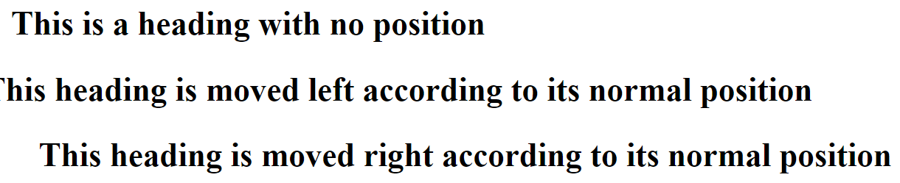
Position

Slide 36
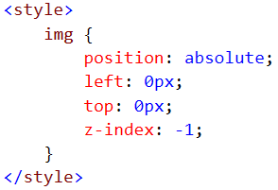
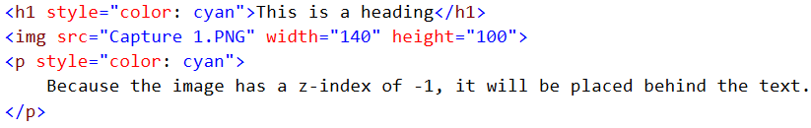
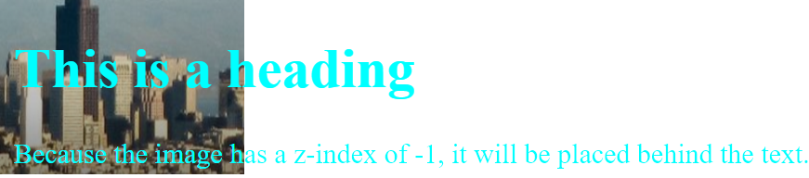
Position
Boxes are positioned in three dimensions
To change the stack level, use z-index (default value is 0)

Slide 37
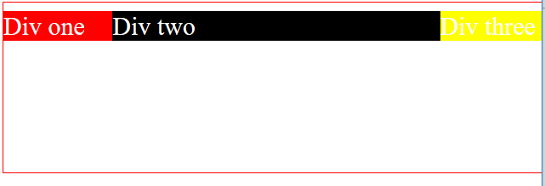
Use Relative & absolute position

Slide 38
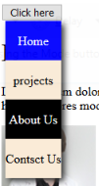
Create a drop down menu using position pro..

Slide 39
Overflow
The overflow property specifies what happens if content overflows an element's box
The default value is visible
overflow: visible|hidden|scroll|auto|initial|inherit;

Slide 40
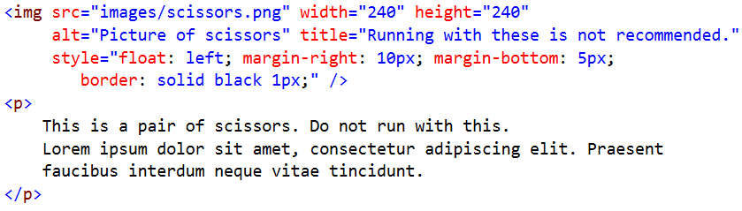
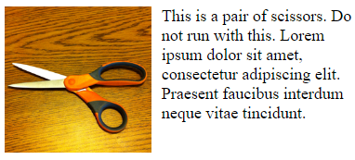
Floating
A floated element is one whose float property has the value right or left (the default is none)
The float property, in its simplest use, can be used to wrap text around images.
Floating an element converts it to a block.
A floated box is shifted to the left or right as far as possible.
A floated box must have an explicit width. Otherwise, the results can be unpredictable.

Slide 41
Use float

Slide 42
Clear
The clear property is used to control the behavior of floating elements.
Elements after a floating element will flow around it. To avoid this, use the clear property.
The clear property specifies on which sides of an element floating elements are not allowed to float;
Syntax:
clear: left|right|both;
Reading Assignment (Clear and Float with page layout)
https://www.w3schools.com/css/css_float.asp

Slide 43
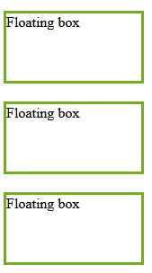
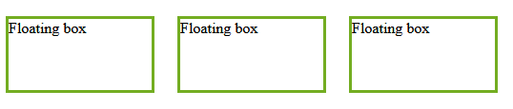
The inline-block Value
It has been possible for a long time to create a grid of boxes that fills the browser width and wraps nicely (when the browser is resized), by using the float property.
we also need to specify a clear property for the element after the floating boxes.
However, the inline-block value of the display property makes this even easier.
.floating-box {
display: inline-block;
width: 150px;
height: 75px;
margin: 10px;
border: 3px solid #73AD21; }

Slide 44
Align
.center { margin: auto; width: 60%; border: 3px solid #73AD21; padding: 10px; }
Center Align - Using margin
No effect if width property is not set (or set to 100%).
Left and Right Align - Using position
One method for aligning elements is to use Position-absolute
can overlap elements.
When aligning elements with position always define margin
& padding for the body element
!DOCTYPE declaration when using Position element
.right { position: absolute; right: 0px; width: 300px; border: 3px solid #73AD21; padding: 10px; }

Slide 45
Align
Left and Right Align - Using float
Another method for aligning elements is to use the float property
When aligning elements with position always define margin
& padding for the body element
body { margin: 0; padding: 0; } .right { float: right; width: 300px; background-color: #b0e0e6; }

Slide 46
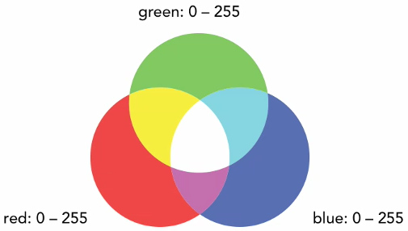
Working with Colors
Notes:
NOTE:
To change the image on this slide, select the picture and delete it. Then click the Pictures icon in the placeholder to insert your own image.

Slide 47
Working with Colors > Keywords
Color Keywords: To declare basic color values, you can use one of over 140 reserved color keywords.
Example: black, gray, maroon, olive, fuchsia, saddlebrown, slategray
You may learn more about them at http://www.w3.org/TR/css3-color/

Slide 48
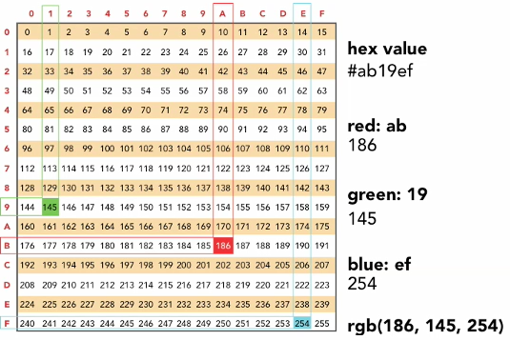
Working with Colors > Hexadecimal
Hexadecimal Notation: uses number/character value pairs to represent RBG values.
You may have to use color palate.
is really nothing more than number character pairs that range 0 to F that are then used to represent RGB values.
It can be represented as 6 characters or, if the pairs match, a three digit shorthand version.
Sample: #ab19ef
Example: #000000 (black), #ffffff (white)
Short Hand example: #336633 -> #363, #ffaacc -> #fac

Slide 49
Working with Colors > RGB
RGB Color: No matter how you define your color in CSS chances are its being displayed using RGB.
RGB stands for red, green and blue and it is the primary color used by screen devices.
RGB is an additive color method, featuring a mixture of red, green and blue values that range between 0 and 255.
If all three are set to 255, you get white
If all three are set to 0, you get black
CSS offer support for RGB values through two forms of syntaxes.

Slide 50
Working with Colors > RGB
Two forms of syntax:
Using color ranges of 0 – 255 for each color value => rgb(x, y, z)
As a percentage between 0 – 100% for each value => rgb(x%, y%, z%)
Browsers allow you to mix percentages and absolute values, but it is not recommended because all browsers doesn’t have an implementation.
Example:
color: rgb(125, 244, 15)
background: rgb(45%, 70%, 20%)

Slide 51
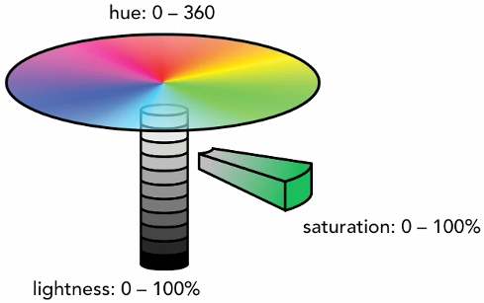
Working with Colors > HSL (Hue, Saturation and Lightness)
A color’s hue is represented as an angle on the color wheel which ranges from 0 to 360.
Red is on 0 and 360
Green is on 120
Blue is on 240
And all other colors are found between those values.
Saturation represents the amount of color, how much color a particular shade has. (How saturated?)
100% fully saturated
And 0% being gray scale

Slide 52
Working with Colors > HSL (Hue, Saturation and Lightness)
Lightness is how dark or bright the color is and just like saturation, it is defined using a percentage.
100% very bright (white)
And 0% being black
Syntax: hsl(hue, saturation%, lightness%)
Example:
bacground: hsl(240, 100%, 85%); bacground: hsl(120, 100%, 85%);
bacground: hsl(60, 100%, 85%); bacground: hsl(15, 100%, 85%);
color: hsl(20, 100%, 100%) – The hue doesn’t matter if both saturation and lightness are 100% or 0%

Slide 53
Transparency of an element > Opacity syntax and RGBA and HSLA syntax
CSS gives us a couple of different ways to set the transparency of an element.
opacity: describes how opaque or transparent an element is and it is based on values from 0 to 1.
Example: opacity: 0; (transparent)
opacity: 1; (opaque)
opacity: 0.5 (semi-transparent)
opacity: 0.25 (very transparent)
You can only define the opacity of an entire element. It is sort of all or nothing type.

Slide 54
Transparency of an element > Opacity syntax and RGBA and HSLA syntax
RGBA and HSLA: This technique involves passing an alpha value through a regular RGB or HSL color definition.
Flexible (Border, text, and background color)
You can then define the transparency either the foreground color, background color or border color.
This method only allows to set alpha values to colors but not to background images.
Example:
background: rgba(102, 0, 0, .2);
background: hsla(65, 80%, 50%, .6)

Slide 55
> Drop Shadows
In CSS for drop shadows, you have two options.
Box Shadows are going to be applied to the containing box of an element.
Text Shadows should be limited to be used on text.
Box Shadow Example:
box-shadow: vertical length, horizontal length, blur radius (how blur do you want this), spread (how far do you want it to fade out), color
box-shadow: 10px 10px 5px 5px rgba(0, 0, 0, .7);
Text Shadow Example:
text-shadow: vertical length, horizontal length, blur radius, color
text-shadow: 10px 10px 5px rgba(0, 0, 0 .7);

Slide 56
Reading Assignment
CSS3 2D Transforms
CSS3 3D Transforms
CSS3 Animations
CSS3 Flexible Box

