Slide 1
Dimensions
Height
Width
Max-width
Notes:
NOTE:
To change the image on this slide, select the picture and delete it. Then click the Pictures icon in the placeholder to insert your own image.

Slide 2
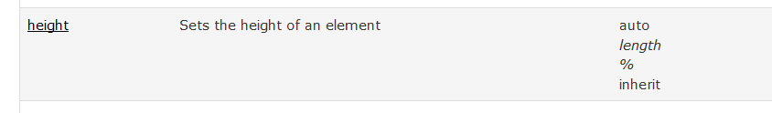
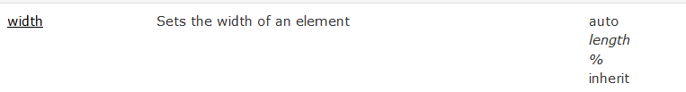
CSS Dimension Properties
The CSS dimension properties allow you to control the height and width of an element.
We can use the height and width properties.
section { width: 500px; height: 100px; border: 3px solid #73AD21; }
Notes:
Pc – is called picas. 1pc = 12pt
Em - Relative to the font-size of the element (2em means 2 times the size of the current font)
Ex - Relative to the x-height of the current font (rarely used)

Slide 3
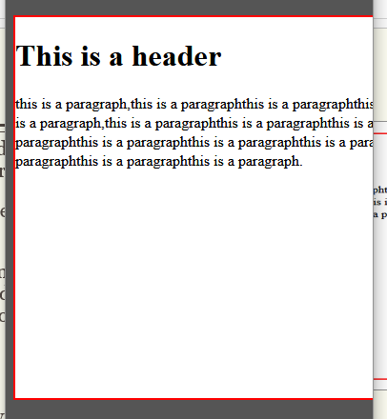
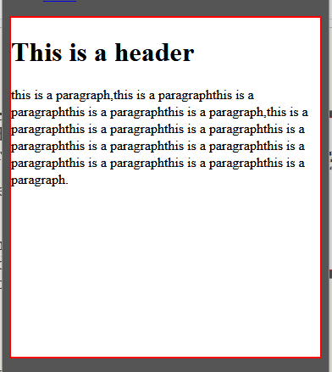
width and max-width
A block-level element always takes up the full width available (stretches out to the left and right as far as it can)
Setting the width of a block-level element will prevent it from stretching out to the edges of its container.
Note: The problem with giving a width to an element is when the browser window is smaller than the width of the element. The browser then adds a horizontal scrollbar to the page.
The solution is using max-width property
It will improve the browser's handling of small windows. This is important when making a site usable on small devices.

Slide 4
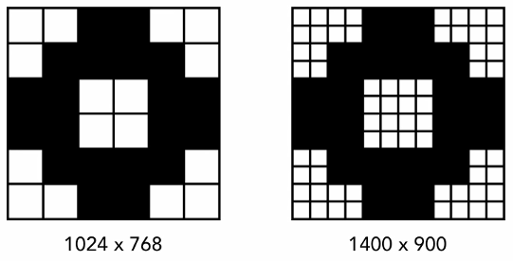
Css Units
Relative
Absolute
Notes:
NOTE:
To change the image on this slide, select the picture and delete it. Then click the Pictures icon in the placeholder to insert your own image.

Slide 5
CSS Units
CSS has several different units for expressing a length.
Many CSS properties take "length" values, such as width, margin, padding, font-size, border-width, etc.
Length is a number followed by a length unit, such as 10px, 2em, etc.
A whitespace cannot appear between the number and the unit. However, if the value is 0, the unit can be omitted.
For some CSS properties, negative lengths are allowed.
There are two types of length units:
Relative
Absolute

Slide 6
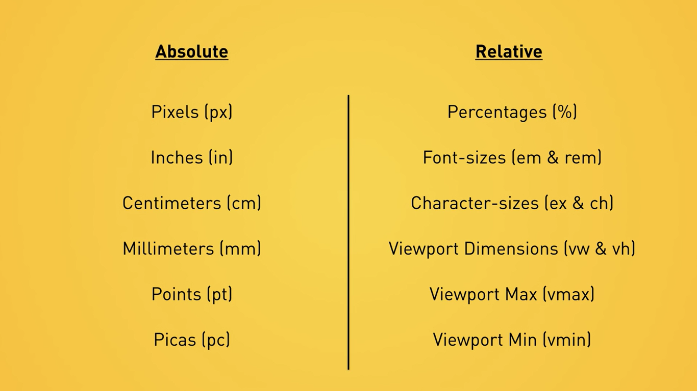

Slide 7
CSS Units…
Absolute Values: The absolute length units are fixed and a length expressed in any of these will appear as exactly that size.
in (inches), cm (centimeters), mm (millimeters), pt (points), pc (picas), px (pixels),
Not good for small screen devices
Relative Values: Relative length units specify a length relative to another length property. Relative length units scales better between different rendering mediums.
em (ems), ex (exes), gd (grids), rem (root ems), vw (viewport width), vh (viewport height), vm (viewport minimum), ch (character)
Well suited for devices like screens

Slide 8
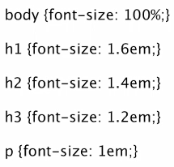
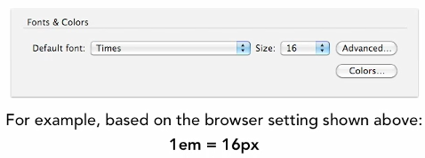
CSS Units
Pixels
EMS: when used with font-size, 1em is equal to the default font size for the device.

Slide 9
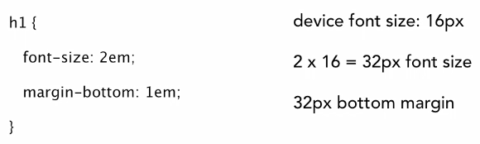
CSS Units
Notes:
EX & REM
Ex is based on the “x-height” of a font.
Root ems are like ems, only they’re relative to the root unit (e.g. body, html), not the element’s immediate parent.

Slide 10
CSS Units
Percentages: percentage values are calculated relative to their parent element. A div with a width of 80% would use 80% of its parent element, while a paragraph with its font-size set to 80% would size the text at 80% of the size of its parent text.
Important for fluid layouts

Slide 11
CSS Values
Words:- text-align: center
Numerical Values:- Numerical values are usually followed by a unit type.
font-size: 12px;
12 is the numerical value and px is the unit type pixels.
Two types of numerical values
Absolute Values: in, pc, px, cm, mm, pt
Relative Values: em, ex, %
Color Values: color: #rrggbb / #rgb (HEX) or colorname (red, blue, yellow, etc) or rgb (x, x, x)
Notes:
Pc – is called picas. 1pc = 12pt
Em - Relative to the font-size of the element (2em means 2 times the size of the current font)
Ex - Relative to the x-height of the current font (rarely used)

Slide 12
Exercise
Create a div element with a red background color and 50 vmin and vmax width & height.

Slide 13
Topography Properties
CSS Fonts
CSS Texts
CSS Background
Notes:
NOTE:
To change the image on this slide, select the picture and delete it. Then click the Pictures icon in the placeholder to insert your own image.

Slide 14
Typography Properties > font-family
We can either use
System fonts:- common fonts shipped with most operating systems.
Arial, Helvetica, Verdana, Georgia, Times New Roman, and others.
Saves overhead and allow you to relay on fonts that have a long and solid track record.
Web fonts:- allow designers to use the @font-face inline rule to define a font-family to use within the page
The font is an external resource that the browser then requests and uses on the page.
designer either host the font themselves, or use one of the many font hosting services available.

Slide 15
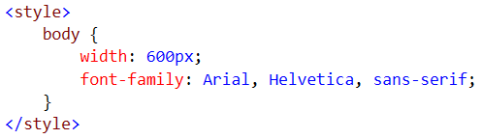
Typography Properties > font-family: System Fonts
Multiple fonts can be defined on a font-family property separated by a comma creating a font stack.
font-family: Arial, Helvetica, sans-serif;
We are defining some kind of a fallback mechanism.
Fonts have categories (generic font family) and we can use the generic name in the font-family, so that the browser picks the operating system’s default font for the family.
Example: serif, san-serif, monospace, cursive, fantasy
Whenever you have a font name which has multiple word in it with white spaces, it is best to go ahead and put it in a double quote.
Example: Georgia, Times, “Times New Roman”, serif

Slide 16
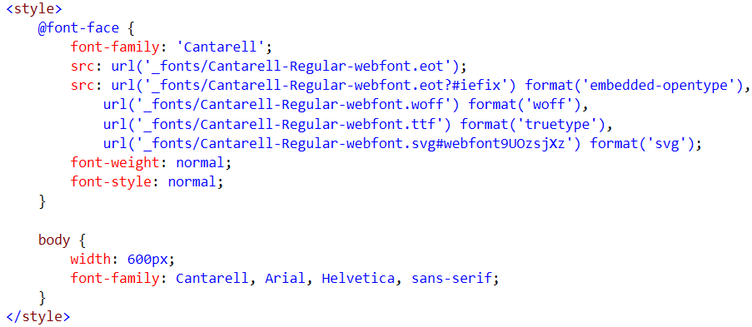
Typography Properties > font-family: Web Fonts
Web fonts allows designers to use the inline @font-face rule to define an external font as a font-family to use within the page.
The font referenced is an external resource that the browser then request and uses on the page.

Slide 17
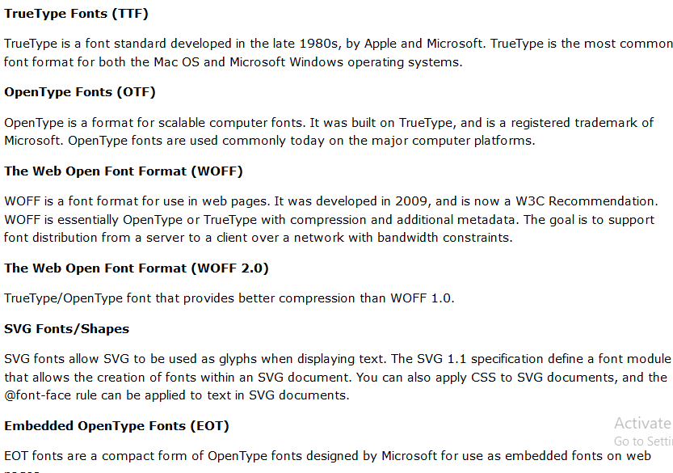
Typography Properties > font-family: Different Font Formats

Slide 18
Typography Properties > font-family: Web Fonts
@font-face properties
font-family: The name you want your font to be referred with
src: web path to the font (url) and format of the font.
font-weight: normal or bold
font-style: normal or italic
Multiple entries for same font family can be added.
When adding multiple entries, we shall add in order of normal, normal; normal, italic; bold, normal; bold, italic for the font-weight and font-style.
To read about fonts
http://fontspring.com, http://fontsquirrel.com

Slide 19
Typography Properties > font-size
To control the size of your font you use the property named font-size.
We can set it in
pixel
Reserved Keywords: (xx-small, x-small, small, medium, large, x-large, xx-large)
Don’t expect them to be the same size on all browsers.
em: (relative value – calculated based on the parent element)
1.8em: Give me 1.8 larger than the default value
1em: Give me the default value
%: (relative value – calculated based on the parent element)
Default browsers font size is 16px.

Slide 20
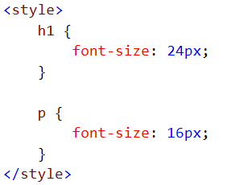
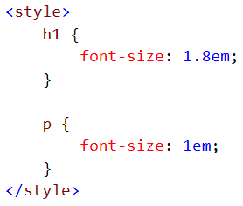
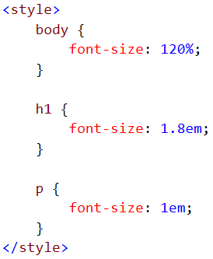
Typography Properties > font-size

Slide 21
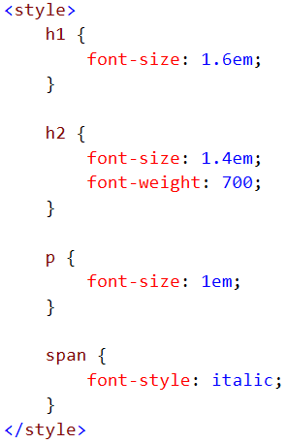
Typography Properties > font-style and font-weight
You can control the weight of text by using the font-weight property, while the font-style property allows you to italicize text.
font-style values
italic, normal, inherit, oblique (skew)
font-weight values
Numeric values (100 – 900 [The darkness value of the font from the lighter to the bolder])
Keyword values (bold, bolder, lighter, normal (no longer bolded), inherit)

Slide 22
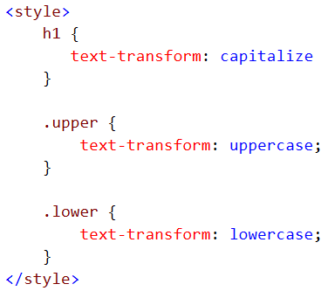
Typography Properties > text-transform
You can’t always control how text is entered or formatted in your site.
Example: Content Management System (text from a database)
Every item on a list should be capitalized
Using the text-transform property, you can control which case is used for the characters within an element.
text-transform values
capitalize, inherit, lowercase, none (undo any transformation you have done in a previous style), uppercase

Slide 23
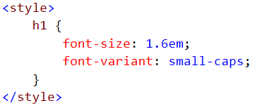

Typography Properties > font-variant
The font-variant property allows us to specify small caps for our text. If the font in use has a defined set of small caps, they will be used. If not, the browser will scale the fonts to achieve the small caps look. This will occasionally cause font weight issues, especially at smaller sizes, so use with caution.
font-variant values
normal (override any small-caps usage), small-caps

Slide 24
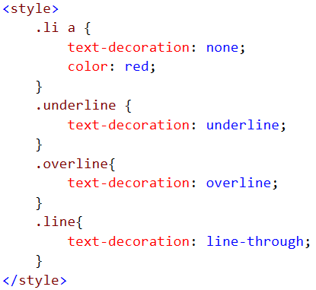

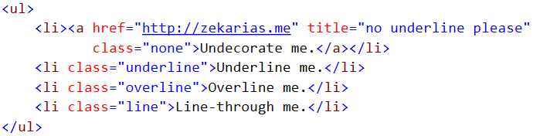
Typography Properties > text-decoration
Using the text-decoration property, you can add special effects or formatting options to text.
This can help you control whether text is underlined or strike through.
text-decoration values (we can combine them)
line-through, underline, overline, none

Slide 25
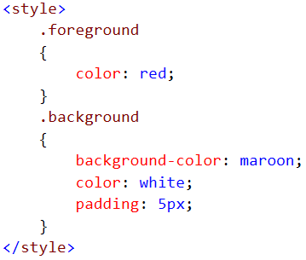
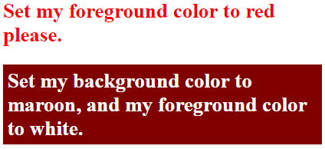
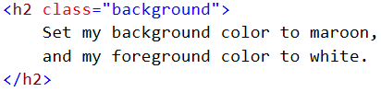
Typography Properties > background-color and color
Designers can set color for text using two basic properties:
the background-color property and
the color property (define the content color).
These can be combined to produce a variety of effects.

Slide 26
Typography Properties > Shorthand Notations
Some of the syntax options in CSS don’t really give you any additional functionality. They are just designed to save you time.
Shorthand notations are designed to do just that.
The font short hand notation allows us to define font families, font size, font style, font weight, font variant and line height all in one property.
font Syntax
font: normal normal normal 100%/1.5 Georgia, “Times New Roman”, Times, serif;
font-weight font-style font-variant font-size/line-height font-family

Slide 27
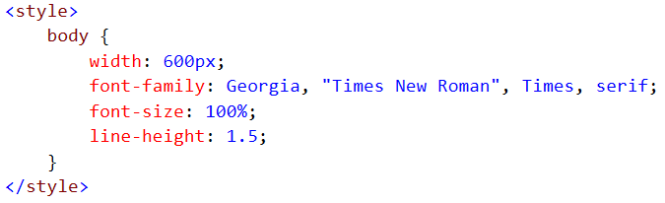
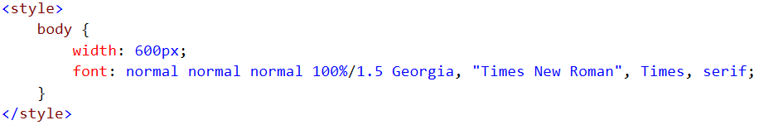
Typography Properties > Shorthand Notations

Slide 28
Typography Properties > Shorthand Notations
Whenever you do font shorthand notation, you have to pass in at least two things. That would be the size of the font and the family of the font and the need to be done in that order.
font: 100% Georgia, “Times New Roman”, Times, serif;
font-size font-family
font: 100%/1.5 Georgia, “Times New Roman”, Times, serif;
font-size/line-height font-family
Be carful when you use the minimalist approach. Because normal is going to be passed and may cause unintended style to be achieved.

Slide 29
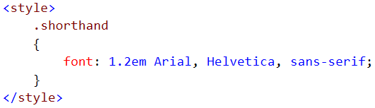

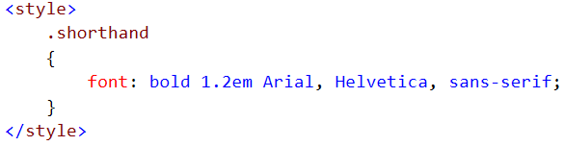

Typography Properties > Shorthand Notations
You don’t have to pass all three of them. You can simply pass bold for font-weight, or small-caps for font-variant or italic for font-style.

Slide 30
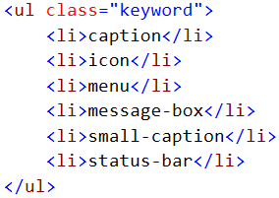
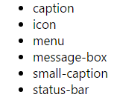
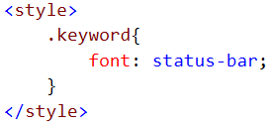
Typography Properties > Shorthand Notations
Shorthand notations also take some special keywords.
You can use a set of optional keywords which instructs the user agent to use the font formatting used by those system fonts. This is especially useful when creating applications or UI widgets. Example: status-bar, small-caption, message-box, menu, icon, caption

Slide 31
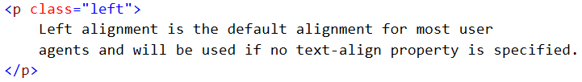
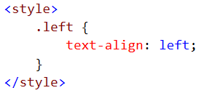
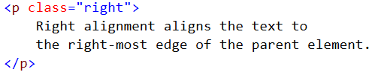
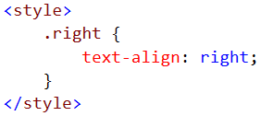
Typography Properties > text-align
To control text alignment with CSS we use the text-align property.
For the most part, text alignment is pretty straightforward. You set alignment through the text-align property, which accepts the left, right, center, justify, or inherit values.

Slide 32
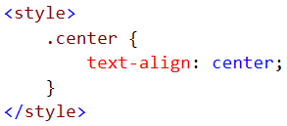
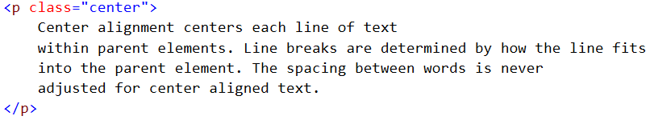

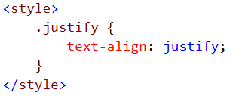
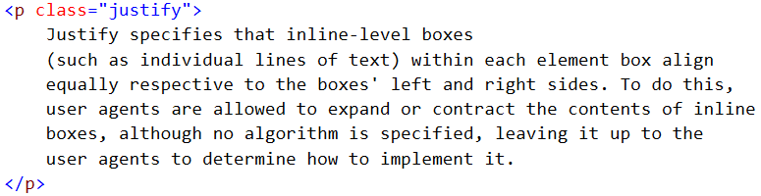
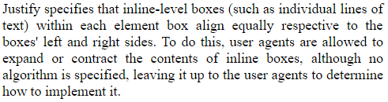
Typography Properties > text-align

Slide 33
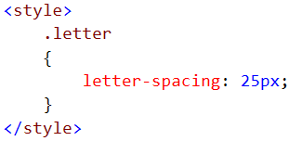

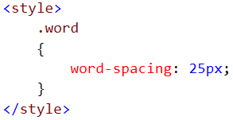
Typography Properties > letter-spacing and word-spacing
CSS gives you control over word and letter spacing through the word-spacing and letter-spacing properties.
-ve value is also possible
Notes:
text-rendering
Tell them about the SVG vendor render specification (kerning)

Slide 34
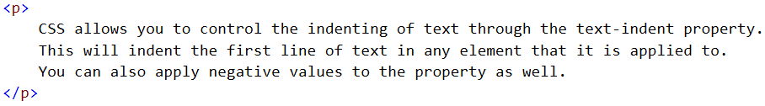
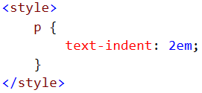
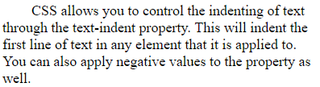
Typography Properties > text-indent
CSS allows you to control the indenting of text through the text-indent property. This will indent the first line of text in any element that it is applied to. You can also apply negative values to the property as well.
Negative values can often help you create what is known as hanging punctuation.

Slide 35
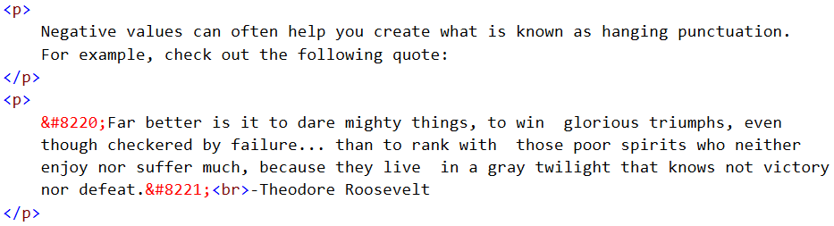
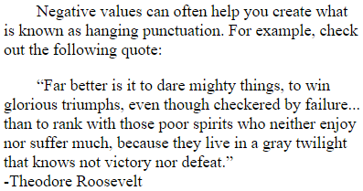
Typography Properties > text-indent
The text in the quote looks indented even when it is not.

Slide 36
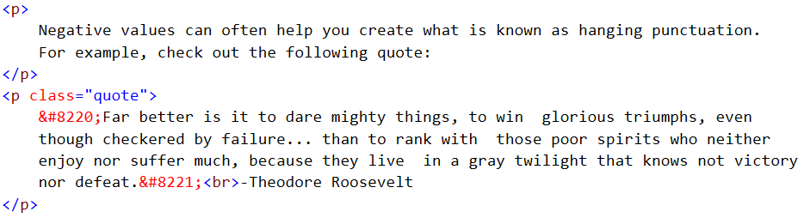
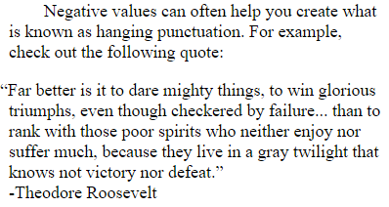
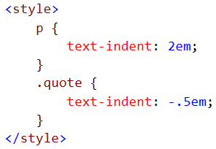
Typography Properties > text-indent

Slide 37
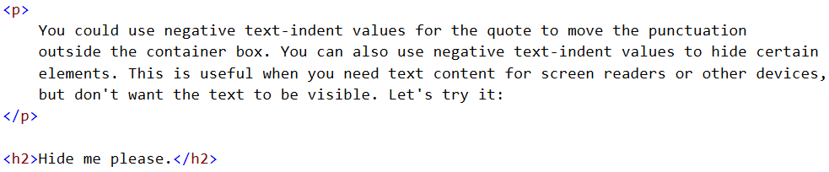


Typography Properties > text-indent

Slide 38
Typography Properties > line spacing (line-height)
Leading, or line spacing, is controlled in CSS through the line-height property.
You can use any unit of measurement with line-height, and it is unique in that it allows you to use a “multiple” value as well.
Multiples are a single number with no unit of measurement specified, the number simply acts as a multiple of the current element's font-size.
normal is the default value for line-height.
If you think about inheriting line-height property from parent elements, use Multiples instead of using a value with a unit of measurement.
Notes:
In graphics design, it is also know us Leading.
There some cool staff you can do with line-height

Slide 39





Typography Properties > line spacing (line-height)
All this result in the same line height for a given paragraph.
We can use line-height to vertically center a text.
If you haven’t specified the height of an element its line height is going to generate the height for you.
If you have a single line of text, that means the line-height becomes the height of that entire element.
Notes:
Height always overrides the line-height

Slide 40

Use Css Topography Properties

Slide 41
CSS Backgrounds
Notes:
NOTE:
To change the image on this slide, select the picture and delete it. Then click the Pictures icon in the placeholder to insert your own image.

Slide 42
background
The background property allows you to control how the background of an element displays.
Backgrounds go all the way up to the beginning edge of the border of an element. So, any padding will be considered as part of the background.
Example:
background-color: yellow;
Background: yellow;

Slide 43


background-image
Syntax:
background-image: url(‘pathtoyourimage’);
By default background images are tiled/repeated.
We can change that by using the background-repeat property.
background-repeat: repeat;
background-repeat: repeat-x; /* specific axis */
background-repeat: no-repeat;

Slide 44
background-position
Syntax:
background-position: horizontalvalue verticalvalue;
Keywords: (center is always assumed if no value is passed)
Horizontalvalue: left center right
Verticalvalue: top center bottom

Slide 45

background-position (percentage values)
Corresponding percentage points are mapped on both the background image and the element. The points are then aligned to determine the background image’s position.

Slide 46
Background Shorthand
Shorthand Notation Syntax:
background: color url background-repeat background-position;

Slide 47
Give a background Image for the following H1 element

