Slide 1
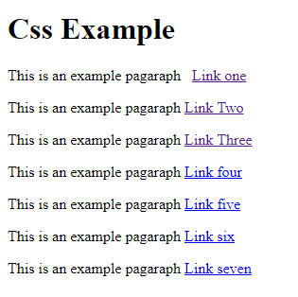
Quiz:-Create the following page inside a div element

Slide 2
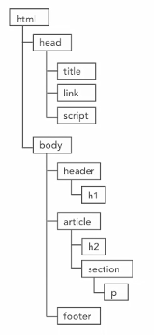
Document Object Model (DOM)
A structural representation of all elements in an HTML document, often used by browsers and scripts to traverse through the documents and retrieve content or apply behaviors.
Browsers apply styles to elements by traversing through the tree.
There are times, however, when the DOM alone cannot help you target elements, such as users hovering over an element or focusing on a form element.
Pseudo-class Selectors: allow us to target elements or instances that lie outside of the DOM or are too specific for simple selectors to target.

Slide 3
CSS Selectors > Pseudo-Class Selectors
Dynamic pseudo-class selectors target elements based on something other than attributes, content, or element type. Usually refers to something that can change over time, or that is based on user interaction.
UI element state pseudo-class selectors target specific user interface elements in regards to whether or not they are currently enabled. (:enabled, :disabled, :checked).
Structural pseudo-class selectors target elements based on specialized information within the DOM that simple selectors cannot target. This can be pattern-matching, child-to-parent relationships, or other structural information. (Example: nth child selector)
Other pseudo-class selectors exist that can’t really be grouped into any one category. These selectors give you even more specific targeting capabilities based on things like language or URL targeting.
Please Read: https://www.w3.org/community/webed/wiki/CSS/Selectors

Slide 4
CSS Selectors > Pseudo-Class Selectors
Is used to define a special state of an element
Can be used to style an element when a user mouse hovers over it, visited and unvisited links and getting focus.
Pseudo-class selectors consists of a colon (:) followed by the selector.
:hover pseudo-class selector
Usually they are preceded by the element you wish to target based on its state.
a:hover targeted pseudo-class selector
And can be combined with other simple selectors as well.
ul a:hover descendent selector with a pseudo-class selector

Slide 5
CSS Selectors > Dynamic PC Selectors
a:link :- targets all links on the page. (Any link with an href attribute)
a:visited :- targets all links with an address that the user already visited
a:hover :- targets all links that is currently hovered over
a:active :- targets all links that are either in focus or currently being clicked on.
The order is very important. If you put the visited styling after the hover styling, then the visited styling will override the hover style.
Developers usually group the link and visited styles together and the hover and active styles together.
a:target :- has more to do with the URL than the actual page itself. If a URL is set to focus to a specific section (link) on the page, the style is applied.

Slide 6
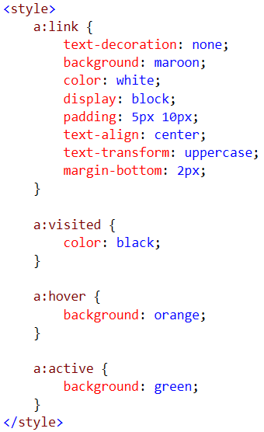




CSS Selectors > Dynamic PC Selectors

Slide 7
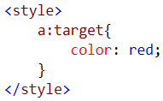
CSS Selectors > Dynamic PC Selectors
URL without fragment (http://localhost:57823/pseudo-class.htm)
URL with fragment (http://localhost:57823/pseudo-class.htm#section1)

Slide 8
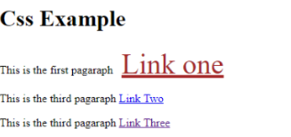
Quiz:-Apply Dynamic PC Selectors for a link one (hint:-first give a class name for link one)
Link and visited =green color
Hover and active=brown color with 40px font size

Slide 9
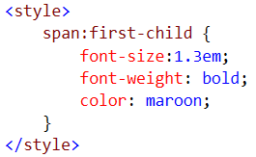
CSS Selectors > Structural PC Selectors
Allow you to target elements based on more complex patterns with in the DOM.
Example: target an element with a condition whether or not it is the first child of an element, or whether it is the only child of it and other factors.
first-child
Find every span in the document and if it’s the first child of its parent element go ahead and give it the styling.

Slide 10
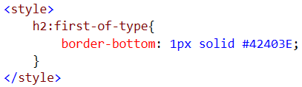

CSS Selectors > Structural PC Selectors
first-of-type
Find every h2 in the document and if it’s the first h2 child of its parent element go ahead and give it the styling.
only-child
Whenever you find a paragraph, and that paragraph is the only child inside of a parent go ahead and give that styling.

Slide 11
CSS Selectors > Structural PC Selectors
First-child
last-child
First-of-type
last-of-type
Only-child
only-of-type

Slide 12
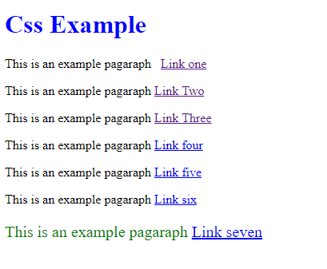
Quiz:-Use Structural PC Selectors to change color & size of h1 & last paragraph
First-child
last-child
First-of-type
last-of-type
Only-child
only-of-type

Slide 13
CSS Selectors > Structural PC Selectors
Of all the structural pseudo-class selectors :nth-child() pseudo-class selector is the most complex of them all.
nth-child selectors allow us to target elements based on patterns that describes which elements within a parent you should target.
We have four flavors of nth-child selectors.
nth-child()
nth-of-type()
nth-last-child()
nth-last-of-type()

Slide 14
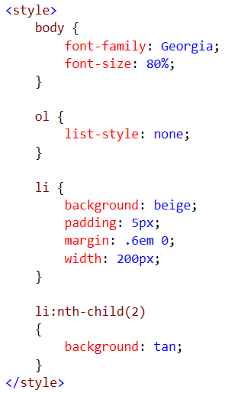
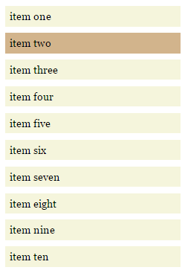
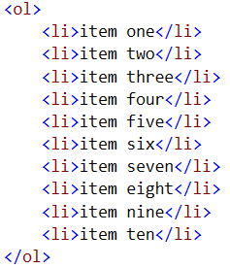
CSS Selectors > Structural PC Selectors
nth-child(2)
Notes:
It looks for every single child (Not simply list items)

Slide 15
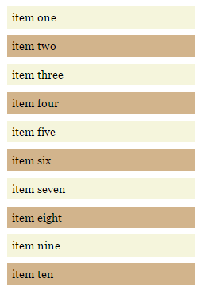

CSS Selectors > Structural PC Selectors
nth-child(2n)
n is a grouping element
On the above element, target every second element

Slide 16
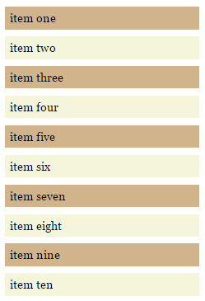

CSS Selectors > Structural PC Selectors
nth-child(odd)
Instead of grouping, one can use keywords
even is also another keyword

Slide 17
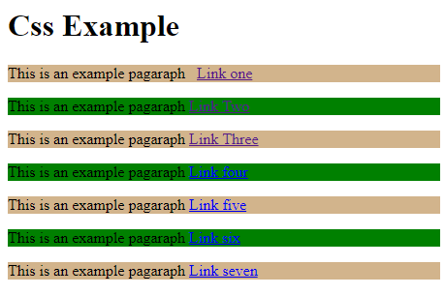
Quiz:-Use nth-child to create the following

Slide 18
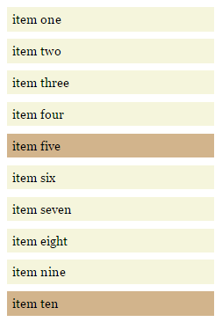
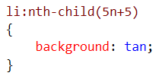
CSS Selectors > Structural PC Selectors
nth-child(2n+1)
The 1 is called offset (beginning with this one)

Slide 19
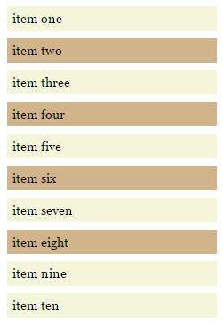
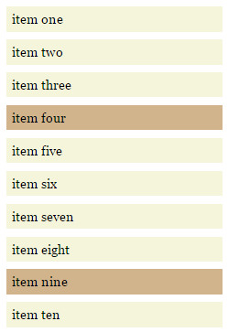
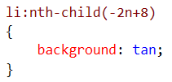

CSS Selectors > Structural PC Selectors
nth-child(-2n+8) nth-child(5n-1)

Slide 20
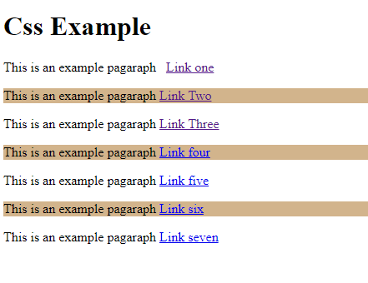
Quiz:-Use nth-child

Slide 21
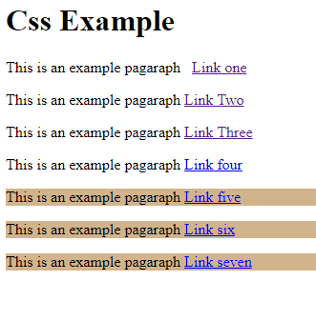
Quiz:-Use nth-last-child

Slide 22
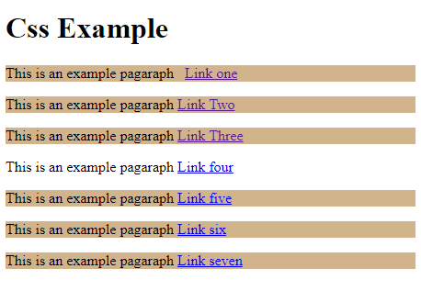
Quiz:-Use nth-child & nth-last-child

Slide 23
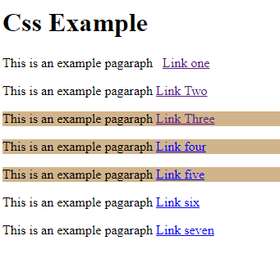
Quiz:-Use nth-child & nth-last-child

Slide 24
CSS Selectors > Pseudo-elements
Pseudo-elements are similar to pseudo-classes in many ways as they allow you to access content beyond the normal capabilities of the DOM.
For Example: Using pseudo-element selectors you could target the first line or first letter of an element.
Pseudo-element selectors also allow us to create what is know as generated content.
That is actually place content on the page that is not contained in the structure of the document.

Slide 25
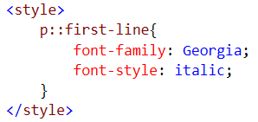
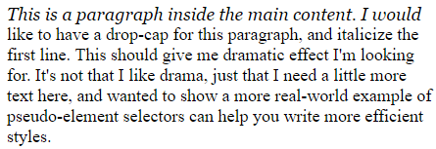
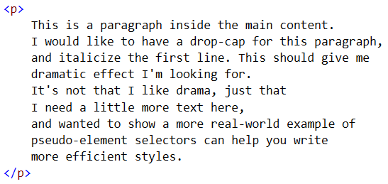
CSS Selectors > Pseudo-elements
p::first-line (written like p:first-line in CSS 2)

Slide 26
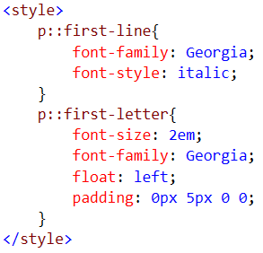
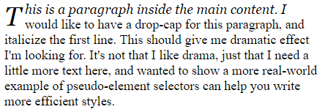
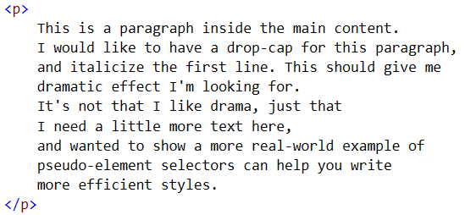
CSS Selectors > Pseudo-elements
p::first-letter

Slide 27
CSS Selectors > Pseudo-elements
Generated content allows us to place content on the page.
:before and :after
Doesn’t show up on the DOM tree
In order to work with :before and :after, we use content attribute.
Content can be: string (Text content), u, counters(chapters), open-quote and close-quote, and attr(x).

Slide 28
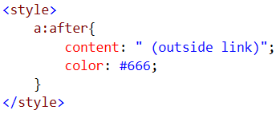
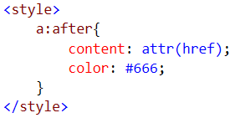

CSS Selectors > Pseudo-elements

Slide 29
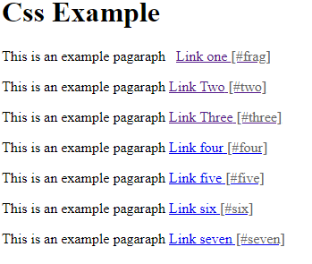
Quiz:-Use :after and content & attr(x) to create the following

Slide 30
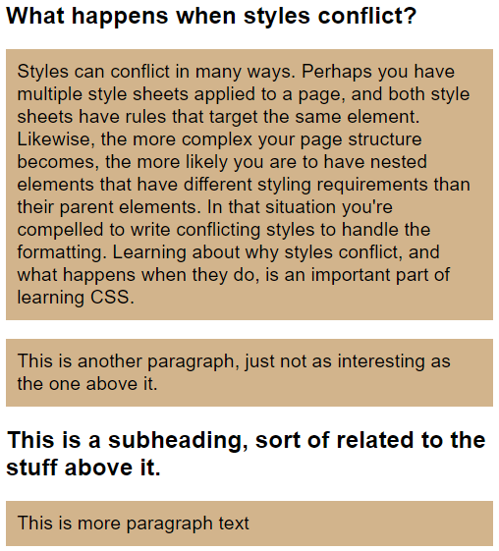
Conflict in Css
The Cascade
Inheritance
Specificity
Notes:
NOTE:
To change the image on this slide, select the picture and delete it. Then click the Pictures icon in the placeholder to insert your own image.

Slide 31
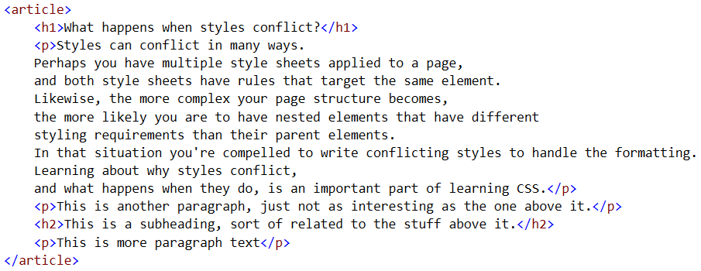
Conflict in CSS
Unless every page you create only holds a single paragraph, you’re eventually going to have to deal with styles that conflict with one another.
Anytime you have multiple rules that target the same element you have conflicting styles.

Slide 32
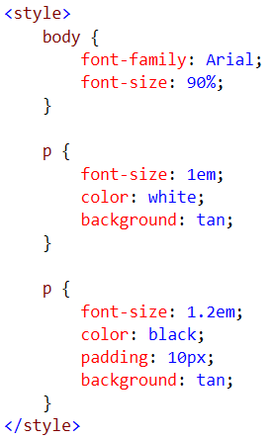
Conflict in CSS
It is not always easy to catch conflicting styles.

Slide 33
Conflict in CSS
When the properties conflict the properties of one rule will replace the other.
If they don’t conflict with one another, the properties are added and the rules are cumulative leaving you with a mixture of the two rules.
What determines which properties are used in the event of a conflict? That is driven by three principles.
The Cascade
Inheritance
Specificity

Slide 34
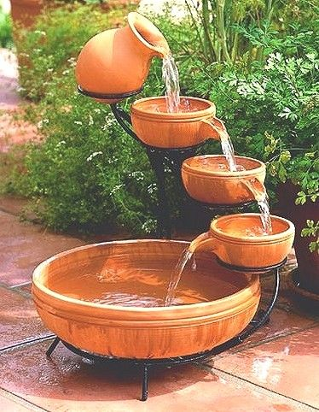
The Cascade
The cascade can be summed up as, the last rule applied wins.
Styles are applied in the order they are found, and in the event of a conflict the style that comes last is the one that is used.

Slide 35
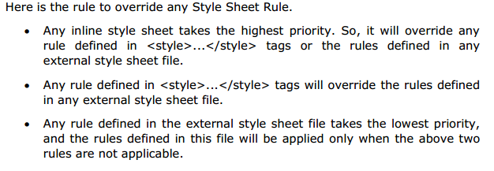
CSS Rules Overriding

Slide 36
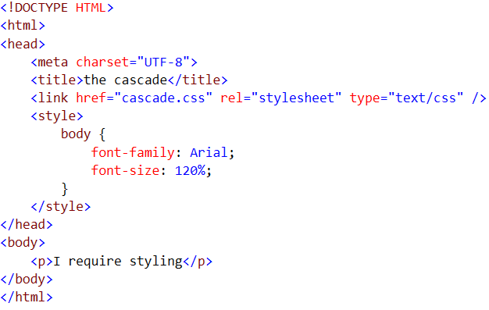


The Cascade > Example
cascade.css

Slide 37
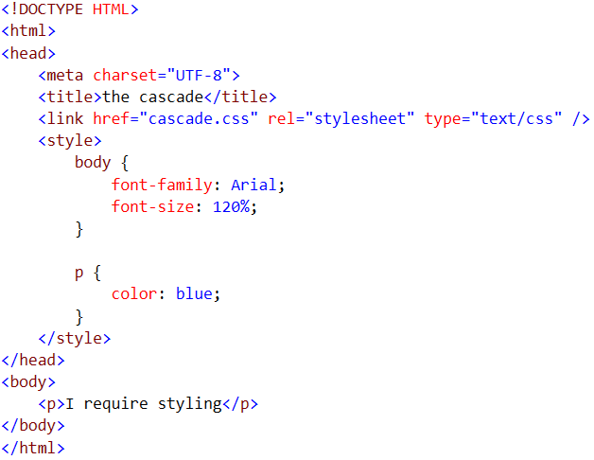

The Cascade > Example…
cascade.css

Slide 38
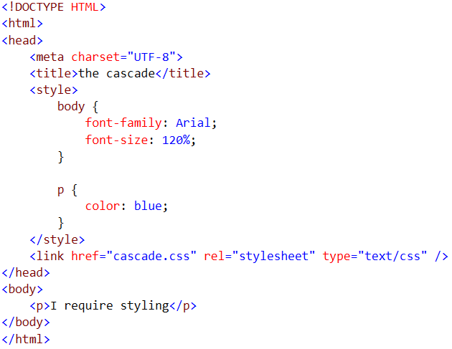

The Cascade > Example…
cascade.css

Slide 39
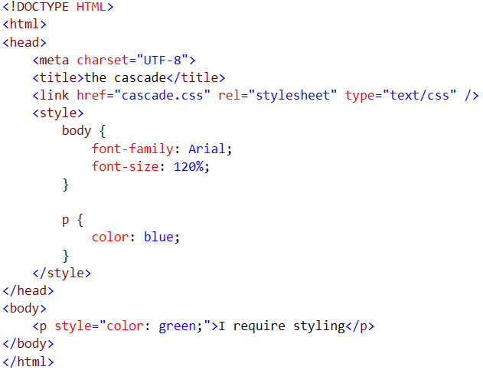

The Cascade > Example…
cascade.css

Slide 40
Inheritance
The process by which properties are passed from parent to child elements without explicit definition.
Allows elements to “inherit” styles from parent elements.
Helpful in reducing the amount of CSS to set styles for child elements.
Unless a more specific style is set on a child element, the element looks to the parent element for its styles.
Styles that relate to text and appearance are inherited by the descendant elements.
Styles that relate to the appearance of boxes created by styling DIVs, paragraphs, and other elements, such as borders, padding, margins are not inherited.

Slide 41
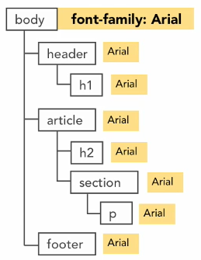
Inheritance
What if you want to apply Arial font for all of your elements in a given HTML document. You just have to apply the font to the body element as shown on the figure.
In the event of a conflict, child element styles will override parent element styles

Slide 42
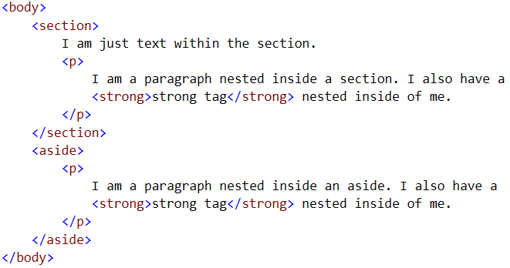
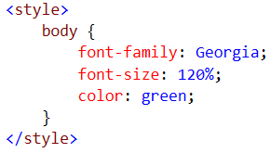
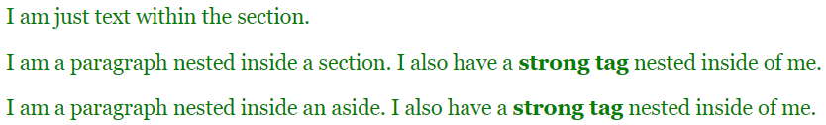
Inheritance > Example

Slide 43
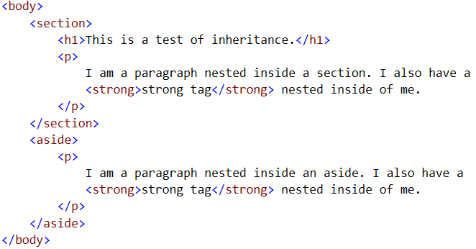
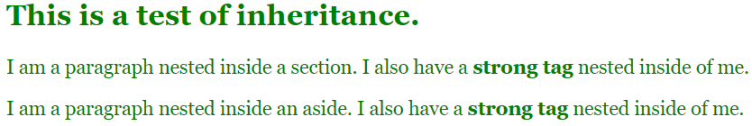
Inheritance > Example…
Not every property inherits.
When they have a property applied to them that conflicts with the parent element, the child element’s property wins.
Browsers and User Agents have default style sheets.

Slide 44
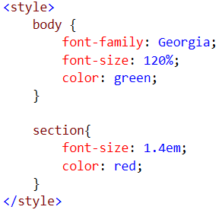
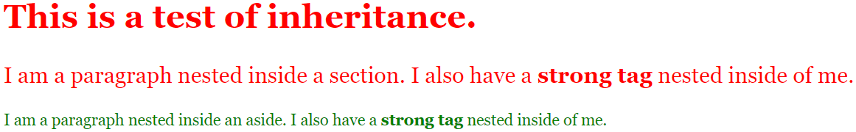
Inheritance > Example…
Cumulative Effect

Slide 45
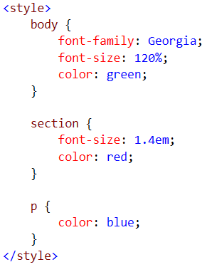

Inheritance > Example…
Property of the paragraph are going to override any properties of a parent element that conflict with it.

Slide 46
Working with Inheritance
As sties become more complex, inheritance become more difficult to track.
Keeping styles organized will help you avoid conflicts caused by inheritance.
Placing your most basic, default styles on top-level elements is an efficient way to style elements site-wide.
Remember that styles are cumulative; you must account for formatting inherited through parent elements.

Slide 47
Specificity
Most of the time the cascade or inheritance can be counted on to resolve styling conflicts. However, there is a third concept. Specificity that can come into play as well.
The specificity of a selector is, how specific is it?
In the event of a conflict between two selectors that inheritance can not solve the specificity of the selector is used to determine which selector has precedence.

Slide 48

Quiz:-Show at least 9 ways to target the <h1> element
Example:-
H1{
Color:red
}

Slide 49

Specificity
classes: Classes, Attributes, and Pseudo-classes
elements: Element Types and Pseudo-elements

Slide 50



Specificity > Example
We have 101 and 1, the 101 always wins

Slide 51



Specificity > Example
Programmers go crazy about this one.
This is not working because there is a selector elsewhere with a higher degree of specificity than the one you are trying to use.
.green has a specificity of 10 and #mainContent p has a specificity of 101.

Slide 52


Specificity > Example
In this case, we know .green has a specificity of 10, which shouldn’t override #mainContent p that has a specificity of 101.
Specificity works just fine until inheritance is involved.
The strong element is nested inside the section and a paragraph. We know from inheritance that those properties like color will inherit. But, if a child element has a style that differs or conflicts with the parent styles, the child styles always wins. In this case we are seeing inheritance and not specificity.

Slide 53

Specificity > Example
.green has a specificity of 10
strong has a specificity of 1
.green wins.

Slide 54


Specificity > Example
.green has a specificity of 10
strong.green has a specificity of 11
strong.green wins.

Slide 55
Specificity
Remember
You always have to keep track how specific a rule is to know if you need something a little bit more specific to override something.
You want to try to keep the specificity of your rules as low as possible. They are easier to parse that way, and they are also a lot easier to override later on.
And semantic naming matters. (a class named green, but it sets its color to purple)
Please go ahead and visit the following link and play with specificity
https://www.sitepoint.com/web-foundations/specificity/

Slide 56
Important
In addition to the cascade, inheritance and specificity there is one more CSS technique that can be used to resolve conflicts and that is the important declaration.
It doesn’t matter what else is going on in your styles, in the event of a conflict, the important declaration wins.
The only thing that can override an important declaration is another more specific important declaration or some kind of user controlled stylesheet.
Don’t use important declaration unless it is absolutely necessary.
Example: color: blue !important;

Slide 57



Important > Example
In the following case regardless of the cascade, specificity or inline style the important declaration wins.

Slide 58
Resolving Conflicts Through Planning > General Guidelines
Avoid using local styles when possible.
They add unwarranted extra layer of complexity to a site.
Updating or modifying styles can become a chore.
Local styles are easy to miss, especially in a team environment.
Do not use inline styles except for very specific circumstances.
They are almost impossible to detect and maintain.

Slide 59
Resolving Conflicts Through Planning > Develop a Strategy for Specificity
Don’t mix class and ID selectors without having a plan that guides when they are to be used.
Sections of ID selectors can be hard to override later if not accounted for.
Rule of Thumb: If you find yourself writing descendent selectors with three or more selectors, consider revising your strategy.

Slide 60
Resolving Conflicts Through Planning > Use Inheritance to your Advantage
If you are familiar with your page structure, you should be able to identify global formatting across your site.
Those formatting needs can then be written as global styles on parent elements, and inherited by the rest of the site.
This results in fewer rules to write and easier styles to maintain.

Slide 61
Resolving Conflicts Through Planning > Think about How Styles Relate to One Another
New designers often make the mistake of styling each element individually, as it’s encountered.
This can lead to bloated style sheets and hard to maintain styles.
Thinking of styles as related formatting allows you to plan and write organized style sheets.

Slide 62

Example of Good Planning

Slide 63

Example of Good Planning. Separate .css file for different font family,animations…

