Slide 1
Client Side Scripting
JavaScript

Slide 2
Introduction
JavaScript is the programming language of the Web.
A programing language that adds interactivity to your page!
All modern HTML pages are using JavaScript.
JavaScript is easy to learn.
JavaScript and Java are completely different languages, both in concept and design.
JavaScript was invented by Brendan Eich in 1995, and became an ECMA standard in 1997.
ECMA-262 is the official name.
Notes:
CSS to control the style and layout of multiple Web pages all at once.
ECMA European Computer Manufacturers Association.

Slide 3
Introduction
JavaScript is defined by the standards organization named European Computer Manufacturers Association (ECMA), specifically the ECMA standard ECMA-262.
is guided by a technical committee called TC39 (TC39-Royalty Free TG). The committee comprises a variety of members from various organizations involved in the development of JavaScript (Mozilla, Google, Microsoft, &c.), as well as members representing non-corpora
No one owns JavaScript, however, the control of ECMAScript is controlled through this committee (and less-corporate) entities.
TC39 strives to release a new version every year (although the features are added incrementally throughout the year)
It doesn’t go by “JavaScript” but by “ECMAScript” and the versions are therefore named “ES2016,” “ES2017,” and so on.

Slide 4
Introduction
Syntax is similar to Java, but it’s not Java per se
Usually JavaScript code is embedded within HTML code using the <script> tag:
Can have more than one pair of script tags in a page
Notes:
CSS to control the style and layout of multiple Web pages all at once.

Slide 5
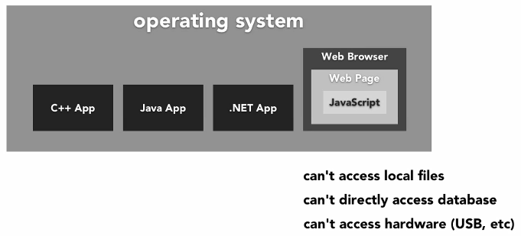
What is a Scripting Language?
A programming language designed for integrating and communicating with other pr languages.
Interpreted by another program at run time rather than compiled by the computers processor.
Javascript is an OOP programming language
Of the web.
E.g:- ASP, JS, PHP, perl and python

Slide 6
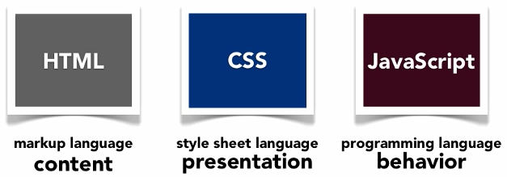
Introduction to JavaScript

Slide 7
What is DHTML
Dynamic HTML (DHTML)
Makes possible a Web page to react and change in response to the user’s actions.
DHTML = HTML + CSS + JavaScript
DHTML
XHTML
CSS
JavaScript
DOM

Slide 8
The Three Layers of the Web DHTML = HTML + CSS + JavaScript
HTML defines Web sites content through semantic tags (headings, paragraphs, lists, sections, articles, footers, …)
<p class=“warning”>There is no <em>download link</em> on this page. </p>
CSS defines ‘rules’ or ‘styles’ for presenting every aspect of an HTML document (presentation)
Font (family, size, color, weight, etc.)
Background (color, image, position, repeat)
Position and layout (of any object on the page)
.warning {color: red; }

Slide 9
The Three Layers of the Web… DHTML = HTML + CSS + JavaScript
JavaScript defines dynamic behavior
Programming logic for interaction with the user, to handle events, etc.
<script type=“text/javascript”>
window.alert(document.getElementsByClassName(“warning”)[0].innerHTML);
</script>

Slide 10
JavaScript
JavaScript is a front-end (client-side) scripting language developed by Netscape for dynamic content
Lightweight, with limited capabilities.
Can be used as object-oriented language
JavaScript is case-sensitive!
JavaScript is an Interpreted Language.
Client-side technology
Embedded in your HTML page
Interpreted by the Web browser
Simple and flexible
Powerful to manipulate the DOM

Slide 11
JavaScript engine(interpreter)
A JavaScript engine is a computer program that executes JavaScript (JS) code.
JS engines are developed by web browser vendors, and every major browser has one.
In a browser, the JS engine runs in concert with the rendering engine via the Document Object Model (DOM).
The first JavaScript engine was created by Brendan Eich in 1995 for the Netscape Navigator web browser.
The first modern JavaScript engine was V8, created by Google for its Chrome browser.

Slide 12
What can JavaScript do?
Can handle events (react to events)
Can read and write HTML elements and modify the DOM tree
Can validate form data
Can access / create / modify browser cookies
Can detect the user’s browser and OS
Can be used as object-oriented language
Can handle exceptions
Can perform asynchronous server calls (AJAX)

Slide 13
JavaScript Advantages
JavaScript allows interactivity such as:
Implementing form validation
React to user actions, e.g. handle keys
Changing an image on moving mouse over it
Sections of a page appearing and disappearing
Content loading and changing dynamically
Performing complex calculations
Custom HTML controls, e.g. scrollable table
Implementing AJAX functionality

Slide 14
Libraries
JavaScript can be used to create reusable libraries.
Some are:
Prototype
Script.aculo.us
Yahoo! User Interface Library
Dojo
jQuery
MooTools
Knockout
Angular(ionic framework for native IOS and android mobile dev)
Reactjs(React Native native IOS and android mobile dev) by facebook
Vue

Slide 15
What do you need to write JavaScript?
No special tools required.
No licensing needed.
You need a text editor.

Slide 16
When is Executed?
JavaScript code is executed during the page loading or when the browser fires an event.
All Statements are executed at page loading or
Some statements just define functions that can be called later
Code is executed sequentially (As soon as the browser gets to it)
Function calls or code can be attached as “event handlers” via tag attributes
Executed when the event is fired by the browser
<img src=“logo.gif” onclick=“alert(‘clicked!’)” />

Slide 17
JavaScript Code Location
A script file is treated as if the code is actually included in the page; the behavior is the same between script files and embedded in JavaScript blocks.
Placing JavaScript in external files has some advantages:
It separates HTML and code.
It makes HTML and JavaScript easier to read and maintain
Cached JavaScript files can speed up page loads.
Place the JavaScript in the body
when the JavaScript dynamically creates web page content as the page is being loaded.
Place the JavaScript in the head tag
When the JavaScript defined in functions and used for page events, as this is loaded before the body.
Place the JavaScript in the External File
To include a JavaScript library or script file in your web page, use this syntax:
<script src="somejavascript.js"></script>
The script element contains no content, but the closing tag is still required

Slide 18
Comments
2 types
Single line: // Author: Tadios N.
Multiline: /* Perhaps some lengthy
license. */

Slide 19
No Script
<noscript> ….any wordtext…</noscript>
<noscript> is an html tag used to let users with old browsers ,that java script is not working on their browsers.

Slide 20
Whitespace and Line Breaks JS is forgiving!
JavaScript ignores spaces, tabs, and newlines that appear in JavaScript programs.
You can use spaces, tabs, and newlines freely in your program and you are free to format and indent your programs in a neat and consistent way that makes the code easy to read and understand.
Semicolons are Optional

Slide 21
Case Sensitivity
JavaScript is a case-sensitive language. This means that the language keywords , variables, function names, and any other identifiers must always be typed with a consistent capitalization of letters.
So the identifiers time and TIME will convey different meanings in JavaScript.
NOTE: Care should be taken while writing variable and function names in JavaScript.

Slide 22
Variables
var myVariable;
myVariable = 200; //200
myVariable = “Hello”; //Hello (double quotes)
myVariable = ‘Hello’; //Hello (single quotes)
myVariable = true;
myVariable = false;

Slide 23
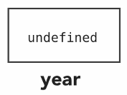
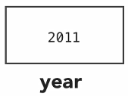
Variables
A variable is a container. (computer memory)
You can create a variable with the var statement:
var year; //its value will be undefined
Should be written as one word.
Can contain letters, numbers, _, $ but can’t start with a number.
You can set values to your variables using the equals (=) sign.
var year = 2011;

Slide 24
Variables and Data Types
JavaScript variables are containers for storing data values.
Type of a variable is dynamic: depends on the type of data it contains
JavaScript has six data types:
Number
String
Boolean (values true and false)
Object
Null (only value of this type is null)
Undefined (value of newly created variable)
Notes:
Names are case sensitive (y and Y are different variables)
Reserved words (like JavaScript keywords) cannot be used as names

Slide 25
Variables and Data Types
Must declare variables before they’re used in the program
Declare at the top of the program & terminate each statement with ‘;’
Initialize variables when appropriate
Local variables (declared within a function) destroyed after function exit
Can only be accessed within the function
Syntax:
var idf [= expression];
Example – Note Assignments
var x= 2.50;
var taxRate = .075;
var y;
Notes:
Names are case sensitive (y and Y are different variables)
Reserved words (like JavaScript keywords) cannot be used as names

Slide 26
Variables and Data Types
JavaScript is untyped language. This means that a JavaScript variable can hold a value of any data type.
Unlike many other languages, you don't have to tell JavaScript during variable declaration what type of value the variable will hold.
The value type of a variable can change during the execution of a program and JavaScript takes care of it automatically.
Example
Var x=“money”;
Var y;
Var y=34.01;
Notes:
Names are case sensitive (y and Y are different variables)
Reserved words (like JavaScript keywords) cannot be used as names

Slide 27
Variables and Data Types
All JavaScript variables must be identified with unique names.
These unique names are called identifiers.
Identifiers can be short names (like x and y), or more descriptive names (age, sum, totalVolume).
Reserved words (like JavaScript keywords) cannot be used as names

Slide 28
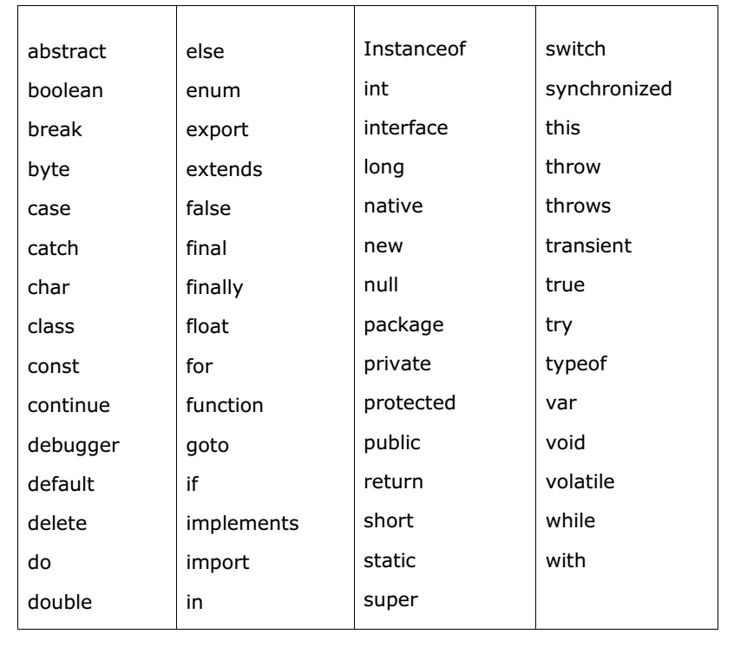
Reserved words

Slide 29
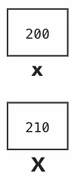
Variables
You can also create a variable without the var statement:
year = 2011;
Overwrites when redefined.
Variable names are case sensitive.
var x = 200;
X = 210;

Slide 30
Variables > Multiple Variables
You can create them with a comma.
var year, month, day;
You can create and initialize them at the same time.
var year = 2011, month = 10, day = 31;

Slide 31
Types of Variables
Local Variables:
Declared using the var keyword.
Variables declared inside a function have a scope of that function.
Global Variables:
Declared without var keyword or attached to window object directly.
i.e., window.someVar = “value”;
Variables defined outside the function will have a scope of page level.

Slide 32
VAR hoisting
console.log(myName); var myName = ‘Sunil’;
Basically, when JavaScript compiles all of your code, all variable declarations using var are hoisted/lifted to the top of their functional/local scope (if declared inside a function)or to the top of their global scope (if declared outside of a function) regardless of where the actual declaration has been made.
This is what we mean by “hoisting”.
A key thing to note is that the only thing that gets moved to the top is the variable declarations , not the actual value given to the variable.

Slide 33
Exercise
Write a js program which displays your full name by first assigning your first and last name to a variable?

Slide 34
Template literals
Template literals are string literals that allow embedded expressions. Template strings
use back-ticks (``) rather than the single or double quotes. A template string could thus be written as:
var greeting = `Hello World!`;
Template strings can use placeholders for string substitution using the ${ } syntax,
var name = "Brendan";
console.log('Hello, ${name}!');

Slide 35
Exercise…Use Template Literals
Write a js program which displays your full name by first assigning your first and last name to a variable?

Slide 36
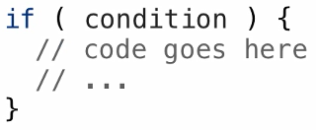
Controlling Program Flow

Slide 37
Controlling Program Flow > if statement
Expression (condition) is combination of values, variable references, function calls and operators that evaluates to some value.
Some comparison operators that we can use are:
Less than (<), greater than (>), less than or equal to (<=), greater than or equal to (>=), equals to (== or ===), not equals to (!=), not (!)
You don’t need to use a curly brace to define a code block, if the code below the if statement is a single line code. (But recommended to always use the blocks)

Slide 38
Controlling Program Flow…
If-else statement: if condition is false then execute the else block.
else-if statements: It’s not reverse of the if-else. It just says if condition is false then check this (else if) condition.
How it looks like:
i.e., if (condition) {
// Some true code
} else if (condition) {
// Some 2nd true code
} else {
// Some false code
}
var book = "maths";
use if /else to check to see if the book maths , history , biology or english and write a message if its correct.

Slide 39
Use if and Logical AND/OR
Let x=11
if the variable x is between 1-10 or 10-20 and even
Output=“number is between 1 to 10 and even”
Else
Output=“number is not between 1 to 2o and is odd”

Slide 40
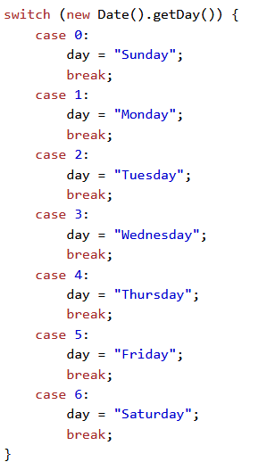
Switch Statement
The switch statement works like in C#:
switch (variable) {
case 1:
// do something
break;
case ‘a’:
// do something else
break;
case 3.14:
// another code
break;
default:
// something completely different
}

Slide 41
Operators and Expressions
Arithmetic Operators
+ - * /
Assignment
=
Logical AND/OR
&&, ||
Increment / Decrement
a += 1; a -= 1;
Unary operator
POST: a++; PRE: a--; ++a; --a;

Slide 42
What is the out put?
<html>
<head><title>JavaScript </title></head>
<script >
var x = 3;
var y = 11;
document.write(x++ * ++y + y +x ) ;
</script>
</body>
</html>
</html>

Slide 43
Operators with =
= assignment
== equality//makes the necessary type conversation
=== strict equality (recommended)//doesn’t make the necessary type conversation.
Strict Equality
var a = 5;
var b = “5”;
if (a === b) {
alert(“Yes, they’re equal”);
} else {
alert(“The are NOT equal”); // Executed
}

Slide 44
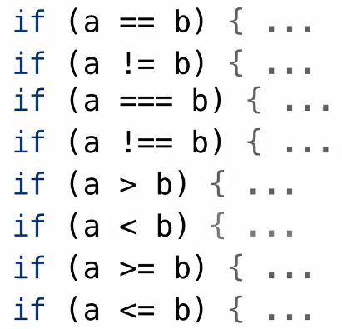
Operators and Expressions
Ternary Operator
Condition ? True : false;
var highScore = (playerOne > playerTwo) ? playerOne : playerTwo;

Slide 45
Console
For debugging purposes, you can use the console.log() method to display data.
Other methods
console.debug()
console.info()
console.warn()
console.error()

Slide 46
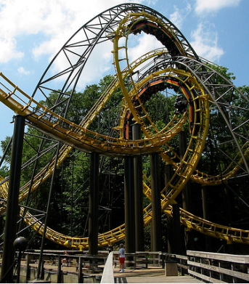
Loops
Loops: Minimizing repetition
while loop: Simplest loop. While condition is true run the code. Condition can be any expression.
do-while loop: Runs at least once, as condition is evaluated after running the loop body. As always condition can be any expression.
for loop: similar to while loop. Usually include declaration, condition and incrementer together on a same line.

Slide 47
Loops Faces
How these look like?
While loop: i.e., while (condiction) {
// Run the code
}
do-while loop: i.e., do {
// Run the code
} while (condition)
for loop: i.e., for (declaration; condition; action) {
// Run the code
}

Slide 48
Loops Example
var counter;
for (counter=0; counter<4; counter++) {
alert(counter);
}
while (counter < 5) {
alert(++counter);
}

Slide 49
Break and Continue plus Labels
The break statement “jumps out” of a loop.
The continue statement “jumps over” one iteration in the loop.
The break and the continue statements are the only JavaScript statements that can “jump out of” a code block.
JavaScript Labels:
label:
statments

Slide 50
Break and Continue plus Labels…
The continue statement (with or without a label reference) can only be used to skip one loop iteration.
The break statement, without a label reference, can only be used to jump out of a loop or a switch.
With a label reference, the break statement can be used to jump out of any code block:
break labelname;
continue labelname;

Slide 51
Exercise use for loop
display even numbers from 1 to 100, and stop the loop at 50?

Slide 52
Exercise use while loop
display even numbers from 1 to 100, and stop the loop at 50?

Slide 53
Exercise use do while
display even numbers from 1 to 100, and stop the loop at 50?

Slide 54
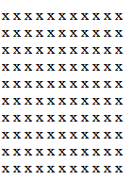
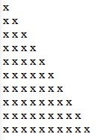
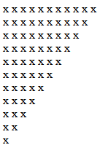
Exercise use nested for loop to create the following shapes

Slide 55
Variables main points
1.variables
..es5 var,es6 let and cont
var =function scope, hoisted
let=block scope, not hoisted but must be initialized first,;
difference between var,let and const is their initialization , simply means the value they are given to begin with.
2. es5 concatenation and es6 template literals
3.Desion making
3.1 if statment
3.2 switch
4.loops
for,
while,
do while,

Slide 56
JavaScript Functions
function average(a, b, c)
{
var total;
total = a+b+c;
return total/3;
}

Slide 57
JavaScript Functions
Code structure – splitting code into parts
If we want to re-run some code again and again from different places, then put the code in a function and call this function.
To keep the browser from executing a script as soon as the page is loaded, you can write your script as a function.
Functions are like little packages of JavaScript code waiting to be called into action.

Slide 58
JavaScript Functions…
A JavaScript function is a block of code designed to perform a particular task.
Define your functions before you call them
Some predefined functions are alert(), prompt() and confirm(). These all are available on the top level window object.
Functions can return values. Values returned by predefined window functions are: undefined, user input string or empty string or null, true or false.
function name(parameter1, parameter2, parameter3) {
code to be executed
}

Slide 59
Functions… > Sample Function
Parameters come in here.
function average(a, b, c)
{
var total;
total = a+b+c;
return total/3;
}
Declaring variables is optional. Type is never declared.
Value returned here.

Slide 60
Functions… > My Functions
Writing your own functions:
i.e.,
function sayHi() {
alert(“Hi”);
}
Calling functions: i.e.,
sayHi();
Parentheses are needed to call the functions.

Slide 61
Functions… > Arguments: Passing data to functions
Arguments or parameters: When a function expects something then it’s called parameters. While we pass the expected data to a function then it’s called arguments.
Declaring parameters:
i.e., function sayHi(name) {
Alert(“Hi” + name);
}
Calling function with arguments:
i.e., sayHi(“Tadios”)
Functions can contain any number of parameters

Slide 62
Functions… > A Secret Array
arguments array: Functions have one secret argument.
They contain the arguments array. This array contains all the arguments passed to the function.
i.e., function poll() {
var affirmative = arguments[0];
var negative = arguments[1];
}
//Calling the function
poll(“affirmative”, “negative”)

Slide 63
Functions… > A Secret Array…
Another example can be
function sum() {
var sum = 0;
for (var i=0; i<arguments.length; i++)
sum += parseInt(arguments[i]);
return sum;
}
//Calling the function
alert(sum(1, 2, 4));
alert(sum(4, 5, 7, 1, 2, 4));

Slide 64
Functions… > Return and Scope
Returning: As we know functions can return values. We use return statement to return something.
i.e., function sayHi(name) {
return “Hi ” + name;
}
Scope: Can be local or global. Ensure functions always declare variables using the var keyword or else they will look for it in global scope and will modify them.

Slide 65
Functions… > I have another face
Alternate function syntax:
i.e., var sayHi = function() {
alert(“Hi”);
}

Slide 66
Parameter Mismatch
function calculateLoan(amount, months, interest, name) {
// lots of code
}
calculateLoan(10000, 60, 7, “Sam Jones”); //correct
calculateLoan(10000, 60, 7, “Sam Jones”, “Something extra”); // extras are ignored
calculateLoan(10000, 60); //missing are passed as “undefined”

Slide 67
Function main points
1.Simple function defination and function invocation
fns /
2.Functions may be classified as Returning and Parameterized functions.
2.1 Default function parameters
2.2 Arguments Array and Rest parameter
3.ES5 Anonymous Functions ...Are concise and not hoisted
4.Function constructor
5.ES 6 Arrow Functions/////Are concise and not hoisted
6.Different between FunctionExpression

Slide 68
Function main points
and Function Declaration
--Function expression and function declaration
are not synonymous. Unlike a function
expression, a function declaration is bound
by the function name.
--function expressions cannot be hoisted
7.Call back functions//A function may be passed
as a parameter to another function.
This mechanism is termed as a Callback.
A Callback would be helpful in events.

Slide 69
Objects
var person1 = { name: “Tadios”, age: 23 };
var person2 = { name: “Ezra”, age: 35 };

Slide 70
Objects
Objects exists as a way of organizing variables and functions into logical groups. If we create objects to organize some variables and functions then the terminology changes slightly, now they are called properties and methods respectively.
We have already used them
var myArray = [10, 20, 30, “Forty”, 50];
console.log(myArray.length);
var todaysDate = new Date();
var ms = todaysDate.getTime();
Built-in objects: String, Date, Math, Boolean, Number, RegExp, Object, Array

Slide 71
Objects… > Object Creation
We can create objects to encapsulate the data and logic.
Syntax: new Object();
Example:
var person = new Object();
person.name = “Tadios N”;
person.age = 23;

Slide 72
Objects… > Object Creation…
Shorthand: { property1: “value”, property2: value, property3: value };
Example:
var person1 = { name: “Tadios”, age: 23 };
var person2 = { name: “Ezra”, age: 35 };

Slide 73
Objects… > Object Creation…
Associating methods with objects.
Example:
person1.speakName = function() {
console.log(“Hello, I’m ” + this.name);
};
Example:
function personDetails() {
console.log(this.name);
}
person1.speakName = personDetails;
person2.speakName = personDetails;

Slide 74
Objects… > Object Creation…
Example: calling the functions
person1.speakName();
person2.speakName();

Slide 75
Using an Object Constructor
Sometimes we like to have an "object type" that can be used to create many objects of one type.
The standard way to create an "object type" is to use an object constructor function:
function person(first, last, age, eye) { this.firstName = first; this.lastName = last; this.age = age; this.eyeColor = eye; } var myFather = new person("John", "Doe", 50, "blue"); var myMother = new person("Sally", "Rally", 48, "green");
Alert(myFather.firstName);

Slide 76
this Keyword
In JavaScript, the thing called this, is the object that "owns" the JavaScript code.
The value of this, when used in a function, is the object that "owns" the function.
The value of this, when used in an object, is the object itself.
The this keyword in an object constructor does not have a value. It is only a substitute for the new object.
The value of this will become the new object when the constructor is used to create an object.

Slide 77
JS Objects Main Points
1.object initialization
2.accessing object values using
2.1 dot notation
2.2 using []
3.The Object() Constructor
4.Constructor Function //
4.1 The ‘this’ keyword refers to the
current object in
use and defines the object’s property.

Slide 78
JS Objects Main Points
5.In JavaScript, objects are a
reference type(references of the object are copied)
not primitive types(values are copies)
-- primitive vs reference types
7.deleting object properties
8.object iteration using forin or if('key' in object)

Slide 79
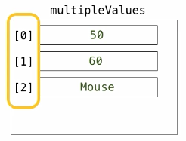
Arrays

Slide 80
Arrays
The Array object is used to store a set of (multiple) values in a single variable name.
Arrays in JS uses a zero-based index.
We define an Array with the new keyword, or by using angled brackets
Example:
var multipleValues = [];
multipleValues[0] = 50;
multipleValues[1] = 60;
multipleValues[2] = “Mouse”;
Example:
var cars = new Array("Saab", "Volvo", "BMW");

Slide 81
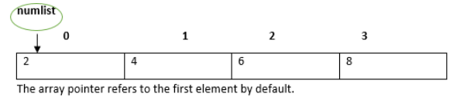
Arrays
For example, a declaration like:
var numlist = [2,4,6,8] will create an array as shown in the following figure.
Note: The pair of [] is called the dimension of the array.

Slide 82
Arrays…
// Shorthand
var multipleValues = [50, 60, “Mouse”];
[0] [1] [2]
// Longhand
var multipleValues = new Array(); arrays are objects
var multipleValues = Array();
var multipleValues = Array(5); // You can specify length, but arrays are dynamic in JS
var multipleValues = new Array(“Audi”, “Volvo”, “BMW”);

Slide 83
Arrays…
Two types: Single dimensional and Multi dimensional (array of array(s)).
i.e, var array = [“1st”, “2nd”, “3rd”];
var arrayM = [[“1st”], [“2nd”], [“3rd“]];
Accessing values stored in array: we use what is called index which is some integer ranges from 0 to array’s length – 1.
console.log(multipleValues[2]); // single dimensional array
console.log(arrayM[0][0]); // multi dimensional array
console.log(multipleValues); //50, 60, “Mouse”

Slide 84
Arrays… > Properties and Methods
var multipleValues = [30, 20, 10, 50, 40];
console.log(multipleValues.length); // returns 5 (number of elements)
multipleValues.sort(); // sorts the array
multipleValues.push(“77”); // adds a new element (77) to multipleValues
multipleValues[multipleValues.length] = 77; // adds a new element (77) to multpleValues (Adding elements with high indexes can create undefined “holes”)

Slide 85
Arrays… > Associative Arrays
Remember the Key-Value pairs?
Arrays with named indexes are called associative arrays (or hashes).
JavaScript does not support arrays with named indexes.
In JavaScript, arrays always used numbered indexes.
Example: var pincodes = [];
pincodes[“Ezra”] = 110062;
pincodes[“Tadios”] = 110044;
pincodes[“Martha”] = 110017;

Slide 86
Arrays… > Associative Arrays…
Accessing Associative arrays (hash tables):
Example: pincodes[“Ezra”]; //110017
pincodes[“Martha”]; // You guess here.
var my_hash = { a:2, b:3, c: “text” };
Associative arrays are actually objects!
All array methods and properties will produce incorrect results.
Example: console.log(pincodes.length); // 0
console.log(pincodes[0]); // undefined

Slide 87
Arrays…
There is no need to use the JavaScript’s built-in array constructor new Array(), use [] instead.
The new keyword only complicates the code. It can also produce some unexpected results.
Example: var points = new Array(40, 100); // creates an array with two elements (40 and 100);
var points = new Array(40); // creates an array with 40 undefined elements

Slide 88
Arrays… > How to recognize an Array
var fruits = ["Banana", "Orange", "Apple", "Mango"];
typeof fruits; // returns object (because a JavaScript array is an object)
Array.isArray(fruits); // returns true
fruits instanceof Array; // return true

Slide 89
Arrays… > Methods
var multipleValues = [10, 20, 30, 40];
.toString(); // coverts an array to a string of (comma separated) array values
multipleValues.toString(); //10,20,30,40
.join(separator); // behaves just like toString(), but in addition you can specify the separator
multipleValues.join(“ * ”); // 10 * 20 * 30 * 40
.pop(); // removes the last element from an array (length affected), and returns it
multipleValues.pop(); // removes the last element (40) from multipleValues
.push(value); // adds new element to an array (at the end), returns the new array length
multipleValues.push(77); // Adds a new element (77) to multipleValues

Slide 90
Arrays… > Methods…
.shift(); // equivalent to popping, working on the first element instead of the last. (removes the first array element and ‘shifts’ all other elements to a lower index. (returns the value that was “shifted out”)
multipleValues.shift(); // removes the first element 10 from multipleValues, and returns 10
.unshift(value); // adds a new element to an array (at the beginning), and “unshifts” older elements, returns the new array length.
multipleValues.unshift(77); // Adds a new element (77) to multipleValues and returns the length (5)
Adding new element at the end of an array using the length property.
multipleValues[multipleValues.length] = 77; // Appends 77 to multipleValues

Slide 91
Arrays… > Methods…
Deleting elements delete, using delete may leave undefined holes in the array. Use pop() or shift() instead.
delete multipleValues[0]; // changes the first element in multipleValues to undefined
.splice(position, noOfElementsToBeRemoved, newElementsToBeAdded…) – Length is recalculated. (returns the elements that were removed – Array)
multipleValues.splice(2, 0, 88, 99); // add 88, and 99 on the second position without removing an element.
multipleValues.splice(0, 1); // removes the first element of multipleValues
.concat() // array1.concat(array2, array3); // concatenates array1 with array2 and array3 and returns a new Array

Slide 92
Arrays… > Methods…
.slice(start, end) // slice out a piece of an array into a new array.
Doesn’t include end index
multipleValues.slice(2); // creates a new array with elements 30, 40
multipleValues.slice(2, 3); // creates a new array with one element 30
.sort() // Sorts the elements (as string)
// For Numberic Sort
multipleValues.sort(function(a, b){ return a – b });
.reverse() // Reverse the order of the elements

Slide 93
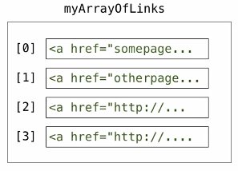
Arrays > Arrays are everywhere
var myArrayOfLinks = document.getElementsByTagName(“a”);

Slide 94
Array Main Points
1.Declaring and Initializing Arrays
2.Accessing Array Elements
3.Array Object
3.1 Array Constructor Accepts Comma-separated Values
4.Array Methods
4.1 concat() //concat() method returns a new array comprised of this array joined with two or more arrays.
4.2 every() every method tests whether all the elements in an array passes the test implemented by the provided function
4.3 some() some method tests whether some elements in an array passes the test implemented by the provided function
4.4 filter() method creates a new array with all elements that pass the test implemented by
4.5 forEach() method calls a function for each element in the array
4.6 indexOf() & lastIndexOf method returns the first & last index at which a given element can be found in the
array, or -1 if it is not present.
4.7 join() method joins all the elements of an array into a string.
4.8 map() method creates a new array with the results of calling a provided function on every element in this array.

Slide 95
Array Main Points …
4.9 push() & pop() & shift() & unshift() method removes the first element from an array and returns that element.
4.10 reduce() method applies a function simultaneously against two values of the array (from
left-to-right) as to reduce it to a single value.
4.11 reverse() method reverses the element of an array. The first array element becomes the last and the last becomes the first.
4.12 slice() method extracts a section of an array and returns a new array.
4.13 sort() method sorts the elements of an array.
4.14 splice() method changes the content of an array, adding new elements while removing old elements
es6 array methods
4.15 find() and findIndex() lets you iterate through an array and get the first element back that causes the given callback function to return true.
4.16 Multidimensional Arrays
4.17 Array of objects

Slide 96
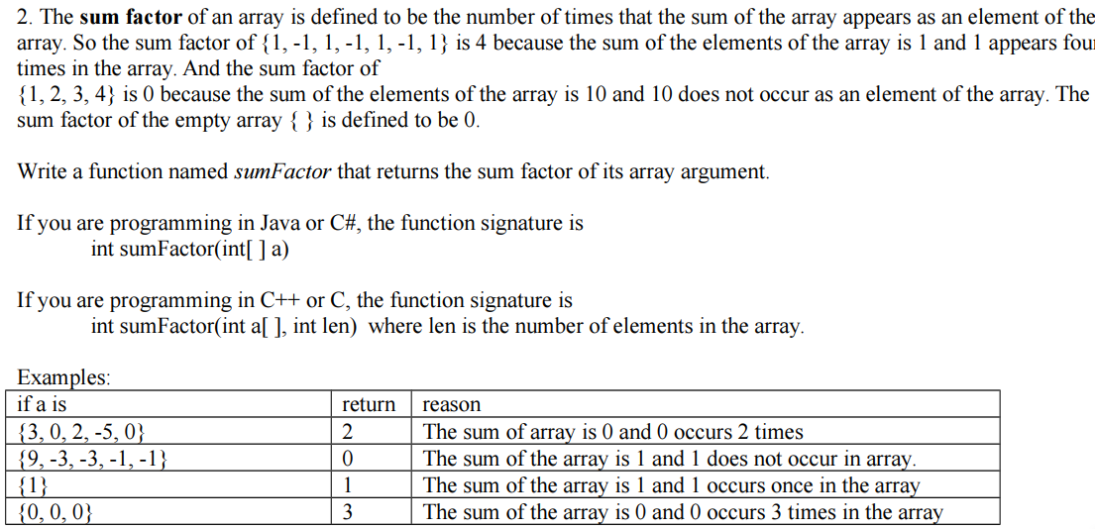
#1 sum factor

Slide 97
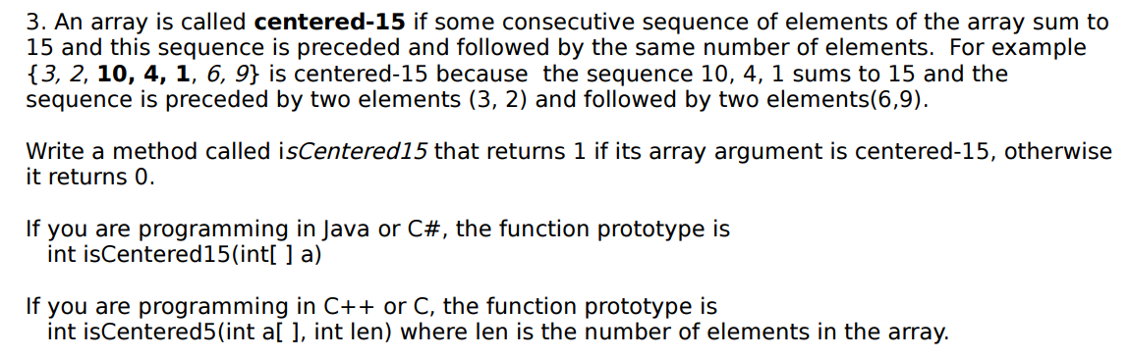
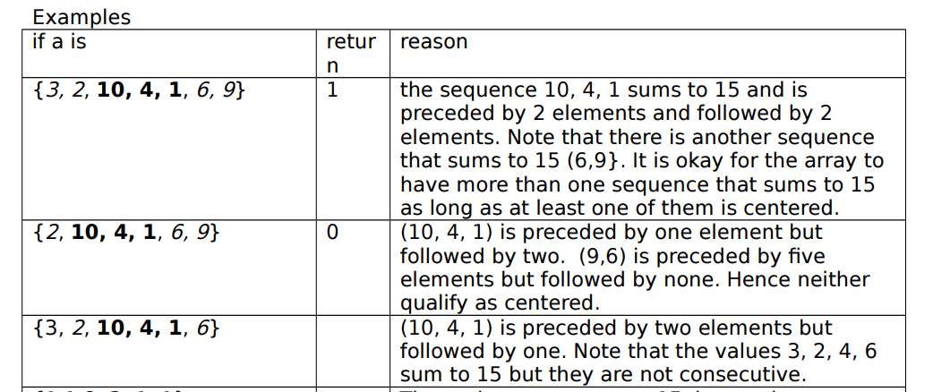
#2 centered

Slide 98
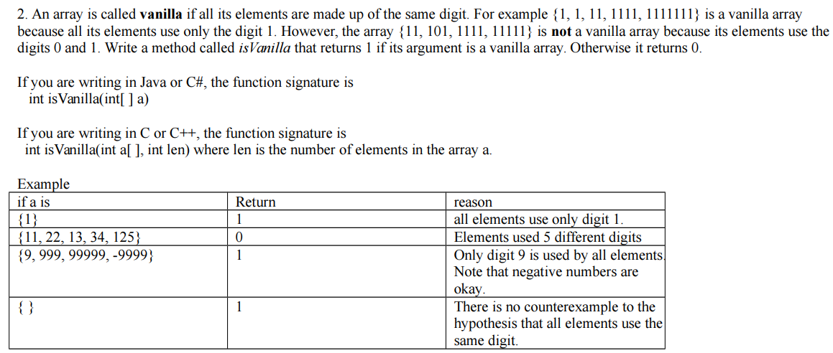
#3 vanilla

Slide 99
Numbers
3, -3, 3.33, -3.33, 123e5, 123e-5.

Slide 100
Numbers
3, -3, 3.33, -3.33, 123e5, 123e-5. These all are number in JS, whether it’s some integer or floating point number.
Operations: addition (+), subtraction (-), division (/), multiplication (*), modulo division (%)
JavaScript numbers are 64-bit floating point numbers.
Result is always promoted to float whenever possible.
i.e. 5 / 3, 3/ 5, 0.5 * 0.5, 0.5 + 5
Assignment operators: +=, -=, *=, /=, %=
Special operators: increment (++), decrement (--)

Slide 101
Numbers…
var foo = 5;
var bar = 5;
console.log(foo + bar); //10
var foo = “5”;
var bar = “5”;
console.log(foo + bar); //55
var foo = 5;
var bar = “5”;
console.log(foo + bar); //55 – one is a string

Slide 102
Numbers…
Integers (numbers without a period or exponent notation) are considered accurate up to 15 digits.
var x = 999999999999999; // x will be 999999999999999
var y = 9999999999999999; // y will be 10000000000000000
The maximum number of decimals is 17, but floating point arithmetic is not always 100% accurate.
var x = 0.2 + 0.1; // x will be 0.30000000000000004
To solve the problem, multiply and divide
var x = (0.2 * 10 + 0.1 * 10) / 10; // x will be 0.3

Slide 103
Numbers
Infinity (or –Infinity) is the value JavaScript will return if you calculate a number outside the largest possible number.
if (myNumber != Infinity) // Execute if not Infinity
Division by 0 (zero) also generates Infinity
var x = 2 / 0; // x will be Infinity
var y = -2 / 0; // y will be –Infinity
Infinity is a number not a type.
typeof Infinity; // returns “number”

Slide 104
Numbers…
var foo = 5;
var bar = “b”;
console.log(foo * bar); //NaN – not a number
var foo = “55”; // could be “abc”
var myNumber = Number(foo); //make it a number
If (isNaN(myNumber)) {
console.log(“It’s not a number!”);
}
var x = NaN; var y = 5; var z = x + y; // z will be NaN
var x = NaN;
var y = “5”;
var z = x + y; // z will be NaN5;
Number() gives you a number
new Number() gives you an object

Slide 105
Numbers… > Methods and Properties
.toString(); // returns a number as a string.
var x = 123; x.toString(); // returns 123 from variable x (123).toString(); // returns 123 from literal 123 (100 + 23).toString(); // returns 123 from expression 100 + 23
.toFixed(numberOfDecimals); // returns a string, with the number written with a specified number of decimals
var x = 9.656; x.toFixed(0); // returns 10 x.toFixed(2); // returns 9.66 x.toFixed(4); // returns 9.6560 x.toFixed(6); // returns 9.656000

Slide 106
Numbers… > Methods and Properties
.toPrecision(length); // returns a number written with a specified length.
var x = 9.656; x.toPrecision(); // returns 9.656 x.toPrecision(2); // returns 9.7 x.toPrecision(4); // returns 9.656 x.toPrecision(6); // returns 9.65600
.parseInt(); parseInt(value) // parse a string and returns a whole number. Spaces are allowed. Only the first number is returned. (Number() doesn’t allow spaces)
parseInt("10"); // returns 10 parseInt("10.33"); // returns 10 parseInt("10 20 30"); // returns 10 parseInt("10 years"); // returns 10 parseInt("years 10"); // returns NaN

Slide 107
Numbers… > Methods and Properties
.parseFloat(); parseFloat(value); // parse a string and returns a number. Spaces are allowed. Only the first number is returned.
parseFloat("10"); // returns 10 parseFloat("10.33"); // returns 10.33 parseFloat("10 20 30"); // returns 10 parseFloat("10 years"); // returns 10 parseFloat("years 10"); // returns NaN
Number Properties
MAX_VALUE – largest number possible in JavaScript
MIN_VALUE – smallest number possible in JavaScript
NEGATIVE_INFINITY - negative infinity (overflow)
POSITIVE_INFINITY – infinity (overflow)
NaN – Not-a-number

Slide 108
The Math Object
The Math object provides some mathematical functions.
var x = 200.6;
var y = Math.round(x); //201 (rounds to its nearest integer)
var a = 200, b = 10000, c = 4;
var biggest = Math.max(a, b, c);
var smallest = Math.min(a, b, c);
Math.PI; // returns 3.141592653589793
Math.pow(x, y); // returns value of x to the power y
Math.pow(8, 2); // returns 64

Slide 109
The Math Object
Math.random(); // returns a number between 0 (inclusive), and 1 (exclusive)
Math.random(); // 0.345617552233215
Math.sqrt(x); // returns the square root of x
Math.sqrt(64); // returns 8
Math.abs(x); // returns the absolute value of x
Math.abs(-5.8); // returns 5.8
Math.ceil(x); // returns the value of x rounded up to its nearest integer
Math.ceil(5.2); // returns 6
Math.floor(x); // returns the value of x rounded down to its nearest integer
Math.floor(5.8); // returns 5

Slide 110
Exercise
Use Math methods to display a random number between 1-20 whenever the page is refreshed , round the number up to the nearest integer?

Slide 111
Strings
var myString = “sample string”;
var myString = ‘sample string’;

Slide 112
Strings
Strings: Series/sequence of characters from zero to infinity. Can contain any character. Can be created using single or double quotes.
i.e., var myString = “sample string”;
var myString = ‘sample string’;
Use backslash (\) to escape special characters.
i.e. var sentence = “Hi this is a \“special\” word here.”;
var anotherSentence = “Hi this is \ttab\t here.”;

Slide 113
String… > Properties and Methods
Strings can be treated as objects. It means, they have information we can access.
var phrase = “This is a simple phrase”;
console.log(phrase.length); //24
console.log(phrase.toUpperCase());
var words = phrase.split(“ ”); //provides an array

Slide 114
String… > Properties and Methods…
var phrase = “We want a groovy keyword.”;
var position = phrase.indexOf(“groovy”); //10
// it returns -1 if the term is not found
if (phrase.indexOf(“DDDD”) == -1) {
console.log(“The word does not occur.”);
}
It can also take a start index
//there is also .lastIndexOf(“text to search”)
.search(“text to search”)

Slide 115
String… > Properties and Methods…
Slice allow us to grab a particular piece of a string.
var phrase = “Yet another phrase.”;
var segment = phrase.slice(6,11); //other – slice(start, end) end is non inclusive
If parameter is negative the count is done from the end of the string.
var segment = phrase.slice(-15, -8); //another
If no second parameter (end) is not provided, the method will slice out the rest of the string.
.substring(start, end) – only positive indexes
.substr(start, length) – takes length

Slide 116
String… > Properties and Methods…
.replace(“replace”, “replace with”) // replace a specified value with another value
.concat(par1, par2, par3, …) // joins two or more strings
.charAt(position) //returns the character at a specified index (position)
.charCodeAt(position) // returns the Unicode of the character at a specified index

Slide 117
Exercise
. Extract the word “template’ from the ff text?
www.Desktop/hh/template.html

Slide 118
String > Comparison
var str1 = “Hello”;
var str2 = “hello”;
//str1 != str2
If (str1.toLowerCase() == str2.toLowerCase()) {
console.log(“Yes, equal”);
}

Slide 119
String > Comparison…
var str1 = “aardvark”;
var str2 = “beluga”;
if (str1 < str2) { … // true
var str1 = “aardvark”;
var str2 = “Beluga”;
if (str1 < str2) { … //false!
ABCD… less than abcd…

Slide 120
Boolean
A JavaScript Boolean represents one of two values: true or false.
Case for True: Everything with a “real” value is true
“<1 space here>”, “string”, “undefined”, 1, 2, 3, -3, -2, -1, true; all represents true value.
Cases for false: Everting without a “real” value is false
“<empty string>”, undefined, null, 0, false, NaN; all represents false value.
Boolean and new Boolean can be used to create boolean values.
One create a boolean type and the other creates a boolean object.
Universal checking program:
<any value> ? “Statement when True” : “Statement when False”;

Slide 121
Date
new Date()
new Date(milliseconds)
new Date(dateString)

Slide 122
Date
The Date object provides date / calendar functions
The Date object lets you work with dates (years, months, days, hours, minutes, seconds, and milliseconds)
A JavaScript date can be written as a string: Sun Mar 26 2017 20:15:44 GMT+0300 (E. Africa Standard Time) or as a number: 1490548544426

Slide 123
Date… > Creating Date Objects
Date objects are created with the new Date() constructor.
There are four ways of initiating a date:
new Date()
new Date(milliseconds)
new Date(dateString)
new Date(year, month, day, hours, minutes, seconds, milliseconds)

Slide 124
Date… > Create Date Objects…
Examples:
var today = new Date(); // current date and time (including the millisecond)
var y2k = new Date(2000, 0, 1); // year, month, day (month is zero based)
var y2k = new Date(2000, 0, 1, 0, 0, 0, 0); // year, month, day, hours, minutes, seconds, milliseconds (Can omit any of the last four)
var d = new Date("October 13, 2014 11:13:00");
var d = new Date(86400000); // creates a new date object as zero time plus the number. (Zero time is 01 January 1970 00:00:00 UTC.)

Slide 125
Date… > Displaying Dates
When you display a date object in HTML, it is automatically converted to a string, with the toString() method.
var d = new Date();
console.log(d); console.log(d.toString()); //Mon Mar 27 2017 04:44:19 GMT+0300 (E. Africa Standard Time)
console.log(d.toUTCString()); //Mon, 27 Mar 2017 01:46:23 GMT
console.log(d.toDateString()); // Mon Mar 27 2017
JS Date formats: "2015-03-25“, "03/25/2015“, "Mar 25 2015" or "25 Mar 2015“, "Wednesday March 25 2015"

Slide 126
Date… > Get Methods
var today = new Date();
today.getMonth(); // returns 0 – 11
today.getFullYear(); // YYYY (not zero-based)
today.getDate(); //1-31 day of month
today.getDay(); // 0-6 day of week. 0 == Sunday
today.getHours(); // 0-23
today.getTime(); // milliseconds since 1/1/1970 (comparison)
today.getSeconds(); // seconds 0 – 59
today.getMilliseconds(); // milliseconds 0 - 999

Slide 127
Date… > Set Methods
var today = new Date();
today.setDate(); // Set the day as a number (1-31)
today.setFullYear(); //Set the year (optionally month and day)
today.setHours(); //Set the hour (0-23)
today.setMilliseconds(); // Set the milliseconds (0-999)
today.setMinutes(); //Set the minutes (0-59)
today.setMonth(); // Set the month (0-11)
today.setSeconds(); // Set the seconds (0-59)
today.setTime(); // Set the time (milliseconds since January 1, 1970)

Slide 128
Date… > Get Methods
You may also use the parse method on the Data object to parse a date from a date string.
var date = Date.parse(“March 29, 2016”);

Slide 129
Date… > Comparison
var date1 = new Date(2000, 0, 1);
var date2 = new Date(2000, 0, 1);
Don’t compare dates directly (objects)
if (date1 == date2) { … // false! (it doesn’t matter if it is == or ===)
Compare dates using the getTime() method
if (date1.getTime() == date2.getTime()) { …
949388400000 == 949388400000 // true!

Slide 130
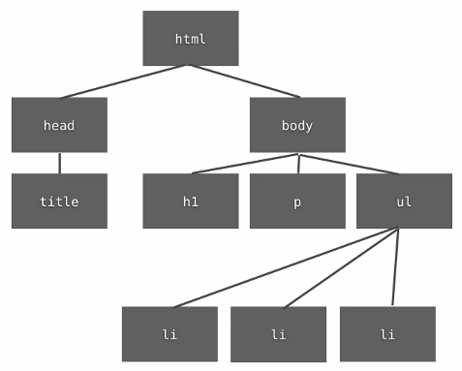
The Document Object Model (DOM)
var todaysDate = new Date();
var ms = todaysDate.getTime();

Slide 131
DOM
Every web page resides inside a browser window which can be considered as an object. A Document object represents the HTML document that is displayed in that window.
The Document object has various properties that refer to other objects which allow access to and modification of document content. The way a document content is accessed and modified is called the Document Object Model, or DOM. The Objects are organized in a hierarchy. This hierarchical structure applies to the organization of objects in a Web document.

Slide 132
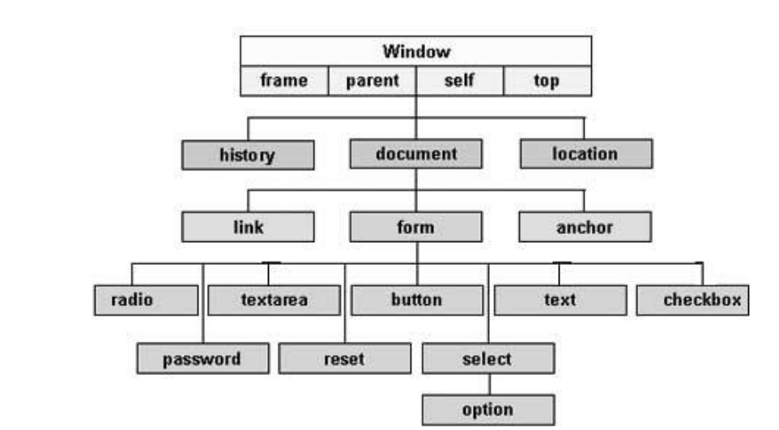

Slide 133
The Document Object
When an HTML document is loaded into a web browser, it becomes a document object.
The document object is the root node of the HTML document and the "owner" of all other nodes: (element nodes, text nodes, attribute nodes, and comment nodes).
The document object provides properties and methods to access all node objects, from within JavaScript.
If you want to access any element in an HTML page, you always start with accessing the document object.
Tip: The document is a part of the Window object and can be accessed as window.document.

Slide 134
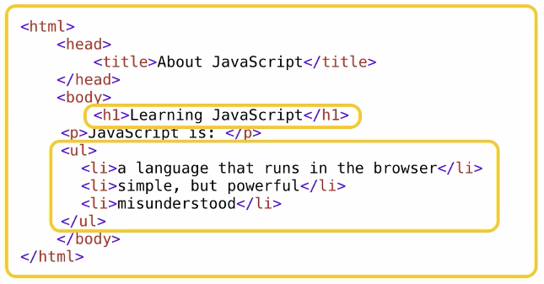
The Document Object Model (DOM)
What is the Document?
It means the page (the html code – as an xml representation and a visual representation)
What are the Objects?
Is just a thing, some thing, any thing that makes sense to treat as an individual piece.

Slide 135
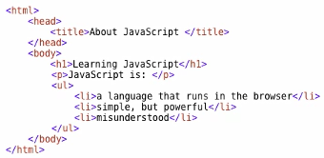
The Document Object Model (DOM)
What is the Model?
Making it abstract
Set of terms we can agree on, set of standards you can use
Tree structure of the document
DOM: agreed-upon set of terms, pieces, web page

Slide 136
The Document Object Model (DOM)
Every HTML element is accessible via the JavaScript DOM API
Document Object Model: Mapping your HTML.
The browser stores its interpreted HTML code as a structure of JavaScript objects, called DOM.
Most DOM objects can be manipulated by the programmer.

Slide 137
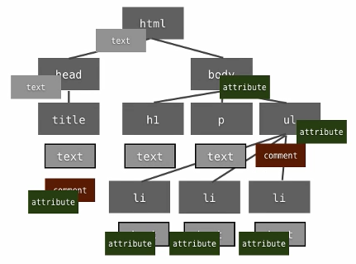
The Document Object Model (DOM) > Nodes & Elements
Even the smallest document has many nodes.
Node Types: There are twelve node types in the DOM.
The three important ones are
Node.ELEMENT_NODE == 1
Node.ATTRIBUTE_NODE == 2
Node.TEXT_NODE == 3

Slide 138
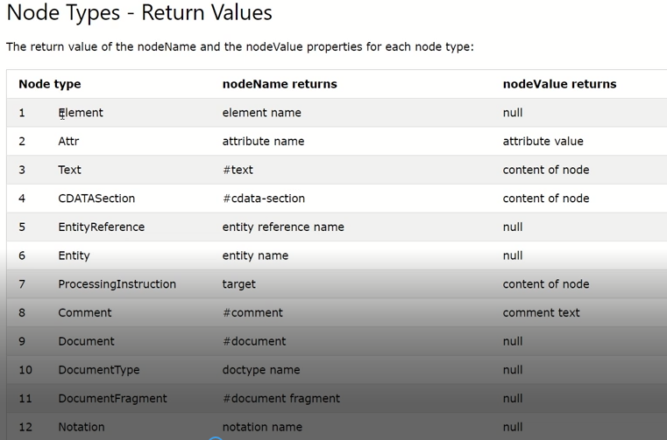
The Document Object Model (DOM) > Nodes & Elements

Slide 139
Elements vs text nodes
<div>
<p>
This is a paragraph of text with a
<a href="page.html">link</a>.
</p>
</div> HTML
Q: How many children does the div above have?
A: 3
an element node representing the <p>
two text nodes representing "\n\t" (before/after the paragraph)
Q: How many children does the paragraph have? The a tag?

Slide 140
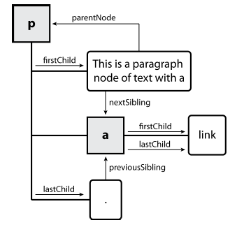
DOM tree traversal example
<p id="foo">This is a paragraph of text with a
<a href="/path/to/another/page.html">link</a>.</p> HTML

Slide 141
1.Node Targeting properties
childNodes[]//node array
firstChild // node
lastChild //node
nextSibling //node
previousSibling //node
parentNode // node
nodeName//returns the node name
nodeType//the type
nodeValue//the value of the node

Slide 142
1.Element Targeting properties
children[]//elem array
nextElementSibling//elem
previousElementSibling//elem
firstElementChild//element
lastElementChild//element
parentElement // element

Slide 143
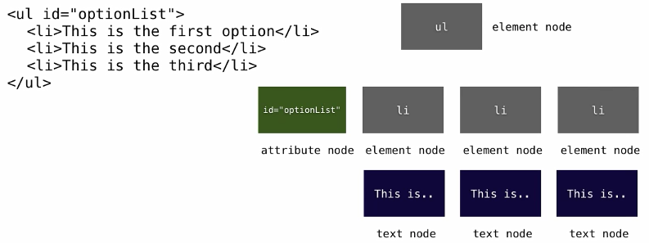
The Document Object Model (DOM) > Nodes & Elements

Slide 144
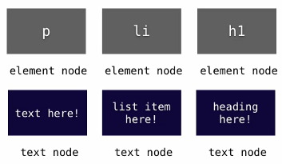
The Document Object Model (DOM) > Nodes & Elements
Element nodes don’t contain text

Slide 145
The Document Object Model (DOM)… > Grand Node
In fact there is a universal node.
Document node
The node exists even if the document is blank.
document
ELEMENT_NODE
Rest of DOM

Slide 146
DOM Manipulation
var todaysDate = new Date();
var ms = todaysDate.getTime();

Slide 147
DOM Manipulation
How to get an element node?
Question: Is it unique in the document? (Id, class, tagName, attribute)
Retrieving an element by Id
document.getElementById(“someId”);
Example:
var myElement = document.getElementById(“abc”); // handle to the document (not detached)
Retrieving an element by Tag
document.getElementsByTagName(“someTagName”);
Example:
var myListItems = document.getElementsByTagName(“li”); // creates an array

Slide 148
DOM Manipulation
Retrieving an element by Name
document.getElementsByName(“someName”); // creates an array
Example:
var myListItems = document.getElementsByTagName(“firstName”);
Retrieving an element by Class Name
Document.getElementsByClassName(“classNames”); //creates an array
Example:
var myListItems = document.getElementsByClassName(“green”);
Retrieving an element (Nested)
Example:
var myListItems = document.getElementsByTagName(“li”);
var myFirstList = document.getElementById(“abc”);
var limitedList = myFirstList.getElementsByTagName(“li”);

Slide 149
DOM Manipulation > Common Element Properties
Most of the properties are derived from the HTML attributes of the tag
E.g. id, name, href, alt, title, src, etc…
style property – allows modifying the CSS styles of the element
Corresponds to the inline style of the element
Not the properties derived from the embedded or external CSS rules
Example: style.width, style.marginTop, style.backgroundImage

Slide 150
DOM Manipulation > Manipulating Style and Classes
Altering style: We can use the style property to alter the style of any element. i.e.,
document.getElementsByTagName(“body”)[0].style.background=“#ddd”;
document.getElementsByTagName(“label”)[0].style.position = “absolute”;
document.getElementsByTagName(“label”)[0].style.left = “300px”;

Slide 151
DOM Manipulation > Common Element Properties…
className – the class attribute of the tag
innerHTML – holds all the entire HTML code inside the element
Read-only properties with information for the current element and its state
tagName, offsetWidth, offsetHeight, scrollHeight, scrollTop, nodeType, etc…

Slide 152
Some of The Document Object Properties
document.title | Returns the <title> element
document.URL | Returns the complete URL of the document
document.body | Returns the <body> element
document.forms | Returns all <form> elements
document.head | Returns the <head> element

Slide 153
Finding HTML Elements
1. Finding HTML Element by Id //Most Common One
Eg:-document.getElementById(“div”);
2.Finding HTML Elements by Tag Name
Eg:-document.getElementsByTagName(“p”);
3. Finding HTML Elements by Class Name
Eg:-document.getElemenstByClassName(“par”);
4. Finding HTML Elements by CSS Selectors
Eg:-document. querySelectorAll("p.par");

Slide 154
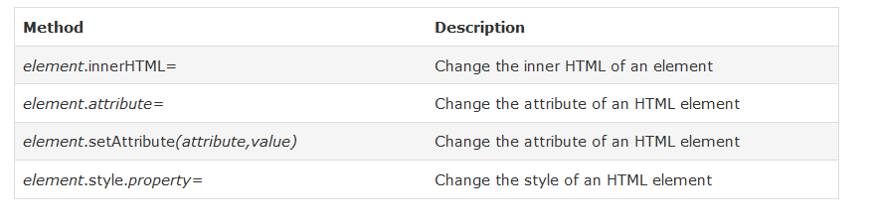
Changing HTML Elements

Slide 155
DOM Manipulation > Accessing Elements through the DOM Tree Structure
We can access elements in the DOM through some tree manipulation properties:
element.childNodes
element.parentNode
element.nextSibling
element.previousSibling
element.firstChild
element.lastChild

Slide 156
DOM Manipulation > Element vs Node Targeting 1.Element Targeting
document.getElementById();//elem
document.getElementsByTagName();//elem araay
document.getElementsByClassName();// elem array
document.querySelector();//elem
document.querySelectorAll();//elem array
children[]//elem array
nextElementSibling//elem
previousElementSibling//elem
firstElementChild//element
lastElementChild//element
parentElement // element

Slide 157
DOM Manipulation > Element vs Node Targeting 1.Node Targeting
childNodes[]//node array
firstChild // node
lastChild //node
nextSibling //node
previousSibling //node
parentNode // node

Slide 158
DOM Manipulation > Element vs Node Targeting 1.Node Testing
nodeName //name of the node,text,element.....
nodeType //1 for element node,3 for text node…
nodeValue // returns the text node value,use it only for text nodes

Slide 159
DOM Manipulation > Changing DOM Content
Setting and Getting Attributes
myElement.getAttribute(“attributeName”); // name – in quotes
myElement.setAttribute(“align”, “left”); // name, value
Setting and Getting the content of an element
innerHTML
myElement.innerHTML; // getting the inner html (simple tag)/ Entire content
myElement.innerHTML = “Some content”; // content to be added inside the element

Slide 160
DOM Manipulation > Changing DOM Content
Steps to insert individual DOM elements
Create the element
Add it to the document (DOM)
Example:
var myNewElement = document.createElement(“li”);
myElement.appendChild(myNewElement);
myNewElement.innerHTML = “New item text”;
// alternatively the text can be set using a text node
var myText = document.createTextNode(“New list item text”);
myNewElement.appendChild(myText);

Slide 161
DOM Manipulation > Changing DOM Content
parent.insertBefore(newElement, existingElement);
Example:
var myNewElement = document.createElement(“li”);
var secondItem = myElement.getElementsByTagName(“li”)[1];
myElement.insertBefore(myNewElement, secondItem); // add the list item as the second list item of its parent.

Slide 162
Adding and Removing a node(HTML Element)
createElement();//use this to create a new node
createTextNode("This is new.")//you can use this property to create a text node
myDiv.textContent='text content';//add text content to an element
appendChild(node)//you can use this property to append a newly created node to your page
removeChild(child) // you can use this method to remove a node (element).
myElement.insertBefore(myNewElement, secondItem)// insert before some element.
Note:-Every Time you want to remove an element you must first refer his parent node.
parentNode.removeChild(child);

Slide 163
Events
var todaysDate = new Date();
var ms = todaysDate.getTime();

Slide 164
The HTML DOM Event Model
JS enables us to write scripts that are triggered by events that occur during the user’s interaction with the page, like clicking a hyperlink, scrolling the browser’s viewport, typing a value into a form field or submitting a form.
JavaScript can register event handlers.
Events are fired by the browser and are sent to the specified JavaScript event handler function.
Can be set with HTML attributes:
Can be accessed through the DOM:
<img src="test.gif" onclick="imageClicked()" />
var img = document.getElementById("myImage");
img.onclick = imageClicked;

Slide 165
Event Handlers
Simplest way to run JS code in response to an event is to use an event handler (function).
How to attach?: element.onevent = eventHandler;
Element
Event handler
onclick
Note: I didn’t provide parentheses to eventHandler

Slide 166
Event Handlers…
All event handlers receive one parameter
It brings information about the event
Contains the type of the event (mouse click, key press, etc.)
Data about the location where the event has been fired (e.g. mouse coordinates)
Holds a reference to the event sender
E.g. the button that was clicked
Holds information about the state of [Alt], [Ctrl] and [Shift] keys
Some browsers do not send this object, but place it in the document.event
Some of the names of the event’s object properties are browser specific

Slide 167
Default Actions and this
Default actions: Things that the browser normally does in response to events.
How to prevent?: return false or true to cancel or let the default action follow.
this keyword: this is an object reference that you get when executing a method on an object. When browser invokes the event handler on some event for an element, then within the event handler this points to the element on which event is fired.
We can’t set the value of this object.

Slide 168
Common DOM Events
Mouse events:
onclick, onmousedown, onmouseup
onmouseover, onmouseout, onmousemove
Key events:
onkeypress, onkeydown, onkeyup
Only for input fields
Interface events:
onblur, onfocus
onscroll

Slide 169
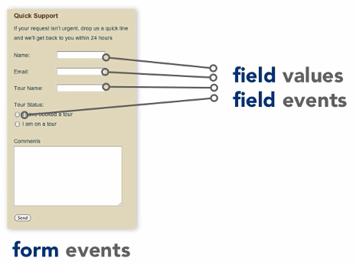
Common DOM Events… > Forms
Things that you consider when working with forms
Field values
Field events
Form events

Slide 170
Common DOM Events… > Forms
Getting form and form Elements
<form id=“frmContact” name=“frmContact” …
…
<input name=“email” …
…
</form>
You can access elements by using getElementById or getElementsByName
Alternatively,
document.forms.nameOfTheForm // document.forms.frmContact
document.forms.frmContact.nameOfElement // document.forms.frmContact.email

Slide 171
Common DOM Events… > Forms…
Text Fields
Main Property
myTextField.value
Main Events
onfocus – when you go into it
onblur – when you leave it (always)
onchange – when value is changed
onkeypress – entire press a key and release it
onkeydown – press a key
onkeyup – release it

Slide 172
Common DOM Events… > Forms…
Checkboxes and Radio Buttons
Main property
myCheckbox.checked // true or false
Main Events
onclick
onchange
Select Lists
Main property
mySelect.type // select-one or select-multiple

Slide 173
Common DOM Events… > Forms…
Select Lists
Main event
onchange
Main property
mySelect.selectedIndex // select-one
mySelect.options[x].selected // true or false (through iteration)

Slide 174
Common DOM Events… > Forms…
Form
Main events
onsubmit // called when the user clicks the submit button (can be used to interrupt form submission before it is sent to the server);
You can return false on the event handler of the onsubmit event to stop the form from being submitted to the server.
A way to validate before data is sent to the server (avoid round trip to the server), but you should always have a server side validation

Slide 175
Form Validation > Example
<form name="myForm" action="/action_page_post.php" onsubmit="return validateForm()" method="post">
Name: <input type="text" name="fname">
<input type="submit" value="Submit">
</form>
function validateForm() {
var x = document.forms["myForm"]["fname"].value;
if (x == "") {
alert("Name must be filled out");
return false;
}
return true;
}

Slide 176
Common DOM Events…
Miscellaneous events
onload, onunload
Allowed only for the <body> element
Fires when all content on the page was loaded / unloaded
Usually used for setting up our events

Slide 177
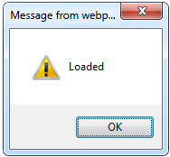
Common DOM Events… > onload Event
<html>
<head>
<script type="text/javascript">
function greet() {
alert("Loaded.");
}
</script>
</head>
<body onload="greet()" >
</body>
</html>

Slide 178
Event Listeners
What’s wrong with event handlers? You can’t assign multiple event handlers to an event. i.e.,
element.onclick = firstHandler;
element.onclick = secondHandler;
Now only secondHandler will be called, as it has replaced the firstHandler.
However we can assign as many event listeners as we want to an event of an element, and all of them will be called.

Slide 179
It’s like Hub
As we can see we can plugin many event listeners at once.
Event listener
Element
click
Event listener
Event listener

Slide 180
Attaching Event Listeners
How to attach event listener?:
Syntax: element.addEventListener(event, function, useCapture);
Example:
element.addEventListener(“event”, eventListener, false);
Object detection:
typeof element.property != “undefined”

Slide 181
Event Parameter
Event parameter of the listener: Browser automatically passes the event parameter to the event listener function. i.e,
function someClickEventListener(event) {
//Use event argument’s methods
}
event parameter has some important methods.
Some of them are: preventDefault() and stopPropagation().

Slide 182
Detaching Event Listeners
How to detach event listener: i.e.,
element.removeEventListener(“event”, eventListener, false);

Slide 183
Event order
If an element and one of its ancestors have an event handler for the same event, which one should fire first?
This depends on the browser
Two Models
Event Capturing
Event Bubbling

Slide 184
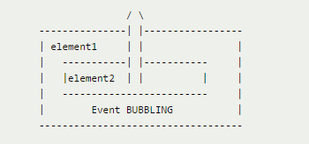
Event bubbling
The concept of event bubbling was introduced to deal with situations where a single event such as a mouse click, may be handled by two or more event handlers defined at different levels of the Document Object Model hierarchy.
If this is the case, the event bubbling process starts by executing the event handler defined for individual elements at the lowest level.
From there, the event bubbles up to the containing elements, then up to even higher-level elements.
Finally, the event ends up being handled at the highest level in the DOM hierarchy, the document element itself.

Slide 185
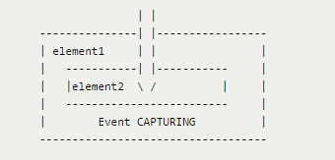
Event Capturing
Event capturing is the opposite of bubbling (events are handled at higher levels first, then sink down to individual elements at lower levels). Event capturing is supported in fewer browsers and rarely used; notably, Internet Explorer prior to version 9.0 does not support event capturing.

Slide 186
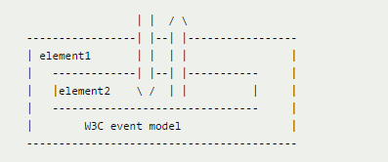
Event Propagation
Often used as a synonym of event bubbling. However, strictly speaking, event propagation is a wider term: it includes not only event bubbling but also event capturing.

Slide 187
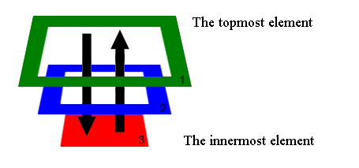
Event Propagation
Event propagation runs in three phases:
Capture phase: Document to element.
Target phase: Element which triggered the event.
Bubbling phase: Element to document.

Slide 188
Event Listeners > Browser Support
Not all browsers support the addEventListener and removeEventListener methods.
IE8 and earlier versions
Opera 6.0 and earlier versions
On such scenarios you should use
element.attachEvent(event, function);
element.detachEvent(event, function);
If you are developing a website which you feel might be accessed from older versions of browsers you might create a generic solution for attaching and detaching event listeners.

Slide 189
Event Listeners > Browser Support…
Example:
var x = document.getElementById("myBtn");
if (x.addEventListener) { // For all major browsers, the latest ones
x.addEventListener("click", myFunction);
} else if (x.attachEvent) { // For earlier versions
x.attachEvent("onclick", myFunction);
}

Slide 190
Timers
var todaysDate = new Date();
var ms = todaysDate.getTime();

Slide 191
Timers: setTimeout()
Make something happen (once) after a fixed delay
var timer = setTimeout(bang, 5000);
5 seconds (5000 milliseconds) after this statement executes, this function is called
clearTimeout(timer);
Cancels the timer

Slide 192
Timers: setInterval()
Make something happen repeatedly at fixed intervals
var timer = setInterval(clock, 1000);
This function is called continuously per 1 second.
clearInterval(timer);
Stop the timer.

Slide 193
Timers: setInterval() > Example
<script type=“text/javascript”>
function timerFunc() {
var now = new Date();
var hour = now.getHours();
var min = now.getMinutes();
var sec = now.getSeconds();
document.getElementById(“clock”).value = “ ” + hour + “:” + min + “:” + sec;
}
setInterval(timerFunc, 1000);
</script>
<input type=“text” id=“clock” />

Slide 194
Browser Access
Browser Object Model: It targets the browser environment rather than the document. It offers some objects that allow us to handle the browser by our script.
window
location
navigator
screen
history
cookies

Slide 195
The Window Object
Supported by all browsers and represents the browser window.
All global JavaScript objects, functions, and variables automatically become members of the window object.
Even the document object (of the HTML DOM) is a property of the window object:
window.document.getElementById(“header”);
Is the same as: document.getElementById(“header”);
Window Size can be determined by the following two properties
window.innerHeight
window.innerWidth

Slide 196

The Screen Object
The screen object contains information about the display
window.moveTo(0, 0);
x = screen.availWidth;
y = screen.availHeight;
window.resizeTo(x, y);

Slide 197
Window Location
The window.location object can be used to get the current page address (URL) and to redirect the browser to a new page.
Can be written without the window prefix
window.location.href – returns URL of the current page
window.location.hostname – returns the domain name of the web host
window.location.pathname – returns the path and filename of the current page
window.location.protocol – returns the web protocol (http: or https:
window.location.assign – loads a new document

Slide 198
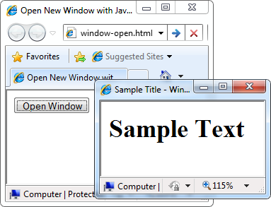
Window > Opening New Window
window.open(URL, name, specs, replace) // opens a new browser window
//window.open("url", "sampleWindow", "features")
var newWindow = window.open("", "sampleWindow", "width=300, height=100, menubar=yes, status=yes, resizable=yes");
newWindow.document.write("<html><head><title>
Sample Title</title>
</head><body><h1>Sample
Text</h1></body>");
newWindow.status = "Hello folks";

Slide 199
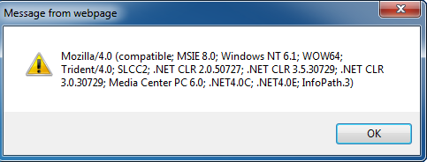
The Navigator Object
The window.navigator object contains information about the visitor's browser.
The window.navigator object can be written without the window prefix.
alert(window.navigator.userAgent);
The browser window
The navigator in the browser window
The userAgent (browser ID)

Slide 200
Document and Location
document object
Provides some built-in arrays of specific objects on the currently loaded Web page
document.location
Used to access the currently open URL or redirect the browser
document.links[0].href = "yahoo.com";
document.write(
"This is some <b>bold text</b>");
document.location = "http://www.yahoo.com/";

Slide 201
Standard Popup Boxes
Alert box with text and [OK] button
Just a message shown in a dialog box:
Confirmation box
Contains text, [OK] button and [Cancel] button:
Prompt box
Contains text, input field with default value:
alert("Some text here");
confirm("Are you sure?");
prompt("enter amount", “10”);

Slide 202
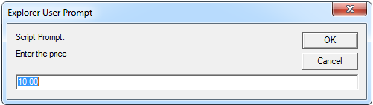
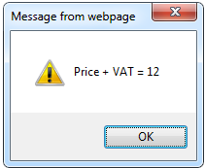
Standard Popup Boxes… > Example: JavaScript Prompt
price = prompt(“Enter the price”, “10.00”);
alert(‘Price + Vat = ’ + price * 1.2);

Slide 203
Common Errors
Issue 1: Syntax errors
function myFunction( { // missing a closing parenthesis
console.log(“You called myFunction); // missing a closing quotation
}
window.onload = function() {
myFunction();
}

Slide 204
Common Errors…
Issue 2: Calling a non-existent function
function myFunction() {
console.log(“You called myFunction”);
}
window.onload = function() {
myfunction(); // Error
}

Slide 205
Common Errors…
Issue 2b: typos very common with DOM methods
var x = document.getElementByID(“something”); // is not a function error
Issue 2c: using a non-existence object method
var myArray = [“one”, “two”, “three”];
console.log(myArray.revers()); // missing e on revers (reverse)
Issue 3: using document.getElementById before the element is part of the DOM. Make sure the DOM is loaded – use window.load
var myImage = document.getElementById(“someImage”);

Slide 206
Common Errors…
Issue 4: assignment instead of equality (This is NOT technically an error)
var a = 10;
var b = 20;
if (a = b) { // Always evaluated to true
console.log(“Something is wrong with the universe.”); // This is executed
} else {
console.log(“This is what I expect!”);
}

Slide 207
Common Errors…
Issue 5: missing parameters in function calls: (This is NOT an error – it’s just an unexpected result.)
function calculate(a, b, c) {
return a + b + c;
}
var result = calculateSum(500, 1000);
console.log(result); //NaN

Slide 208
Setting Inline Styles
myElement.style.color = “#ff0000”;
myElement.style.left = “40px;
myElement.style.backgroundRepeat = “repeat-x”;

Slide 209
Style Property Naming
#example {
width: 230px; myElement.style.width = “230px”
color: #fff; myElement.style.color = “#fff”;
font-weight: bold; myElement.style.fontWeight = “bold”;
background-color: #193742; myElement.style.backGroundColor = “#193742”
}
hyphens camelCase

Slide 210
Setting the Class
myElement.class (reserved word)
“class” is a reserved word in JavaScript – it cannot be used.
myElement.className = “someCSSclass”;
myElement.className = “”; //clear the CSS class
Example:
document.getElementById(“mainContent”).onclick = function() {
if (document.getElementById(“mainContent”).className == “example”) {
document.getElementById(“mainContent”).className = “”;
} else {
document.getElementById(“mainContent”).className = “example”;
}
};

Slide 211
JavaScript Style Guideline
Your code should be easily readable
Your code should be consistent
You should know accepted best practices
JavaScript is readable

Slide 212
JavaScript Style Guideline… > Naming Conventions
Variables
var letters, numbers, $, _ (can start with a number)
var _XYZ$$_lk5sh33; (not a good name, we want clarity, we want readability, we want meaning.)
Variables and Functions: Camelcase
var score;
var highScore;
var evenHigherScore;
function calculate() { …
function calculateDistance() { …
function checkFormFields() { …

Slide 213
JavaScript Style Guideline… > Naming Conventions
Functions: use verb noun format
Example: createElement, appendChild, getElementById
Objects: uppercase first letter
Example: Math, Date

Slide 214
JavaScript Style Guideline… > Brace Style
if (x) {
//…
} else {
// …
}
Open the curly braces on the same line as the keyword.
Always use blocks. (recommendation – might forget and add some code)

Slide 215
JavaScript Style Guideline… > Define your functions before you call them
function someFunction() {
otherFunction();
}
function otherFunction(x) {
//…
}
It is preferred to have otherFunction function definition before someFunction function definition.

Slide 216
Guideline Review
Use camelCase for variables, functions and methods
Open curly braces on the same line
Always use blocks – even if only one line
Define your functions before you call them
Always use semicolons to end a statement
Always use var when declaring a variable.

Slide 217
Things you can explore
Manipulating cookies using JavaScript
Minify a JavaScript file
Code Check (jslint.com)
Validation (Not only error)

Slide 218
Form and Form Elements Properties & Event Reference

Slide 219
Form and Form Elements Properties & Event Reference
Event | Element(s) | Description
blur | input, select, textarea | Removes keyboard focus
click | input | Simulates a mouse click
focus | input, select, textarea | Gives keyboard focus
reset | form | Reset all control’s value to default
select | input, textarea | Selects all the contents
submit | form | Submits the form without triggering submit event

Slide 220
Form and Form Elements Properties & Event Reference
Property | Element(s) | Description
elements | form | A node list containing all the form controls
checked | input | true only for checkbox and radio inputs if checked else false
disabled | button, input, optgroup, option, select, textarea | While true controls is unavailable to user
form | button, input, option, select, textarea | A reference to the form containing this control

Slide 221
Form and Form Elements Properties & Event Reference
Property | Element(s) | Description
index | option | Index of this option control within the select control that contains it (0 for first)
options | select | A node list containing all the options controls
selected | option | true if this option is selected else false.
selectedIndex | select | Index of the currently selected option (0 for the first)
value | button, input, option, select, textarea | Current value of this control, as it would be submitted to the server

Slide 222
Form and Form Elements Properties & Event Reference
Event | Element(s) | Triggered when…
change | input, select, textarea | Control lost focus after its value has changed
select | input, textarea | User has selected some text
submit | form | User has requested to submit the form

Slide 223
Exercise I
Prompt for amount, interest rate and number of years. Now calculate the Simple Interest using the values, and show in alert box.
Check if any given string is palindrome. Use input element to get the string.
Calculate the area of a circle. (Use a form with input textbox for radius, a button and display the result in a <p> tag)
Copy text of first text box to second text box on every change of value in first text box - Use Event Listener)
Allow submission of form only if the user has entered his name (should not be blank) and age (must be greater than or equals to 18) – Use Event Listener
Write a JavaScript function that alerts the text and values of the selected options on a multi-select list and a drop down list when their values are changed. – Use Event Handler

Slide 224
Exercise II
Change the color of a div element on mouse over and restore it on mouse out. Use event handler
Create a webpage that asks the user about his name and says goodbye to him/her when leaving the page.
Create a Web page that shows 20 <div> elements with random location, size and color.
Create a Clock object and encapsulate methods like start and stop for starting and stopping the click. Implementation must use Prototype pattern and event listener mechanism. Display the clock in some div or span or p element and use a button to start and stop the tick.
Functions: start, stop, display
p/span/div and a button for starting and stopping

