Slide 1
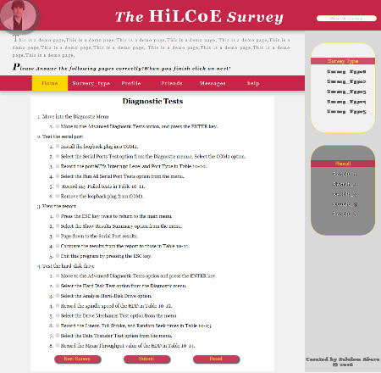
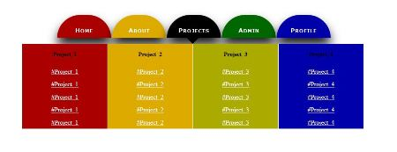
Chapter 3 CSS(Cascading Style Sheets)
Notes:
NOTE:
To change the image on this slide, select the picture and delete it. Then click the Pictures icon in the placeholder to insert your own image.

Slide 2
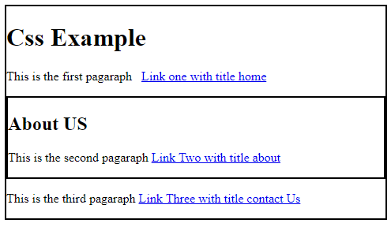
Quiz one ..Create the ff page.Boxes represent a div element.

Slide 3
What is CSS?
Every web page is composed of HTML (Hypertext Markup Language) code that describes the content
Example:
<p>An<strong>important</strong><font color=“#FFFF00”>paragraph</font>.</p>
Displays:
An important paragraph.
Repetitive and hard to maintain.

Slide 4
What is CSS?
Layers of a web page:
Content:
Text, images, animation, video, etc.
Presentation:
How the content will appear to a human through a web browser, text reader, etc.
Behavior:
Real-time user interaction with the page: validation, sorting, drag-n-drop etc.

Slide 5
Style Sheet Languages
Style sheet languages are used to describe the presentation of structured documents, like HTML, XML and other markup languages.

Slide 6
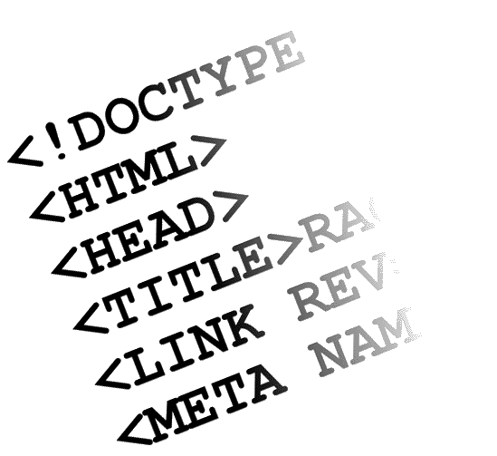


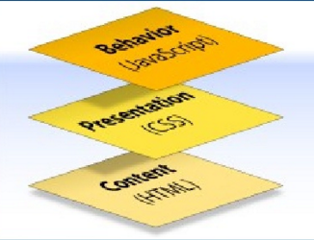
What is CSS?
Cascading Style Sheets
Contains the rules for the presentation of HTML
= +
CSS was introduced to keep the presentation information separate from HTML markup (content).
CSS separates the presentation from the content.

Slide 7
What are Cascading Style Sheets?
Cascading Style Sheets (CSS) are rules. Each rule consists of a selector and a declaration (which, in turn, is made up of a property and a value).
They were established by the World Wide Web Consortium (W3C). CSS rules control the look (Style) of web pages or XML files by providing central locations (Sheets) where HTML or XML tags are interpreted by the browser.

Slide 8
Why CSS?
Flexible, can be applied in several ways.
Easy to maintain.
Accessibility to different users with different devices.
CSS caching = less bandwidth + fast loading

Slide 9
Every keystroke counts!
Smaller files load more quickly
Save disk space
For Example
Given a page webreg.html
Original: 27.2K
Embedded Style Sheet: 26.2K
External Style Sheet: 25.6K
Why use Style Sheets?
separate structure from appearance
create consistent appearance
ease of maintenance
increase accessibility
apply additional effects
reduce use of non-standard tags
reduce web page file size

Slide 10

What is CSS? > Before CSS
Initially designers used presentation tags like (FONT, B, BR, TABLE ETC.) and spacer GIFs to control the design of web pages.
Any modification in the design of websites was a very difficult and boring task, as it involves manually editing every HTML page.
Providing support for multiple browsers was a difficult task.

Slide 11
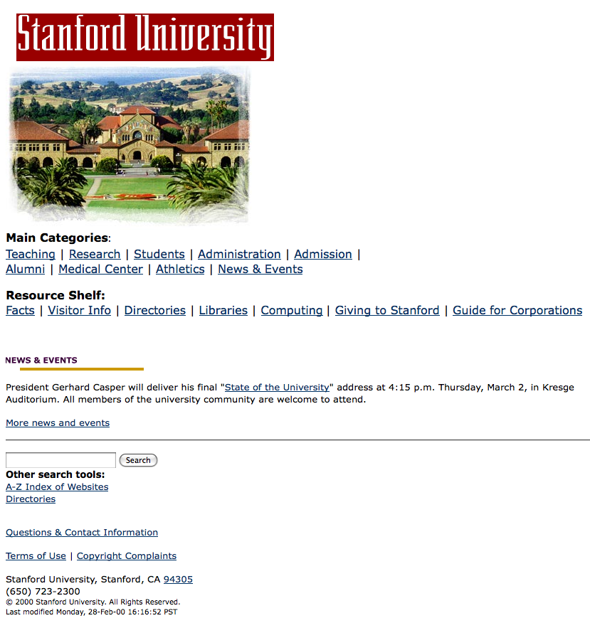

Brief history… 1997-2001
Content: HTML 4.01
Presentation: CSS1

Slide 12
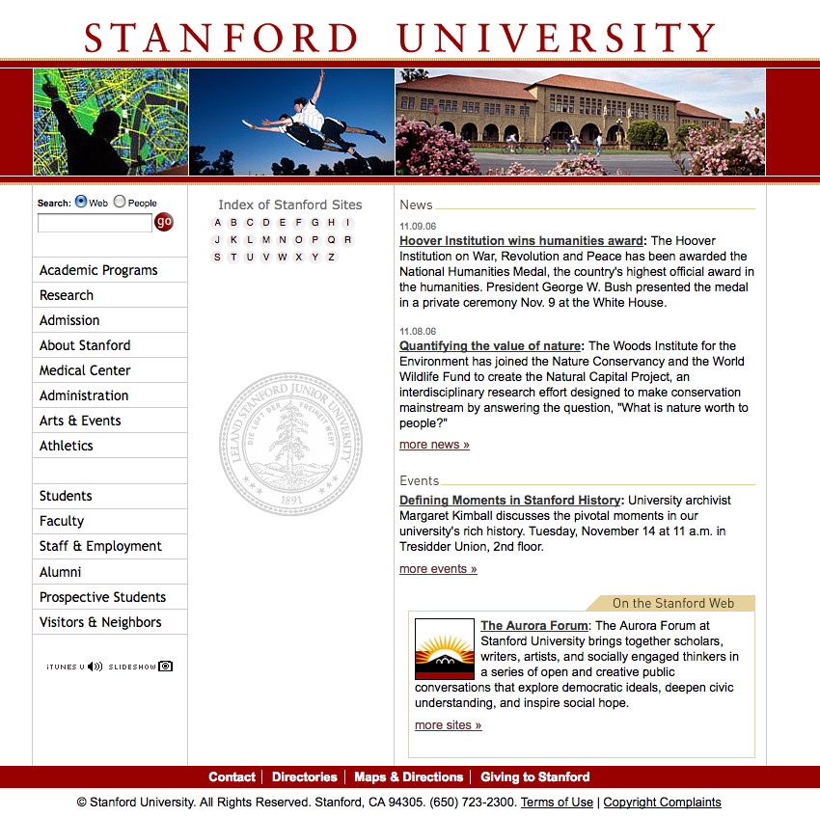

Brief history… 2001-2006
Content: XHTML 1
Presentation: CSS2

Slide 13

Brief history… 2007-present
Content: HTML5
Presentation: CSS3

Slide 14
Pros and Cons of Using CSS
Pros
Greater designer control of the appearance of the page
Easier management of site-wide changes
Greater accessibility to web sites by non-graphical browsers and web-page-reading software
Cons
Different browsers may interpret Style Sheets in different ways
Some styles may not be seen at all on some browsers

Slide 15
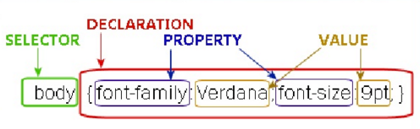
General Syntax
Style Definition:
Selector {
property: value;
}
Example: body { font-family: Verdana; font-size: 9px; }
The selector can either be a grouping of elements, an identifier, class, or single HTML element (body, div, etc.)
Each declaration includes a CSS property name and a value, separated by a colon.
A CSS declaration always ends with a semicolon, and declaration blocks are surrounded by curly braces

Slide 16
CSS Syntax
Case insensitive
In most cases the use of whitespaces does not matter, within a selector it does matter specifying which elements are targeted.
Comments: Comments are useful for organizing styles, annotating code, or communicating with team members.
/*
This is
a comment
*/

Slide 17
Source of Styles
Author / Developer Style Sheets
Inline Style Sheets
Embedded Style Sheets
External Style Sheets
User Style Sheets
Browser Default Style Sheets

Slide 18


Source of Styles > Author (Developer) Style Sheets
Inline Styles:
Allows you to format HTML elements directly as attribute of that element itself.
This is achieved through the style attribute which is supported by every HTML tag.
The simplest way but repetitive across multiple HTML elements

Slide 19
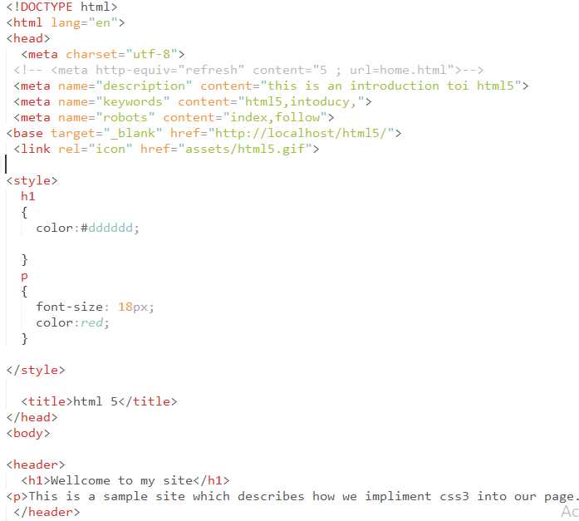
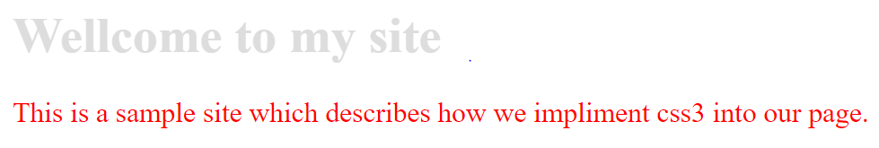
Source of Styles > Author (Developer) Style Sheets
Embedded Styles:
Embedded styles allow you to write styles to control the page content in the head of the page’s HTML.
This is achieved through the style tag.
Inefficient as a means of controlling styles across an entire site.
Repetitive across multiple pages.

Slide 20
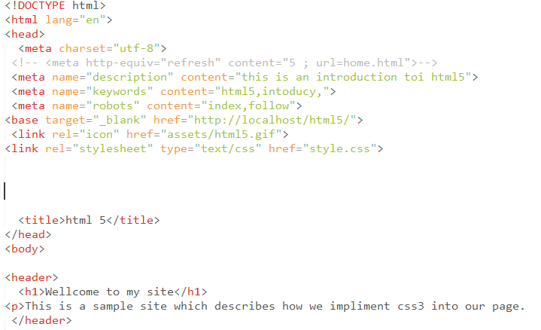
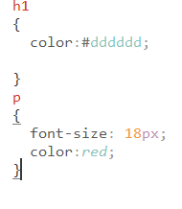
Source of Styles > Author (Developer) Style Sheets
External Styles
Allow controlling styles across multiple pages or even an entire site.
This can achieved in two ways.
One is through the link tag (Empty tag) specified in the pages head and a separate (independent) stylesheet file.
type attribute: specifies the MIME type of the resource
rel attribute: defines the relationship that the linked resource has to the document from which it's referenced.
style.css

Slide 21

Source of Styles > Author (Developer) Style Sheets
External Styles
Another way to associate a stylesheet file to an HTML page is through the <style> tag and an inline style rule called @import.
style.css page1.html
If you have to use @import, it must be specified above any rules in the style tag.

Slide 22
Structuring HTML Correctly
Without a logical, consistent structure to your HTML, writing efficient CSS is impossible.
HTML Authoring Best Practices
Focus on using clear, semantic code.
Structure your code consistently throughout your site.
Simplify your code whenever possible. Avoid non-semantic markup.
Coding Strategy
Approach initial coding with only the structure and content in mind.
Design is considered, but should not influence code structure unless absolutely necessary.
This approach creates lean, semantic markup that is easier to style.
Focus on the relationship between HTML structure and CSS organization.

Slide 23
Use tools for website designing ,planning and prototyping
Many developers and designers use good old pen and paper to plan their designs, however this doesn’t really fit well with larger projects, where collaboration / signoff is required from many different people.
Others jump straight to HTML to create mockups – which I feel can limit creativity a little, as it puts you in the mindset of what can be done with HTML / CSS. Some of these prototyping tools for web design might be useful for prototyping purposes – some of them with social features.
http://www.webdistortion.com/2009/02/22/useful-online-tools-for-easier-website-planning-and-prototyping/

Slide 24
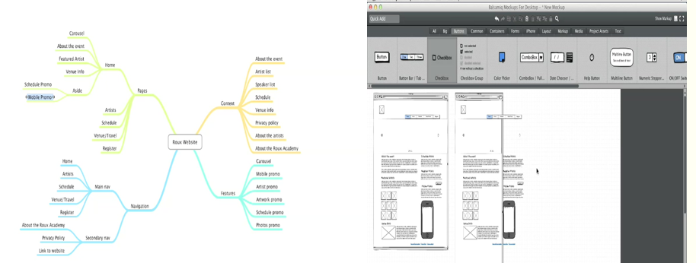
Planning and prototyping(using mindmeister and mockups)

Slide 25
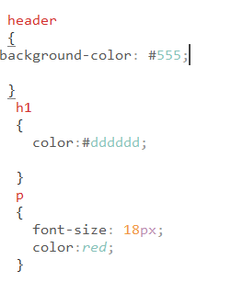
CSS Selectors
Notes:
NOTE:
To change the image on this slide, select the picture and delete it. Then click the Pictures icon in the placeholder to insert your own image.

Slide 26
CSS Selectors
In CSS, selectors are patterns used to select that element(s) you want to style.
Selectors allow us to target elements on a page.
Selectors: Type/Element/Tag based selector, Identifier Selector, Class Selector, Grouping Selector, Descendant Selector, Child Selector, Adjacent Sibling Selector, General Sibling Selector, Attribute Selector, Universal Selector, Pseudo-classes.

Slide 27
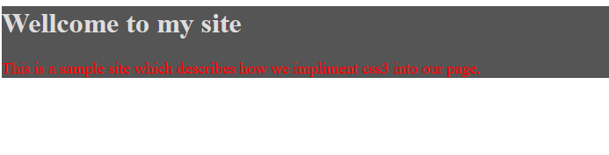
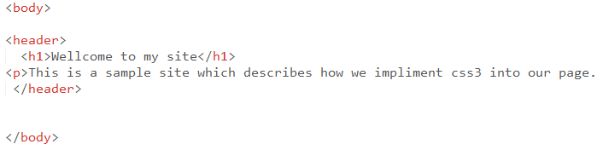
CSS Selectors > Element Selector
Also known as type selector and tag based selector.
The element selector allows you to target content on the page based on the element that contains it.
Specify the style(s) for a single HTML element.
Extremely powerful, but very broad.

Slide 28
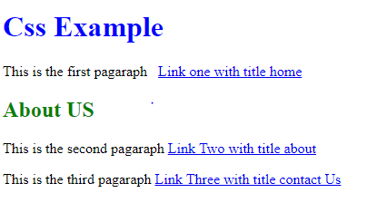
Quiz:-Use Element Selector

Slide 29
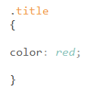
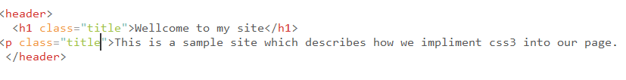
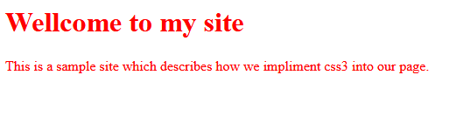
CSS Selectors > Class Selector (.)
Class selectors allow you to target any element on the page that has the same class attribute.
Class based styles can be used by multiple HTML elements.
They are defined using the period (.) character together with a class name.

Slide 30
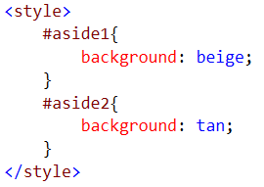
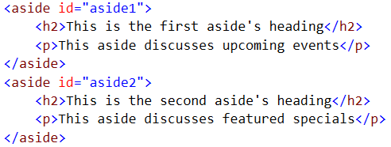
CSS Selectors > Id Selector (Identifier Selector) (#)
Id selectors work in much the same way as class selectors in that, they allow us to target any element on the page with a specific Id attribute.
They are defined using the pound (#) character together with the Id of the element we want to target.
In an event where Id and Class selector conflict with each other, the Id selector styling will be used in favor of the class because it is more specific.

Slide 31
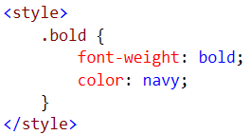
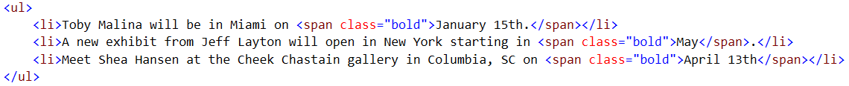
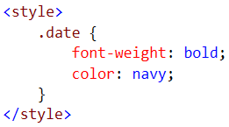
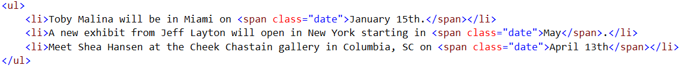
CSS Selectors > Considerations (Id & Class)
Class and Id attributes extend the meaning of your HTML code.

Slide 32
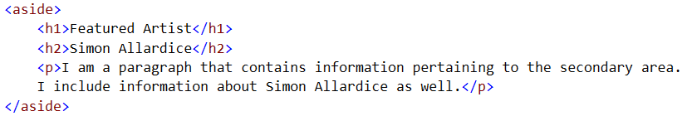
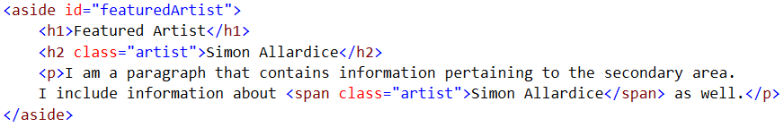
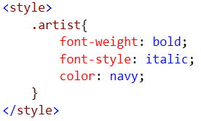
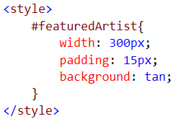
CSS Selectors > Considerations (Id & Class)

Slide 33
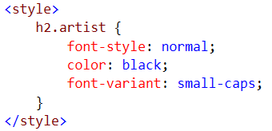
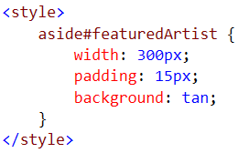
CSS Selectors > Class and Id Selectors with the Element
Below is an example of an element specific selector with class and id.
Notice that there is no space between the element name and the class or id selector.

Slide 34
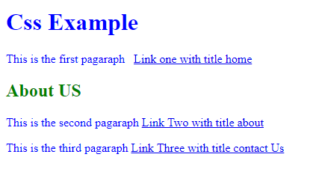
Quiz:-use class & id selectors

Slide 35
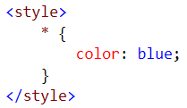
CSS Selectors > Universal Selectors (*)
Universal selectors are used to select any element.
The following code sets the text color of all elements in a page to blue.

Slide 36
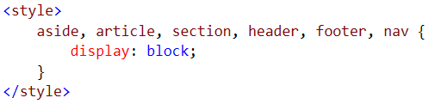
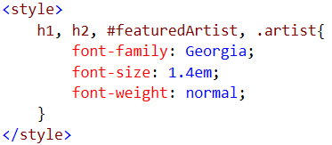
CSS Selectors > Grouping Selectors (,)`
Often you will find several different elements on the page require the exact same styling.
Allows you to specify a single style for multiple elements at one time.
Multiple selectors can be grouped in a single declaration by using comma (,)

Slide 37
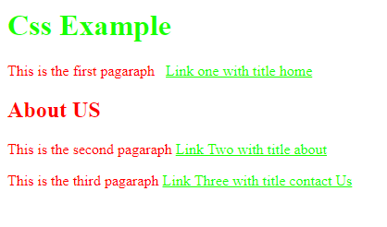
Quiz:-Group selectors

Slide 38
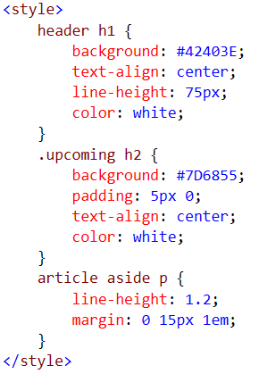
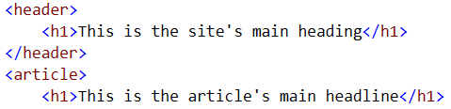
CSS Selectors > Descendant Selector (space)
The most powerful targeting ability CSS gives us is the ability to combine selectors together in what is known as descendant selectors.
Allow to more precisely target content based on the relationship between nested tags and their parents.
Descendant selectors are used to select elements that are descendants (not necessarily children) of another element in the document tree.

Slide 39
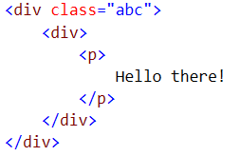
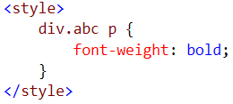
CSS Selectors > Descendant Selector (space)

Slide 40
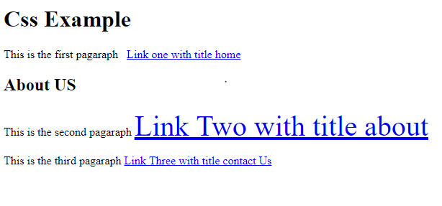
Quiz:-use a descendant selector to change the font size of link two

Slide 41
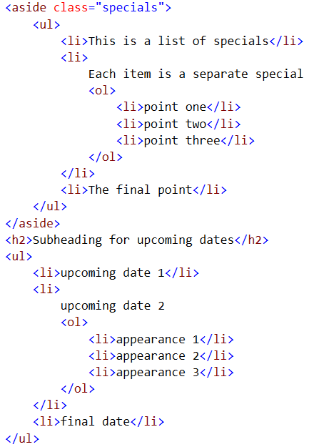
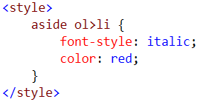
CSS Selectors > Child Selectors (>)
A child selector is used to select an element that is a direct child of another element (parent). Child selectors will not select all descendants, only direct children.

Slide 42
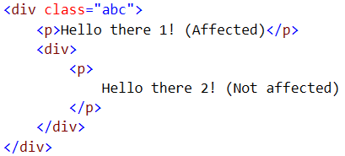
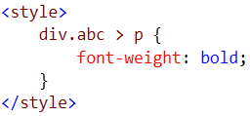
CSS Selectors > Child Selectors (>)

Slide 43
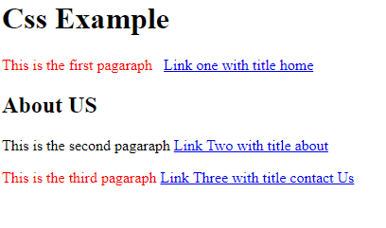
Quiz:-Use Child Selectors to change colors of the first & third paragraph

Slide 44
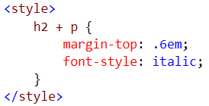
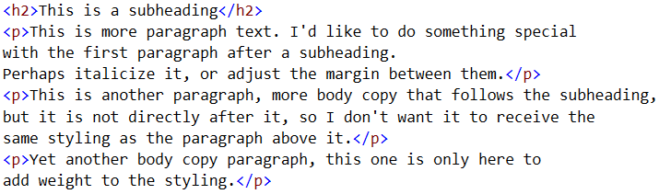
CSS Selectors > Adjacent Selectors (+)
Also called adjacent sibling selectors.
Sibling = has the same parent
Adjacent = immediately following
Allow you to target elements based on which elements follow one another in your code. Essentially adjacent selector allow you to style an element based on which element comes before it in the document, providing that both of those elements are inside the same parent.

Slide 45
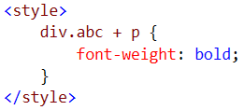

CSS Selectors > Adjacent Selectors (+)

Slide 46

Quiz:- Use Adjacent Selectors To change the last paragraph color

Slide 47


CSS Selectors > General Sibling Selectors (~)
Sibling = has the same parent element
General = just following
Allow you to target elements based on which elements follow in your code. Essentially general sibling selector allow you to style an element based on which element comes before it (not necessarily immediately) in the document, providing that both of those elements are inside the same parent.

Slide 48

Quiz:-Use General Sibling Selectors

Slide 49

CSS Selectors > Attribute Selectors
Attribute selectors selects elements based upon the attributes present in the HTML tags and their value.
Attributes are specified using brackets.
[attribute=“value”] (case sensitive)
[attribute] (doesn’t matter what the value is)

Slide 50



CSS Selectors > Attribute Selectors

Slide 51



CSS Selectors > Attribute Selectors

Slide 52



CSS Selectors > Attribute Selectors

Slide 53

Quiz :- Use Attribute selectors to change the color of the second link

Slide 54


CSS Selectors > Attribute Selectors
Allow us to much patterns as well
Tilde (~): It basically says go ahead and look for a white space separated list that includes the word.

Slide 55



CSS Selectors > Attribute Selectors
Another pattern matching character
Caret (^): It basically says go ahead and match any string that begins with a certain value.

Slide 56


CSS Selectors > Attribute Selectors
Another pattern matching character
Dollar Sign ($): It basically says go ahead and match any string that ends with a certain value.

Slide 57



CSS Selectors > Attribute Selectors
Another pattern matching character
Asterisk Sign (*): It basically says go ahead and match any string that contains a certain value.

Slide 58

Quiz:-Use attribute selector & Asterisk Sign

