Slide 1
Our team
1. Nancy Khaled
2. Nureen Ehab
3. Mahmoud Abo AlSaud

Slide 2
Retail Analysis
Numbers tell the story; analytics reveals the strategy

Slide 3
01
Business Problem

Slide 4

Too much data!
Large amounts of transactional data generated daily:
Multiple tables and instances
Data spanning across time
Distraction
No real added value

Slide 5
Goal
A dashboard that transforms raw data into actionable business insights
Supports strategic and operational decision-making
Plan for the future

Slide 6
Dataset Overview
Sales 2017
Sales 2018
Customers
Products
Region
Returns
Stores
Calendar

Slide 7
02
SQL

Slide 8
Data Engineering
01
Schema Architecture
Establishing core Dimensions & Fact tables
02
Data Ingestion
Bulk loading historical business data from CSVs

Slide 9
Data Engineering
03
Quality Assurance
Performing row-count audits for validation
04
Performance Tuning
Non-Clustered Indexes on large scale Fact tables

Slide 10
Data Engineering
05
Analytical Business Intelligence
Multi-dimensional insights across 3 core sectors: Sales & Profit, Customer Demographics , and Product Performance & Returns
06
Serving Layer (SQL Views)
Standardizing raw data for Power BI consumption

Slide 11
Data Engineering
07
Pipeline Automation
Custom Stored Procedures for maintenance
08
Cross-System Reconciliation
Auditing Power BI measures against DB totals

Slide 12
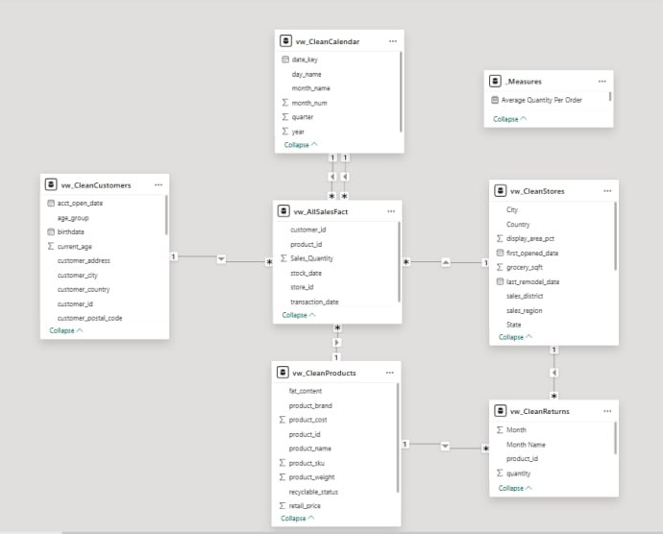
Data Modeling: The Galaxy Schema
Sales & Return tables: Fact
Other tables: Dimensions

Slide 13
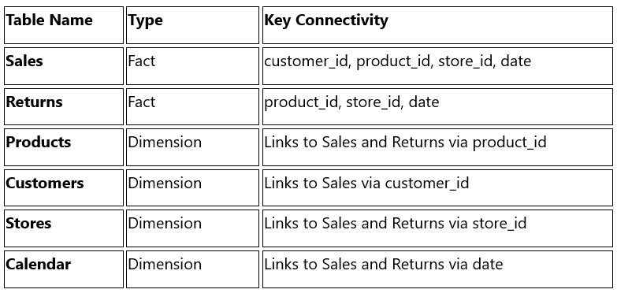
Relationship Mapping

Slide 14
Data Cleaning Challenges
Skewed Outliers in Customer Age
Challenge: Historical birthdates from 1998 resulted in unrealistically high current ages when calculated against the year 2026.
Solution: Replaced the current date with the Max Transaction Date.
Inaccurate RFM Customer Segmentation
Challenge: Simple additive scoring (R+F+M=12) incorrectly classified over 35% of the database as "VIP Customers.“
Solution: Developed hardcoded conditional logic to ensure precise, realistic tier distribution.

Slide 15
03
Power BI

Slide 16
Dashboard Features
Interactive visuals
Multiple Pages
Dynamic filtering and slicers
Time-series analysis
Drill-down analysis
Easy to Use

Slide 17
Key DAX Measures
YoY change
MoM change
Average order value
Total Revenue
Total Cost
Total Profit
Total Quantity
Return Rate
Loyal Customer Count
Top stores/products/…

Slide 18
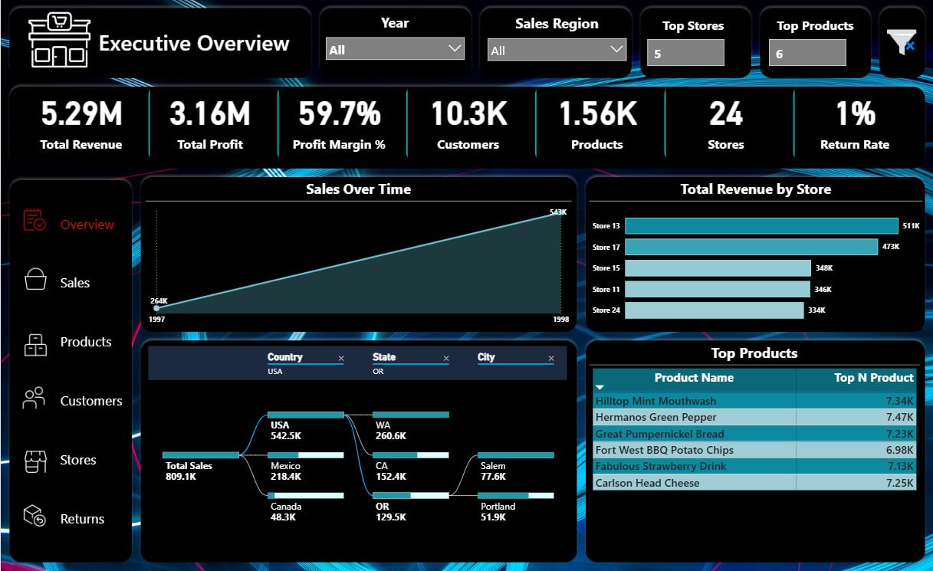

Slide 19
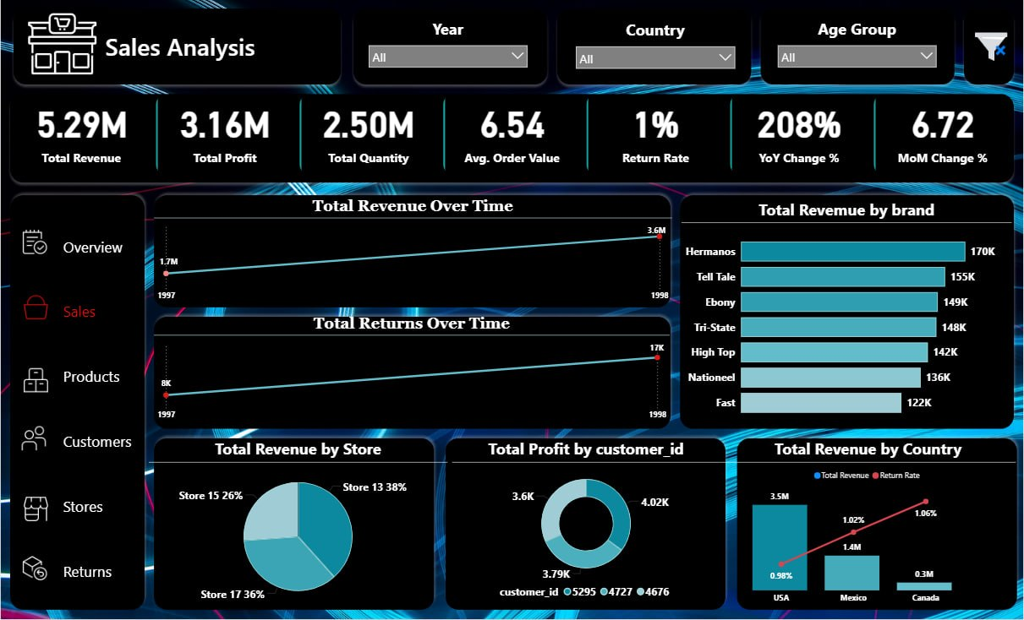

Slide 20
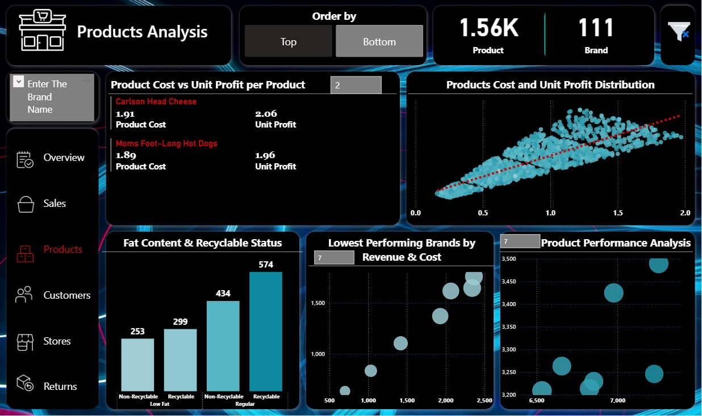

Slide 21
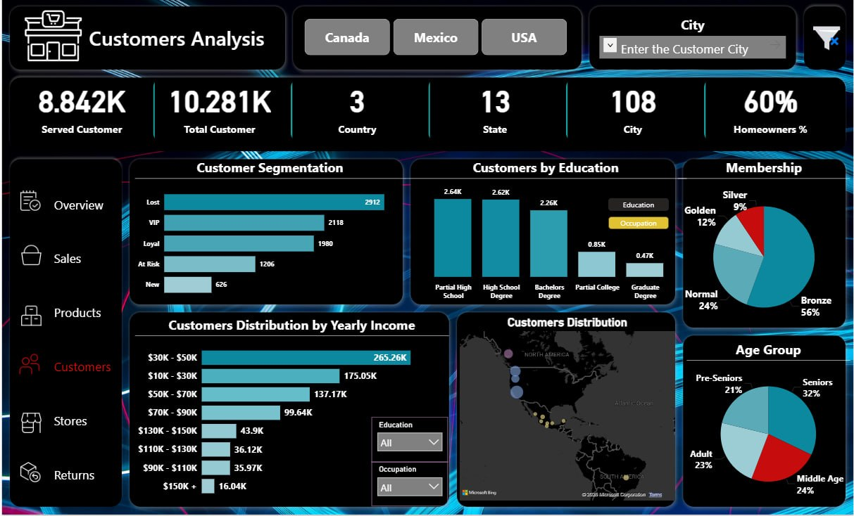

Slide 22
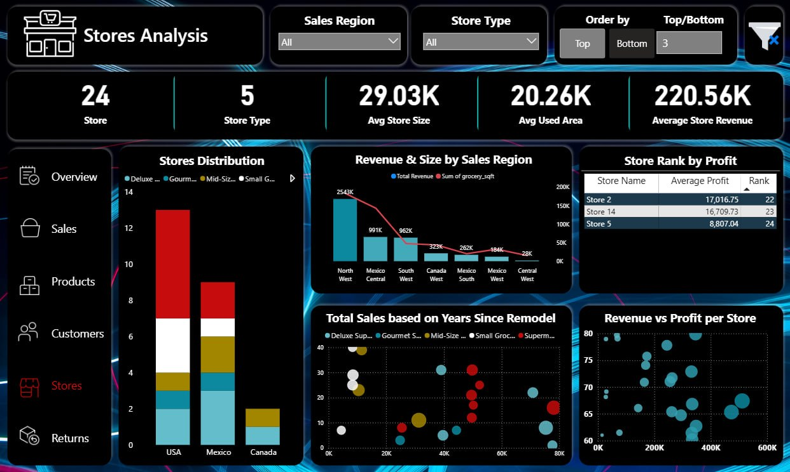

Slide 23
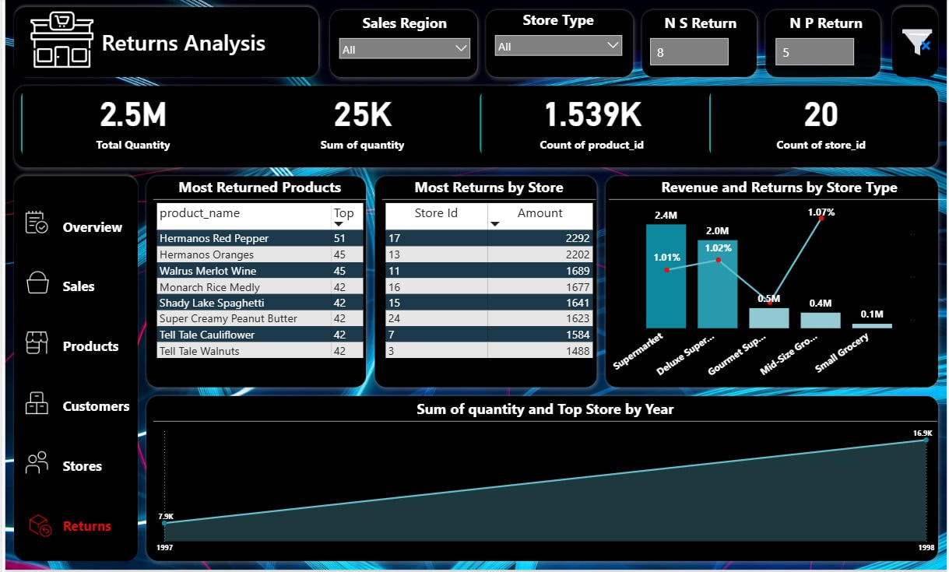

Slide 24
Sales Insights
Revenue growth: 208% year-over-year from 1997 to 1998.
Highest-performing brand: Hermanos, approximately $170K in revenue.
Top-performing country: USA, approximately $3.5M in revenue with a 0.98% return rate.
Highest return concern: Canada, approximately $300K in revenue with a 1.08% return rate.
Returns trend: Product returns increased alongside sales growth. (natural correlation )

Slide 25
Products Insights
Lowest-contributing categories: Many Categories had only 1 product, including King.
Highest unit cost product: Carlson Head Cheese, approximately $1.91 cost and $2.06 profit per unit.
Most efficient product: Carmorant Copper Pot Scrubber, approximately $1.22 cost and $2.73 profit per unit.
Regular products: represent 64.5% of the portfolio.
Low-fat products: represent 35.5% of the portfolio.

Slide 26
Customers Insights
Customer engagement: Approximately 85% of registered customers completed purchases.
Largest purchasing segment: Senior customers, contributing approximately 32% of purchases.
Most active income group: Customers earning between $30K–$50K annually.
Most preferred membership: Bronze card, used by approximately 56% of customers.

Slide 27
Customers Insights
Dominant education segment: Customers with Partial High School or High School Degree education, representing approximately 59.5% of purchasing customers.
Highest customer share: California, representing approximately 37% of customers but only 18.7% of revenue.
Most efficient state: Washington, generating nearly 32% of revenue with only 23% of customers.
Store distribution impact: Washington outperformed California partly due to operating 7 stores versus 4 stores.

Slide 28
Customers Insights
Strongest sales efficiency: Oregon, contributing approximately 16.5% of revenue with only 12% of customers.
Weakest regional efficiency: British Columbia, contributing only 6% of revenue despite representing 15.5% of customers.
Customer retention challenge: Approximately 33% of customers are inactive, while 14% are at risk.
Highest inactive customer rate: Canada at approximately 55%, compared to 33% in the USA and 6% in Mexico.

Slide 29
Returns Insights
Returned products: approximately 1% of total sold quantity.
Highest return country: USA, contributing approximately 66.5% of total returns.
Highest return store: Store 17 recorded the largest number of product returns.
Highest return store type: Mid-Size Grocery stores, with an approximately 1.07% return rate.
Peak return season: December recorded the highest return activity.

Slide 30
Stores Insights
Strongest sales region: North West, supported by the largest total store area.
Highest regional efficiency: South West, it matched Mexico Central’s revenue with operating with only 47K sqft compared to 143K sqft in Mexico central.
Best-performing store: Store 13, contributing approximately 9.5% of total revenue and 67.5% display area.
Second-best store: Store 17, contributing nearly 9% of total revenue and 65.5% display area.

Slide 31
Stores Insights
Lowest space efficiency: Stores 2, 18, and 20 generated weak revenue despite high display area percentages nearing 79%.
Most efficient store type: Deluxe Supermarkets outperformed traditional supermarkets in sales efficiency, with Store 13 achieving the strongest overall performance.

Slide 32
Recommendations
Remodel underperforming and outdated stores, as remodeled stores have demonstrated higher sales performance and improved customer engagement.
Expand the number of stores in California to better serve its large customer base, especially since Washington currently operates more stores despite having fewer customers.
Focus marketing and product strategies on senior customers by offering age-appropriate products, improving in-store accessibility, and enhancing customer convenience.
Analyze Store 13 as a benchmark model, since its performance exceeds that of multiple stores combined, and apply its successful operational and sales strategies across other locations.

Slide 33
Any Questions?
Thank You

