Slide 1


Ada Lovelace Akademi
Veri Bilimi Akademisi
Proje Sunumu
Analyzing of Heart Disease Indicators
&
Application of Machine Learning Methods
Fatma Nur Kutlu Doğan

Slide 2
About Me
Born in Bilecik/Bozüyük
YTÜ Chemical Engineering
Chemical Engineering at Hayat Kimya Company in 2 years
First Codes
Data Science Career
Production, Quality,
R&D
Up School Data Science
SistersLab
Orienteering Team Member

Slide 3
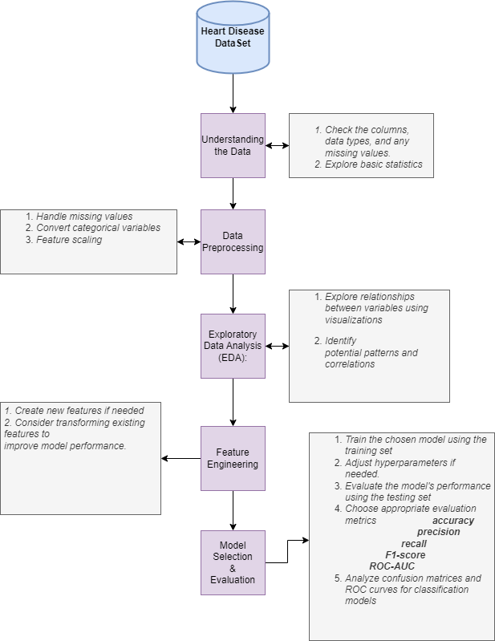
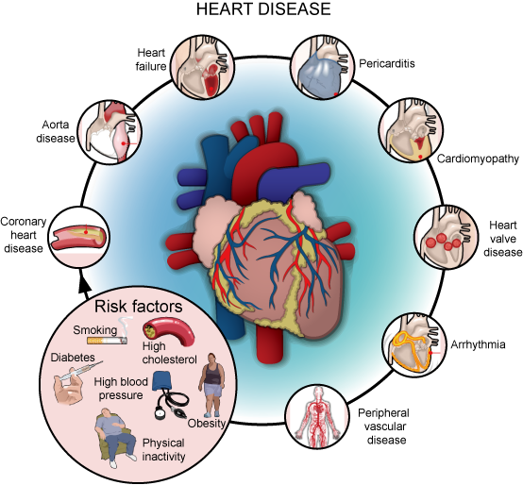
FlowChart

Slide 4
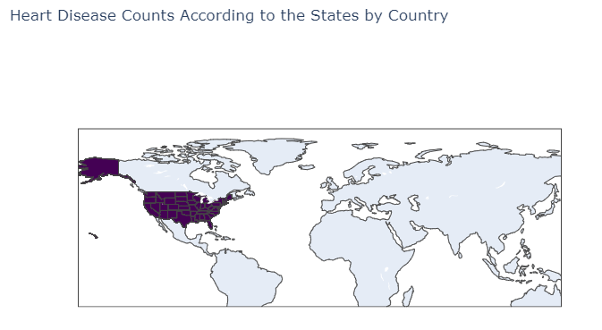
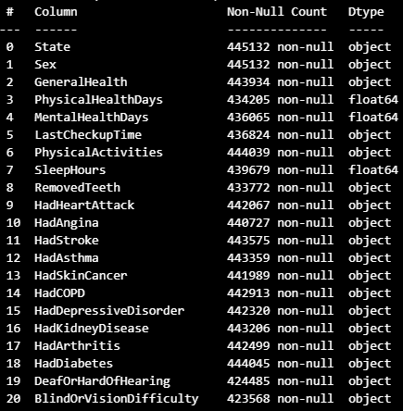
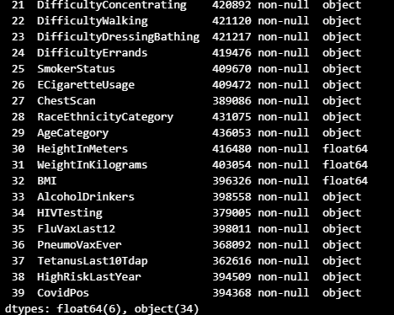
1.Understanding Heart Disease Data Set
Data was collected from people in 50 states in America through telephone interviews.
Shape : (445132, 40)
Categorical Data Set
Purpose of the Project: To discover indicators related to heart disease

Slide 5
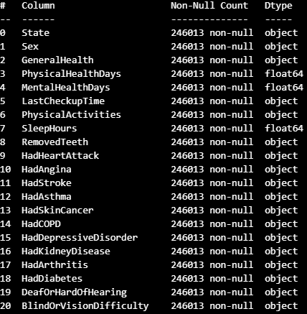
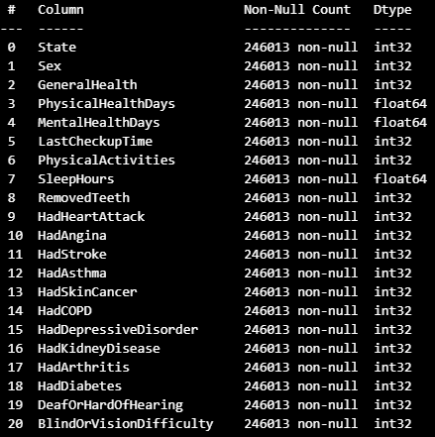
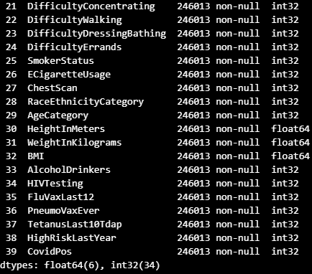
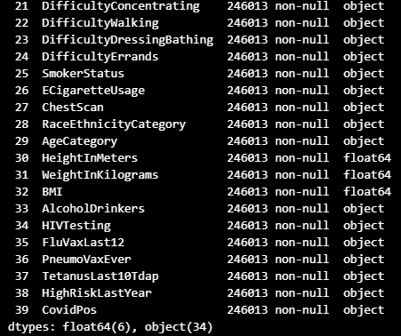
2.Data Preprocessing
Check Null Values
Remove Missing Values
Check Duplicated Values
df.isnull().sum()
df = df.dropna(axis=1)
df.duplicated().sum()
Check Outliers
By box Plot
Prepare Categorical Data numerically for correlation only
Label Encoder
df
df_encoded

Slide 6
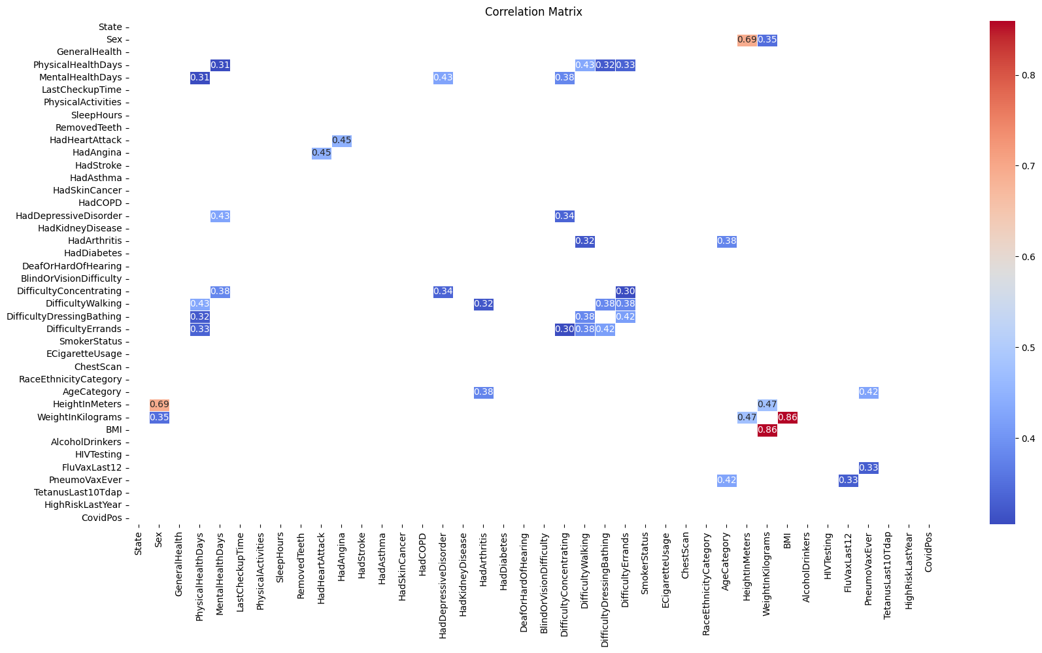
Exploratory Data Analysis Correlation Analysis
State
Sex
GeneralHealth
PhysicalHealthDays
MentalHealthDays
HadHeartAttack
HadAngina
HadDepressiveDisorder
HadKidneyDisease
HadArthritis
HadDiabetes
DifficultyConcentrating
DifficultyWalking
DifficultyDressingBathing
DifficultyErrands
SmokerStatus
AgeCategory
HeightInMeters
WeightInKilograms
BMI
AlcoholDrinkers
FluVaxLast12
PneumoVaxEver

Slide 7
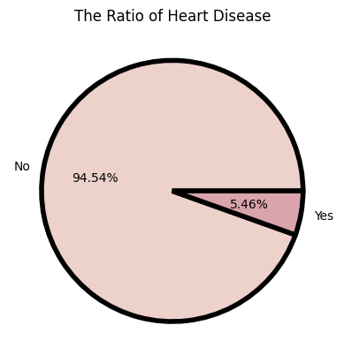
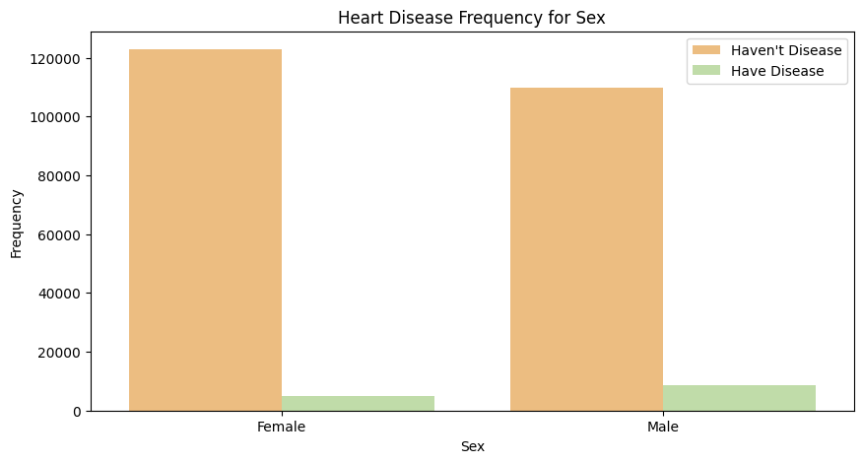
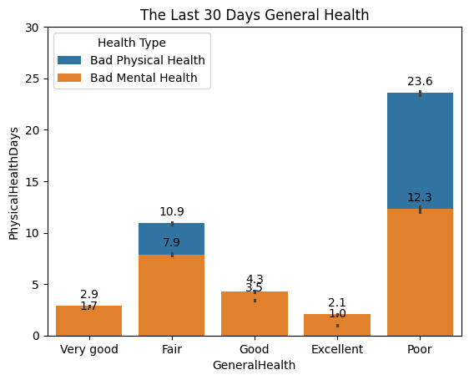
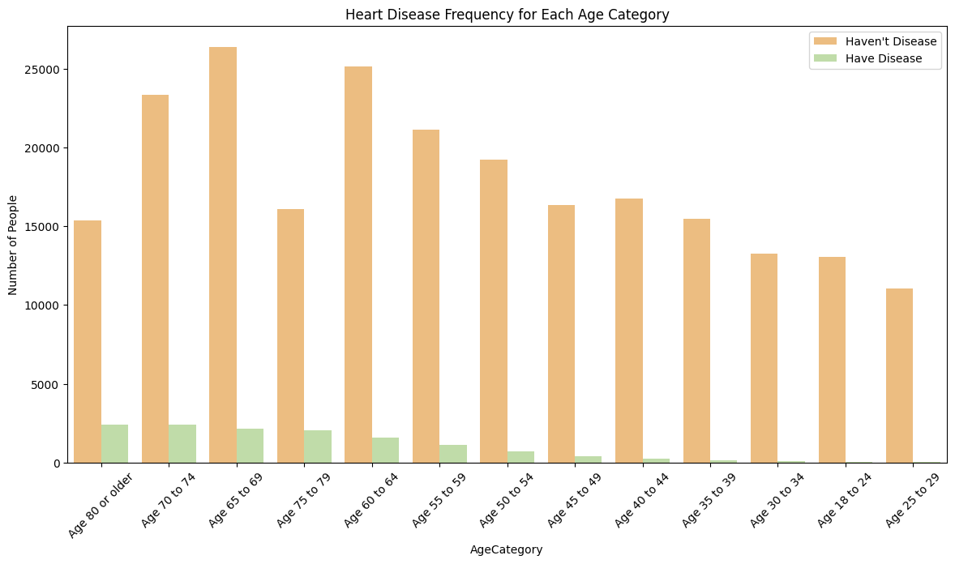
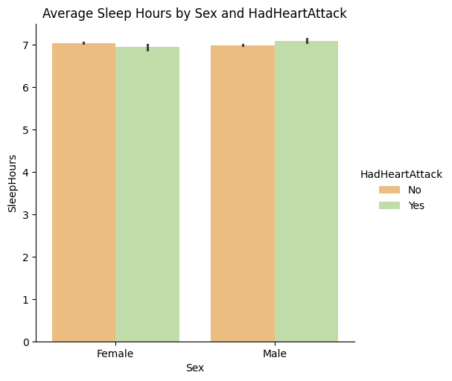
3.Exploratory Data Analysis Visualization- Learn Your Profile

Slide 8
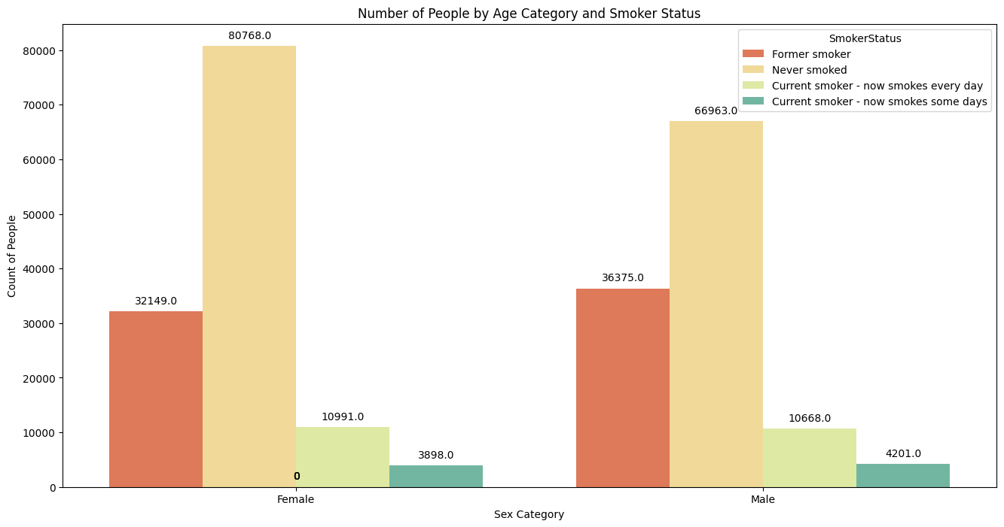
3.Exploratory Data Analysis Visualization- Smoker Status

Slide 9
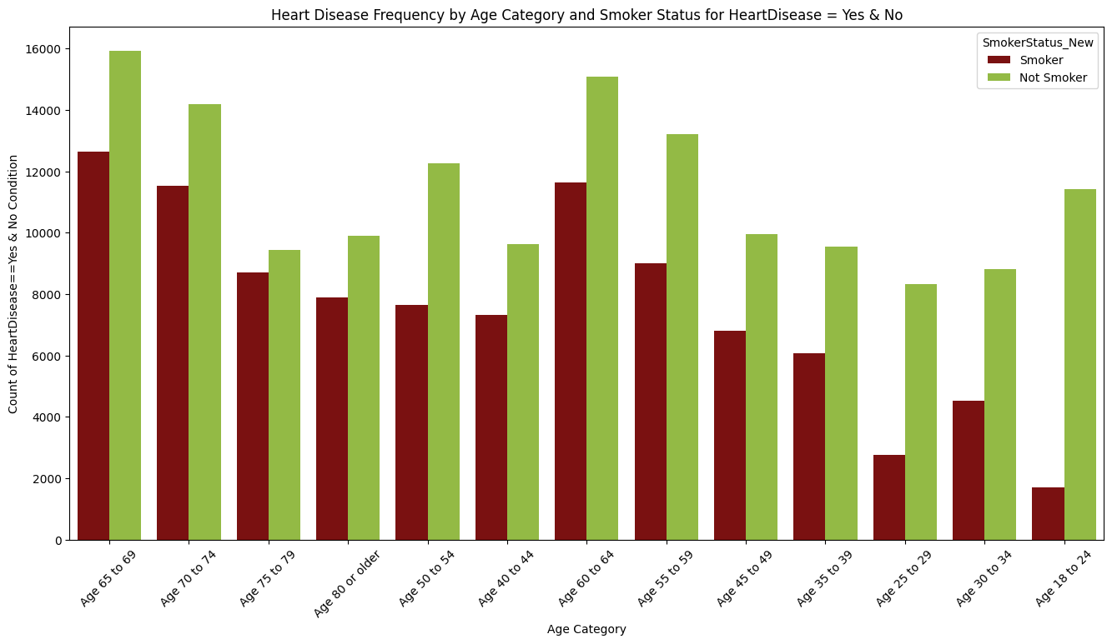
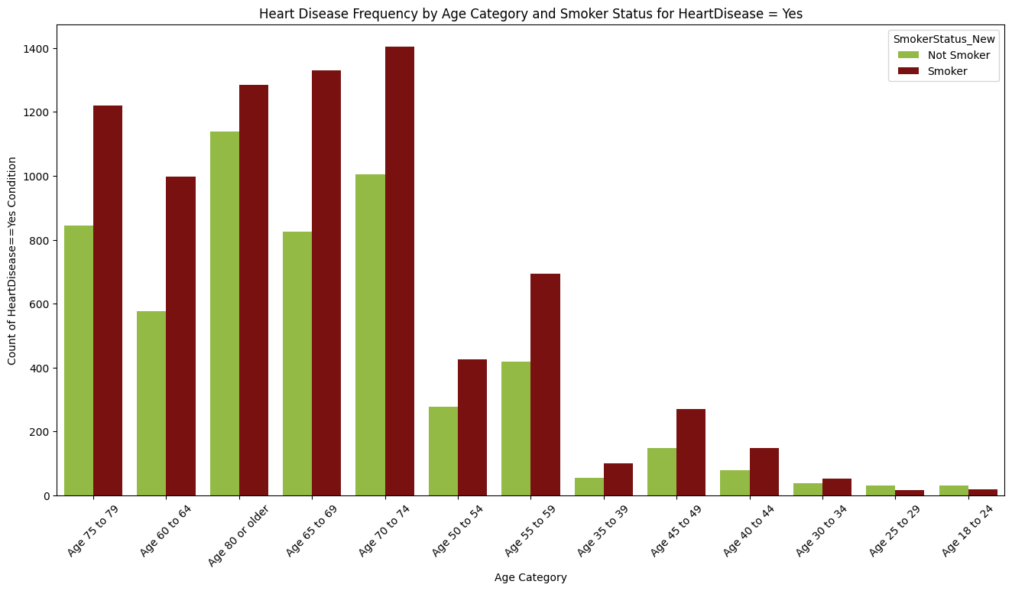
3.Exploratory Data Analysis Visualization- Smoker Status

Slide 10
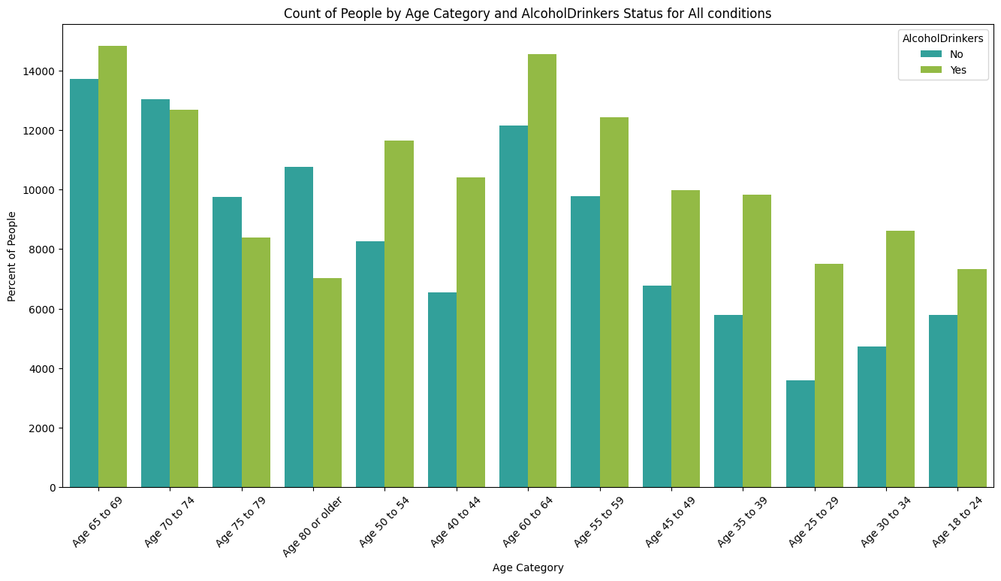
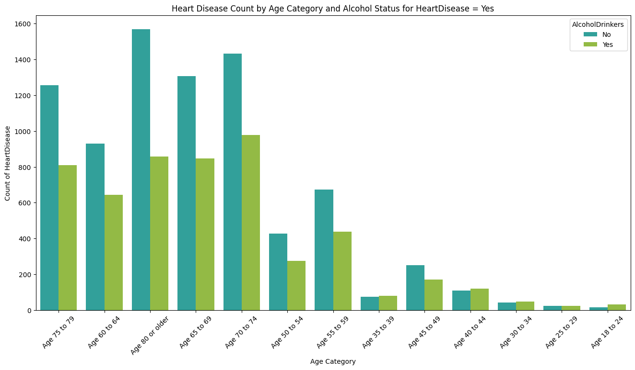
3.Exploratory Data Analysis Visualization- Alkol Status

Slide 11
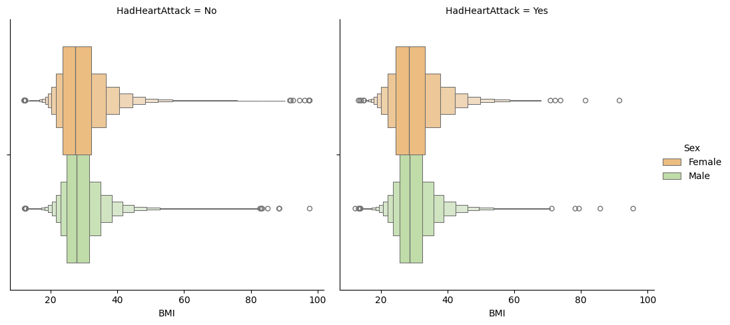
3.Exploratory Data Analysis Visualization- BMI

Slide 12
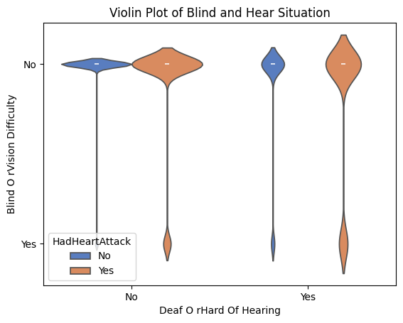
3.Exploratory Data Analysis Visualization- Deaf and Blind Status

Slide 13
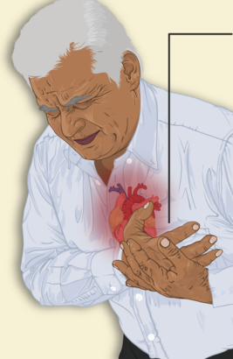
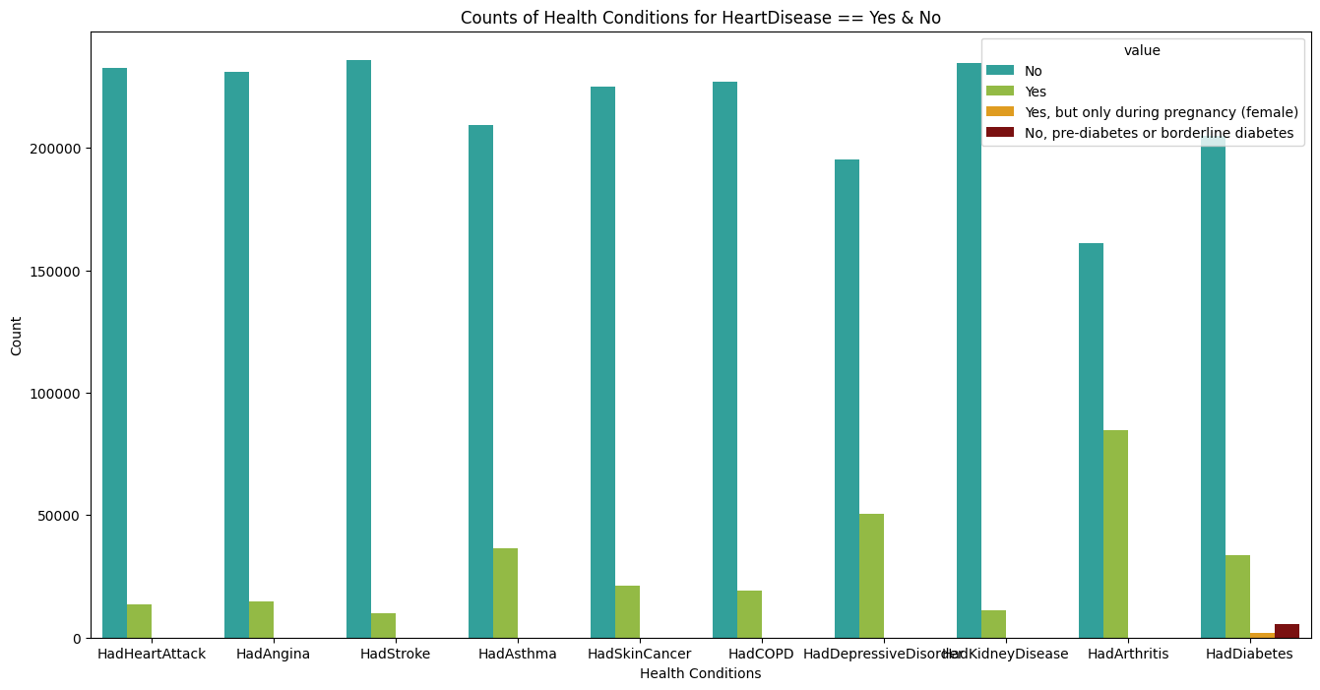
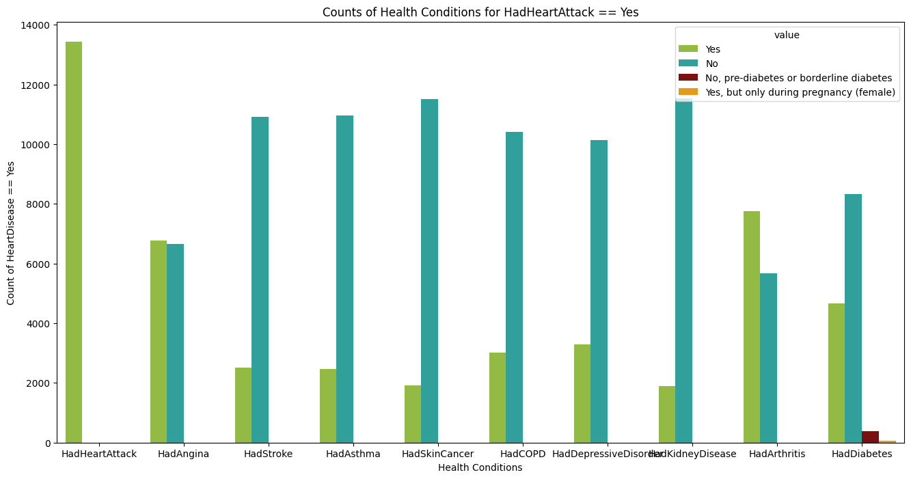
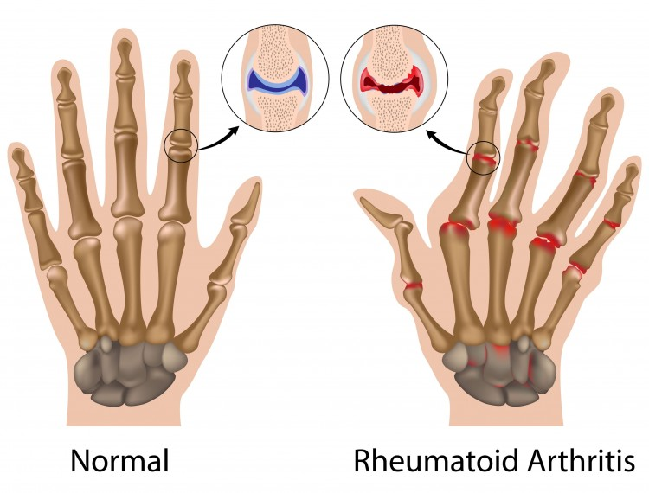
3.Exploratory Data Analysis Visualization- General Physical Health Disease Search by Heart Disease
Had Angina
Had Arthritis

Slide 14
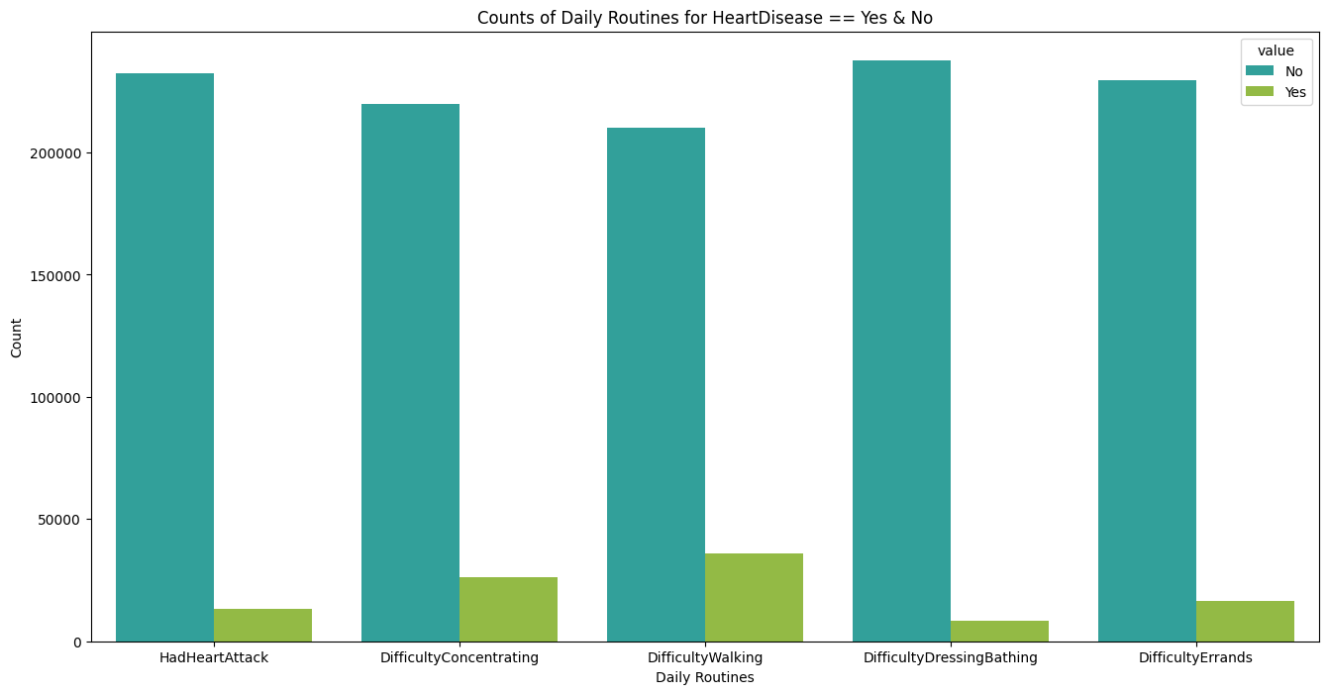
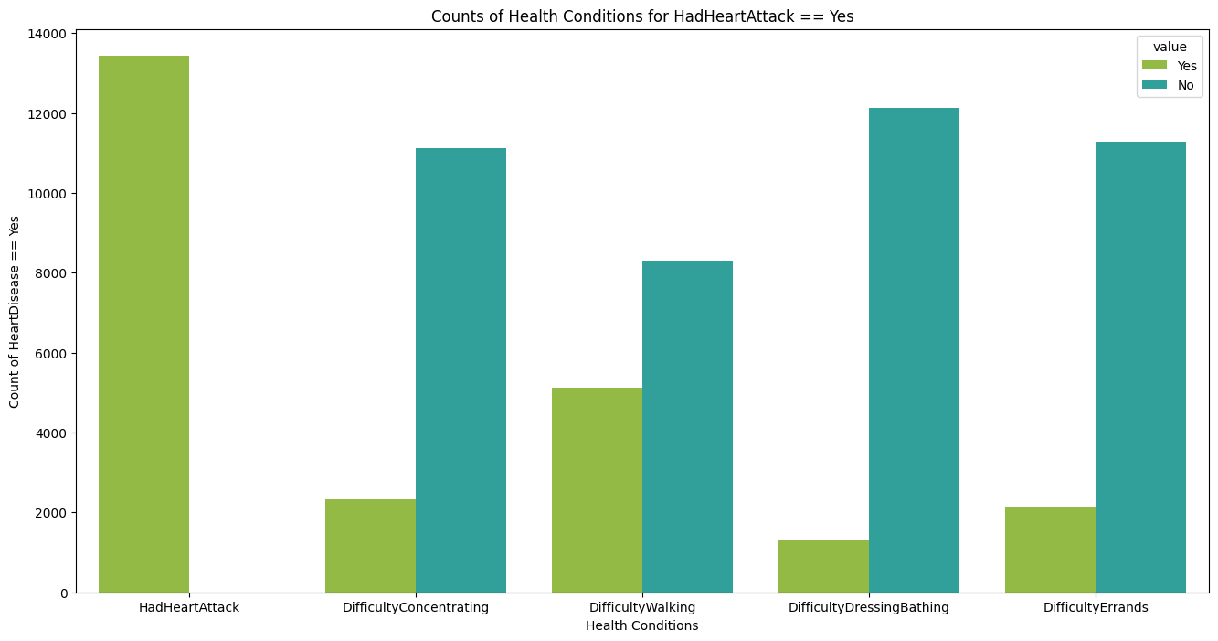
3.Exploratory Data Analysis Visualization- Daily Work Analysis

Slide 15
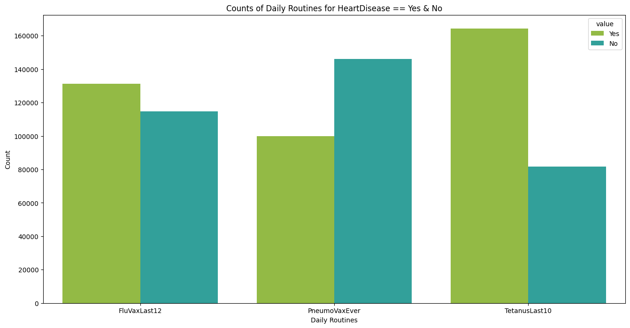
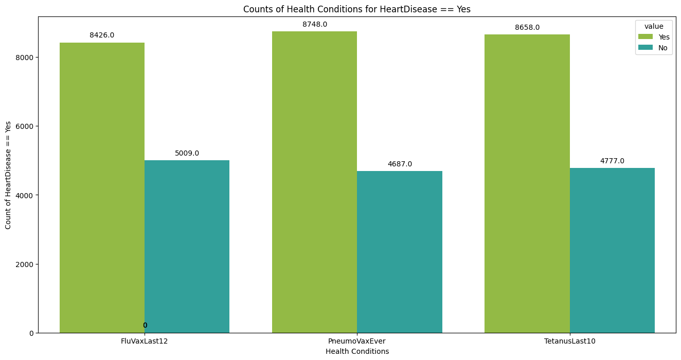

Exploratory Data Analysis Visualization- Vaccine
zatüre

Slide 16
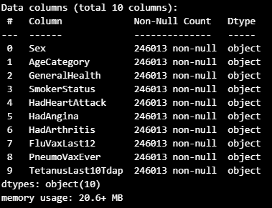
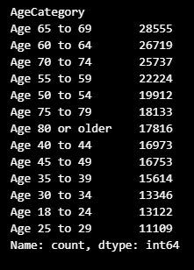
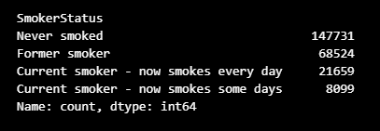
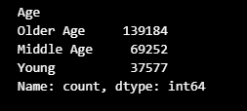

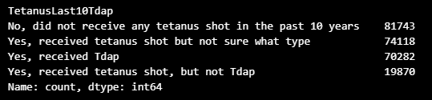

4. Feature Engineering
Before
Before
After
After
Before
Before
After

Slide 17
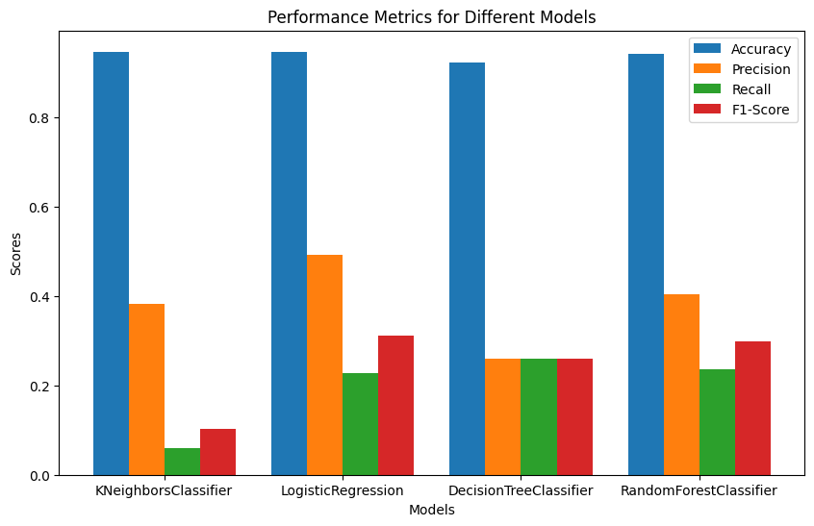
5. Model Selection
1.Label Encoder
2.Split and Normalize the Dataset
3. Quick Testing For ideal Models

Slide 18
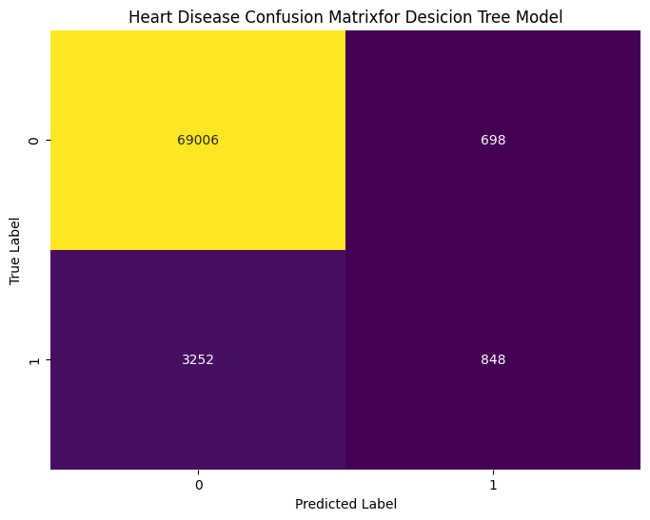
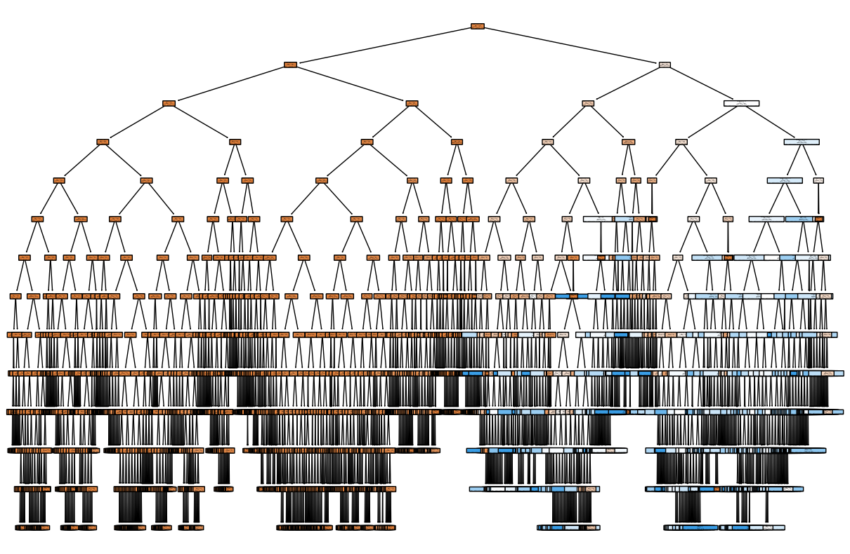
5. Model Selection & Evaluation Desicion Tree
Accuracy: 0.9464798655899409 Precision: 0.5485122897800776 Recall: 0.20682926829268292
F1-Score: 0.3003896563939072 Confusion Matrix: [[69006 698]
[ 3252 848]]

Slide 19

5. Model Selection & Evaluation Random Forest
Accuracy: 0.9467237548100373 Precision: 0.5549738219895288 Recall: 0.20682926829268292
F1-Score: 0.3013503909026297 Confusion Matrix: [[69024 680]
[ 3252 848]]

Slide 20

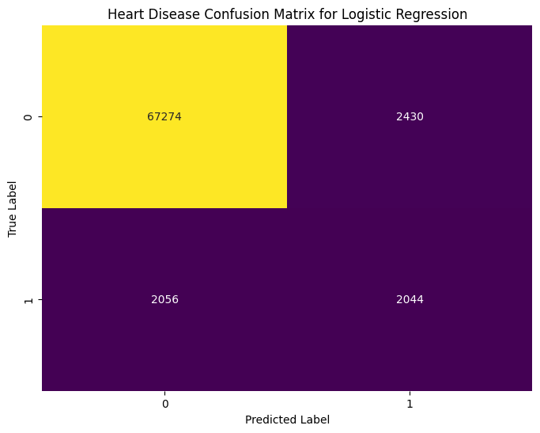
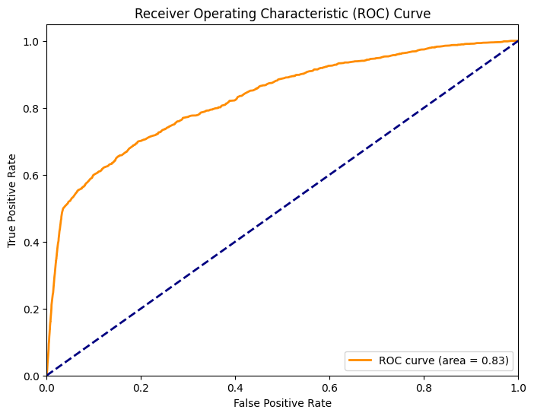
5. Model Selection & Evaluation Logistic Regression
Accuracy: 0.9392173865915127 Precision: 0.45686186857398303 Recall: 0.49853658536585366
F1-Score: 0.47679029624446 Confusion Matrix: [[67274 2430]
[ 2056 2044]]

Slide 21
THANK YOU FOR LISTENING!

