Slide 1


SnOasis Group 6
Snow Cone Business: A Data Driven Approach
Nicholas Jacob, Zayne Mclaughlin, Yechang Qi, James Wahome

Slide 2

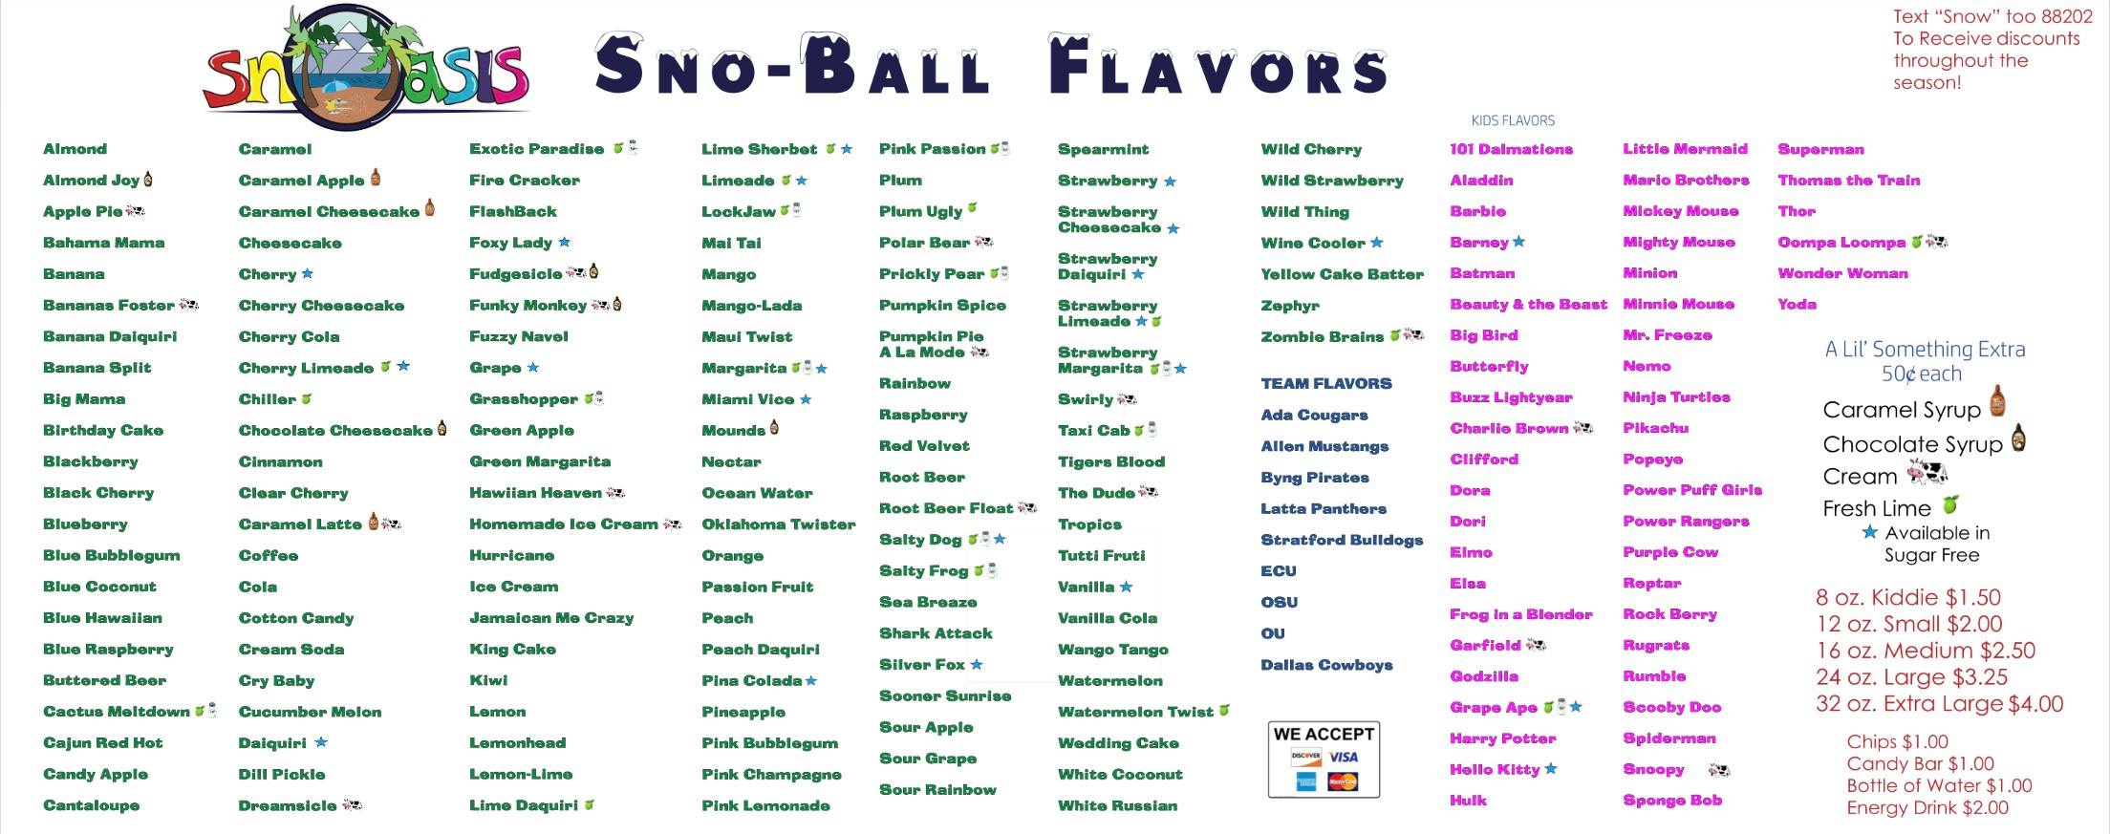
Our Business Partner
Located in Ada Oklahoma
Open Seasonally
Two permanent locations
Food truck (mobile)

Slide 3
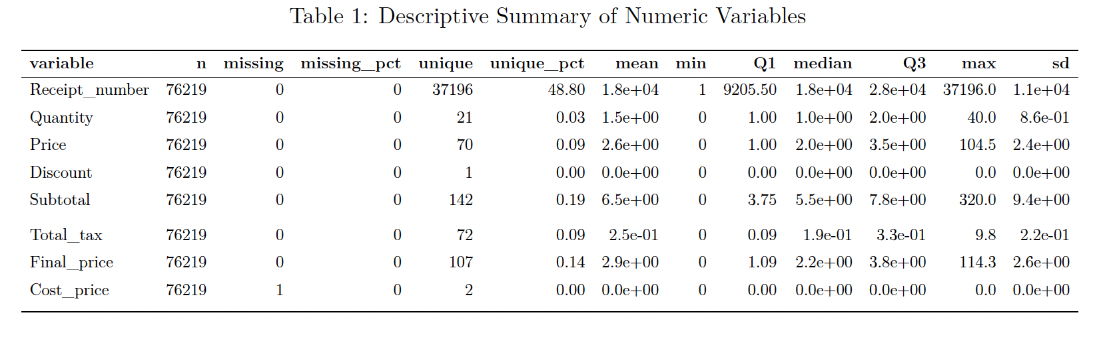
Our Data
Complete Seasonal Data for 2023
Transactional
Location
Messy Time

Slide 4
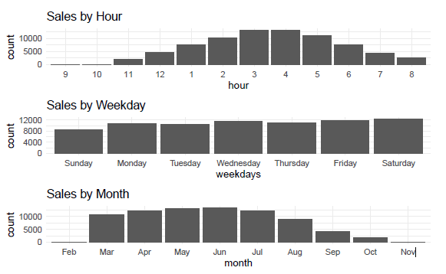
Seasonal Sale Break Down
Breakdown captured in different timeframes (hour/weekday/month)
Sales Peaks Times
Seasonal trends

Slide 5
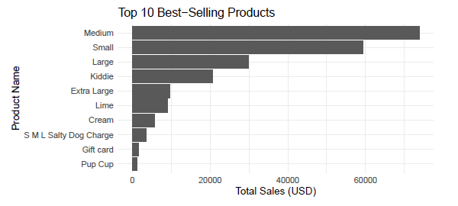
Total Sales

Slide 6
Model Validation
Apriori Algorithm Validation:
Applied Apriori to uncover frequent item sets and generate association rules.
Ensured results met thresholds for support, confidence, and lift.
Key Findings:
Rule Example: {Large} → {Lime}
Support: 34%
Confidence: 56% (High likelihood Lime is purchased with Large cones).
Lift: 1.036 (Association stronger than random chance).

Slide 7
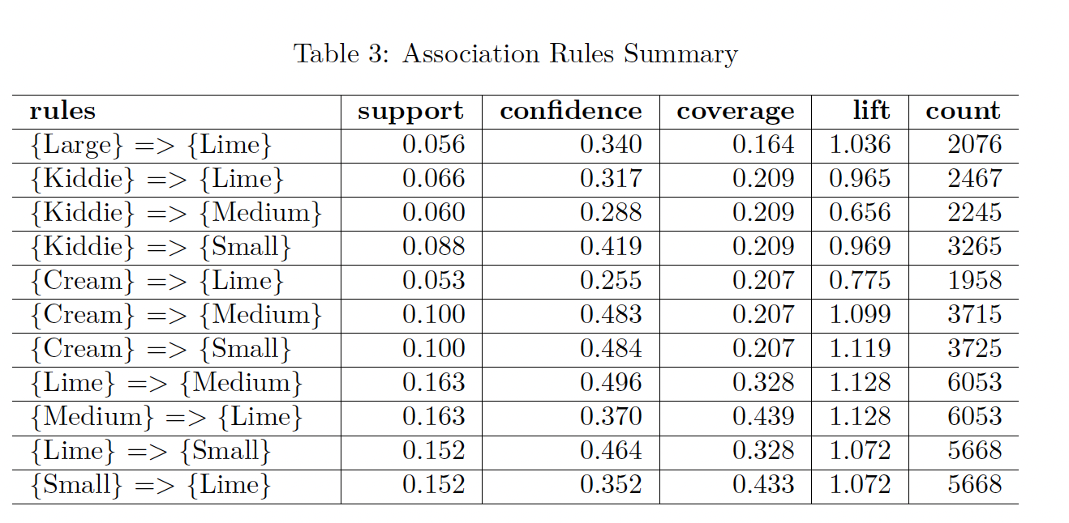
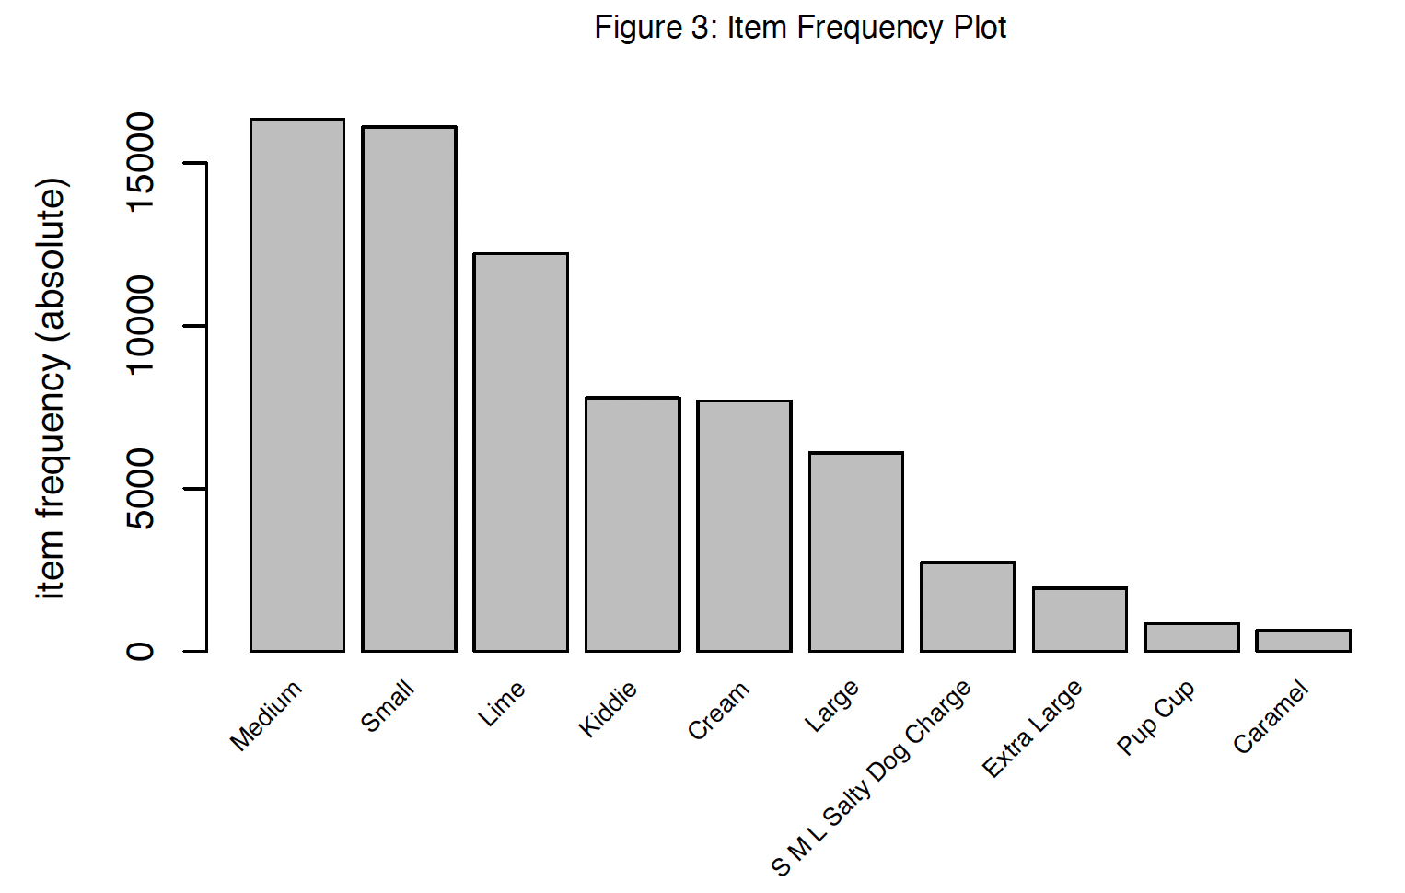
Association Rule Mining
Approach: Apriori algorithm to uncover purchasing patterns.
Key Findings:
- Strong associations like {Large} → {Lime}.
- Opportunities: Promotions like free Lime with Large cones.

Slide 8
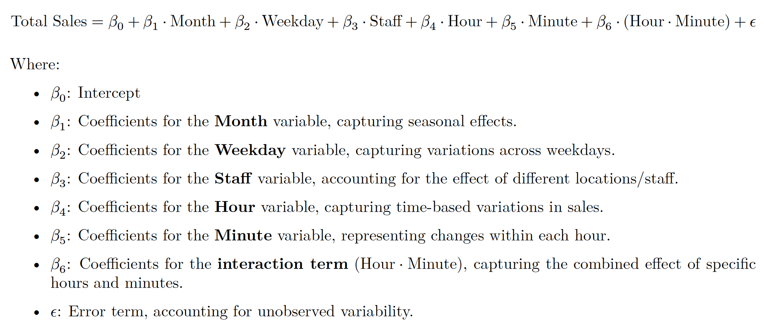
Regression Analysis
Regression Model:

Slide 9
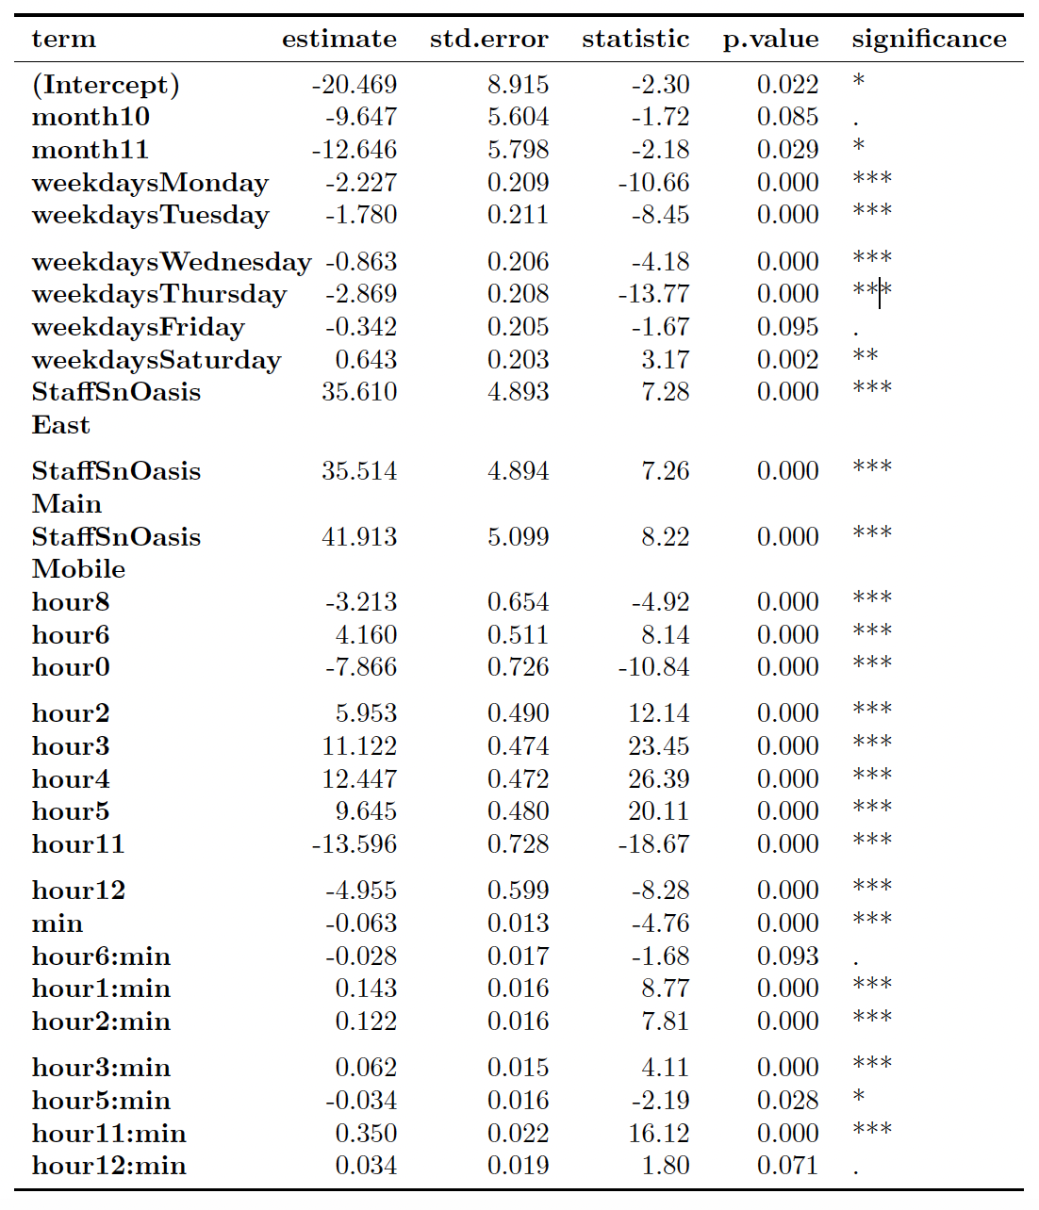
Regression Analysis
Significant Results:
- Sales peak (3-5 PM)
High demand on Saturdays
Sales decline in November

Slide 10
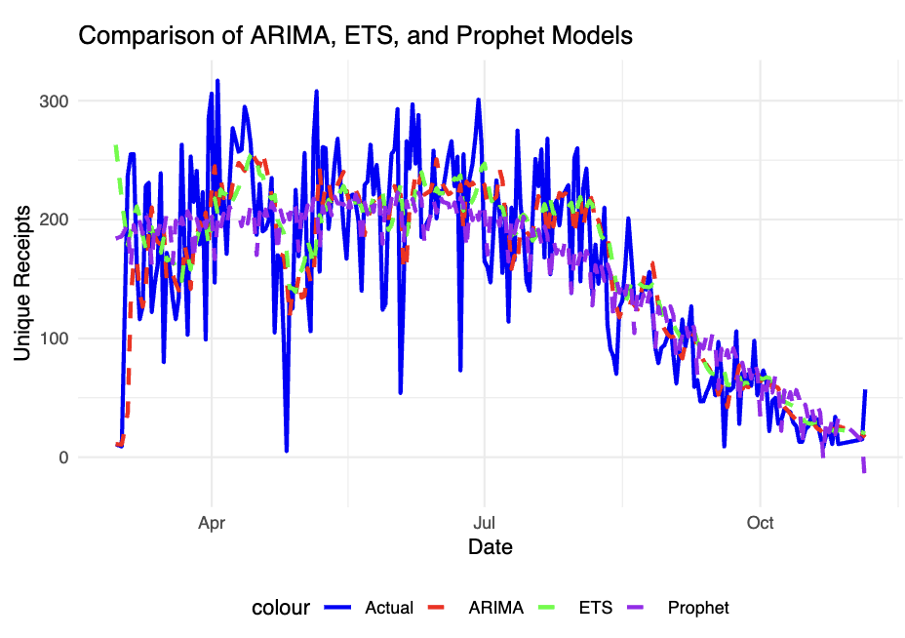
Sales Prediction
Model | RMSE
ARIMA | 50.9
ETS | 54.0
Prophet | 50.7

Slide 11
Insights & Future Direction
Optimize staffing for early peaks and weekends.
Seasonal promotions for high-demand periods.
Targeted campaigns leveraging product associations.
Explore clustering models for inventory management.
Implement dynamic pricing and demand forecasting.

Slide 12
Conclusion
Peak sales occur between 3–5 PM and on Saturdays.
Sales significantly decline in November.
Staffing Optimization: Increase workforce during peak hours and weekends.
Promotions: Introduce targeted offers during low-demand periods and leverage strong product associations (e.g., free lime flavor with large cones).
Seasonal Adjustments: Launch marketing campaigns to sustain sales in November.
Implement dynamic pricing models based on sales predictions.
Explore clustering for inventory and resource management.
Extend analysis to include weather and location-based impacts on sales.

