Slide 1


SnOasis
Snow Cone Business: A Data Driven Approach
Nicholas Jacob, Zayne Mclaughlin, Yechang Qi, James Wahome

Slide 2

Our Business Partner
Located in Ada Oklahoma
Open Seasonally
Two permanent locations
Food truck (mobile)

Slide 3
Our Data
Complete Seasonal Data for 2023
Transactional
Location
Messy Time

Slide 4
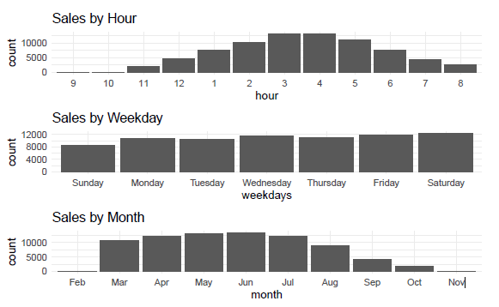
Seasonal Sale Break Down

Slide 5
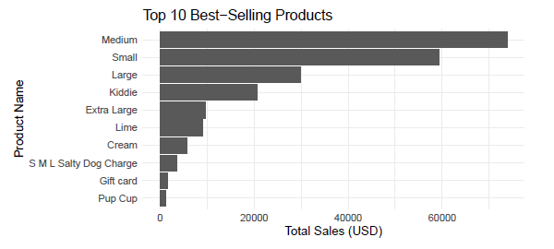
Total Sales

Slide 6
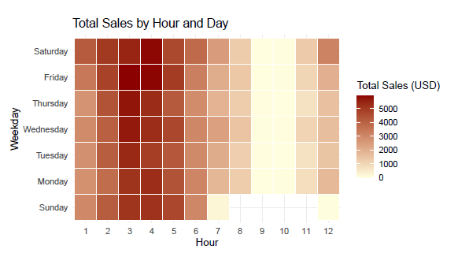
Heat Map of Sales

