Slide 1
CS 5483: Network Science
Sridhar Radhakrishnan
School of Computer Science
University of Oklahoma
Module 8: Fundamentals of Network Theory: The Structure of Real-World Networks

Slide 2
Real-World Networks and Features
Module 8.1

Slide 3
Why Study Random Graphs?
So far:
We have investigated methods to construct networks
Defined metrics to measure the structure of the networks
Metrics: centrality, diameter, degree distribution, components, average path lengths, etc.
Developed algorithms for the measurement
Next Question:
If we know a network has some particular property, such as a particular degree distribution, its diameter, or the centrality of its nodes, then
What effect will that have on the broader behavior of the system?
Answer:
To answer the above question, we need to build mathematical models with the known measures.

Slide 4
Why Study Random Networks?
We need to build networks that mimic the patterns of connections in networks.
These models allow us to create artificial networks with known parameters, with two major uses:
It will give us insight into fundamental questions of the structure – Why networks look the way they do and how they change with changing parameters
They provide a foundation on which to build an understanding of processes taking place on networks, such as diseases spreading on social networks or search engines searching the web.
Previously we studied the structure of scale-free networks (the ones that follow power-law)
Now we can build scale-free and non-scale-free networks and compare them empirically (and find statistical significance)
We can build many networks satisfying the properties at random and measure each.
That is we need not search for real-world data to measure many properties and statistically show the significances.

Slide 5
Random Graphs
Module 8.1

Slide 6
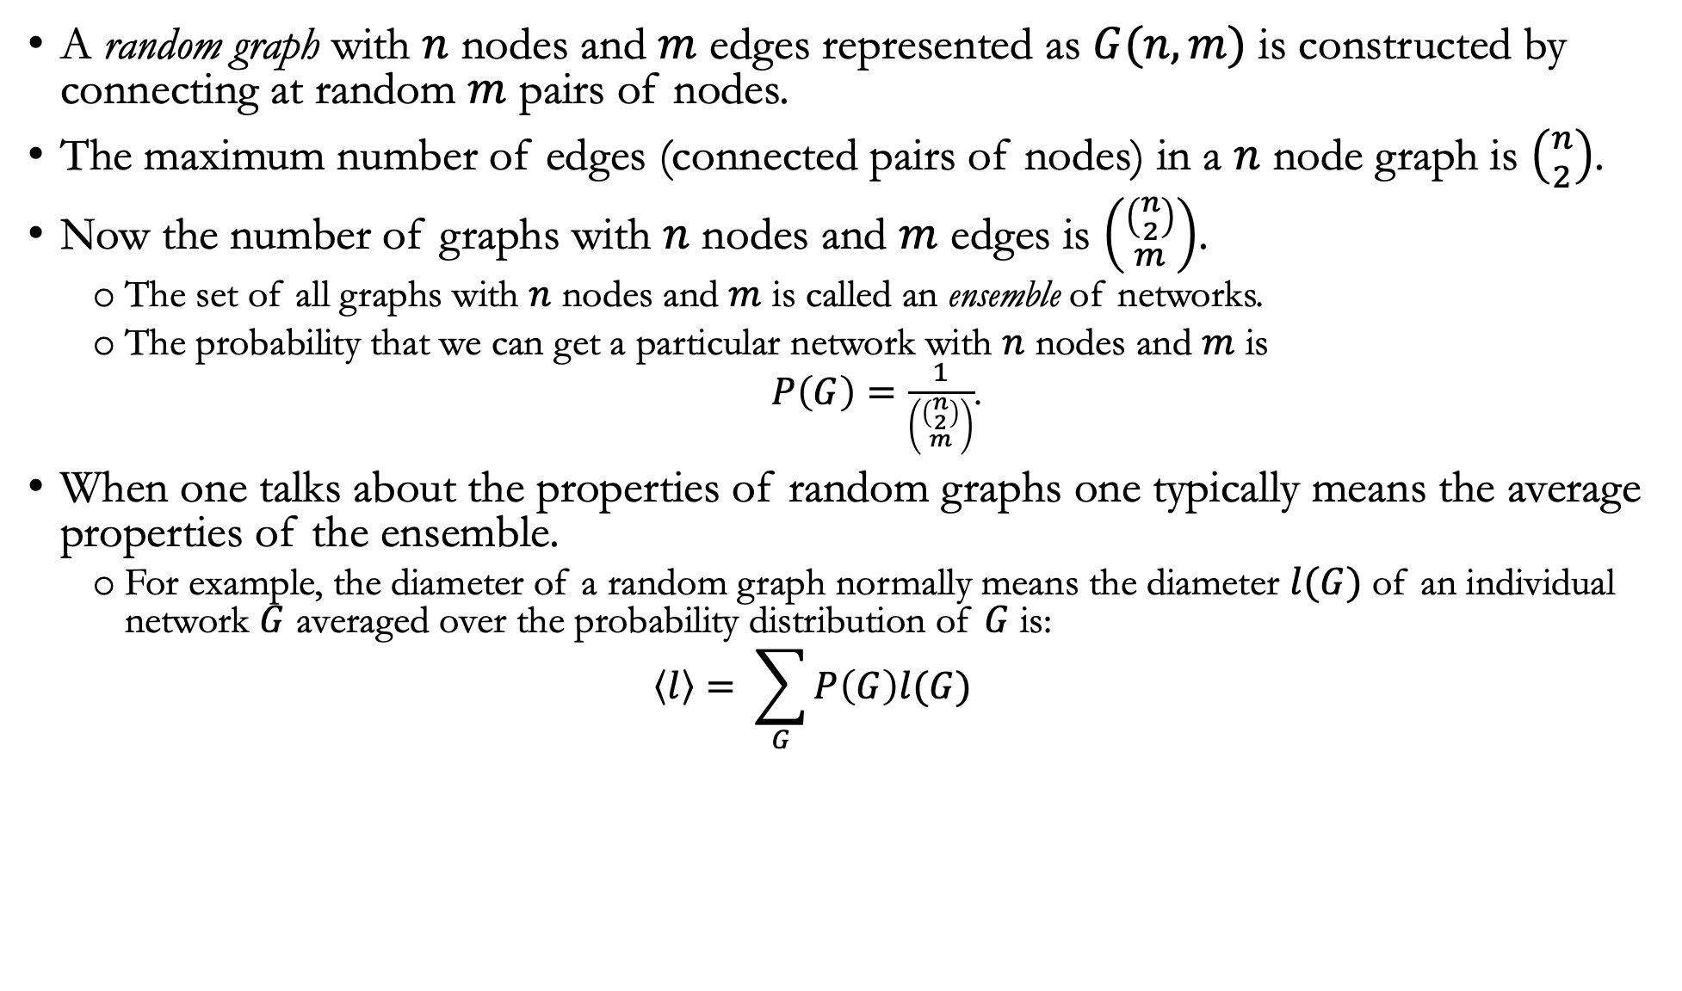
Random Graphs
A random graph with $n$ nodes and $m$ edges represented as $G(n,m)$ is constructed by connecting at random $m$ pairs of nodes.
The maximum number of edges (connected pairs of nodes) in a $n$ node graph is $\left({n \atop 2}\right)$.
Now the number of graphs with $n$ nodes and $m$ edges is $\left({\left({n \atop 2}\right) \atop m}\right)$.
The set of all graphs with $n$ nodes and $m$ is called an ensemble of networks.
The probability that we can get a particular network with $n$ nodes and $m$ is
$P\left(G\right)=\frac{1}{\left({\left({n \atop 2}\right) \atop m}\right)}$.
When one talks about the properties of random graphs one typically means the average properties of the ensemble.
For example, the diameter of a random graph normally means the diameter $l(G)$ of an individual network $G$ averaged over the probability distribution of $G$ is:
$$\left\langle l\right\rangle = \sum_{G}{P\left(G\right)l(G)}$$

Slide 7
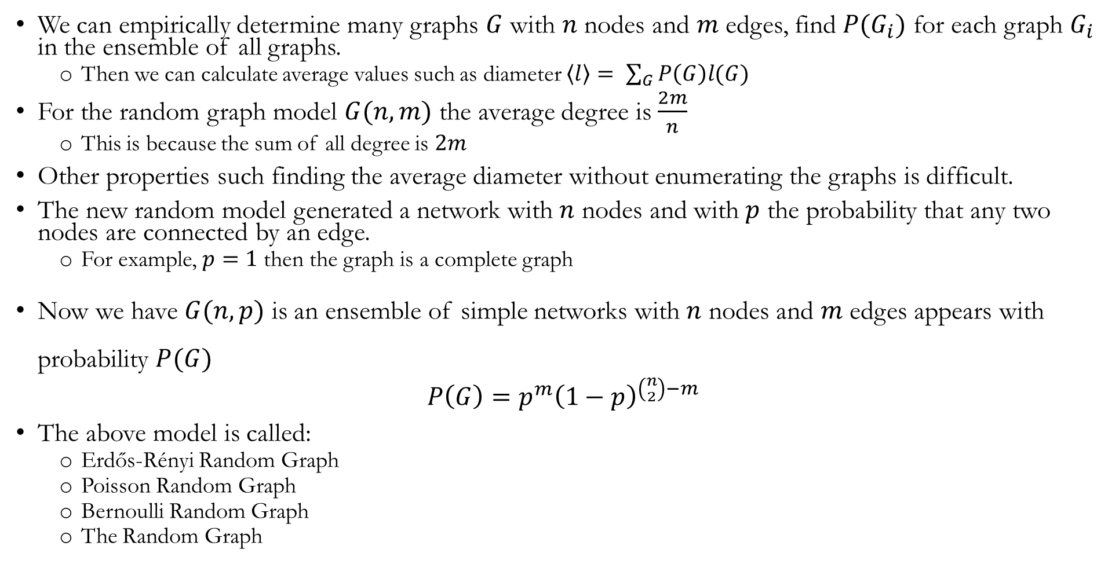
Random Graphs – A new Model
We can empirically determine many graphs $G$ with $n$ nodes and $m$ edges, find $P(G_{i})$ for each graph $G_{i}$ in the ensemble of all graphs.
Then we can calculate average values such as diameter $\left\langle l\right\rangle = \sum_{G}{P\left(G\right)l(G)}$
For the random graph model $G(n,m)$ the average degree is $\frac{2m}{n}$
This is because the sum of all degree is $2m$
Other properties such finding the average diameter without enumerating the graphs is difficult.
The new random model generated a network with $n$ nodes and with $p$ the probability that any two nodes are connected by an edge.
For example, $p=1$ then the graph is a complete graph
Now we have $G(n,p)$ is an ensemble of simple networks with $n$ nodes and $m$ edges appears with probability $P(G)$
$$P\left(G\right)=p^{m}{\left(1−p\right)}^{\left({n \atop 2}\right)−m}$$
The above model is called:
Erdős-Rényi Random Graph
Poisson Random Graph
Bernoulli Random Graph
The Random Graph

Slide 8
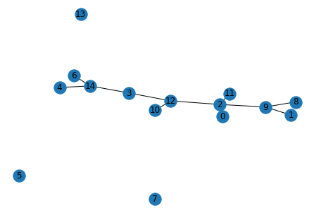
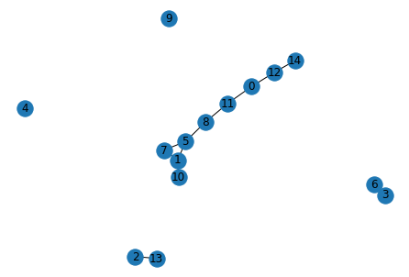
Random Network with NetworkX
UGNM = nx.gnm_random_graph (15,11)
nx.draw (UGNM,with_labels=True)
UG = nx.fast_gnp_random_graph(15,0.1)
nx.draw(UG,with_labels=True)
UG.size() %% 11 edges

Slide 9
Properties of Random Graphs: Models, Mean Degree, Degree Distribution, and Giant Component
Module 8.2

Slide 10
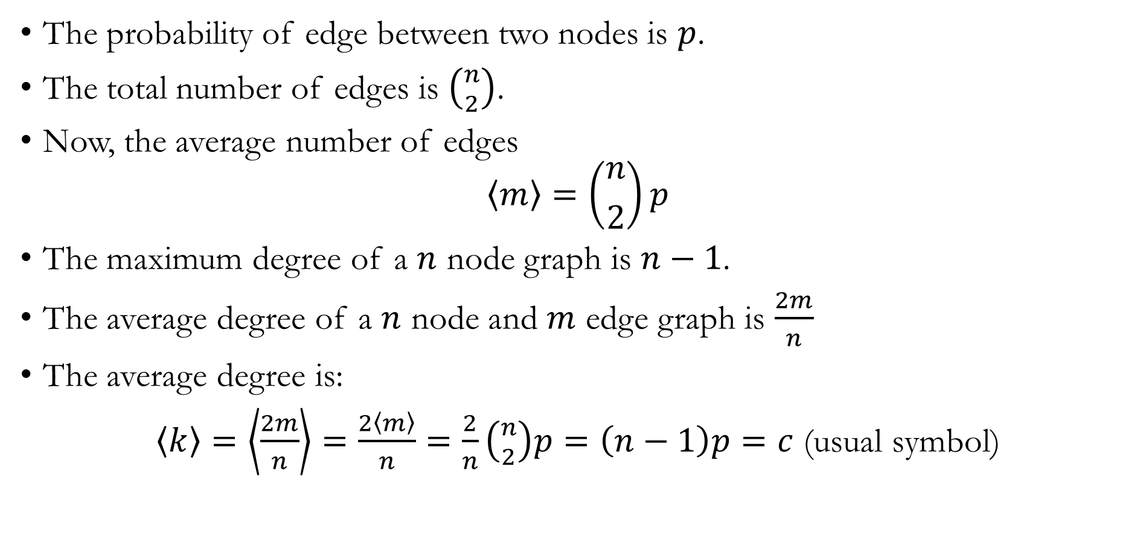
Mean Number of Edges and Mean Degree: $G(n,p)$ model
The probability of edge between two nodes is $p$.
The total number of edges is $\left({n \atop 2}\right)$.
Now, the average number of edges
$$\left\langle m\right\rangle =\left({n \atop 2}\right)p$$
The maximum degree of a $n$ node graph is $n−1$.
The average degree of a $n$ node and $m$ edge graph is $\frac{2m}{n}$
The average degree is:
$\left\langle k\right\rangle =\left\langle \frac{2m}{n}\right\rangle =\frac{2\left\langle m\right\rangle }{n}=\frac{2}{n}\left({n \atop 2}\right)p=\left(n−1\right)p=c$ (usual symbol)

Slide 11
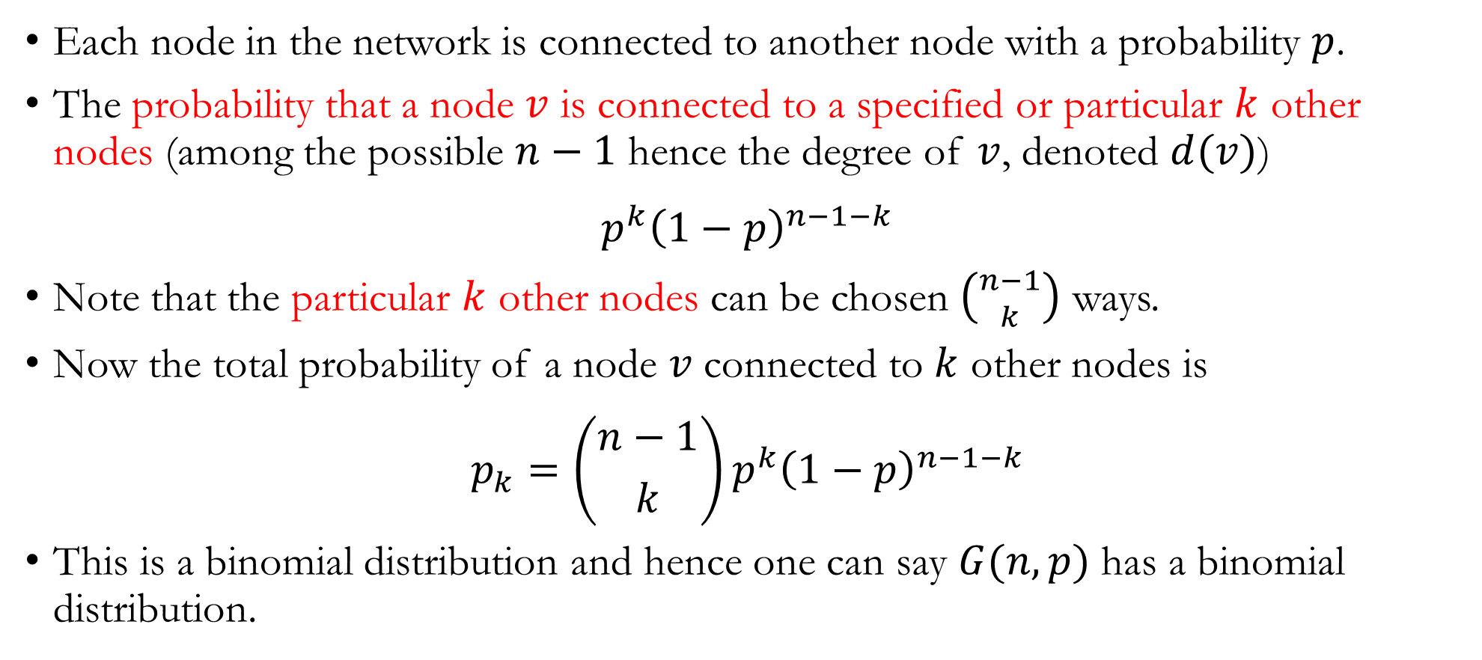
Degree Distribution: $G(n,p)$ model
Each node in the network is connected to another node with a probability $p$.
The probability that a node $v$ is connected to a specified or particular $k$ other nodes (among the possible $n−1$ hence the degree of $v$, denoted $d(v)$)
$$p^{k}{\left(1−p\right)}^{n−1−k}$$
Note that the particular $k$ other nodes can be chosen $\left({n−1 \atop k}\right)$ ways.
Now the total probability of a node $v$ connected to $k$ other nodes is
$${p_{k}=\left({n−1 \atop k}\right)p}^{k}{\left(1−p\right)}^{n−1−k}$$
This is a binomial distribution and hence one can say $G(n,p)$ has a binomial distribution.

Slide 12
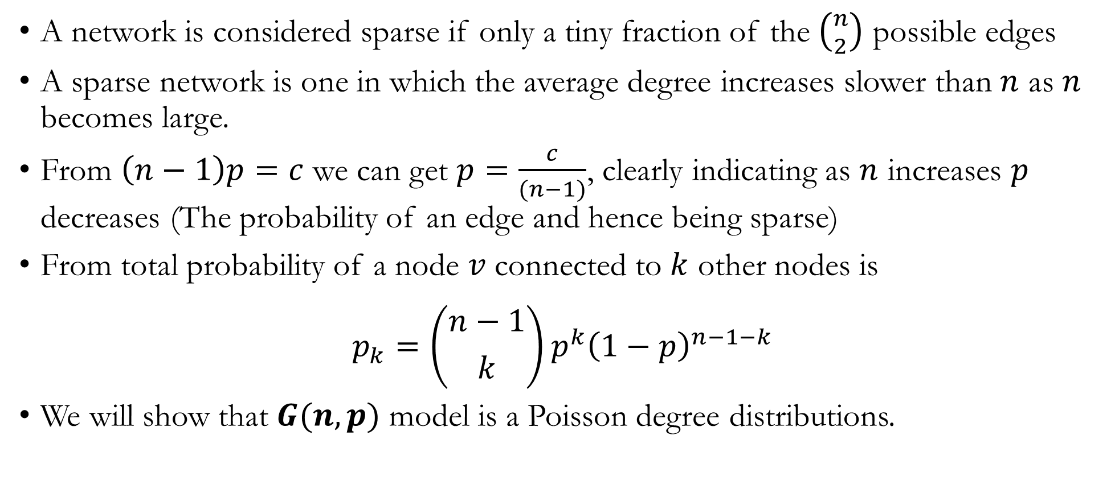
Degree Distribution: $G(n,p)$ model – Sparse Networks
A network is considered sparse if only a tiny fraction of the $\left({n \atop 2}\right)$ possible edges
A sparse network is one in which the average degree increases slower than $n$ as $n$ becomes large.
From $\left(n−1\right)p=c$ we can get $p=\frac{c}{(n−1)}$, clearly indicating as $n$ increases $p$ decreases (The probability of an edge and hence being sparse)
From total probability of a node $v$ connected to $k$ other nodes is
$${p_{k}=\left({n−1 \atop k}\right)p}^{k}{\left(1−p\right)}^{n−1−k}$$
We will show that $G(n,p)$ model is a Poisson degree distributions.

Slide 13
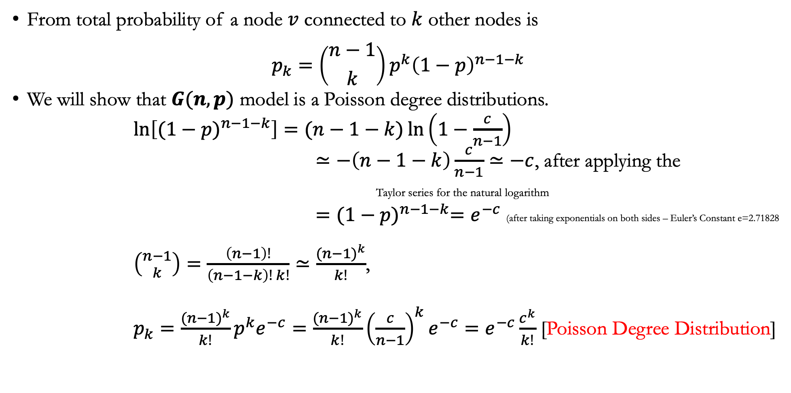
Degree Distribution: $G(n,p)$ model – Sparse Networks
From total probability of a node $v$ connected to $k$ other nodes is
$${p_{k}=\left({n−1 \atop k}\right)p}^{k}{\left(1−p\right)}^{n−1−k}$$
We will show that $G(n,p)$ model is a Poisson degree distributions.
$\ln\left[{(1−p)}^{n−1−k}\right]=(n−1−k)\ln\left(1−\frac{c}{n−1}\right)$
$≃−\left(n−1−k\right)\frac{c}{n−1}≃−c$, after applying the
Taylor series for the natural logarithm
$={(1−p)}^{n−1−k}=e^{−c}$ (after taking exponentials on both sides – Euler’s Constant e=2.71828
$\left({n−1 \atop k}\right)=\frac{\left(n−1\right)!}{\left(n−1−k\right)! k!}≃\frac{{(n−1)}^{k}}{k!}$,
$p_{k}=\frac{{(n−1)}^{k}}{k!}p^{k}e^{−c}=\frac{{(n−1)}^{k}}{k!}{\left(\frac{c}{n−1}\right)}^{k}e^{−c}=e^{−c}\frac{c^{k}}{k!}$ [Poisson Degree Distribution]

Slide 14
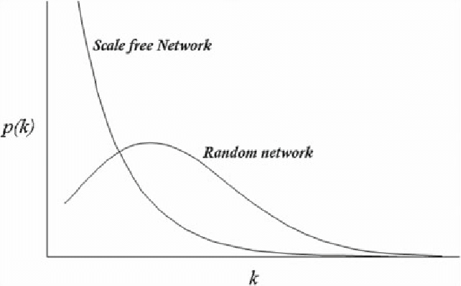
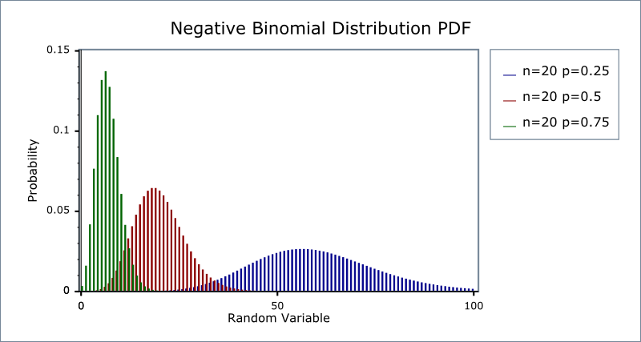
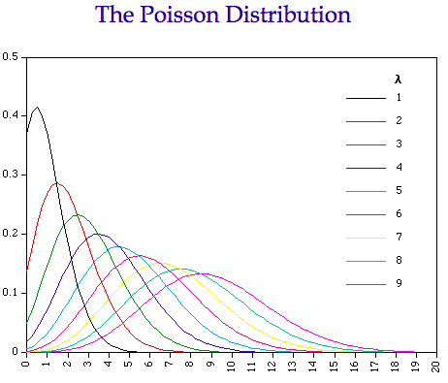
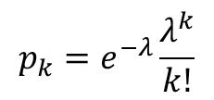
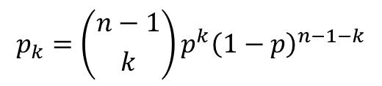
Degree Distribution: $G(n,p)$ model
https://www.statisticshowto.com/negative-binomial-experiment/
$${p_{k}=\left({n−1 \atop k}\right)p}^{k}{\left(1−p\right)}^{n−1−k}$$
$$p_{k}=e^{−λ}\frac{λ^{k}}{k!}$$
https://medium.com/@cssamanda1989/statistics-101-binomial-and-poisson-distribution-af4f3cf3e774

Slide 15
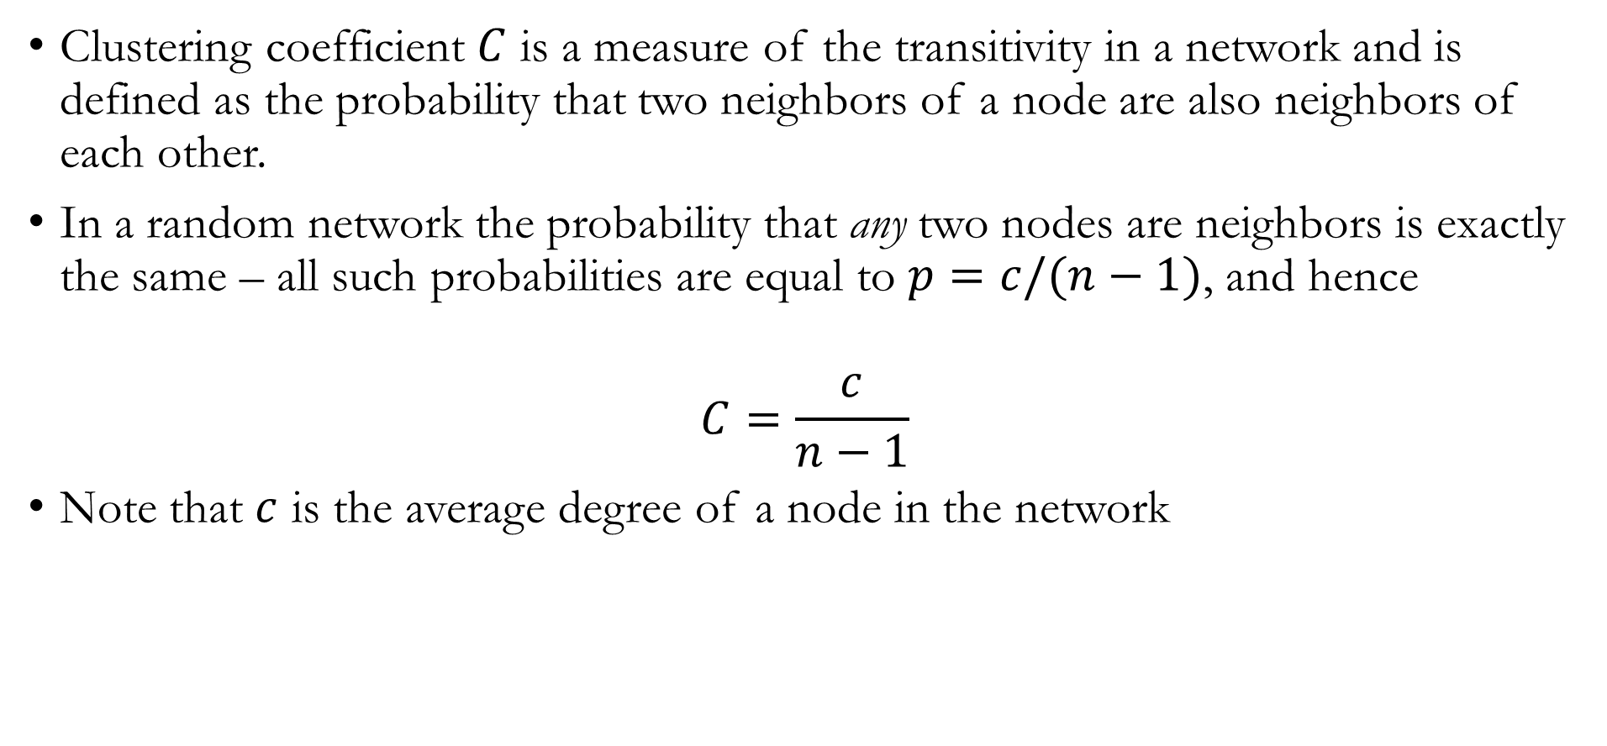
Clustering Coefficient: $G(n,p)$ model
Clustering coefficient $C$ is a measure of the transitivity in a network and is defined as the probability that two neighbors of a node are also neighbors of each other.
In a random network the probability that any two nodes are neighbors is exactly the same – all such probabilities are equal to $p=c/(n−1)$, and hence
$$C=\frac{c}{n−1}$$
Note that $c$ is the average degree of a node in the network

Slide 16
Properties of Random Graphs: Giant Component
Module 8.3

Slide 17
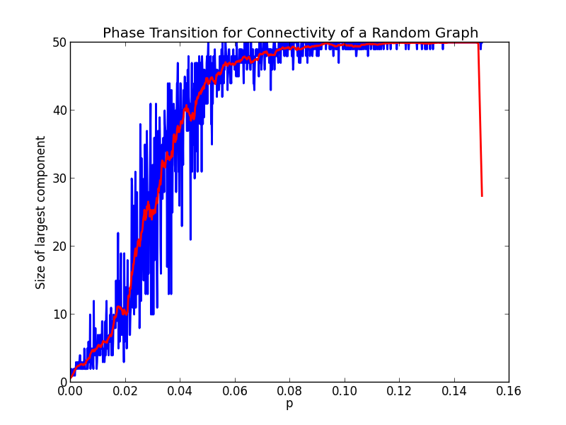
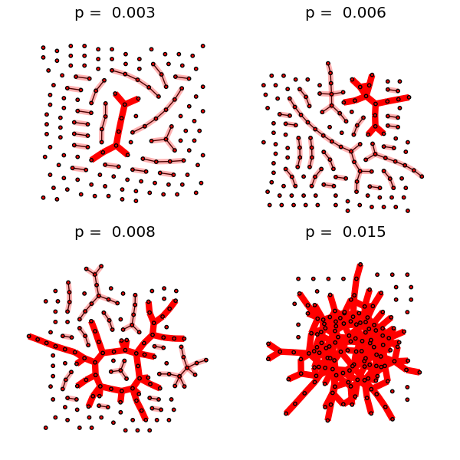
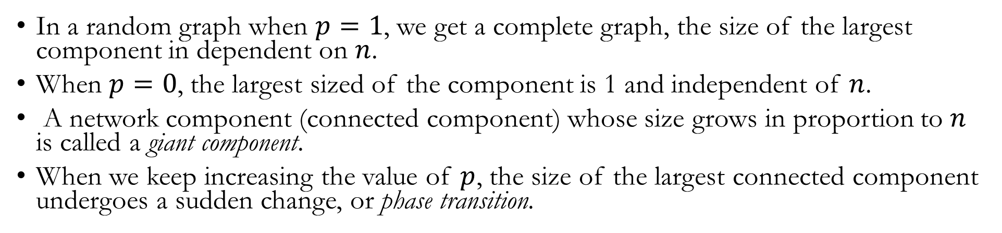
Giant Component: $G(n,p)$ model
In a random graph when $p=1$, we get a complete graph, the size of the largest component in dependent on $n$.
When $p=0$, the largest sized of the component is 1 and independent of $n$.
A network component (connected component) whose size grows in proportion to $n$ is called a giant component.
When we keep increasing the value of $p$, the size of the largest connected component undergoes a sudden change, or phase transition.
https://networkx.org/documentation/networkx-1.10/_images/giant_component.png
https://jeremykun.com/2015/02/02/the-giant-component-and-explosive-percolation/

Slide 18
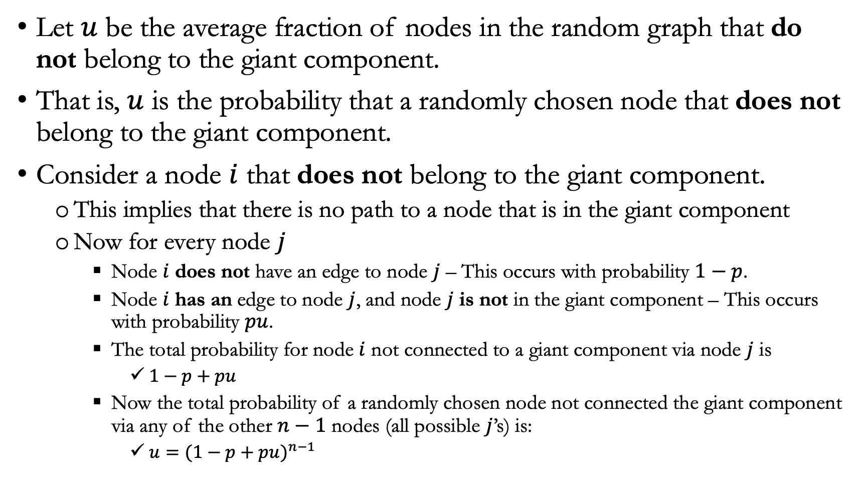
Giant Component: $G(n,p)$ model – Determining the Size
Let $u$ be the average fraction of nodes in the random graph that do not belong to the giant component.
That is, $u$ is the probability that a randomly chosen node that does not belong to the giant component.
Consider a node $i$ that does not belong to the giant component.
This implies that there is no path to a node that is in the giant component
Now for every node $j$
Node $i$ does not have an edge to node $j$ – This occurs with probability $1−p$.
Node $i$ has an edge to node $j$, and node $j$ is not in the giant component – This occurs with probability $pu$.
The total probability for node $i$ not connected to a giant component via node $j$ is
$1−p+pu$
Now the total probability of a randomly chosen node not connected the giant component via any of the other $n−1$ nodes (all possible $j$’s) is:
$u={(1−p+pu)}^{n−1}$

Slide 19
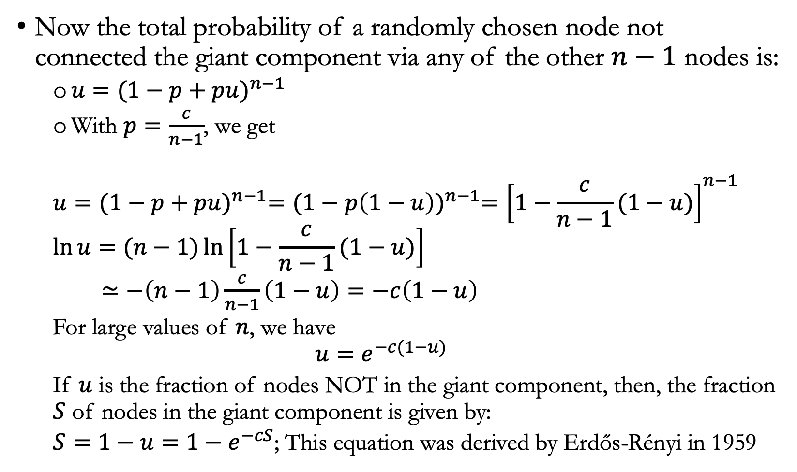
Giant Component: $G(n,p)$ model – Determining the Size
Now the total probability of a randomly chosen node not connected the giant component via any of the other $n−1$ nodes is:
$u={(1−p+pu)}^{n−1}$
With $p=\frac{c}{n−1}$, we get
$$u={{(1−p+pu)}^{n−1}={(1−p\left(1−u\right))}^{n−1}=\left[1−\frac{c}{n−1}(1−u)\right]}^{n−1}$$
$$\ln{u}=(n−1)\ln\left[1−\frac{c}{n−1}(1−u)\right]$$
$≃−\left(n−1\right)\frac{c}{n−1}\left(1−u\right)=−c\left(1−u\right)$
For large values of $n$, we have
$$u=e^{−c(1−u)}$$
If $u$ is the fraction of nodes NOT in the giant component, then, the fraction $S$ of nodes in the giant component is given by:
$S=1−u=1−e^{−cS}$; This equation was derived by Erdős-Rényi in 1959

Slide 20
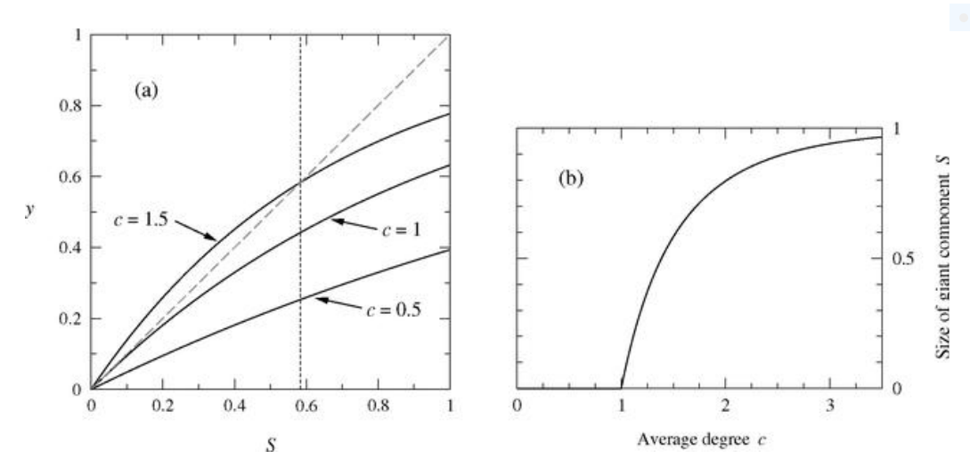
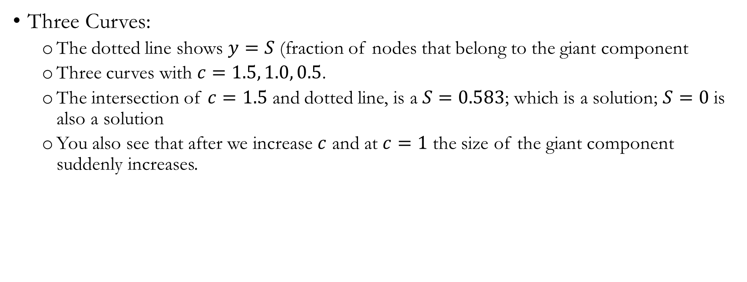
Giant Component: $G(n,p)$ model - – Determining the Size
Three Curves:
The dotted line shows $y=S$ (fraction of nodes that belong to the giant component
Three curves with $c=1.5, 1.0, 0.5$.
The intersection of $c=1.5$ and dotted line, is a $S=0.583$; which is a solution; $S=0$ is also a solution
You also see that after we increase $c$ and at $c=1$ the size of the giant component suddenly increases.

Slide 21
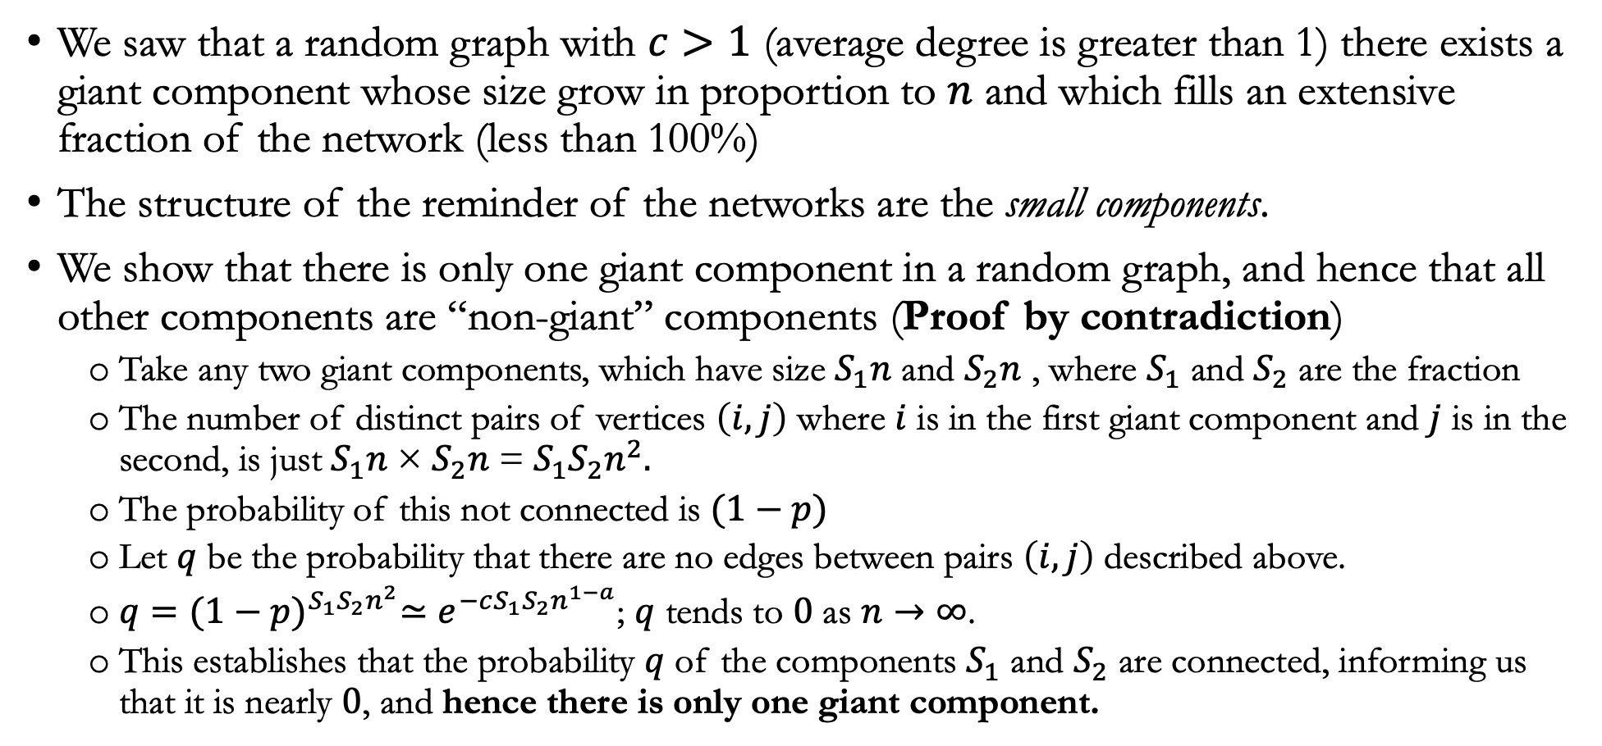
How many Giant Components?
We saw that a random graph with $c>1$ (average degree is greater than 1) there exists a giant component whose size grow in proportion to $n$ and which fills an extensive fraction of the network (less than 100%)
The structure of the reminder of the networks are the small components.
We show that there is only one giant component in a random graph, and hence that all other components are “non-giant” components (Proof by contradiction)
Take any two giant components, which have size $S_{1}n$ and $S_{2}n$ , where $S_{1}$ and $S_{2}$ are the fraction
The number of distinct pairs of vertices $\left(i,j\right)$ where $i$ is in the first giant component and $j$ is in the second, is just $S_{1}n$ × $S_{2}n$ = ${S_{1}S}_{2}n^{2}.$
The probability of this not connected is $(1−p)$
Let $q$ be the probability that there are no edges between pairs $\left(i,j\right)$ described above.
$q={{(1−p)}^{{S_{1}S}_{2}n^{2}}≃e}^{−cS_{1}S_{2}n^{1−a}}$; $q$ tends to $0$ as $n→∞$.
This establishes that the probability $q$ of the components $S_{1}$ and $S_{2}$ are connected, informing us that it is nearly $0$, and hence there is only one giant component.

Slide 22
Properties of Random Graphs: Small Components and Small-World Effect
Module 8.4

Slide 23
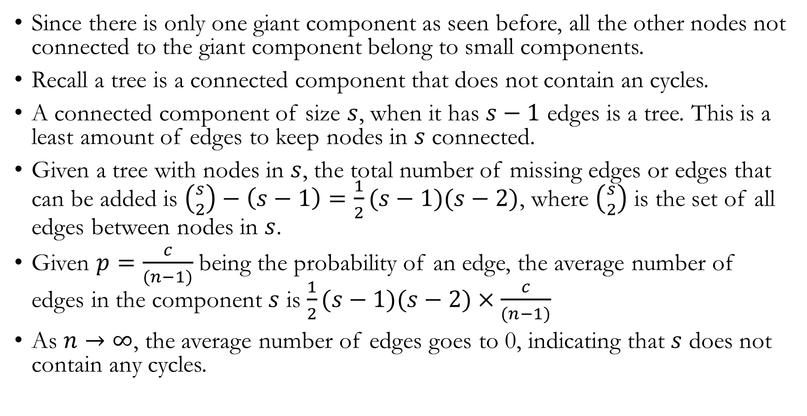
Small Components: $G(n,p)$ model
Since there is only one giant component as seen before, all the other nodes not connected to the giant component belong to small components.
Recall a tree is a connected component that does not contain an cycles.
A connected component of size $s$, when it has $s−1$ edges is a tree. This is a least amount of edges to keep nodes in $s$ connected.
Given a tree with nodes in $s$, the total number of missing edges or edges that can be added is $\left({s \atop 2}\right)−\left(s−1\right)=\frac{1}{2}(s−1)(s−2)$, where $\left({s \atop 2}\right)$ is the set of all edges between nodes in $s$.
Given $p=\frac{c}{(n−1)}$ being the probability of an edge, the average number of edges in the component $s$ is $\frac{1}{2}(s−1)(s−2)×\frac{c}{(n−1)}$
As $n→∞$, the average number of edges goes to 0, indicating that $s$ does not contain any cycles.

Slide 24
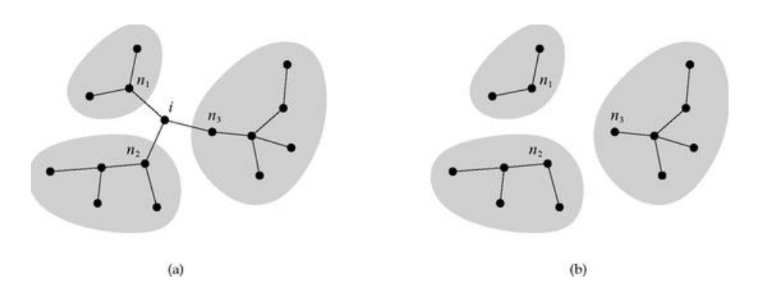
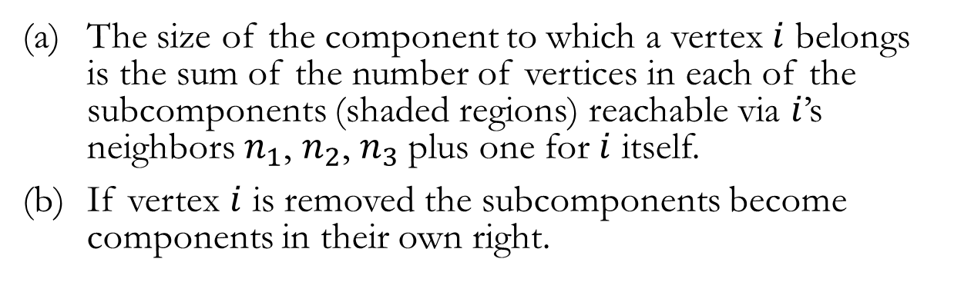
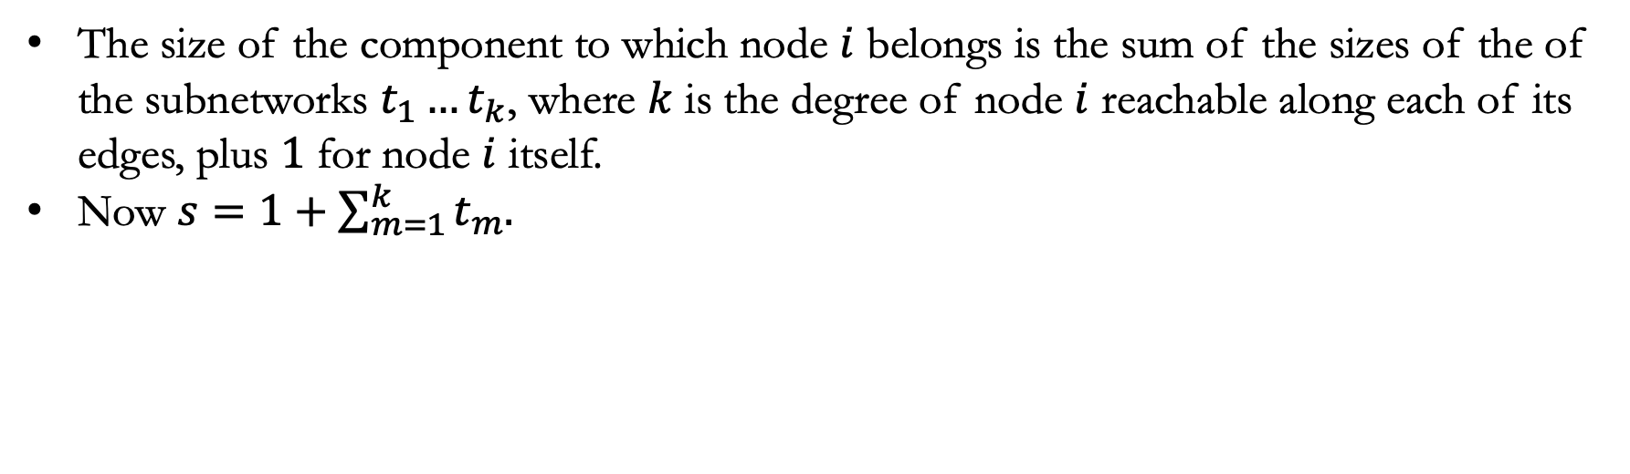
Small Components
The size of the component to which a vertex $i$ belongs is the sum of the number of vertices in each of the subcomponents (shaded regions) reachable via $i$’s neighbors $n_{1}$, $n_{2}$, $n_{3}$plus one for $i$ itself.
If vertex $i$ is removed the subcomponents become components in their own right.
The size of the component to which node $i$ belongs is the sum of the sizes of the of the subnetworks $t_{1}…t_{k}$, where $k$ is the degree of node $i$ reachable along each of its edges, plus $1$ for node $i$ itself.
Now $s=1+\sum_{m=1}^{k}{t_{m}.}$

Slide 25
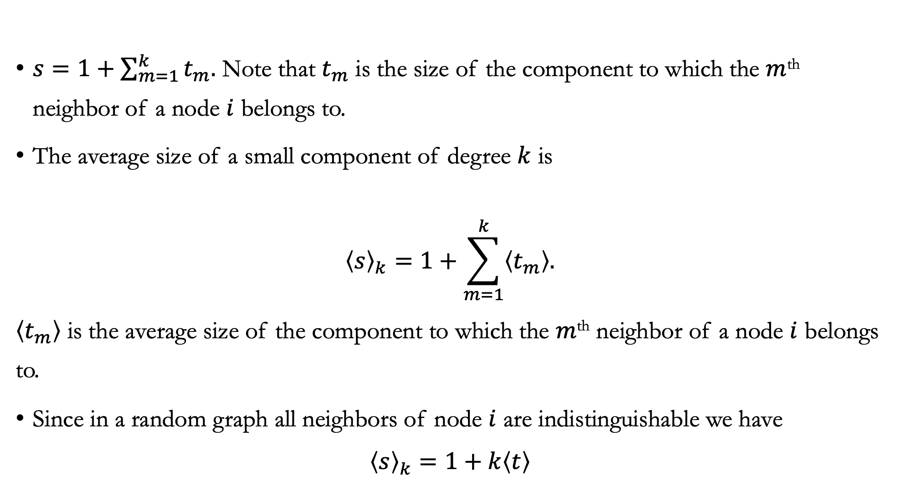
Small Components: Average Size
$s=1+\sum_{m=1}^{k}{t_{m}.}$ Note that $t_{m}$ is the size of the component to which the $m$^{th} neighbor of a node $i$ belongs to.
The average size of a small component of degree $k$ is
$${\left\langle s\right\rangle }_{k}=1+\sum_{m=1}^{k}{\left\langle t_{m}\right\rangle .}$$
$\left\langle t_{m}\right\rangle$ is the average size of the component to which the $m$^{th} neighbor of a node $i$ belongs to.
Since in a random graph all neighbors of node $i$ are indistinguishable we have
$${\left\langle s\right\rangle }_{k}=1+k\left\langle t\right\rangle$$

Slide 26
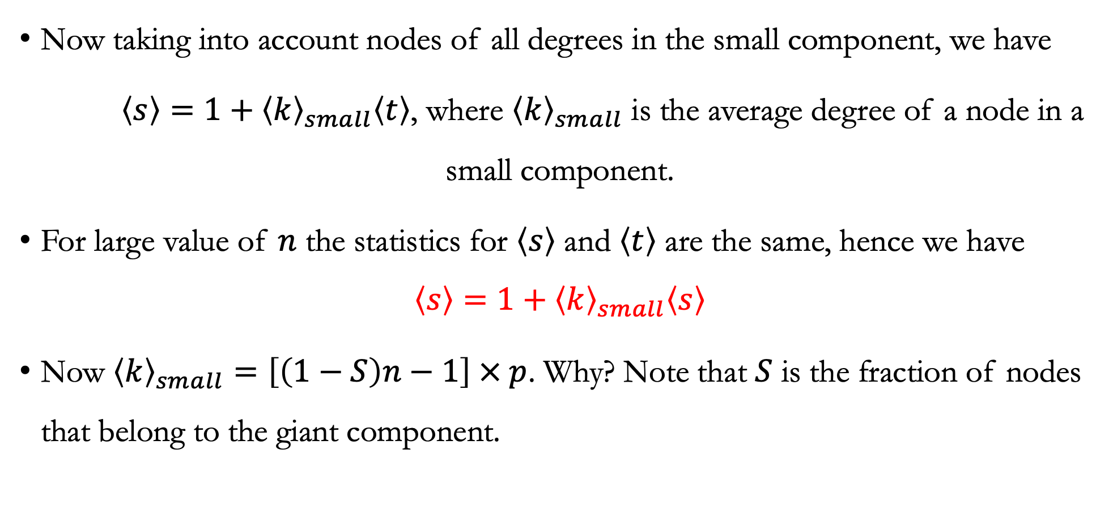
Small Component: Average Degree
Now taking into account nodes of all degrees in the small component, we have
$\left\langle s\right\rangle =1+{\left\langle k\right\rangle }_{small}\left\langle t\right\rangle$, where ${\left\langle k\right\rangle }_{small}$ is the average degree of a node in a small component.
For large value of $n$ the statistics for $\left\langle s\right\rangle$ and $\left\langle t\right\rangle$ are the same, hence we have
$$\left\langle s\right\rangle =1+{\left\langle k\right\rangle }_{small}\left\langle s\right\rangle$$
Now ${\left\langle k\right\rangle }_{small}=\left[\left(1−S\right)n−1\right] × p$. Why? Note that $S$ is the fraction of nodes that belong to the giant component.

Slide 27
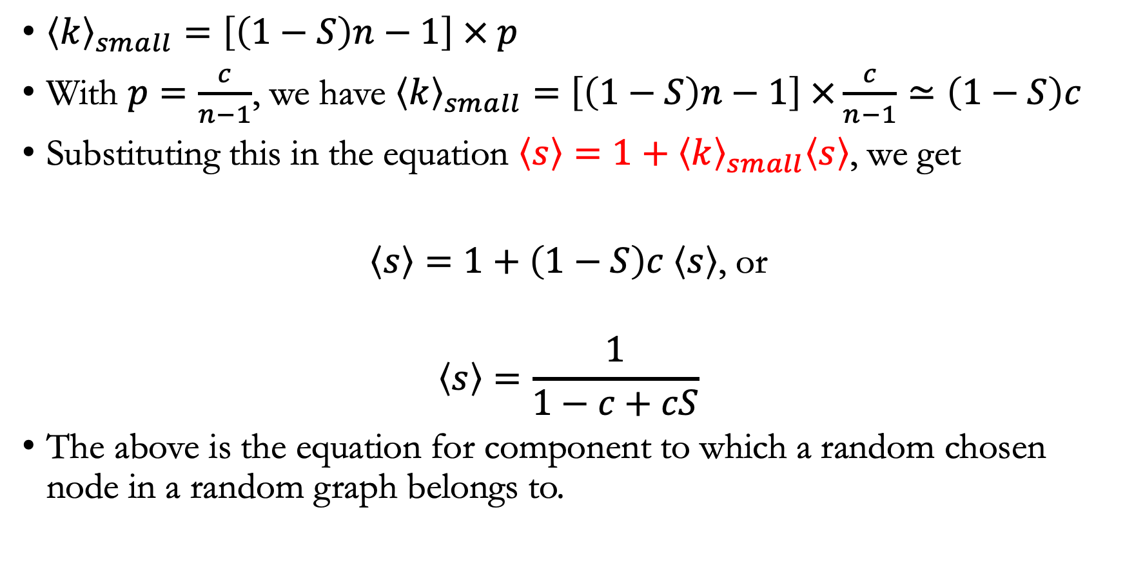
Small Components: Average Size
${\left\langle k\right\rangle }_{small}=\left[\left(1−S\right)n−1\right] × p$
With $p=\frac{c}{n−1}$, we have ${\left\langle k\right\rangle }_{small}=$ $\left[\left(1−S\right)n−1\right] ×\frac{c}{n−1}≃\left(1−S\right)c$
Substituting this in the equation $\left\langle s\right\rangle =1+{\left\langle k\right\rangle }_{small}\left\langle s\right\rangle$, we get
$\left\langle s\right\rangle =1+\left(1−S\right)c \left\langle s\right\rangle$, or
$$\left\langle s\right\rangle =\frac{1}{1−c+cS}$$
The above is the equation for component to which a random chosen node in a random graph belongs to.

Slide 28
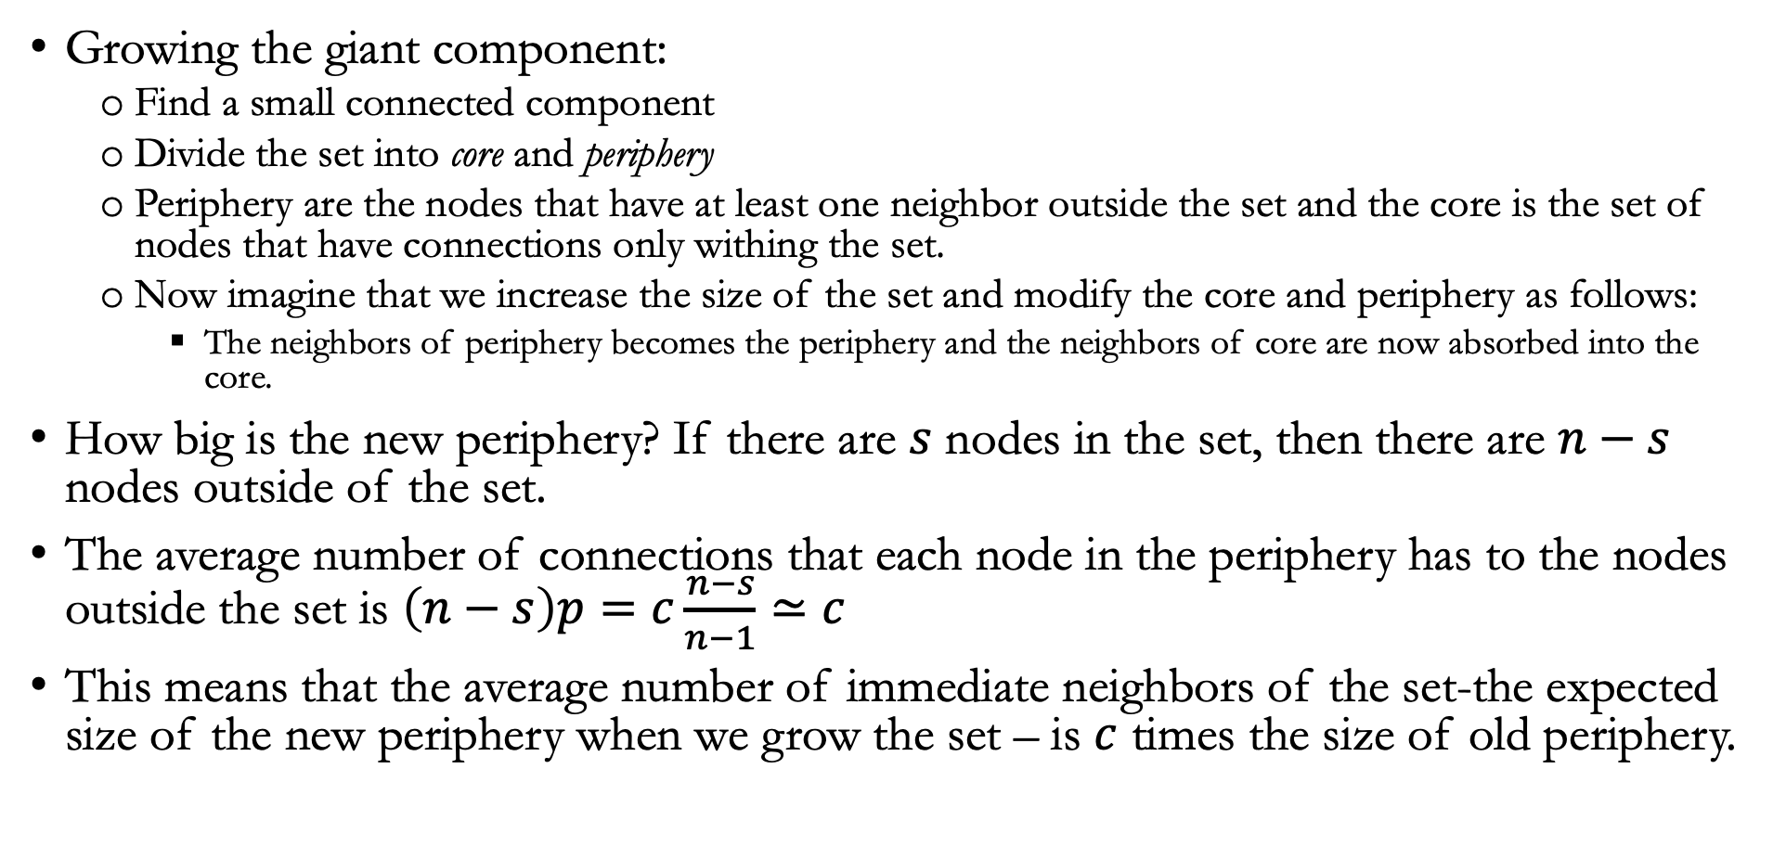
Small World
Growing the giant component:
Find a small connected component
Divide the set into core and periphery
Periphery are the nodes that have at least one neighbor outside the set and the core is the set of nodes that have connections only withing the set.
Now imagine that we increase the size of the set and modify the core and periphery as follows:
The neighbors of periphery becomes the periphery and the neighbors of core are now absorbed into the core.
How big is the new periphery? If there are $s$ nodes in the set, then there are $n−s$ nodes outside of the set.
The average number of connections that each node in the periphery has to the nodes outside the set is $\left(n−s\right)p=c\frac{n−s}{n−1}≃c$
This means that the average number of immediate neighbors of the set-the expected size of the new periphery when we grow the set – is $c$ times the size of old periphery.

Slide 29
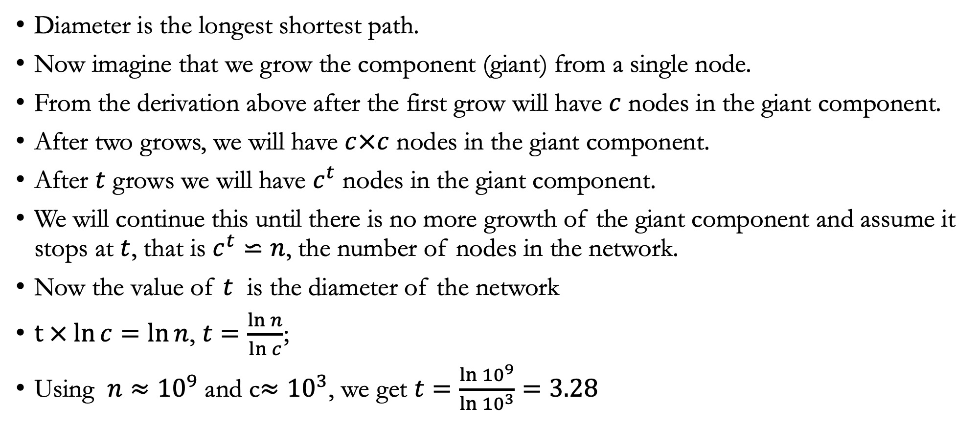
Small World: Diameter
Diameter is the longest shortest path.
Now imagine that we grow the component (giant) from a single node.
From the derivation above after the first grow will have $c$ nodes in the giant component.
After two grows, we will have $c×c$ nodes in the giant component.
After $t$ grows we will have $c^{t}$ nodes in the giant component.
We will continue this until there is no more growth of the giant component and assume it stops at $t$, that is $c^{t}⋍n$, the number of nodes in the network.
Now the value of $t$ is the diameter of the network
$t × ln{c=\ln{n}}$, $t=\frac{\ln{n}}{\ln{c}}$;
Using $n≈{10}^{9}$ and c$≈{10}^{3}$, we get $t=\frac{\ln{{10}^{9}}}{\ln{{10}^{3}}}=3.28$

Slide 30
Information From Real World Data

