Slide 1
WQD7010 Network & Security
Dr. Saaidal Razalli Bin Azzuhri
Dept. of Comp. System & Technology
Fac. of Science Comp & IT

Slide 2
Chapter 4 (Part 2)
Key Distribution and User Authentication
Notes:
This chapter covers two important related concepts. First is the complex topic of cryptographic
key distribution, involving cryptographic, protocol, and management considerations.
This chapter gives the reader a feel for the issues involved and provides a
broad survey of the various aspects of key management and distribution.
This chapter also examines some of the authentication functions that have been
developed to support network-based user authentication. The chapter includes a detail
discussion of one of the earliest and also one of the most widely used key distribution
and user authentication services: Kerberos. Next, the chapter looks at key distribution
schemes that rely on asymmetric encryption. This is followed by a discussion of X.509
certificates and public-key infrastructure. Finally, the concept of federated identity
management is introduced.

Slide 3
Authentication Procedure
X.509 includes three alternative authentication procedures:
– One-Way Authentication
> for unidirectional messages (like email)
– Two-Way Authentication
> for interactive sessions when timestamps are used
– Three-Way Authentication
for interactive sessions with no need for timestamps (and hence synchronised clocks).
all use public-key signatures

Slide 4
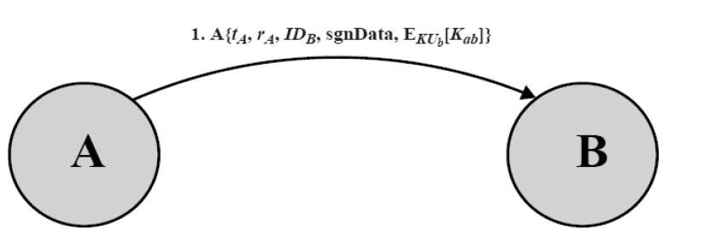
X.500 One-Way Authentication
1 message ( A B) used to establish with synchronized clocks
the identity of A and that message is from A
message was intended for B
integrity & originality of message
message must include timestamp, nonce, B's identity and is signed by A
timestamp need to be checked ‘or’ relied upon

Slide 5
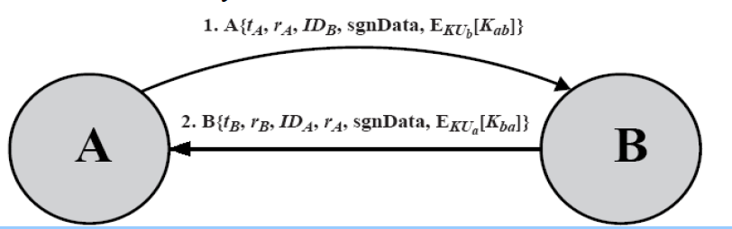
X.500 Two-Way Authentication
2 messages (A B, B A) for two way authentication, with synchronized
clocks in addition:
the identity of B and that reply is from B
that reply is intended for A
integrity & originality of reply
reply includes original nonce from A, also timestamp and nonce from B
timestamp need to be checked or relied upon

Slide 6
X.500 Three-Way Authentication
3 messages (AB, BA, AB) which enables above authentication without synchronized clocks
has reply from A back to B containing signed copy of nonce from B
implies timestamps need not be checked or relied upon

Slide 7
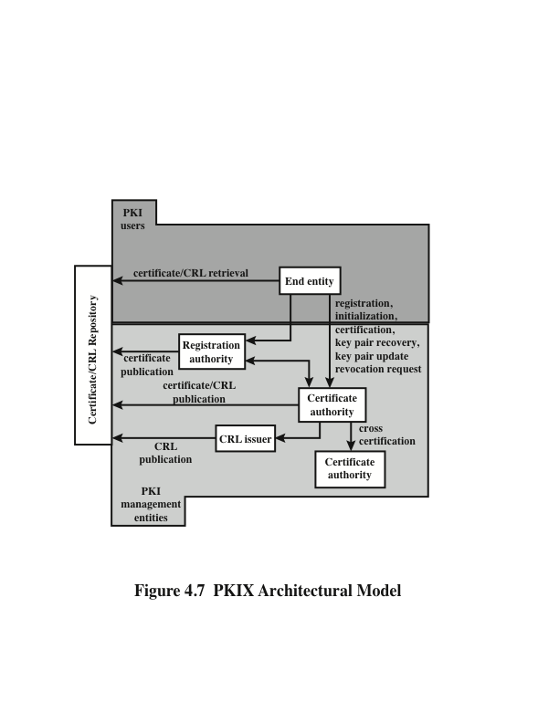
• End entity: A generic term used to denote end users, devices (e.g., servers,
routers), or any other entity that can be identified in the subject field of a public
key certificate. End entities typically consume and/or support PKI-related
services.
• Certification authority (CA): The issuer of certificates and (usually) certificate
revocation lists (CRLs). It may also support a variety of administrative functions,
although these are often delegated to one or more registration authorities.
• Registration authority (RA): An optional component that can assume a number
of administrative functions from the CA. The RA is often associated with the
end entity registration process, but can assist in a number of other areas as well.
• CRL issuer: An optional component that a CA can delegate to publish CRLs.
• Repository: A generic term used to denote any method for storing certificates
and CRLs so that they can be retrieved by end entities.
Notes:
RFC 4949 (Internet Security Glossary ) defines public-key infrastructure (PKI) as
the set of hardware, software, people, policies, and procedures needed to create,
manage, store, distribute, and revoke digital certificates based on asymmetric cryptography.
The principal objective for developing a PKI is to enable secure, convenient,
and efficient acquisition of public keys. The Internet Engineering Task Force
(IETF) Public Key Infrastructure X.509 (PKIX) working group has been the driving
force behind setting up a formal (and generic) model based on X.509 that is
suitable for deploying a certificate-based architecture on the Internet. This section
describes the PKIX model.
Figure 4.7 shows the interrelationship among the key elements of the PKIX
model. These elements are
• End entity: A generic term used to denote end users, devices (e.g., servers,
routers), or any other entity that can be identified in the subject field of a public
key certificate. End entities typically consume and/or support PKI-related
services.
• Certification authority (CA): The issuer of certificates and (usually) certificate
revocation lists (CRLs). It may also support a variety of administrative functions,
although these are often delegated to one or more registration authorities.
• Registration authority (RA): An optional component that can assume a number
of administrative functions from the CA. The RA is often associated with the
end entity registration process, but can assist in a number of other areas as well.
• CRL issuer: An optional component that a CA can delegate to publish CRLs.
• Repository: A generic term used to denote any method for storing certificates
and CRLs so that they can be retrieved by end entities.

Slide 8
PKIX Management functions
Functions that potentially need to be supported by management protocols:
Registration
Initialization
Certification
Key pair recovery
Key pair update
Revocation request
Cross certification
Alternative management protocols:
Certificate management protocols (CMP)
Designed to be a flexible protocol able to accommodate a variety of technical, operational, and business models
Certificate management messages over CMS (CMC)
Is built on earlier work and is intended to leverage existing implementations
Notes:
PKIX identifies a number of management functions that potentially need to be supported
by management protocols. These are indicated in Figure 4.7 and include the
following:
• Registration: This is the process whereby a user first makes itself known to
a CA (directly, or through an RA), prior to that CA issuing a certificate or
certificates for that user. Registration begins the process of enrolling in a PKI.
Registration usually involves some off-line or online procedure for mutual authentication.
Typically, the end entity is issued one or more shared secret keys
used for subsequent authentication.
• Initialization: Before a client system can operate securely, it is necessary to
install key materials that have the appropriate relationship with keys stored
elsewhere in the infrastructure. For example, the client needs to be securely
initialized with the public key and other assured information of the trusted
CA(s) to be used in validating certificate paths.
• Certification: This is the process in which a CA issues a certificate for a user’s
public key and returns that certificate to the user’s client system and/or posts
that certificate in a repository.
• Key pair recovery: Key pairs can be used to support digital signature creation
and verification, encryption and decryption, or both. When a key pair is used
for encryption/decryption, it is important to provide a mechanism to recover the
necessary decryption keys when normal access to the keying material is no longer
possible, otherwise it will not be possible to recover the encrypted data. Loss of
access to the decryption key can result from forgotten passwords/PINs, corrupted
disk drives, damage to hardware tokens, and so on. Key pair recovery allows end
entities to restore their encryption/decryption key pair from an authorized key
backup facility (typically, the CA that issued the end entity’s certificate).
• Key pair update: All key pairs need to be updated regularly (i.e., replaced
with a new key pair) and new certificates issued. Update is required when the
certificate lifetime expires and as a result of certificate revocation.
• Revocation request: An authorized person advises a CA of an abnormal situation
requiring certificate revocation. Reasons for revocation include private
key compromise, change in affiliation, and name change.
• Cross-certification: Two CAs exchange information used in establishing
a cross-certificate. A cross-certificate is a certificate issued by one CA to
another CA that contains a CA signature key used for issuing certificates.
The PKIX working group has defined two alternative management protocols
between PKIX entities that support the management functions listed in the preceding
subsection. RFC 2510 defines the certificate management protocols (CMP).
Within CMP, each of the management functions is explicitly identified by specific
protocol exchanges. CMP is designed to be a flexible protocol able to accommodate
a variety of technical, operational, and business models.
RFC 2797 defines certificate management messages over CMS (CMC), where
CMS refers to RFC 2630, cryptographic message syntax. CMC is built on earlier work
and is intended to leverage existing implementations. Although all of the PKIX functions
are supported, the functions do not all map into specific protocol exchanges.

Slide 9
Identity Management
A centralized, automated approach to provide enterprise wide access to resources by employees and other authorized individuals
Focus is defining an identity for each user (human or process), associating attributes with the identity, and enforcing a means by which a user can verify identity
Central concept is the use of single sign-on (SSO) which enables a user to access all network resources after a single authentication
Principal elements of an identity management system:
Authentication
Authorization
Accounting
Provisioning
Workflow automation
Delegated administration
Password synchronization
Self-service password reset
Federation
Notes:
Federated identity management is a relatively new concept dealing with the use of
a common identity management scheme across multiple enterprises and numerous
applications and supporting many thousands, even millions, of users. We begin our
overview with a discussion of the concept of identity management and then examine
federated identity management.
Identity management is a centralized, automated approach to provide enterprise wide
access to resources by employees and other authorized individuals. The focus
of identity management is defining an identity for each user (human or process),
associating attributes with the identity, and enforcing a means by which a user can
verify identity. The central concept of an identity management system is the use
of single sign-on (SSO). SSO enables a user to access all network resources after a
single authentication.
Typical services provided by a federated identity management system include
the following:
■ Point of contact: Includes authentication that a user corresponds to the user
name provided, and management of user/server sessions.
■ SSO protocol services: Provides a vendor-neutral security token service for
supporting a single sign on to federated services.
■ Trust services: Federation relationships require a trust relationship-based
federation between business partners. A trust relationship is represented by
the combination of the security tokens used to exchange information about a
user, the cryptographic information used to protect these security tokens, and
optionally the identity mapping rules applied to the information contained
within this token.
■ Key services: Management of keys and certificates.
■ Identity services: Services that provide the interface to local data stores, including
user registries and databases, for identity-related information management.
■ Authorization: Granting access to specific services and/or resources based on
the authentication.
■ Provisioning: Includes creating an account in each target system for the user,
enrollment or registration of user in accounts, establishment of access rights
or credentials to ensure the privacy and integrity of account data.
■ Management: Services related to runtime configuration and deployment.

Slide 10
Identity Management
Typical services provided by a federated identity management system include the following:
Point of contact: Includes authentication that a user corresponds to the user name provided, and management of user/server sessions.
SSO protocol services: Provides a vendor-neutral security token service for supporting a single sign on to federated services.
Trust services: Federation relationships require a trust relationship-based federation between business partners. A trust relationship is represented by the combination of the security tokens used to exchange information about a user, the cryptographic information used to protect these security tokens, and optionally the identity mapping rules applied to the information contained within this token.
Key services: Management of keys and certificates.
Identity services: Services that provide the interface to local data stores, including user registries and databases, for identity-related information management.
Authorization: Granting access to specific services and/or resources based on the authentication.
Provisioning: Includes creating an account in each target system for the user, enrollment or registration of user in accounts, establishment of access rights or credentials to ensure the privacy and integrity of account data.
Management: Services related to runtime configuration and deployment.

Slide 11
Identity Management
A centralized, automated approach to provide enterprise wide access to resources by employees and other authorized individuals
Focus is defining an identity for each user (human or process), associating attributes with the identity, and enforcing a means by which a user can verify identity
Central concept is the use of single sign-on (SSO) which enables a user to access all network resources after a single authentication
Principal elements of an identity management system:
Authentication
Authorization
Accounting
Provisioning
Workflow automation
Delegated administration
Password synchronization
Self-service password reset
Federation
Notes:
Federated identity management is a relatively new concept dealing with the use of
a common identity management scheme across multiple enterprises and numerous
applications and supporting many thousands, even millions, of users. We begin our
overview with a discussion of the concept of identity management and then examine
federated identity management.
Identity management is a centralized, automated approach to provide enterprise wide
access to resources by employees and other authorized individuals. The focus
of identity management is defining an identity for each user (human or process),
associating attributes with the identity, and enforcing a means by which a user can
verify identity. The central concept of an identity management system is the use
of single sign-on (SSO). SSO enables a user to access all network resources after a
single authentication.
Typical services provided by a federated identity management system include
the following:
■ Point of contact: Includes authentication that a user corresponds to the user
name provided, and management of user/server sessions.
■ SSO protocol services: Provides a vendor-neutral security token service for
supporting a single sign on to federated services.
■ Trust services: Federation relationships require a trust relationship-based
federation between business partners. A trust relationship is represented by
the combination of the security tokens used to exchange information about a
user, the cryptographic information used to protect these security tokens, and
optionally the identity mapping rules applied to the information contained
within this token.
■ Key services: Management of keys and certificates.
■ Identity services: Services that provide the interface to local data stores, including
user registries and databases, for identity-related information management.
■ Authorization: Granting access to specific services and/or resources based on
the authentication.
■ Provisioning: Includes creating an account in each target system for the user,
enrollment or registration of user in accounts, establishment of access rights
or credentials to ensure the privacy and integrity of account data.
■ Management: Services related to runtime configuration and deployment.

Slide 12
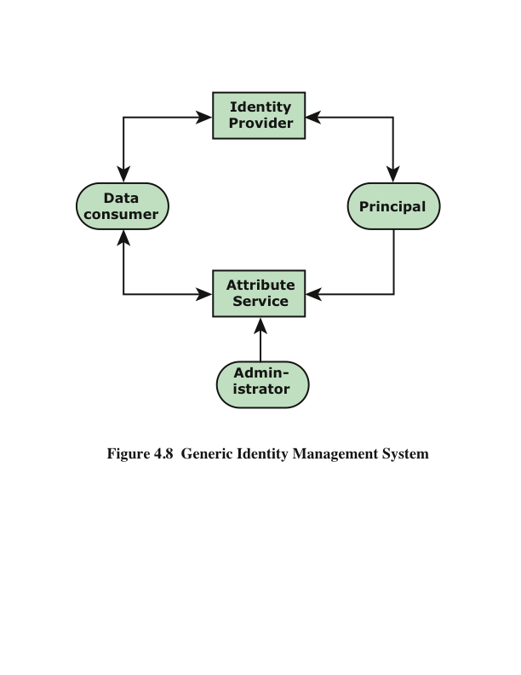
A principal is an identity holder. Typically, this is a human user that seeks access to resources and services on the network. User devices, agent processes, and server systems may also function as principals.
Principals authenticate themselves to an identity provider . The identity provider associates authentication information with a principal, as well as attributes and one or more identifiers.
Increasingly, digital identities incorporate attributes other than simply an identifier and authentication information (such as passwords and biometric information). An attribute service manages the creation and maintenance of such attributes. For example, a user needs to provide a shipping address each time an order is placed at a new Web merchant, and this information needs to be revised when the user moves. Identity management enables the user to provide this information once, so that it is maintained in a single place and released to data consumers in accordance with authorization and privacy policies. Users may create some of the attributes to be associated with their digital identity, such as address.
Administrators may also assign attributes to users, such as roles, access permissions, and employee information.
Data consumers are entities that obtain and employ data maintained and provided by identity and attribute providers, which are often used to support authorization decisions and to collect audit information. For example, a database server or file server is a data consumer that needs a client’s credentials so as to know what access to provide to that client.
Notes:
Figure 4.8 [LINN06] illustrates entities and data flows in a generic identity
management architecture. A principal is an identity holder. Typically, this is
a human user that seeks access to resources and services on the network. User
devices, agent processes, and server systems may also function as principals.
Principals authenticate themselves to an identity provider . The identity provider
associates authentication information with a principal, as well as attributes and one
or more identifiers.
Increasingly, digital identities incorporate attributes other than simply
an identifier and authentication information (such as passwords and biometric
information). An attribute service manages the creation and maintenance of such
attributes. For example, a user needs to provide a shipping address each time an
order is placed at a new Web merchant, and this information needs to be revised
when the user moves. Identity management enables the user to provide this information
once, so that it is maintained in a single place and released to data consumers
in accordance with authorization and privacy policies. Users may create
some of the attributes to be associated with their digital identity, such as address.
Administrators may also assign attributes to users, such as roles, access permissions,
and employee information.
Data consumers are entities that obtain and employ data maintained and provided
by identity and attribute providers, which are often used to support authorization
decisions and to collect audit information. For example, a database server or
file server is a data consumer that needs a client’s credentials so as to know what
access to provide to that client.

Slide 13
Identity federation
Identity federation is, in essence, an extension of identity management to multiple security domains
Federated identity management refers to the agreements, standards, and technologies that enable the portability of identities, identity attributes, and entitlements across multiple enterprises and numerous applications and supports many thousands, even millions, of users
Another key function of federated identity management is identity mapping
The federated identity management protocols map identities and attributes of a user in one domain to the requirements of another domain
Notes:
Identity federation is, in essence, an extension of identity management to multiple
security domains. Such domains include autonomous internal business units,
external business partners, and other third-party applications and services. The
goal is to provide the sharing of digital identities so that a user can be authenticated
a single time and then access applications and resources across multiple
domains. Because these domains are relatively autonomous or independent, no
centralized control is possible. Rather, the cooperating organizations must form a
federation based on agreed standards and mutual levels of trust to securely share
digital identities.
Federated identity management refers to the agreements, standards, and
technologies that enable the portability of identities, identity attributes, and entitlements
across multiple enterprises and numerous applications and supports many
thousands, even millions, of users. When multiple organizations implement interoperable
federated identity schemes, an employee in one organization can use a single
sign-on to access services across the federation with trust relationships associated
with the identity. For example, an employee may log onto her corporate intranet
and be authenticated to perform authorized functions and access authorized services
on that intranet. The employee could then access her health benefits from an
outside health-care provider without having to reauthenticate.
Beyond SSO, federated identity management provides other capabilities. One
is a standardized means of representing attributes. Increasingly, digital identities
incorporate attributes other than simply an identifier and authentication information
(such as passwords and biometric information). Examples of attributes include
account numbers, organizational roles, physical location, and file ownership. A user
may have multiple identifiers; for example, each identifier may be associated with a
unique role with its own access permissions.
Another key function of federated identity management is identity mapping.
Different security domains may represent identities and attributes differently.
Furthermore, the amount of information associated with an individual in one
domain may be more than is necessary in another domain. The federated identity
management protocols map identities and attributes of a user in one domain to the
requirements of another domain.

Slide 14
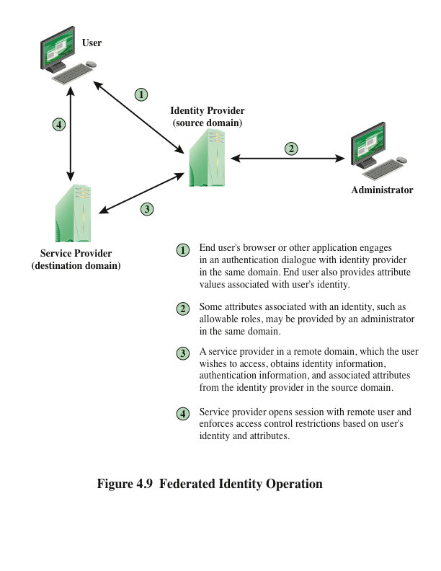
Notes:
Figure 4.9 illustrates entities and data flows in a generic federated identity
management architecture.
The identity provider acquires attribute information through dialogue and
protocol exchanges with users and administrators. For example, a user needs to
provide a shipping address each time an order is placed at a new Web merchant,
and this information needs to be revised when the user moves. Identity management
enables the user to provide this information once, so that it is maintained in a
single place and released to data consumers in accordance with authorization and
privacy policies.
Service providers are entities that obtain and employ data maintained and provided
by identity providers, often to support authorization decisions and to collect
audit information. For example, a database server or file server is a data consumer
that needs a client’s credentials so as to know what access to provide to that client.
A service provider can be in the same domain as the user and the identity provider.
The power of this approach is for federated identity management, in which the service
provider is in a different domain (e.g., a vendor or supplier network).

Slide 15
Standards Used by Federated Identity Management
The Extensible Markup Language (XML)
Appear similar to HTML documents that are visible as Web pages, but provide greater functionality
Includes strict definitions of the data type of each field
Provides encoding rules for commands that are used to transfer and update data objects
The Simple Object Access Protocol (SOAP)
Minimal set of conventions for invoking code using XML over HTTP
Enables applications to request services from one another with XML-based requests and receive responses as data formatted with XML
WS-Security
A set of SOAP extensions for implementing message integrity and confidentiality in Web services
Assigns security tokens to each message for use in authentication
Security Assertion Markup Language (SAML)
An XML-based language for the exchange of security information between online business partners
Conveys authentication information in the form of assertions about subjects
Notes:
Federated identity management uses a number of standards as the
building blocks for secure identity exchange across different domains or heterogeneous
systems. In essence, organizations issue some form of security tickets for their
users that can be processed by cooperating partners. Identity federation standards
are thus concerned with defining these tickets in terms of content and format, providing
protocols for exchanging tickets, and performing a number of management
tasks. These tasks include configuring systems to perform attribute transfers and
identity mapping, and performing logging and auditing functions. The key standards
are as follows:
• The Extensible Markup Language (XML): A markup language uses sets of
embedded tags or labels to characterize text elements within a document so as
to indicate their appearance, function, meaning, or context. XML documents
appear similar to HTML (Hypertext Markup Language) documents that are
visible as Web pages, but provide greater functionality. XML includes strict
definitions of the data type of each field, thus supporting database formats
and semantics. XML provides encoding rules for commands that are used to
transfer and update data objects.
• The Simple Object Access Protocol (SOAP): A minimal set of conventions
for invoking code using XML over HTTP. It enables applications to request
services from one another with XML-based requests and receive responses
as data formatted with XML. Thus, XML defines data objects and structures,
and SOAP provides a means of exchanging such data objects and performing
remote procedure calls related to these objects. See [ROS06] for an informative
discussion.
• WS-Security: A set of SOAP extensions for implementing message integrity
and confidentiality in Web services. To provide for secure exchange of SOAP
messages among applications, WS-Security assigns security tokens to each
message for use in authentication.
• Security Assertion Markup Language (SAML): An XML-based language for
the exchange of security information between online business partners. SAML
conveys authentication information in the form of assertions about subjects.
Assertions are statements about the subject issued by an authoritative entity.
The challenge with federated identity management is to integrate multiple
technologies, standards, and services to provide a secure, user-friendly utility. The
key, as in most areas of security and networking, is the reliance on a few mature
standards widely accepted by industry. Federated identity management seems to
have reached this level of maturity.

Slide 16
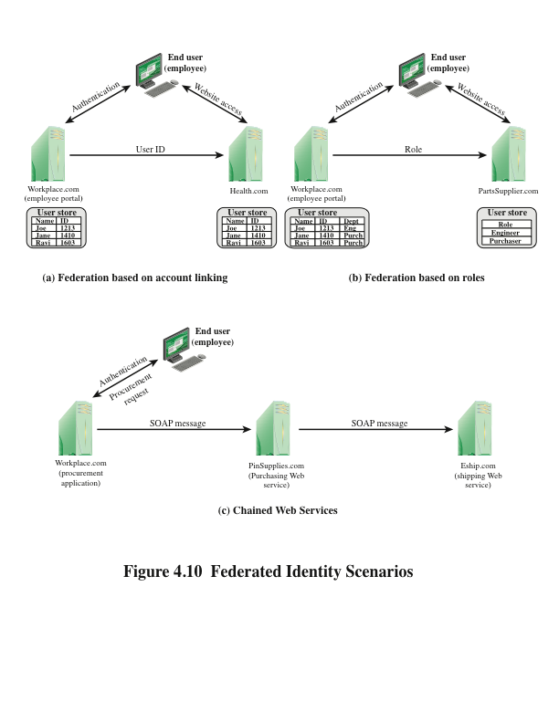
Notes:
To get some feel for the functionality of identity federation, we look
at three scenarios, taken from [COMP06]. In the first scenario (Figure 4.10a),
Workplace.com contracts with Health.com to provide employee health benefits.
An employee uses a Web interface to sign on to Workplace.com and goes through
an authentication procedure there. This enables the employee to access authorized
services and resources at Workplace.com. When the employee clicks on a
link to access health benefits, her browser is redirected to Health.com. At the same
time, the Workplace.com software passes the user’s identifier to Health.com in a
secure manner. The two organizations are part of a federation that cooperatively
exchanges user identifiers. Health.com maintains user identities for every employee
at Workplace.com and associates with each identity health-benefits information
and access rights. In this example, the linkage between the two companies is based
on account information and user participation is browser based.
Figure 4.10b shows a second type of browser-based scheme. PartsSupplier.
com is a regular supplier of parts to Workplace.com. In this case, a role-based
access control (RBAC) scheme is used for access to information. An engineer of
Workplace.com authenticates at the employee portal at Workplace.com and clicks
on a link to access information at PartsSupplier.com. Because the user is authenticated
in the role of an engineer, he is taken to the technical documentation and
troubleshooting portion of PartSupplier.com’s Web site without having to sign
on. Similarly, an employee in a purchasing role signs on at Workplace.com and is
authorized, in that role, to place purchases at PartSupplier.com without having to
authenticate to PartSupplier.com. For this scenario, PartSupplier.com does not
have identity information for individual employees at Workplace.com. Rather, the
linkage between the two federated partners is in terms of roles.
The scenario illustrated in Figure 4.10c can be referred to as document based
rather than browser based. In this third example, Workplace.com has a purchasing
agreement with PinSupplies.com, and PinSupplies.com has a business relationship
with E-Ship.com. An employee of Workplace.com signs on and is authenticated to
make purchases. The employee goes to a procurement application that provides a
list of Workplace.com’s suppliers and the parts that can be ordered. The user clicks
on the PinSupplies button and is presented with a purchase order Web page (HTML
page). The employee fills out the form and clicks the submit button. The procurement
application generates an XML/SOAP document that it inserts into the envelope
body of an XML-based message. The procurement application then inserts the
user’s credentials in the envelope header of the message, together with Workplace.
com’s organizational identity. The procurement application posts the message to the
PinSupplies.com’s purchasing Web service. This service authenticates the incoming
message and processes the request. The purchasing Web service then sends a SOAP
message its shipping partner to fulfill the order. The message includes a PinSupplies.
com security token in the envelope header and the list of items to be shipped as well
as the end user’s shipping information in the envelope body. The shipping Web
service authenticates the request and processes the shipment order.

Slide 17
Further Reading
Chapter 4 of the textbook: Network Security Essentials-Application & Standards” by William Stallings 6th Edition, PrenticeHall, 2017
Section 4.6 (Public Key Infrastructure) of the same textbook

