Slide 1
WQD7010 Network & Security
Dr. Saaidal Razalli Bin Azzuhri
Dept. of Comp. System & Technology
Fac. of Science Comp & IT

Slide 2
Chapter 4
Key Distribution and User Authentication
Notes:
This chapter covers two important related concepts. First is the complex topic of cryptographic
key distribution, involving cryptographic, protocol, and management considerations.
This chapter gives the reader a feel for the issues involved and provides a
broad survey of the various aspects of key management and distribution.
This chapter also examines some of the authentication functions that have been
developed to support network-based user authentication. The chapter includes a detail
discussion of one of the earliest and also one of the most widely used key distribution
and user authentication services: Kerberos. Next, the chapter looks at key distribution
schemes that rely on asymmetric encryption. This is followed by a discussion of X.509
certificates and public-key infrastructure. Finally, the concept of federated identity
management is introduced.

Slide 3
Remote user authentication principles
In most computer security contexts, user authentication is the fundamental building block and the primary line of defense
User authentication is the basis for most types of access control and for user accountability
RFC 4949 (Internet Security Glossary) defines user authentication as the process of verifying an identity claimed by or for a system entity
Identification step
Presenting an identifier to the security system
Verification step
Presenting or generating authentication information that corroborates the binding between the entity and the identifier
Notes:
In most computer security contexts, user authentication is the fundamental building
block and the primary line of defense. User authentication is the basis for most
types of access control and for user accountability. RFC 4949 (Internet Security
Glossary) defines user authentication as the process of verifying an identity claimed
by or for a system entity. This process consists of two steps:
■ Identification step: Presenting an identifier to the security system. (Identifiers
should be assigned carefully, because authenticated identities are the basis for
other security services, such as access control service.)
■ Verification step: Presenting or generating authentication information that
corroborates the binding between the entity and the identifier.
In essence, identification is the means by which a user provides a claimed identity
to the system; user authentication is the means of establishing the validity of
the claim. Note that user authentication is distinct from message authentication. As
defined in Chapter 3, message authentication is a procedure that allows communicating
parties to verify that the contents of a received message have not been altered and
that the source is authentic. This chapter is concerned solely with user authentication.

Slide 4
NIST Model for Electronic User Authentication
NIST SP 800-63-2 (Electronic Authentication Guideline, August 2013 defines electronic user authentication as the process of establishing confidence in user identities that are presented electronically to an information system
Systems can use the authenticated identity to determine if the authenticated individual is authorized to perform particular functions
In many cases, the authentication and transaction or other authorized function take place across an open network such as the Internet
Equally, authentication and subsequent authorization can take place locally, such as across a local area network
Notes:
NIST SP 800-63-2 (Electronic Authentication Guideline , August 2013) defines electronic
user authentication as the process of establishing confidence in user identities
that are presented electronically to an information system. Systems can use the authenticated
identity to determine if the authenticated individual is authorized to perform
particular functions, such as database transactions or access to system resources. In
many cases, the authentication and transaction or other authorized function take
place across an open network such as the Internet. Equally, authentication and subsequent
authorization can take place locally, such as across a local area network.

Slide 5
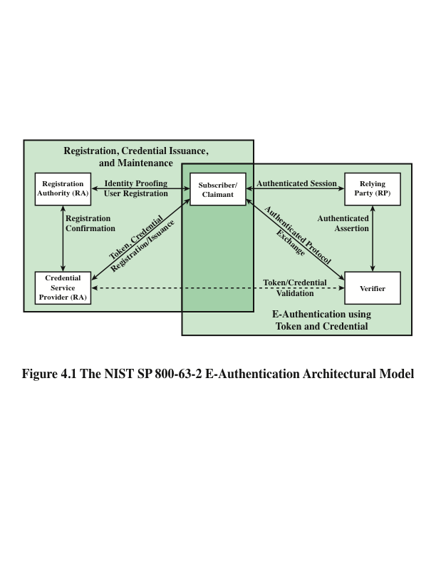
CSP
Notes:
SP 800-63-2 defines a general model for user authentication that involves
a number of entities and procedures. We discuss this model with reference to
Figure 4.1.
The initial requirement for performing user authentication is that the user must
be registered with the system. The following is a typical sequence for registration. An
applicant applies to a registration authority (RA) to become a subscriber of a credential
service provider (CSP). In this model, the RA is a trusted entity that establishes
and vouches for the identity of an applicant to a CSP. The CSP then engages
in an exchange with the subscriber. Depending on the details of the overall authentication
system, the CSP issues some sort of electronic credential to the subscriber.
The credential is a data structure that authoritatively binds an identity and additional
attributes to a token possessed by a subscriber, and can be verified when presented
to the verifier in an authentication transaction. The token could be an encryption
key or an encrypted password that identifies the subscriber. The token may be issued
by the CSP, generated directly by the subscriber, or provided by a third party. The
token and credential may be used in subsequent authentication events.
Once a user is registered as a subscriber, the actual authentication process can
take place between the subscriber and one or more systems that perform authentication
and, subsequently, authorization. The party to be authenticated is called a
claimant and the party verifying that identity is called a verifier. When a claimant
successfully demonstrates possession and control of a token to a verifier through an
authentication protocol, the verifier can verify that the claimant is the subscriber
named in the corresponding credential. The verifier passes on an assertion about the
identity of the subscriber to the relying party (RP). That assertion includes identity
information about a subscriber, such as the subscriber name, an identifier assigned
at registration, or other subscriber attributes that were verified in the registration
process. The RP can use the authenticated information provided by the verifier to
make access control or authorization decisions.
An implemented system for authentication will differ from or be more complex
than this simplified model, but the model illustrates the key roles and functions
needed for a secure authentication system.

Slide 6
Means of authentication
There are four general means of authenticating a user’s identity, which can be used alone or in combination
Something the individual knows
Examples include a password, a personal identification number (PIN), or answers to a prearranged set of questions
Something the individual possesses
Examples include cryptographic keys, electronic keycards, smart cards, and physical keys
This type of authenticator is referred to as a token
Something the individual is (static biometrics)
Examples include recognition by fingerprint, retina, and face
Something the individual does (dynamic biometrics)
Examples include recognition by voice pattern, handwriting characteristics, and typing rhythm
Notes:
There are four general means of authenticating a user’s identity, which can be used
alone or in combination:
■ Something the individual knows: Examples include a password, a personal
identification number (PIN), or answers to a prearranged set of questions.
■ Something the individual possesses: Examples include cryptographic keys,
electronic keycards, smart cards, and physical keys. This type of authenticator
is referred to as a token .
■ Something the individual is (static biometrics): Examples include recognition
by fingerprint, retina, and face.
■ Something the individual does (dynamic biometrics): Examples include
recognition by voice pattern, handwriting characteristics, and typing rhythm.
All of these methods, properly implemented and used, can provide secure
user authentication. However, each method has problems. An adversary may be
able to guess or steal a password. Similarly, an adversary may be able to forge or
steal a token. A user may forget a password or lose a token. Furthermore, there
is a significant administrative overhead for managing password and token information
on systems and securing such information on systems. With respect to biometric
authenticators, there are a variety of problems, including dealing with false
positives and false negatives, user acceptance, cost, and convenience. For network-based
user authentication, the most important methods involve cryptographic keys
and something the individual knows, such as a password.

Slide 7
Symmetric Key Distribution using symmetric encryption
For symmetric encryption to work, the two parties to an exchange must share the same key, and that key must be protected from access by others
Frequent key changes are usually desirable to limit the amount of data compromised if an attacker learns the key
Key distribution technique
The means of delivering a key to two parties that wish to exchange data, without allowing others to see the key
Notes:
For symmetric encryption to work, the two parties to an exchange must share
the same key, and that key must be protected from access by others. Furthermore,
frequent key changes are usually desirable to limit the amount of data compromised
if an attacker learns the key. Therefore, the strength of any cryptographic
system rests with the “key distribution technique,” a term that refers to the means of
delivering a key to two parties that wish to exchange data, without allowing others
to see the key.

Slide 8
Key Distribution
For two parties A and B, there are the following options:
1
2
3
4
A key can be selected by A and physically delivered to B
A third party can select the key and physically deliver it to A and B
If A and B have previously and recently used a key, one party could transmit the new key to the other, using the old key to encrypt the new key
If A and B each have an encrypted connection to a third party C, C could deliver a key on the encrypted links to A and B
Notes:
Key distribution can be achieved in a number of ways. For two
parties A and B, there are the following options:
1. A key could be selected by A and physically delivered to B.
2. A third party could select the key and physically deliver it to A and B.
3. If A and B have previously and recently used a key, one party could transmit
the new key to the other, using the old key to encrypt the new key.
4. If A and B each have an encrypted connection to a third party C, C could
deliver a key on the encrypted links to A and B.
Options 1 and 2 call for manual delivery of a key. For link encryption, this is
a reasonable requirement, because each link encryption device is only going to be
exchanging data with its partner on the other end of the link. However, for end-to-end
encryption over a network, manual delivery is awkward. In a distributed system,
any given host or terminal may need to engage in exchanges with many other
hosts and terminals over time. Thus, each device needs a number of keys supplied
dynamically. The problem is especially difficult in a wide-area distributed system.
Option 3 is a possibility for either link encryption or end-to-end encryption,
but if an attacker ever succeeds in gaining access to one key, then all subsequent
keys are revealed. Even if frequent changes are made to the link encryption keys,
these should be done manually. To provide keys for end-to-end encryption, option
4 is preferable.
For option 4 , two kinds of keys are used:
• Session key: When two end systems (hosts,
terminals, etc.) wish to communicate,
they establish a logical connection (e.g., virtual circuit). For the duration
of that logical connection, called a session, all user data are encrypted with
a one-time session key. At the conclusion of the session the session key is
destroyed.
• Permanent key: A permanent key is a key used between entities for the purpose
of distributing session keys.
A necessary element of option 4 is a key distribution center (KDC) . The KDC
determines which systems are allowed to communicate with each other. When permission
is granted for two systems to establish a connection, the key distribution
center provides a one-time session key for that connection.
In general terms, the operation of a KDC proceeds as follows:
1. When host A wishes to set up a connection to host B, it transmits a connection request
packet to the KDC. The communication between A and the KDC is
encrypted using a master key shared only by A and the KDC.
2. If the KDC approves the connection request, it generates a unique one-time
session key. It encrypts the session key using the permanent key it shares with
A and delivers the encrypted session key to A. Similarly, it encrypts the session
key using the permanent key it shares with B and delivers the encrypted session
key to B.
3. A and B can now set up a logical connection and exchange messages and data,
all encrypted using the temporary session key.
The automated key distribution approach provides the flexibility and dynamic
characteristics needed to allow a number of users to access a number of servers and
for the servers to exchange data with each other. The most widely used application
that implements this approach is Kerberos, described in the next section.

Slide 9
Access Control
In today's organizations, we mostly have open distributed architecture consisting of
– workstations (clients)
– distributed/centralized servers.
Enforcement of access restriction to the services on servers is crucial for security
Three threats exist:
– User pretends to be another user
– User alters the network address of a workstation
– User eavesdrops on exchanges and uses a replay attack
A workstation cannot be trusted for access control purpose

Slide 10
Access Control
Three approaches to security can be considered:
1. rely on client workstations to assure user(s) identity and rely on server to enforce a security policy based on user id
2. require that client systems authenticate themselves to servers, but trust the client systems to assure user(s) identity
3. require the user to prove identity for each service on the server and also the server to prove its identity to clients
The first or second strategy may be suitable for a small closed environment
– inadequate for larger open environment
The third approach is needed
– supported by Kerberos authentication protocol

Slide 11
Kerberos
In Greek mythology, a many headed dog, the guardian of the entrance of Hades, the god of the underworld

Slide 12
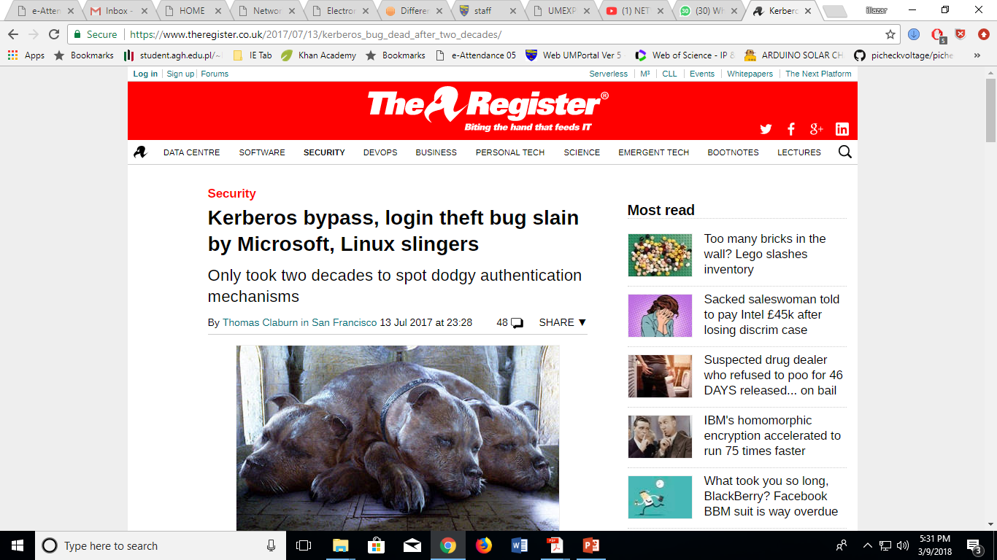

Slide 13
Kerberos
Provides a centralized authentication server to authenticate users to servers and servers to users
> allows users access to services distributed through network
> without needing to trust all workstations
> rather all trust a central authentication server
Relies on conventional/Symmetric encryption
– makes no use of public-key/Asymmetric encryption
Two versions: version 4 and 5
Version 4 makes use of DES

Slide 14
Kerberos: Requirements
The first published report identified its requirements as:
– Security - Eavesdropping and spoofing must be non possible for an outsider
– Availability - If Kerberos is unavailable all the services become unavailable
– Transparency - The authentication process must be transparent but not password typing
– Scalability - capable of supporting large number of clients and servers

Slide 15
Kerberos: Overview
It’s a basic third-party authentication scheme
• Employs an Authentication Server (AS)
– users initially negotiate with AS to identify self
– AS provides a non-corruptible authentication credential (ticket granting ticket TGT)
Employs a Ticket Granting server (TGS)
– users subsequently request access to other services
from TGS on basis of users TGT
Before going into details, we consider a simple authentication dialogues

Slide 16
Why Authentication Server
When a request is made by a client for a network service, the server must be able to confirm the identity of the clients
This places a substantial burden on the server where each client/server interaction requires authentication
An alternative is to use an Authentication Server (AS)
AS stores the password of all users in a centralized database and shares a unique key with each server

Slide 17
A simple Authentication Dialogue (1)
C = Client
AS = authentication server
V = server
IDc = identifier of user on C
IDv = identifier of V
Pc = password of user on C
ADc = network address of C
Kv = secret encryption key shared by AS and V
TS = timestamp
|| = concatenation
Consider the
following
notations:

Slide 18
A simple Authentication Dialogue (2)
C sends a message to AS
AS checks the database for user ID and password match, and whether the user has access permission to (Server) V.
– If passed, it takes the user as authentic
– AS creates a ticket.
> The ticket contains user ID, server ID and network address, all encrypted by a secret key shared by AS and V.
C sends a message to V with C's ID and the ticket.
V decrypts the ticket
– verifies whether the user ID in the ticket is the same as the unencrypted user ID
- If those matches, the server grants requested service

Slide 19
A simple Authentication Dialogue (3)
There are a few problems with this scheme:
– the user needs to enter password every time a service is accessed
> each attempt for the same service requires re-entering the password
– a new ticket for every different service
– password is transmitted in plaintext format
> easy for an eavesdropper to capture the password
C AS: IDc || Pc || IDv

Slide 20
A more secure Authentication Dialogue (1)
An improved scheme:
– avoiding plaintext password
– Employ another server, called ticket granting server (TGS)
>TGS satisfies two requirements
– only one password query per session
– protection of the user’s password

Slide 21
A more secure Authentication Dialogue (2)
The client requests a ticket-granting ticket from AS
- AS sends a ticket encrypted with a key Kc derived from the user's password, no password is transmitted.
- ticket is reusable - timestamp is include to counter ticker spoofing
The client C requests a service using granting ticket (TGS), decrypts the ticket using secret shared key K_{v}, checks lifetime, used id, network address
Client requests access to service V using service granting ticket

Slide 22
A more secure Authentication Dialogue (3)
Problem still remains:
– Lifetime1 & 2 associated with the ticket- granting ticket
– If too short repeatedly asked for password
– If too long greater opportunity to replay
The threat is that an opponent will steal the ticket and use it before it expires
Kerberos authentication dialogue addresses these problems

Slide 23
Kerberos v4 Overview
A basic third-party authentication scheme
Have an Authentication Server (AS)
– users initially negotiate with AS to identify self
– AS provides a non-corruptible authentication credential
(ticket granting ticket TGT)
Have a Ticket Granting server (TGS)
– users subsequently request access to other services
from TGS on basis of users TGT
• using a complex protocol of DES

Slide 24
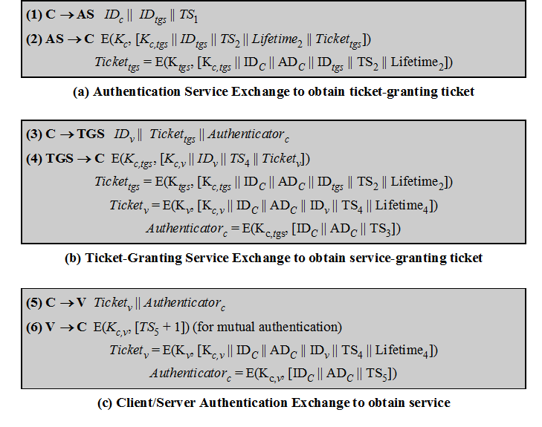
Kerberos V.4
Authentication
dialogue

Slide 25
Kerberos V.4 (1)
A session key K_{c,tgs} is introduced
The ticket contains the session key
The authenticator proves client’s identity
– can be used only once
– has a short lifetime
– threat of stealing both the ticket and authenticator for later presentation is removed
The authenticator is encrypted by the session key

Slide 26
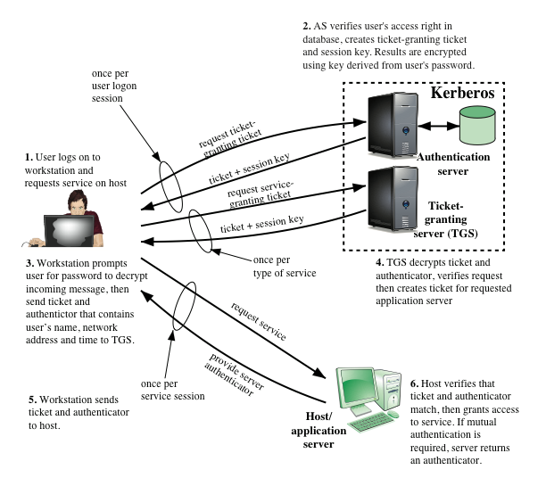
Overview of Kerberos
Notes:
Figure 4.2 provides simplified overview.

Slide 27
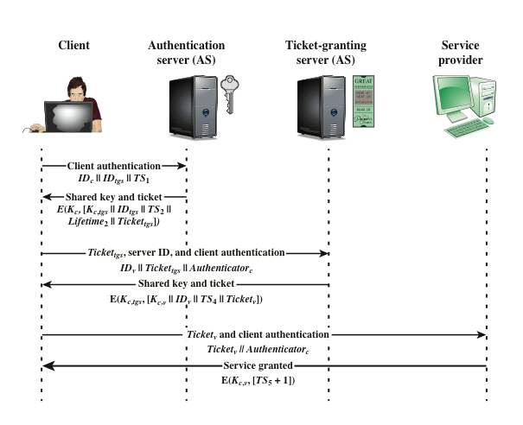
Kerberos Exchange
Notes:
Figure 4.2 illustrates the Kerberos exchanges among the parties.

Slide 28
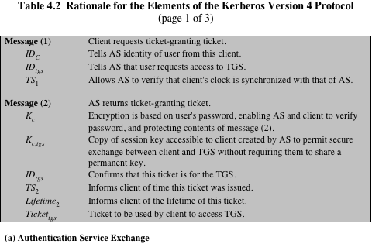
Notes:
Table 4.2 summarizes the justification for each of the elements in the Kerberos protocol.

Slide 29
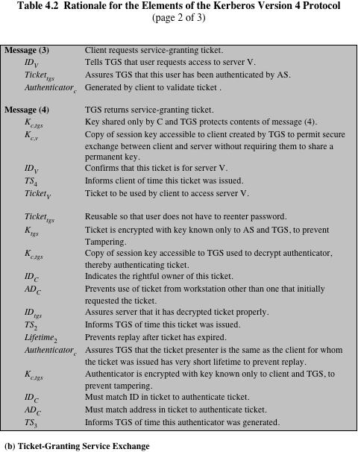
Notes:
Continuation of Table 4.2

Slide 30
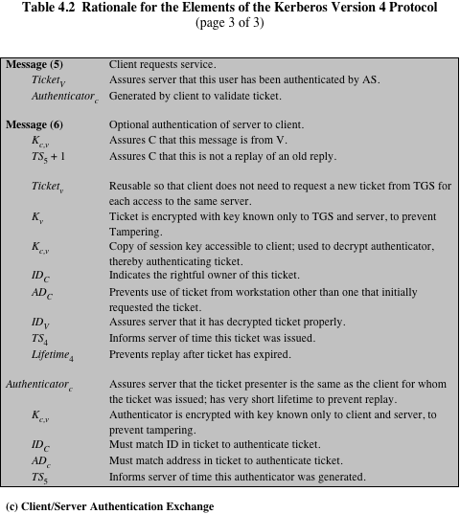
Notes:
Continuation of Table 4.2

Slide 31
Kerberos V.4 (3)
Currently two Kerberos versions:
– V4 and v5 version
– Kerberos v5 is an Internet standard
– specified in RFC1510, and used by many utilities
To use Kerberos:
– need to have a Key Distribution Centre (KDC) on your network
– need to have Kerberised applications running on all participating
systems
– major problem - US export restrictions (at one time)
– Kerberos cannot be directly distributed outside the US in source
format (& binary versions must obscure crypto routine entry points and have no encryption) – MIT makes it freely available
– else crypto libraries must be re-implemented locally

Slide 32
Differences between versions 4 and 5
Environmental shortcomings
Technical deficiencies
Encryption system dependence
Internet protocol dependence
Message byte ordering
Ticket lifetime
Authentication forwarding
Interrealm authentication
Double encryption
PCBC encryption
Session keys
Password attacks
Notes:
Version 5 is intended to address the
limitations of version 4 in two areas: environmental shortcomings and technical
deficiencies. We briefly summarize the improvements in each area. Kerberos version
4 did not fully address the need to be of general purpose. This led to the following
environmental shortcomings
Encryption system dependence
Internet protocol dependence
Message byte ordering
Ticket lifetime
Authentication forwarding
Interrealm authentication
Apart from these environmental limitations, there are technical deficiencies
in the version 4 protocol itself. Most of these deficiencies were documented in
[BELL90], and version 5 attempts to address these. The deficiencies are the
Following:
Double encryption
PCBC encryption
Session keys
Password attacks

Slide 33
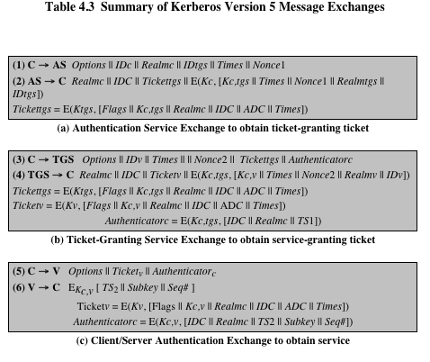
Notes:
Table 4.3 summarizes the basic version
5 dialogue. This is best explained by comparison with version 4 (Table 4.1).
First, consider the authentication service exchange . Message (1) is a client
request for a ticket-granting ticket. As before, it includes the ID of the user and the
TGS. The following new elements are added:
■ Realm: Indicates realm of user.
■ Options: Used to request that certain flags be set in the returned ticket.
■ Times: Used by the client to request the following time settings in the ticket:
from: the desired start time for the requested ticket
till: the requested expiration time for the requested ticket
rtime: requested renew-till time
■ Nonce: A random value to be repeated in message (2) to assure that the
response is fresh and has not been replayed by an opponent.
Message (2) returns a ticket-granting ticket, identifying information for the
client, and a block encrypted using the encryption key based on the user’s password.
This block includes the session key to be used between the client and the TGS, times
specified in message (1), the nonce from message (1), and TGS identifying information.
The ticket itself includes the session key, identifying information for the client,
the requested time values, and flags that reflect the status of this ticket and the
requested options. These flags introduce significant new functionality to version 5.
For now, we defer a discussion of these flags and concentrate on the overall structure
of the version 5 protocol.
Let us now compare the ticket-granting service exchange for versions 4 and 5.
We see that message (3) for both versions includes an authenticator, a ticket, and
the name of the requested service. In addition, version 5 includes requested times
and options for the ticket and a nonce—all with functions similar to those of message
(1). The authenticator itself is essentially the same as the one used in version 4.
Message (4) has the same structure as message (2). It returns a ticket plus
information needed by the client, with the information encrypted using the session
key now shared by the client and the TGS.
Finally, for the client/server authentication exchange , several new features
appear in version 5. In message (5), the client may request as an option that mutual
authentication is required.
If mutual authentication is required, the server responds with message (6).
This message includes the timestamp from the authenticator. Note that in version 4,
the timestamp was incremented by one. This is not necessary in version 5, because
the nature of the format of messages is such that it is not possible for an opponent
to create message (6) without knowledge of the appropriate encryption keys. The
subkey field, if present, overrides the subkey field, if present, in message (5). The
optional sequence number field specifies the starting sequence number to be used
by the client.

Slide 34
Kerberos V.5
The following new elements are added:
Realm: Indicates the realm of the user
Options: Used to request that certain flags be set in the returned ticket
Times: Used by the client to request the following time settings in the ticket
from: the desired start time
till: the requested expiration time for the requested ticket
rtime: requested renew-till time
Nonce: A random value to be repeated in message (2) to assure that the response is fresh and has not been replaced by an opponent

Slide 35
Key distribution using asymmetric encryption
One of the major roles of public-key encryption is to address the problem of key distribution
There are two distinct aspects to the use of public-key encryption in this regard:
The distribution of public keys
The use of public-key encryption to distribute secret keys
Public-key certificate
Consists of a public key plus a user ID of the key owner, with the whole block signed by a trusted third party
Typically, the third party is a certificate authority (CA) that is trusted by the user community, such as a government agency or a financial institution
A user can present his or her public key to the authority in a secure manner and obtain a certificate
The user can then publish the certificate
Anyone needing this user’s public key can obtain the certificate and verify that it is valid by way of the attached trusted signature
Notes:
One of the major roles of public-key encryption is to address the problem of key
distribution. There are actually two distinct aspects to the use of public-key encryption
in this regard.
• The distribution of public keys.
• The use of public-key encryption to distribute secret keys.
On the face of it, the point of public-key encryption is that the public key is public.
Thus, if there is some broadly accepted public-key algorithm, such as RSA, any
participant can send his or her public key to any other participant or broadcast the
key to the community at large. Although this approach is convenient, it has a major
weakness. Anyone can forge such a public announcement. That is, some user could
pretend to be user A and send a public key to another participant or broadcast such
a public key. Until such time as user A discovers the forgery and alerts other participants,
the forger is able to read all encrypted messages intended for A and can use
the forged keys for authentication.
The solution to this problem is the public-key certificate . In essence, a certificate
consists of a public key plus a user ID of the key owner, with the whole block
signed by a trusted third party. Typically, the third party is a certificate authority
(CA) that is trusted by the user community, such as a government agency or a financial
institution. A user can present his or her public key to the authority in a secure
manner and obtain a certificate. The user can then publish the certificate. Anyone
needing this user’s public key can obtain the certificate and verify that it is valid by
way of the attached trusted signature. Figure 4.3 illustrates the process.
One scheme has become universally accepted for formatting public-key certificates:
the X.509 standard. X.509 certificates are used in most network security
applications, including IP security, secure sockets layer (SSL), and S/MIME—all of
which are discussed in subsequent chapters. X.509 is examined in detail in the next
section.

Slide 36
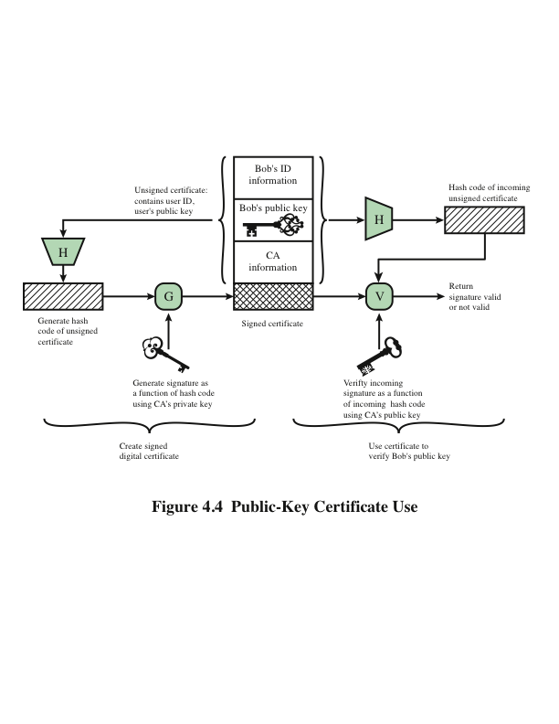
Notes:
Figure 4.4 illustrates the generation of a public-key certificate.

Slide 37
X.509 Certificates
ITU-T recommendation X.509 is part of the X.500 series of recommendations that define a directory service
Defines a framework for the provision of authentication services by the X.500 directory to its users
The directory may serve as a repository of public-key certificates
Defines alternative authentication protocols based on the use of public-key certificates
Was initially issued in 1988
Based on the use of public-key cryptography and digital signatures
The standard does not dictate the use of a specific algorithm but recommends RSA
Notes:
ITU-T recommendation X.509 is part of the X.500 series of recommendations that
define a directory service. The directory is, in effect, a server or distributed set
of servers that maintains a database of information about users. The information
includes a mapping from user name to network address, as well as other attributes
and information about the users.
X.509 defines a framework for the provision of authentication services by the
X.500 directory to its users. The directory may serve as a repository of public-key
certificates. Each certificate contains the public key of a user and is signed with the
private key of a trusted certification authority. In addition, X.509 defines alternative
authentication protocols based on the use of public-key certificates.
X.509 is an important standard because the certificate structure and authentication
protocols defined in X.509 are used in a variety of contexts. For example, the
X.509 certificate format is used in S/MIME (Chapter 8), IP Security (Chapter 9),
and SSL/TLS (Chapter 6).
X.509 was initially issued in 1988. The standard was subsequently revised
in 1993 to address some of the security concerns documented in [IANS90] and
[MITC90]. The standard is currently at version 7, issued in 2012.

Slide 38
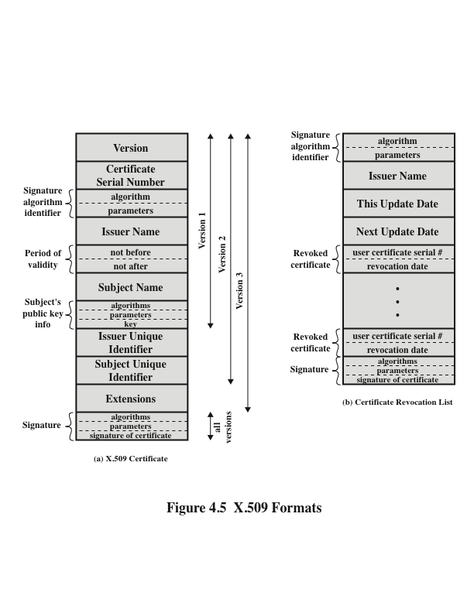
Notes:
X.509 is based on the use of public-key cryptography and digital signatures.
The standard does not dictate the use of a specific digital signature algorithm nor a
specific hash function. Figure 4.5 illustrates the overall X.509 scheme for generation
of a public-key certificate. The certificate for Bob’s public key includes unique identifying
information for Bob, Bob’s public key, and identifying information about
the CA, plus other information as explained subsequently. This information is then
signed by computing a hash value of the information and generating a digital signature
using the hash value and the CA’s private key.
Figure 4.5a shows the general format of a certificate, which includes the following
Elements.
■ Version: Differentiates among successive versions of the certificate format;
the default is version 1. If the Issuer Unique Identifier or Subject Unique
Identifier are present, the value must be version 2. If one or more extensions
are present, the version must be version 3. Although the X.509 specification is
currently at version 7, no changes have been made to the fields that make up
the certificate since version 3.
■ Serial number: An integer value, unique within the issuing CA, that is unambiguously
associated with this certificate.
■ Signature algorithm identifier: The algorithm used to sign the certificate,
together with any associated parameters. Because this information is repeated
in the Signature field at the end of the certificate, this field has little, if any,
utility.
■ Issuer name: X.500 name of the CA that created and signed this certificate.
■ Period of validity: Consists of two dates: the first and last on which the certificate
is valid.
■ Subject name: The name of the user to whom this certificate refers. That is,
this certificate certifies the public key of the subject who holds the corresponding
private key.
■ Subject’s public-key information: The public key of the subject, plus an identifier
of the algorithm for which this key is to be used, together with any
associated parameters.
■ Issuer unique identifier: An optional bit string field used to identify uniquely
the issuing CA in the event the X.500 name has been reused for different
entities.
■ Subject unique identifier: An optional bit string field used to identify uniquely
the subject in the event the X.500 name has been reused for different entities.
■ Extensions: A set of one or more extension fields. Extensions were added in
version 3 and are discussed later in this section.
■ Signature: Covers all of the other fields of the certificate. One component of
this field is the digital signature applied to the other fields of the certificate.
This field includes the signature algorithm identifier.

Slide 39
Obtaining a user’s certificate
Any user with access to CA can get any certificate from it
Only the issuing CA can modify a certificate
– any modification is detected
Because certificates cannot be forged, they can be placed in a public directory

Slide 40
CA Hierarchy (1)
If both users share a common CA then it is assumed they know its public key
Otherwise CA's must form a hierarchy
Use certificates linking members of hierarchy to validate other CA's
– each CA has certificates for clients (forward) and parent (backward)
Each client trusts parents certificates
Enables verification of any certificate from one CA by users of all other CAs in hierarchy

Slide 41
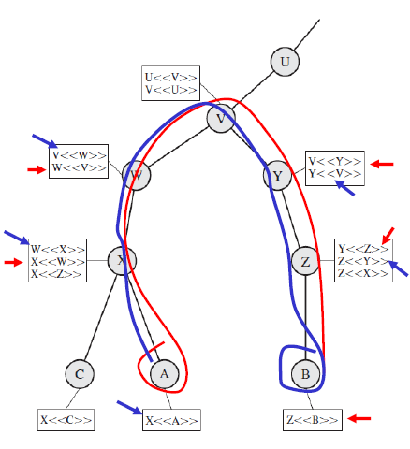
CA Hierarchy (2)
Figure shows X.509 hierarchy to mutually verify clients certificates
X <<C>> the certificate of user C issued by certification authority X
The connected circles indicate the hierarchical relationship among the CAs; the associated boxes indicate certificates maintained in the directory for each CA entry
A acquires B certificate using chain:
X<<W>>W<<V>>V<<Y>>Y<<Z>>Z<<B>>
B acquires A certificate using chain:
Z<<Y>>Y<<V>>V<<W>>W<<X>>X<<A>>

Slide 42
Revocation of certificates
Each certificate includes a period of validity
Typically a new certificate is issued just before the expiration of the old one
It may be desirable on occasion to revoke a certificate before it expires for one of the following reasons:
The user’s private key is assumed to be compromised
The user is no longer certified by this CA; reasons for this include subject’s name has changed, the certificate is superseded, or the certificate was not issued in conformance with the CA’s policies
The CA’s certificate is assumed to be compromised
Notes:
Recall from Figure 4.5 that each certificate includes
a period of validity, much like a credit card. Typically, a new certificate is issued just
before the expiration of the old one. In addition, it may be desirable on occasion to
revoke a certificate before it expires for one of the following reasons.
1. The user’s private key is assumed to be compromised.
2. The user is no longer certified by this CA. Reasons for this include subject’s
name has changed, the certificate is superseded, or the certificate was not
issued in conformance with the CA’s policies.
3. The CA’s certificate is assumed to be compromised.
Each CA must maintain a list consisting of all revoked but not expired certificates
issued by that CA, including both those issued to users and to other CAs.
These lists also should be posted on the directory.
Each certificate revocation list (CRL) posted to the directory is signed by the
issuer and includes (Figure 4.5b) the issuer’s name, the date the list was created, the
date the next CRL is scheduled to be issued, and an entry for each revoked certificate.
Each entry consists of the serial number of a certificate and revocation date for
that certificate. Because serial numbers are unique within a CA, the serial number
is sufficient to identify the certificate.
When a user receives a certificate in a message, the user must determine
whether the certificate has been revoked. The user could check the directory each
time a certificate is received. To avoid the delays (and possible costs) associated
with directory searches, it is likely that the user would maintain a local cache of certificates
and lists of revoked certificates.

Slide 43
X.509 Version 3
Includes a number of optional extensions that may be added to the version 2 format
Each extension consists of:
An extension identifier
A criticality indicator
An extension value
The certificate extensions fall into three main categories:
Key and policy information
Subject and issuer attributes
Certification path constraints
Notes:
The X.509 version 2 format does not convey all of the information that recent
design and implementation experience has shown to be needed. [FORD95] lists the
following requirements not satisfied by version 2:
1. The Subject field is inadequate to convey the identity of a-key owner to a
public-key user. X.509 names may be relatively short and lacking in obvious
identification details that may be needed by the user.
2. The Subject field is also inadequate for many applications, which typically recognize
entities by an Internet e-mail address, a URL, or some other Internet related
identification.
3. There is a need to indicate security policy information. This enables a security
application or function, such as IPSec, to relate an X.509 certificate to a given
policy.
4. There is a need to limit the damage that can result from a faulty or malicious
CA by setting constraints on the applicability of a particular certificate.
5. It is important to be able to identify different keys used by the same owner at
different times. This feature supports key life cycle management, in particular
the ability to update key pairs for users and CAs on a regular basis or under
exceptional circumstances.
Rather than continue to add fields to a fixed format, standards developers
felt that a more flexible approach was needed. Thus, version 3 includes a number
of optional extensions that may be added to the version 2 format. Each extension
consists of an extension identifier, a criticality indicator, and an extension value.
The criticality indicator indicates whether an extension can be safely ignored. If
the indicator has a value of TRUE and an implementation does not recognize the
extension, it must treat the certificate as invalid.
The certificate extensions fall into three main categories: key and policy information,
subject and issuer attributes, and certification path constraints.

Slide 44
Key and policy information (X.509 Version 3)
These extensions convey additional information about the subject and issuer keys, plus indicators of certificate policy
A certificate policy is a named set of rules that indicates the applicability of a certificate to a particular community and/or class of application with common security requirements
Includes:
Authority key identifier
Subject key identifier
Key usage
Private-key usage period
Certificate policies
Policy mappings
Notes:
These extensions convey additional information
about the subject and issuer keys, plus indicators of certificate policy. A certificate
policy is a named set of rules that indicates the applicability of a certificate to a
particular community and/or class of application with common security requirements.
For example, a policy might be applicable to the authentication of electronic
data interchange (EDI) transactions for the trading of goods within a given
price range.
This area includes the following:
• Authority key identifier: Identifies the public key to be used to verify the signature
on this certificate or CRL. Enables distinct keys of the same CA to be
differentiated. One use of this field is to handle CA key pair updating.
• Subject key identifier: Identifies the public key being certified. Useful for subject
key pair updating. Also, a subject may have multiple key pairs and, correspondingly,
different certificates for different purposes (e.g., digital signature
and encryption key agreement).
• Key usage: Indicates a restriction imposed as to the purposes for which, and
the policies under which, the certified public key may be used. May indicate
one or more of the following: digital signature, nonrepudiation, key encryption,
data encryption, key agreement, CA signature verification on certificates,
and CA signature verification on CRLs.
• Private-key usage period: Indicates the period of use of the private key corresponding
to the public key. Typically, the private key is used over a different
period from the validity of the public key. For example, with digital signature
keys, the usage period for the signing private key is typically shorter than that
for the verifying public key.
• Certificate policies: Certificates may be used in environments where multiple
policies apply. This extension lists policies that the certificate is recognized as
supporting, together with optional qualifier information.
• Policy mappings: Used only in certificates for CAs issued by other CAs. Policy
mappings allow an issuing CA to indicate that one or more of that issuer’s
policies can be considered equivalent to another policy used in the subject
CA’s domain.

Slide 45
Certificate subject and issuer attributes (X.509 Version 3)
These extensions support alternative names, in alternative formats, for a certificate subject or certificate issuer and can convey additional information about the certificate subject to increase a certificate user’s confidence that the certificate subject is a particular person or entity
Includes:
Subject alternative name
Issuer alternative name
Subject directory attributes
Notes:
These extensions support alternative
names, in alternative formats, for a certificate subject or certificate issuer and can
convey additional information about the certificate subject to increase a certificate
user’s confidence that the certificate subject is a particular person or entity. For
example, information such as postal address, position within a corporation, or
picture image may be required.
The extension fields in this area include the following:
• Subject alternative name: Contains one or more alternative names, using any
of a variety of forms. This field is important for supporting certain applications,
such as electronic mail, EDI, and IPSec, which may employ their own
name forms.
• Issuer alternative name: Contains one or more alternative names, using any of
a variety of forms.
• Subject directory attributes: Conveys any desired X.500 directory attribute
values for the subject of this certificate.

Slide 46
Certification path constraints (X.509 Version 3)
These extensions allow constraint specifications to be included in certificates issued for CAs by other CAs
The constraints may restrict the types of certificates that can be issued by the subject CA or that may occur subsequently in a certification chain
Includes:
Basic constraints
Name constraints
Policy constraints
Notes:
These extensions allow constraint specifications
to be included in certificates issued for CAs by other CAs. The constraints may
restrict the types of certificates that can be issued by the subject CA or that may
occur subsequently in a certification chain.
The extension fields in this area include the following:
• Basic constraints: Indicates if the subject may act as a CA. If so, a certification
path length constraint may be specified.
• Name constraints: Indicates a name space within which all subject names in
subsequent certificates in a certification path must be located.
• Policy constraints: Specifies constraints that may require explicit certificate
policy identification or inhibit policy mapping for the remainder of the certification
path.

Slide 47
Summary
Remote user authentication principles
The NIST model for electronic user authentication
Means of authentication
Symmetric key distribution using symmetric encryption
Kerberos
Version 4
Version 5
Key distribution using asymmetric encryption
Public-key certificates
Public-key distribution of secret keys
X.509 certificates
Certificates
X.509 Version 3
Notes:
Chapter 4 summary.

Slide 48
Further Reading
Chapter 4 of the textbook: Network Security Essentials-Application & Standards” by William Stallings 6th Edition, PrenticeHall, 2017
Section 4.6 (Public Key Infrastructure) of the same textbook

