Slide 1
ERD & CLASS DIAGRAM
Presented by,
1905074 – Md. Tahmid Islam Tomal
1905080 – Hasibul Hasan

Slide 2
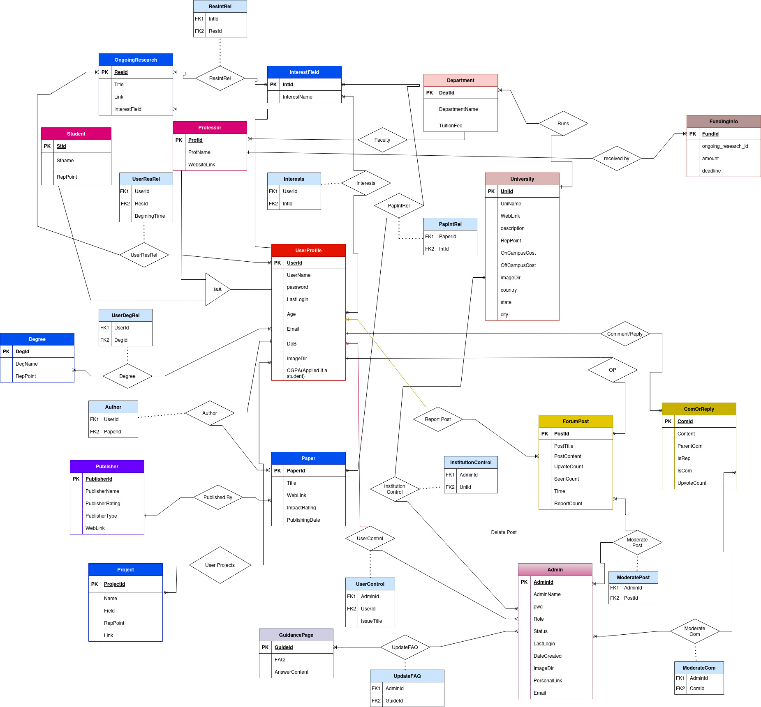
ERD

Slide 3
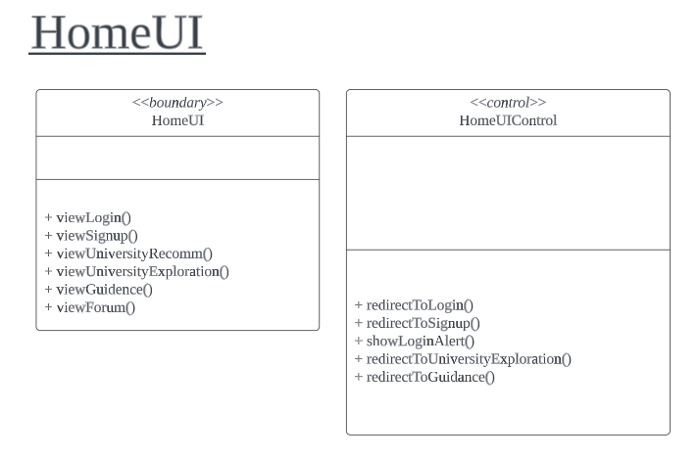
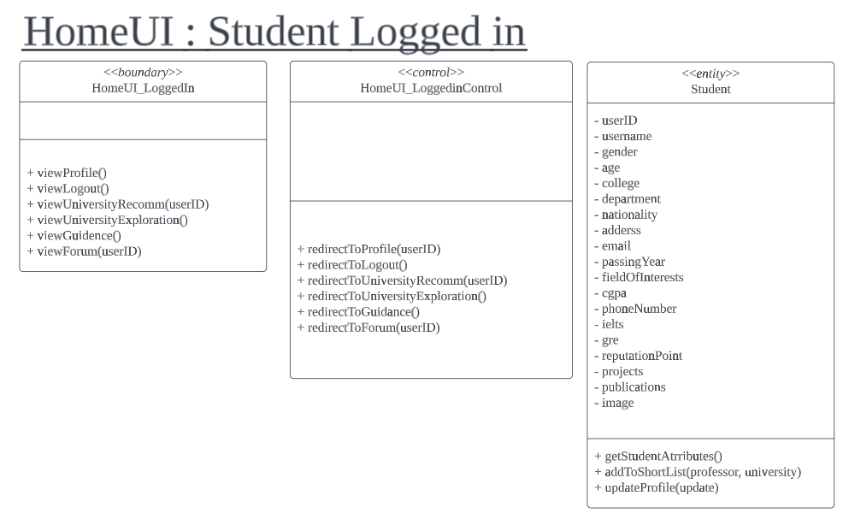
Home UI

Slide 4
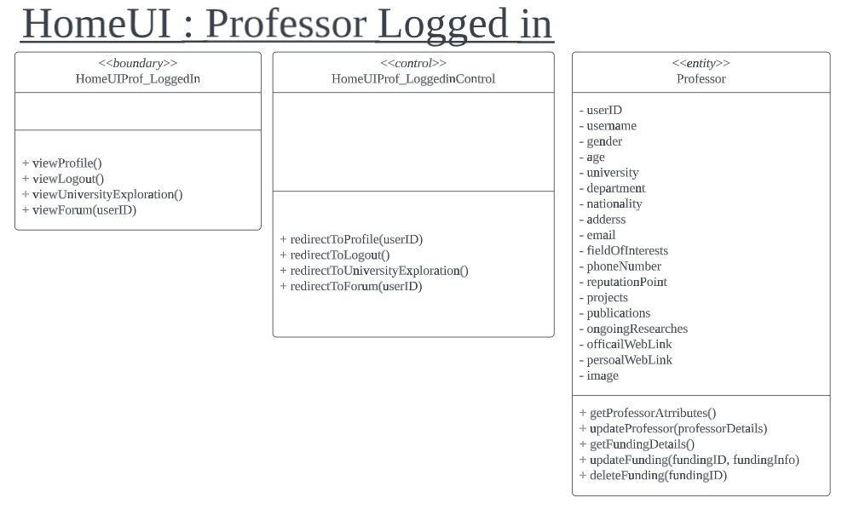
Home UI : Professor

Slide 5
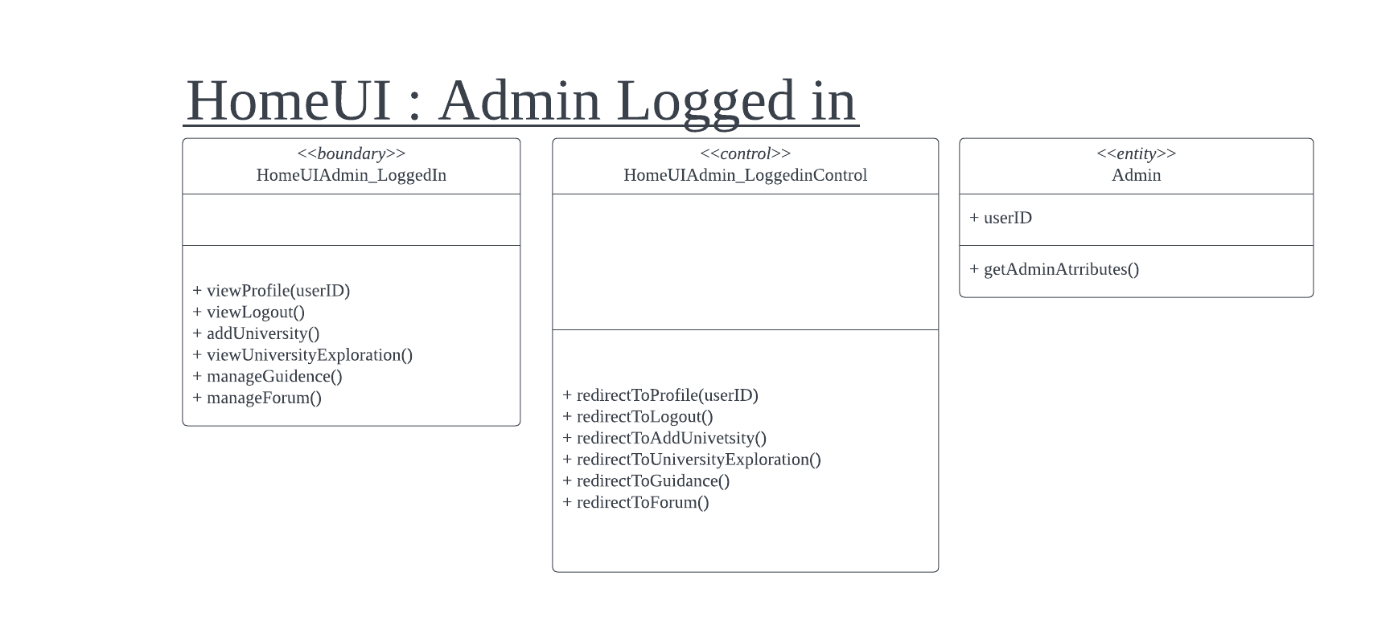
Home UI : Admin

Slide 6
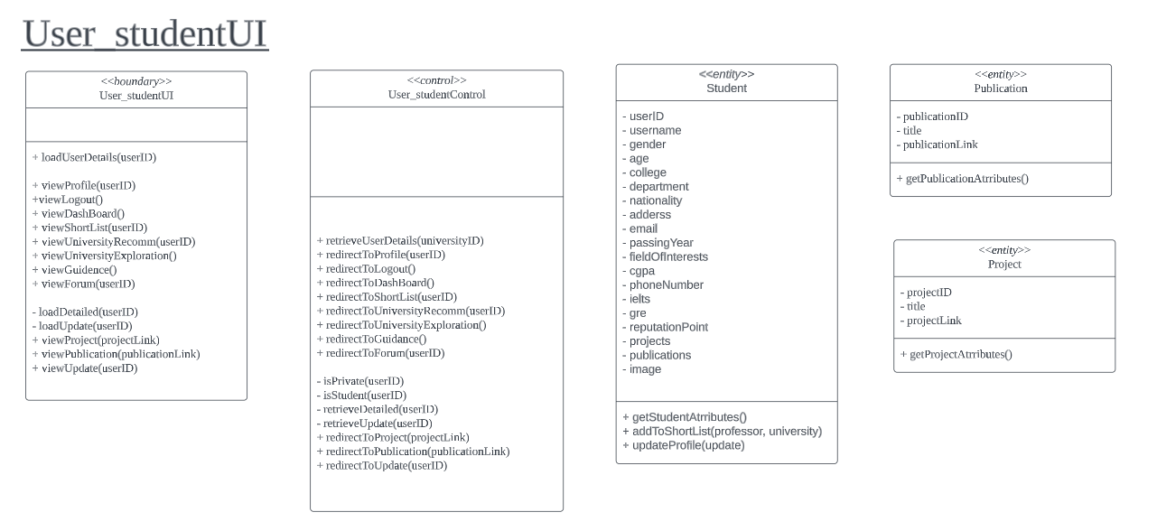
User Profile

Slide 7

User Profile

Slide 8
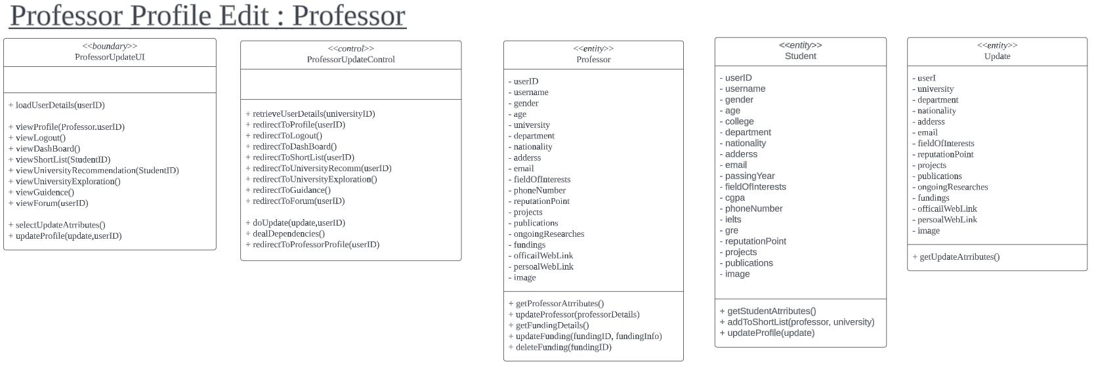
User Profile

Slide 9
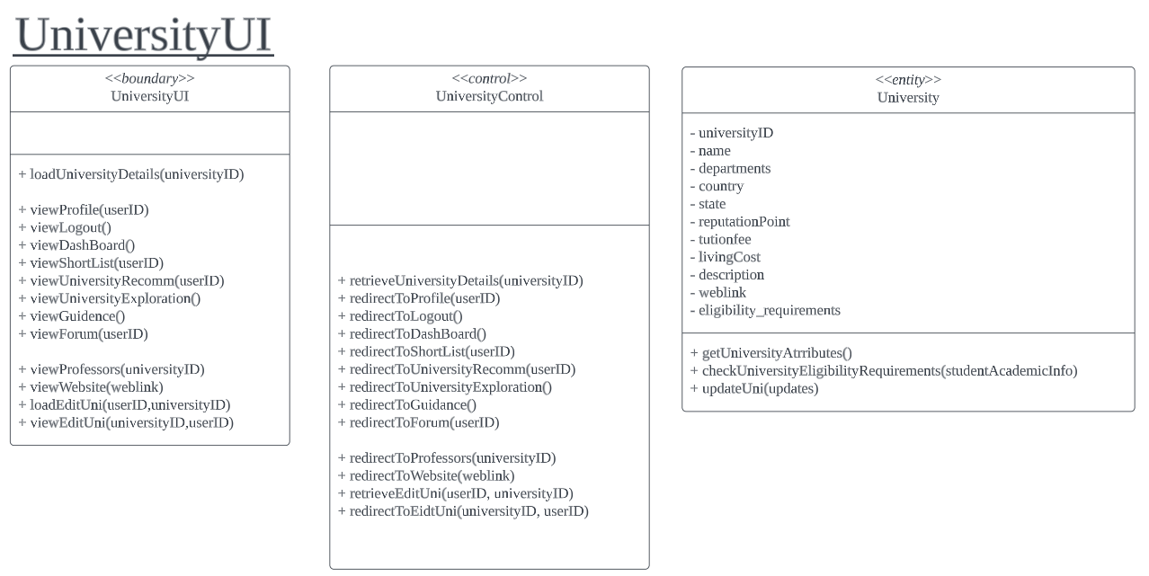
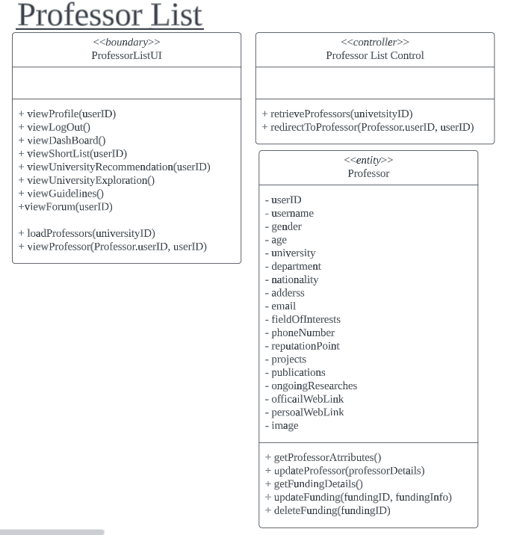
University Profile

Slide 10
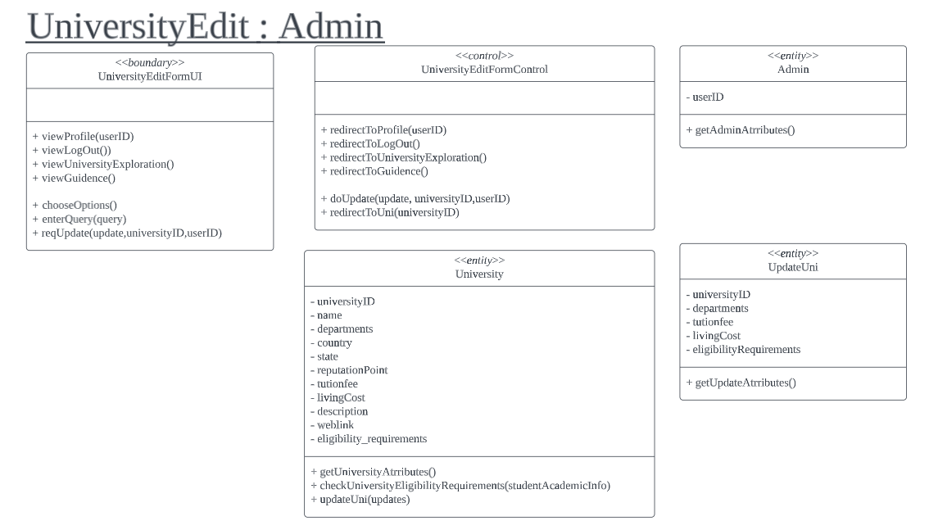
University Profile : Edit

Slide 11
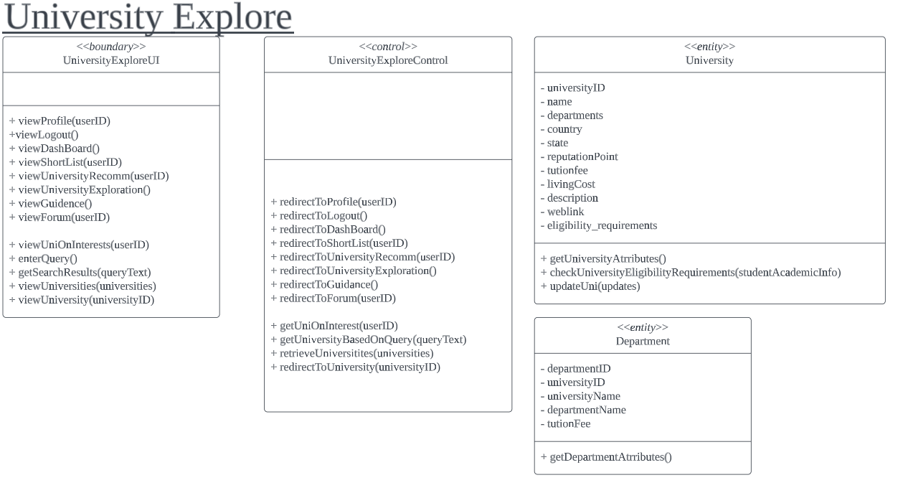
Explore Universities

Slide 12
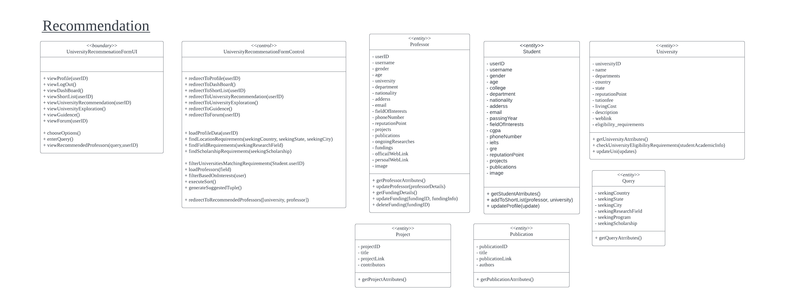
University Recommendation

Slide 13
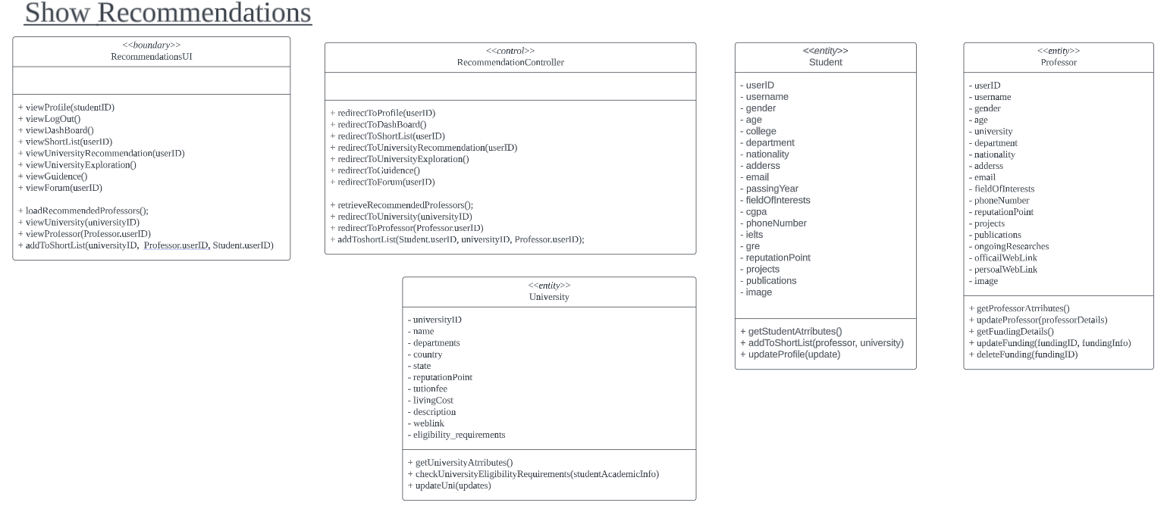
University Recommendation: Show

Slide 14
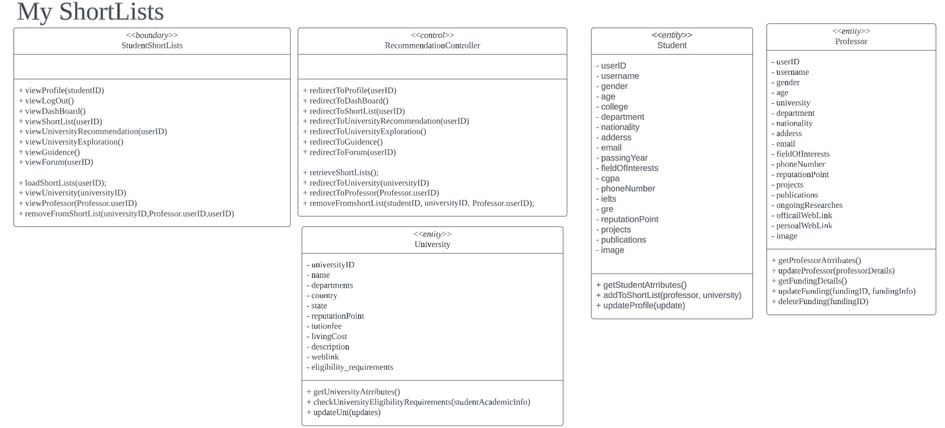
My Shortlist

Slide 15

Guideline

Slide 16
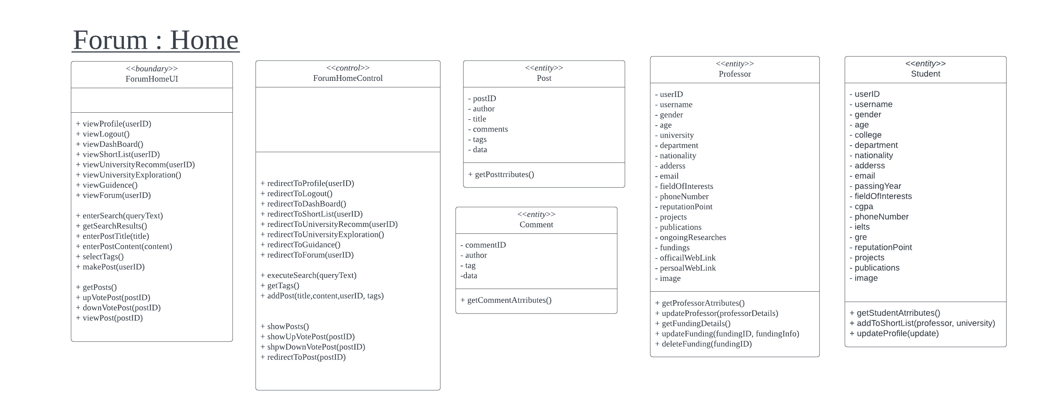
Forum Home

Slide 17
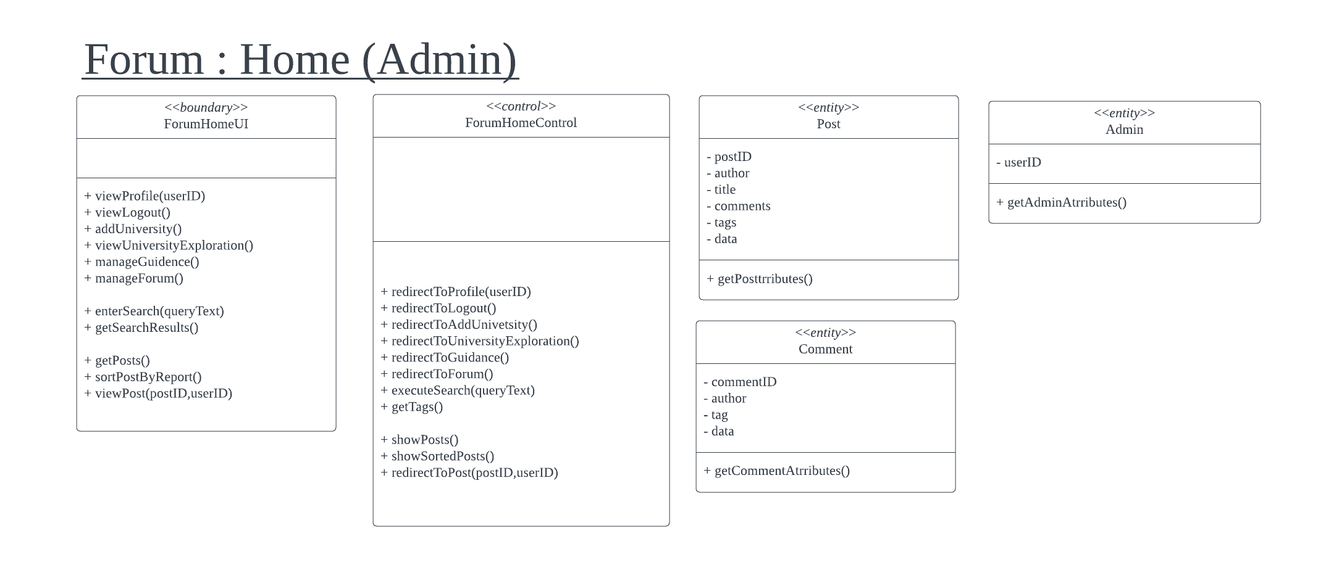
Forum Home : Admin

Slide 18
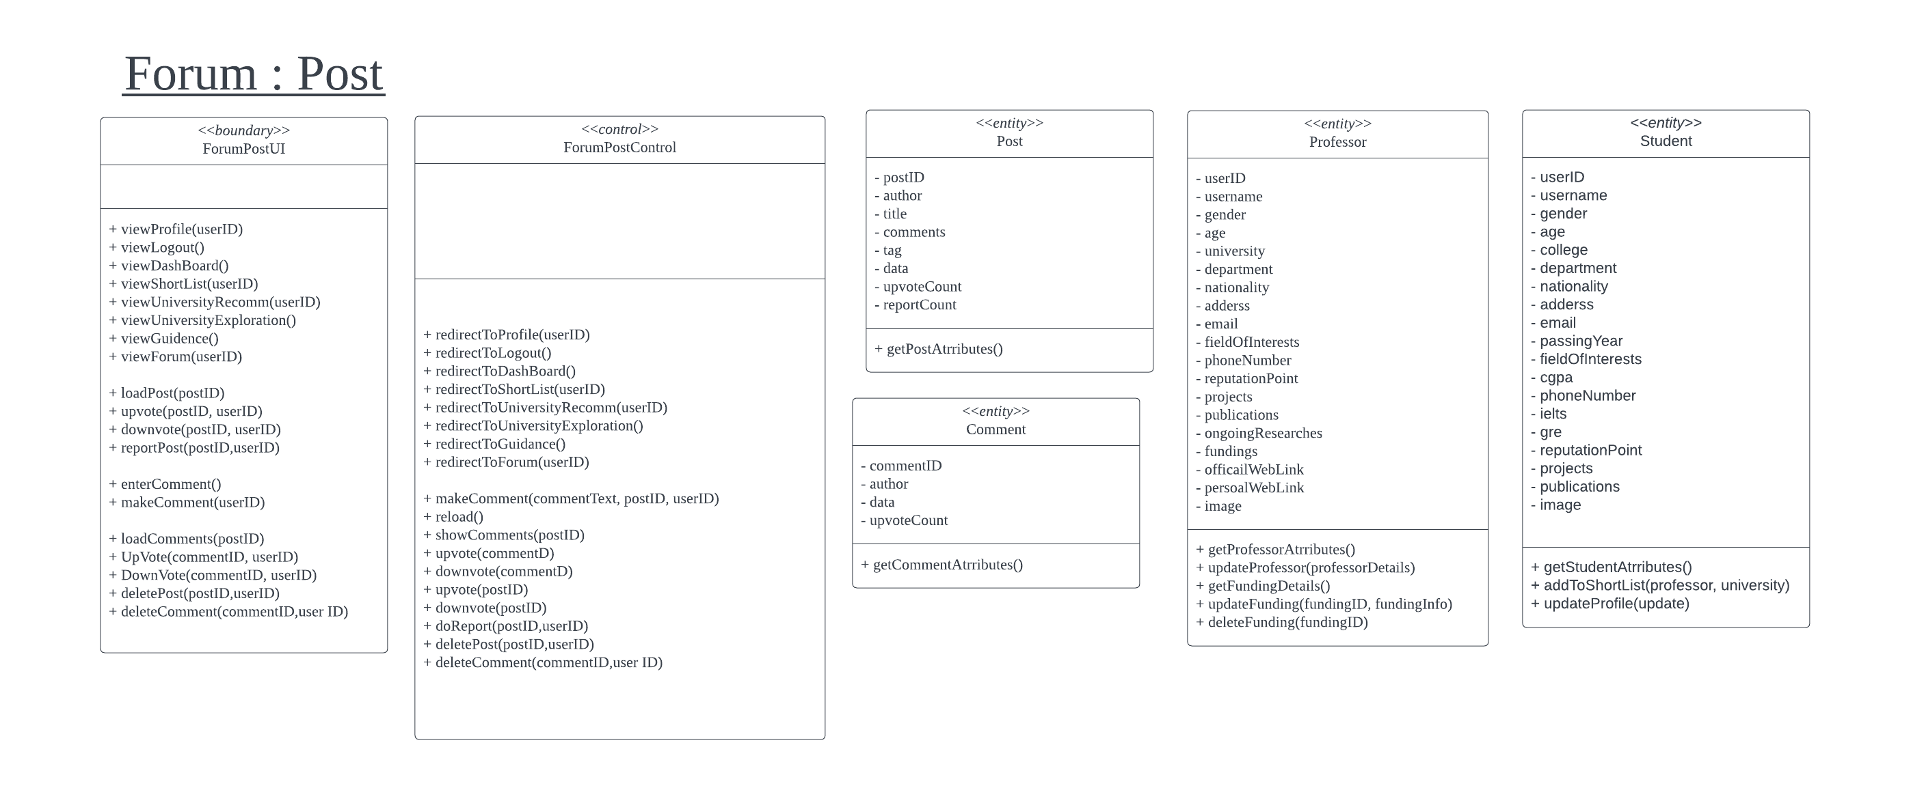
Forum Post

Slide 19
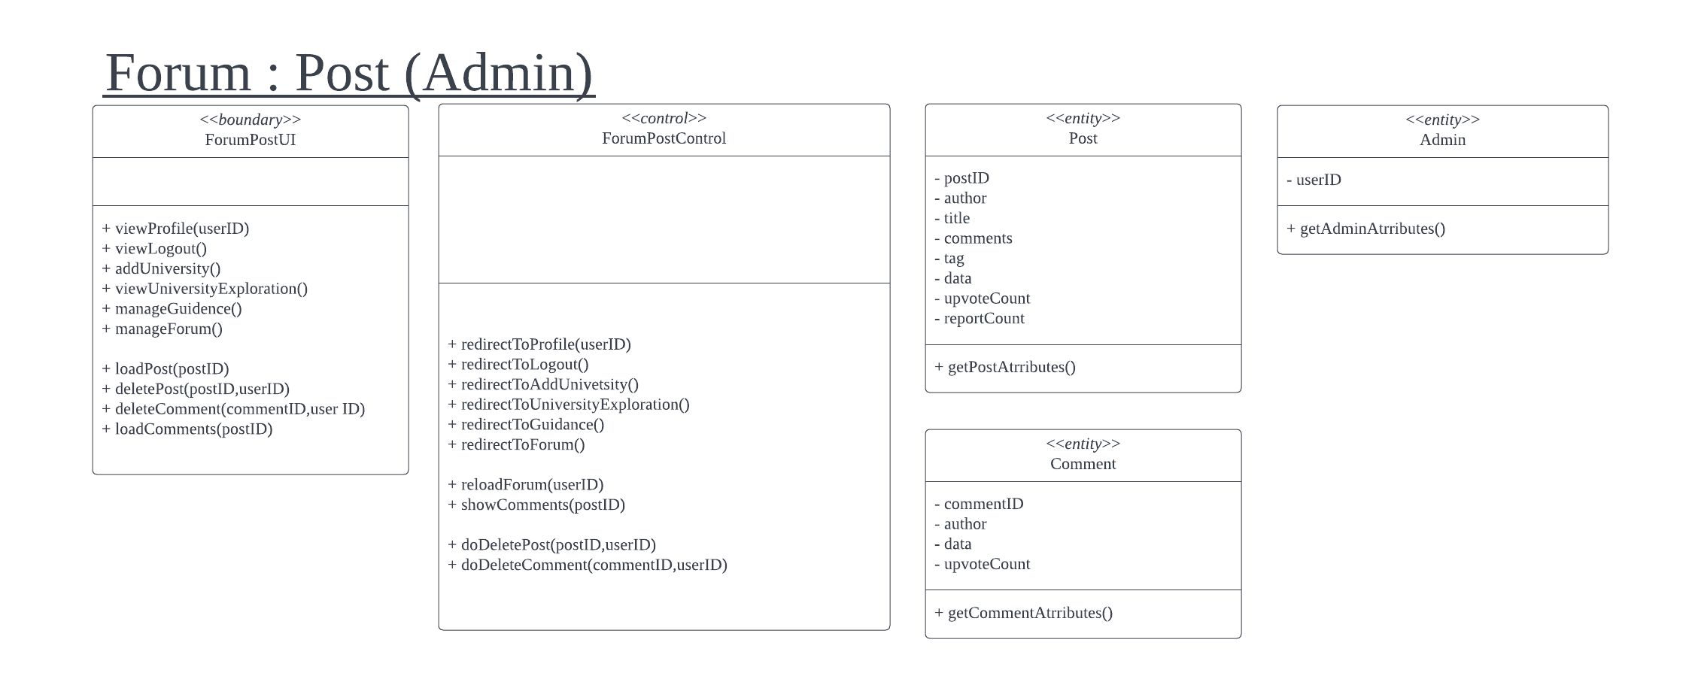
Forum Post: Admin

