Slide 1

HealthGear: A Real-time Wearable System for Monitoring and Detecting Sleep Apnea
Nuria Oliver
Microsoft Research

Slide 2

Introduction
Need for wearable health monitoring devices:
  Aging population in developed countries
  Rural areas in developing countries
They would:
  Enable the detection of early signs of health deterioration
  Notify health care providers in critical situations
  Enhance sense of connectedness with loved ones
  Find correlations between lifestyle and health
  New dimension in sports conditioning
  Transform health care

Slide 3
However…
To make these devices practical a series of technical, legal and sociological obstacles need to be overcome:
  Non-intrusive
  Comfortable to wear
  Efficient in power consumption
  Preserve privacy
  User-friendly
  Low failure rate
  Minimal false alarms

Slide 4
HealthGear
Real-time, wearable health monitoring system
Cell phone as central processing unit (Audiovox SMT5600)
  Personal Computer for millions of people
  Communication capabilities (GPRS, etc)
  Multimodal: camera, microphone, etc
Continuous recording of blood oximetry, heart-rate and plethysmographic signal
Real-time analysis and presentation of physiological data to the user

Slide 5
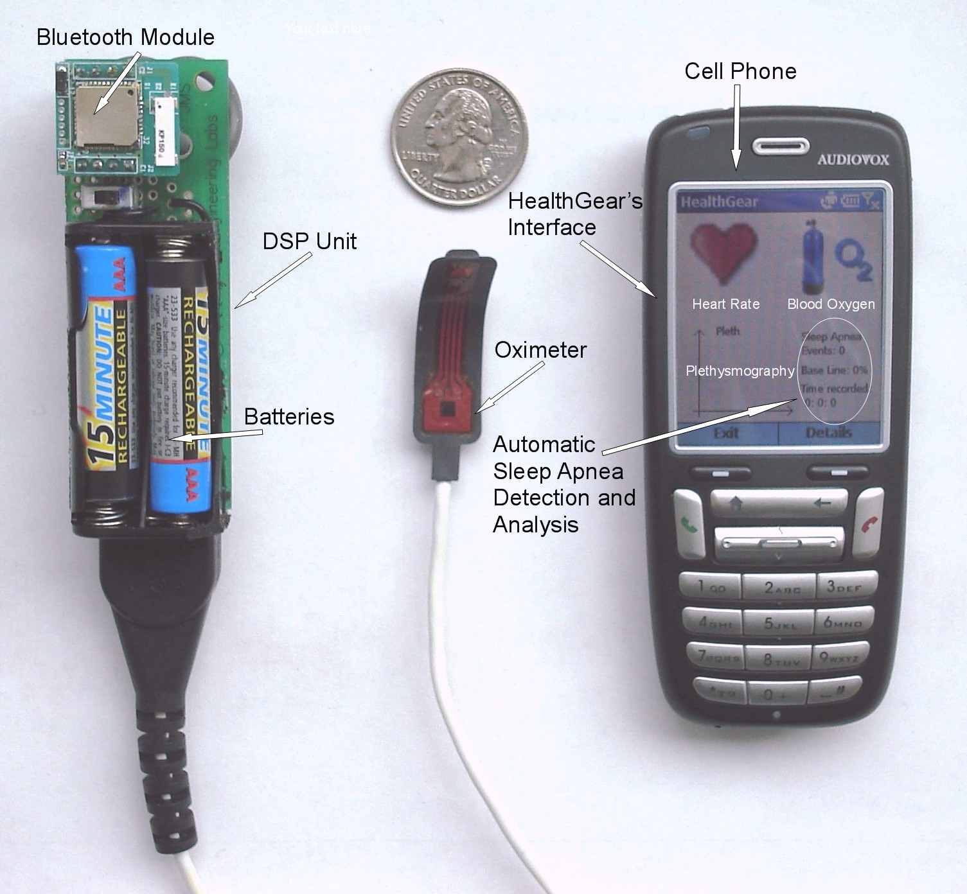
HealthGear

Slide 6
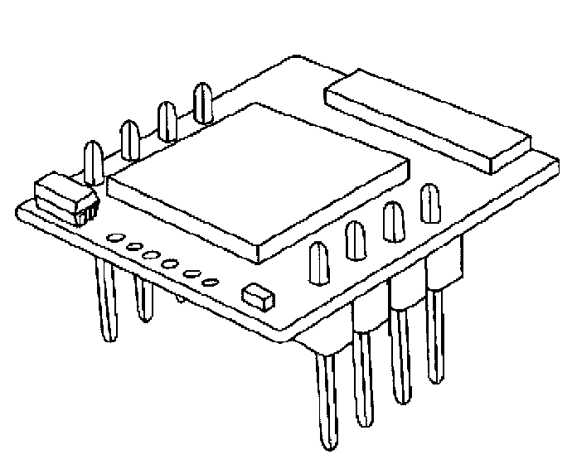


Architecture
GPRS
Transmission Module
SmartPhone
Bluetooth Transmitter
Bluetooth Transceiver
Storage
Serial Stream
SD Card
Up to 2.0 Gb
DSP
Raw Data
LCD
Display
Analogical Data
Diagnosis
Sensor
Analysis
CLIENT
SERVER

Slide 7
Sleep Apnea
Underdiagnosed but common condition
  Affects children and adults
  4% in men and 2% in women (higher for elderly)
  Untreated causes $3.4 billion of medical costs
  40 million undiagnosed Americans
Periods of interrupted breathing (apnea) and periods of reduced breathing (hypoapnea)
Leads to:
  Hypoxia, asphyxia and awakenings
  Increased heart-rate, high blood pressure
  Extreme fatigue, poor concentration
  Compromised immune system
  Cardio/cerebrovascular problems

Slide 8
Sleep Apnea: Diagnosis
Nocturnal Polysomnography (PSG):
  In sleep center for 1-2 nights
  Continuous, simultaneous multi-channel measurements of 8 physiological signals ☺
  Very expensive, cumbersome, time consuming, just one sample and subject to manual scoring and human error ☹
Pulse oximetry:
  Useful as screening and diagnostic tool
  One simple, light-weight sensor on finger, toe or earlobe

Slide 9
Automatic Detection of Sleep Apnea
Multithreshold Time Analysis:
  Defines multiple levels of desaturation (drop gap) and resaturation (return gap)
  Desaturation starts as soon as the oxygen level falls below a baseline by a certain amount and continues until the signal recovers to a level, which is lower than the baseline by 25% of the specified amount
  Our algorithm defines 11 threshold for all possible values of desaturation from 5% to 15% in increments of 1%

Slide 10
Automatic Detection of Sleep Apnea
Spectral Analysis:
  Periodogram of the mean-subtracted oximetry signal
  Sleep apnea events are detected as a peak in the range 0.015-0.04Hz
  This frequency has a fisiological explanation corresponding to the typical lenghts of apnea events

Slide 11
Sleep Study
21 volunteers:
  80% male, ages 25-65
  30% healthy, 70% with sleep apnea or suspected
Wore HealthGear for one full night in their own homes

Slide 12
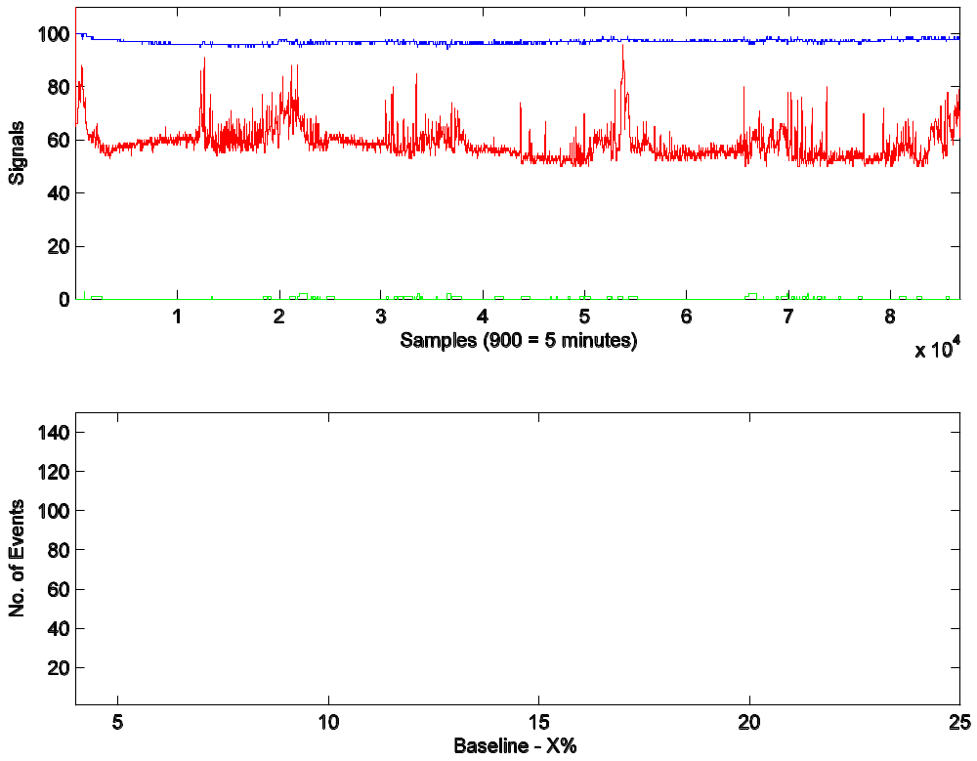
No Apnea

Slide 13
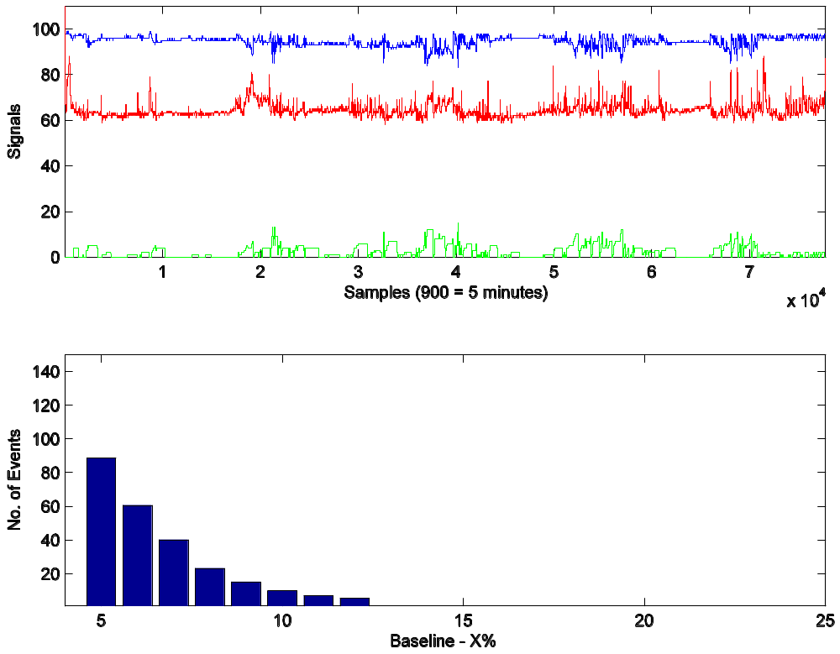
Mild-Severe Apnea

Slide 14
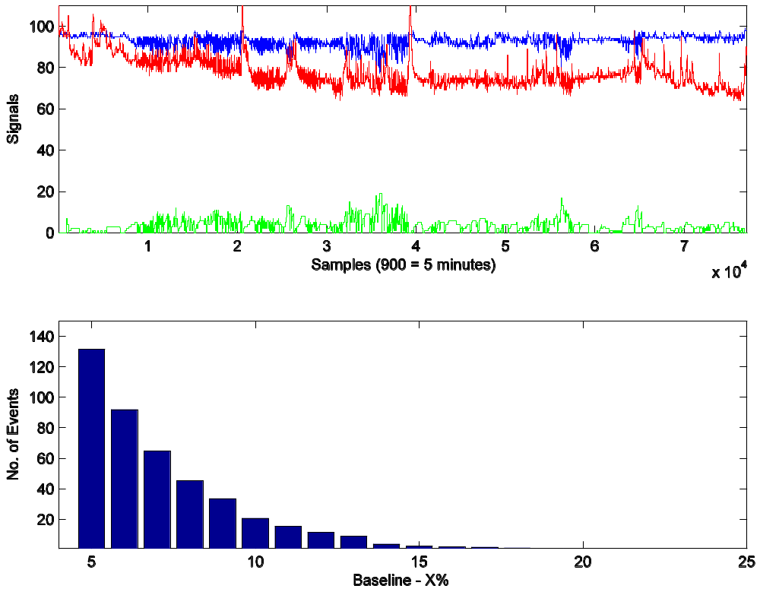
Severe Apnea

Slide 15
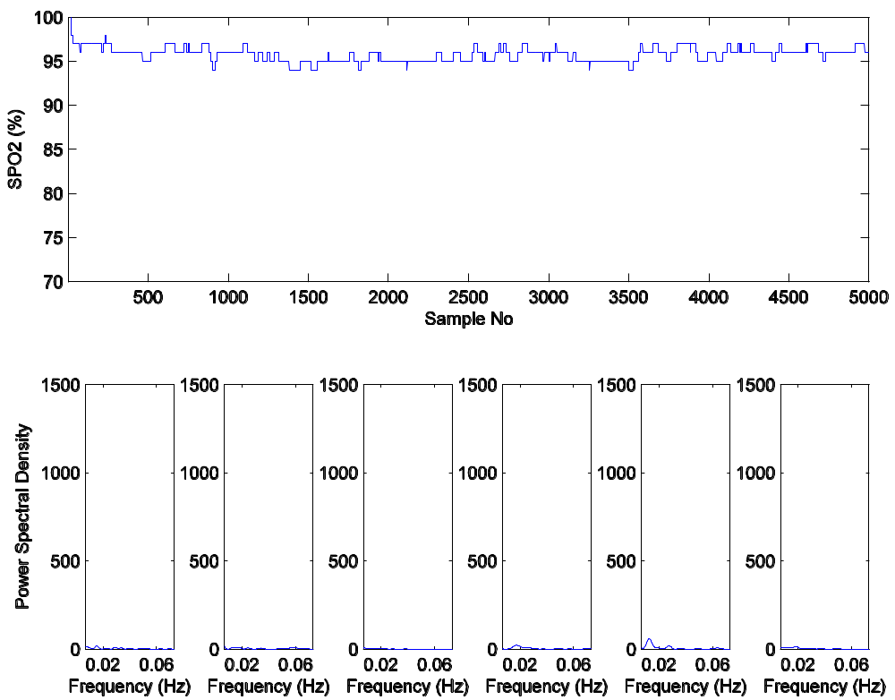
No Apnea

Slide 16
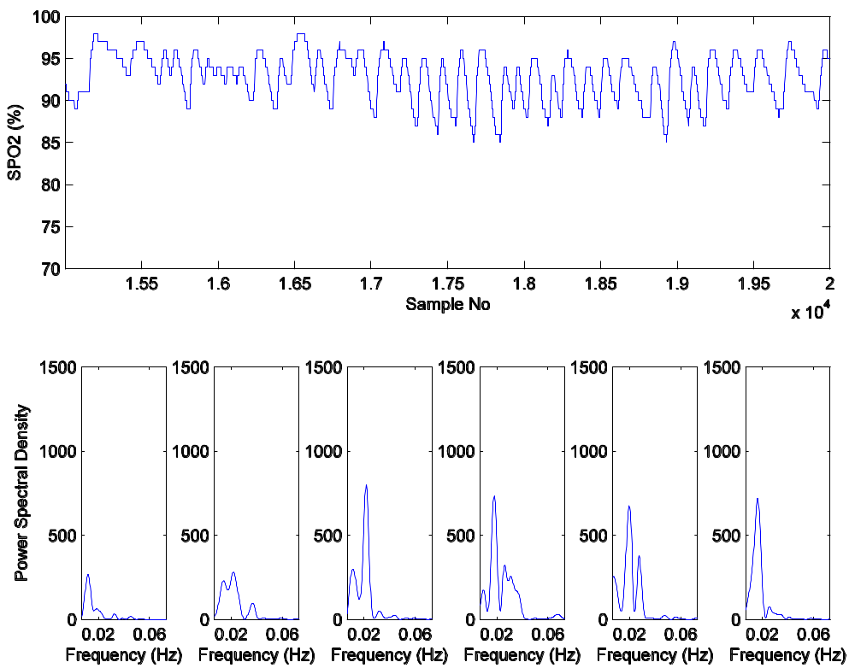
Mild-Severe Apnea

Slide 17
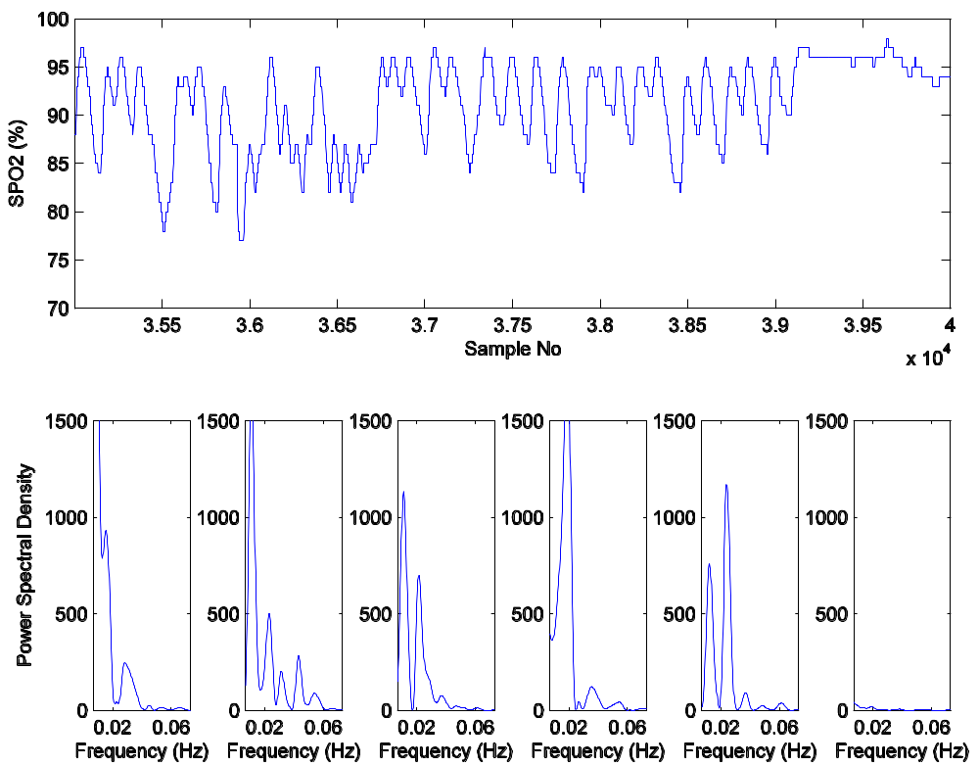
Severe Apnea

Slide 18
Conclusions & Future Work
Accurate sleep apnea detection
Light-weight sleep monitoring system
High acceptance rates
Long-term sleep studies
Collaboration with doctors
Additional sensors
Identifying correlations between lifestyle, environmental factors and physiology

Slide 19
Thank You!

