Slide 1
Data lakes/warehouses in the cloud
By Yair Segal

Slide 2
Content
Introductions
About the workshop
Cloud providers
Pre reqs
Data lakes/warehouses background
Data formats
General architecture
IAC and CI/CD
Workshop exercise

Slide 3
Introduction

Slide 4
About the workshop
Workshop content:
https://github.com/yairs2000/DataInCloud
Not meant to deliver production experience. Just the basics.

Slide 5





Cloud providers
AWS
Azure
Google

Slide 6
Pre reqs
Terraform
Cloud accounts
VS Code

Slide 7
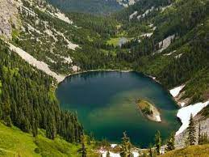
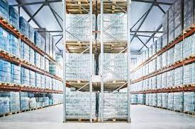
Data lakes/warehouses background
Data lake
Data warehouse
Raw
Unorganized
Fast write
Slow read
Accept all data
Processed
Structured
Fast read
Slow write
Relational data

Slide 8
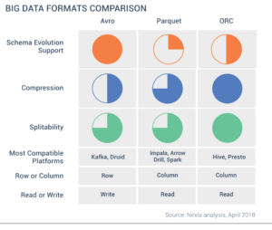
Data formats
AVRO, Parquet, ORC

Slide 9
General architecture

Slide 11
IAC and CI/CD

Slide 12
Workshop exercise

