Slide 1
Data lakes/warehouses in the cloud
By Yair Segal

Slide 2
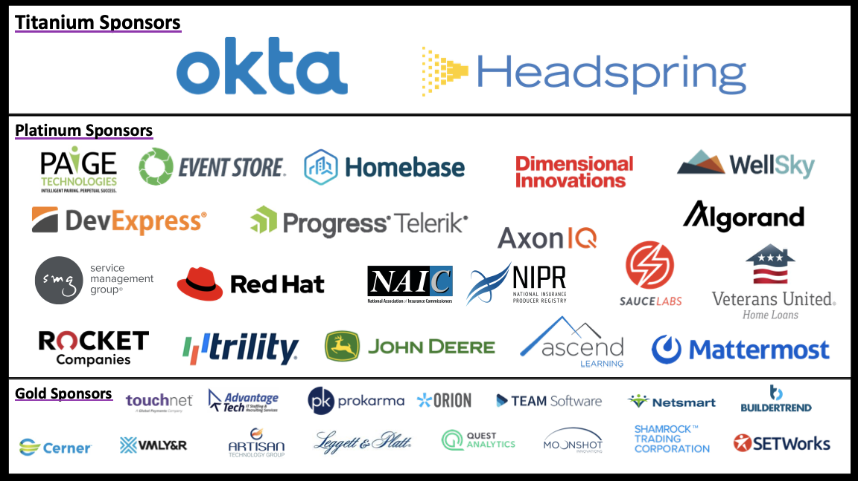

Slide 3
Content
Introductions
About the workshop
Cloud providers
Pre reqs
Data lakes/warehouses background
Data formats
General architecture
IAC and CI/CD
Workshop exercise

Slide 4

Introduction

Slide 5
About the workshop
Workshop content:
https://github.com/yairs2000/DataInCloud
Not meant to deliver production experience. Just the basics.

Slide 6
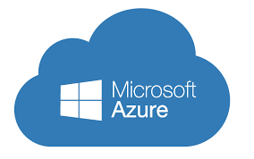




Cloud providers
AWS
Azure
Google

Slide 7
Pre reqs
Terraform
Cloud accounts
VS Code
AWS CLI/SDK
AZURE CLI/SDK

Slide 8
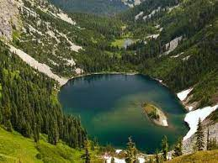
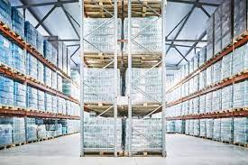
Data lakes/warehouses background
Data lake
Data warehouse
Raw
Unorganized
Fast write
Slow read
Accept all data
Processed
Structured
Fast read
Slow write
Relational data

Slide 9
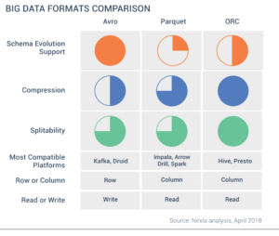
Data formats
AVRO, Parquet, ORC

Slide 10
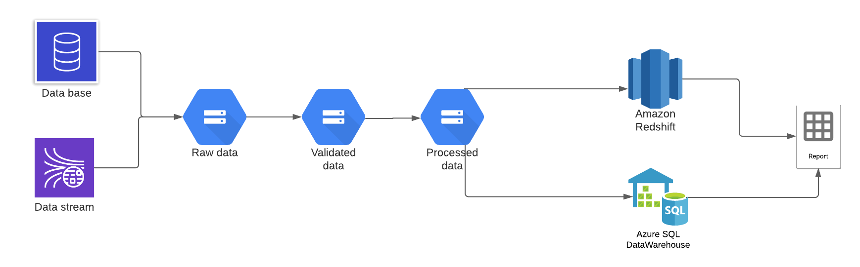
General architecture

Slide 11
Additional components
AWS Lambda
Azure datafactory

Slide 12
IAC and CI/CD
Why infrastructure as code?
IAC options – Native(Cloud formation, Azure templates), Terraform, Pulumi
Why add CI/CD
CI/CD options – AWS pipelines, Azure DEVOPS

Slide 13
Workshop exercise
Get crime data in to the cloud
Data is provided in a CSV format
Need to be able to load to lake flow into data warehouse and report on
Choose a platform set up code and start working. CI/CD is optional
All code is written in terraform and C# and is in repo
Make this your workshop.

